Slide 1
How Analogy Helped Create the New Science of Thermodynamics
John D. Norton
Department of History and Philosophy of Science
University of Pittsburgh

Slide 2
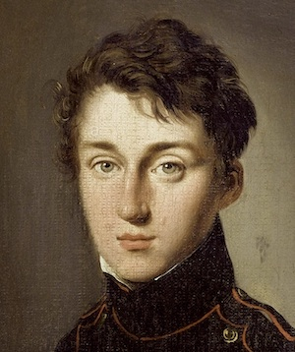
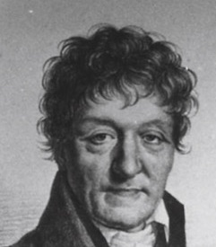
This Talk
Sadi Carnot invented the foundations of thermodynamics in 1824:
Lazare Carnot formulated a general theory of ordinary machines in 1783.
By analogy
Puzzle 1.
Why did he seek a general theory of heat engines at all?
Solution 1.
Lazare sought the most general theory for all ordinary machines.
Puzzle 2.
How did he come to conceive the very strange notion of thermodynamically reversible process?
Solution 2.
Lazare’s most efficient machines were reversible.

Slide 3
Sadi Carnot’s Reflections on the Motive Power of Fire

Slide 4
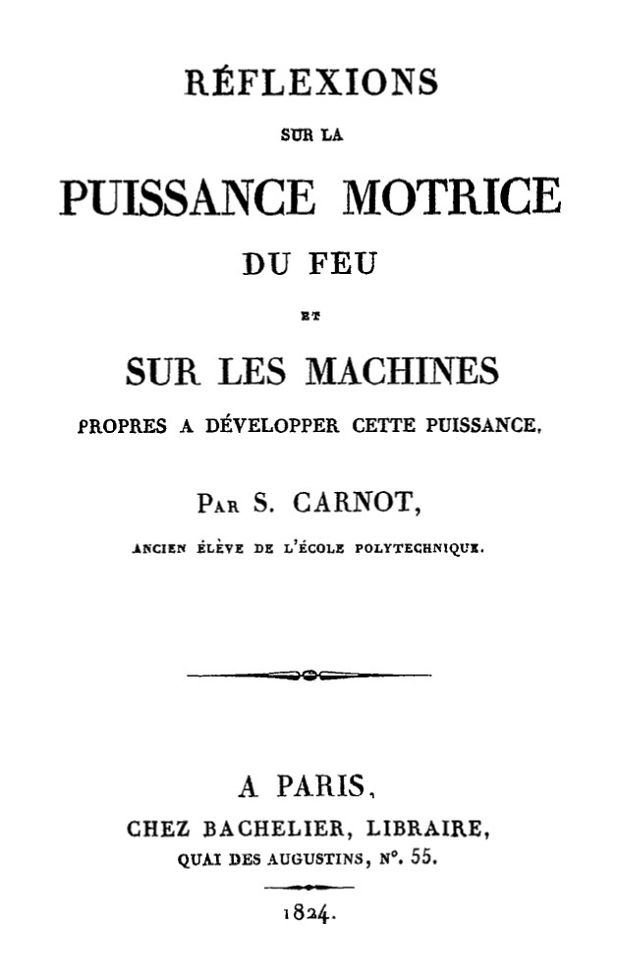
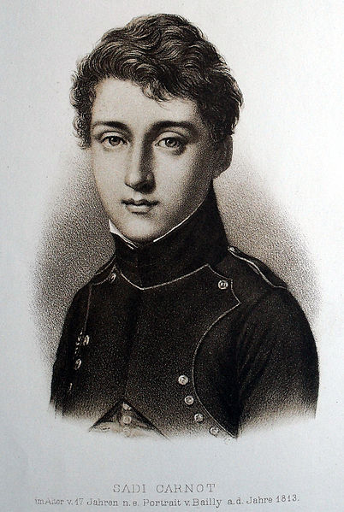
Sadi Carnot’s Réflexions sur La Puissance Motrice de Feu
Age 17, in 1813

Slide 5
Carnot’s Theoretical Model
Heat source
Caloric flow
Motion of caloric generates motive power.
Motive power
Engine
Conservation of caloric requires heat sink.
No notion of conserved energy.
Later becomes independent second law of thermodynamics
Heat sink

Slide 6
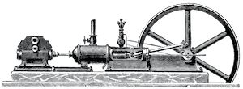
Carnot’s Main Results
Maximum efficiency is determined solely by the temperatures of the heat source and heat sink.
A heat engine composed only of reversible processes realizes this maximum efficiency.
No other design features matter.
i.e. steam engine, hot air engines, alcohol vapor engine, etc. can all achieve this maximum efficiency

Slide 7
Proof method
Couple to identical engine running in reverse
Reversible engine
All motive power consumed.
All caloric returned to hot source.

Slide 8
For reductio: A more efficient engine?
Couple to first engine running in reverse
More efficient engine
SOME motive power consumed.
All caloric returned to hot source.
Surplus motive power produced without any net changes elsewhere
…perpetual motion!

Slide 9
First Puzzle
How did Sadi Come to Seek General Theory?

Slide 10
Sadi Carnot, Réflexions…
“The phenomenon of the production of motion by heat has not been considered from a sufficiently general point of view. … In order to consider in the most general way the principle of the production of motion by heat, it must be considered independently of any mechanism or any particular agent. It is necessary to establish principles applicable not only to steam engines* but to all imaginable heat-engines, what-ever method working substance by which it is operated.”
*“We distinguish here the steam-engine from the heat-engine in general. The latter may make use of any agent whatever, of the vapor of water or of any other, to develop the motive power of heat.”

Slide 11
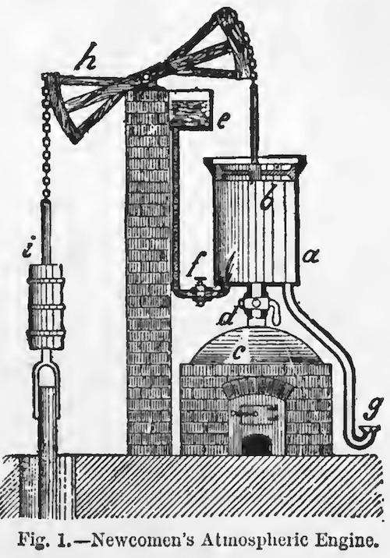
Steam engines have many disparate parts
Mechanical coupling
Many disparate parts
??
Many disparate governing principles
Cylinder and piston
Why expect a single principle
… to cover them all?
Boiler
… to cover all imaginable heat engines and not just steam engines?
Furnace
Water pump

Slide 12
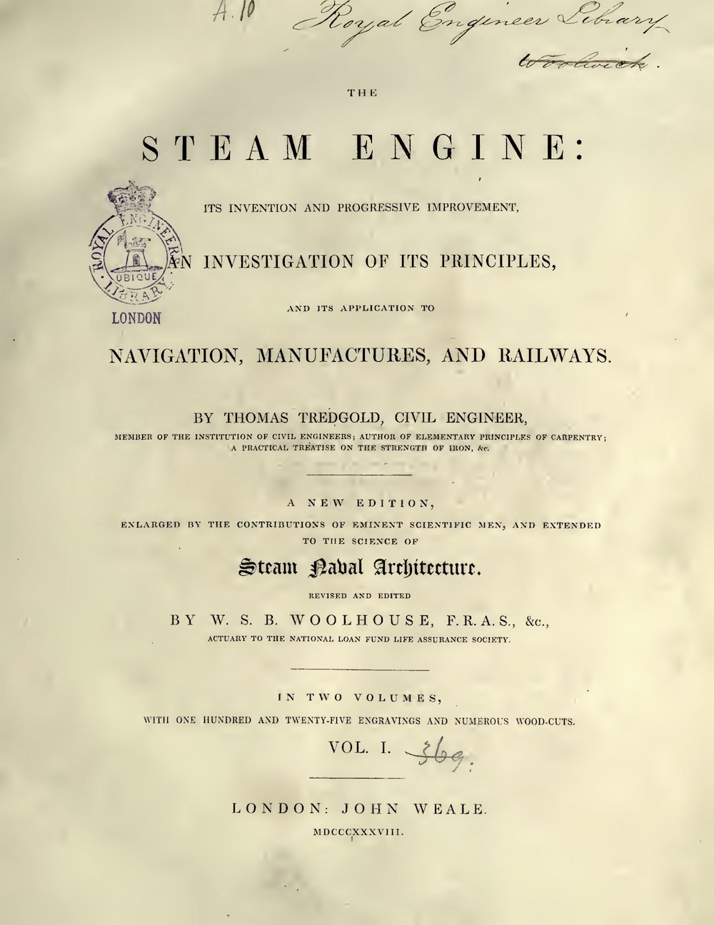
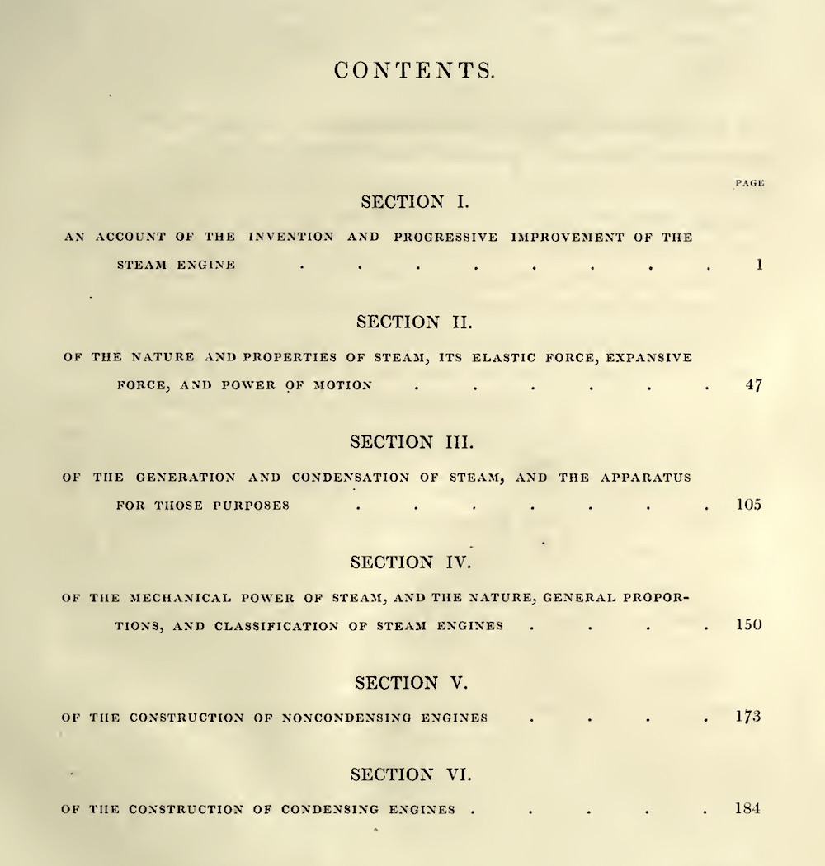
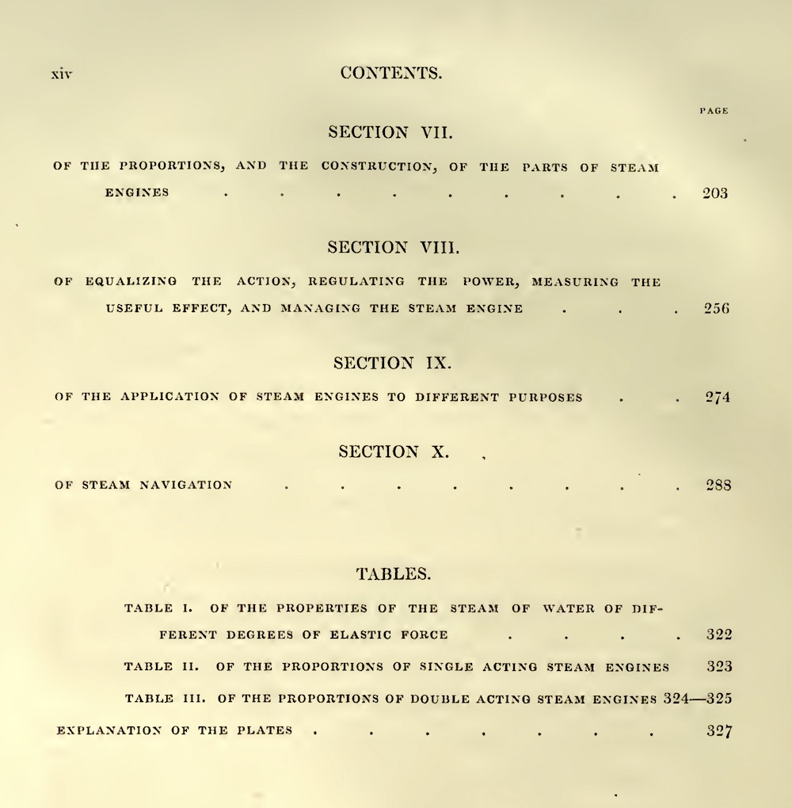
Authoritative work on steam engines, 1827, 1838
AN INVESTIGATION OF ITS PRINCIPLES
Components treated individually.
Properties of fluids. Generation and condensation of steam. Deriving mechanical power from steam. etc. etc.

Slide 13
Lazare…

Slide 14
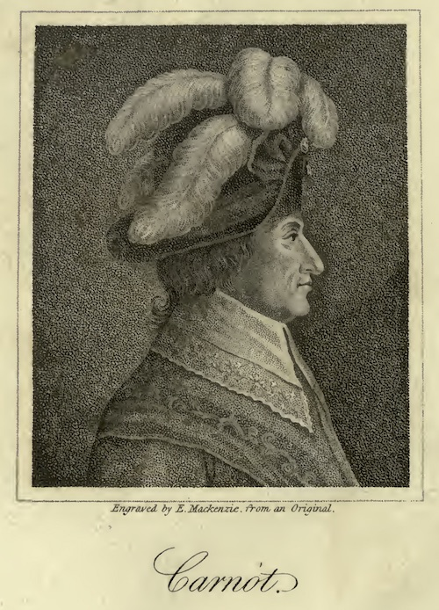
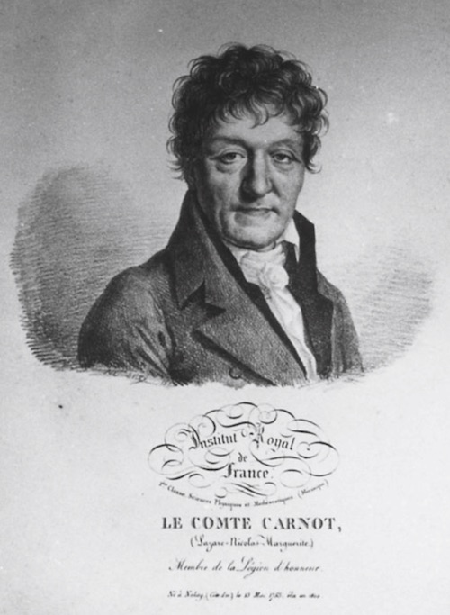
Lazare Carnot

Slide 15
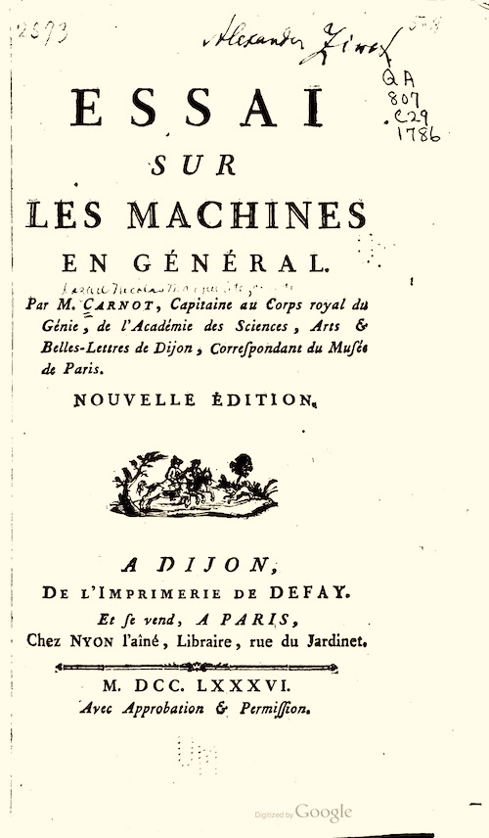
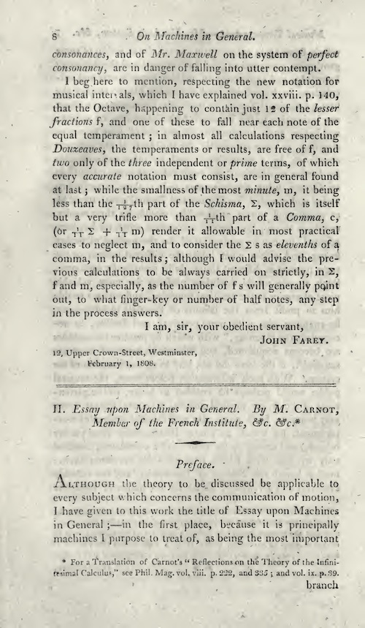
Essay upon Machines in General
1783

Slide 16
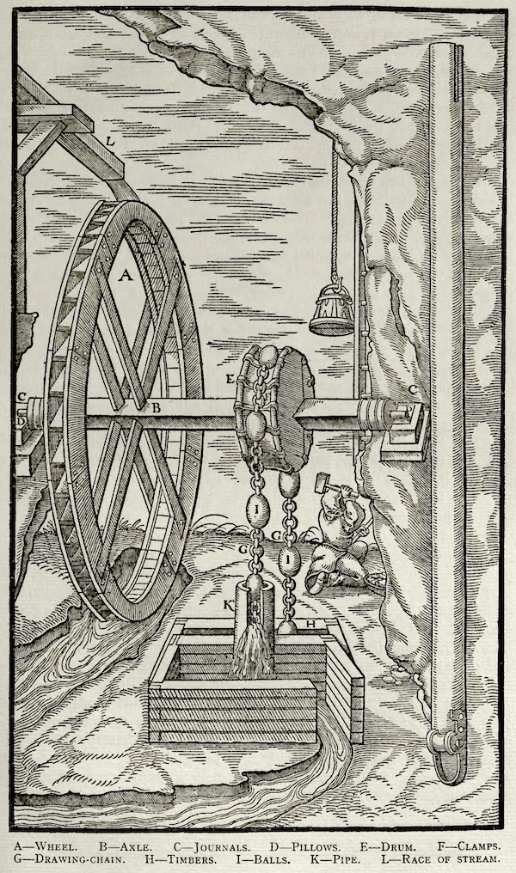
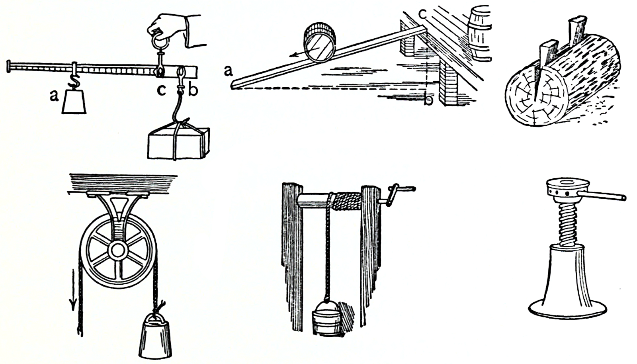
Machines transmit motive power
Extended to hydraulic and pneumatic machine.
inclined plane
wedge
lever
screw
pulley
winch
Six classic simple machine

Slide 17
Lazare’s goal: “…upon Machines in General”
“In my opinion, however, too little attention has been bestowed in the development of those properties which are common to machinery in general, and which for this reason no more belong to the cords of a machine than to the lever, the vice, or any other machine, whether simple or compound.” (1808, p. 12)

Slide 18
Second Puzzle
How did Sadi
Come to conceive Thermodynamically Reversible Processes?

Slide 19


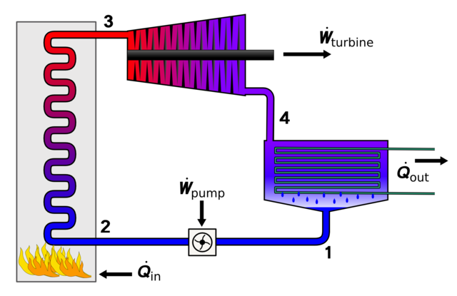
Irreversible heating
melting ice
Heat passes through a large temperature difference from hot to cold…
hot brick
… but does no work. The lost heat could have been used in an engine to create useful work.
https://commons.wikimedia.org/wiki/File:Rankine_cycle_layout.png

Slide 20
Greatest perfection with insensible temperature differences
“The motive power of heat is independent of the agents employed to realize it; its quantity is ﬁxed solely by the temperatures of the bodies between which is eﬀected, ﬁnally, the transfer of the caloric.
We must understand here that each of the methods of developing motive power attains the perfection of which it is susceptible. This condition is found to be fulﬁlled if, as we remarked above, there is produced in the body no other change of temperature than that due to change of volume, or, what is the same thing in other words, if there is no contact between bodies of sensibly diﬀerent temperatures.” (p. 68)

Slide 21
Reversible heating
Make temperatures differences insensibly small.
Transfer one unit of caloric
Big temperature difference
Smaller temperature difference
Still smaller temperature difference
Ιnsensible temperature difference

Slide 22
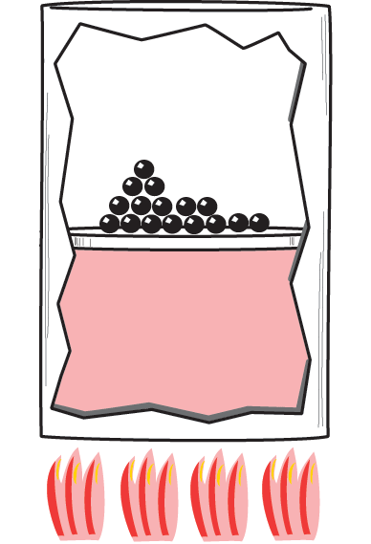
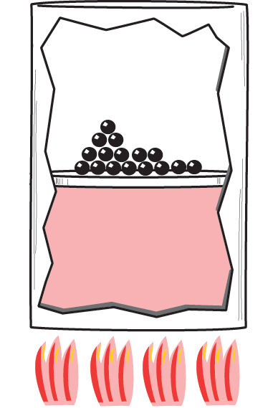
Reversible heating does work
Isothermal expansion of an ideal gas
Gas and surroundings at equilibrium.
Temperatures of gas and heat source match.
Pressure force balanced by weights.
Small weight removed.
Pressure force exceeds weight.
Heat from source reheats gas.
Gas expands slightly and cools. Work done in raising weights.

Slide 23
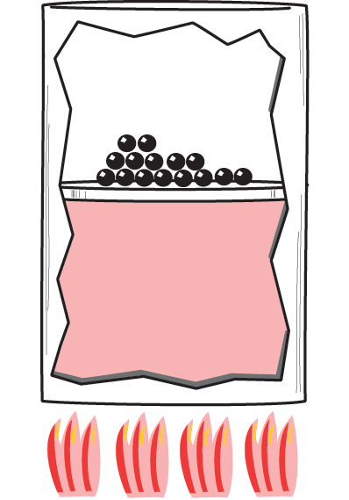



Insensible difference supports reversibility
Gas expands
slight disturbance
remove small mass
Gas and surroundings at equilibrium
replace small mass
slight disturbance
Gas compresses

Slide 24
Reversible processes are very strange
Make temperatures differences insensibly small.
Transfer one unit of caloric
ΔT = 1
Time =1
ΔT = 0.1
Time =10
ΔT = 0.001
Time =1000
ΔT = 0
Time =
∞
Nothing happens!

Slide 25
The Impossible Process
Reversible processes must meet two conditions.
I. Equilibrium.
The states through which the process passes are equilibrium states.
II. Change.
The process advances from state to state.
There is no change.
The states are not in equilibrium.
These two conditions contradict and cannot be jointly satisfied.

Slide 26
Sadi’s answer
“In reality the operation cannot proceed exactly as we have assumed. To determine the passage of caloric from one body to another, it is necessary that there should be an excess of temperature in the ﬁrst, but this excess may be supposed as slight as we please. We can regard it as insensible in theory, without thereby destroying the exactness of the arguments.” (p. 58)
“We may perhaps wonder here that the [cool] body B [used to condense steam] being at the same temperature as the steam is able to condense it. Doubtless this is not strictly possible, but the slightest diﬀerence of temperature will determine the condensation, which suﬃces to establish the justice of our reasoning. It is thus that, in the diﬀerential calculus, it is suﬃcient that we can conceive the neglected quantities indeﬁnitely reducible in proportion to the quantities retained in the equations, to make certain of the exact result.”(p. 53)
Limit state in the differential calculus is well-defined.
Limit process in Sadi’s case is no process at all.

Slide 27
Lazare…

Slide 28
Lazare’s dissipative ontology
Corpuscles are ”hard” bodies undergoing inelastic collisions
mW² = mV² + mU²
initial
vis viva
final
vis viva
lost
vis viva

Slide 29
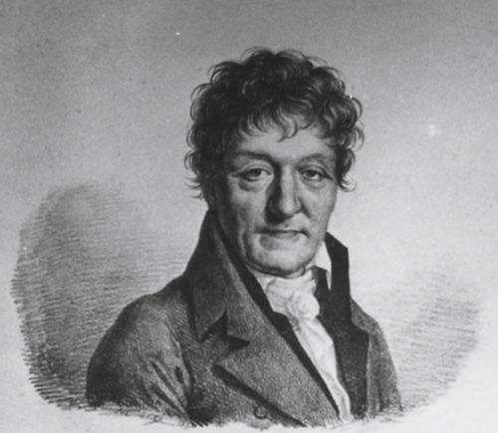
Lazare’s dissipative ontology
How else can I distinguish efficient from inefficient machines?
If collisions conserve vis viva, then all machines are equally efficient.
Kinetic theory of gases is impossible.
Later work based on a conservative ontology.
DEAD
END
A scientific dead end

Slide 30
Lazare’s strategies for minimizing loss
1. No Shocks
“… in order to make [machines] them produce the greatest possible effect, it must necessarily that there be no percussion, i.e. that the movement should always change by imperceptible degrees;…”
(1808, pp.11-12)

Slide 31
Lazare’s strategies for minimizing loss
2. Reversible geometrical movements
Geometrical movement of winch
• Raising and lowering of weights without shocks.
• Movement can be reversed.
Configurations of bodies during movement determined by geometry alone.

Slide 32
Lazare’s strategies for minimizing loss
2. Reversible geometrical movements
NON- Geometrical movement of winch
• Shocks when weights drop and rise too far.
• Movement canNOT be reversed.
Configurations of bodies during movement determined by geometry alone.

Slide 33
The Fertile Analogy

Slide 34
Dissipative systems are sufficiently alike
Lazare’s strategies for minimizing loss in ordinary machines.
Sadi’s strategies for minimizing loss in heat engines.
≈

Slide 35


Dissipative systems are sufficiently alike
Lazare
Sadi
1. Minimize shocks, all unbalanced mechanical forces.
1. Minimize temperature differences, all unbalanced thermal forces.
2. Use reversible geometrical movements.
2. Use reversible thermal processes.
limit
BUT
limit
Benign inertial motion.
No process at all.

Slide 36
Waterwheel
Analogy

Slide 37
Waterwheel analogy
“According to established principles at the present time, we can compare with sufficient accuracy the motive power of heat to that of a waterfall. Each has a maximum that we cannot exceed, whatever may be, on the one hand, the machine which is acted upon by the water, and whatever, on the other hand, the substance acted upon by the heat. The motive power of a waterfall depends on its height and on the quantity of the liquid; the motive power of heat depends also on the quantity of caloric used, and on what may be termed, on what in fact we will call, the height of its fall,* that is to say, the difference of temperature of the bodies between which the exchange of caloric is made. In the waterfall the motive power is exactly proportional to the difference of level between the higher and lower reservoirs. In the fall of caloric the motive power undoubtedly increases with the difference of temperature between the warm and the cold bodies; but we do not know whether it is proportional to this difference. We do not know, for example, whether the fall of caloric from 100 to 50 degrees furnishes more or less motive power than the fall of this same caloric from 50 to zero. It is a question which we propose to examine hereafter.”
Sadi’s full text.
*The matter here dealt with being entirely new, we are obliged to employ expressions not in use as yet, and which perhaps are less clear than is desirable.

Slide 38
Waterwheel analogy
fall of caloric
fall of water
motive power
motive power

Slide 39
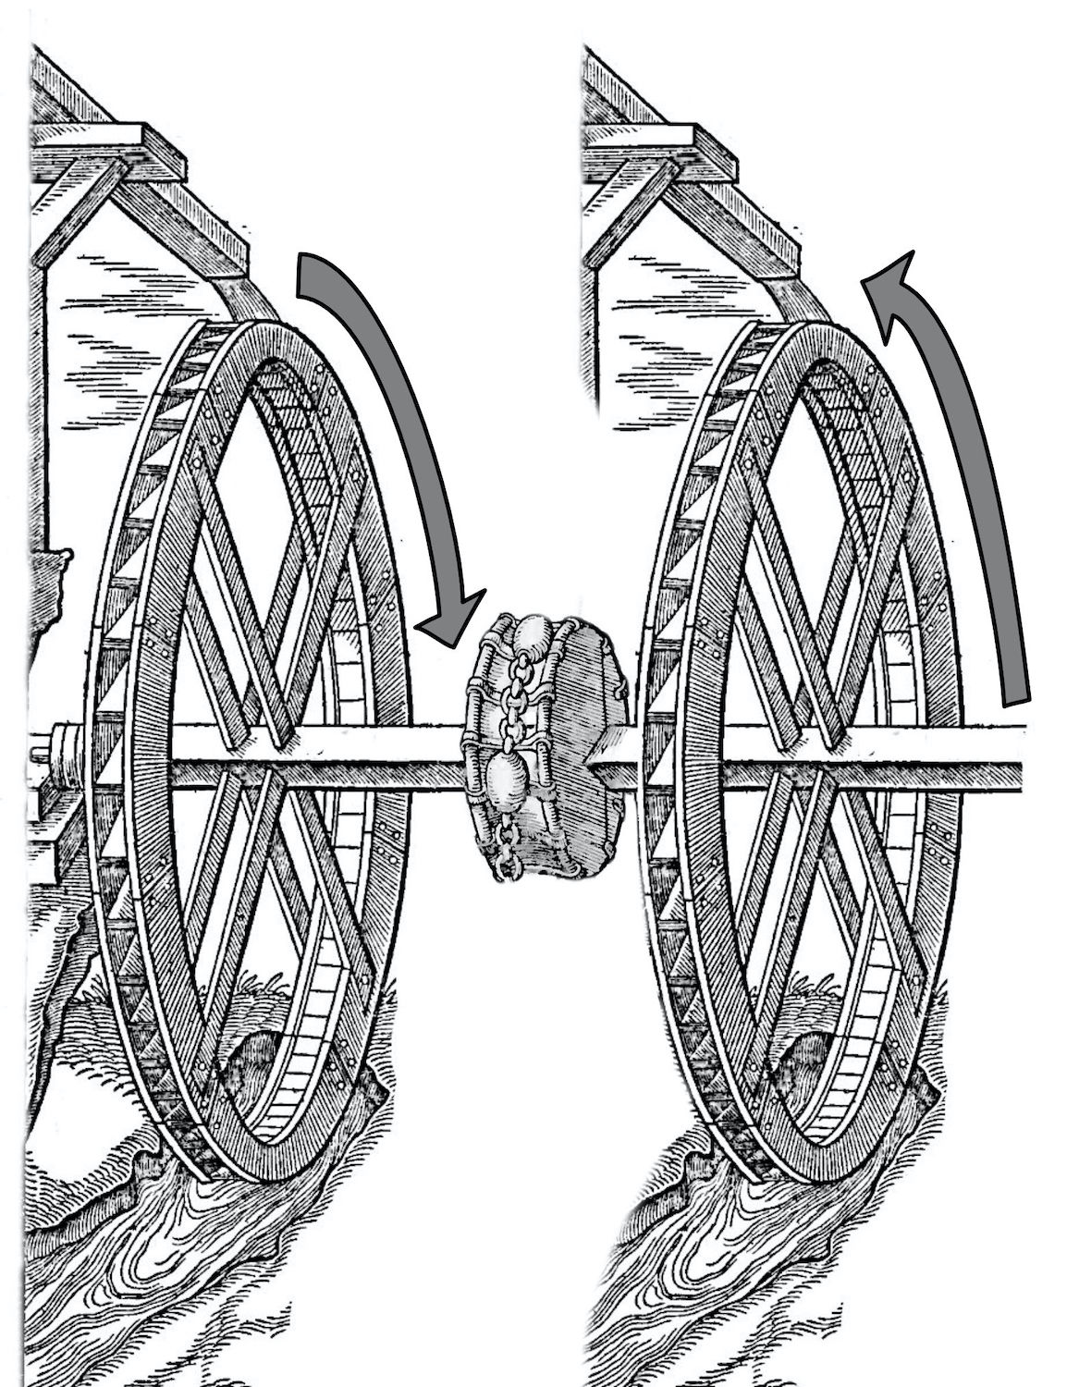
Similar inferences

Slide 40
Analogy or Application?
We may regard a fluid as an assemblage of an infinity of solid corpuscles detached from each other…”
(1808, p. 223)
“… but is it possible to conceive the phenomena of heat and electricity as due to anything else than some kind of motion of the body, and as such should they not be subjected to the general laws of mechanics?”
(p. 237)
fall of caloric
fall of water

Slide 41
Conclusion

Slide 42
This Talk
Sadi Carnot invented the foundations of thermodynamics in 1824:
Lazare Carnot formulated a general theory of ordinary machines in 1783.
By analogy
Puzzle 1.
Why did he seek a general theory of heat engines at all?
Solution 1.
Lazare sought the most general theory for all ordinary machines.
Puzzle 2.
How did he come to conceive the very strange notion of thermodynamically reversible process?
Solution 2.
Lazare’s most efficient machines were reversible.

Slide 43
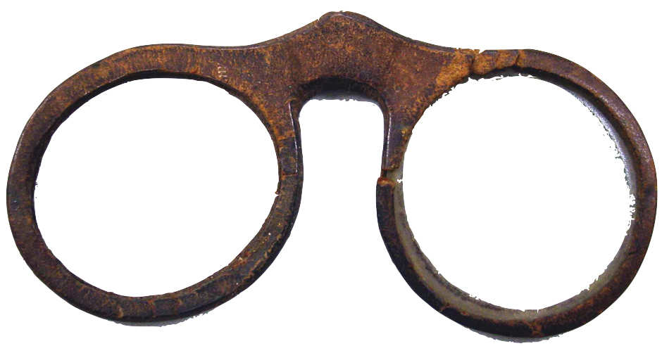
Read

Slide 44
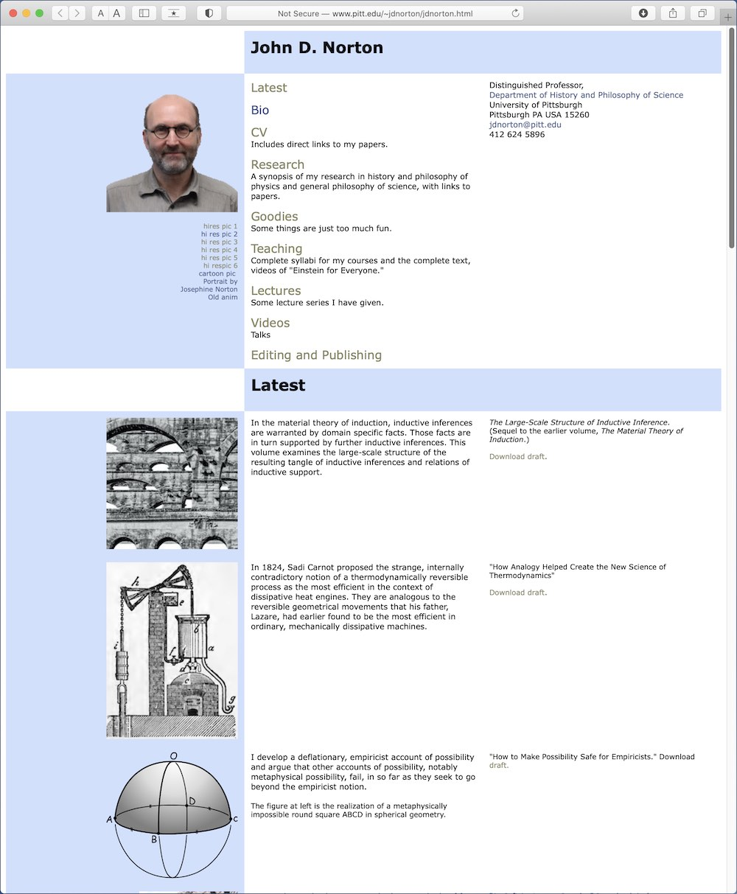
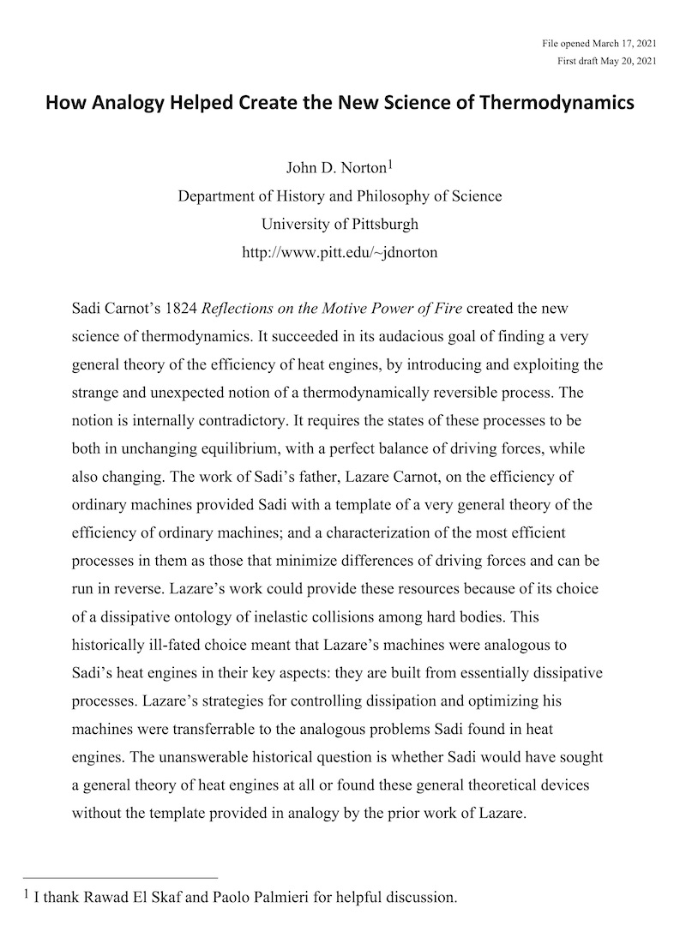

Slide 45
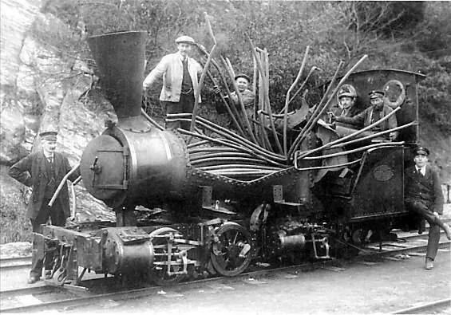
THE END

