Slide 1
The Metaphysics of Causation An Empiricist Critique
John D. Norton
Department of History and Philosophy of Science
University of Pittsburgh
“The Metaphysics of Causation: An Empiricist Critique” in Yafen Shen, ed., Alternative Approaches to Causation. Oxford University Press, forthcoming. https://sites.pitt.edu/~jdnorton/homepage/cv.html#causation_empiricist

Slide 2

ImageFX response to prompt: The Metaphysics of Causation: An Empiricist Critique https://aitestkitchen.withgoogle.com/tools/image-fx

Slide 3
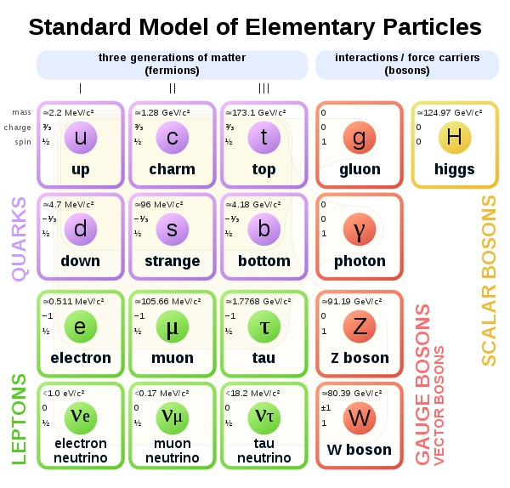
Empiricism?
e
Small-e empiricism
We can only learn contingent truths of the world from experiences of the world.
We can learn that there truly are quarks.
E
Big-E empiricism
The only contingent truths of the world we can learn are experiences of the world.
We cannot know that there truly are quarks.

Slide 4
Causal Antifundamentalism The form of causal skepticism defended here

Slide 5
Causal Fundamentalism: the doctrine
Nature is governed by cause and effect; and the burden of individual sciences is to find the particular expressions of the general notion in the realm of their specialized subject matter.
There is a universally applicable principle of causality.
Causation factually restricts how things can connect in the world.
Unity of meaning of causal talk in different domains.

Slide 6
Causal Fundamentalism: the doctrine
Nature is governed by cause and effect; and the burden of individual sciences is to find the particular expressions of the general notion in the realm of their specialized subject matter.
There is a universally applicable principle of causality.
DENIED

Slide 7
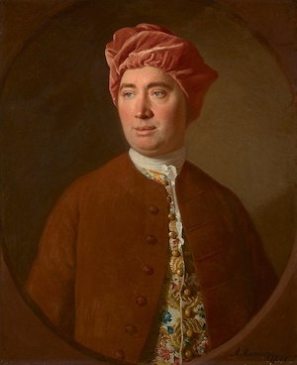
NOT Humean Skepticism
Thus not only our reason fails us in the discovery of the ultimate connexion of causes and effects, but even after experience has inform’d us of their constant conjunction, ‘tis impossible for us to satisfy ourselves by our reason, why we shou'd extend that experience beyond those particular instances, which have fallen under our observation.
We suppose, but are never able to prove, that there must be a resemblance betwixt those objects, of which we have had experience and those which lie beyond the reach of our discovery.
Treatise of Human Nature, Book 1, Part III, Section VI pp. 91-92.
David Hume
Inductive Skeptic

Slide 8
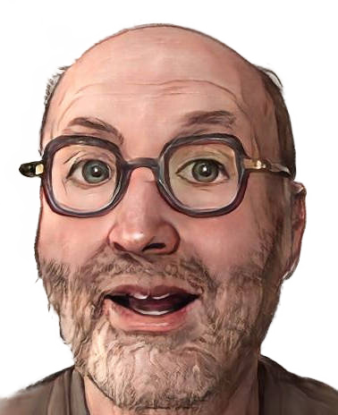
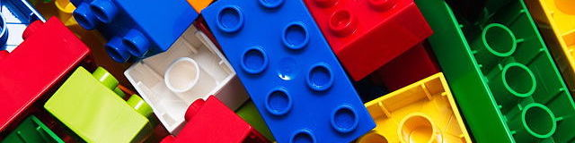
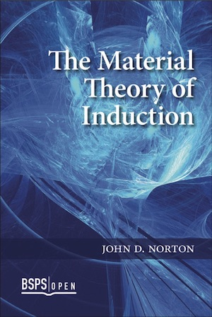
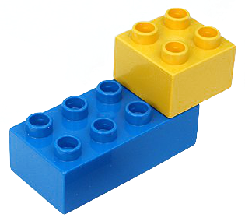
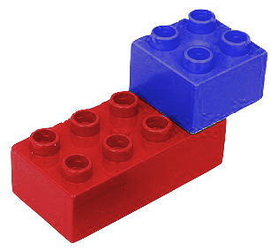
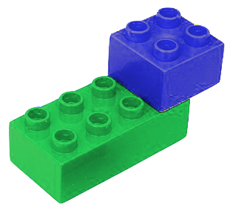
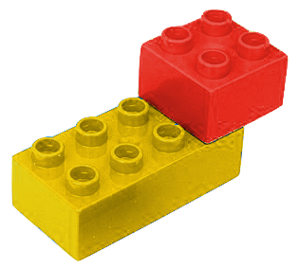
NOT Humean Skepticism
Things connect together in all sorts of interesting and complicated ways.
Inductive optimist
We can learn inductively of new, unexperienced cases from old experienced cases.
+0
Causal metaphysics has nothing factual to add.

Slide 9

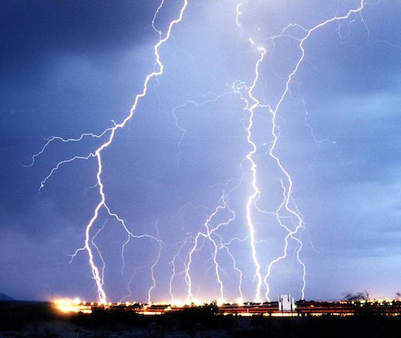
NOT Causal Eliminativism
Russell: “…oddly enough, in advanced sciences such as gravitational astronomy, the word ‘cause’ never occurs…”
A potential difference between the clouds and the earth caused a lightning strike.
A potential difference between the clouds and the earth ionized the air and led to an electrical discharge.
Mere play with synonyms.
Consequence of antifundamentalism not its substance.

Slide 10
A Dilemma for Causal Fundamentalism

Slide 11
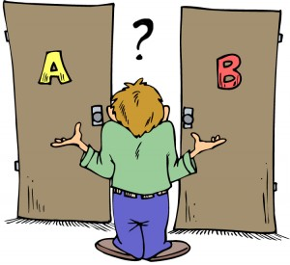
The Dilemma
Conforming a science to cause and effect…
EITHER (first horn)
…places a restriction on the factual content of a science
We must find some restriction that can be properly applied to all sciences.
No appropriate restriction; no enduring principle of causality.
OR (second horn)
…it does not place a restriction on the factual content of a science.
The imposition of the causal framework makes no difference to the factual content of the sciences.
It is an exercise in labeling.

Slide 12
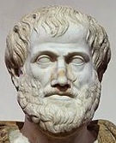
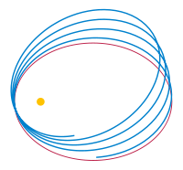
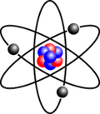
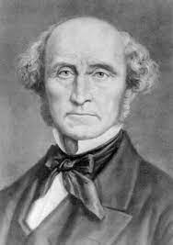
First horn
History of failure to provide facts of causation independently. Causal metaphysics repeatedly corrected by newer science.
4th c. BC. Aristotle’s four causes. Material, formal, efficient, final.
17th c. mechanical philosophy. No place for final causes.
17th c. Newton. Action at a distance? “…so great an absurdity that no man, who has in philosophical matters a competent faculty of thinking, can ever fall into it.”
18th, 19th c. No mechanism found; no finite velocity measured; no shielding. Gravity is action at a distance.
19th century dogma of determinism. No agents/patients, continued existence of cause. Causation is determinism. Causes guarantee effect.
20th c. Quantum theory. Physics supplies probabilities only of effects.
“The Law of Causation … is but the familiar truth, that invariability of succession is found by observation to obtain between every fact in nature and some other fact which has preceded it; independently of all considerations respecting the ultimate mode of production of phenomena, and of every other question regarding the nature of “Things in themselves.” J. S. Mill, System of Logic (Book III, Chapter V, §2. p. 236.)

Slide 13
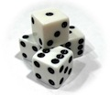
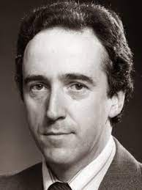
First horn
History of failure to provide facts of causation independently. Causal metaphysics repeatedly corrected by newer science.
20th c. Dogma of probabilism
Measure problem of inflationary cosmology
Classical spacetimes in GR without Cauchy surfaces
Quantum systems with non-separable Hamiltonians
Infinitely many masses colliding classically
Toy classical systems (domes)
“I shall argue in this chapter and the next that causation’s connotations require every cause to raise the chances of its effects.” (p. 67)
“The first point I must make about chances is that they are probabilities. My other claims about chance may be contentious, but not this one: everyone measures chances by numbers which satisfy the standard calculus of probabilities.” (p. 21)
Hugh Mellor, The Facts of Causation. (1995)

Slide 14
Second horn
Causation places no factual restriction on science.
Causal notions cannot contradict any science.
Any science can admit causal description if we choose suitable meanings for our causal terms.
Facilitate understanding of a science; may even be necessary for understanding.
Heuristic value: seeking causes has proven fertile.
More…
Value of causal concepts is pragmatic.

Slide 15
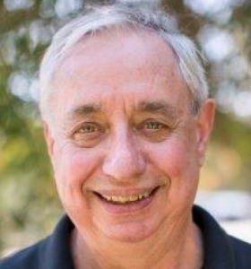
Second horn
Causation places no factual restriction on science.
Woodward’s interventionist account of causation.
A
causes
B
Intervention on A
associated with a
change in B.
=
Only a definition.
No factual assertion that such relations exist in the world.
Pragmatic value:
Manipulable associations are of special value to us.
Important to point out which they are.

Slide 16
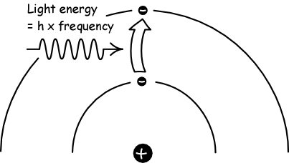
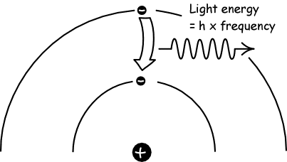
Familiar causal talk
Electrons jump among their energy levels in a hydrogen atom in the presence of an electromagnetic field according to the transition amplitudes of quantum electrodynamics.
Incident radiation causes an electron to jump to a higher energy level.
It then jumps down, seeking its lowest energy state, which is the final cause.
vs
Causal notions add nothing factual.
No independent causal principle.
No independent ontology of causes.
Pragmatic value in helping us understand.
Superimposed narrative is a “folk science.”

Slide 17
Curie’s Principle

Slide 18
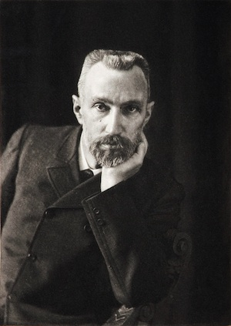
Curie’s Principle
A symmetry of a cause
a symmetry of its effect.
manifests as
“When certain causes produce certain effects, the symmetry elements of the causes must be found in the their effects.”
Pierre Curie, 1896

Slide 19
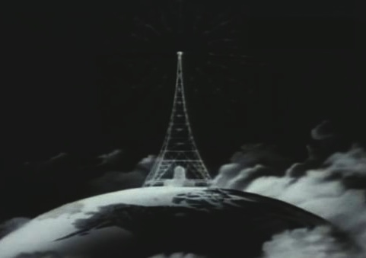
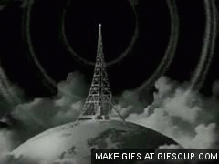
Curie’s Principle
A symmetry of a cause
a symmetry of its effect.
manifests as
Present state: Spherically symmetric source of radiation.
Future state:
Emitted spherically symmetric waves.

Slide 20
Curie’s principle is…
A deep truth of causal metaphysics
Leibniz’s principle of sufficient reason applied to causation.
Cheap generality
Achieved by necessary vagueness. (H. Freudenthal)
For deterministic and indeterministic systems. (Ismael)
Demonstrable truth
Irrefutable
Always protected by seeking hidden asymmetries. (Chalmers)
Falsehood
Counterexamples:
Indeterministic systems (van Frasssen)
Spontaneous symmetry breaking (??)
Time reversal. (Roberts)

Slide 21
… a Truism

Slide 22
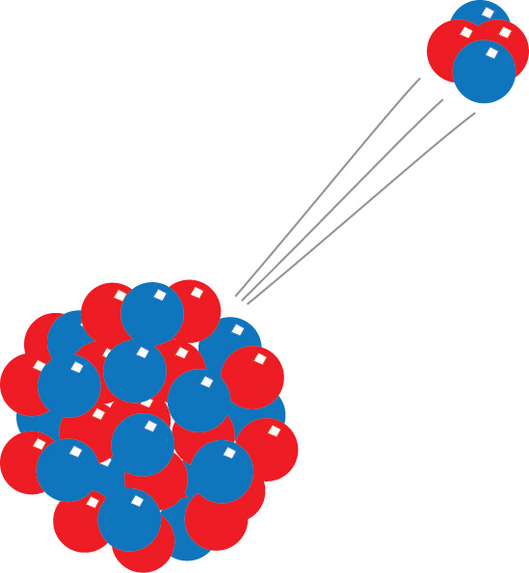
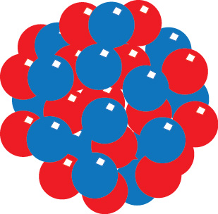
Curie’s principle says …
a cause carries a symmetry
the effect carries that symmetry.
IF
THEN
Abundant counterexamples:
Cause.
Spherically symmetric atom.
Effect.
Spatially asymmetric emission event.

Slide 23
Curie’s principle says …
the dependence of effect on cause respects the symmetry,
a cause carries a symmetry
the effect carries that symmetry.
IF
AND
THEN
… then it is protected from the counterexamples, but…
1
Curie’s principle is now a tautology.
It is true no matter what “cause,” “effect” and “symmetry” mean.
2
Its instantiation in any system is arbitrary.
It depends on how we choose to stipulate that the terms “cause” and “effect” map into the system.
Truism = result easily gained by stipulation.

Slide 24
Example

Slide 25
Alpha Decay (Curie principle does not apply.)
Cause.
Spherically symmetric atom.
Effect.
Spatially asymmetric emission event.

Slide 26
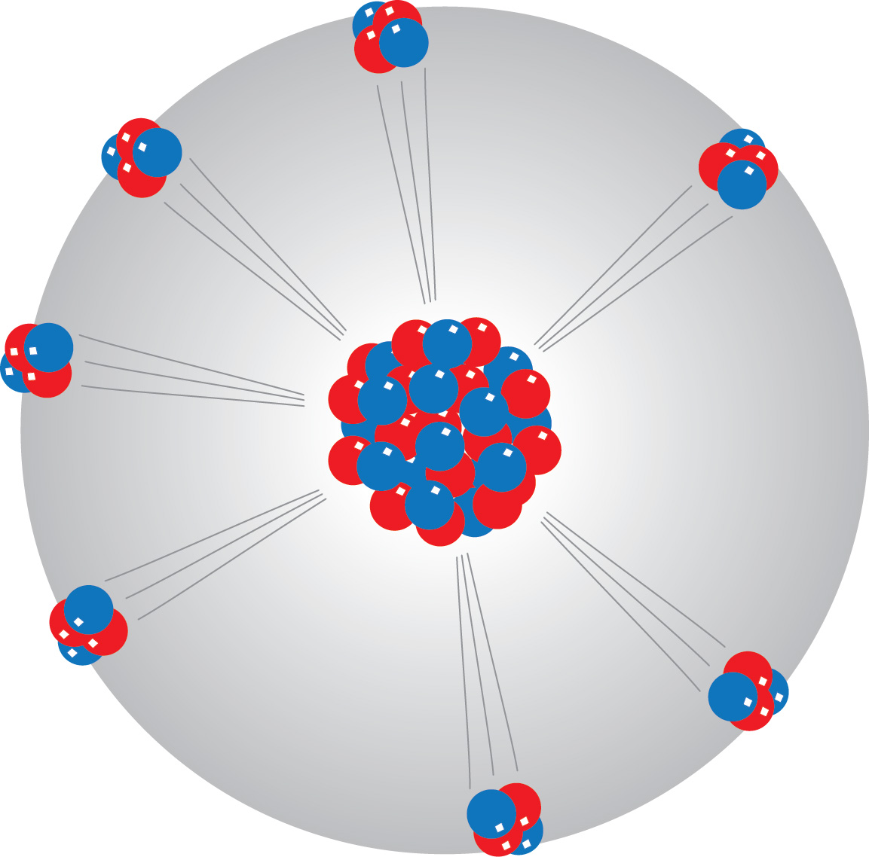
Alpha Decay (Curie principle applies)
Cause.
Spherically symmetric atom.
Effect.
Spatially symmetric probability distribution over emission events.

Slide 27
Which is the right effect?
Individual decay events?
Probability distribution over decay events?
Token causation
Type causation
…whichever you like.

Slide 28
Second horn
Causation places no factual restriction on science.
Any science can admit causal description if we choose suitable meanings for our causal terms.
Causal notions cannot contradict any science.
Any science can admit causal description if we choose suitable meanings for our causal terms.
Facilitate understanding of a science; may even be necessary for understanding.
Heuristic value: seeking causes has proven fertile.
More…
Value of causal concepts is pragmatic.

Slide 29
The debate over Downward Causation

Slide 30
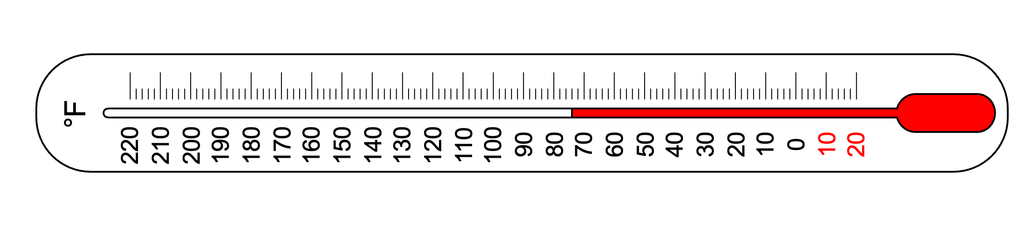
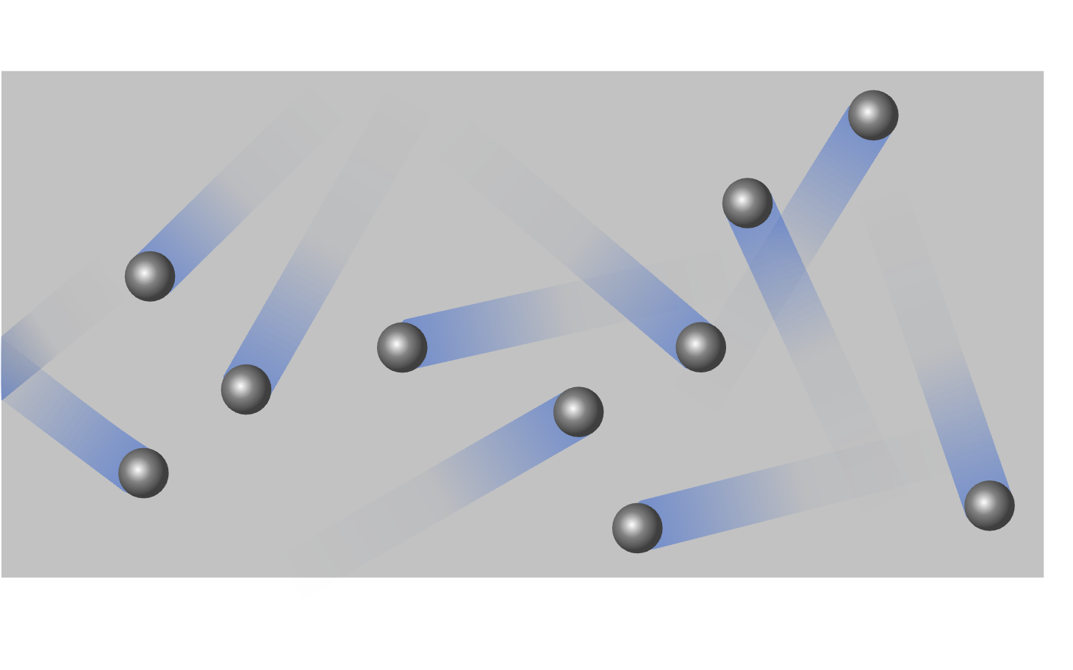
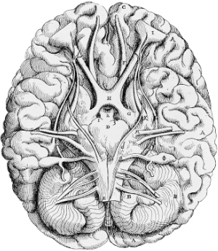
Downward causation
Upper level
The mental
Thermodynamics
causally acts on
Lower level
Statistical physics
The physical

Slide 31

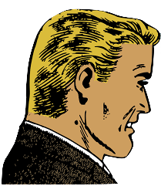
Is downward causation possible?
NO!
It violates trusted causal maxims!
YES!
Why not….
31
31
31

Slide 32
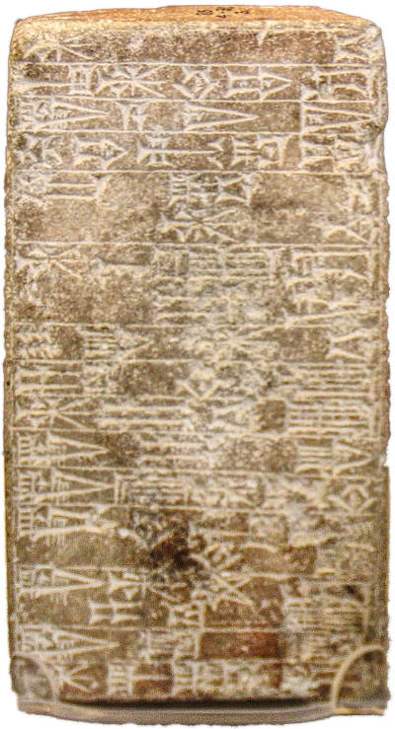
Causal maxims
“Exclusion. No single event can have more than one sufﬁcient cause occurring at any given time—unless it is a genuine case of causal overdetermination.” (Kim, 2005, p. 42)
“Closure. If a physical event has a cause that occurs at t, it has a physical cause that occurs at t.” (Kim, 2005, p. 43)
Wholes to parts. Wholes cannot act causally on their parts. (Craver and Bechtel, 2007)
Asymmetry. The causal relation is asymmetric: causes act on their effects, but effects do not act on their causes. (Craver and Bechtel, 2007)
Time delay. The causal relation is time ordered: causes precede their effects. (Craver and Bechtel, 2007)

Slide 33
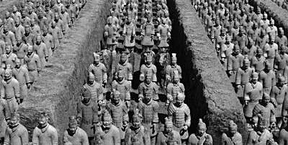
Justifications
??????
Most common: Tacit
Precise meaning of cause vague.
Maxims are declared.
Argumentum ad populum
Causes explain.
Recovered causal maxims from explanatory maxims. (Kim)
Interrelations among maxims
“the possibility of bottom-up and top-down influence ‘propagated’ simultaneously across levels results in problematic causal circles.” (Bechtel and Craver)

Slide 34
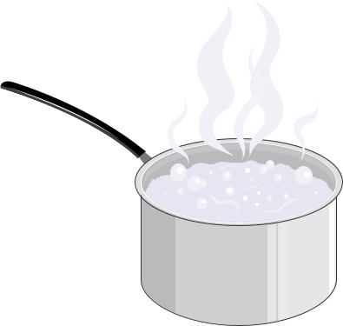
Fragility of Maxims
“Exclusion.
No single event can have more than one sufﬁcient cause occurring at any given time—unless it is a genuine case of causal overdetermination.”
Succeeds
for Salmon-Dowe conserved quantity theory of causation.
“Closure.
If a physical event has a cause that occurs at t, it has a physical cause that occurs at t.”
Fails
for Woodward interventionist account.
Causal relations identified depend on variables examined.
Intervene on upper-level temperature to manipulate lower-level water molecule speeds.

Slide 35

Fragility of Maxims
Wholes to parts.
Wholes cannot act causally on their parts.
Laplace:
“We ought then to regard the present state of the universe as the effect of its anterior state and as the cause of the one which is to follow.”
Today’s total arrangement of the planetary system causes tomorrow’s eclipse.
Asymmetry.
The causal relation is asymmetric: causes act on their effects, but effects do not act on their causes.
Incompatible with:
Time reversible physics.
Dynamic equilibrium in chemistry
A + B C+ D
Time delay.
The causal relation is time ordered: causes precede their effects.
Incompatible with:
Instantaneous gravitational action at distance
Theories of backward causation.

Slide 36
Conclusion

Slide 37
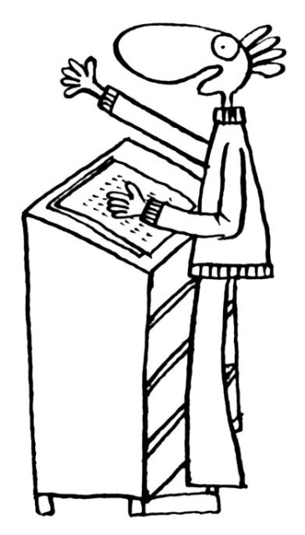
I have claimed…
Causation is about the physical connectedness of things in the world. Its discovery is the province of empirical science.
Causal metaphysics does not provide a repository of causal knowledge independent of empirical science.
It adds factually to science.
Attempt at a priori science. Repeated failure.
Dilemma for causal metaphysics.
It does not add factually to science.
Exercise in labeling.
May be pragmatically useful.
Efforts to discover a factual principle of causality have failed.

Slide 38
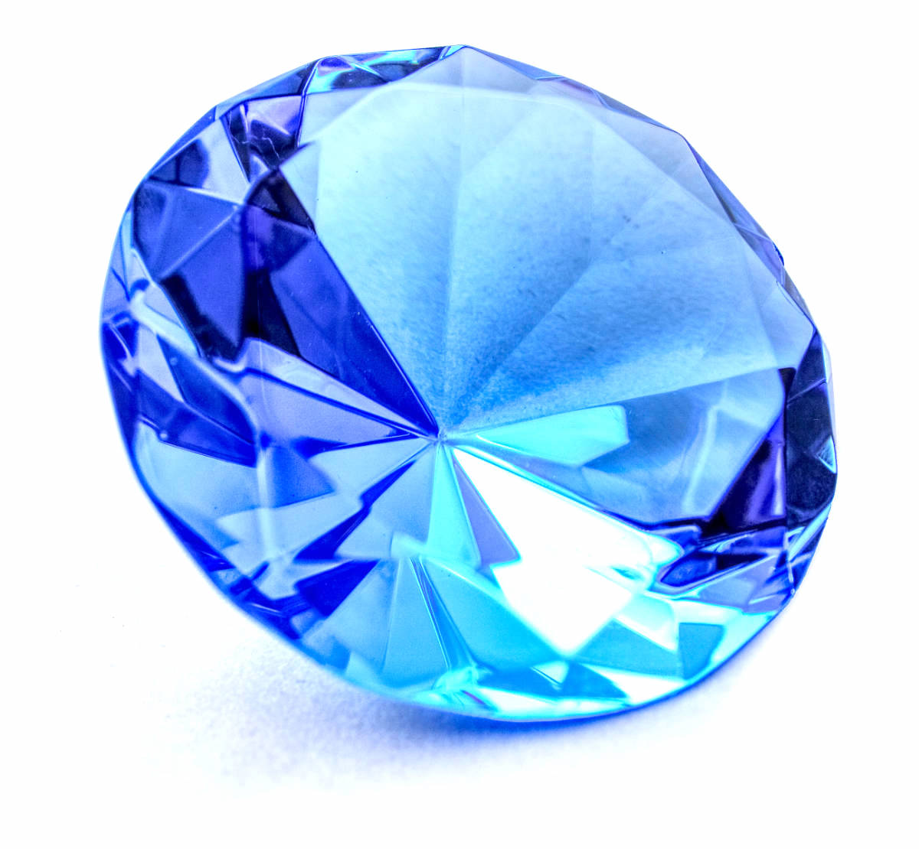

Slide 39
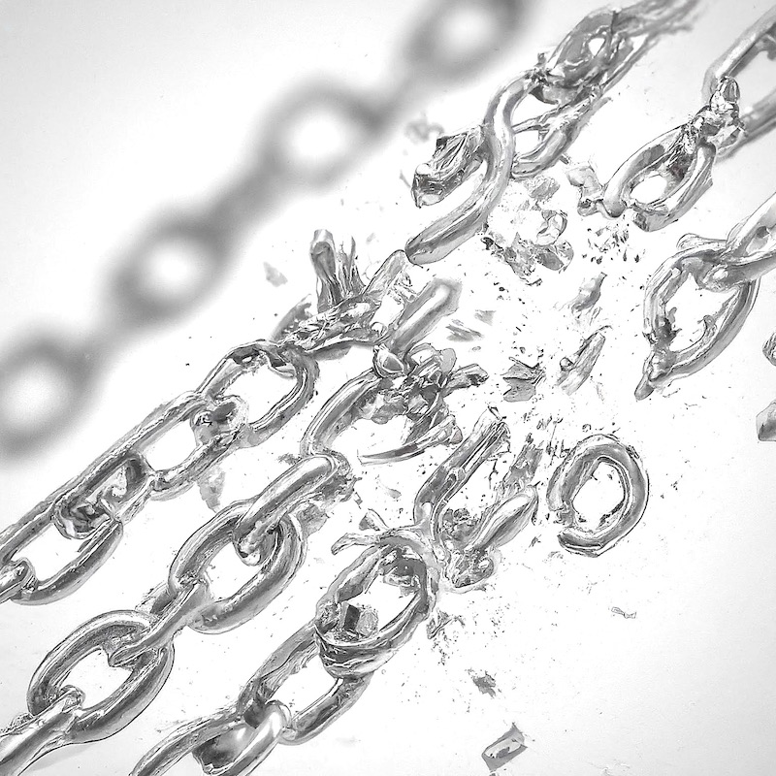

Free…
Metaphysicians are freed from the shackles
of endlessly failed attempts to find a true, factual principle of causation.
ImageFX prompt “many chains breaking photorealistic”
https://aitestkitchen.withgoogle.com/tools/image-fx
Empiricists are freed from the shackles
of Hume’s excessive inductive skepticism about induction and causation.
We are free to use the term “causation”
any way we d*mn well please.

Slide 40
The End

Slide 41
Appendices

Slide 42
An Independent Principle of Causality in Electromagnetic Scattering?

Slide 43
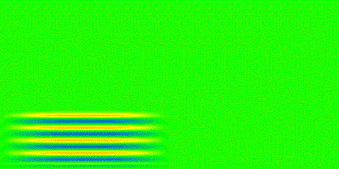
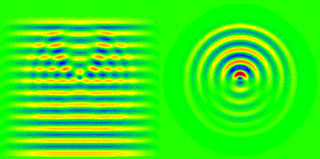
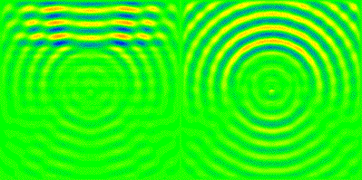
Scattering from a dielectric
Incident plane wave approaches from left…
…excites dielectric atom and generates scattered field…
…and passes.
Total field (incident plus scattered)
Scattered field (total minus incident)
Frames from animation at http://www.met.rdg.ac.uk/~swrhgnrj/maxwell/circle3.html

Slide 44
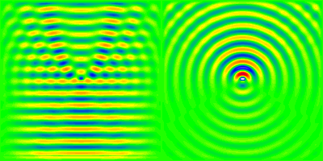
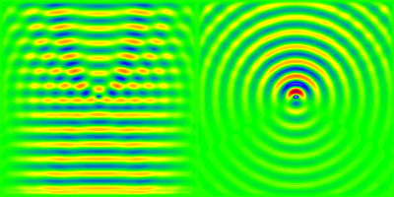
Classical electrodynamics is time reversible.
Forward
Reversed
Ordinary scattering processes are possible.
Time reversed scattering processes are possible.
How do we recover the ordinary outward scattering of our common experience?

Slide 45
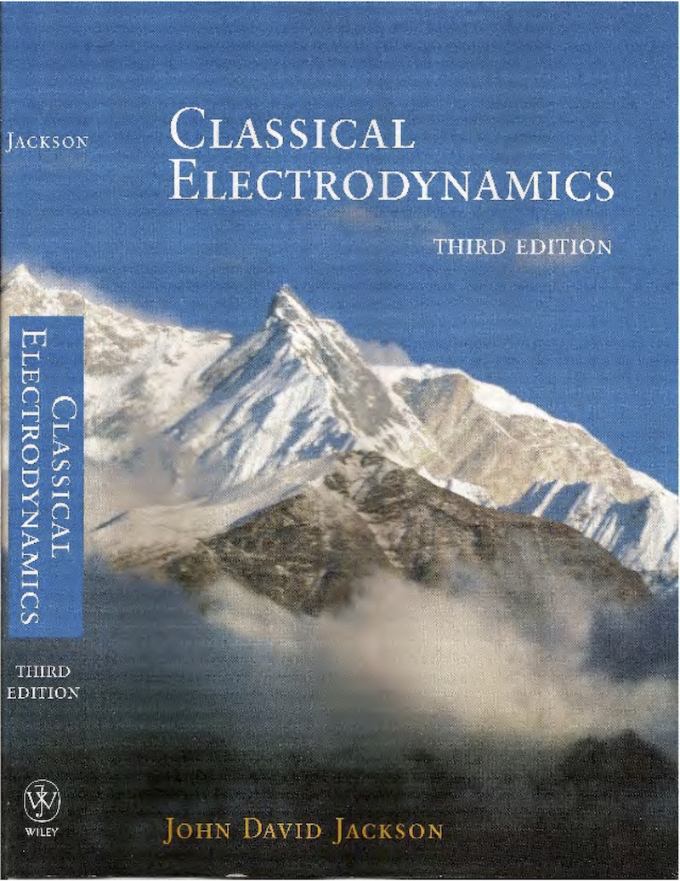
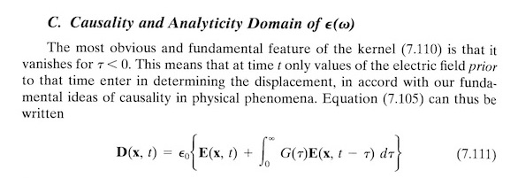
P. 322
Set G(τ) = 0 for τ < 0.
“… only values of the electric field prior to that time enter ... in accord with our fundamental ideas of causality in physical phenomena.”

Slide 46
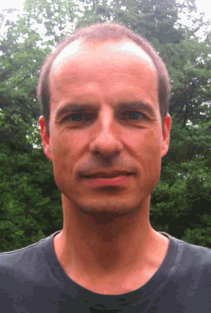
Mathias Frisch: This is a principle of causality
‘The most Sacred Tenet’? Causal Reasoning in Physics” 2009
“… we postulate as an additional constraint on all causally possible models that an effect cannot temporally precede its causes.”
Universality not assumed
“Causal assumptions—just as other scientific assumptions—can play a substantive and legitimate role in a certain domain—and their use can be physically well-founded in that domain—even if we do not take the assumptions to have universal scope and even if we in fact believe that the assumptions fail outside of their domain of application.”

Slide 47

Time Reversed Scattering is Possible…
… but rare and very hard to set up.
Our choice restricts the analysis to ordinary scattering, through selection of boundary and initial conditions.
Reversed scattering does happen.

Slide 48
What precisely does this principle say?
“An effect cannot temporally precede its cause.”
Must be precise enough to be applied in a computation in mathematical physics.
Which state is the effect and which the cause, in any process with states that evolve over time?
The cause comes earlier? That makes the principle true by definition.
What counts as a cause? An effect?
States over time? At an instant? Which hypersurface of simultaneity?
What sorts of processes are properly causal?
“Causal” means later states depend on earlier?
What of Lagrange principles that pick out motions by extremizing the entire history?

Slide 49
Basic Physics of Scattering
Scattered field at position x
incident fields at same position x and other times
is a linear sum of
(“LIN”)
Hence incident can only contribute to scattered for
t-t’>=0
i.e. t’<t.
No influence from future (“NIFF”).
G(x,s)=0 for all s<0.
How do we arrive at this relation?

Slide 50
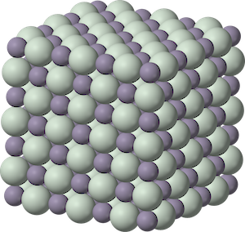
Curie’s Principle
A symmetry of a cause
a symmetry of its effect.
Curie’s version.
manifests as
crystal lattice and external fields
Properties: mechanical, electric, magnetic, thermal;
piezoelectric, piezomagnetic, pyroelectric, pyromagnetic, piezo-caloric, magneto-caloric, magneto-electric polarization…

Slide 51
Failures in Deterministic Systems

Slide 52
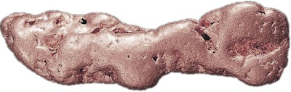
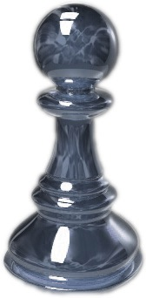
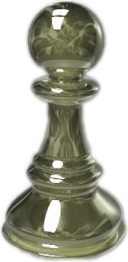
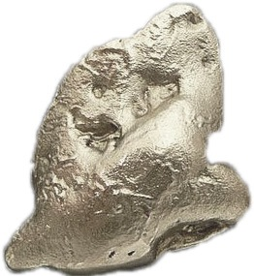
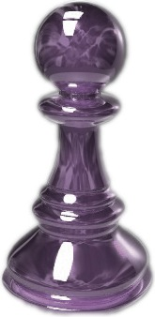



Determinism is not Enough
Deterministic dependency
Symmetric causes
Asymmetric effects

Slide 53
Galileo’s Law of Fall (Failure)
Cause.
Many symmetries in initial state.
Effect.
Few symmetries in ensuing fall.
More symmetric cause
Law harboring asymmetry
Less symmetric effect
+

Slide 54
Fall in a Newtonian Field (Success)
Cause.
Few symmetries in initial state.
Effect.
Same symmetries in ensuing fall.
Few symmetries in cause.
Law preserves symmetries.
Same symmetries in effect.
+

Slide 55
Must asymmetries be confined to causes?
Galileo’s law of fall
More symmetric initial state
law harboring asymmetry
Less symmetric final state
+
relocate asymmetry
Fall in a Newtonian field
Few symmetries in initial state
law preserves symmetries
Same symmetries in final state
+
…NO

