Slide 1
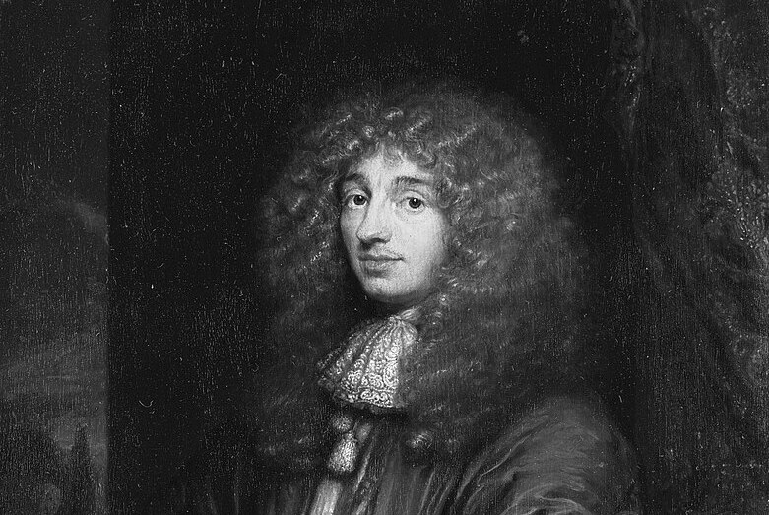
Chance Combinatorics
The Theory that History Forgot
John D. Norton
Department of History and
Philosophy of Science
University of Pittsburgh
My. text.

Slide 2
The Project

Slide 3
“How close were earlier ideas to modern probability theory?”

Slide 4
“What conception of chance was used in the seventeenth century?”

Slide 5

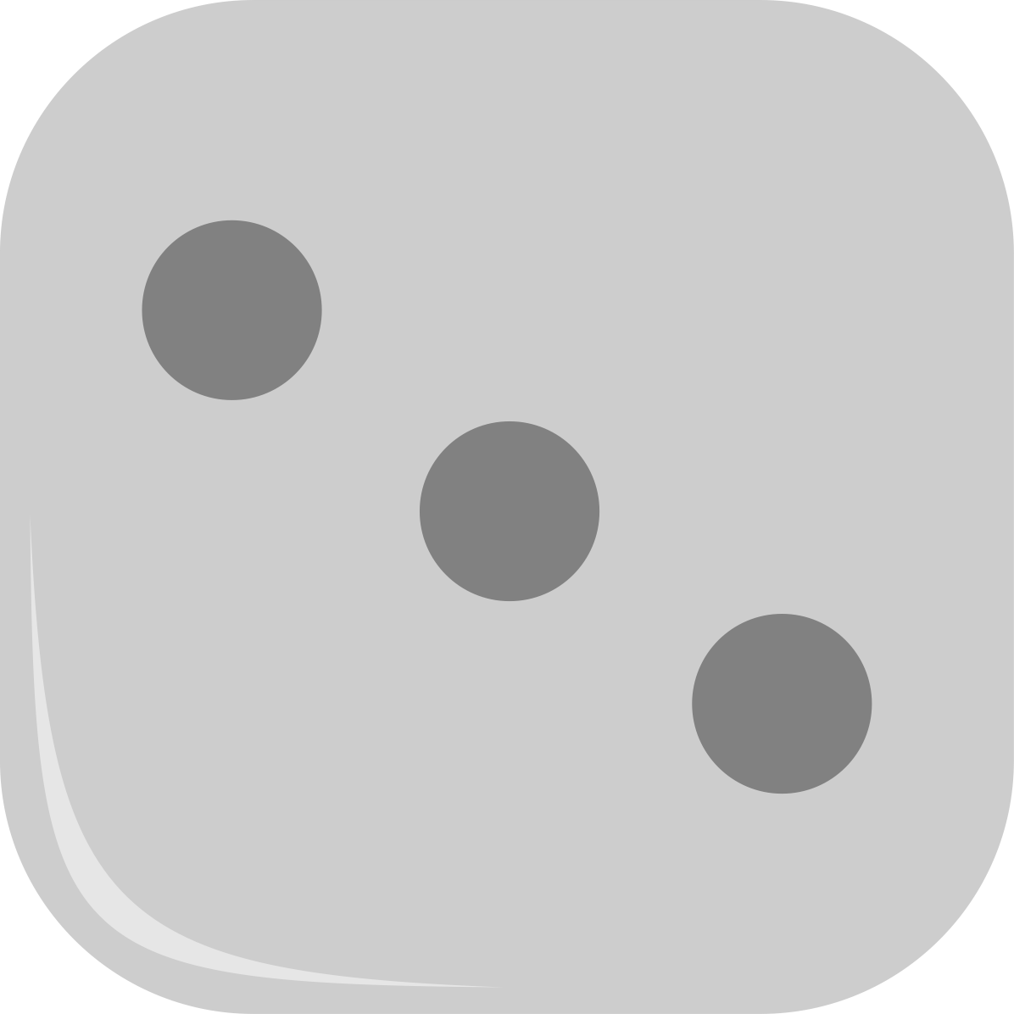




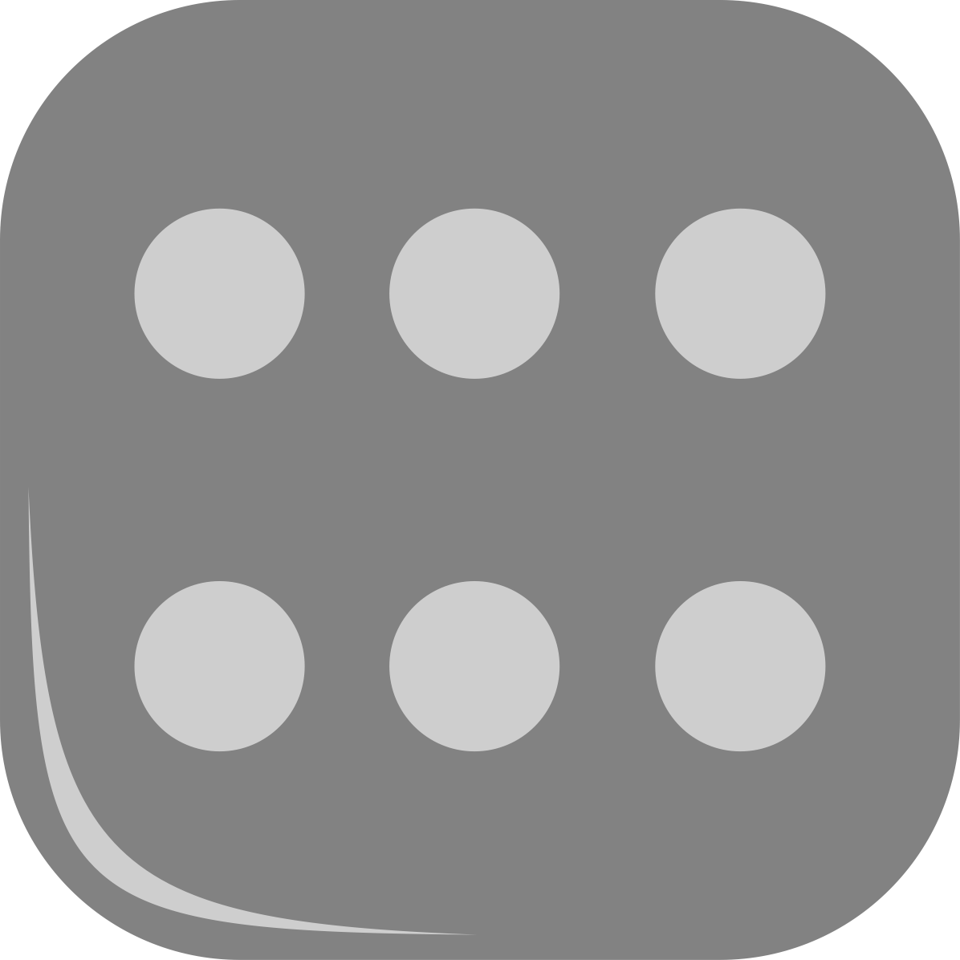

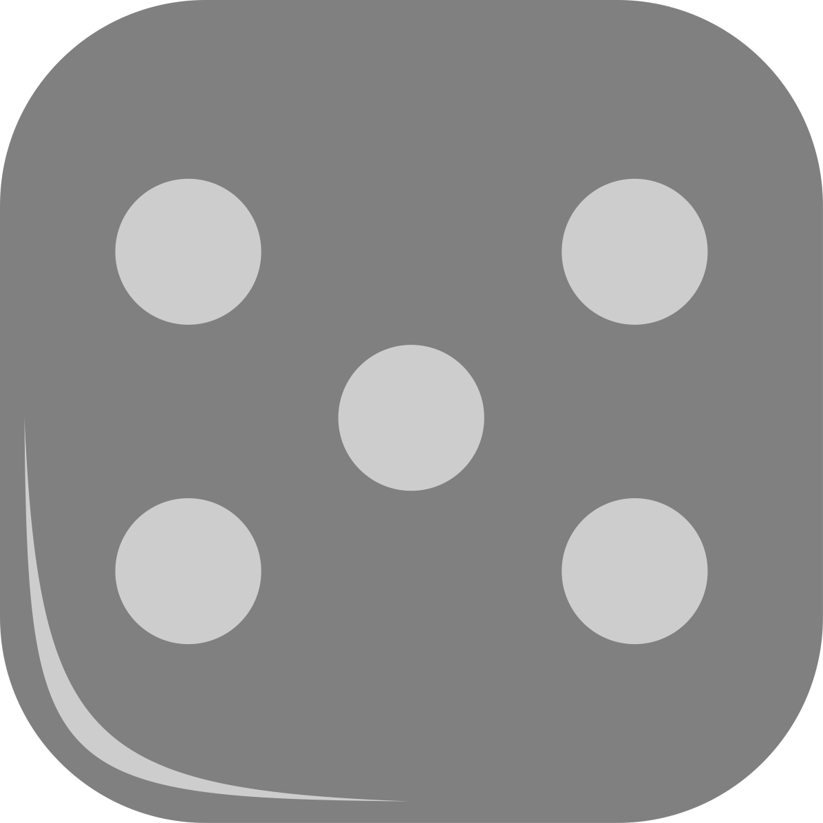
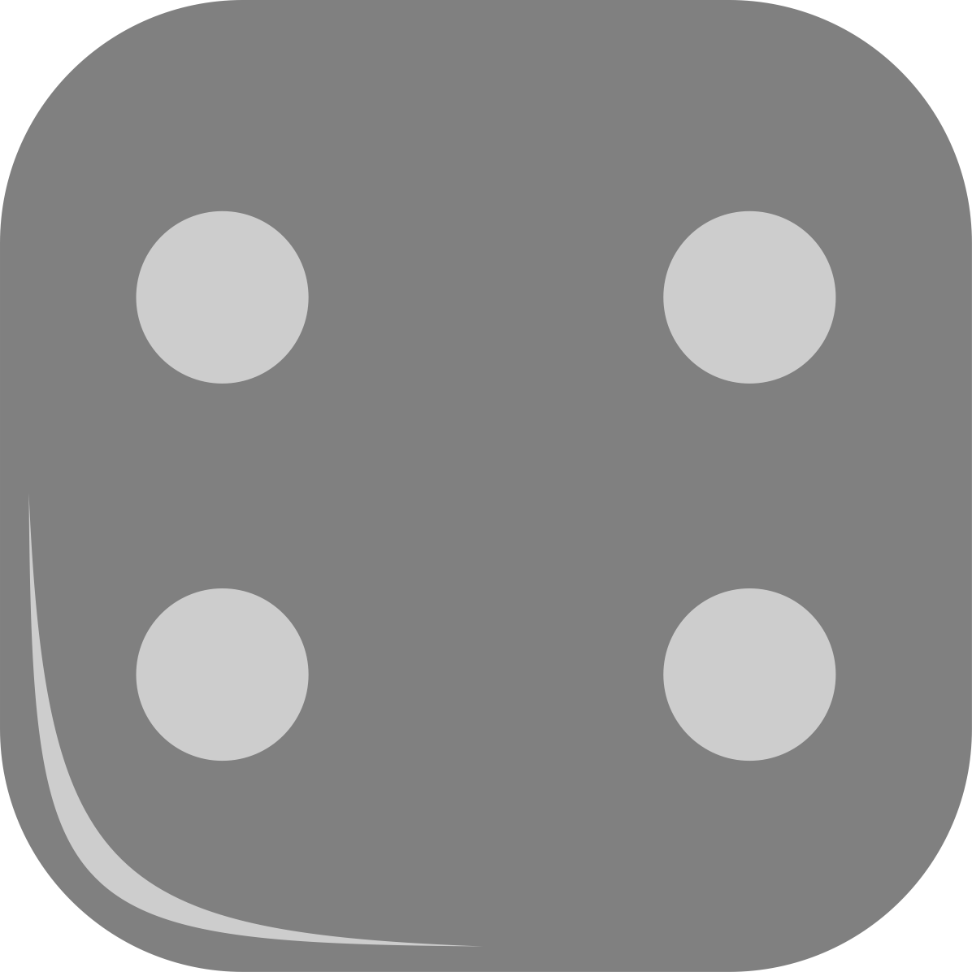
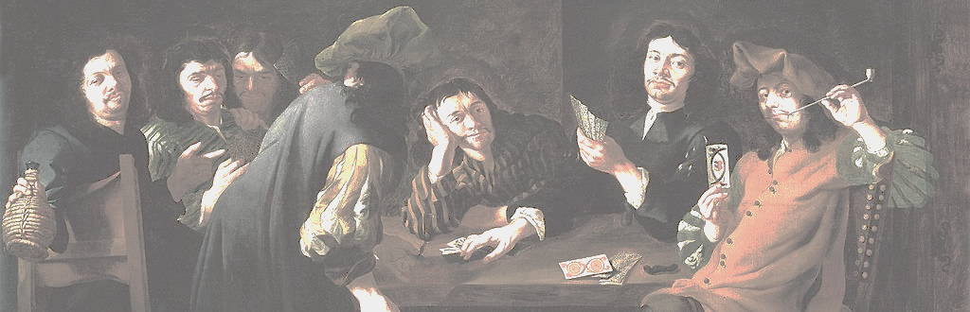
Summary
Present
Setting
A finite set of primitive cases
with selection among them by a physical process, such as die casts, whose mechanical operation assured the equality of their chances.
Mathematics
The combinatorics of counting primitive cases. It answered question such as “how many combinations of casts of two dice give a sum of seven?”
Interpretation
Which are the wagers that are equally fair to all players, for a given game where equal chance outcomes are known.

Slide 6
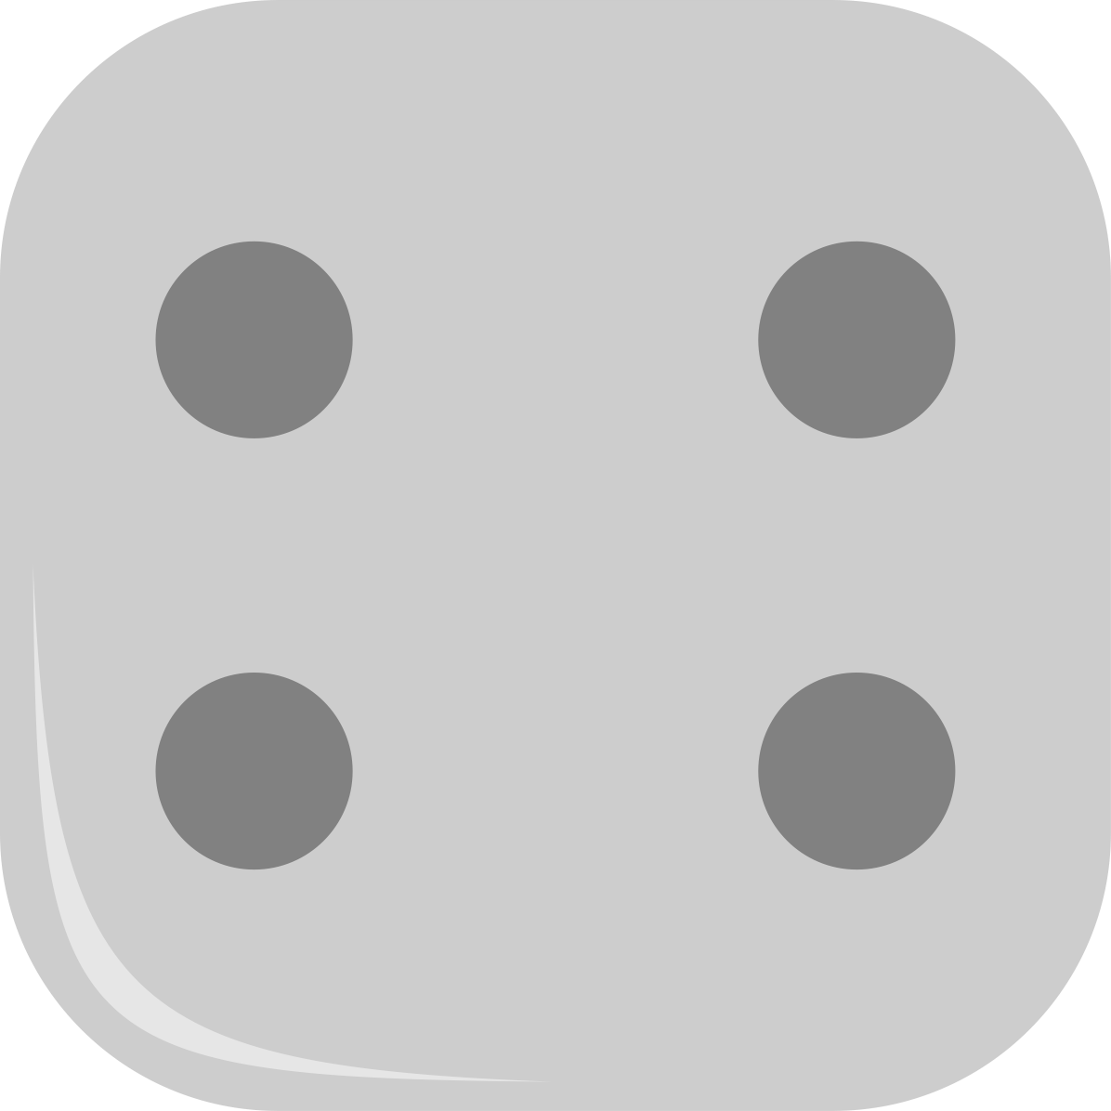
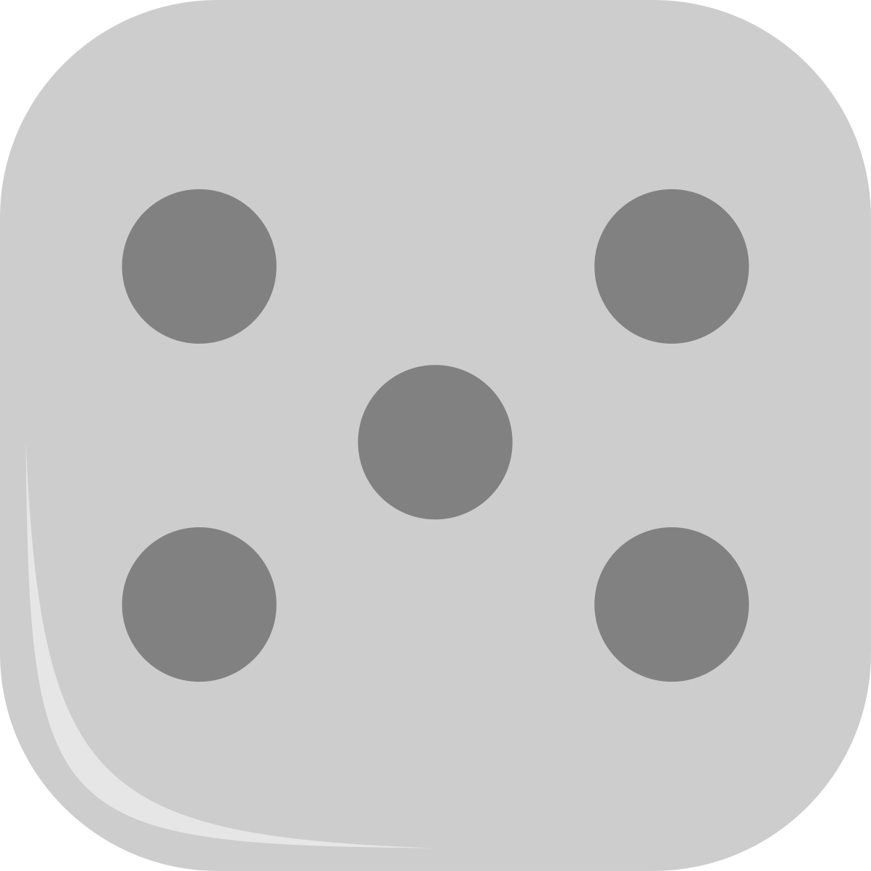
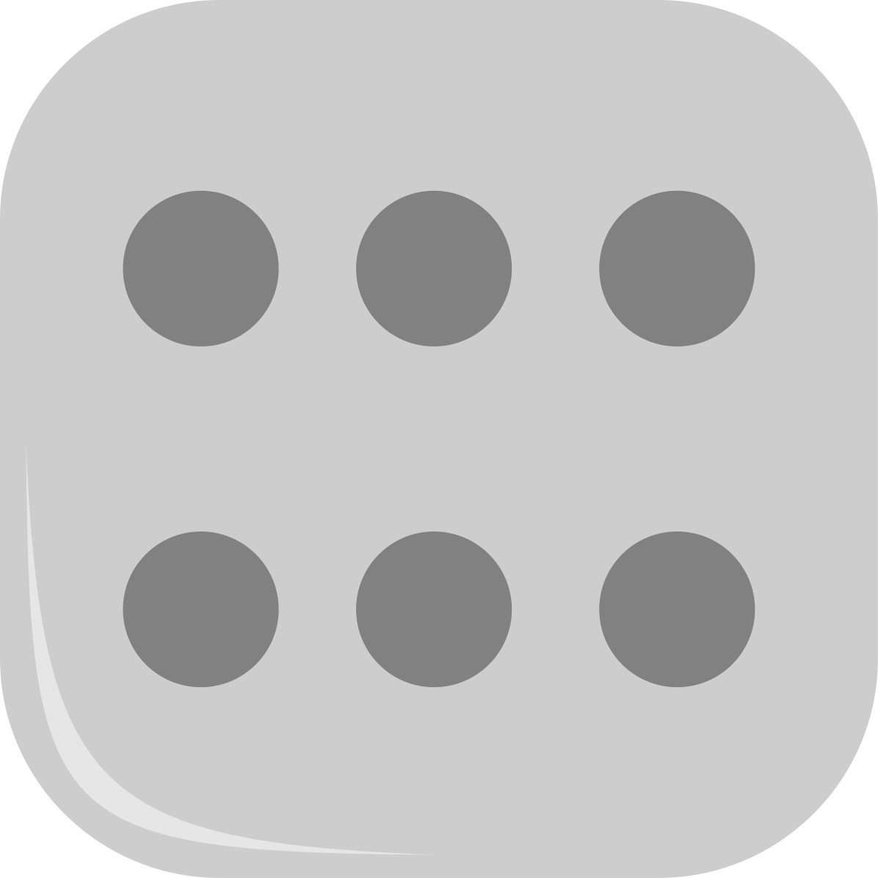
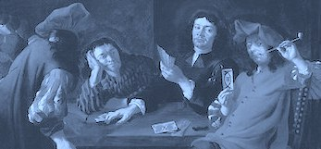
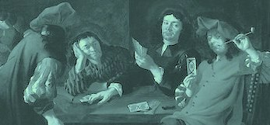
Summary
Absent
Measure of belief
Chances do not measure subjective belief. Chances are objective properties of the physical devices.
Connection to frequencies.
No precise rule connecting frequencies to chances. Higher chance outcomes occur more often.
Probability
The ratio of the favorable number of chances to all chances is not distinguished as a fundamental quantity.
P(.)
Comparison across different games.
Import of chance counts in one game cannot be compared against that in another.

Slide 7
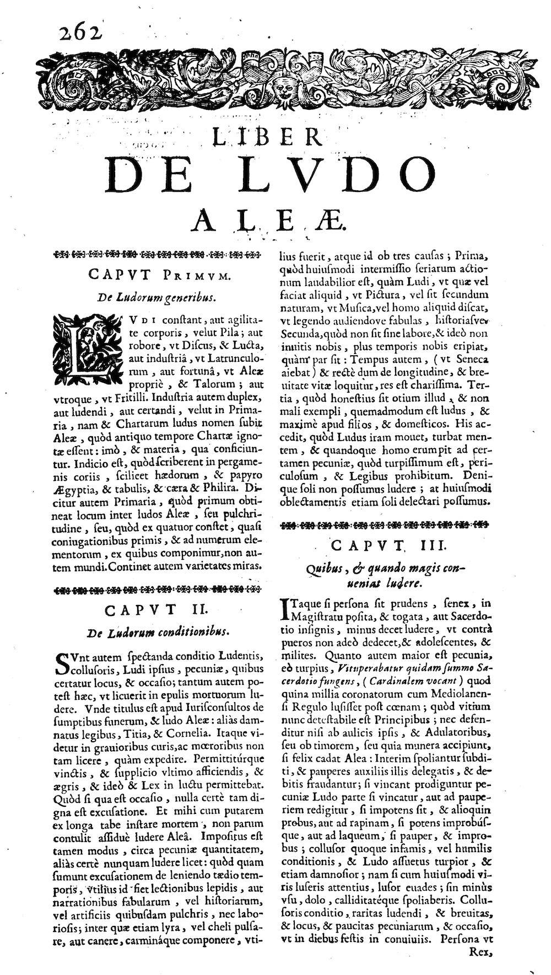
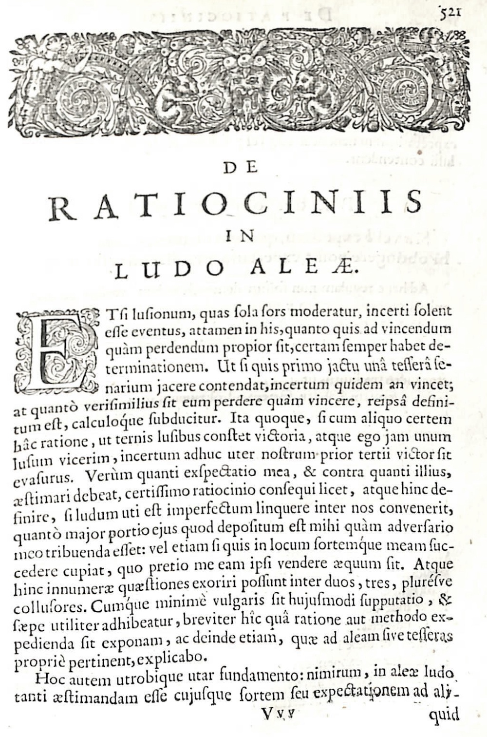
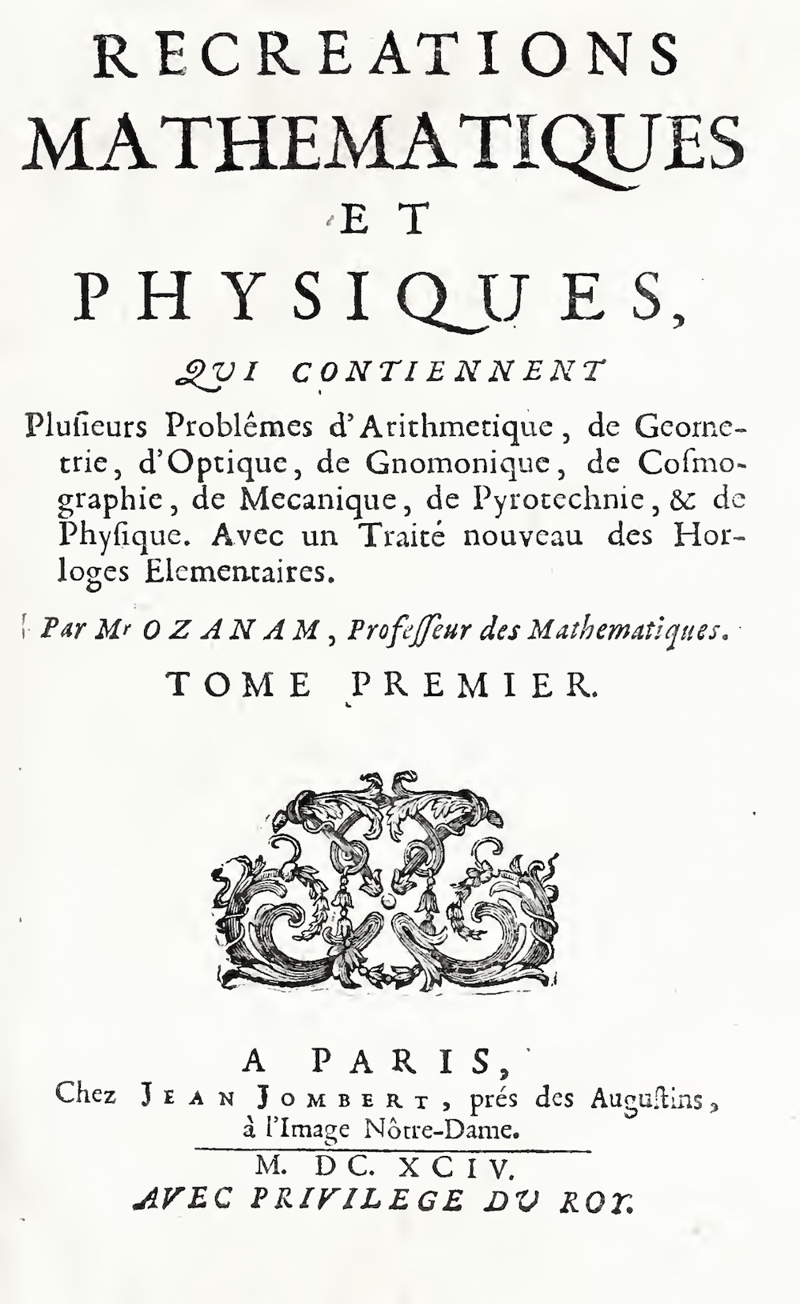
Who?
Gerolamo Cardano. Liber de Ludo Aleae. 1663
Christiann Huygens. De Ratiociniis in Ludo Aleae. 1657
Jacques Ozanam. Récréations Mathématique et Physiques. 1694 Vol. 1

Slide 8
Who?
Evidence of widespread use and understanding of chance.
Galileo Galilei “Sopra le scoperte dei dadi” [concerning an investigation on dice], ~1613-23.
Solves problem posed by “…him who has ordered me…”
Pierre de Fermat and Blaise Pascal, correspondence. 1654
Solves the problem of points, posed by Chevalier de Méré
Antoine Arnauld and Pierre Nicole, La Logique ou l’Art de Penser. “Port Royal Logic” Ch 15. 1662.
Solves problem posed by Pepys
Isaac Newton, Correspondence with Samuel Pepys. 1693

Slide 9
Present

Slide 10
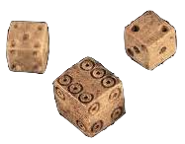
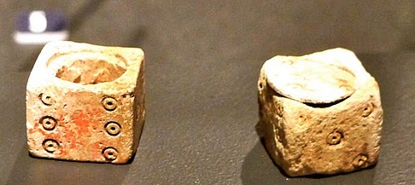
Setting
A finite set of primitive cases
with selection among them by a physical process, such as die casts, whose mechanical operation assured the equality of their chances.
Cardano’s principle
“6. The Fundamental Principle of Gambling
The most fundamental principle of all in gambling is simply equal conditions, e.g. of opponents, of bystanders, of money, of situation, of the dice box, and of the die itself.”
Artefacts
Carefully manufactured fair dice
17th c. dice from Jamestown, England
Elaborate 16th c. literature on faked dice:
“Fullams”: dice loaded with quicksilver or lead.
“Bristles”: a short hair set in one side.
“Flats”: dice reduced in length on one axis.
“langret”: or “barred die” elongated on the axis.
…
loaded dice

Slide 11
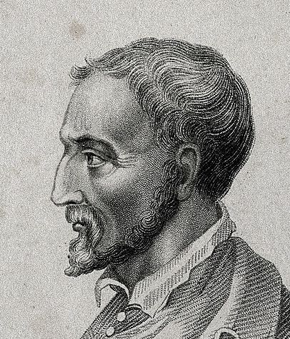


Frequencies and Chances can only be connected loosely
… the die has six [faces and points]; in six casts each point should turn up once; but since some will be repeated, it follows that others will not turn up.
Cardano
But the throw (1,2) can turn up in two ways, so that for it there is equality in nine casts; and if it turns up more frequently or more rarely, that is a matter of luck.

Slide 12
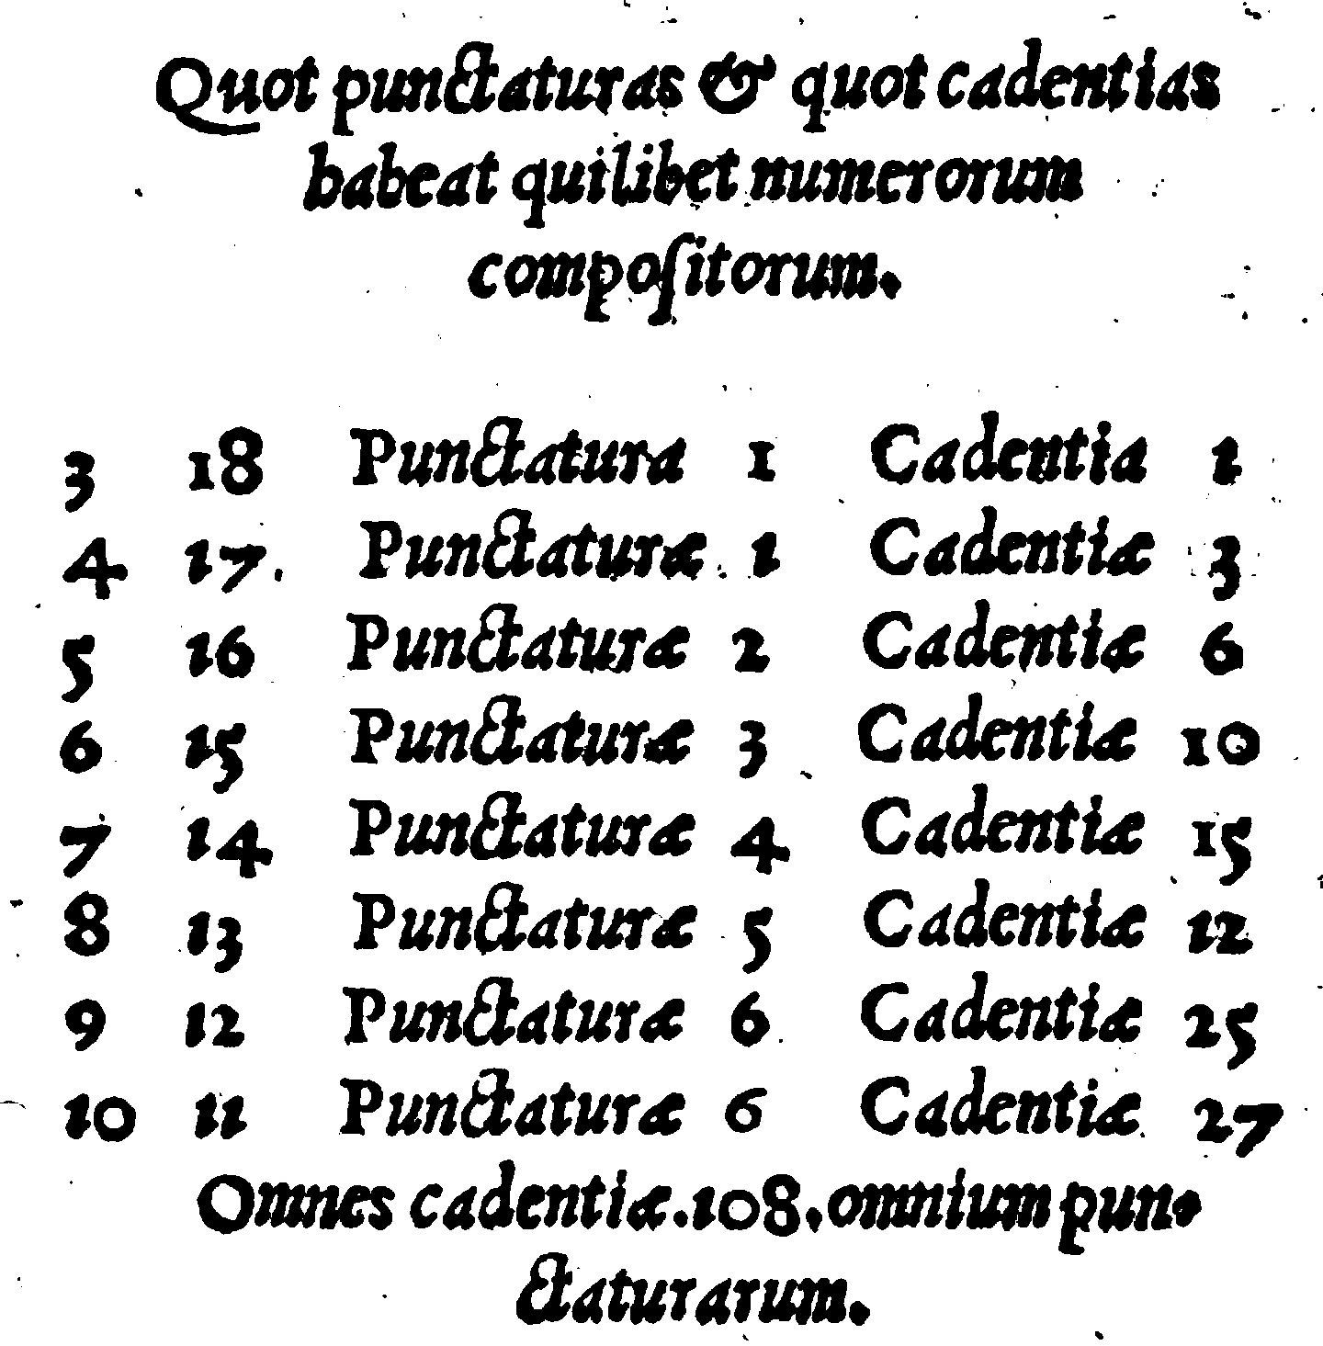
Mathematics
The combinatorics of counting primitive cases. It answered question such as “how many combinations of casts of two dice give a sum of seven?”
13th century “De Vetula”
Each compound number has the following number of pips and ways of casting.
3 18 pips 1 casts 1
4 17 pips 2 casts 3
5 16 pips 2 casts 6
6 15 pips 3 casts 10
7 14 pips 4 casts 15
8 13 pips 5 casts 12 [21]
9 12 pips 6 casts 25
10 11 pips 6 casts 27
In all, 108 casts of all the pips.
For three dice,
two ways to cast a 5 if we neglect the order of pips
(1-1-3, 1-2-2);
and 6 ways if we distinguish them
(1-1-3, 1-3-1, 3-1-1, 1-2-2, 2-1-2, 2-2-1).
Widely used in the 17th c.

Slide 13

Interpretation
Which are the wagers that are equally fair to all players, for a given game where equal chance outcomes are known
Cardano’s rule
“…consider … the number of those casts which represents in how many ways the favorable result, and compare that number to the remainder of the circuit, and according to that proportion should the mutual wagers be laid so that one may contend on equal terms.”
1
2
Wins with
M chances
N chances
Fair wager
M
to
N

Slide 14
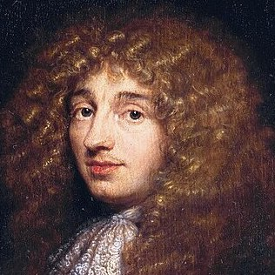
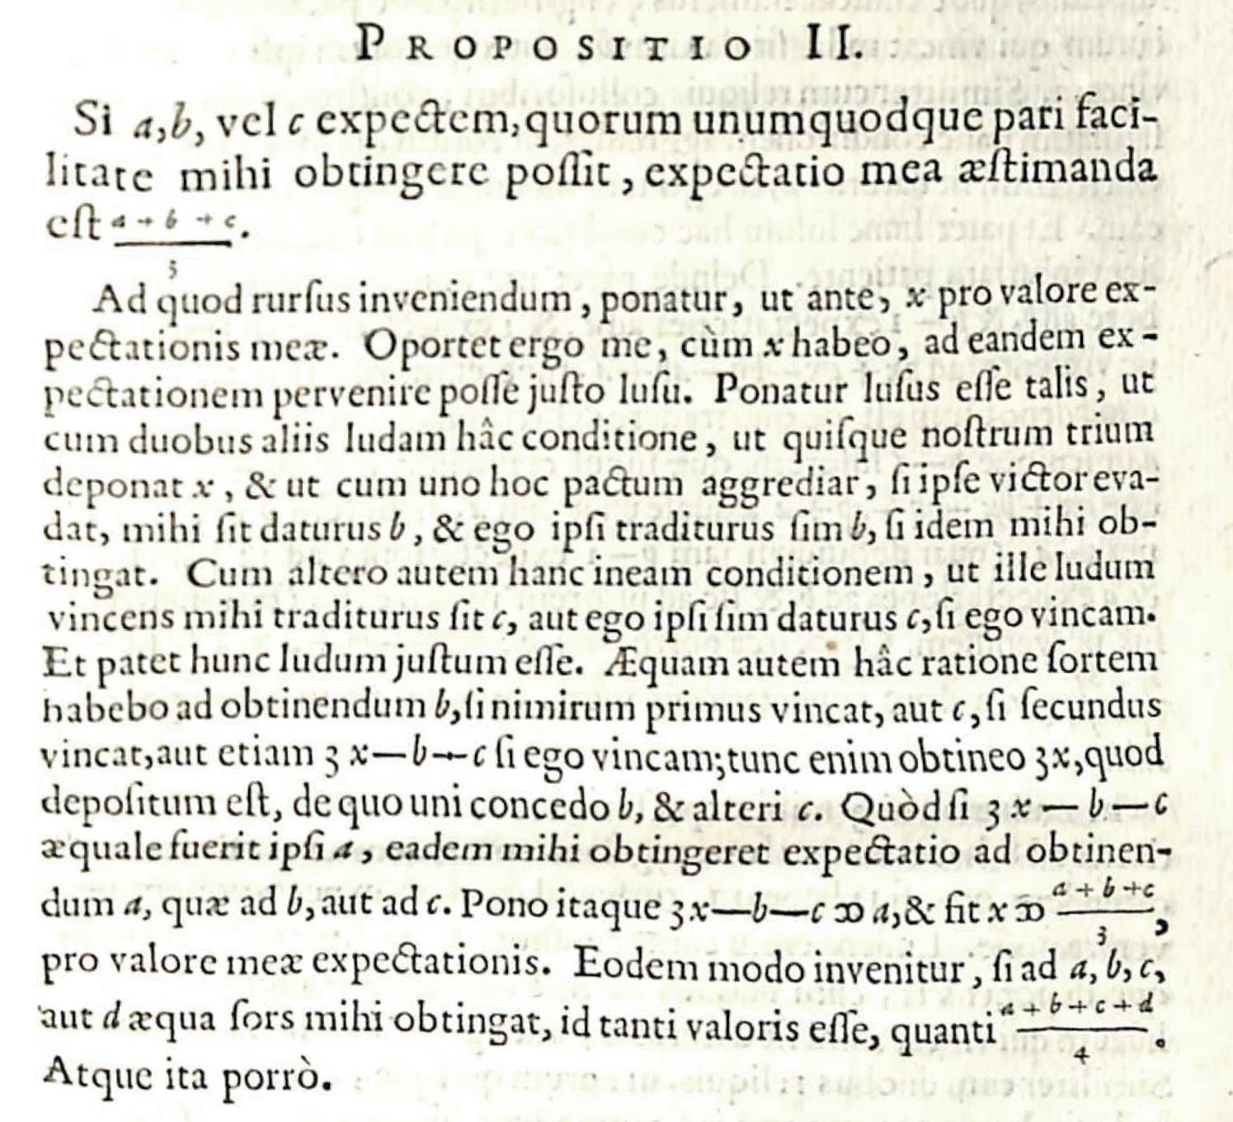
Huygen’s completion
Cardano’s rule
Requires consideration of stakes by two players.
Huygens’ rule.
“Expectation” Stakes one player should advance given the structure of the game.
Huygens: “my expectation to win something is worth just such a sum as would get me the same expectation in a fair game.”
Game pays a, b, c
with equal chances
Expectation
= fair wager = (a+b+c)/3

Slide 15
Huygens’ proof
No frequencies.
No expectation
= probability
x utility.
Three players play the same game with payoffs:
Player 1
Player 2
Player 3
Outcome 1
a
b
c
Outcome 2
b
c
a
Outcome 3
c
a
b
Expectation
= fair stake
= (a+b+c)/3
For each outcome, payout is a+b+c.
Game treats each player symmetrically

Slide 16
Absent

Slide 17
Summary
Absent
Measure of belief
Chances do not measure subjective belief. Chances are objective properties of the physical devices.
Connection to frequencies.
No precise rule connecting frequencies to chances. Higher chance outcomes occur more often.
Probability
The ratio of the favorable number of chances to all chances is not distinguished as a fundamental quantity.
P(.)
Comparison across different games.
Import of chance counts in one game cannot be compared against that in another.

Slide 18
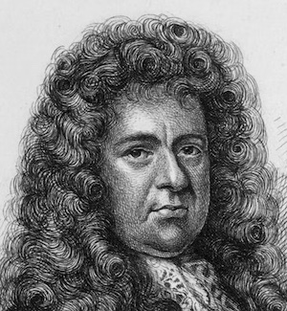
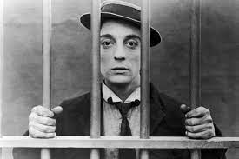
Pepys’ problem as posed to Newton.
One choice.
…supposing [the dice] instead of 1, 2, 3, &c to bee branded wth ye 6 initiall Letters of ye Alphabet A. B. C. D. E. F. And the Case should then bee this; Peter a Criminal Convict being doom'd to dye, Paul his Friend prevails for his having ye benefitt of One Throw only for his Life, upon Dice soe prepared; with ye Choice of any one of these Three Chances for it, viz.
Pepys to Newton, December 9, 1693
One F, at least upon Six such Dice.
Two F's at least upon Twelve such Dice,
Or
Three F's at least upon Eighteen such Dice.
Question.—Which one of these Chances should Peter in this Case choose?
A
B
C
D
E
F

Slide 19
The Modern Analysis
31031
At least one
in 6 casts
F
P = = 0.665
46656
1346704211
At least two
in 12 casts
F
F
P = = 0.619
2176782336
60666401980916
P = = 0.597
At least three
in 18 casts
F
F
F
101559956668416

Slide 20
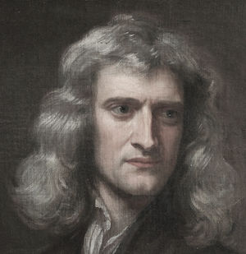
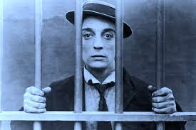
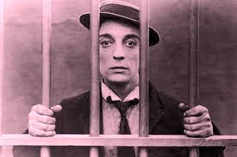
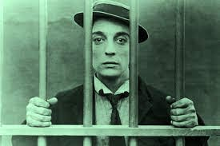
Newton’s Reformulation.
Three Wagers
A hath six dice in a box, with which he is to fling at least one six, for a wager laid with R.
Newton to Pepys, December 16, 1693
B hath twelve dice in another box, with which he is to fling at least two sixes, for a wager laid with S.
C hath eighteen dice in another box, with which he is to fling at least three sixes, for a wager laid with T.
The stakes of R, S, & T, are equal; what ought A, B, & C to stake, that the parties may play upon equal advantage?

Slide 21
Newton’s Analysis
Fair wager
A stakes 31,031
to R’s 15,625
At least one
in 6 casts
A stakes 665l. 2s. 1/2d.
to R’s (1,000l - 665l. 2s. 1/2d.)
At least two
in 12 casts
B stakes 1,346,704,211
to S’s 830,078,125
B stakes 618l. 13s. 4d.
to S’s (1,000l - 618l. 13s. 4d.)
At least three
in 18 casts
(numbers too big)

Slide 22
Summary
Absent
Measure of belief
Chances do not measure subjective belief. Chances are objective properties of the physical devices.
Connection to frequencies.
No precise rule connecting frequencies to chances. Higher chance outcomes occur more often.
Probability
The ratio of the favorable number of chances to all chances is not distinguished as a fundamental quantity.
P(.)
Comparison across different games.
Import of chance counts in one game cannot be compared against that in another.

Slide 23
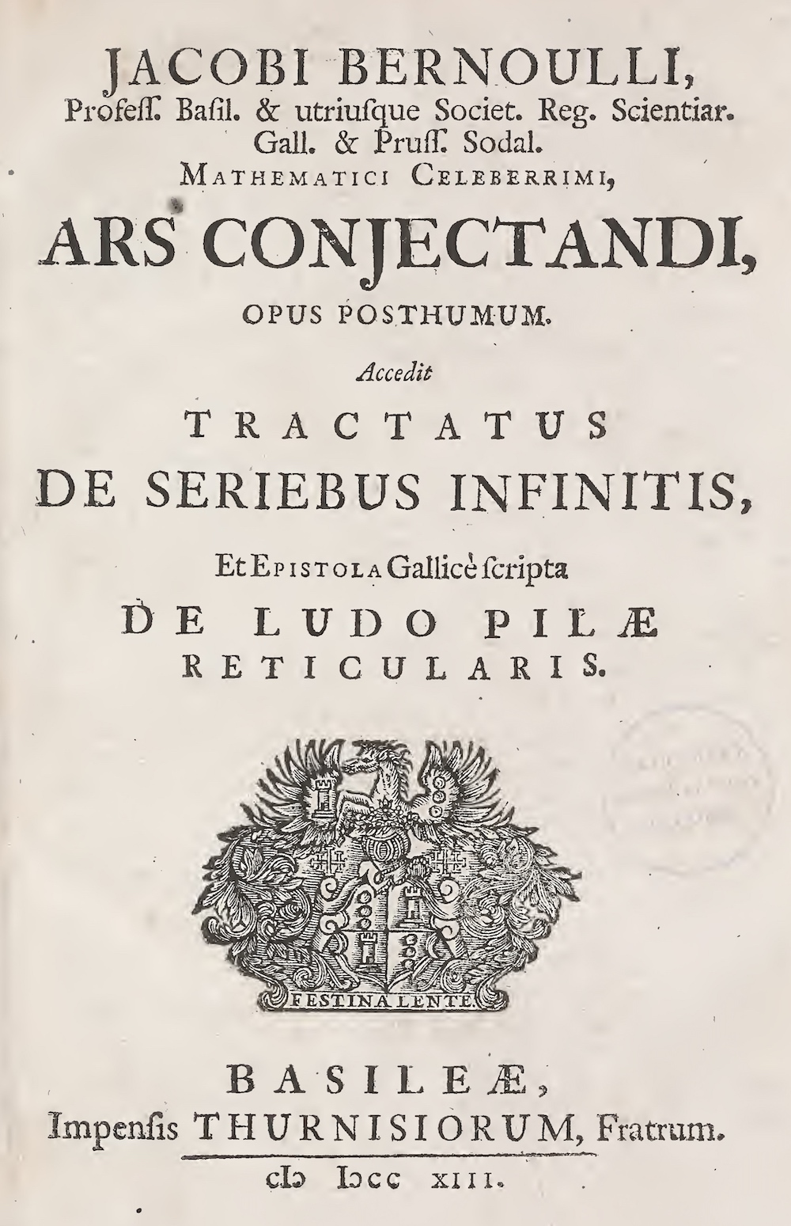
Jacob Bernoulli,
Ars Conjectandi.
1713

Slide 24
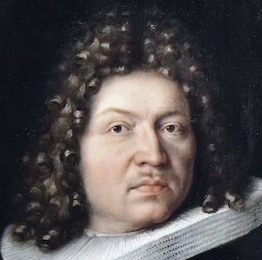
Extends Chances beyond Games
If, for example, there once existed three hundred people of the same age and body type as Titius now has, and you observed that two hundred of them died before the end of a decade, while the rest lived longer,
?
Ch IV, Book IV
you could safely enough conclude that there are twice as many cases in which Titius also may die within a decade as there are cases in which he may live beyond a decade.
Titius

Slide 25
Weak Law of Large Numbers
Chances FROM Frequencies
… as the number of observations increases, so the probability increases of obtaining the true ratio between the numbers of cases in which some event can happen and not happen, such that this probability may eventually exceed any given degree of certainty.
Ch IV, Book IV

Slide 26
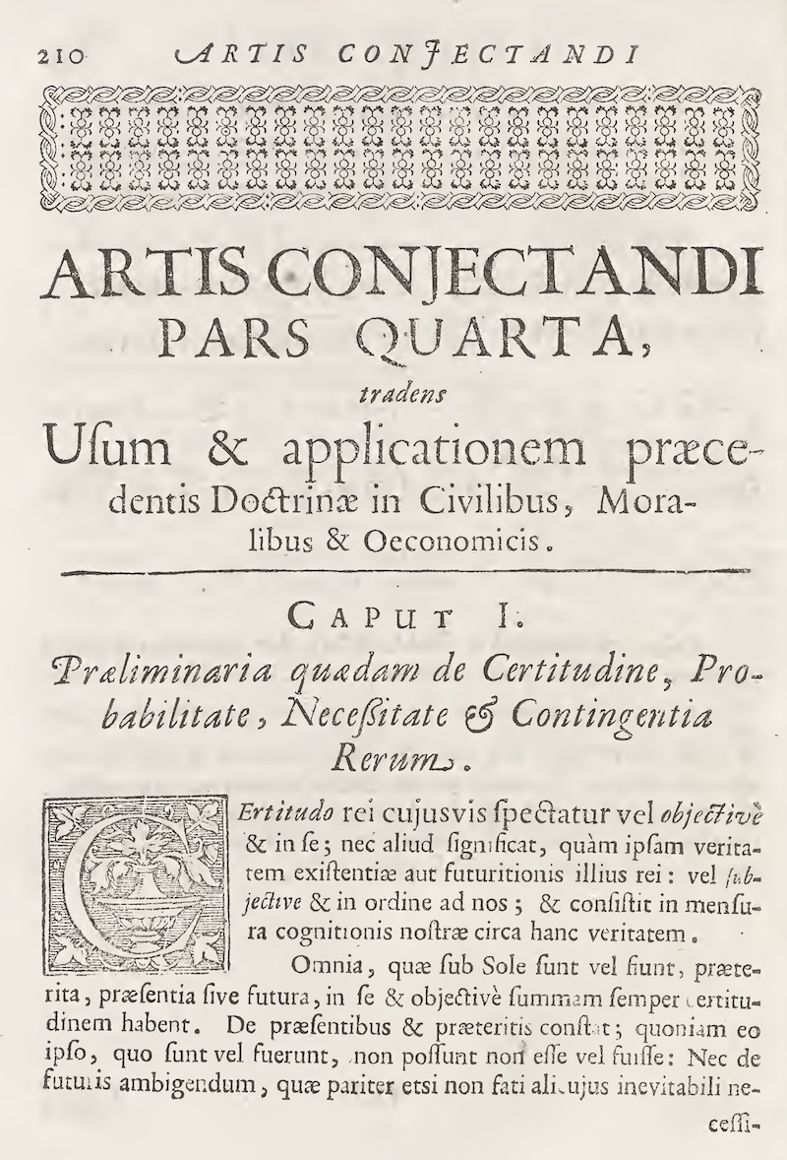
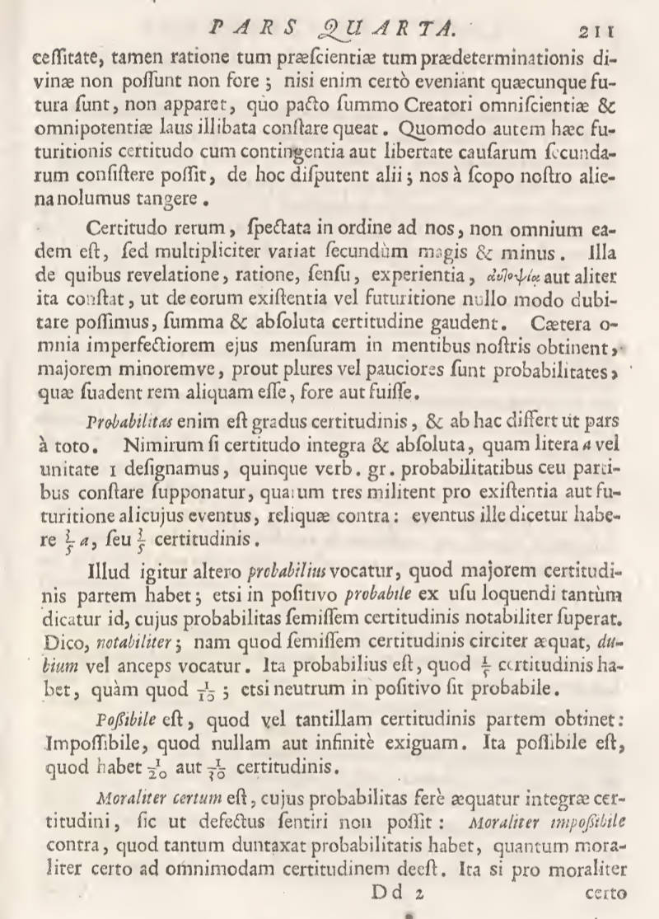
Probability becomes a fundamental quantity
Frequencies yield probabilities, not absolute counts of chances.
Probability, indeed, is degree of certainty, and differs from the latter as a part differs from the whole. Truly, if complete and absolute certainty, which we represent by the letter a or by 1, is supposed, for the sake of argument, to be composed of five parts or probabilities, of which three argue for the existence or future existence of some outcome and the others argue against it, then that outcome will be said to have 3a/5 or 3/5 of certainty.

Slide 27
Conclusion

Slide 28
“What conception of chance was used in the seventeenth Century?”

Slide 29

Read

Slide 30
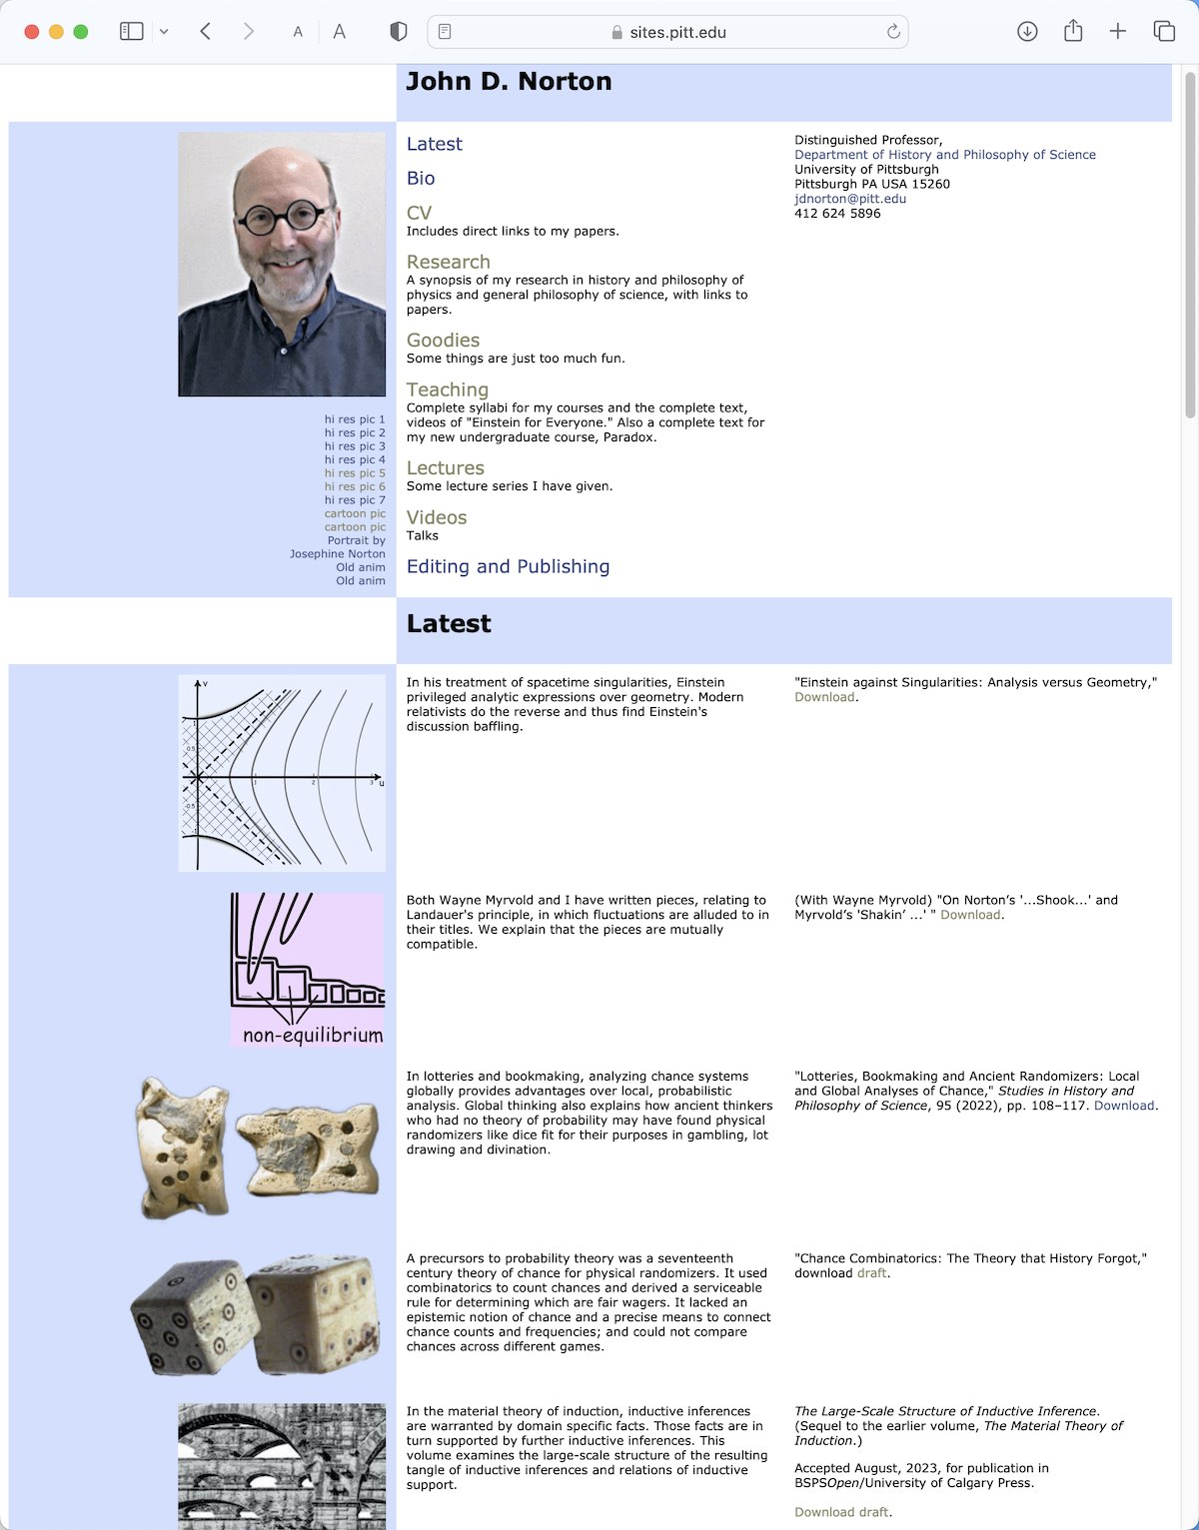
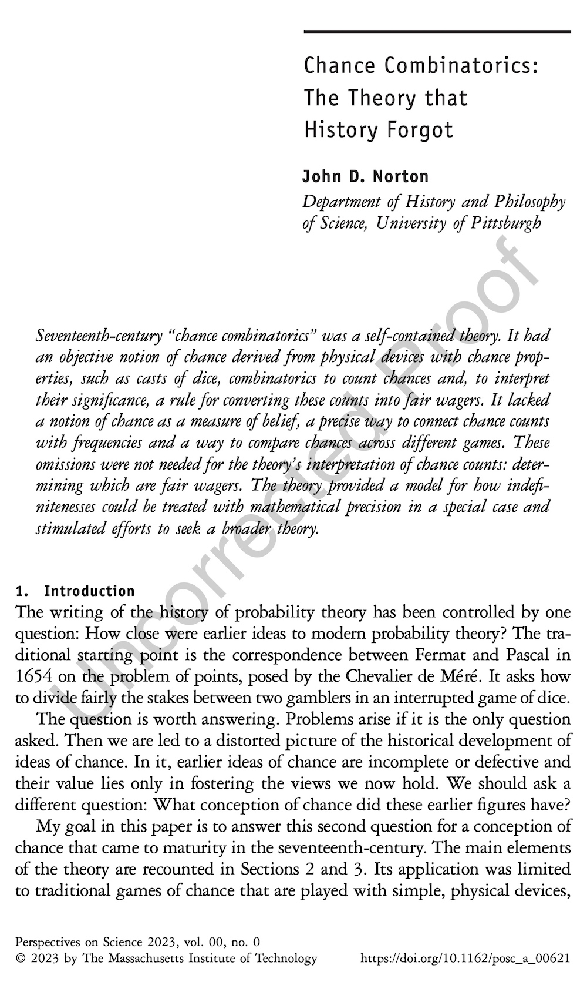

Slide 31
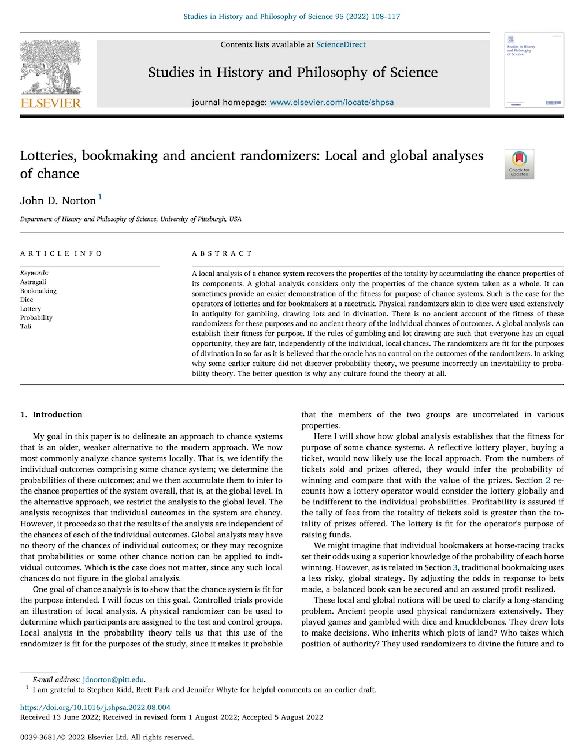

Slide 32
End

