Slide 1
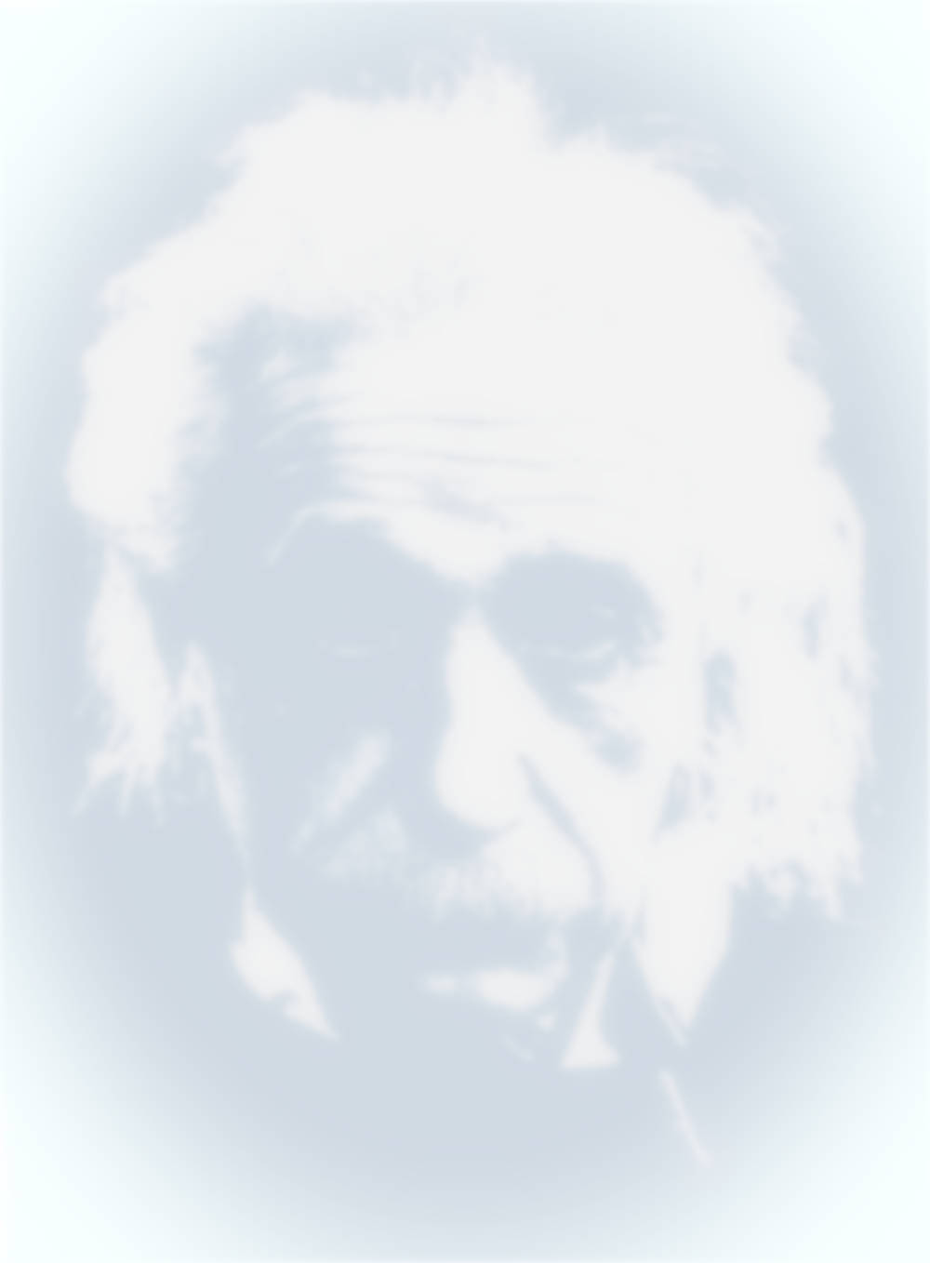
Einstein on Singularities Analysis versus Geometry
John D. Norton
Department of History and
Philosophy of Science
University of Pittsburgh
My text

Slide 3
Disclaimer
This is a talk in history of science.
It recounts how Einstein treated spacetime singularities.
It does not recommend Einstein’s methods over the geometric methods now used.

Slide 4
The Problem Einstein in a wedge

Slide 5
Schwarzschild spacetime
$ds^{2}=−\frac{1}{1−\frac{2m}{r}}dr^{2}−r^{2}\left(dθ^{2}+\sin^{2}θdφ^{2}\right)+\left(1−\frac{2m}{r}\right)dt^{2}$
In Kruskal coordinates

Slide 6
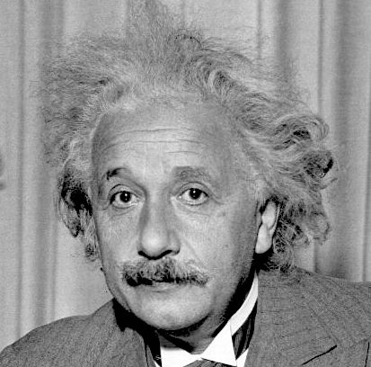
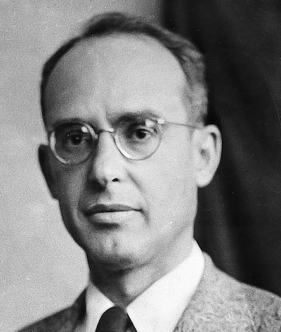
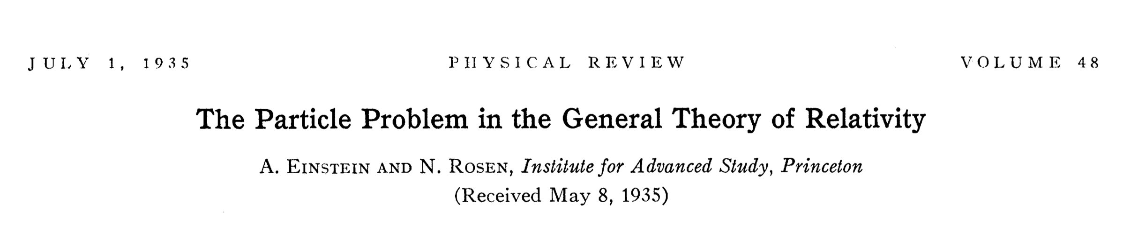
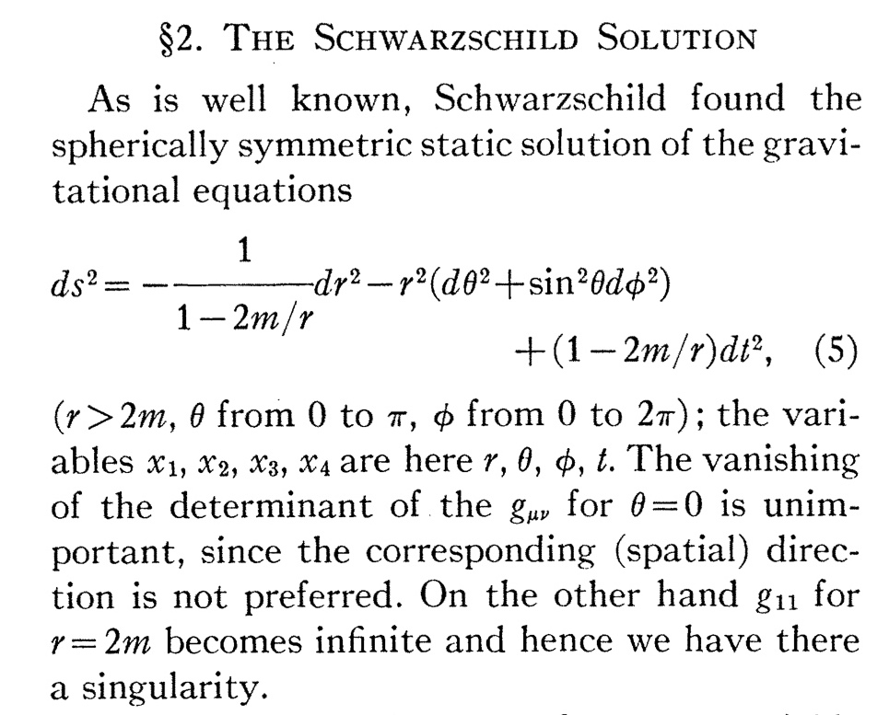
Singularity at the Schwarzschild radius “r=2m”
“… g₁₁ for r = 2m becomes infinite and hence we have there a singularity.”

Slide 7
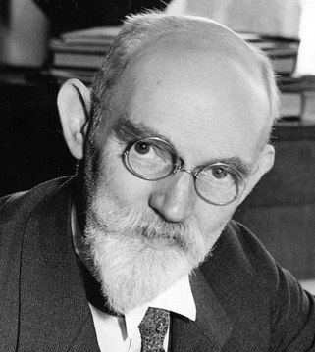
De Sitter spacetime
ds² = - dr² - R²sin²(r/R) [dψ² + sin²ψ dθ²] + cos²(r/R) c²dt²

Slide 8
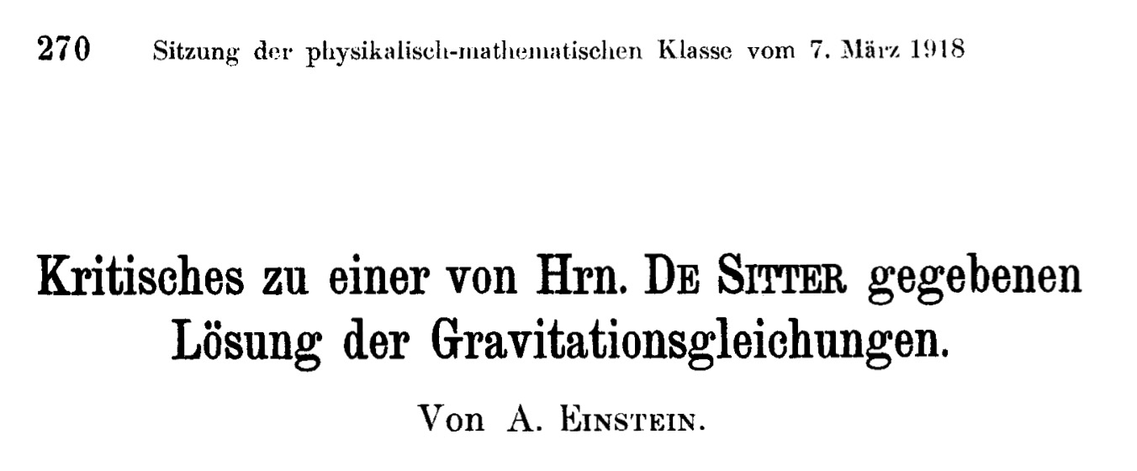
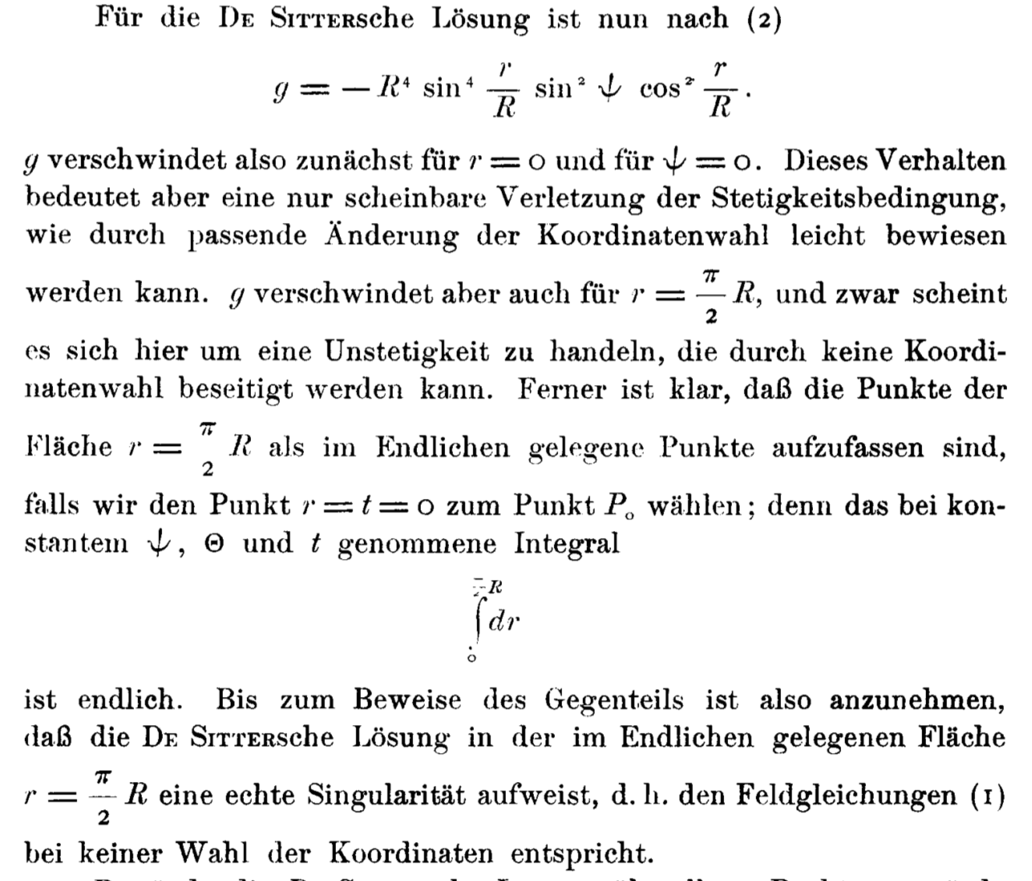
Singularity at the “mass horizon”
However g vanishes also for r = πR/2, and indeed here is a discontinuity that cannot be eliminated through any choice of coordinates.
…
Until proven otherwise, it is therefore to be assumed that the de Sitter solution has a real singularity in the surface located at r = πR/2, that is does not conform with the [λ-augmented gravitational] field equations for any choice of coordinates.

Slide 9
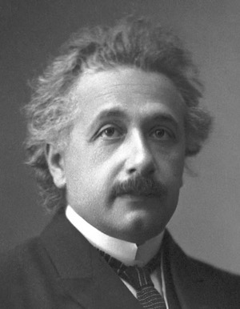
Did Einstein not know…?
Coordinate systems “go bad” at r = 2m, r = πR/2.
Both spacetimes are regularly extendable beyond the “singularities.”

Slide 10
He knew…

Slide 11
Minkowski spacetime
in Born hyperbolic “Rindler” coordinates…
ds² = - dx₁² - dx₂² - dx₃² + α²x₁² dx₄²

Slide 12
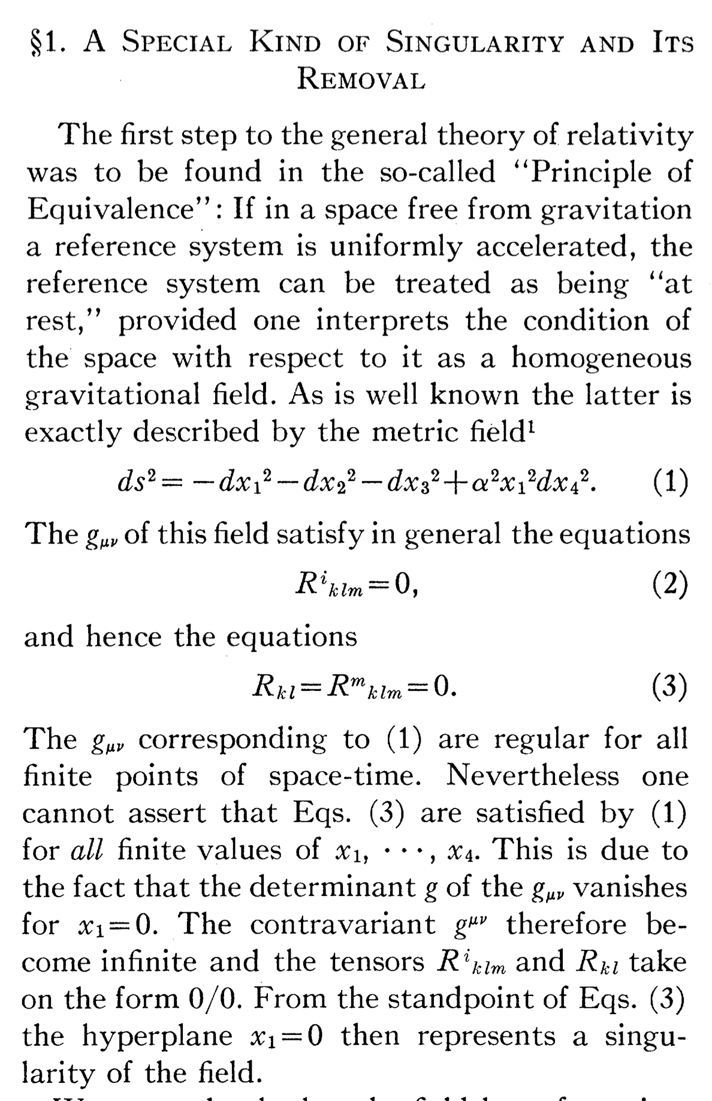
… is singular.
“From the standpoint of Eqs. (3) [source free gravitational field equations] the hyperplane x₁ = 0 then represents a singularity of the field.”

Slide 13
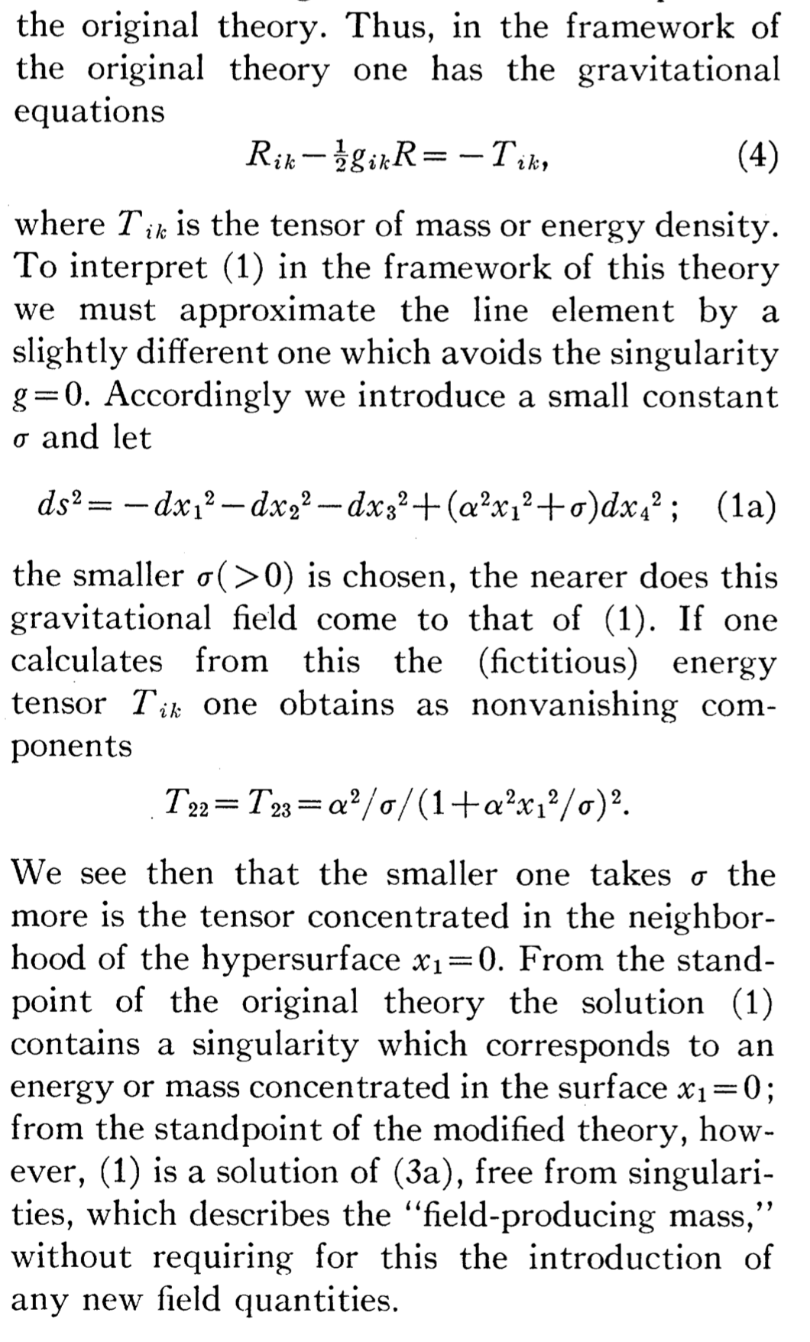
Singularity as infinite mass concentration
“From the standpoint of the original theory the solution (1) contains a singularity which corresponds to an energy or mass concentration on the surface x₁ = 0…”

Slide 14
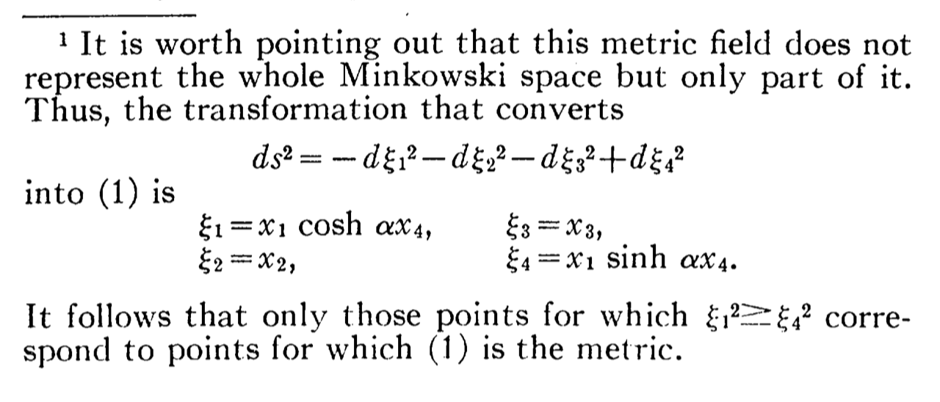
The coordinate system does not cover the full Minkowski spacetime

Slide 15
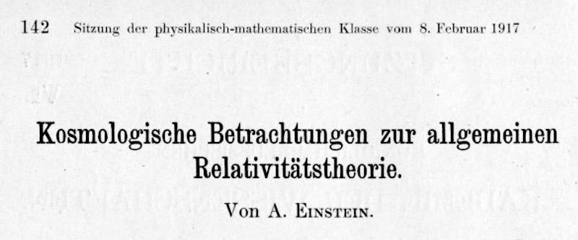
Einstein knew of the full de Sitter hyperboloid
Einstein’s 1917 universe
Three-dimensional space is closed and spherical.

Slide 16
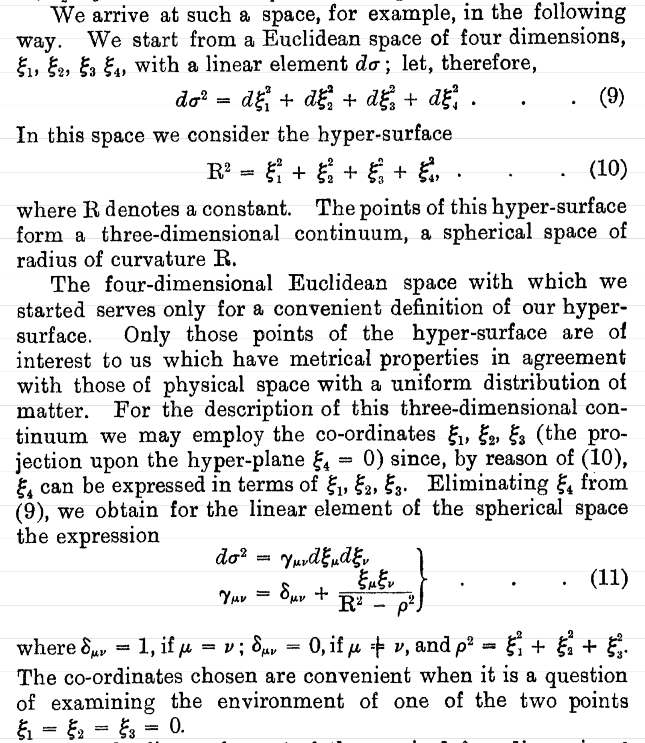
Einstein’s construction
Four-dimensional Euclidean space.
Three-dimensional sphere embedded.
Recover line element for spherical space.

Slide 17
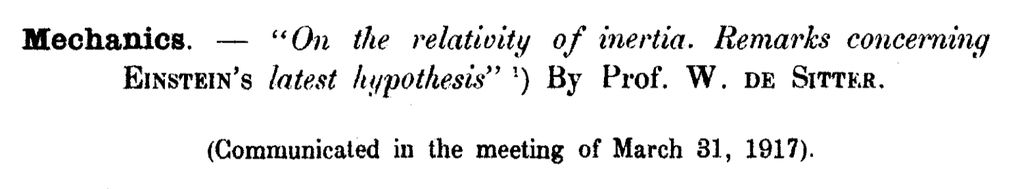
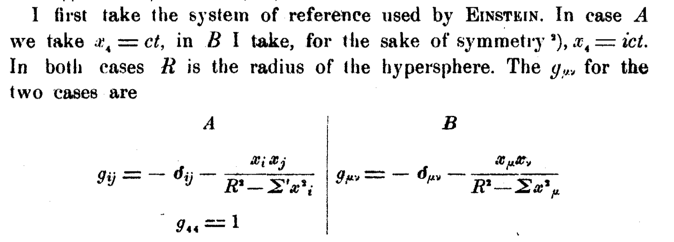
de Sitter uses the same construction
Einstein’s 1917 construction of a three-dimensional spherical space.
De Sitter’s 1917 construction of a four-dimensional hypersphere (using x₄=ict)
And a four-dimensional hyperboloid using x₄=ct.
Hand-written version send to Einstein by de Sitter in letter of March 20, 1917.

Slide 18
The Solution Geometry versus Analysis

Slide 19
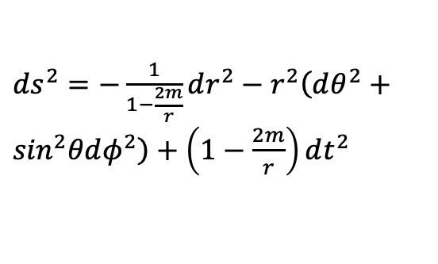
Modern View
Serves to describe geometry
Geometry is primary
Analytic expressions are secondary
$ds^{2}=−\frac{1}{1−\frac{2m}{r}}dr^{2}−r^{2}\left(dθ^{2}+\sin^{2}θdφ^{2}\right)+\left(1−\frac{2m}{r}\right)dt^{2}$
Geometry corrects analytic expressions
Coordinates “go bad” at r = 2m
Replace with better analytic expressions.

Slide 20
Einstein’s View
Einstein’s 1917 recovery of the line element of a spherical space
Useful to suggest analytic expressions
Geometry is secondary
Analytic expressions are Primary
$ds^{2}=−\frac{1}{1−\frac{2m}{r}}dr^{2}−r^{2}\left(dθ^{2}+\sin^{2}θdφ^{2}\right)+\left(1−\frac{2m}{r}\right)dt^{2}$
Conflict?
If physical requirements favor analytic expression
Examples to come
Analytic expression prevails

Slide 21
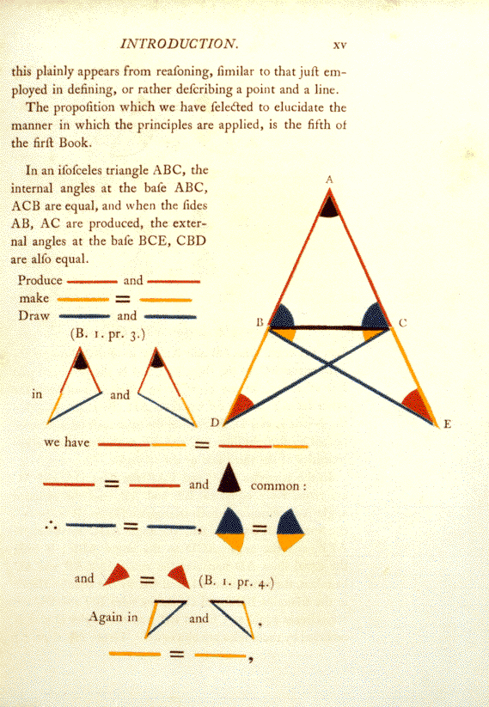
Einstein’s disdain for geometry
Dennis Lehmkuhl (2014) “Why Einstein did not believe that general relativity geometrizes gravity,” Studies in History and Philosophy of Modern Physics, 46, pp. 316–326.
“It is preposterous to belief that “geometrization” means something essential. It is for me a kind of novice aid [Eselbrücke = donkey bridge] for the discovery of numerical laws. Whether one attaches a “geometrical” conception to a theory is an inessential private matter. The essential thing with Weyl is that he subjects the formulas to a new condition (“gauge invariance”) as well as invariance with respect to [spacetime] transformations.”
Einstein to Hans Reichenbach, April 24, 1926

Slide 22
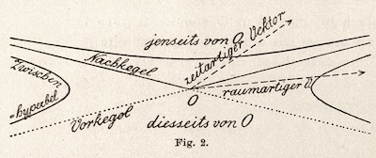
Geometry
Einstein
“coordinates”
“transformations of coordinates”
“variables”
“substitutions [of variables]” (sometimes)
Vanishing Riemann curvature tensor
Vanishing Riemann-Christoffel tensor
Spacetime is flat
g_{μν} can be transformed to constants.
ds² = dx² + dy² + dz² + d(ict)²
“ … the natural laws … of the (special) theory of relativity assume mathematical forms, in which the time co-ordinate plays exactly the same ro1e as the three space coordinates. …purely formal addition to our knowledge…”
Meaning of Relativity, pp. 38-39
Minkowski showed that special relativity is really the geometry of a pseudo-Euclidean spacetime.

Slide 23
Einstein’s approach developed

Slide 24
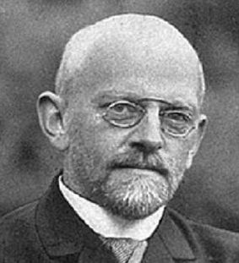
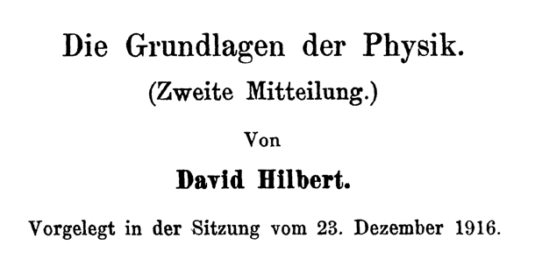
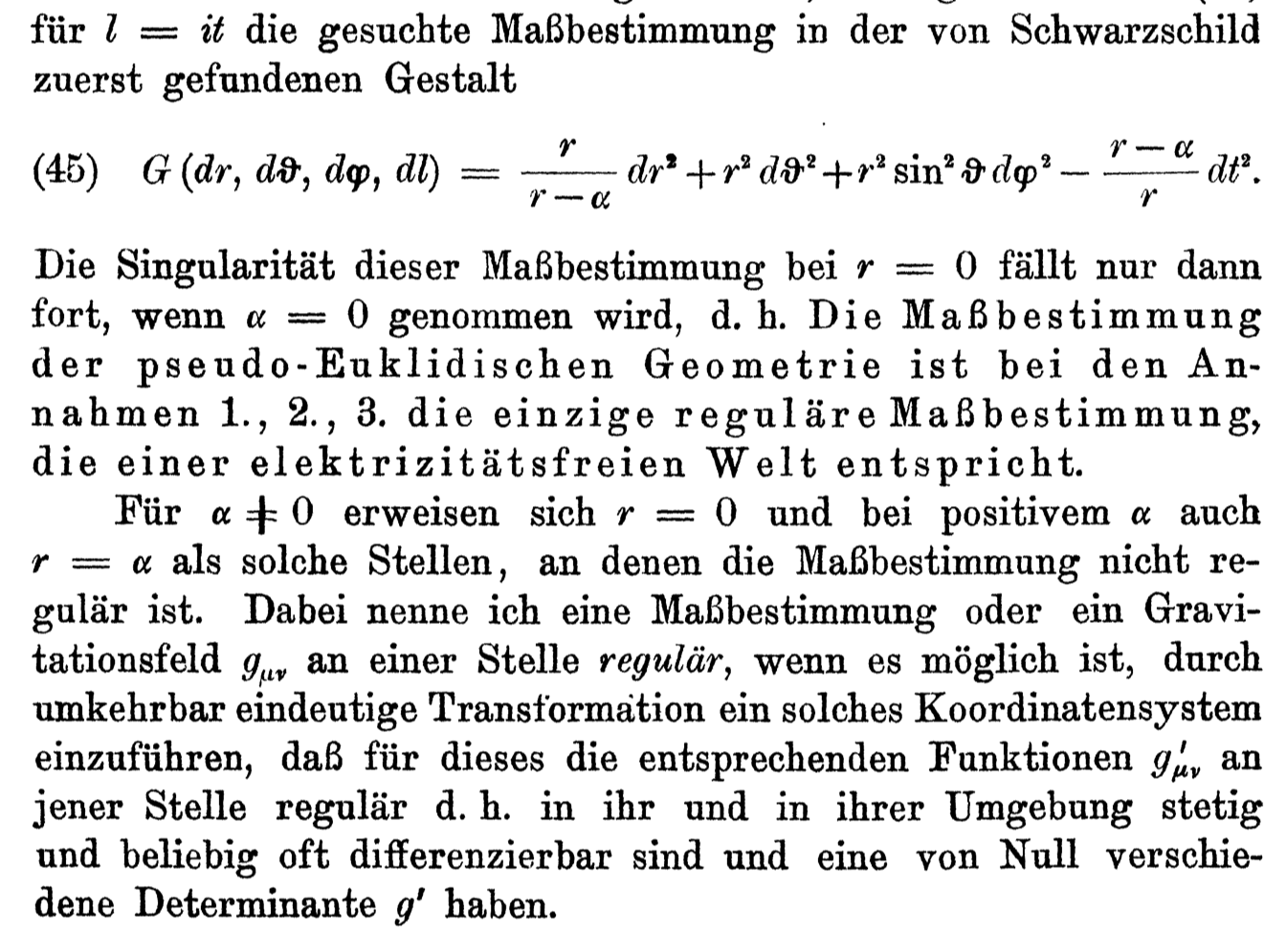
Hilbert’s definition of a singularity
Einstein’s definition is similar.
Schwarzschild line element
For α ≠ 0, it turns out that at r = 0 and for positive α also r = α [=2m>0], for such positions the metric is not regular.
That is, I call a metric or a gravitational field
g_{μν}, at a position, regular,
if it is possible, through
reversible, one-to-one transformation,
to introduce such a coordinate system, that,
for it, the corresponding
functions g’_{μν},
are regular at that position, i. e. in it
and in its neighborhood [they] are
continuous and arbitrarily often differentiable
and have a
determinant g’ different from zero.

Slide 25
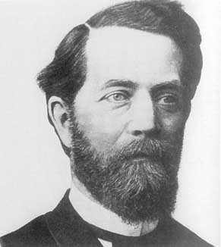
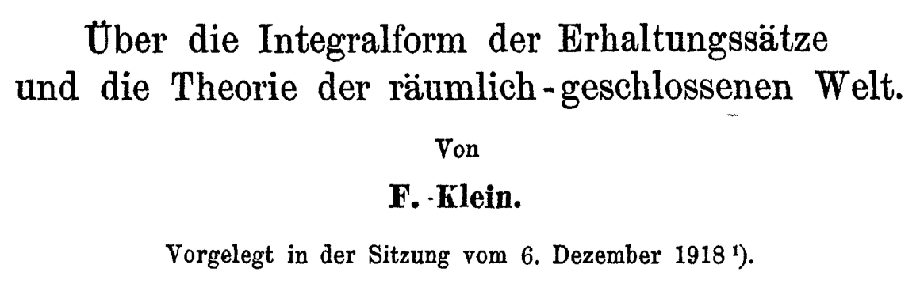
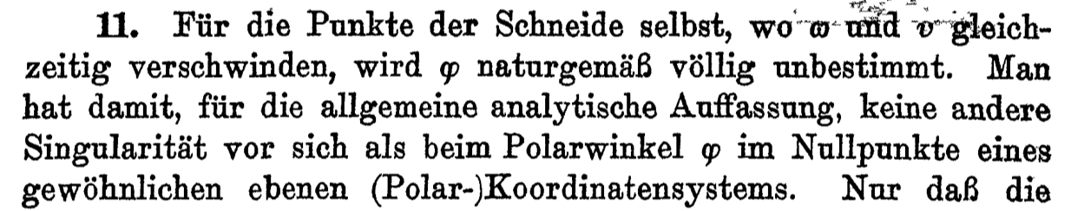
The Geometer objects
ds² = - dr² - R²sin²(r/R) [dψ² + sin²ψ dθ²] + cos²(r/R) c²dt²
“For the general analytic conception, one has thereby no singularity present other than that of the polar angle ϕ at the origin of a common (polar-) coordinate system.”

Slide 26
Einstein’s topological reply
Einstein to Klein, June 20, 1918
“You are quite right. De Sitter’s world is, in itself, free of singularities and its world points are all equivalent. A singularity only comes about through the substitution that affords the transition to the static form of the line element. This substitution alters the analysis-situs relations. That is, two hypersurfaces
t = t₁
and t = t₂
intersect in the original representation, while they do not intersect in the static [representation]. This is related to the fact that one must have masses for the static conception, but not in contrast in the first [one].”

Slide 27
Einstein’s topological reply
Klein’s geometry
Einstein’s analytic expression,
interpreted independently of the hyperboloid
ds² = - dr² - R²sin²(r/R) [dψ² + sin²ψ dθ²] + cos²(r/R) c²dt²
Surfaces of constant t are stipulated to remain distinct at r = πR/2.
A geometric picture (not Einstein’s!)
Constant t surfaces intersect in the full hyperboloid.
Klein accepts Einstein’s explanation:
“I am happy to adopt the understanding that Einstein has expressed in correspondence that the difference in our mutual results must be based on the difference in the coordinates used. What I designate as a single point of intersection with the application of the [coordinates] ξ, η, ζ , ν and ω, is a simply extended region with the use of the [coordinates] θ, ϕ, ψ , t (because of the undetermined, remaining values of t). [JDN: Corresponding to r/R, ψ, θ, t].” (Klein, 1918a, p. 423)

Slide 28
Physical reasons
Choose the analytic expression over the full hyperboloid since:
Einstein’s singularity meets Hilbert’s definition.
1. Mach’s principle
“the g-field is determined by the masses of bodies without residue.”
Singularity is a locus of matter.
Hermann Weyl’s “mass horizon.”
Transformation to the full hyperboloid is
MANY t to ONE t
2. The spacetime line element is static.
Independent of t. No dxdt terms.
BUT… masses fall towards the mass horizon, so Einstein’s 1917 universe is his favorite.

Slide 29
Principle of Equivalence
Hyperbolic coordinates in a Minkowski spacetime is merely a convenient device for generating the line element of a homogenous gravitational field:
ds² = - dx₁² - dx₂² - dx₃² + α²x₁² dx₄²
The principle is a physical postulate that this line element represents homogeneous gravity.
Geodesics are parabolic trajectories of bodies in free fall, slowing asymptotically towards x₁=0.
Topologically distinct from the full Minkowski spacetime.
t = x₄ surfaces do not intersect
Attracting masses in stress-energy tensor discontinuity at at x₁ = 0?

Slide 30
Schwarzschild spacetime
Einstein:
Region of spacetime beyond r = 2m is unphysical.
Not empty space. As yet unknown matter theory prevails.
“Hadamard catastrophe”
Black holes cannot form by gravitational collapse.
Albert Einstein “On a Stationary System With Spherical Symmetry Consisting of Many Gravitating Masses,”
The Annals of Mathematics, 40, No. 4 (Oct., 1939), pp. 922-936.
!?!?
$ds^{2}=−\frac{1}{1−\frac{2m}{r}}dr^{2}−r^{2}\left(dθ^{2}+\sin^{2}θdφ^{2}\right)+\left(1−\frac{2m}{r}\right)dt^{2}$
Exterior gravitational field of the sun is static.
A static line element.

Slide 31
Einstein-Rosen Bridges (now)
Geometry of two dimensions of space.
All pass through v = 0.

Slide 32
Einstein-Rosen Bridges (then)
Represents many events extended in time.
Einstein and Rosen’s picture.

Slide 33
Two Traditions in the History of Mathematics

Slide 34
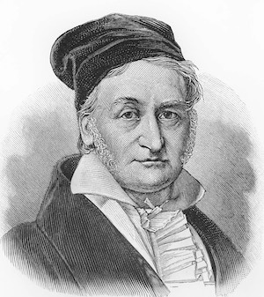
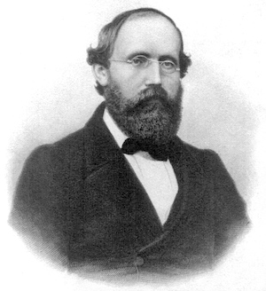
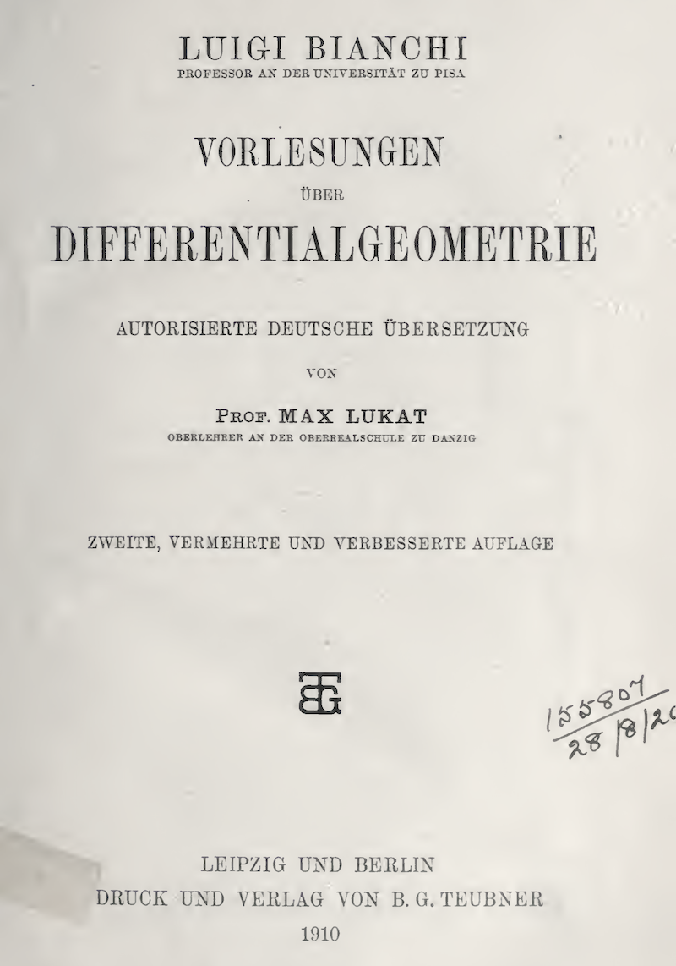
Differential Geometry
Gauss’ theory of curved surfaces. 1828
(two dimensional)
√(Edp2 + 2Fdpdq + Gdq2)
Disquisitiones Generales circa Superficies Curvas.
Does NOT contain the Riemann curvature tensor.
Riemann’s inaugural address 1854
(extension to higher dimensions)
“Ueber die Hypothesen, welche der Geometrie zu Grunde liegen” (1854)
Bianchi-Lukat
Max Lukat Luigi Bianchi: Vorlesungen über Differentialgeometrie. 2nd ed. Leipzig and Berlin: B. G. Teubner. 1910

Slide 35
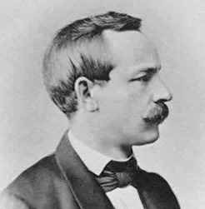
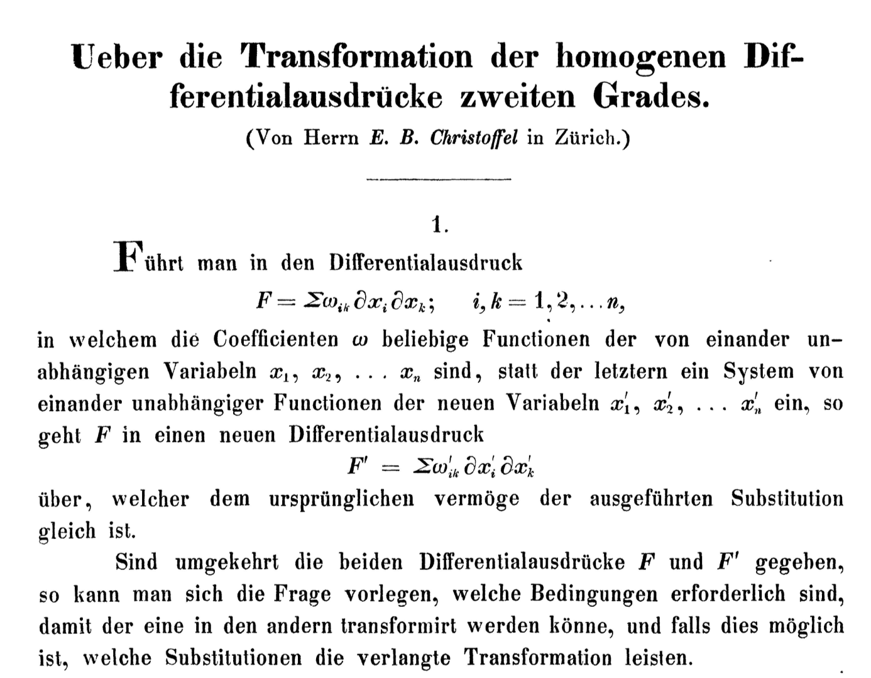
Quadratic Differential Forms
Two quadratic differential forms.
“… which conditions are necessary, such that the one could be transformed into the other…”
Last paragraph of last page mentions a connection to geometry.
Elwin Bruno Christoffel, “Ueber die Transformation der homogenen Differentialausdrücke zweiten Grades.” Journal für die reine und angewandte Mathematik,70 (1869), pp. 46-70.

Slide 36
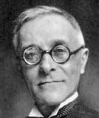
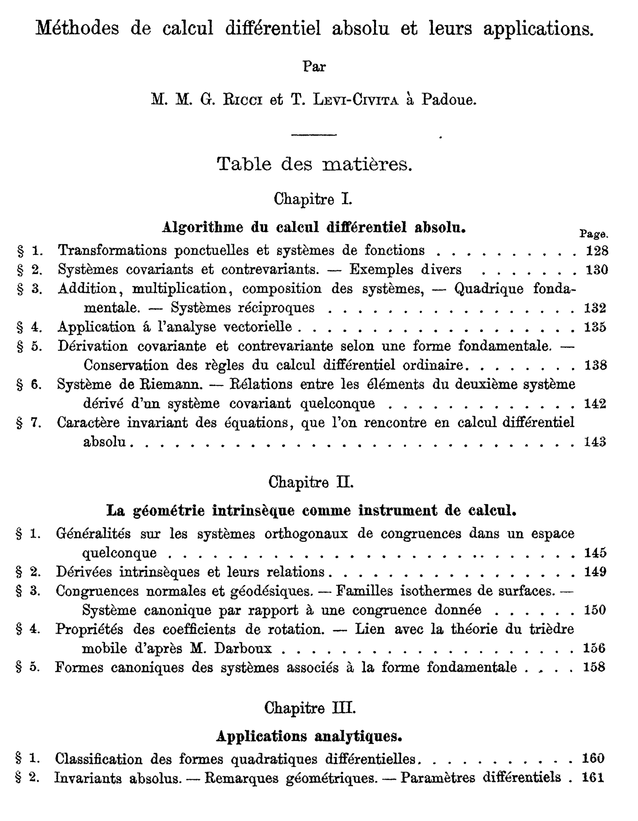
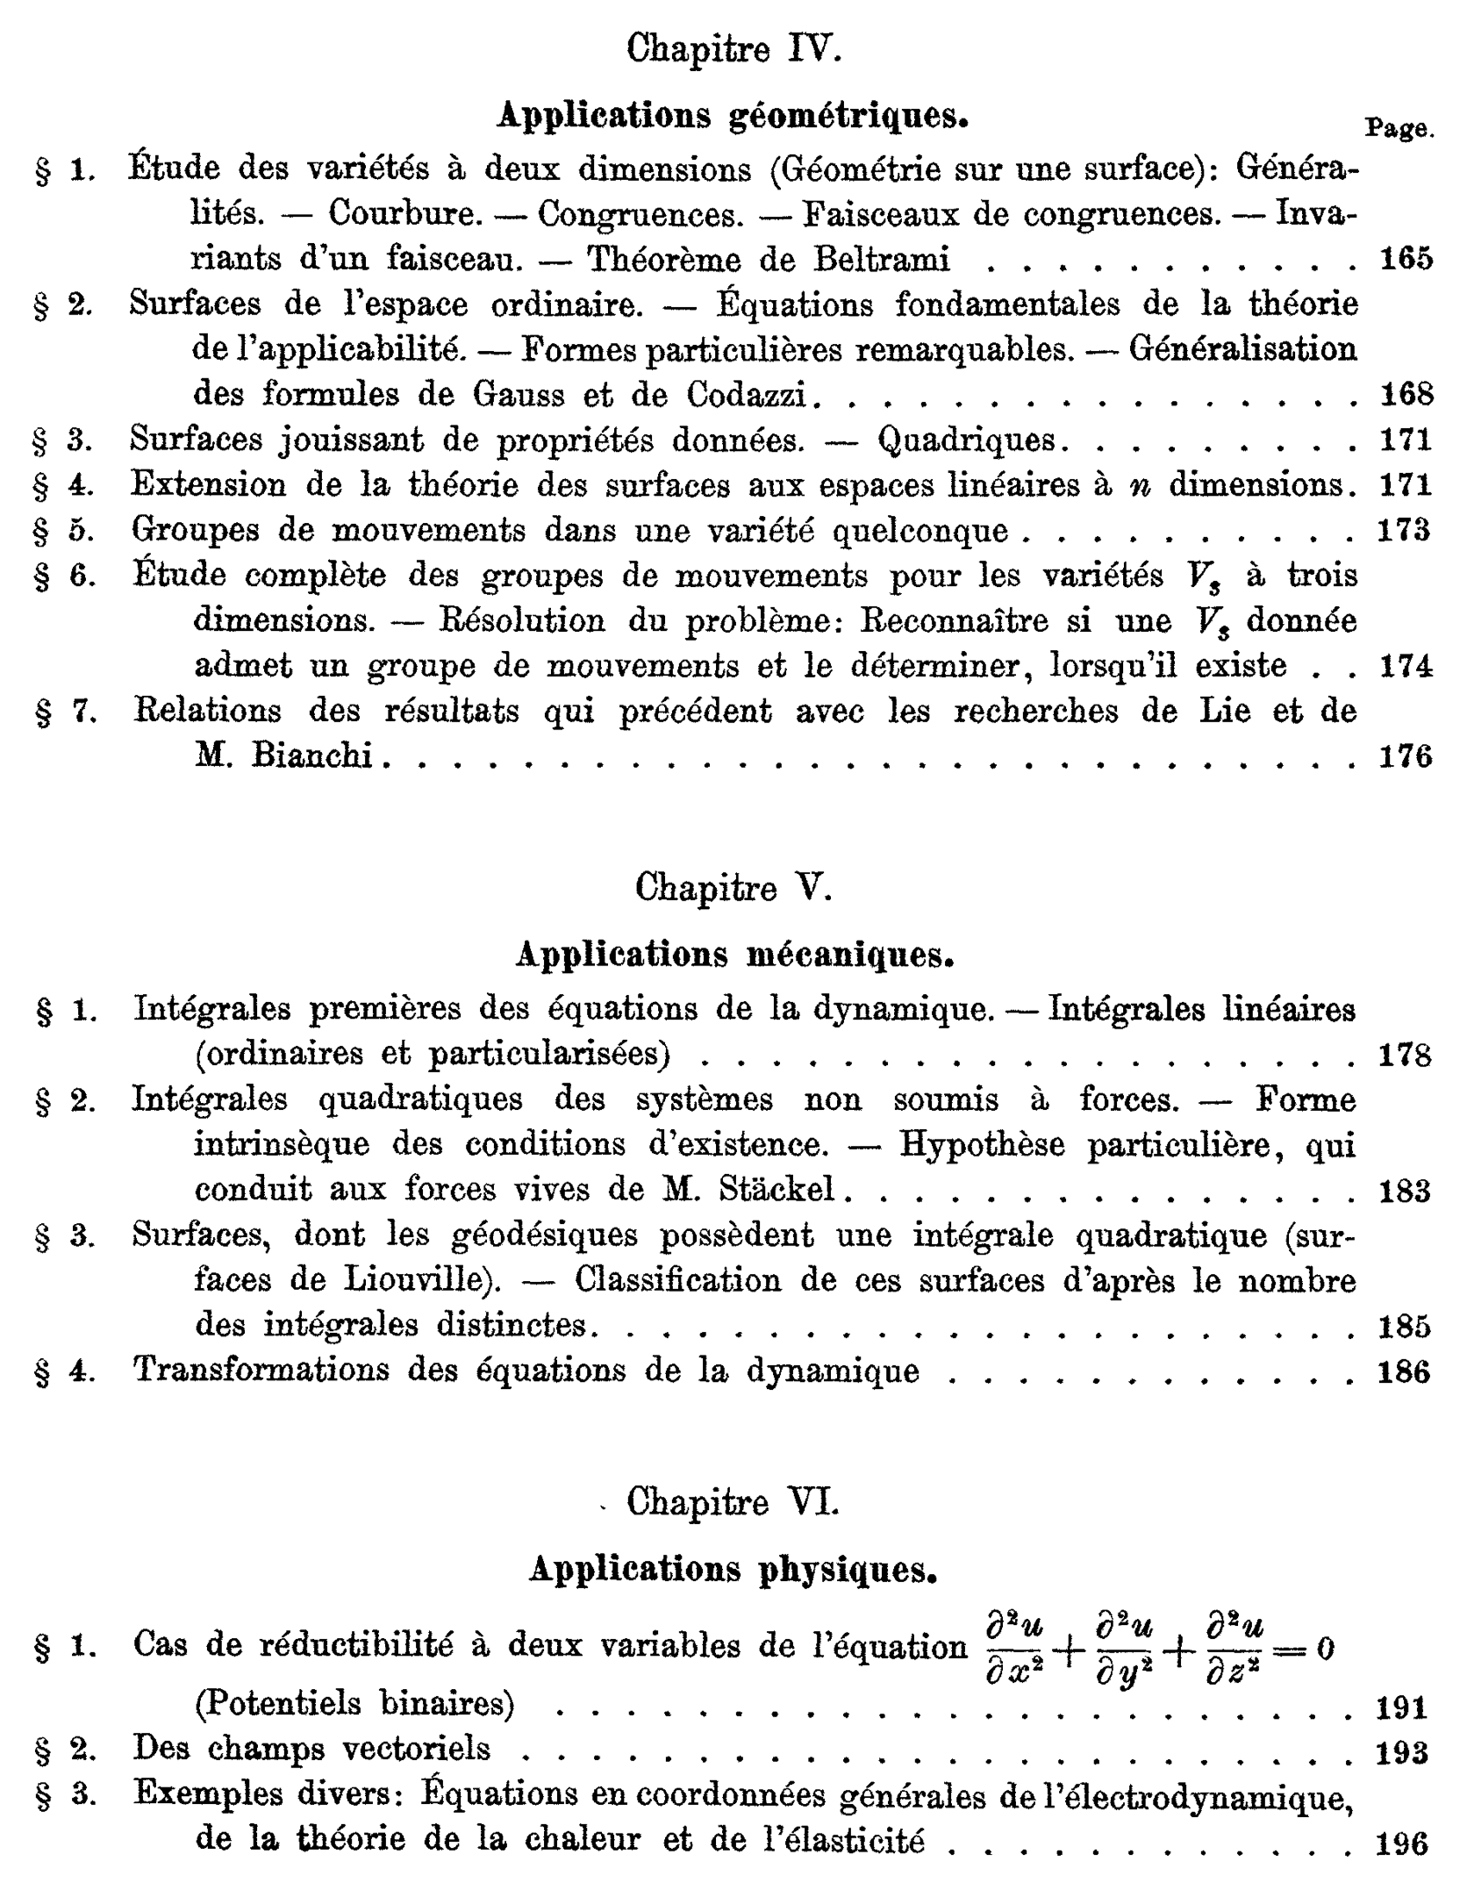
Ricci, Levi-Civita 1900
A general calculus.
Geometry only one specialized application.

Slide 37
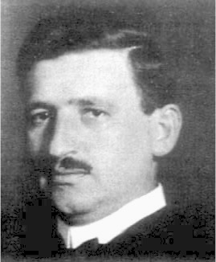
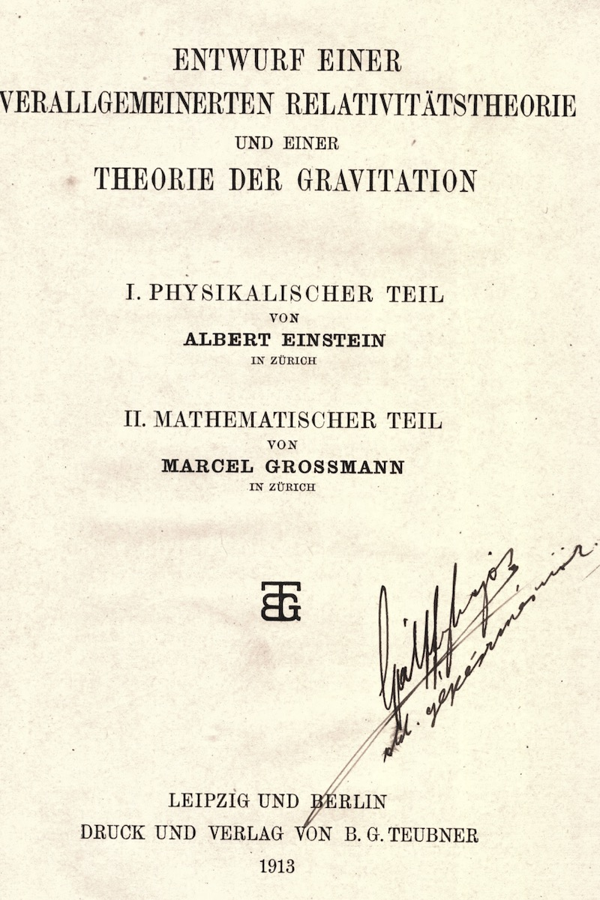
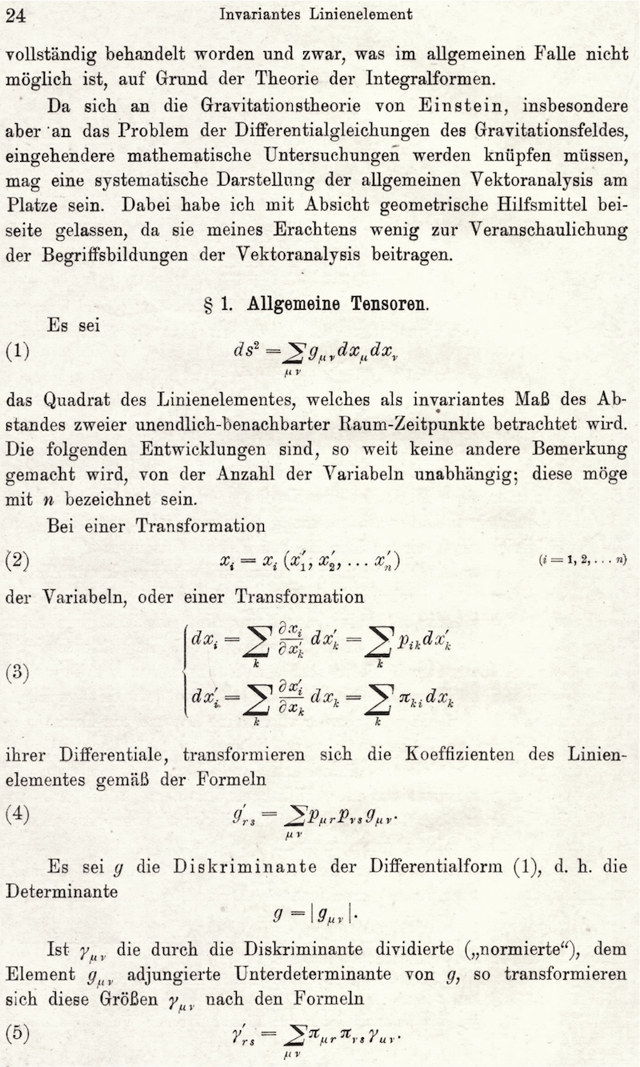
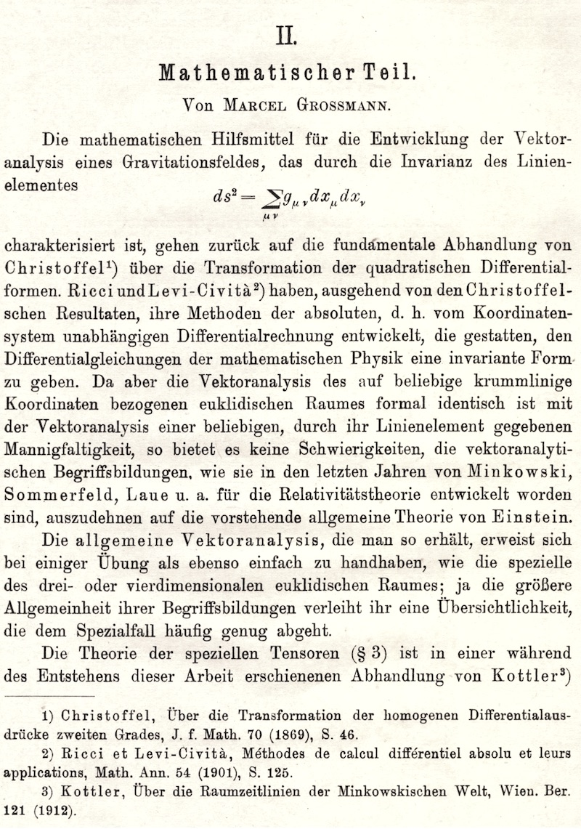
Einstein and Grossmann, 1913
… I have deliberately set aside geometrical aids, since, in my opinion, they contribute little to the intuitive understanding [Veranschaulichung] of the formation of concepts of the vector analysis.

Slide 38
Singularities?

Slide 39
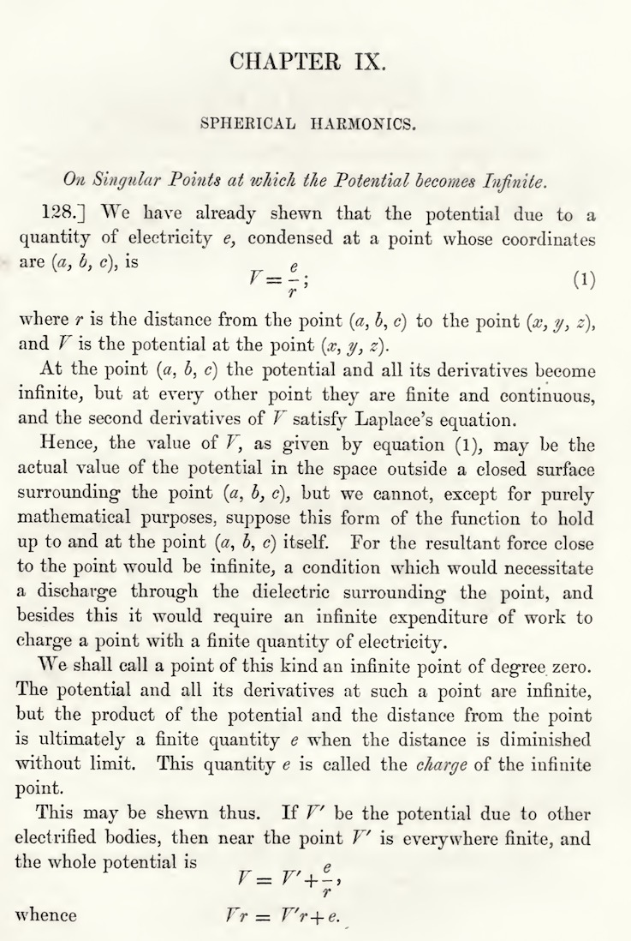
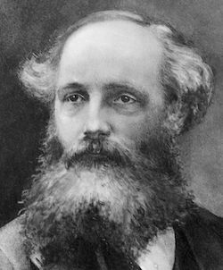
The Nineteenth Century
Most common appearance in geometry. A feature of curves and surfaces to be investigated. Some are smooth; some are kinked.
Rare mention in physics. Untroubling.
Maxwell, Treatise, 1873, p. 157
“At the point (a, b, c) the potential and all its derivatives become infinite, but at every other point they are finite and continuous, and the second derivatives of V satisfy Laplace’s equation.”

Slide 40
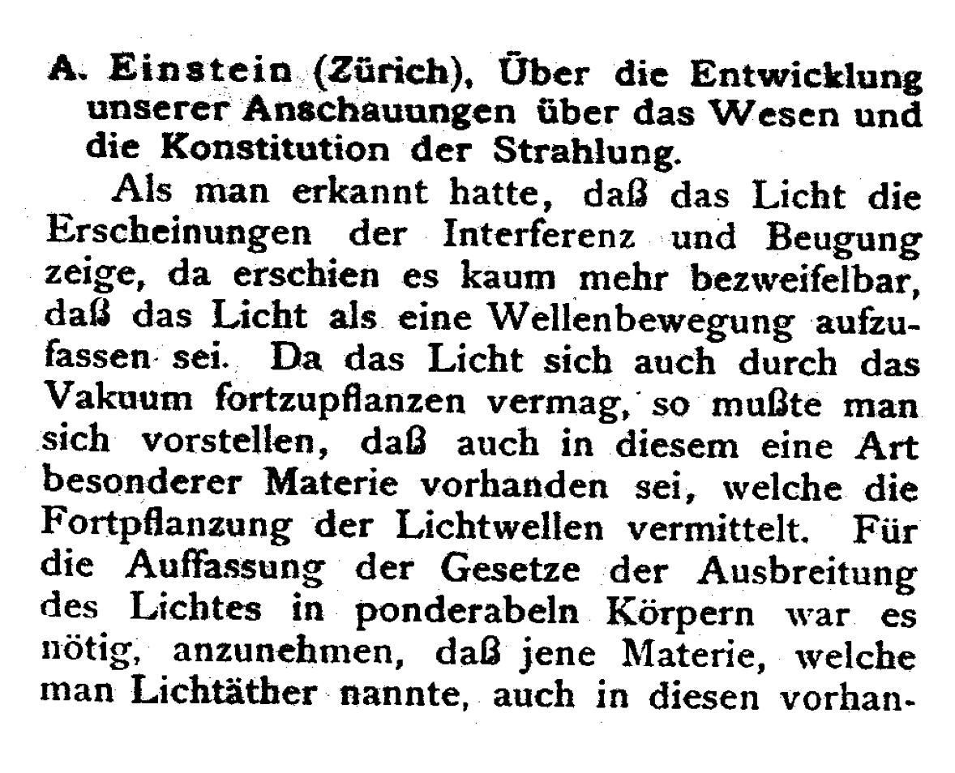
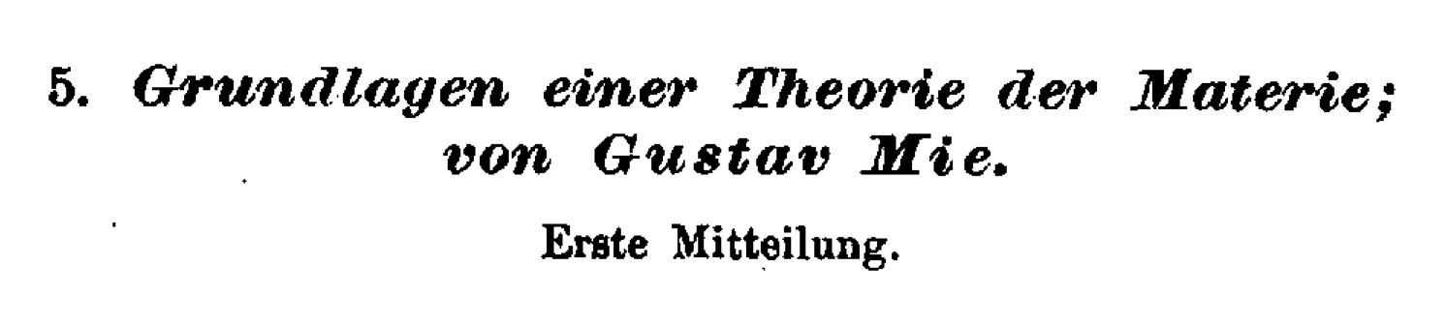
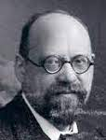
Early Twentieth Century
Einstein, 1909
Light quanta as singularities in the electromagnetic field.
Gustav Mie’s 1912-13 theory of matter.
Focus of finding singularity free solutions of his field equation.

Slide 41
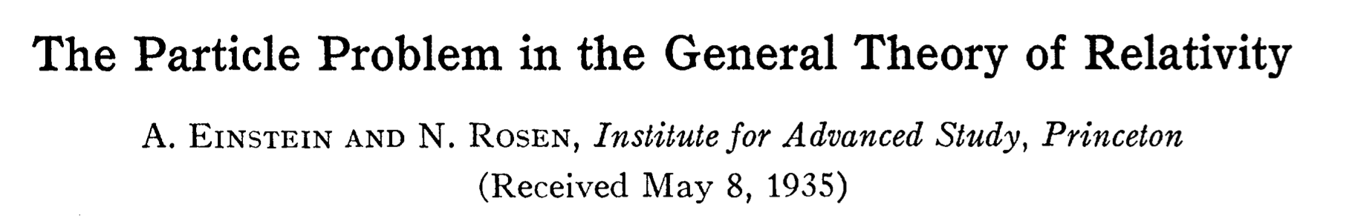
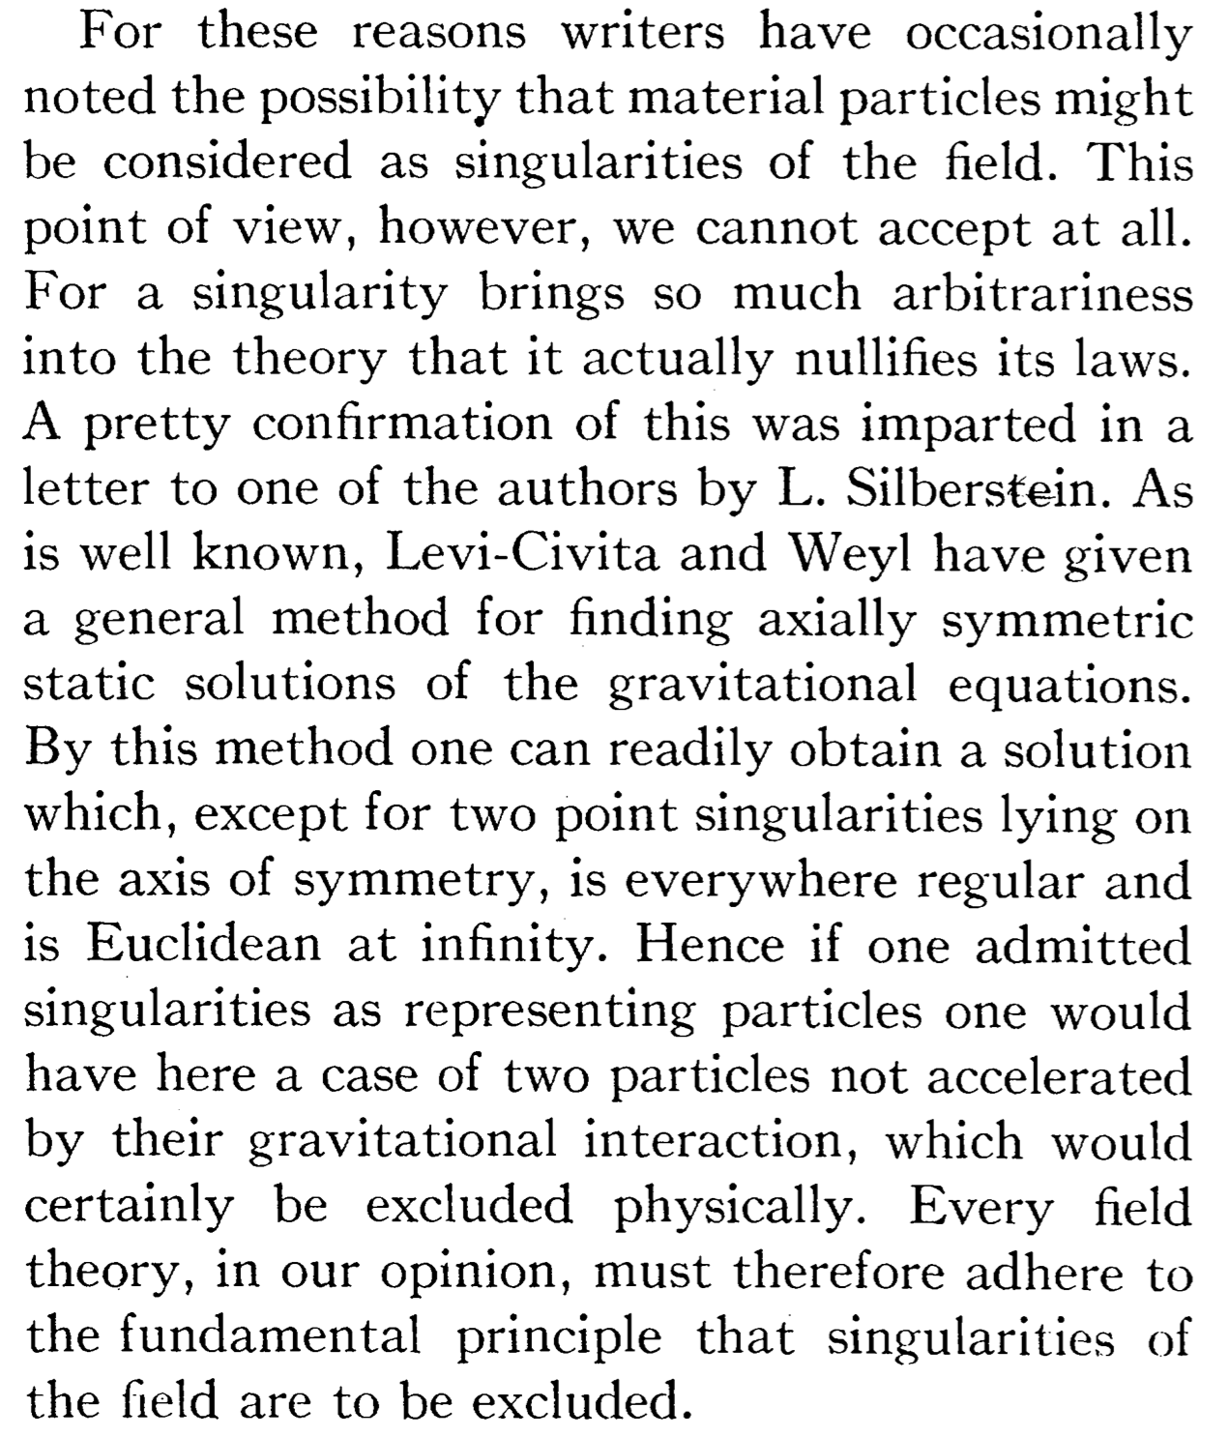
Einstein against Singularities
“…a singularity brings so much arbitrariness into the theory that is actually nullifies its laws.
…
Every field theory, on our opinion, must therefore adhere to the fundamental principle that singularities of the field are to be excluded.”

Slide 42
Einstein against Arbitrariness
“… I would like to state a theorem which at present can not be based upon anything more than upon a faith in the simplicity, i.e., intelligibility, of nature: there are no arbitrary constants of this kind; that is to say, nature is so constituted that it is possible logically to lay down such strongly determined laws that within these laws only rationally completely determined constants occur (not constants, therefore, whose numerical value could be changed without destroying the theory).--- “
Einstein, Autobiographical Notes, p. 63
“Should one admit the appearance of singularities?
…
it is my opinion that singularities must be excluded. It does not seem reasonable to me to introduce into a continuum theory points (or lines, etc.) for which the ﬁeld equations do not hold. Moreover, the introduction of singularities is equivalent to postulating boundary conditions (which are arbitrary from the point of view of the ﬁeld equations) on ‘surfaces’ which closely surround the singularities.”
Meaning of Relativity, p. 164

Slide 43
Conclusion

Slide 44
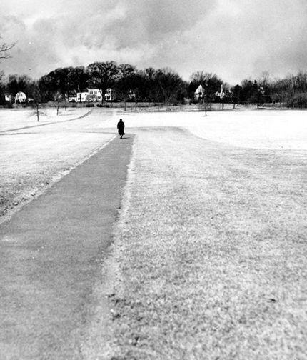
“Newton, forgive me…”
“Enough of this. Newton, forgive me; you found the only way which, in your age, was just about possible for a man of highest thought- and creative power. The concepts, which you created, are even today still guiding our thinking in physics, although we now know that they will have to be replaced by others farther removed from the sphere of immediate experience, if we aim at a profounder understanding of relationships.”
Einstein, Autobiographical Notes pp. 31-33

Slide 45

Read

Slide 47
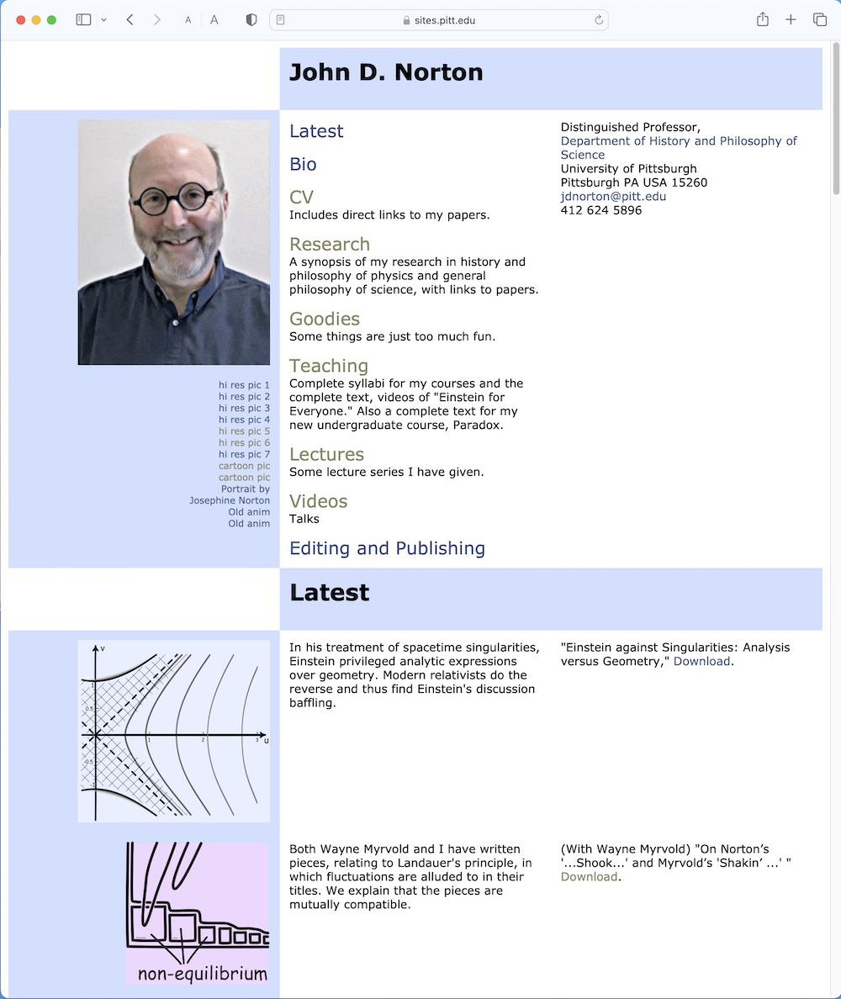

Slide 48
End

