Slide 1
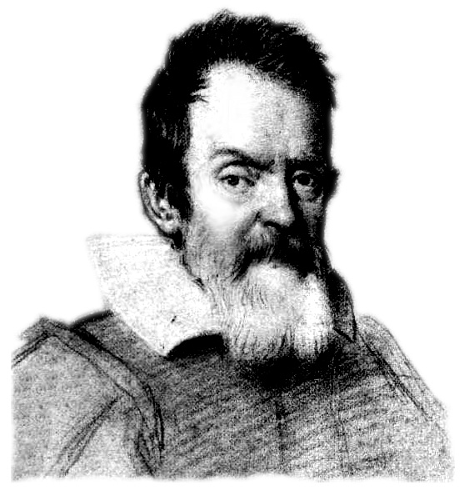
Galileo’s refutation of the speed-distance
law of fall rehabilitated
John D. Norton
and
Bryan W. Roberts
John D. Norton & Bryan W. Roberts, “Galileo’s refutation of the speed-distance law of fall rehabilitated” http://philsci-archive.pitt.edu/archive/00005479/
Forthcoming in Centaurus as a “spotlight” issue with comments from critics and our response.

Slide 2
This Talk

Slide 3

Galileo Galilei, Discourses and Mathematical Demonstrations Concerning Two New Sciences. 1638.
First and second day.
First new science
Resistance bodies offer to fracture.
Third and fourth day.
Second new Science
Motion.
including
Naturally accelerated motion.

Slide 4
Speed-Distance Law of Fall:
“Uniformly accelerated motion is that in which the speed goes increasing according to the increase of space traversed.”
— Sagredo
Two New Sciences

Slide 5
Speed-Distance Law of Fall:
“… has so much the plausible and probable, that our Author himself… had labored for some time under the same fallacy.”
— Salviati
Two New Sciences

Slide 6
Galileo’s “very clear proof” that it is false:
“
When speeds have the same ratio as the spaces passed or to be passed, those spaces come to be passed in equal times;
if therefore the speeds with which the falling body passed the space of four braccia were the doubles of the speeds with which it passed the first two braccia, as one space is double the other space, then the times of those passages are equal;
but for the same moveable to pass the four braccia and the two in the same time cannot take place except in instantaneous motion. But we see that the falling heavy body makes its motion in time, and passes the two braccia in less [time] than the four; therefore it is false that its speed increases as the space. (Galileo’s Two New Sciences, 1638)
”

Slide 7
Galileo’s argument…
…was not “a course in fallacious reasoning.”
…ingeniously and correctly identifies why the speed-distance law in untenable.
…fails only in the last step.

Slide 8
Illustrious tradition of confusion

Slide 9
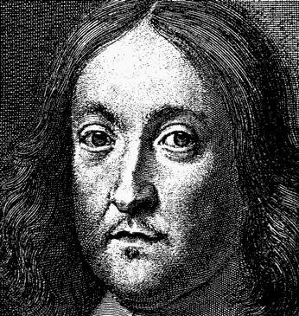
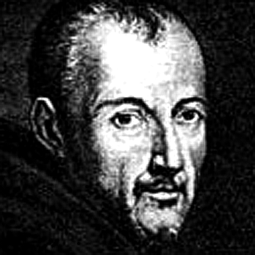
“the undemonstrated conclusion of a clear-sighted and Lyncaeo man”
— P. Fermat, c.1646
“[the speed-distance law] can
nevertheless be understood in a correct way”
— M. Mersenne, 1639

Slide 10
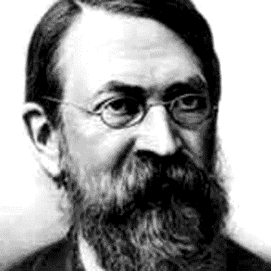
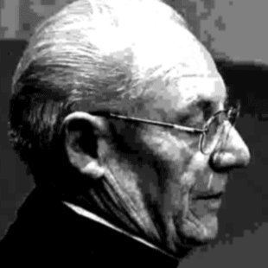
“a course of fallacious reasoning”
— E. Mach, 1893
“a slip of the pen… applying the law of uniform motion to motion which is not so”
— Costabel & Lerner, 1973

Slide 11
“The refutation of space proportionality in the Discorsi is thus no refutation…. Galileo’s argument is also incompatible with classical mechanics”
— Damerow, McLaughlin,
Freudenthal & Renn, 1992

Slide 12
We claim…

Slide 13
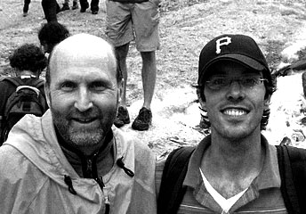
There is a simple, cogent, correct reconstruction of Galileo’s argument.

Slide 14
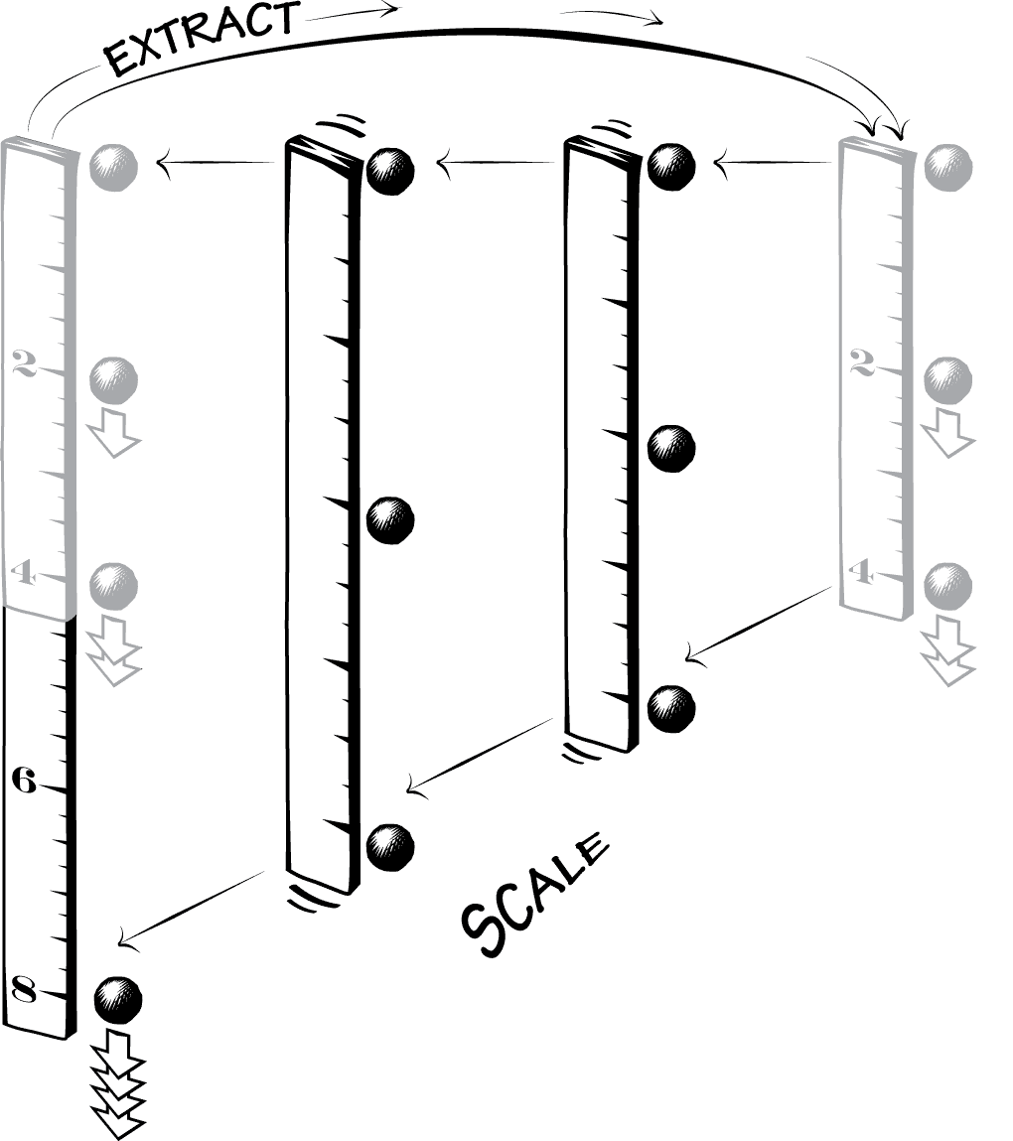
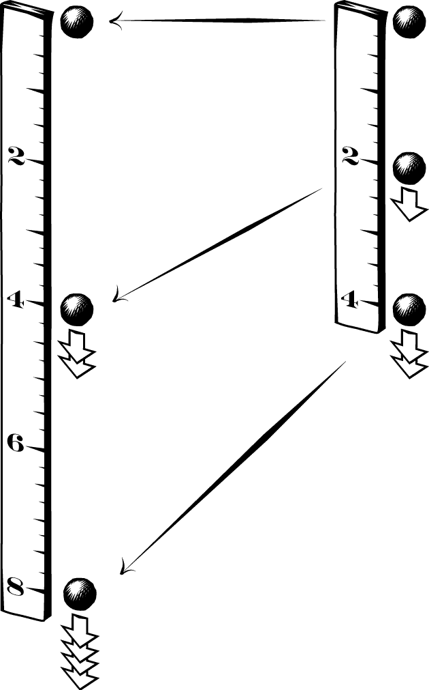
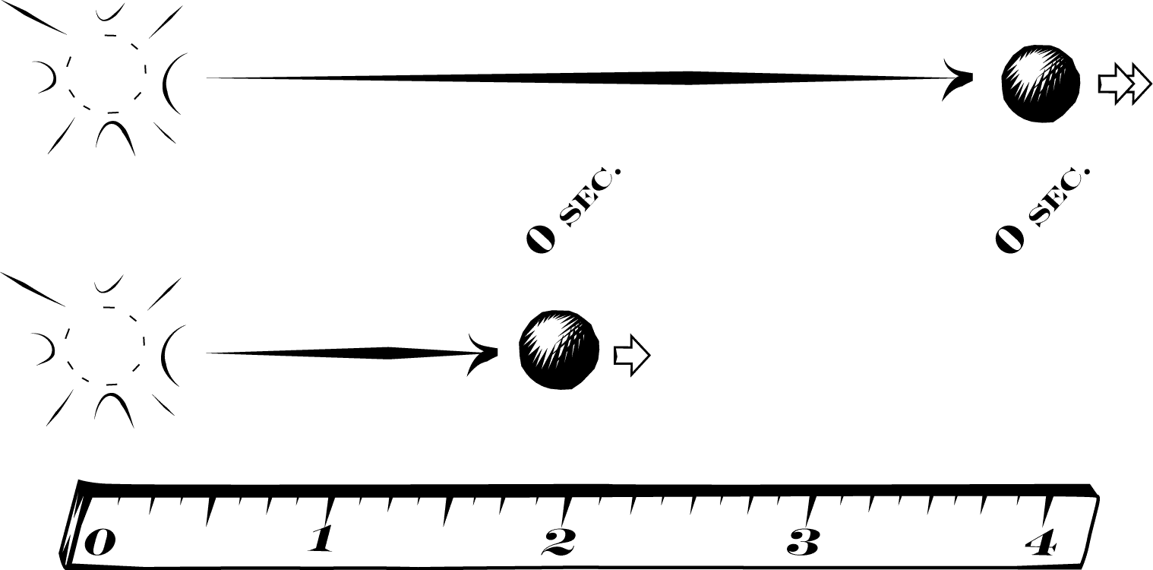
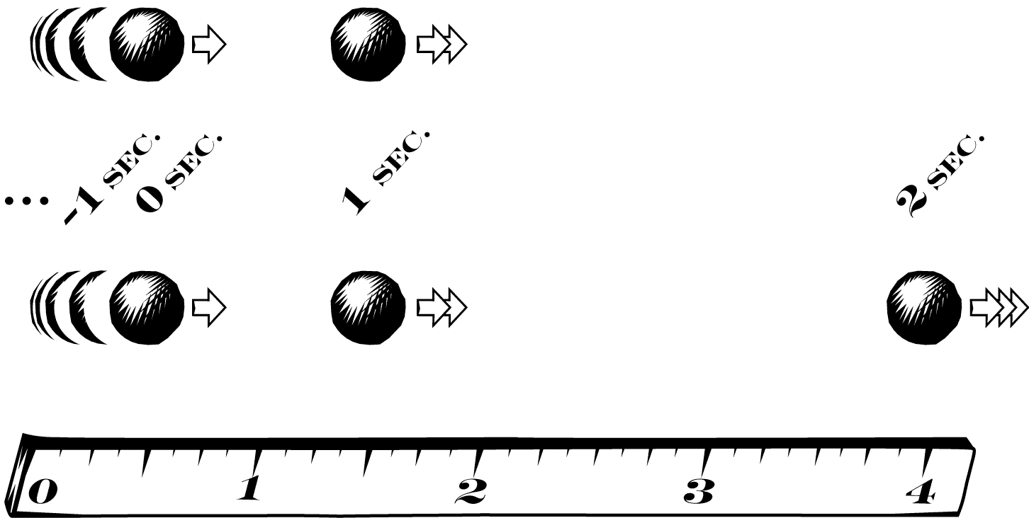
1.
Scaling
2.
Self-Similarity
+
3.
Equal Time
4.
Instantaneous motion
Infinite time motion

Slide 15
1.

Slide 16
Galileo’s Text | Our Interpretation
When speeds have the same ratio as the spaces passed or to be passed, those spaces come to be passed in equal times…
Scaling: if any motion is scaled up by doubling all its speeds and distances, then the original and scaled motions take place in the same time. (General result about any motion)
1.

Slide 17
1. Scaling

Slide 18
Galileo’s Text | Standard View | Our View
When speeds have the same ratio as the spaces passed or to be passed, those spaces come to be passed in equal times… | ONE Motion | TWO Motions
1.

Slide 19
2.

Slide 20
Galileo’s Text | Our Interpretation
…If the speeds with which the falling body passed the space of four braccia were the doubles of the speeds with which it passed the first two braccia, as one space is double the other space…
IF Self-Similarity: the motion over four braccia is a scaled up duplicate of the motion over two braccia… (Result holds only for motions whose speed is proportional to distance)
2.

Slide 21
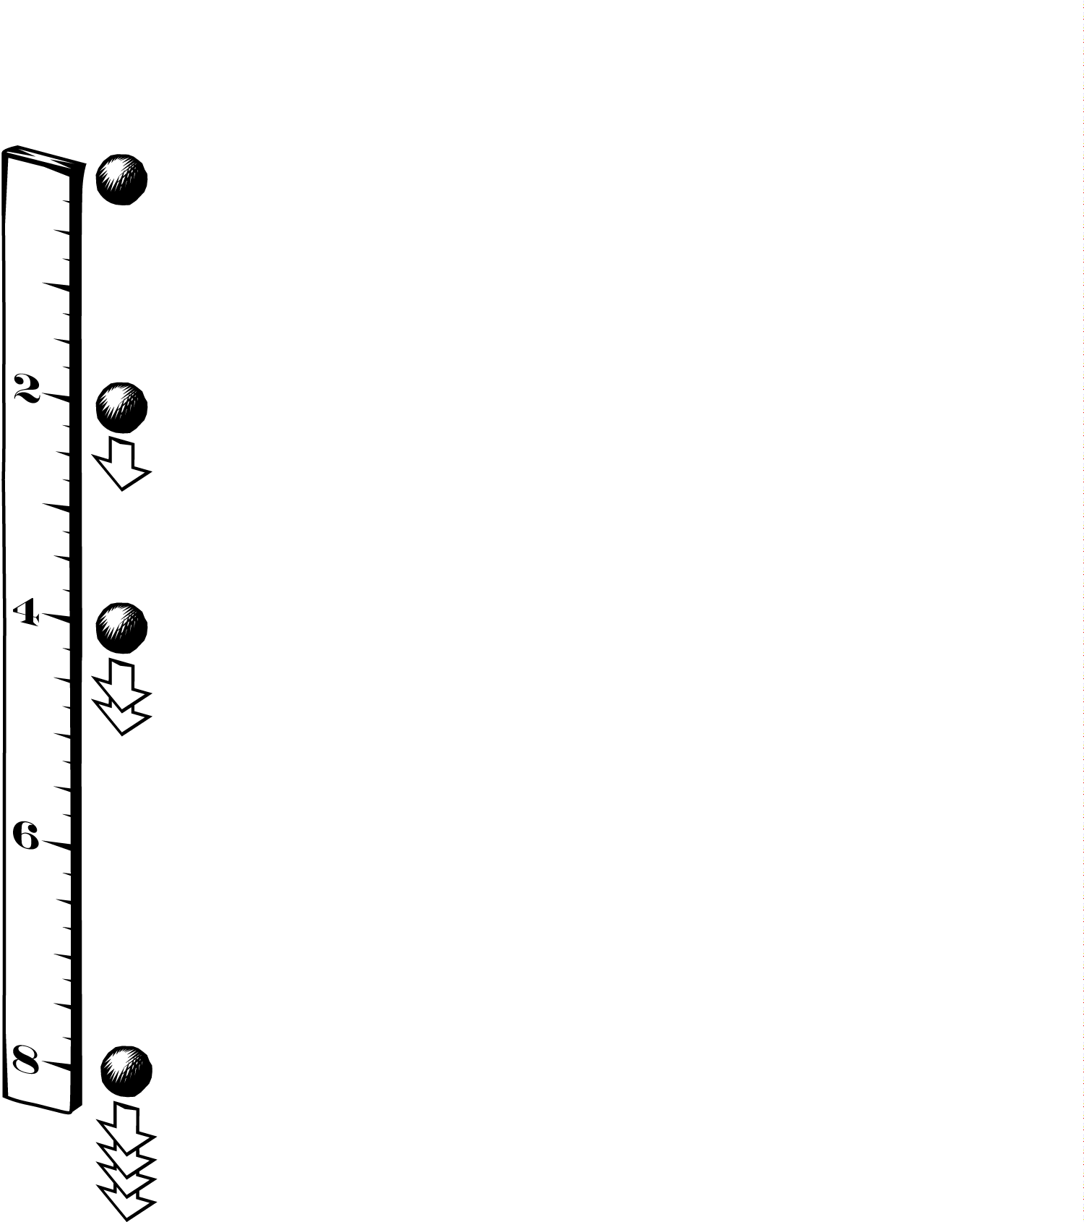
2. Self-Similarity

Slide 22
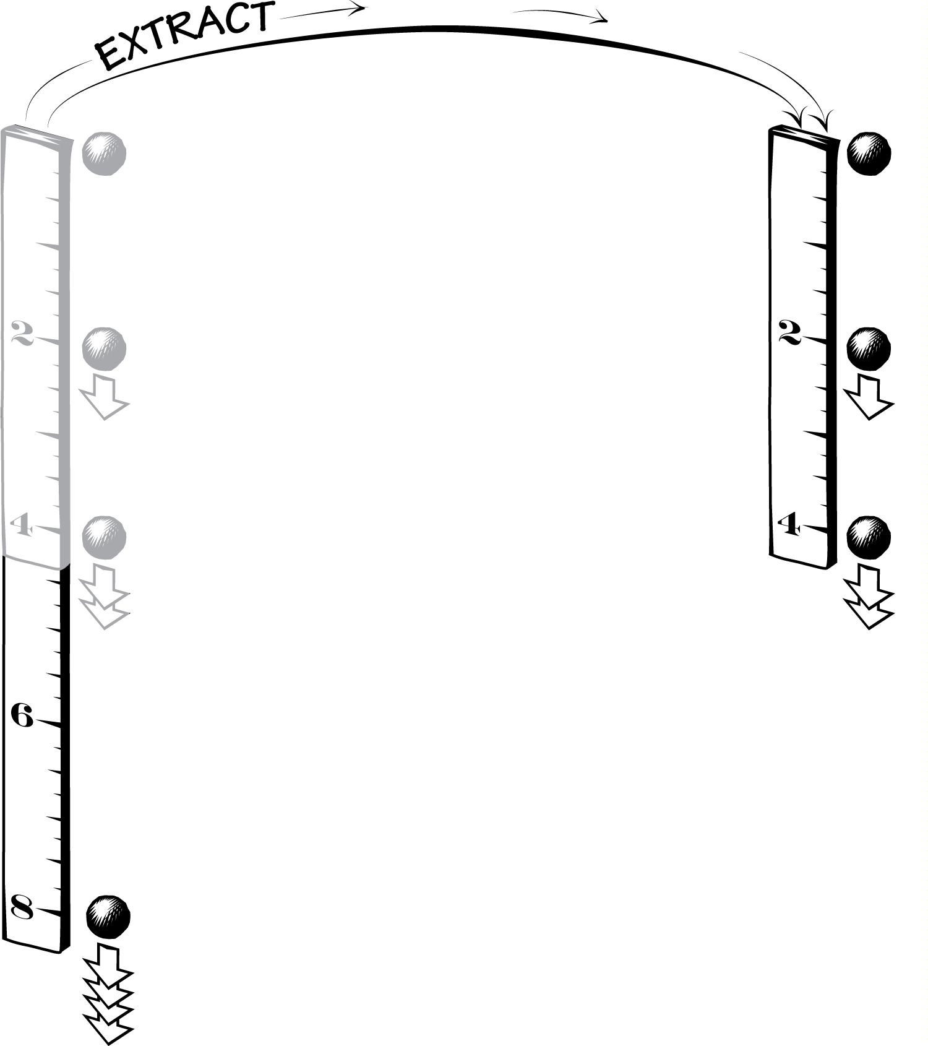
2. Self-Similarity

Slide 23
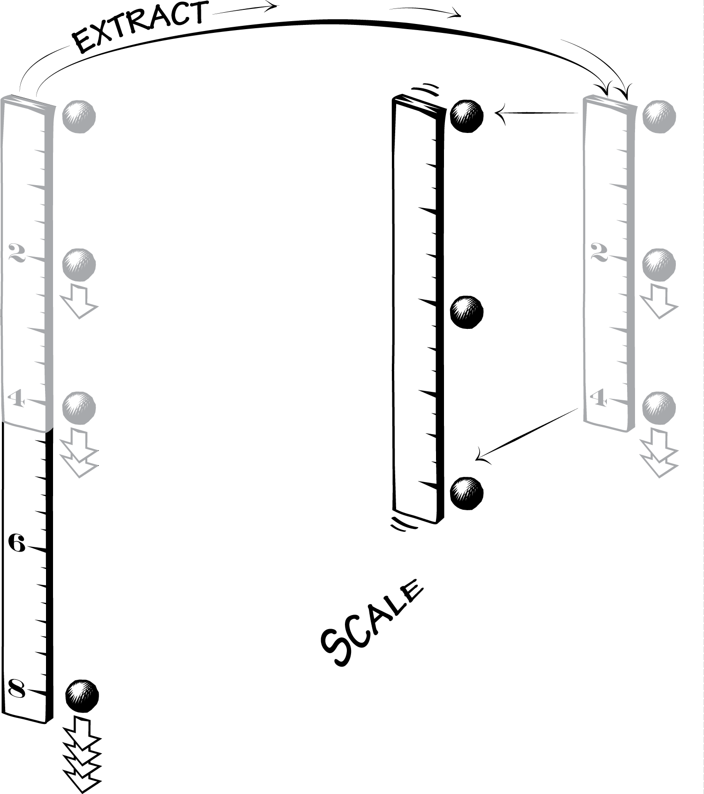
2. Self-Similarity

Slide 24
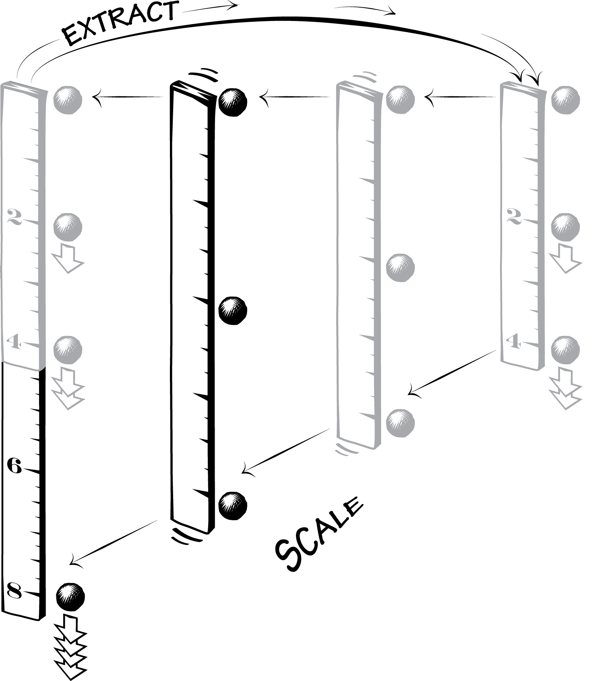
2. Self-Similarity

Slide 25
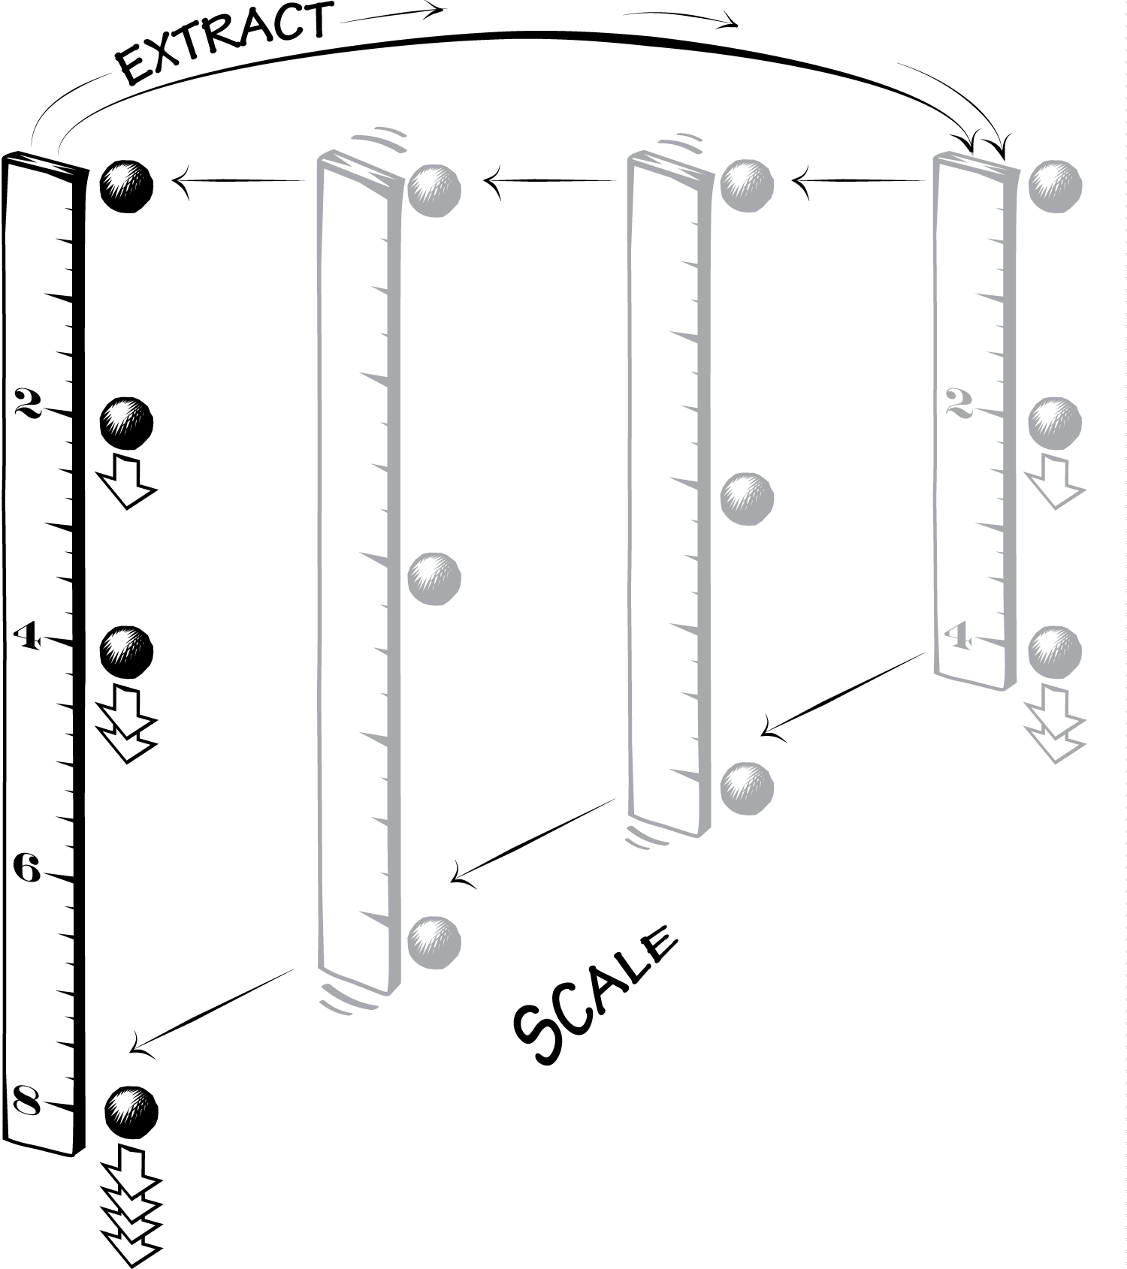
2. Self-Similarity

Slide 26
3.

Slide 27

Galileo’s Text | Our Interpretation
…then the times of those passages are equal…
3.
THEN Equal Time Result (ET): the times a body takes to fall 2 braccia and 4 braccia are equal.
=

Slide 28
Galileo’s Text | Standard View | Our View
When speeds have the same ratio as the spaces passed or to be passed, those spaces come to be passed in equal times… | ONE Motion | TWO Motions
…then the times of those passages are equal… | 3 reasserts 1 (argument is circular) | 3 is a novel conclusion (argument not circular)
1.
3.

Slide 29
4.

Slide 30
Galileo’s Text | Our Interpretation
…but for the same moveable to pass the four braccia and the two in the same time cannot take place except in instantaneous motion.
Downfall: Galileo assumes that ET is only possible if motion is instantaneous. But it is also possible for infinite time motion.
4.

Slide 31
4. Downfall

Slide 32
4. Downfall
Speed-Distance Law of Fall:

Slide 33
4. Downfall

Slide 34
4. Downfall
… + 1 + 1 + 1 + 1 + 1 + 1
… + 1 + 1 + 1 + 1 + 1 + 1 + 1

Slide 35
Galileo’s Text | Our Interpretation
When speeds have the same ratio as the spaces passed or to be passed, those spaces come to be passed in equal times… | Scaling: if any motion is scaled up by doubling all its speeds and distances, then the original and scaled motions take place in the same time. (General result about any motion)
…If the speeds with which the falling body passed the space of four braccia were the doubles of the speeds with which it passed the first two braccia, as one space is double the other space… | IF Self-Similarity: the motion over four braccia is a scaled up duplicate of the motion over two braccia… (Result holds only for motions whose speed is proportional to distance)
…then the times of those passages are equal… | THEN Equal Time Result (ET): the times a body takes to fall 2 braccia and 4 braccia are equal.
…but for the same moveable to pass the four braccia and the two in the same time cannot take place except in instantaneous motion. | Downfall: Galileo assumes that ET is only possible if motion is instantaneous. But it is also possible for infinite time motion.
1.
2.
3.
4.

Slide 36
Scaling
The Overlooked Context

Slide 37
1. The Two New Sciences is largely about scaling.
What is the effect on the support blocks required when you scale up a boat?
— Sagredo’s opening query

Slide 38
2. Galileo displays adeptness at expressing a variety of arguments in terms of scaling.
Discussion of the strength of cylinders, and also irregular objects, under scaling.

Slide 39
3. Galileo expresses a similar scaling argument a few pages before the passage in question.
“If a [uniformly moving] moveable passes through two spaces in equal times, these spaces will be to one another as the speeds. And if the spaces are as the speeds, the time will be equal” (Proposition II Theorem II).

Slide 40
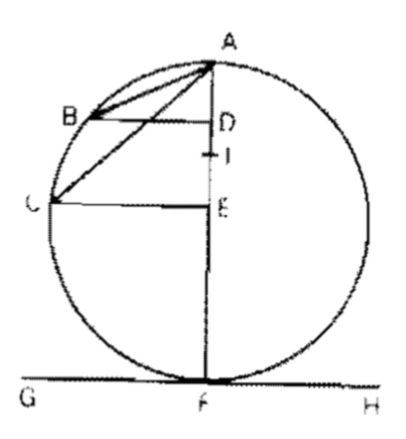
4. A precise instance of the scaling theorem follows immediately from Galileo’s results on inclined planes.

Slide 41
5. The argument in Galilean diagrams

Slide 42
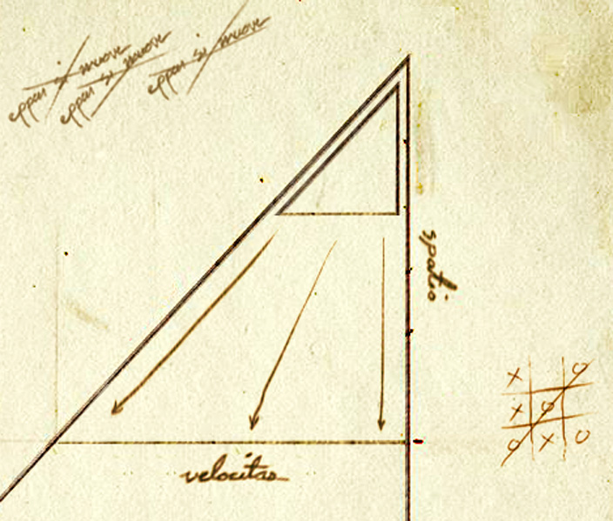

Slide 43
Downfall: Why did Galileo miss the infinite time solution?

Slide 44
Two types of infinity

Slide 45
1. Counting an infinite number of objects: a rolling wheel may cross “infinitely many voids” (Day 1)

Slide 46
2. Approaching an infinite physical magnitude: one may “increase in infinitum the force applied” (Day 1)

Slide 47
Counting: Galileo appears willing to discuss this kind of infinity.
Physical magnitudes (like time): Galileo seems to restrict himself to an arbitrary increase.

Slide 48
Relation to a more modern analysis

Slide 49
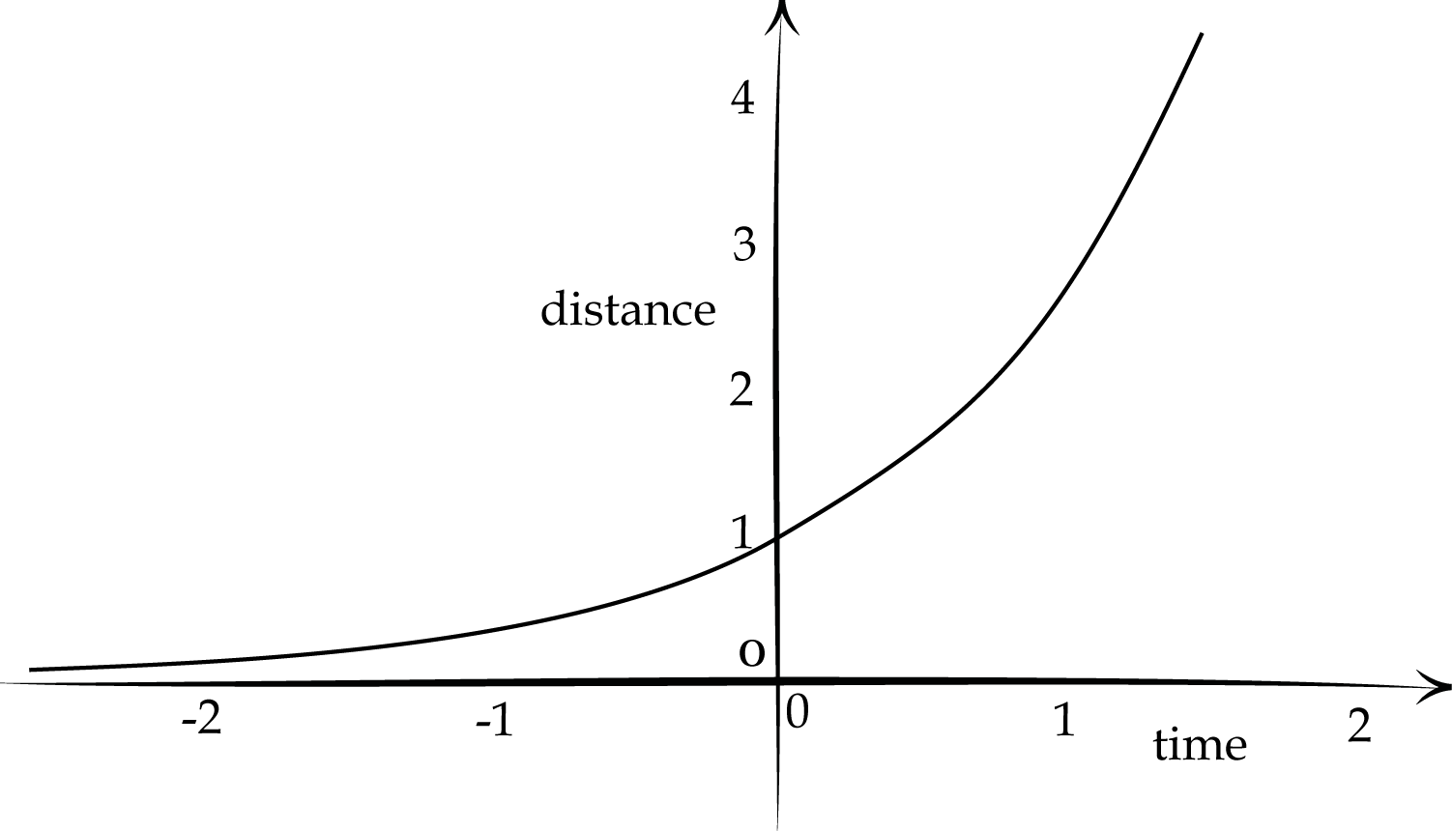
Speed is proportional to distance
dx/dt = x
x(t) = exp(t)
Δx(t) = x(t+1) – x(t)
= exp(t)(e-1)
= e. Δx(t-1)
t | … | -3 | -2 | -1 | 0 | 1 | 2
x | … | 1/e³ | 1/e² | 1/e | 1 | e | e²

Slide 50
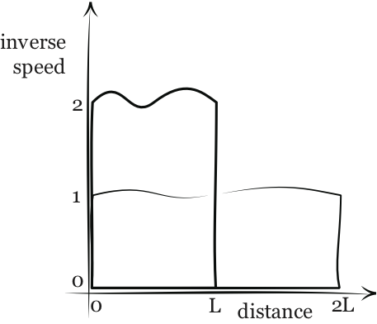
The Scaling Result
v(x) in x = 0 to L
1
time =
dx
v
scale up by doubling
v’(x’) = 2 v(x)
x’ = 2x
x’=2L
x=L
1
1
time’ =
dx’
=
d2x
v’
2v
0
x=L
1
0
=
dx
= time
v
0

Slide 51
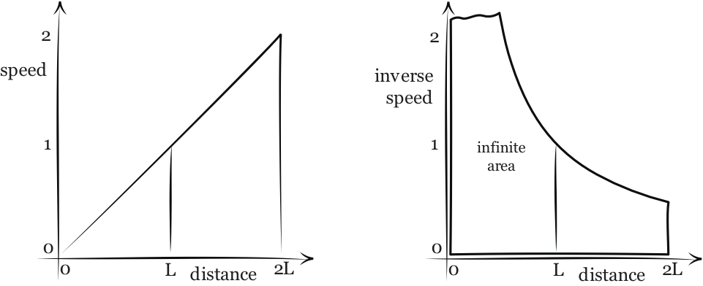
Self Similarity, Equal (infinite) Time
v(x) = x
in
x = 0 to L
v’(x’) = 2v(x) = 2x = x’
for x’ = 2x
in
x’ = 0 to 2L

Slide 52
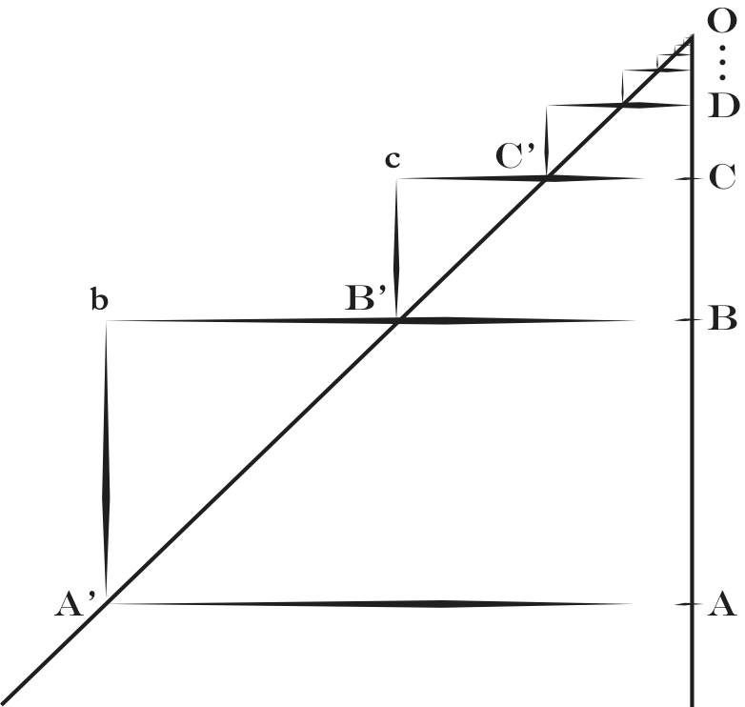
Self Similarity, Equal (infinite) Time
...
+
1
+
1
+
1
+
1
+
1
+
1
+
1
In a Galilean style geometric figure.
Rescaled equal time motions

Slide 53
Self Similarity, Equal (infinite) Time
...
+
1
+
1
+
1
+
1
+
1
+
1
+
1
In a Galilean style geometric figure.
Rescaled equal time motions

Slide 54
Concluding…

Slide 55
1.
Scaling
2.
Self-Similarity
+
3.
Equal Time
4.
Instantaneous motion
Infinite time motion

Slide 56
Galileo’s argument…
…was not “a course in fallacious reasoning.”
…ingeniously and correctly identifies why the speed-distance law in untenable.
…fails only in the last step.

Slide 57

Thank you.
John D. Norton & Bryan W. Roberts.
“Galileo’s Refutation of the Speed-Distance Law Rehabilitated”
http://philsci-archive.pitt.edu/archive/00005479/
Forthcoming in Centaurus as a “spotlight” issue with comments from critics and our response.

Slide 58
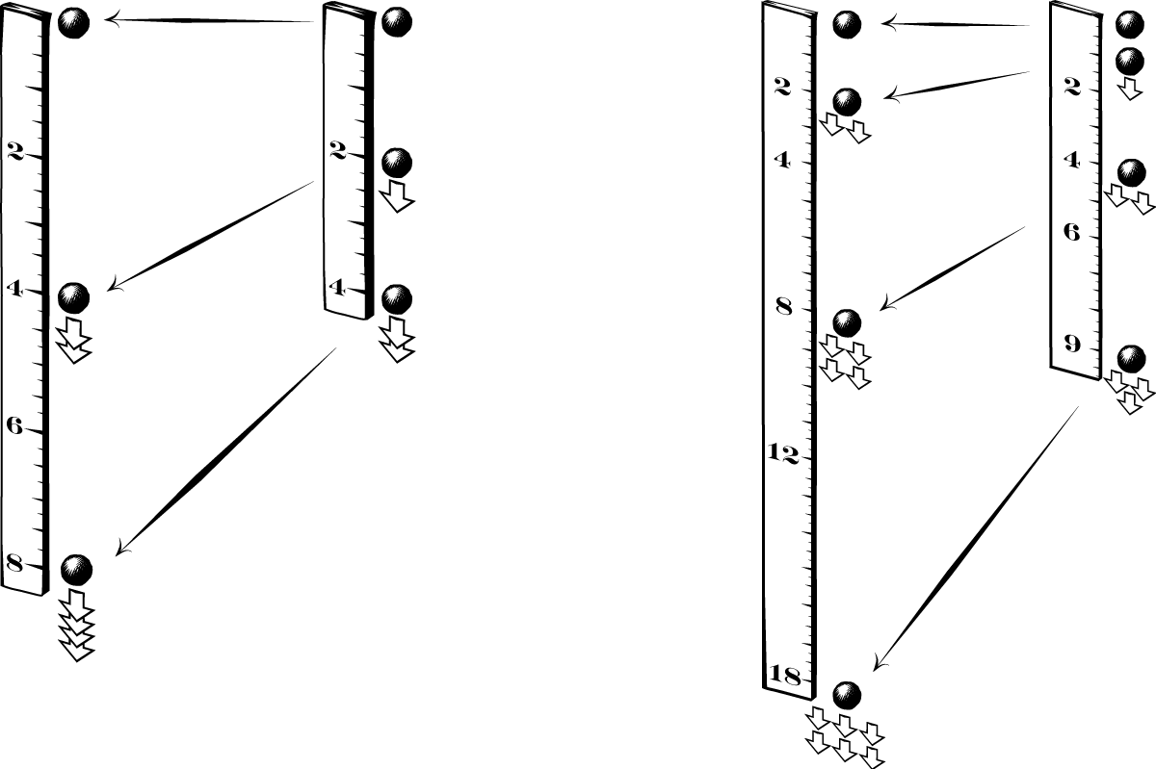
Scaling Laws of Fall
speed ∝ distance
speed ∝ time

