Slide 1


The Large-Scale Structure of Inductive Inference
John D. Norton
Department of History and
Philosophy of Science
University of Pittsburgh
Ninth Quadrennial Fellows Conference
June 2-4, 2024
University of Miami, Florida, USA

Slide 2
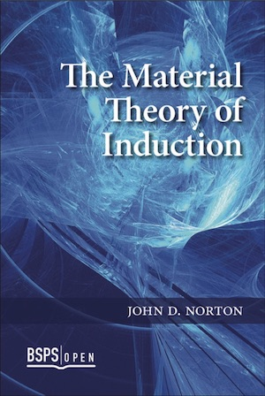
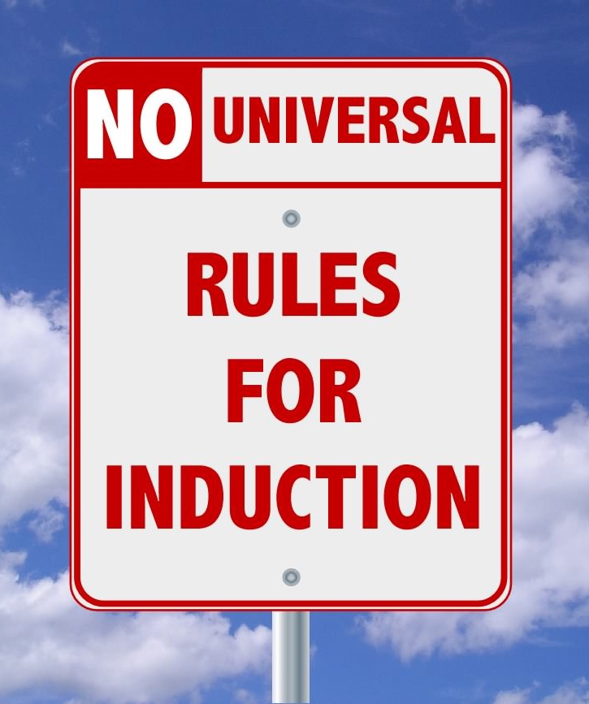

Slide 3
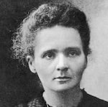
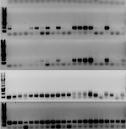
Inductive Inferences Warranted Exclusively by Background Facts
This sample of radium chloride is crystallographically monoclinic.
All samples of radium chloride are crystallographically monoclinic.
Haüy’s principle: generally, all samples of a pure crystalline substance belong to the same crystallographic family.
DNA of suspect and perpetrator match.
Very improbable that suspect and perpetrator are different people.
Distribution of DNA in the population. Subjects are chosen randomly. (Equal probability.)

Slide 4
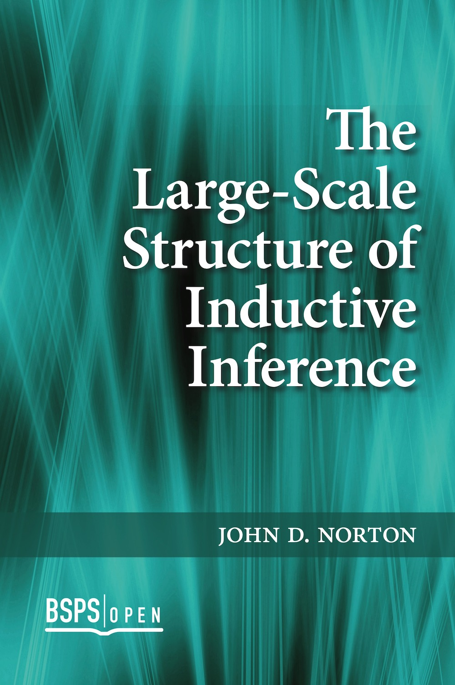
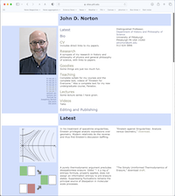
Inductive Support for warranting facts?
Available on my website https://sites.pitt.edu/
~jdnorton/jdnorton.html
More inductive inferences/support.
More warranting facts.
More inductive inferences/support.
More warranting facts.
More inductive inferences/support.
…

Slide 5
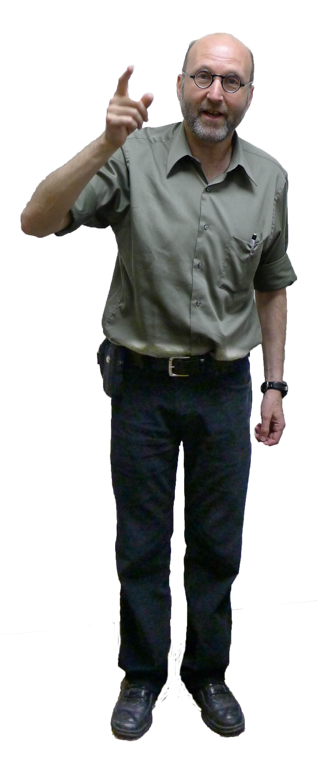
Main Claims
1. Relations of inductive support have a nonhierarchical structure.
2. Hypotheses, initially without known support, are used to erect nonhierarchical structures.
3. Locally deductive relations of support can be combined to produce an inductive totality.
4. There are self-supporting inductive structures.

Slide 6
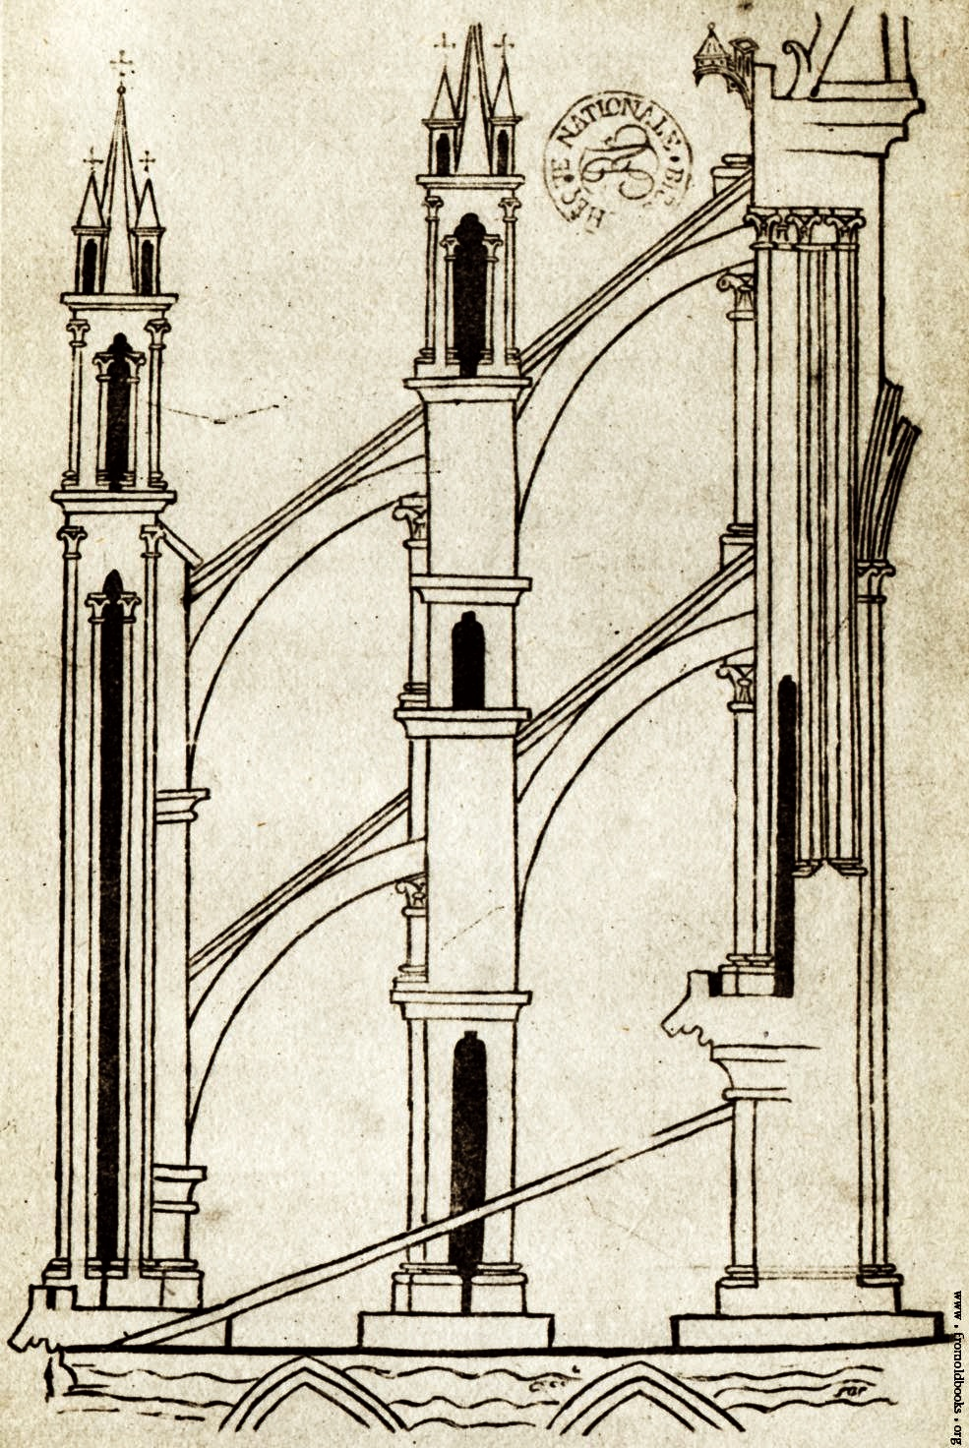
1.
Relations of inductive support have a nonhierarchical structure.

Slide 7

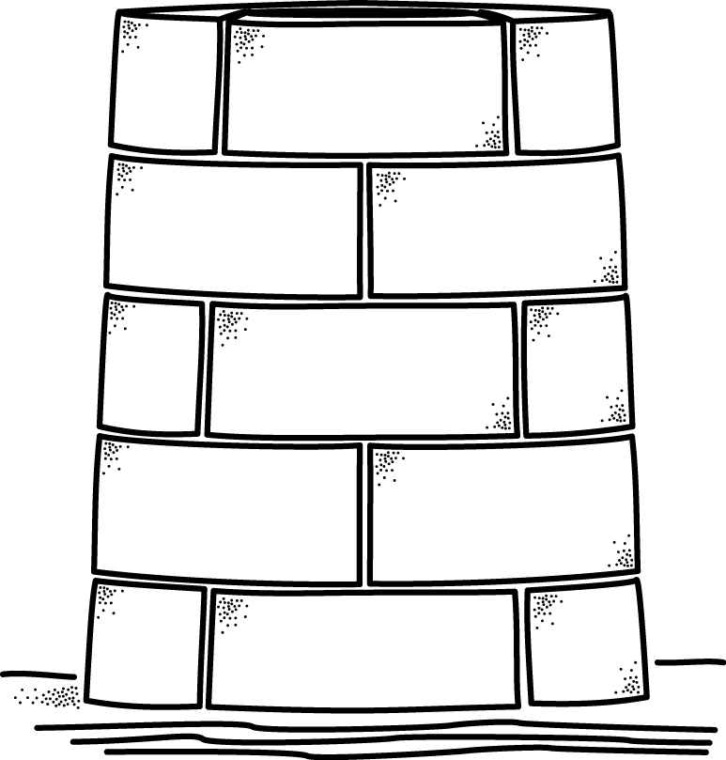
??? Hierarchical structure of inductive support ???
warranted by a proposition higher up
propositions of increasing generality
proposition here
can ONLY be supported by
propositions lower down.
observational bedrock

Slide 8
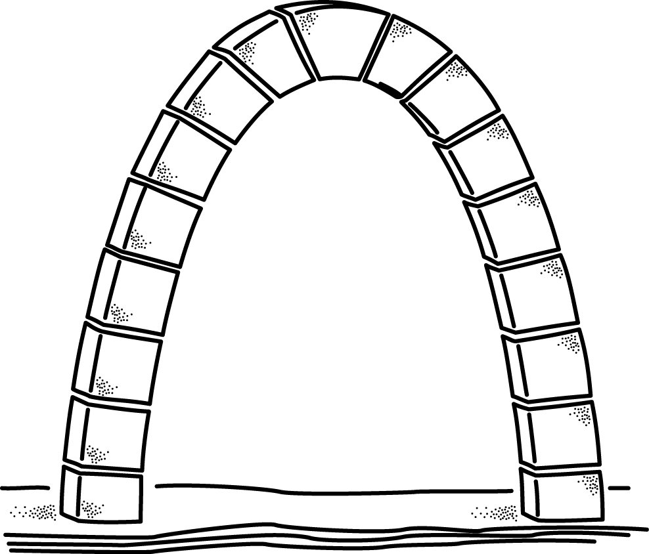
Non-hierarchical structure of inductive support
proposition here
warrant
somewhere else
supported by
propositions above
and
propositions of increasing generality
propositions below
observational bedrock

Slide 9
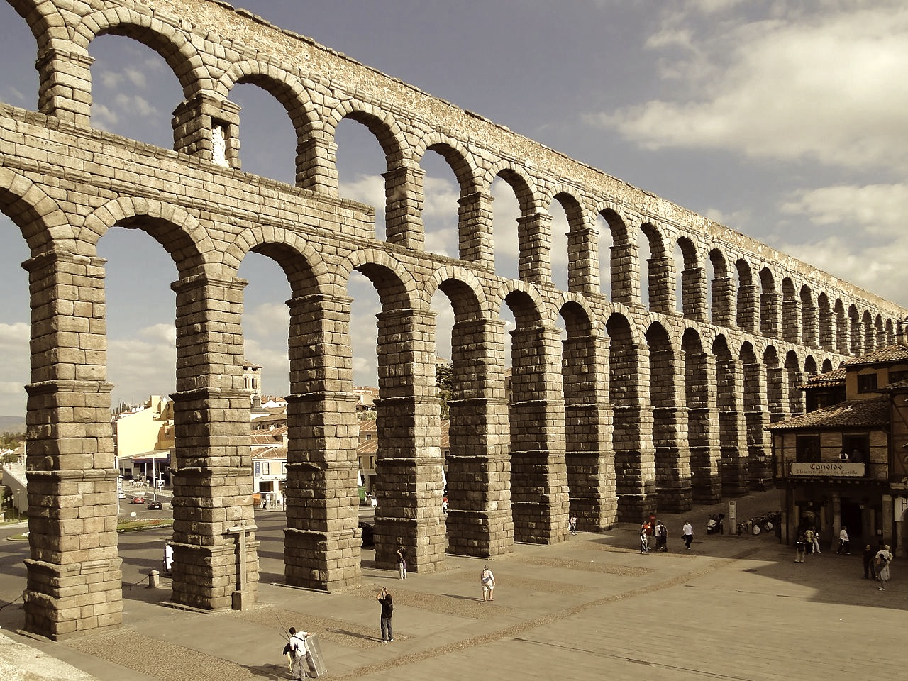
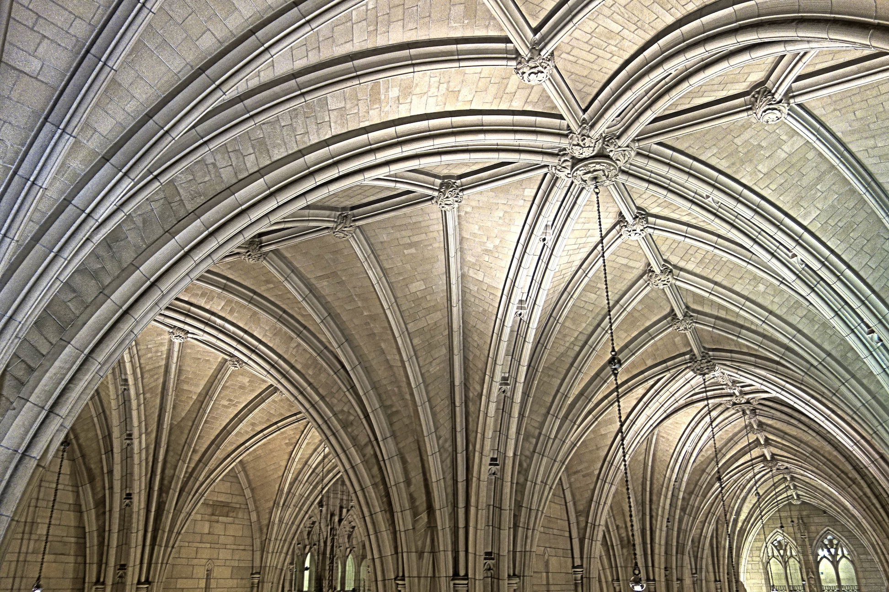

Slide 10
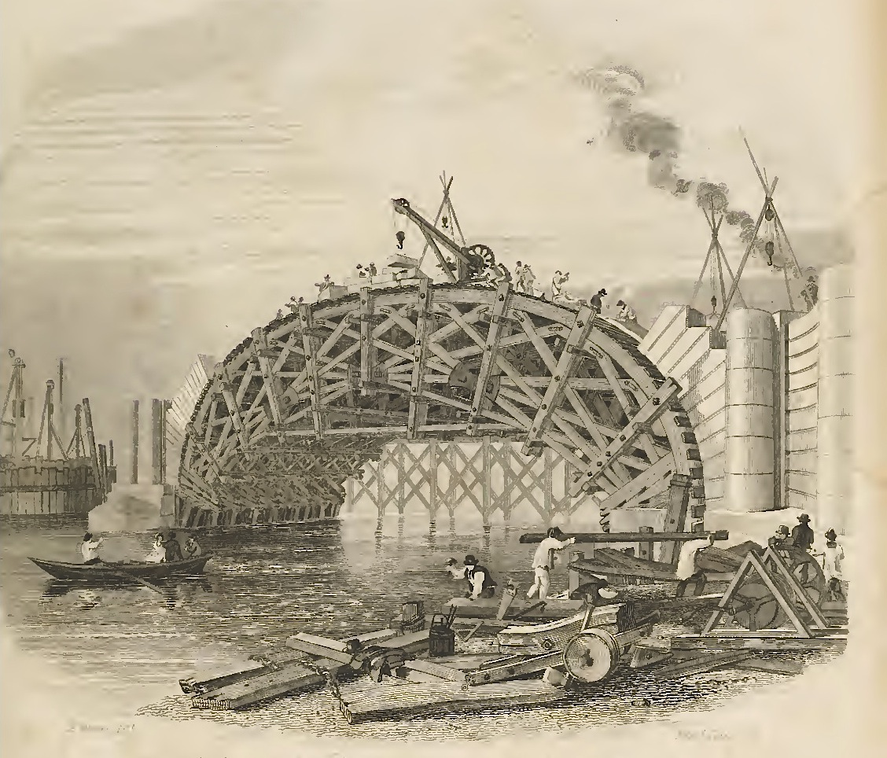
2.
Hypotheses, initially without known support, are used to erect nonhierarchical structures.

Slide 11
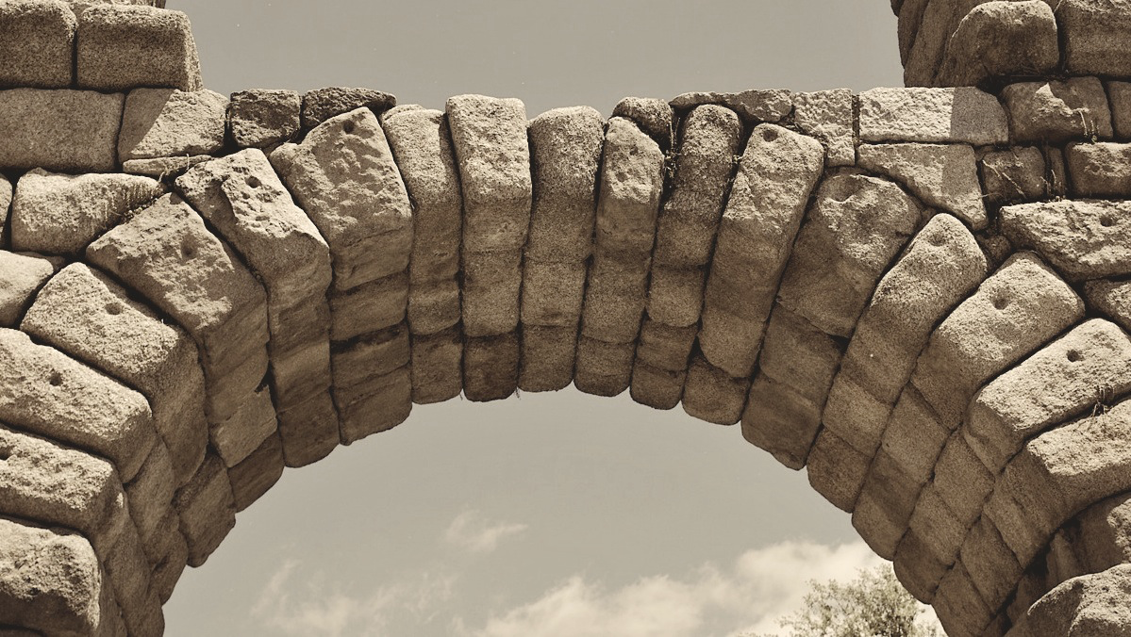
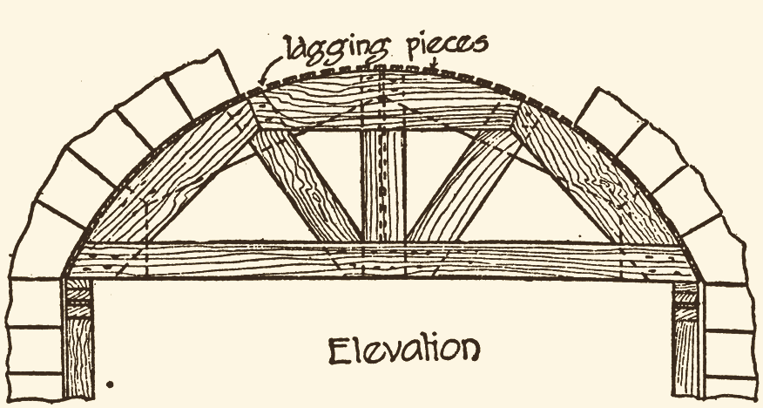
But How…?
How can an arch be constructed?
Not by
stacking stones.
Scaffolding “centring”

Slide 12
But How…?
How can inductively self-supporting structures be built?
Not by a linear chain of inferences.
Hypotheses
Introduced temporarily without proper inductive support.
Expectation is that inductive support will be provided as science proceeds.
NOT hypothetico-deductive confirmation. Inductive support from elsewhere in the science

Slide 13
The Problem of Induction

Slide 14
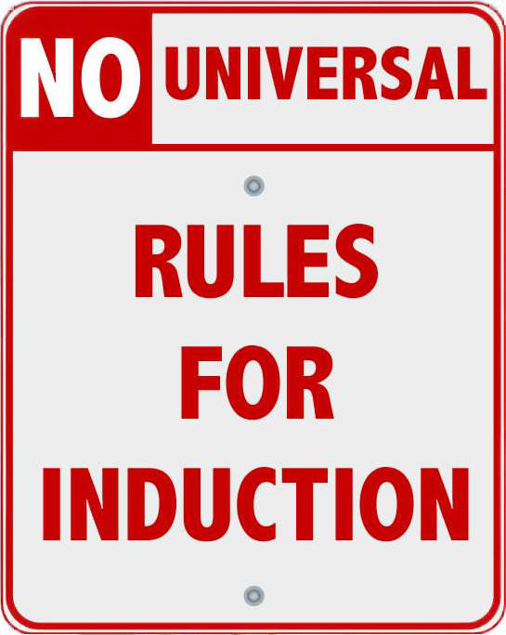
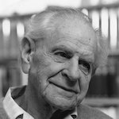
Regress Formulation
Principle₁ of induction
Principle₂ of induction
Principle₃ of induction
Karl Popper
…
“To justify it [first principle of induction], we should have to employ inductive inferences;
and to justify these we should have to assume an inductive principle of a higher order; and so on.
Thus the attempt to base the principle of induction on experience breaks down, since it must lead to an inﬁnite regress.”

Slide 15
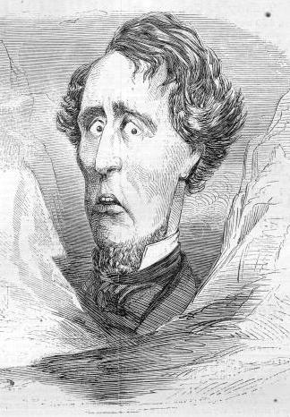
Yes, But …
… Isn’t there an analogous problem for the material theory?

Slide 16
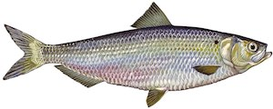
Infinite regress of ever more general warranting facts?
Relations of inductive support are nonhierarchical.
First induction warranted by an hypothesis.
No first general fact to warrant first induction?
Vicious circularity?
Circularities are benign.
No underdetermination.
No contradiction.
A fish is ten inches long plus half its length.

Slide 17
Conclusion: A distributed warrant for inductive inference
No general principle or law.
No principle of the uniformity of nature.
In a mature science…
each individual proposition
is well supported by the
other propositions in the science.
The totality of the science is well supported.

Slide 18
That’s all
there is to it!
THE END.

