Slide 1

The Infinite Lottery
John D. Norton
Department of History and Philosophy of Science
University of Pittsburgh
APRIL 24, 2018
THE POPPER SEMINAR

Slide 2
Overview

Slide 3

=
Inductive inference
Probabilistic reasoning
Not always!

Slide 4
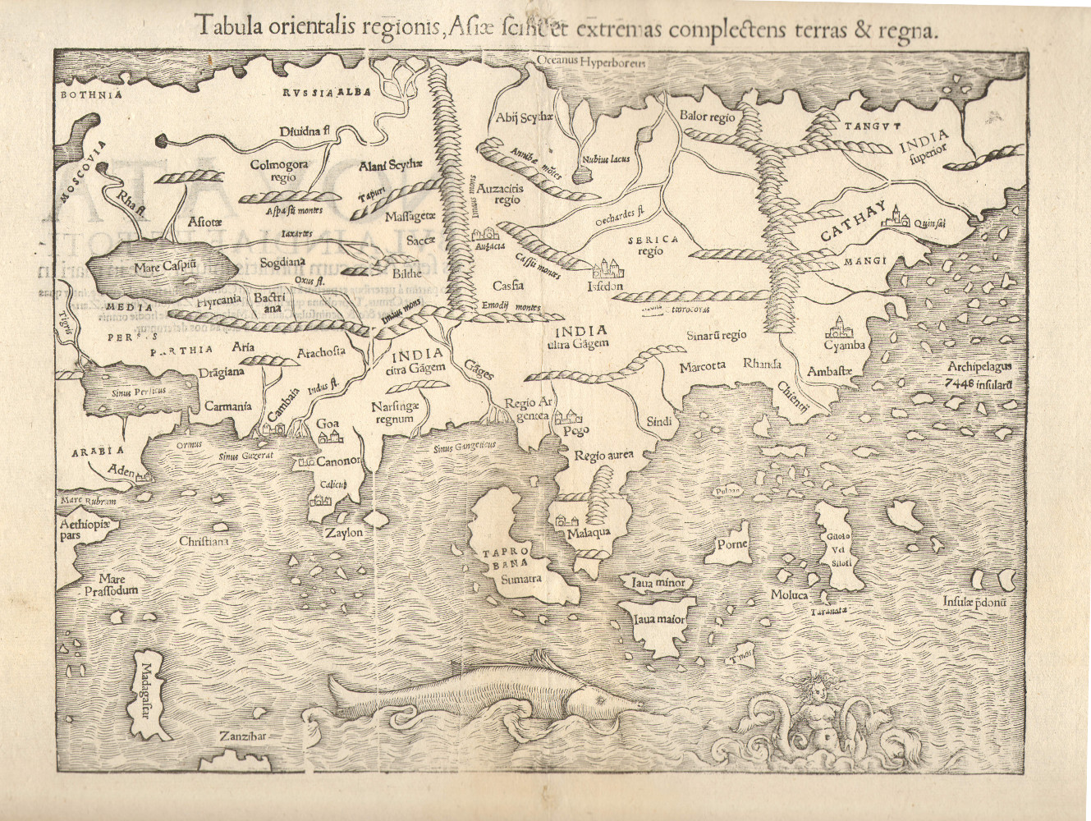
Something else here
Probabilistic inference here
Something else here
Something else here
Something else here
What determines which logic goes where?
Background facts.

Slide 5
An infinite lottery machine

Slide 6
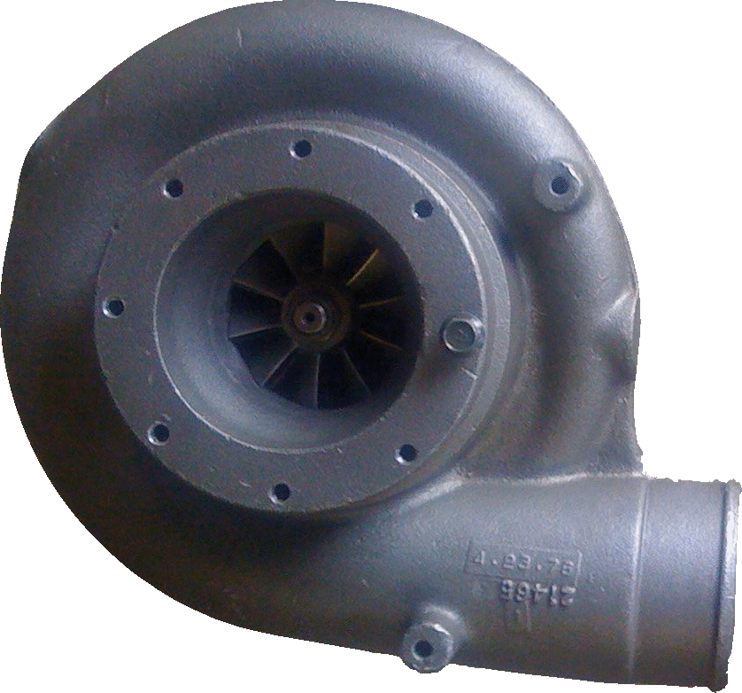
An infinite lottery machine
27
Fair selection made among infinitely many balls 1, 2, 3, …
= without favor to any number or numbers.
1
3
2

Slide 7
“Choosing without favor”
≠ each outcome has equal probability.
Probability may not be well-defined.
Label independence
All true statements pertinent to the chances of different outcomes remain true when the labels are arbitrarily permuted.
1
2
1
3
2
3
4
3
2
4
1
4
“1 or 2 arise roughly as often as 3 or 4.”
“1 or 2 arise roughly as often as 3 or 4.”
“1 or 2 arise roughly as often as 3 or 4.”

Slide 8
An infinite lottery machine
27
Permuting the labels on the balls has no effect on the chances of the outcomes.
1
3
2
“Chance” is now generalized beyond probability. A general, as yet unspecified, measure of indefiniteness.

Slide 9
Odd and even
…
odd
1
3
5
7
9
…
even
2
4
6
8
10
Not invariant under label permutation.
Not invariant under label permutation.
Chance (odd) =
Chance (even)
Chance (odd) >
Chance (even)
Chance (odd) =
Chance (even)
Chance (odd) <
Chance (even)

Slide 10
Odd and even, again
…
1
3
5
7
9
odd
13
17
odd sub₁
…
2
4
6
8
19
even
11
15
10
odd sub₂
From permutation of row labels:
Ch(even) = Ch(odd sub₁) = Ch (odd sub₂)
=
Ch (odd)
= Ch(odd sub₁ OR odd sub₂)
Additivity fails.

Slide 11
All co-infinite infinite sets have the same chance.
1
2
3
4
5
6
7
4
…
1
10²
2
3
8
9
10¹
10³
10⁴
10⁵
10, 100,
1000,
10000, …
Ch( )
= Ch(odd)
= Ch(even)
= Ch[ ]
no powers of 10
1, 2, 3, 4,
5, 6,7, 8, 9,
11, 12, …

Slide 12
Outcome sets equivalent under label independence
finite_{n}: finite set with n members n = 1, 2, 3, …
e.g. Members of finite₃ are
{1, 2, 3}, {27, 5, 134}, …
infinite_{co-infinite}: infinite set whose complement is also infinite
e.g. even numbers, odd numbers, prime numbers, powers of ten, …
infinite_{co-finite}: infinite set whose complement is finite of size n n = 1, 2, 3, …
e.g. complements of finite_{3,} all numbers greater than ten, …

Slide 13
Equivalent sets have equal chances.
Ch(finite_{n}) = V_{n} n = 1, 2, 3, …
Ch(infinite_{co-infinite}) = V∞
Ch(infinite_{co-finite-n}) = V_{-n} n= 1, 2, 3, …
“unlikely”
Ch(empty-set) = V₀
“certainly not”
Ch(all-outcomes) = V₋₀
“certain”
“as likely
as not”
“likely”
V₂
V∞
V∞
V₋₂
Ch( ) < Ch( ) = Ch( ) < Ch( )
10, 100,
1000,
10000,
3, 4, 5, 6
7, 8, 9, …
1, 2
odd
for a generic lottery machine.

Slide 14
Using the Logic

Slide 15
1000 independent drawings
All 1000 numbers are less than or equal to N.
All 1000 numbers are the same
8
8
8
…
8
1
N
7
…
3
Chance is V_{N1000}
“unlikely”
Chance is V∞
“as likely as not”

Slide 16
Frequency of even in N drawing
5
3
2
8
6
7
4
9
…
7
Chance (0 even in N draws) =
Chance (1 even in N draws) =
Chance (2 even in N draws) =
…
Chance (N/2 even in N draws) =
…
Chance (N-1 even in N draws) =
Chance (N even in N draws) =
V∞
V∞
V∞
V∞
V∞
V∞
The logic provides
no expectation that frequencies of even draws will mass around N/2.

Slide 17
Match Credences to Chances?

Slide 18
A Dutch Book
ONE = {1, 4, 7, 10, …}
TWO = {2, 5, 8, 11, ...}
THREE = {3, 6, 9, 12, ...}
Ch(ONE) =
Ch(not-ONE)
Ch(TWO) =
Ch(not-TWO)
Ch(THREE) =
Ch(not-THREE)
ONE
TWO
THREE
TWO
THREE
ONE
THREE
ONE
TWO
Accept even odds bets on outcomes of equal chance.
On ONE
On TWO
On THREE
Net
ONE
gain $1
lose $1
lose $1
lose $1
TWO
lose $1
gain $1
lose $1
lose $1
THREE
lose $1
lose $1
gain $1
lose $1

Slide 19
A Dutch Book Theorem
IF
Therefore…
Your credences match the non-probabilistic, infinite lottery chances.
…Non-probabilistic credences are incoherent.
and
You accept even odds bets on (exclusive, exhaustive) outcomes with equal credences.
… If you hold non-probabilistic credences, this betting behavior is incoherent.
THEN
The Dutch book scenario is not benign. It covertly favors probabilistic credences by supposition.
A sure-loss Dutch book can be made against you.

Slide 20
Measure Problem in Eternal Inflation Cosmology

Slide 21
Countable infinity of pocket universes spawned in eternal inflation.
Countable infinity like ours.
9
10
12
4
like
unlike
5
unlike
unlike
6
13
4
1
10
like
unlike
like
6
14
like
13
11
8
unlike
7
11
like
3
6
2
8
unlike
7
like
3
2
like
11
8
unlike
6
3
3
Countable infinity unlike ours.

Slide 22
The Measure Problem
What is the probability that a pocket universe is like our universe?
Guth (2000, p. 568; 2007, p. 11)
“However, as soon as one attempts to define probabilities in an eternally inflating spacetime, one discovers ambiguities. The problem is that the sample space is infinite, in that an eternally inflating universe produces an infinite number of pocket universes. The fraction of universes with any particular property is therefore equal to infinity divided by infinity—a meaningless ratio. To obtain a well-defined answer, one needs to invoke some method of regularization.”
Guth (2000, p. 568; 2007, p. 11)

Slide 23
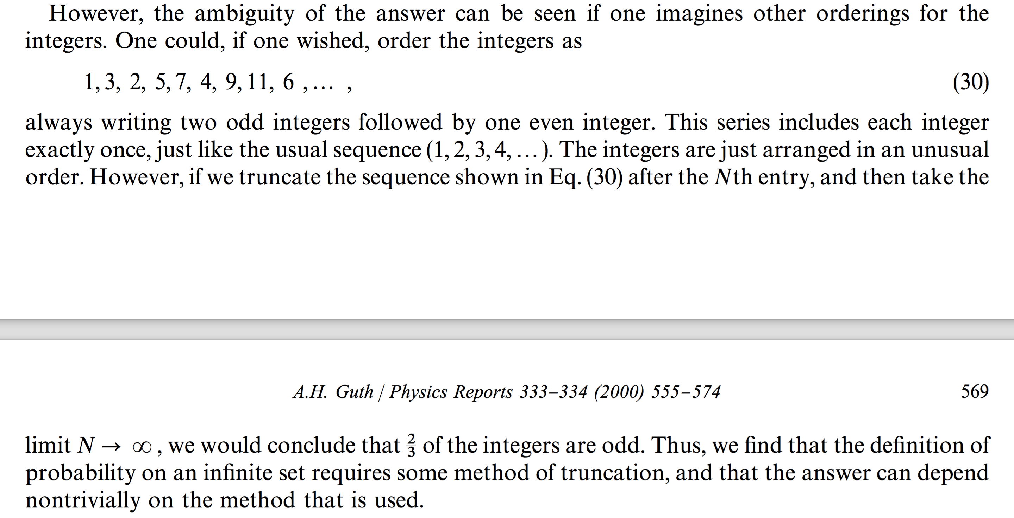
The Counting Argument

Slide 24
The Counting Argument
1, 2, 3, 4, 5, 6, 7, 8, 9, …
Half are odd.
1, 3, 2, 5, 7, 4, 9, 11, 6, …
Two-thirds are odd.
Therefore, Probability(odd) cannot be defined.

Slide 25
Prediction Impossible?
In an eternally inflating universe, anything that can happen will happen; in fact, it will happen an infinite number of times. Thus, the question of what is possible becomes trivial -- anything is possible, unless it violates some absolute conservation law.
To extract predictions from the theory, we must therefore learn to distinguish the probable from the improbable.
Guth (2000, §6, 2007, §4)
And if inflation produces a multiverse in which, to quote a previous statement from one of the responding authors (Guth), “anything that can happen will happen”—it makes no sense whatsoever to talk about predictions.
Ijjas, Steinhardt and Loeb (2017)

Slide 26
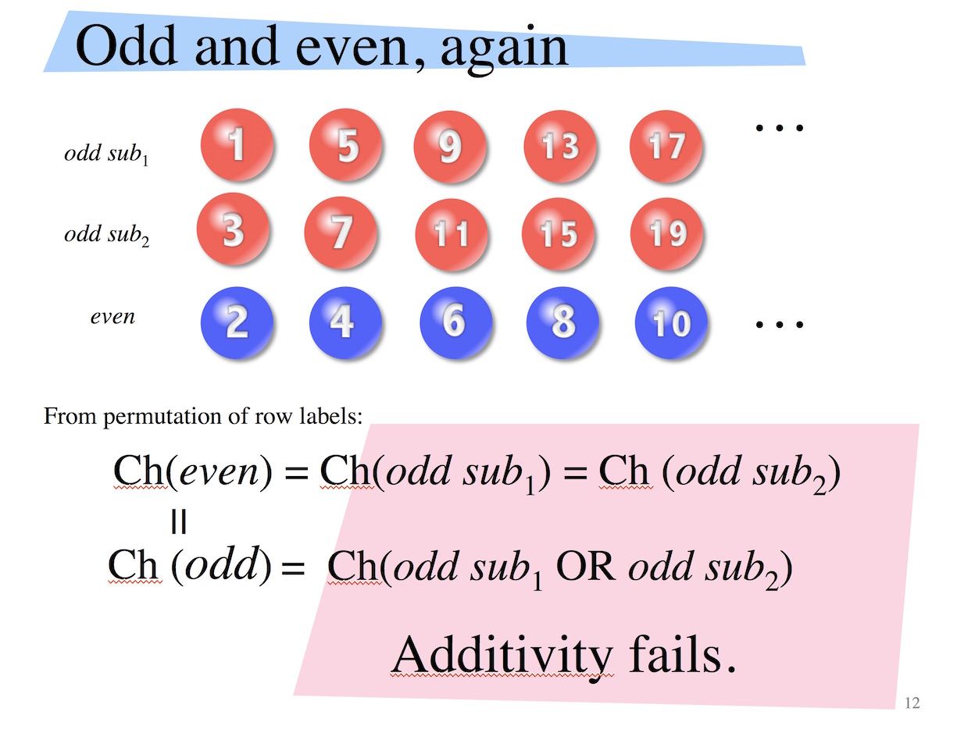
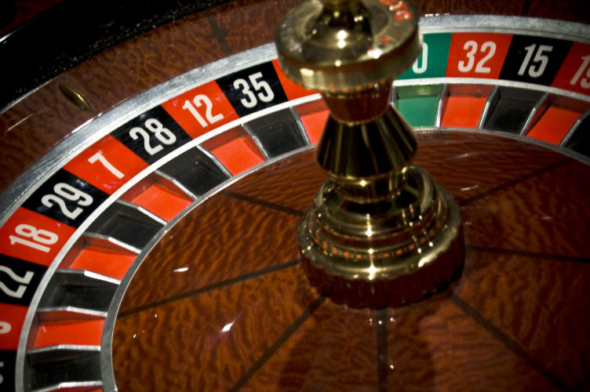
Prediction IS possible, but …
The governing inductive logic is the weaker “infinite lottery” logic.
The predictions are negative. The best we get is that like and unlike have equal chance in the sense of the infinite lottery logic.
Analogy in probability:
No run of red, no matter how long, is of any use in predicting the next outcome.
The counting argument is readily adapted to establish the applicability of this logic.

Slide 27
Frequencies?
Divide the eternally inflating universe into very many—N—sectors.
Pick one in each
(following infinite lottery rules).
…
1
2
3
N

Slide 28
Frequencies?
Divide the eternally inflating universe into very many—N—sectors.
Pick one in each
(following infinite lottery rules).
Chance (0 like in N sectors) =
Chance (1 like in N sectors) =
Chance (2 like in N sectors) =
…
Chance (N/2 like in N sectors) =
…
Chance (N-1 like in N sectors) =
Chance (N like in N sectors) =
V∞
V∞
V∞
V∞
V∞
V∞
The logic provides
no expectation that frequencies of like draws will mass around N/2.

Slide 29
Conclusion How to think about infinite lottery chances.

Slide 30
Probabilities: The Hard Case
fapp = “for all practical purposes.
Probability very near 1:
fapp, will occur.
1.0
0.9
Pr = 0.6: occurs with probability very near 1 in about 60% of many trials.
0.8
0.7
Intermediate values represent distinct cases. How do we separate Pr = 0.5 from Pr = 0.6?
0.6
0.5
0.4
Pr = 0.5: occurs with probability very near 1 in about 50% of many trials.
0.3
0.2
Probability very near 0:
fapp, will not occur.
0.1
0

Slide 31
Infinite Lottery Chances: The Easy Case
fapp = “for all practical purposes.
fapp, will occur.
V₋₁, V₋₂, …
All intermediate outcomes have the same inductive support.
“As likely as not.”
V∞
fapp, will not occur.
V₁, V₂, …

Slide 32
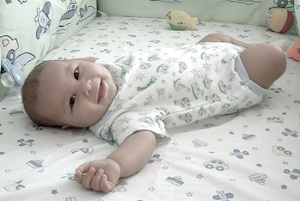
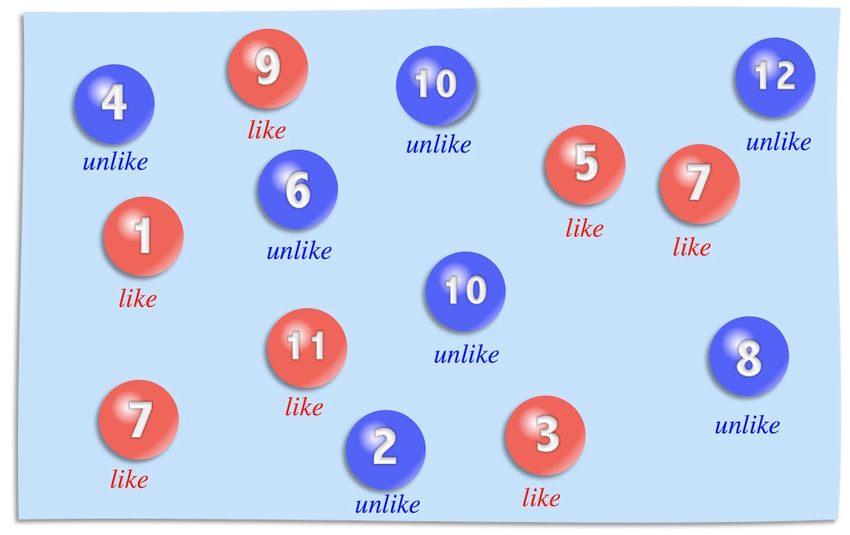
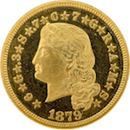
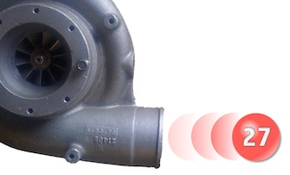
Benchmarking with a randomizer
The probability that your unborn child will be a girl is 0.5.
The chance
that eternal inflation spawns a pocket universe like ours is “as likely as not.”
The probability
is the same as tossing a head in a fair coin toss.
The chance is the same as drawing an even number in an infinite lottery.

Slide 33

Read

Slide 34
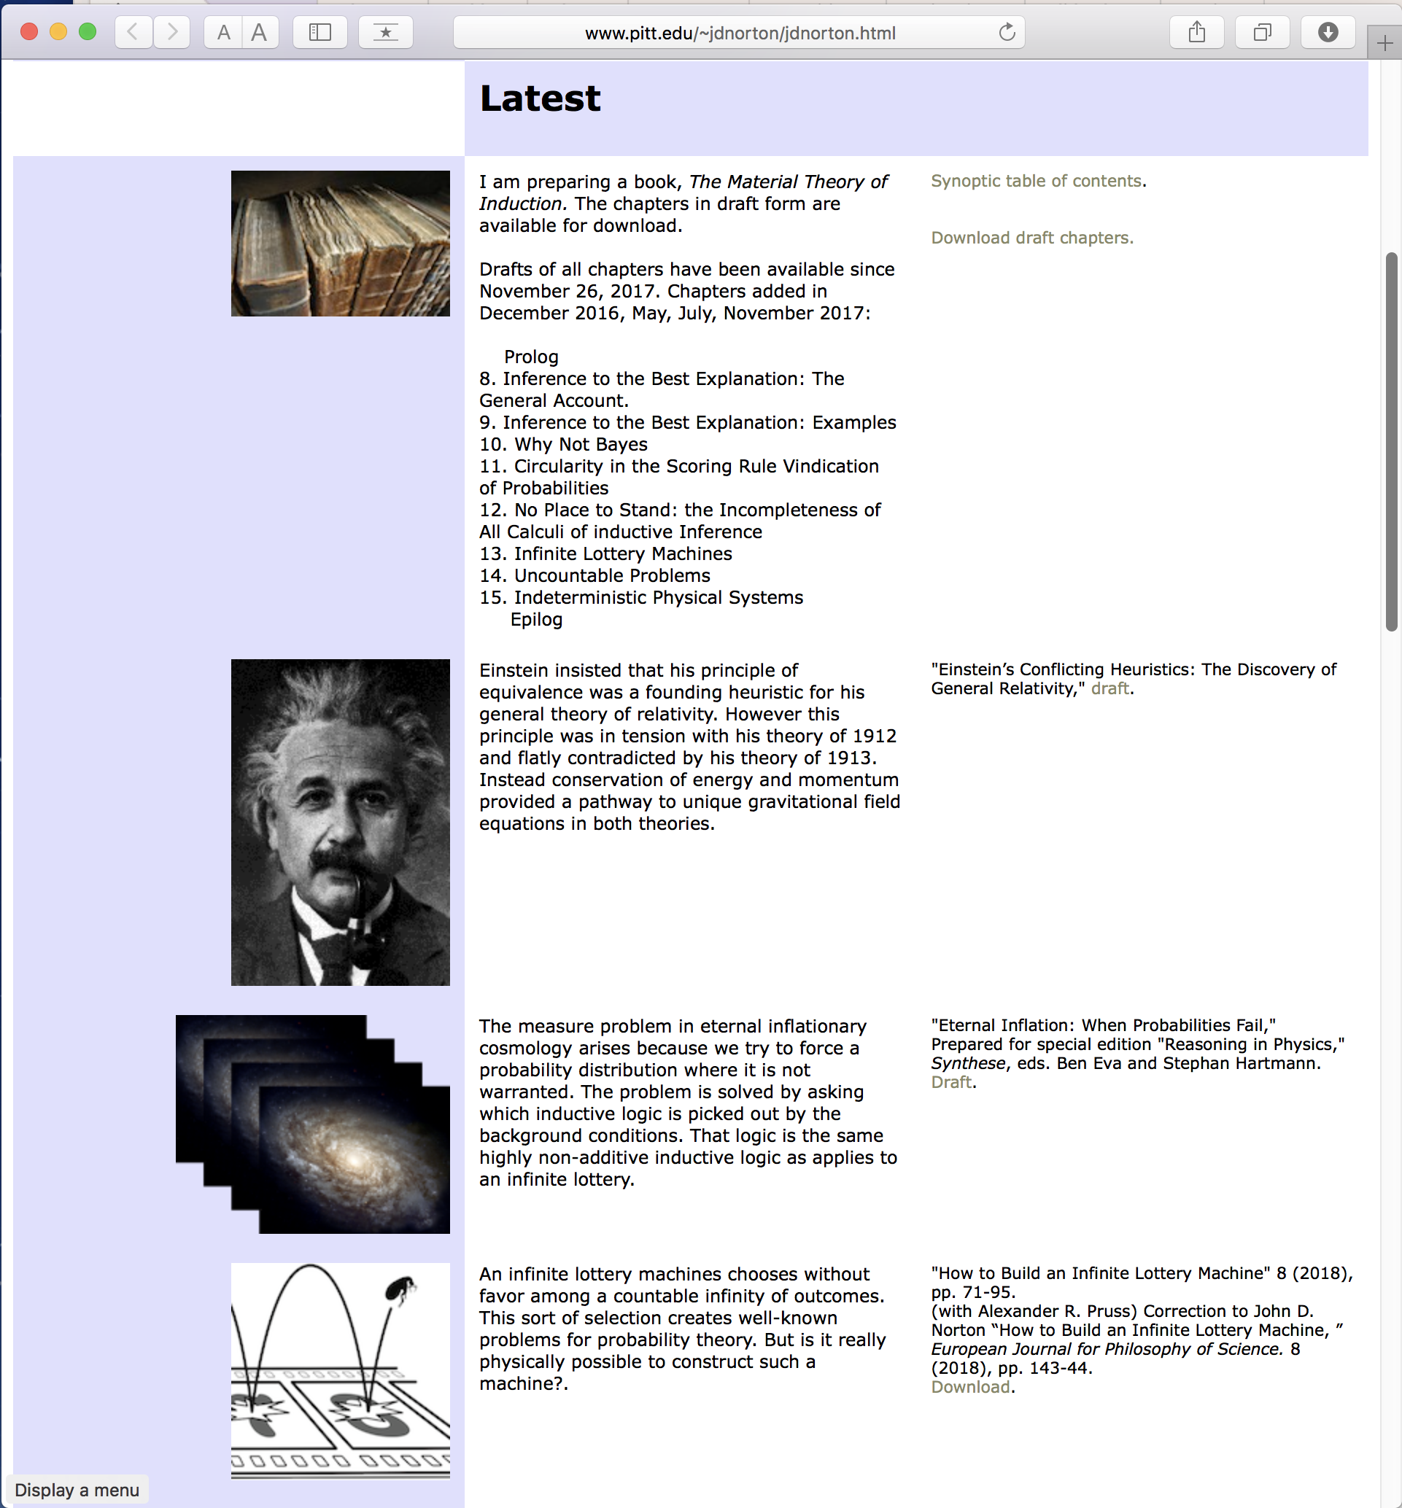
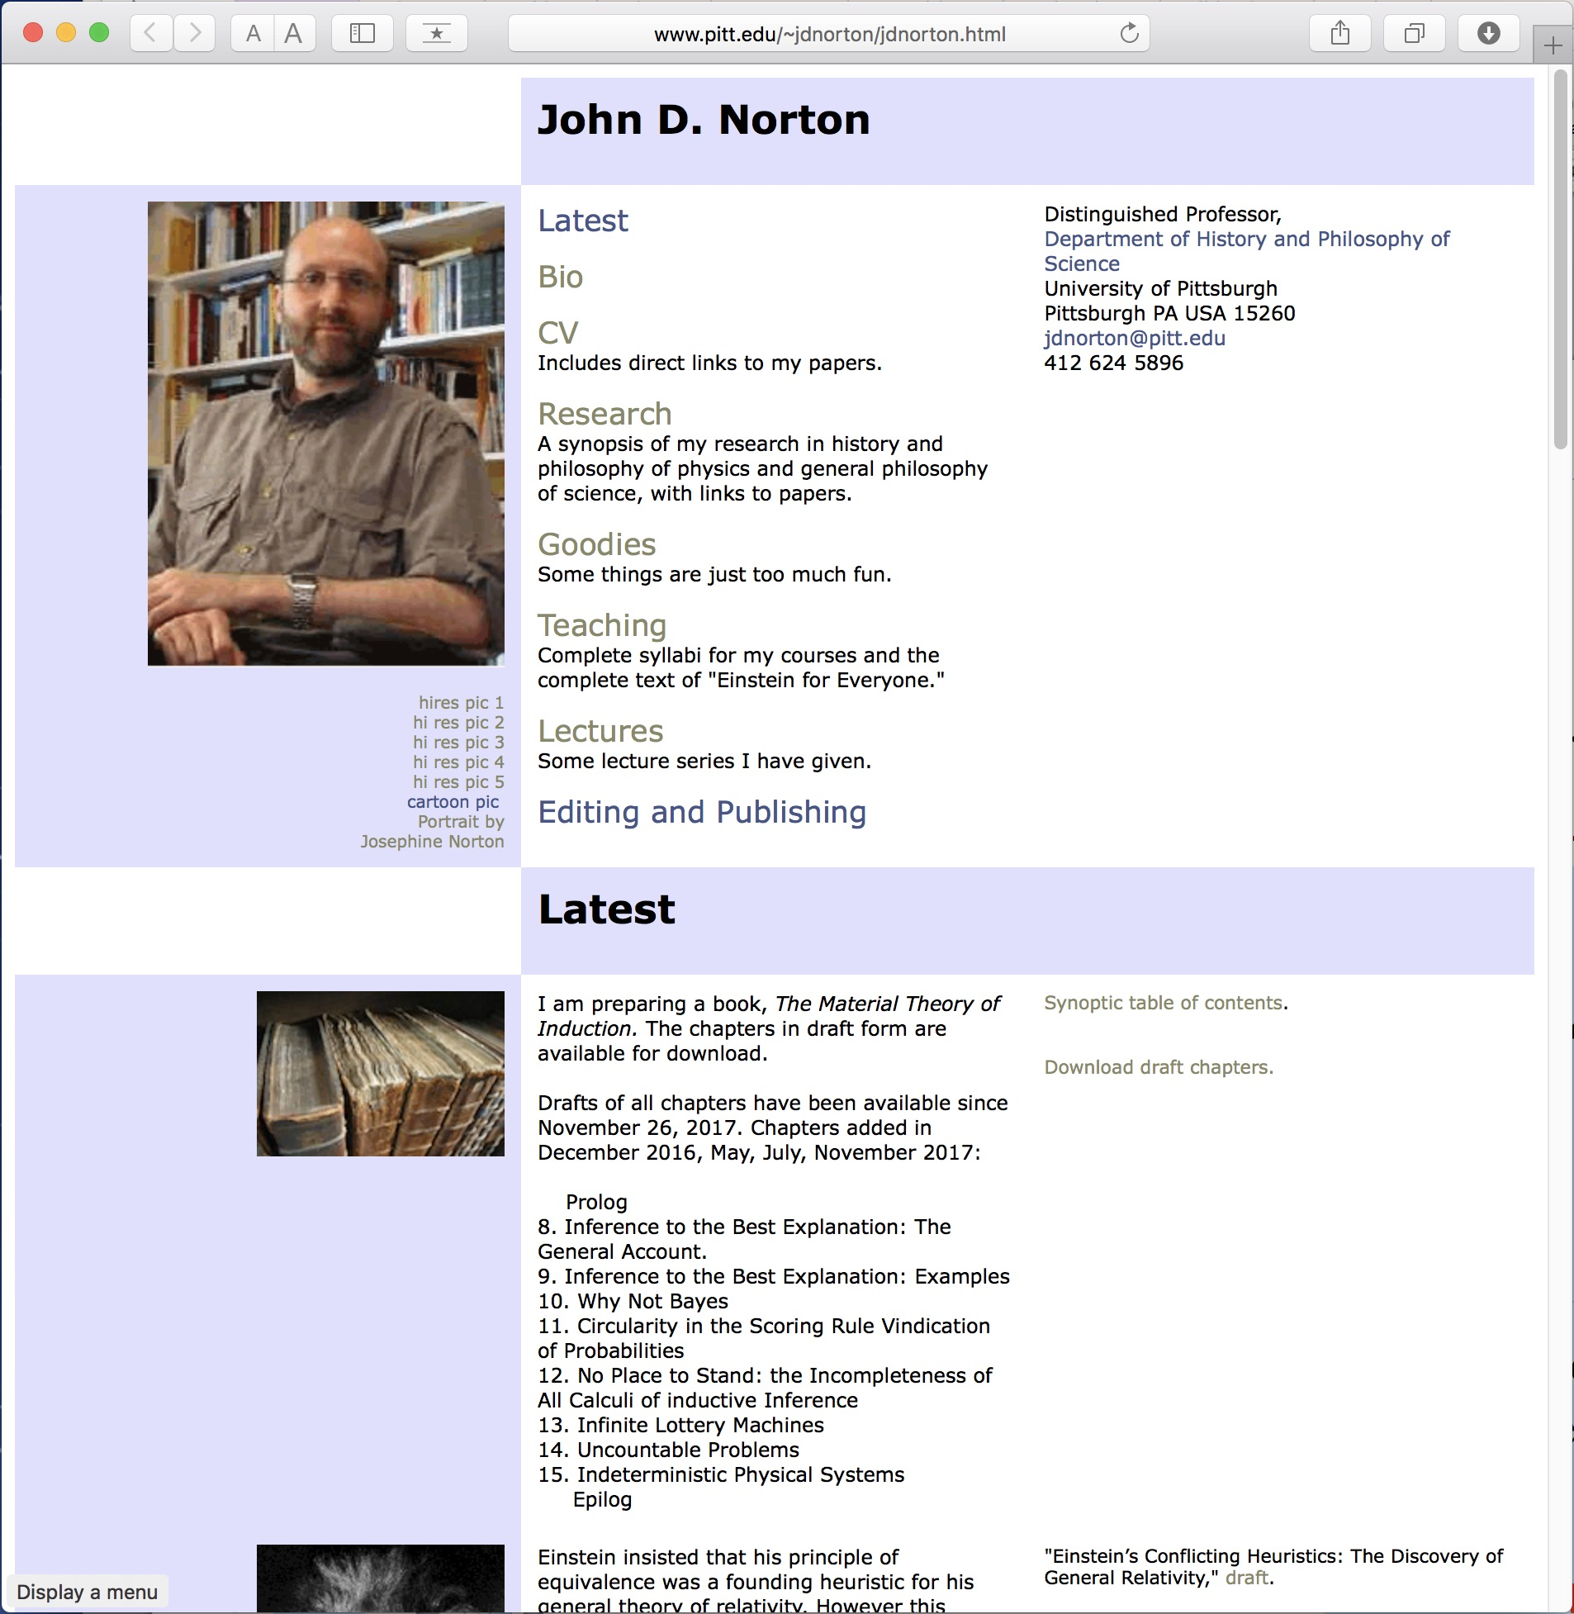

Slide 36


Slide 37
Appendices

Slide 38

Probabilistic Analysis
Probability P(n) of outcome n must satisfy:
1
Fairness of selection
ε = P(1) = P(2) = P(3) = ….
ε = 0
P(1) + P(2) + P(3)+ …
= 0 + 0 + 0 + …
= 0
2
Normalization
P(1) + P(2) + P(3)+ … = 1
ε > 0
P(1) + P(2) + P(3)+ …
= ε + ε + ε + …
= ∞
Contradiction

Slide 39
Escapes?
Drop countable additivity.
Finite additivity only.
Infinitesimal probabilities
OR
P(1) = 0
P(1) + P(2) = 0
P(1) + P(2) + P(3) = 0
...
ε = P(1) = P(2) = P(3) = ….
where
0 < ε <
( )
any positive real number
CANNOT take infinite limit.
Both preserve finite additivity.
My claim:
Finite additivity must go!
Posit independently:
P({1, 2, 3, …}) = 1
P(even) = P({2, 4, 6, ...}) = ½
= P(odd) = P({1, 3, 5, ...})
...

Slide 40
Problems in inductive inference
To what extend should we expect:
• Some specific number to be drawn?
27? 3,668? …
• Some set of numbers?
Odd numbers? Even numbers? Numbers greater than 100?...
• Outcomes on repeated trials?
100 trials, all with numbers greater than 100?

Slide 41
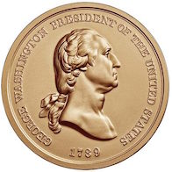
But what does the chance function Ch(.) mean?
NOT: give an explicit definition.
NOT: subjective Bayesian elicitation
The probabilists’ approach:
Contrive circumstances in which an assertion of probability is re-expressed as an assertion of very high or very low probability.
Connect with non-probabilistic expectations, else all we do is relate probabilities to probabilities, without giving them independent meaning.
Coin toss:
P(H=heads) = 0.5
In very many independent coin tosses,with probability near one, there will be roughly one half H.
Rule of coordination:
Very low probability outcomes generally do not happen; and very high probability outcomes generally do.

Slide 42
Chance Ch(.) informally
Unlikely: succeeds in only finitely many cases.
Ch(finite_{n}) = V_{n} n = 1, 2, 3, …
Ch(infinite_{co-infinite}) = V∞ “as likely as not”
Ch(infinite_{co-finite-n}) = V_{-n} n= 1, 2, 3, …
Intermediate chances all the same; easier than probabilistic case.
Likely: fails in only finitely many cases.
Rule of coordination:
Very low chance outcomes V_{n} generally do not happen; and very high chance outcomes V_{-n} generally do.

Slide 43
Chance of a number less than or equal to N?
1
2
…
N
…
N+1
N+2
Chance is V_{N}
Does not happen
Chance is V_{-N}
Does happen
…no matter how big N is!

Slide 44
Odd and even, again
…
1
5
9
13
17
odd
odd sub₁
3
7
11
15
19
odd sub₂
…
even
2
4
6
8
10
From permutation of row labels:
Ch(even) = Ch(odd sub₁) = Ch (odd sub₂)
=
Ch (odd)
= Ch(odd sub₁ OR odd sub₂)
Additivity fails.

