Slide 1
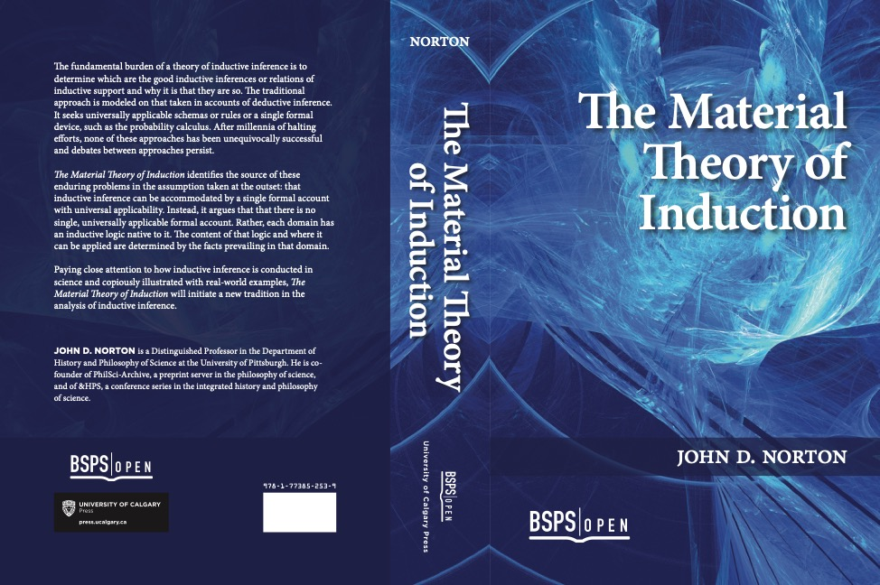
The Material Theory of Induction, Introduced
John D. Norton
Department of History and Philosophy of Science
University of Pittsburgh

Slide 2
Material Theory of Induction

Slide 3
A warm up problem in inductive inference
1, 3, 5, 7, …
What’s next?

Slide 4
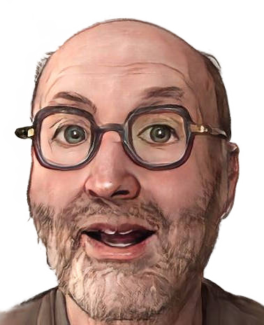
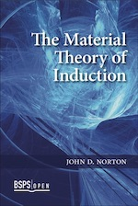
This Talk
There are no universal rules of inductive inference.
All inductive inferences are warranted by facts that obtain locally only.
Examples
Curie and Radium
1, 3, 5, 7, …
General argument
for the material theory.

Slide 5
An Example

Slide 6
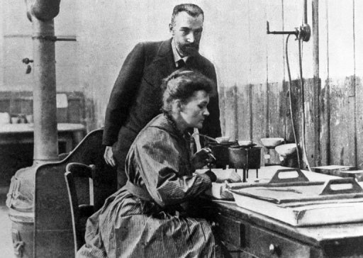

Slide 7
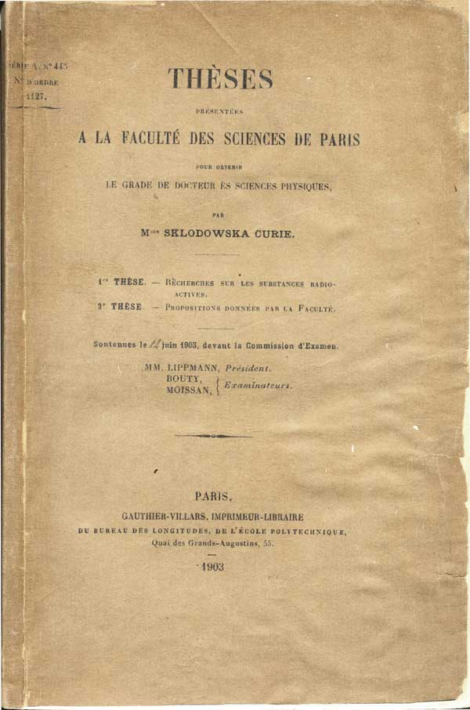

Slide 8
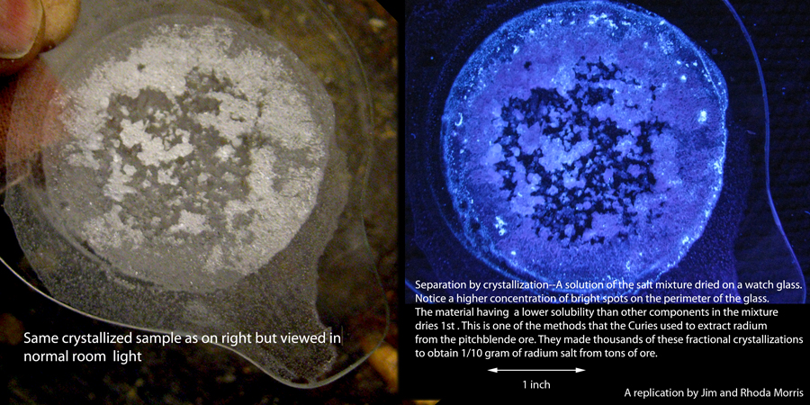
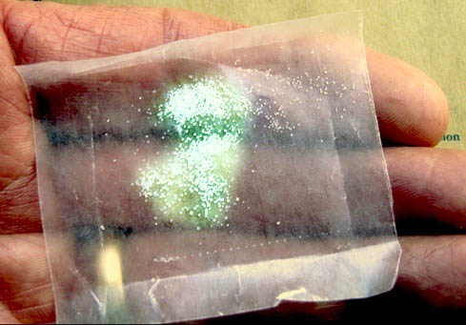
Sample isolated is 1/10 gram
…from tons of pitchblende ore, over more than three years.
this much
Images from “A Personal Interview with Marie Curie.”Jim and Rhoda Morris. http://scientificscience.org/Marie_%20Curie/index.htm

Slide 9
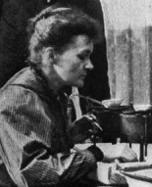
Its crystalline properties declared
The crystals, which form in very acid solution, are elongated needles, those of barium chloride having exactly the same appearance as those of radium chloride.
(Dissertation, 1903)
In chemical terms radium differs little from barium; the salts of these two elements are isomorphic.
(Nobel Prize Address, 1911)

Slide 10
The Inference Justified Formally
This sample of Radium Chloride
crystals just like Barium Chloride
Some A’s are B.
has
All A’s are B.
All samples of Radium Chloride
crystals just like Barium Chloride
have
enumerative induction
BUT…
This sample of Radium Chloride …
… appears colorless.
… weighs less that 1/5g.
Must all samples be so?
… has crystals smaller than 1mm.
… is at temperature 25C.
… is in Paris.
… prepared by Marie Curie.

Slide 11
??Repair??: Augment Schema with Domain Specific Facts.
Some A’s are B.
All A’s are B.
Restrict to things that can carry projectable properties.
Restrict to projectable properties.
Properties without spatiotemporal limits?
Things in dishes in Curie’s lab?
Crystallized things
in dishes in Curie’s lab?
Shapes?
(of the right sort?)
Colors or lack of?
Pure chemical compounds in dishes in Curie’s lab?
etc.
Sizes?
etc.
Probabilities to the rescue?
No. Must first figure out what is projectable and then encode that in priors, likelihoods.

Slide 12

Add more domain specific facts
The induction is more secure. The facts do the work.
The formal schema contributes less.

Slide 13
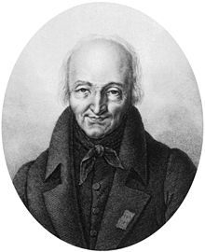
The Inference Justified by Facts.
This sample of Radium Chloride
crystals just like Barium Chloride
has
Haüy’s principle
René
Just Haüy
1743-1822
All samples of Radium Chloride
crystals just like Barium Chloride
have
Haüy’s principle
Generally, each crystalline substance has a single characteristic crystallographic form.
Isomorphous groups.
Crystalline substances tend to come in groups with analogous chemical compositions and closely similar crystal forms.

Slide 14
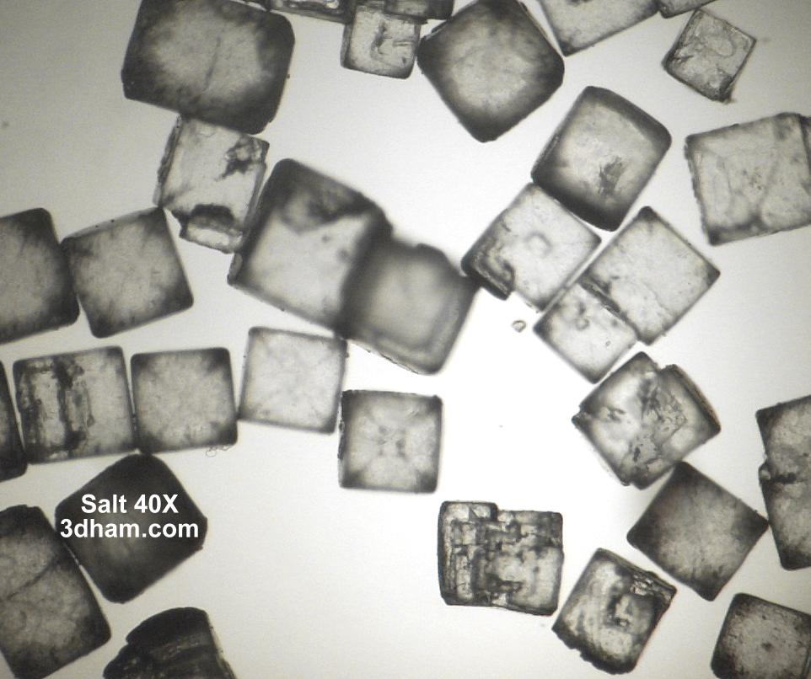
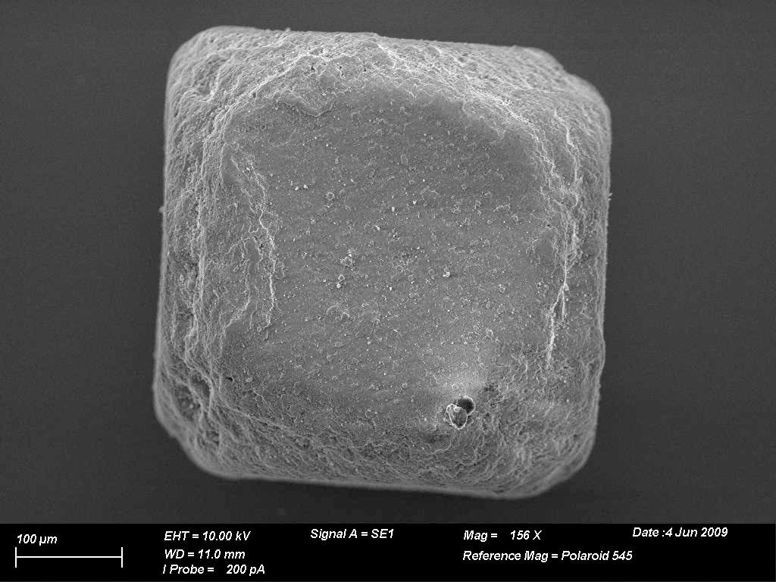
The very hard problem:
Which properties are projectable?
Common salt NaCl belongs to the cubic family
Electron micrograph of a single salt crystal.

Slide 15
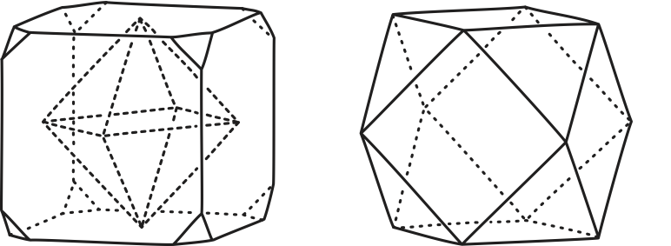
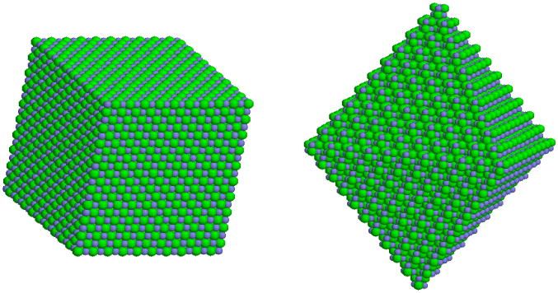
The very hard problem:
Which properties are projectable?
Cube as primitive form
Many shapes possible for crystals

Slide 16
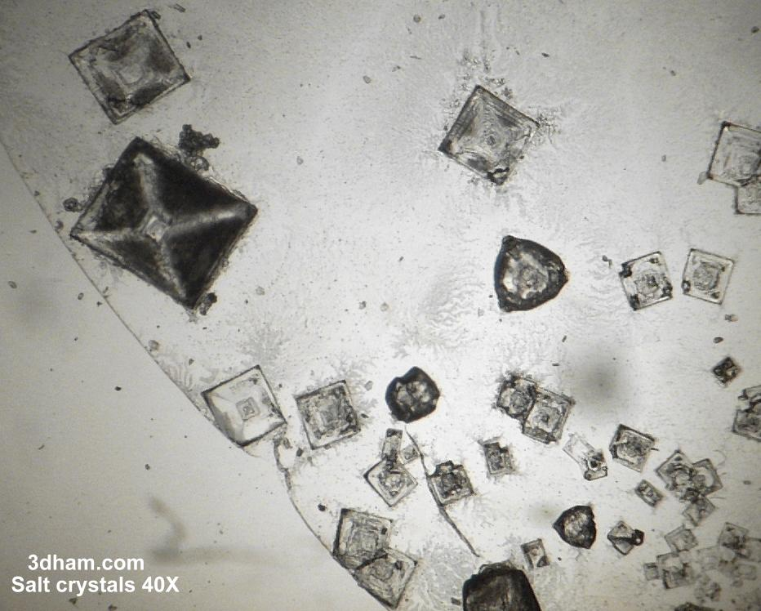
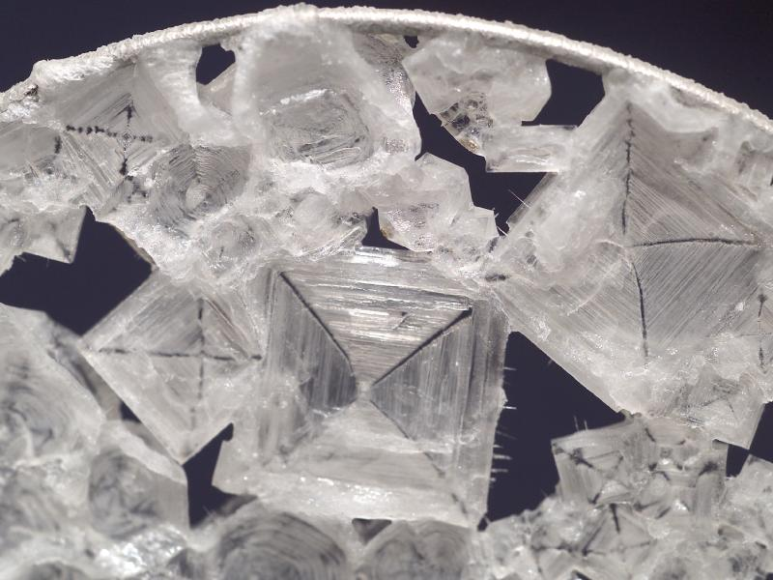
The very hard problem:
Which properties are projectable?
octahedral salt crystals grown in space

Slide 17
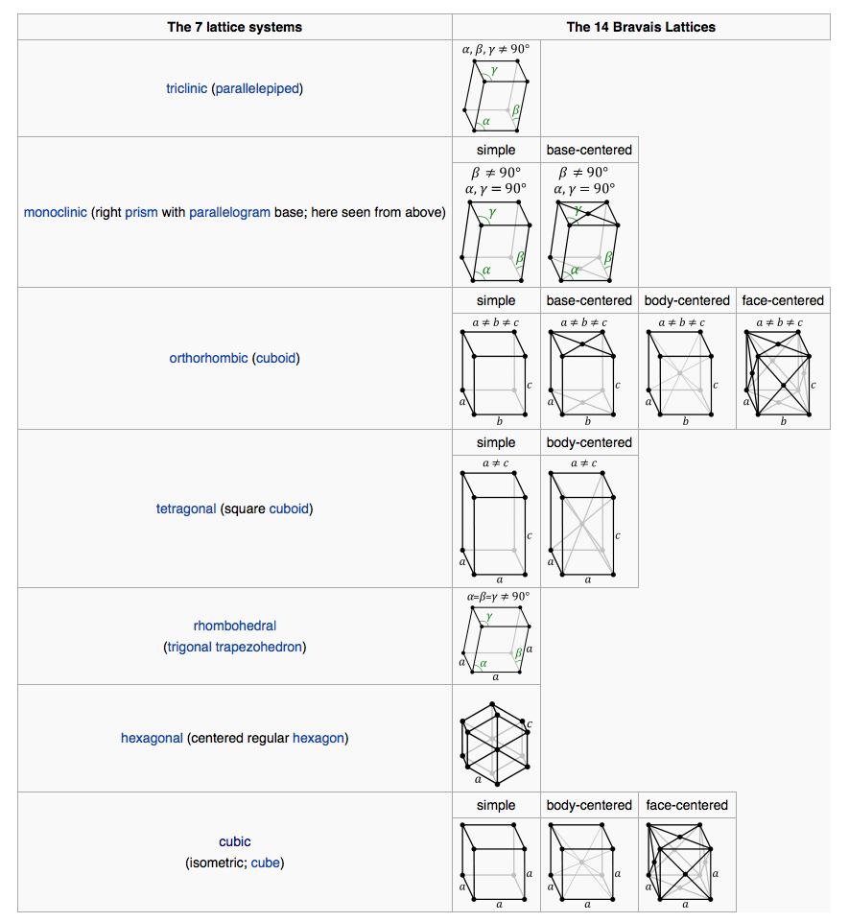
Barium Chloride
Radium Chloride
from wikipedia

Slide 18
The Inference Justified by Facts.
This sample of Radium Chloride
crystals just like Barium Chloride
has
Haüy’s principle
René
Just Haüy
1743-1822
All samples of Radium Chloride
crystals just like Barium Chloride
have
Haüy’s principle
Generally, each crystalline substance has a single characteristic crystallographic form.
Isomorphous groups.
Crystalline substances tend to come in groups with analogous chemical compositions and closely similar crystal forms.
“Generally” makes the inference inductive.
Inductive risk of polymorphism
= multiple crystal forms for same substance.
e.g. Dimorphism
Carbon = graphite and diamond.
Calcium carbonate = calcite and aragonite.
Iron sulphide = pyrite and marcasite

Slide 19
Cascade of Warrants.
This sample of Radium Chloride
crystals just like Barium Chloride
has
warrants
All samples of Radium Chloride
crystals just like Barium Chloride
have
Some A’s are B.
if
A = pure crystalline substance
B = one of seven crystallographic forms
All A’s are B.
warrants
Haüy’s principle

Slide 20
Generalizing

Slide 21
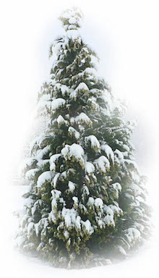
Deduction
Winters past
have been snowy.
AND
Winters future will be snowy.
warrant within the premises
Winters past
have been snowy.
(meaning of AND)
Conclusion merely restates part of premises.
A
B
AND
“AND” does all the work.
A universal schema is possible.
A

Slide 22
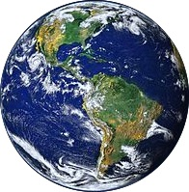
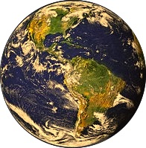
Induction
Winters past
have been snowy.
warrant outside the premises
Winters past
have been snowy.
AND
Winters future will be snowy.
FACT: our world is hospitable to this inductive inference.
Conclusion asserts
more than premises.
Hospitable:
World without climate change.
Inhospitable:
World with warming climate change.
vs
Cascade
of warrants
Whether a schema applies in some domain depends on the facts prevailing in the domain.

Slide 23
General Argument

Slide 24
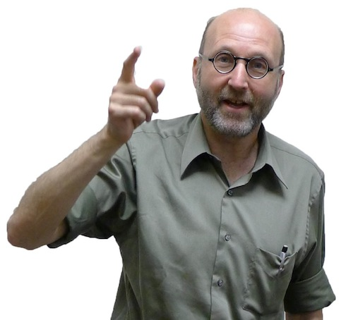


The General Argument
There are no universal, inductive inference schemas.
All inductive inferences are warranted by facts.
(The conclusion so far.)
There are no universal warranting facts.
(No non-vacuous, factual principle of the uniformity of nature.)
All induction is local.
Each domain has its own inductive logic, according to the background facts that prevail there.

Slide 25
1, 3, 5, 7, …

Slide 26
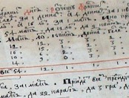

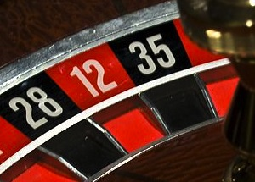
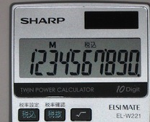
The Inductive Problem is Insoluble…
…unless we specify a context.
The numbers are drawn from:
Familiar sequences of elementary number theory.
Odd numbers: 1, 3, 5, 7, 9, 11, 13, 15, …
Odd primes (with 1): 1, 3, 5, 7, 11, 13, 17, …
etc.
Page numbers of a book.
(from right hand side)
…, xv, xvii, 1, 3, 5, 7, 9, …
Roulette wheel spins.
1, 3, 5, 7, 35, 18, 21, 24, …
Calculator screen digits.
359
= 0 . 1 3 5 7 2 7 7 8 8 2 8 ...
2645
…then different sorts of solution are possible.

Slide 27
Bayes is no help.
posteriors
likelihoods
priors
P(odd | 1,3,5,7)
P(1,3,5,7 | odd)
P(odd)
=
x
P(prime* | 1,3,5,7)
P(1,3,5,7 | prime*)
P(prime*)
prime*
= odd primes with 1
1
1

Slide 28

Bayes is no help.
posteriors
priors
P(odd | 1,3,5,7)
P(odd)
=
P(prime* | 1,3,5,7)
P(prime*)
What have we learned from the evidence 1, 3, 5, 7
(Subjective Bayesian)
arbitrary prejudice
Nothing
ratio
posteriors
=
ratio priors
(Objective Bayesian)
external facts of some sort
Incompleteness: the result depends on externally supplied inductive content.

Slide 29
A General Calculus? One Big Calculation?
IN
OUT
All background facts of science
universal calculus
Proper warrant for all hypotheses of science
Shown elsewhere
There is no, non-trivial, complete calculus of inductive inference.
Non-trivial results are only possible if we add further inductive content externally to the one big calculation.
“A Demonstration of the Incompleteness of Calculi of Inductive Inference,” Brit. J. Phil. Sci. 70 (2019), 1119–1144.

Slide 30
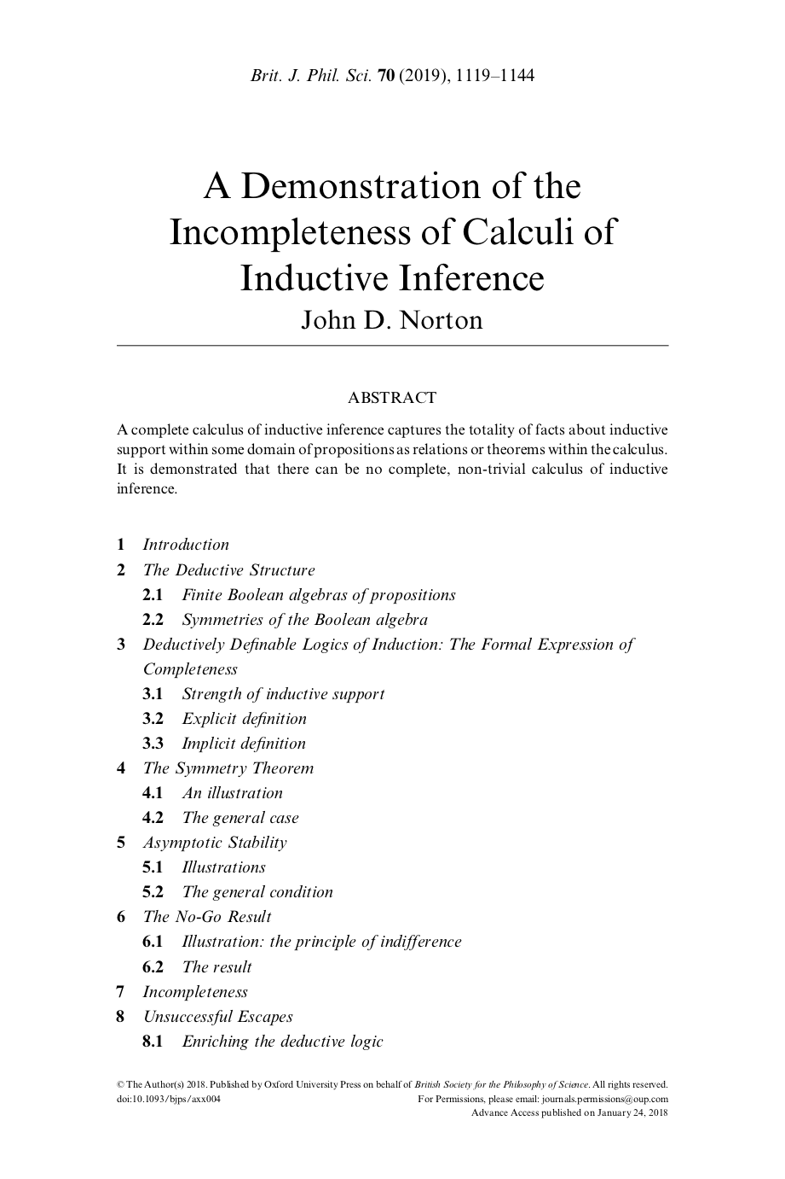

Slide 31
Galileo’s
Law of Fall

Slide 32
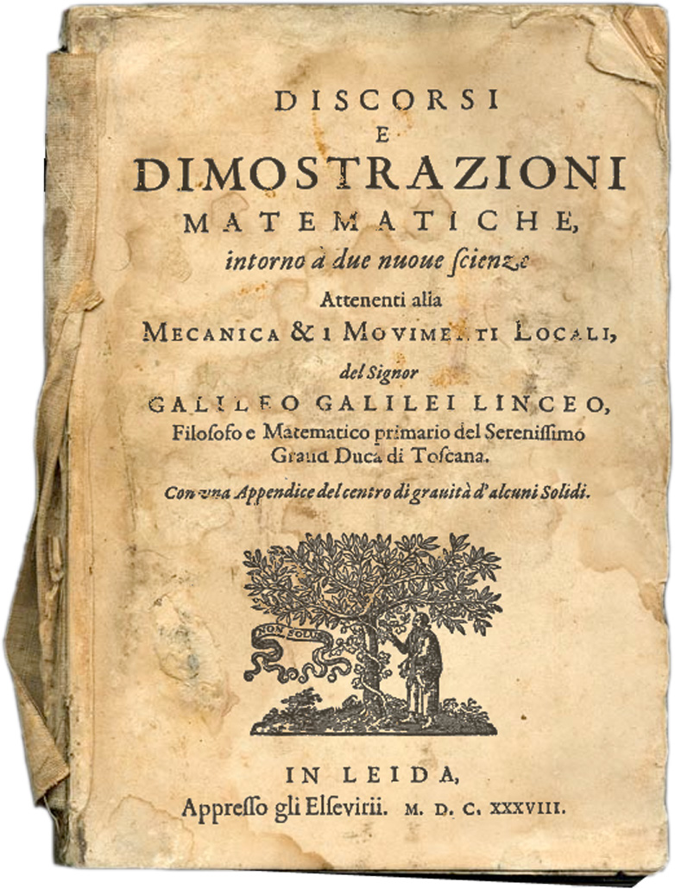
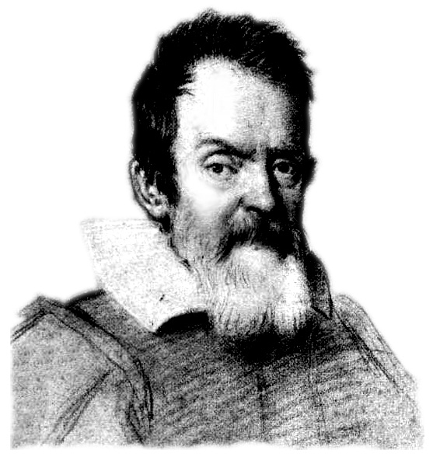

Slide 33
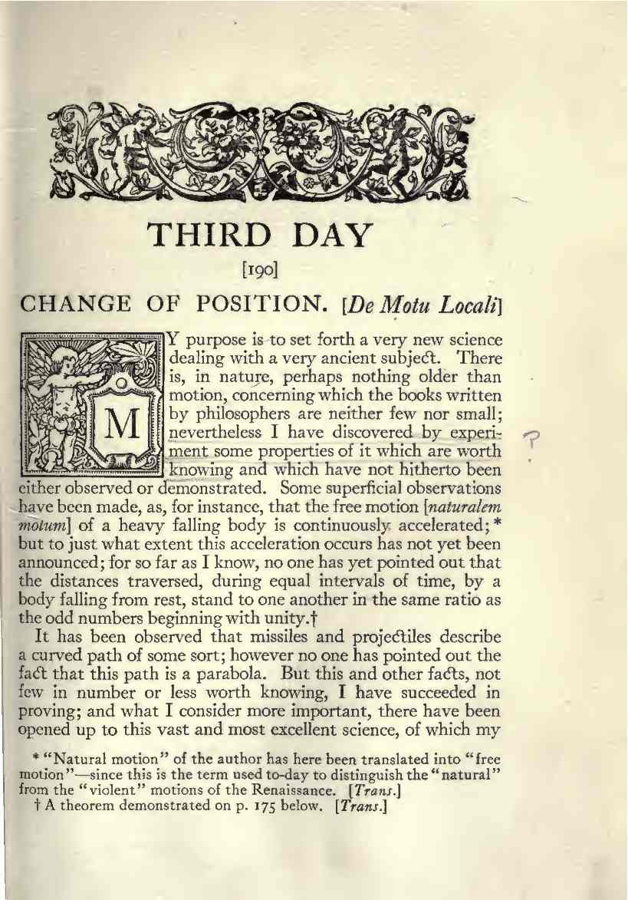
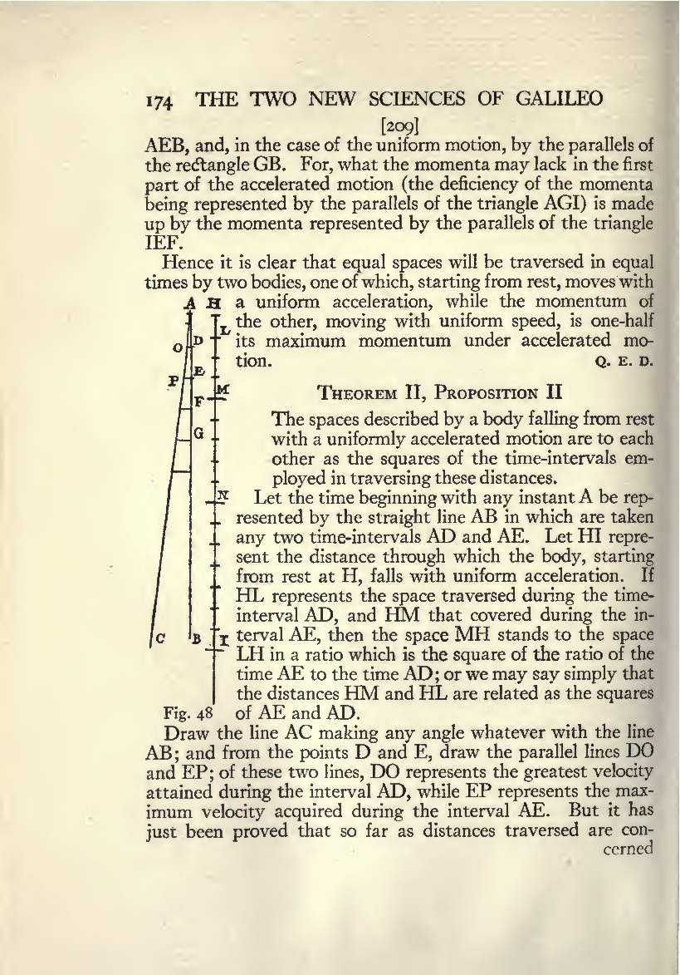
Cumulative distance
fallen
grows as
time²

Slide 34
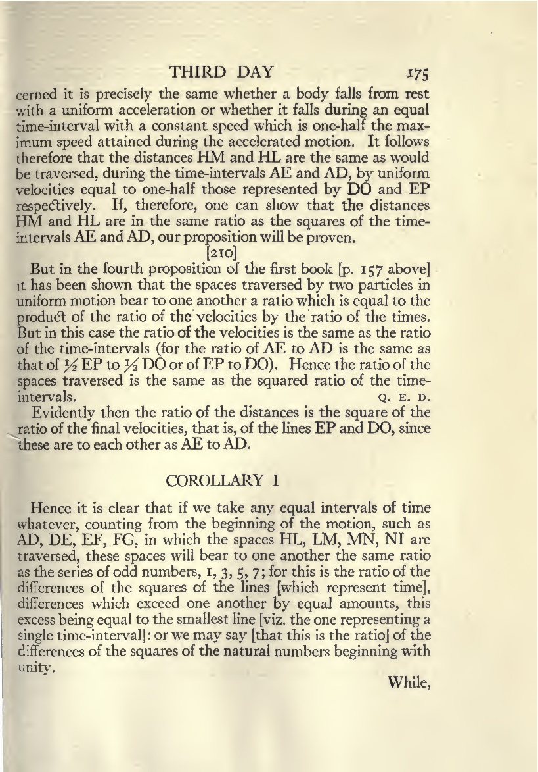
Taking any equal intervals of time whatever…
incremental
distances
fallen
grow
in the ratio of
odd numbers
1, 3, 5, 7.

Slide 35
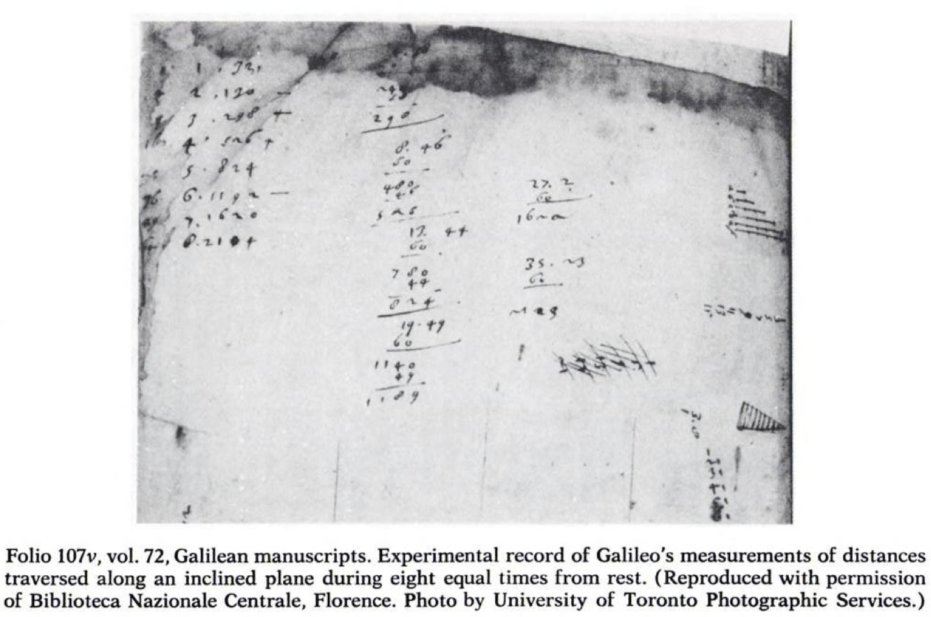
From Stillman Drake, Galileo at Work, p. 87

Slide 36
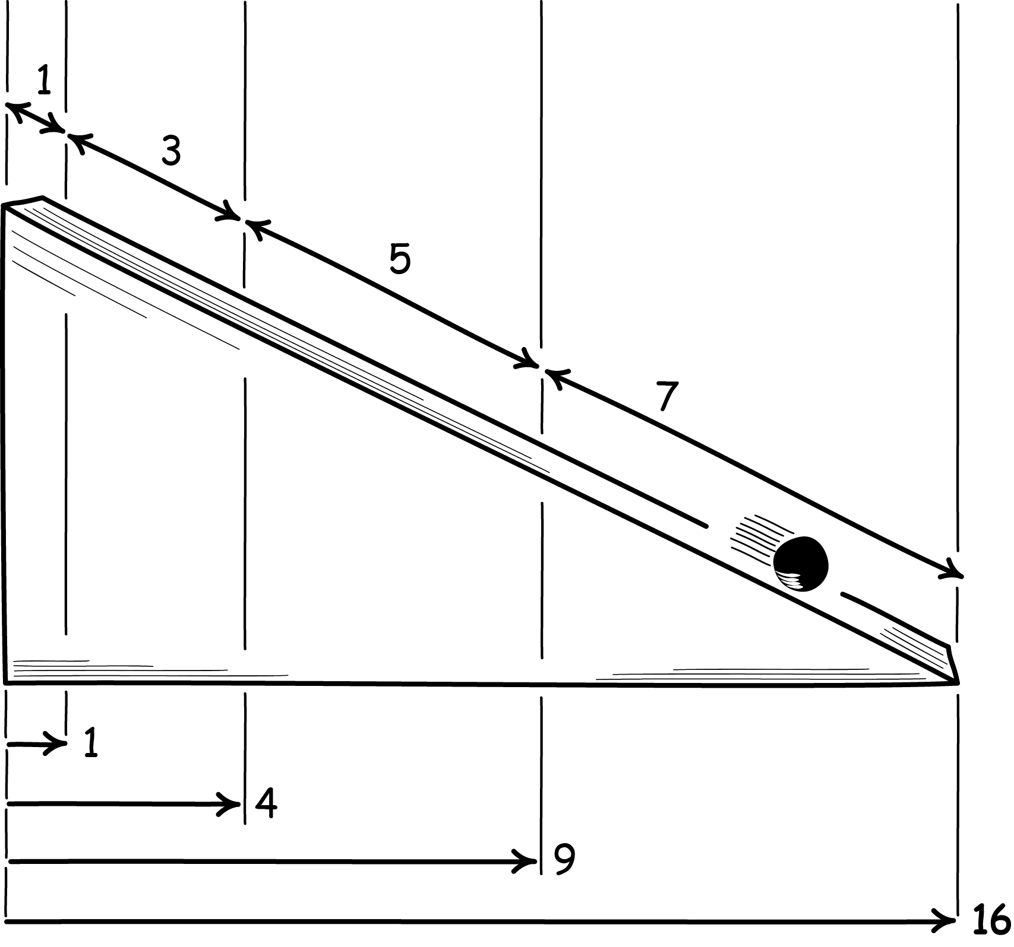
In equal times…
Incremental
distances
fallen “d”
Cumulative
distances
fallen “s”

Slide 37
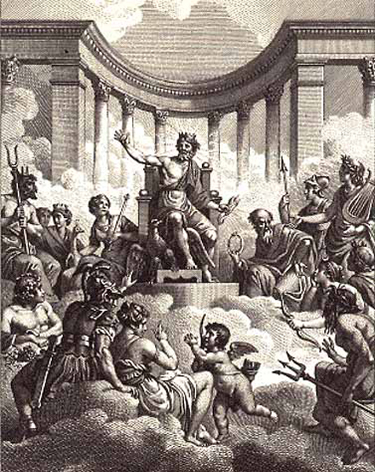
The induction: first justification
observed distances
1, 3, 5, 7
warrants
all
distances
1, 3, 5, 7, 9, … (odd numbers) …
“...why should I not believe that such increases take place in a manner which is exceedingly simple and rather obvious to everyone?”
Two New Sciences
warrants
“Philosophy is written in this grand book, the universe, which stands continually open to our gaze. But the book cannot be understood unless one first learns to comprehend the language and read the letters in which it is composed. It is written in the language of mathematics, and its characters are triangles, circles, and other geometric figures without which it is humanly impossible to understand a single word of it; without these, one wanders about in a dark labyrinth.”
The Assayer

Slide 38

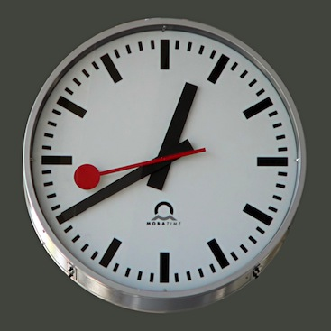
Galileo had no standard unit of time
…only measures of sameness of times.

Slide 39
Odd number rule is invariant under change of unit of time
Distances…
1
3
5
7
9
11
13
15
old unit of time
new unit of time
= 2 x old unit of time
4
12
20
28
=
4x1
4x3
4x5
4x7

Slide 40
Almost NO OTHER rule is invariant under change of unit of time
Distances…
1
2
3
4
5
6
7
8
old unit of time
new unit of time
= 2 x old unit of time
3
7
11
15
=
4x1-1
4x2-1
4x3-1
4x4-1

Slide 41
Functional analysis shows:
(not accessible to Galileo)
The only* laws of fall invariant
under a change of unit of time are:
Cumulative distances
s(t) = constant t^{p}
Incremental distances
d(t) = constant (t^{p}-(t-1)^{p})
*Assume s(t) differentiable at one time t only. Real p> 0.
One datum:
First times in ratio 1:3
Determines the one free parameter p.
Fixes the law completely.
1, 3, 5, 7

Slide 42
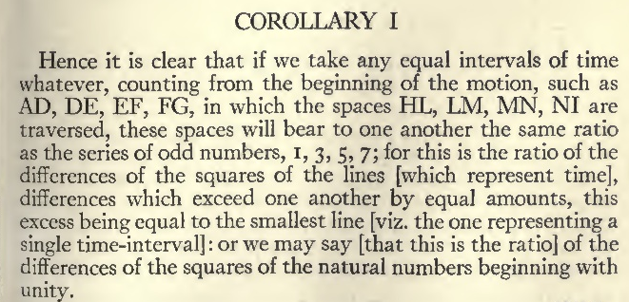
The induction: second justification
observed distances
1, 3
warrants
all
distances
1, 3, 5, 7, 9, … (odd numbers) …
Contingent fact:
invariance fails for fall in resisting media.
The law is invariant under a change of the unit of time.
Hence it is clear that if we take any equal intervals of time whatever, counting from the beginning of the motion, such as AD, DE, EF, FG, in which the spaces HL, LM, MN, NI are traversed, these spaces will bear to one another the same ratio as the series of odd numbers, 1, 3, 5, 7;...

Slide 43
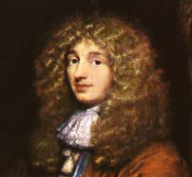
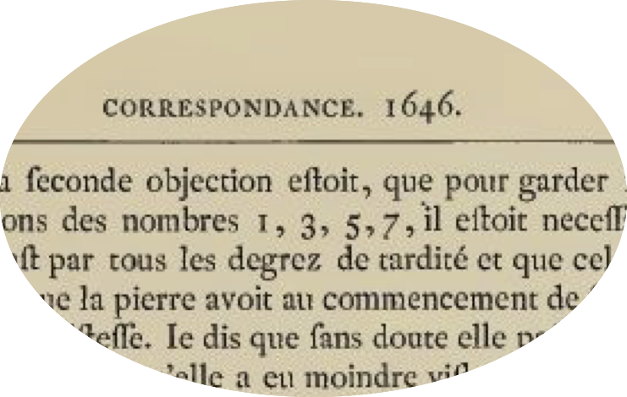
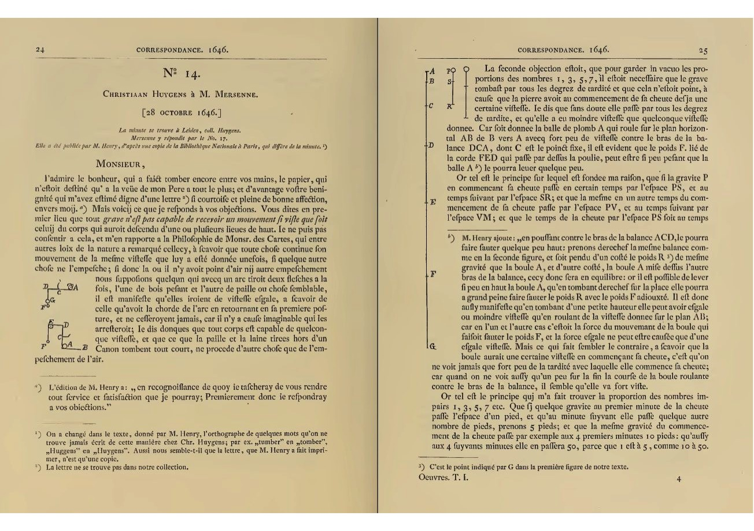
Huygens to Mersenne, October 28, 1646
Seventeen year old Huygens, independently of his reading of Two New Science, found the invariance.

Slide 44
Conclusion

Slide 45
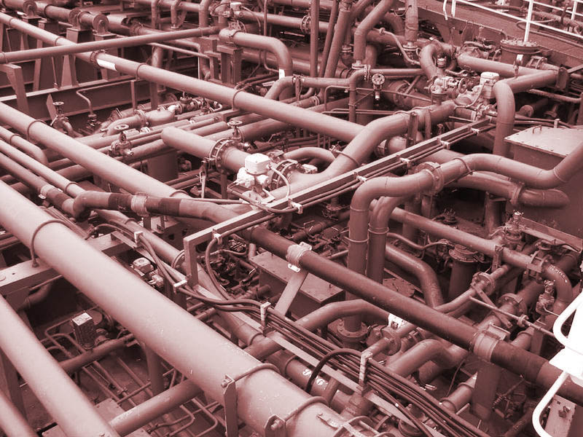
Dualist view of inductive inference
Active schema guide passive facts
as
pipes guide water.

Slide 46
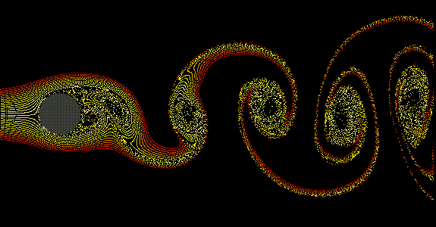
Monist view of inductive inference
Facts organize themselves into inferential structures
as
fluid systems organize themselves into stable structures.

Slide 47

Read

Slide 49
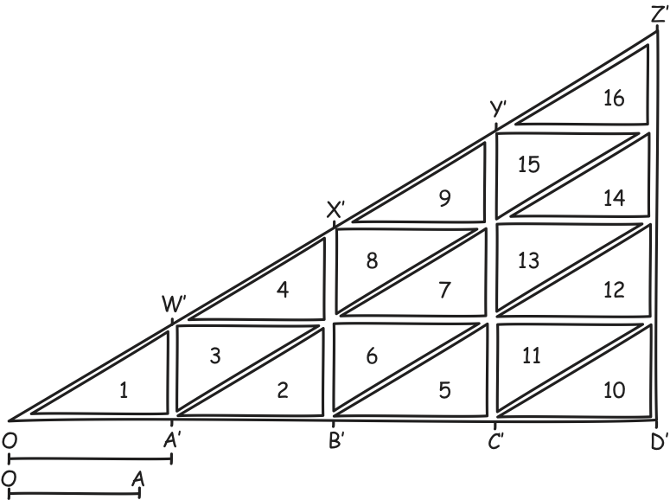
Finis

