Slide 1

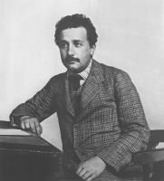

How Hume and Mach Helped Einstein Find Special Relativity
John D. Norton

Slide 2
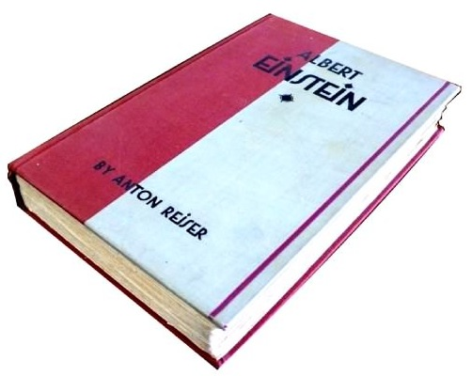
“…a special kinship.”
“He [the student Einstein] approached the broader aspects of thought through philosophical studies,
chiefly through his readings in Kant and Schopenhauer,
and later through his study of Hume, with whom he felt a special kinship.”
Anton Reiser = Rudolf Kayser,
Einstein’s step son-in-law,
married to Ilse Einstein.
Anton Reiser, Albert Einstein: A Biographical Portrait. Albert & Charles Boni, New York, 1930.

Slide 3
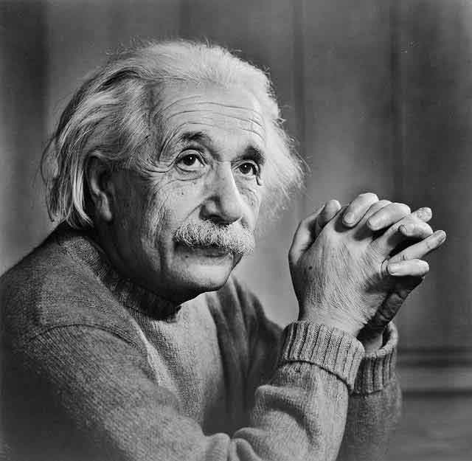
“…obscure stuff….”
“If one reads Hume’s books, one is amazed that many and sometimes even highly esteemed philosophers after him have been able to write so much obscure stuff
and even find grateful readers.”
“Remarks on Bertrand Russell’s Theory of Knowledge” in The Philosophy of Bertrand Russell, Vol V. of The Library of Living Philosophers. P. A. Schlipp, ed., Tudor. 1944.

Slide 4
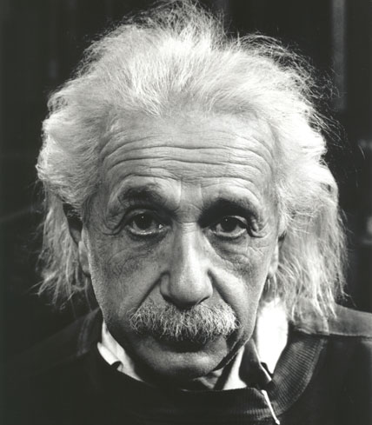
Was Einstein’s reading of Hume any practical use?
“Today everyone knows, of course, that all attempts to clarify this paradox [of chasing the beam of light] satisfactorily were condemned to failure as long as the axiom of the absolute character of time, or of simultaneity, was rooted unrecognized in the unconscious. To recognize clearly this axiom and its arbitrary character already implies the essentials of the solution of the problem. The type of critical reasoning required for the discovery of this central point was decisively furthered, in my case, especially by the reading of David Hume’s and Ernst Mach’s philosophical writings.”
Albert Einstein, Autobiographical Notes

Slide 5

This Talk
How Einstein’s reading of Hume and Mach played a decisive role at the crucial moment in Einstein’s 1905 discovery of special relativity.
The help did not come from Hume and Mach’s analysis of the notions of space and time specifically…

Slide 6
How to Use Concepts in Physical Theories
Concepts must be properly grounded in experience, else they fail to represent the physically real and are fictional. (From Hume and Mach)
Concepts without proper physical grounding need not be abjured (contrary to Mach and Hume?). They can be retained in a physical theory as long as their arbitrary character is recognized and in a way that does not unwittingly introduce false presumptions.
The breakthrough in Einstein’s 1905 discovery of special relativity came when he applied this view to the traditional concept of the simultaneity of distant events.

Slide 7
The Pathway to Special Relativity:
Crisis and Breakthrough

Slide 8
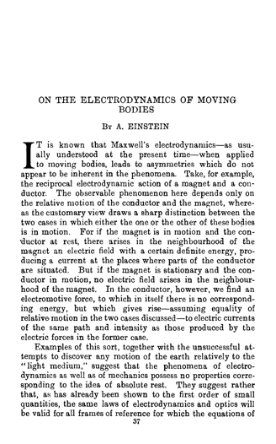
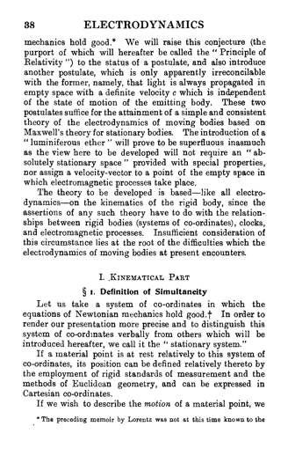

Slide 9
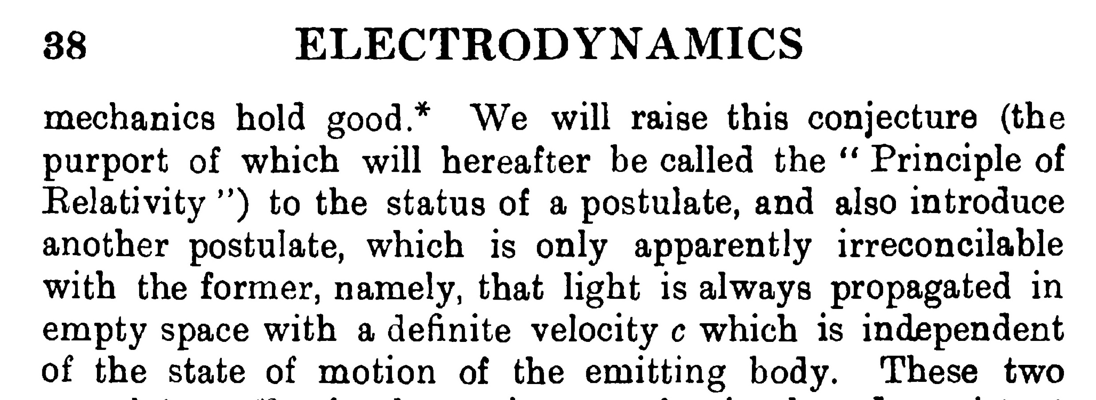

Slide 10

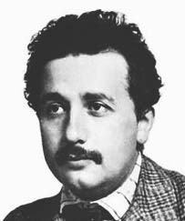
Reconcile the “Apparently Incompatible” …
Principle of Relativity
From ether drift experiments, observables in electrodynamics, classical mechanics. Magnet and conductor.
with
Light Postulate
From Maxwell’s electrodynamics. All efforts to alter it had failed. Emission theories of light are untenable.

Slide 11
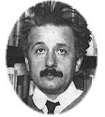
Einstein Recalls the Decisive Moment
“The Step”
“Why are these two things inconsistent with each other? I felt that I was facing an extremely difficult problem. I suspected that Lorentz’s ideas had to be modified somehow, but spent almost a year on fruitless thoughts. And I felt that was puzzle not to be easily solved.
But a friend of mine living in living in Bern (Switzerland) [Michele Besso] helped me by chance. One beautiful day, I visited him and said to him: ‘I presently have a problem that I have been totally unable to solve. Today I have brought this “struggle” with me.’ We then had extensive discussions, and suddenly I realized the solution. The very next day, I visited him again and immediately said to him: ‘Thanks to you, I have completely solved my problem.”
My solution actually concerned the concept of time. Namely, time cannot be absolutely defined by itself, and there is an unbreakable connection between time and signal velocity. Using this idea, I could now resolve the great difficulty that I previously felt.
After I had this inspiration, it took only five weeks to complete what is now known as the special theory of relativity.”
From a lecture given in Kyoto, Dec. 14, 1922. Notes by Jun Ishiwara; translation Akira Ukawa; revised John Stachel.

Slide 12


Einstein’s analysis in his 1905 “On the Electrodynamics of Moving Bodies” (simplified):
The platform observer judges the two flashes to be simultaneous and the two clocks to be properly synchronized.
The moving observer judges the A flash to happen earlier and the two clocks not to be properly synchronized.

Slide 13

Relativity of simultaneity
Inertial observers in relative motion may disagree on the time order of spatially separated events.
What the thought experiment shows
Principle of relativity
+
Light postulate
Relativity of simultaneity
The deduction reversed
Principle of relativity
+
Relativity of simultaneity
Same speed of light for all inertial observers
…the two principles are compatible if we revise our notions of space and time.
Notes:
Is there empirical content in the theory? Is the compatibility of the two principles just an artifact of our conventional decision to proclaim simultaneity in an idiosyncratic way? NO. That Einstein’s definition works is a contingent matter, requiring the truth of the facts that underpin special relativity.
--It would fail in a Galilean covariant theory of light. In the latter, in one frame, light will have many speeds according to the speed of the emitter. No single resynchronization of clocks will be able to bring all these different speeds to the same constant c.
--It would fail in an ether theory in which light moves at c with respect to the ether. On observer moving at c would see frozen light and no clock resynchronization protocol would set it into motion at any speed, let alone c.

Slide 14
The central insight
A view about how concepts should be used in physical theories.

Slide 15
Concepts must be properly grounded in experience...
“After seven years of reflection in vain (1898-1905), the solution came to me suddenly with the thought that our concepts and laws of space and time can only claim validity insofar as they stand in a clear relation to experiences; and that experience could very well lead to the alteration of the concepts and laws. By a revision of the concept of simultaneity into a more malleable form, I thus arrived at the special theory of relativity.”
From a 1924 recording transcribed by Herneck in 1966.
“The concept [of simultaneity] does not exist for the physicist until he has the possibility of discovering whether or not it is fulfilled in an actual case.”
A. Einstein, Relativity, §8
“…an illustration which Einstein offered in discussion. Suppose somebody uses the word ‘hunchback.’ If this concept is to have any clear meaning, there must be some way of finding out whether or not a man has a hunched back. If I could conceive of no possibility of reaching such a decision, the word would have no real meaning for me.”
To Wertheimer in a 1916 interview.

Slide 16
…so we may purge a priori (absoluteness of simultaneity) from our concepts.
“The illusion which prevailed prior to the enunciation of the theory of relativity--that, from the point of view of experience the meaning of simultaneity in relation to spatially distant events and, consequently, that the meaning of physical time is a priori clear--this illusion had its origin in the fact that in our everyday experience we can neglect the time of propagation of light. We are accustomed on this account to fail to differentiate between "simultaneously seen" and "simultaneously happening"; and, as a result, the difference between time and local time is blurred.
The lack of definiteness which, from the point of view of its empirical significance, adheres to the notion of time in classical mechanics was veiled by the axiomatic representation of space and time as given independently of our sense experiences. Such a use of notions--independent of the empirical basis
to which they owe their existence--does not necessarily damage science. One may, however, easily be led into the error of believing that these
notions, whose origin is forgotten, are logically necessary and therefore unalterable, and this error may constitute a serious danger to the progress of science.”
Einstein, “Physics and Reality,” 1936.

Slide 17
…and Einstein credits Hume and Mach
“Today everyone knows, of course, that all attempts to clarify this paradox [of chasing the beam of light] satisfactorily were condemned to failure as long as the axiom of the absolute character of time, or of simultaneity, was rooted unrecognized in the unconscious. To recognize clearly this axiom and its arbitrary character already implies the essentials of the solution of the problem. The type of critical reasoning required for the discovery of this central point was decisively furthered, in my case, especially by the reading of David Hume’s and Ernst Mach’s philosophical writings.”
Albert Einstein, Autobiographical Notes

Slide 18
Mach

Slide 19
Einstein attributes this view of concepts to Mach
from Einstein’s obituary
for Mach, 1916
Empirical grounding of concepts
“Science is, according to Mach, nothing but the comparison and orderly arrangement of factually given contents of consciousness, in accord with certain gradually acquired points of view and methods….
…concepts have meaning only in so far as they can be found in things, just as they are the points of view according to which these things are organized. (Analysis of concepts)”
Dangers of a priori
“Concepts that have proven useful in ordering things can easily gain authority over us such that we forget their worldly origin and take them as immutably given. They are then rather rubber-stamped as a ‘necessity of thought’ and an ‘a priori given,’ etc. Such errors often make the path of scientific progress impassable for a long time…”

Slide 20
Einstein attributes this view of concepts to Mach
from Einstein’s obituary
for Mach, 1916
Quotes of Mach’s reanalysis of judgments of time
(as expressions of dependence upon pendulum oscillations or the Earth’s position);
of motion; Newton’s bucket.
Illustration
Einstein sees link to simultaneity
It is not improbable that Mach would have hit upon relativity theory if, in the time that he was of young and fresh spirit, physicists would already have been moved by the question of the meaning of the constancy of the speed of light. In this absence of this stimulation, which follows from Maxwell-Lorentz electrodynamics, even Mach’s critical urge did not suffice to arouse a feeling for the necessity of a definition of simultaneity for spatially distant events.

Slide 21
Hume

Slide 22
“…and still much more Hume…”
“Your exposition is also quite right that positivism suggested rel. theory, without requiring it. Also you have correctly seen that this line of thought was of great influence on my efforts and indeed E. Mach and still much more Hume, whose treatise on understanding I studied with eagerness and admiration shortly before finding relativity theory.”
Einstein to Moritz Schlick, Dec 14 1915
“treatise on understanding” =
“A Treatise of Human Nature”?
or “An Enquiry concerning Human Understanding”?
Editors, Einstein Papers, Vol. 2
• On the known reading list of “Einstein’s Olympia Academy”
• First part then available in new German translation (and Einstein recalled reading Hume in German)

Slide 23
David Hume, A Treatise of Human Nature
Dependence of concepts on experience
“…all our simple ideas proceed either mediately or immediately, from their correspondent impressions.
This then is the first principle I establish in the science of human nature…”
Book 1, Part 1, Section 1.
Application to time
“As ‘tis from the disposition of visible and tangible objects we receive the idea of space, so from the succession of ideas and impressions we form the idea of time, nor is it possible for time alone ever to make its appearance, or be taken notice of by the mind.
…time cannot make its appearance to the mind either alone, or attended with a steady unchangeable object, but is always discover’d by some perceivable succession of changeable objects.”
Book 1, Part II, Section III.

Slide 24
David Hume, A Treatise of Human Nature
Inapplicability of concept without corresponding experience
“I know there are some who pretend, that the idea of duration is applicable in a proper sense to objects, which are perfectly unchangeable…But to be convinced of its falsehood we need but reflect on the foregoing conclusion, that the idea of duration is always deriv’d from a succession of changeable objects, and can never be convey’d to the mind by any thing stedfast and unchangeable…
…Ideas always represent the objects or impressions from which they are deriv’d, and can never without a fiction represent or be appl’d to any other…”
Book 1, Part II, Section III.
This mode of analysis is applied throughout the Treatise.
We have no idea of substance beyond the collection of particular qualities. We have no idea of causation beyond contiguity and succession--no necessary connection.
Notes:
Substance discussed in Book 1, Part I. Section VI.
Causation discussed in Book I, Part III.

Slide 25
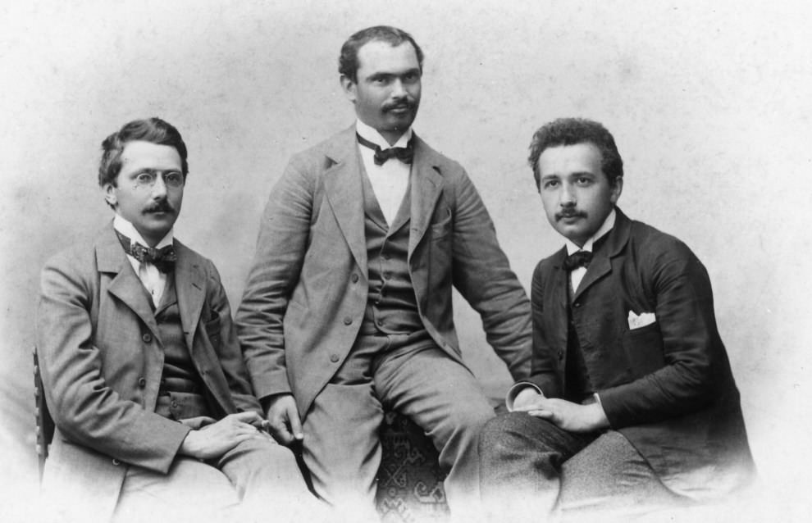
“Olympia Academy” 1902+
“Together we read, after Pearson, Mach’s Analysis of Sensations and Mechanics, Mill’s Logic, Hume’s Treatise on Human Nature (sic), … [much more]…
We devoted weeks to the discussion of David Hume’s eminently penetrating criticism of conceptions of substance and causality.”
Solovine, “Introduction” to Albert Einstein, Letters to Solovine: 1906-1955. New York Citadel, 1993.
Maurice Solovine
Albert Einstein
Conrad Habicht

Slide 26
Why Hume more than Mach?

Slide 27
Why Hume more than Mach?
A conjecture: Einstein thought that Mach (but not Hume) denied the freedom of creation of concepts exercised by Einstein when he introduced a new definition of distant simultaneity in 1905?
“I see [Mach’s] weakness in this, that he more or less believed science to consist in a mere “ordering” of empirical “material”; that is to say, he did not recognize the freely constructive element in the formation of concepts. In a way he thought that theories arose through discoveries and not through inventions. He even went so far that he regarded “sensations” not only as material which has to be investigated, but, as it were, as the building blocks of the real world…”
Einstein to Besso on 6. Jan. 1948
“Hume saw clearly that certain concepts, as for example that of causality, cannot be deduced from the material of experience by logical methods.”
Einstein, Autobiographical Notes

Slide 28
Einstein absolves Hume of Machian Guilt
“…the concepts which arise in our thought in our linguistic expressions are all--when viewed logically--the free creations of thought which cannot inductively be gained from sense experiences…
As soon as one is at home in Hume’s critique one is easily led to believe that all those concepts and proposition which cannot be deduced from the sensory raw material are, on account of their ‘metaphysical’ character, to be removed from thinking…
…by his clear critique Hume did not only advance philosophy in a decisive way but also--through no fault of his--created a danger for philosophy in that, following his critique, a fateful ‘fear of metaphysics’ arose which has come to be a malady of contemporary empiricistic philosophy…”
“Remarks on Bertrand Russell’s Theory of Knowledge” in The Philosophy of Bertrand Russell, Vol V. of The Library of Living Philosophers. P. A. Schlipp, ed., Tudor. 1944.

Slide 29
Winding Up

Slide 30
This Talk
What did Einstein learn from Hume and Mach?
The requirement that concepts must be properly grounded in experience.
The warning that use of concepts not so grounded may unwittingly introduce false presumptions.
The courage to mount his own account of how concepts not properly grounded in experience may be introduced via definitions.
Einstein’s opportunism
He drew on Hume and Mach selectively just as it suited his purposes in physical theorizing. Einstein did not effectively address the systematic problems of the view.
How can experience of particulars yield universally applicable concepts?
Hume: Missing shade of blue.
Mach: It cannot. “No one is warranted in extending these principles beyond the boundaries of experience.”
Einstein: It is a “miracle”; “leaves us in awe”; “we shall never understand [it]”.
Notes:
Missing shade of blue in Bk 1, Pt. 1, Sec 1. See also sec VII
Mach. Science of Mechanics p. 280
Einstein. Physics and Reality.

