Slide 1
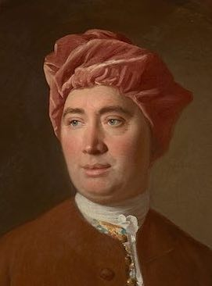
How the material theory of induction dissolves the problem of induction
???
John D. Norton
Department of History and
Philosophy of Science
University of Pittsburgh

Slide 2
Main Claims
The problem of induction.
Justify universal rules of inductive inference?
Circularity or (Popper’s version)
an infinite regress.
The material theory of induction
No universal rules of inductive inference.
The problem of induction cannot be set up.
YES BUT!!
Attempts to recreate…
… an analogous problem for the material theory of induction
Fail

Slide 3
The Problem of Induction

Slide 4
Inductive (Ampliative) Inference
Logically weaker
Premises
e.g. evidence
Logically stronger
Conclusion
e.g. theory
Universal rule or principle of inductive inference:
• Enumerative induction
• Analogy
• Inference to the simplest hypothesis
• Inference to the best explanation
• Probabilistic relations of support
…
…

Slide 5
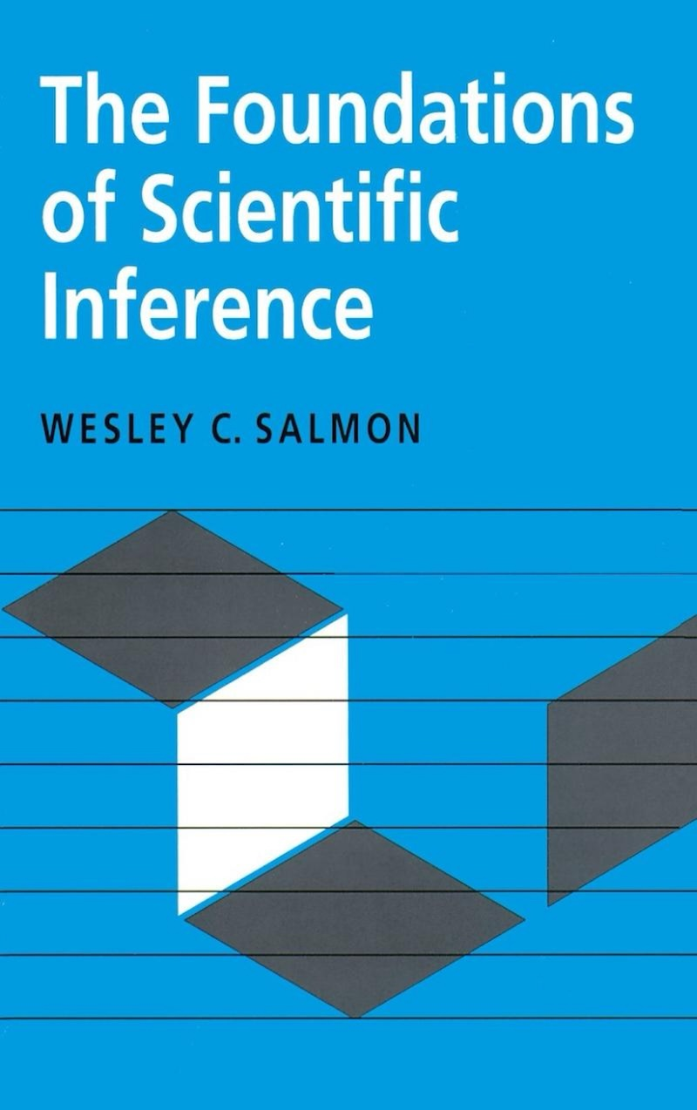
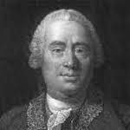
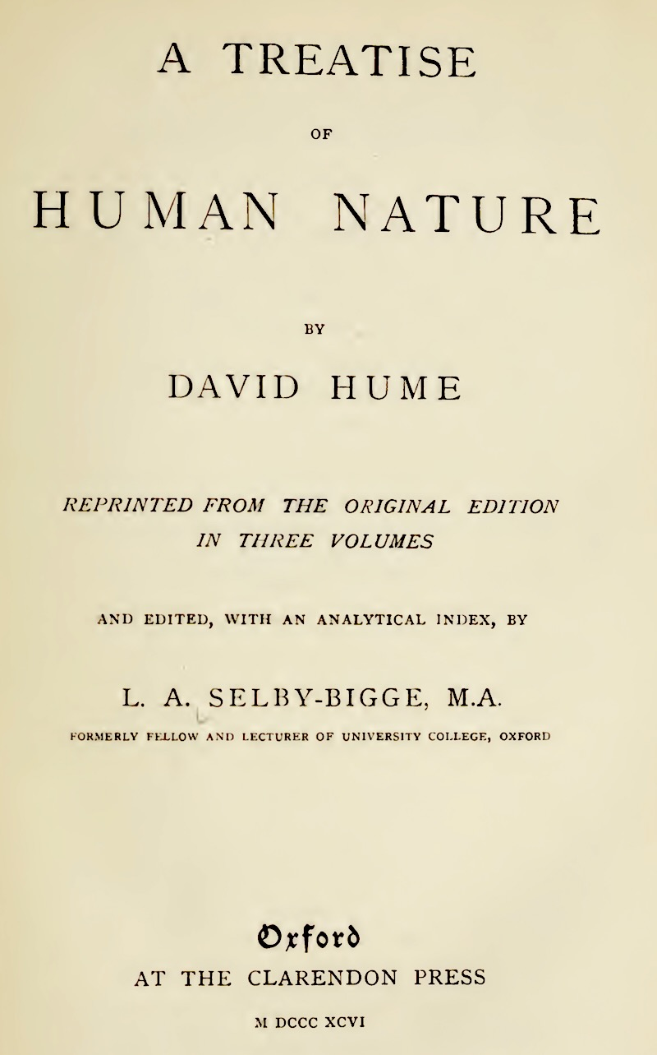
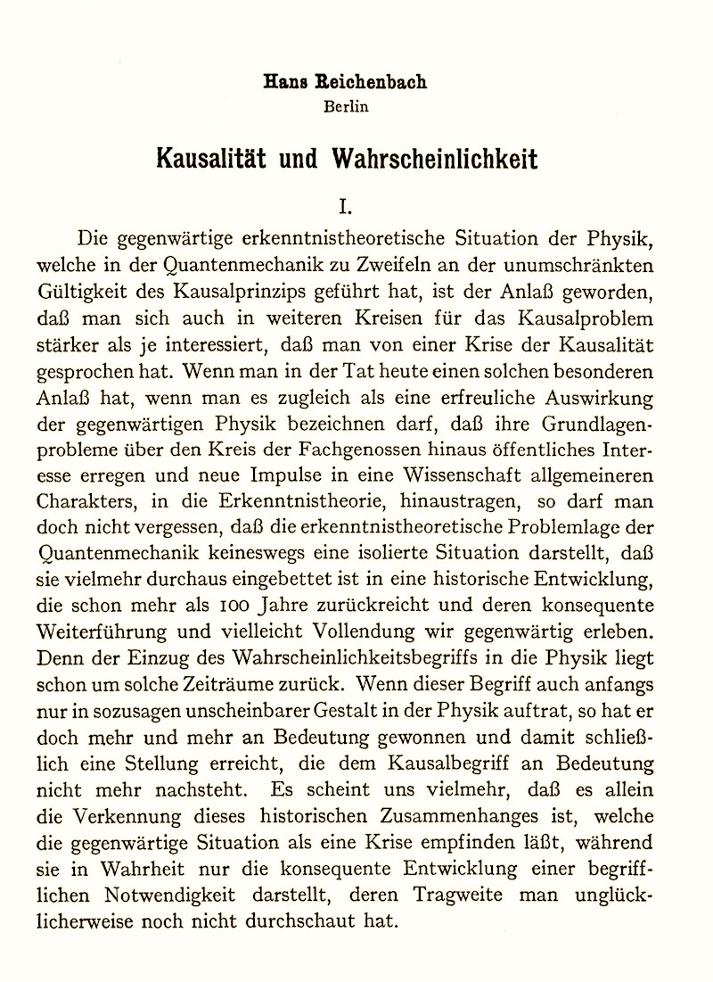
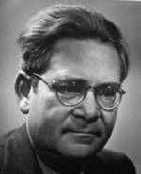
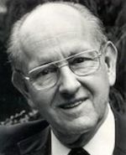
The Problem of Induction:
Circularity Formulation
David Hume
Hans Reichenbach
Wesley Salmon

Slide 6
The Problem of Induction:
Circularity Formulation
Universal rule of inductive inference
“Hume's position can be summarized succinctly:
We cannot justify any kind of ampliative inference.
If it could be justified deductively it would not be ampliative.
It cannot be justified nondemonstratively because that would be viciously circular.”
David Hume
Hans Reichenbach
Wesley Salmon

Slide 7
The Problem of Induction:
Circularity Formulation
Universal rule of inductive inference
Second inductive horn of dilemma
“…, we cannot justify any sort of ampliative inference inductively.
To do so would require the use of some sort of nondemonstrative inference. But the question at issue is the justification of nondemonstrative inference,
so the procedure would be question begging.
Before we can properly employ a nondemonstrative inference in a justifying argument, we must already have justified that nondemonstrative inference.
”
David Hume
Hans Reichenbach
Wesley Salmon

Slide 8
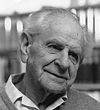
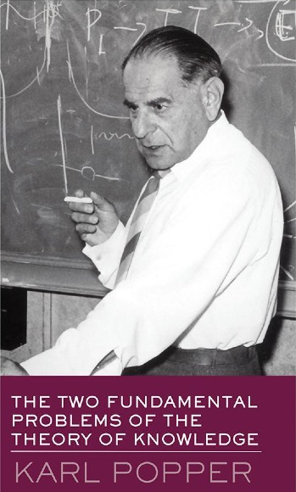
The Problem of Induction:
Infinite Regress Formulation
Karl Popper
justified by
Second-order principle of induction
justified by
First-order principle of induction
justified by
Natural laws

Slide 9
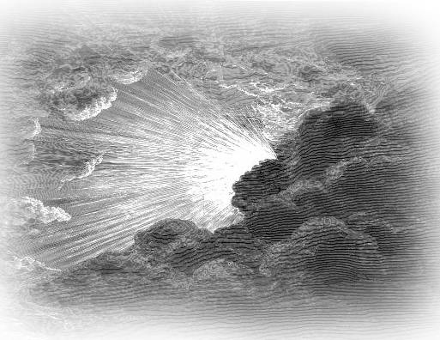
The Escape

Slide 10
A theory of induction…
that does not justify inductive inferences with a universal rule or universal principles.
justified by
Second-order principle of induction
Universal rule of inductive inference
justified by
First-order principle of induction
justified by
Natural laws

Slide 11
The Material Theory of Induction, very briefly

Slide 12
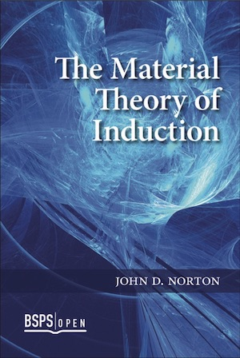
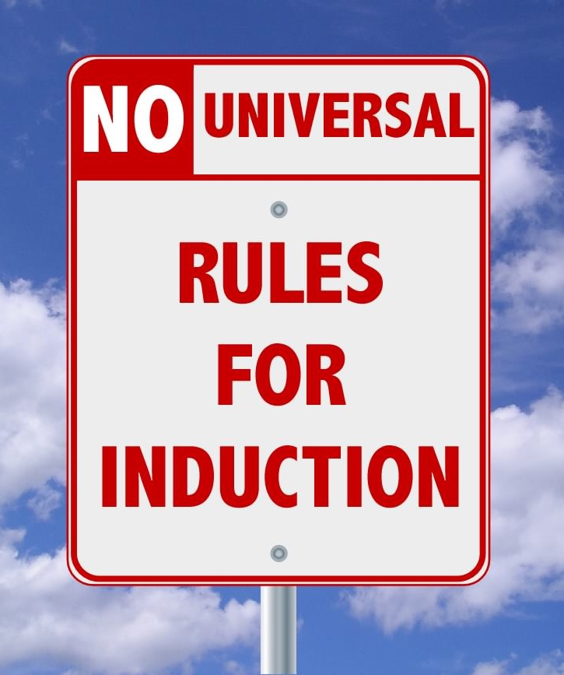

Slide 13
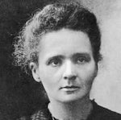
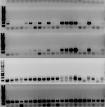
Inductive Inferences Warranted Exclusively by Background Facts
This sample of radium chloride is crystallographically monoclinic.
All samples of radium chloride are crystallographically monoclinic.
Haüy’s principle: generally, all samples of a pure crystalline substance belong to the same crystallographic family.
DNA of suspect and perpetrator match.
Very probable that suspect and perpetrator are the same person.
Distribution of DNA in the population. Subjects are chosen randomly. (Equal probability.)

Slide 14
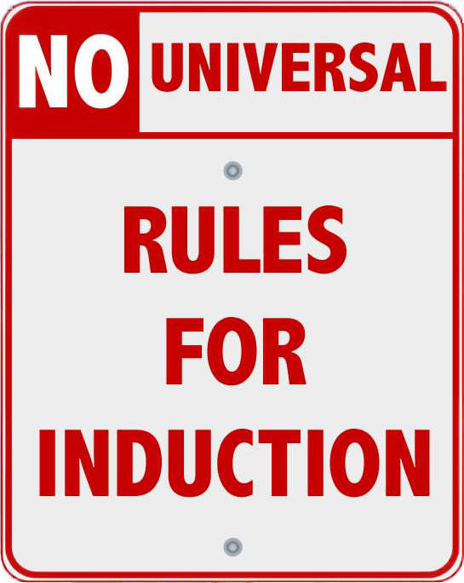

No justification of induction overall
Justification of
individual inductive inferences
by many individual facts distributed over the sciences.

Slide 15
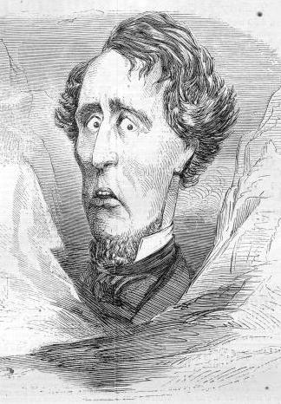
Yes, But …
… Isn’t there an analogous problem for the material theory?

Slide 16
Yes, But …
Inductive support for warranting facts?
More inductive inferences/support.
More warranting facts.
More inductive inferences/support.
More warranting facts.
More inductive inferences/support.
…

Slide 17
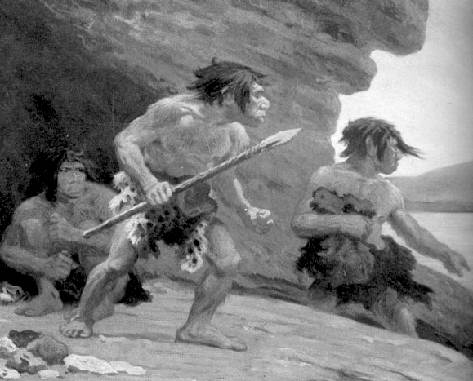
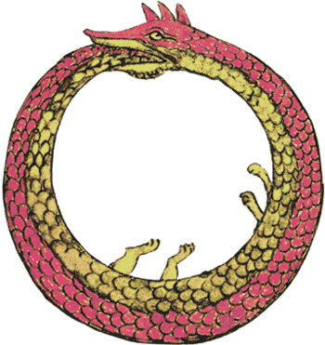
Attempts to recreate an analogous problem for the material theory
… all fail
Regress end
Infinite regress of ever more general warranting facts?
Regress start
Origin of first general, warranting fact?
Something vicious in relations among warranting facts?
Circularity

Slide 18
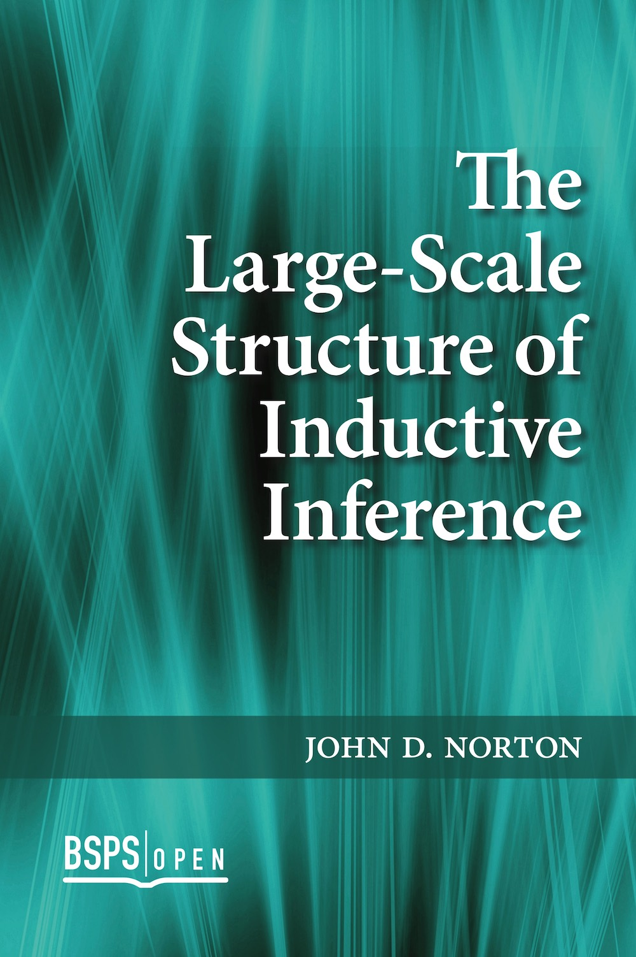
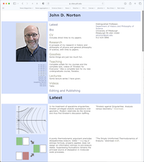
2014
Available on my website https://sites.pitt.edu/
~jdnorton/jdnorton.html

Slide 19
Regress end

Slide 20
What justifies…?
This sample of radium chloride is crystallographically monoclinic.
All samples of radium chloride are crystallographically monoclinic.
Haüy’s principle: generally, all samples of a pure crystalline substance belong to the same crystallographic family.
What justifies Haüy’s principle?

Slide 21
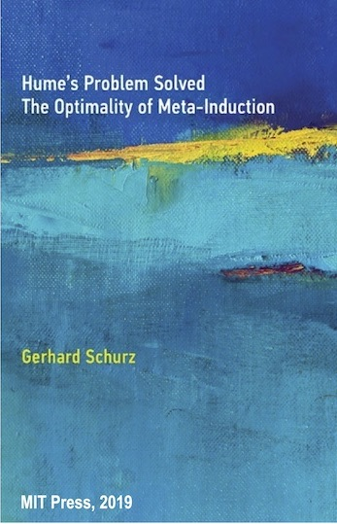
“A closer look at Norton’s example shows that
the uniformity assumptions that justify inductive inferences become more and more general.
For example, the inference
(I1) “Some samples of bismuth melt at 271°C; so all samples of bismuth do so”
is justified by the uniformity assumption
(U1) “Samples of the same element agree in their physical properties.”
The inductive inference that justifies U1 has the form
(I2): “So far all observed samples of the same element agreed in their physical properties; so this is generally so.”
Now the inductive uniformity that justifies the reliability of (I2) is already maximally general and asserts the following principle of spatiotemporal invariance
(U2): “Physically identical entities differing only in their location in space and time behave in an identical way.” ” (pp. 17-18)

Slide 22
Schurz’s supposition (2019)…
2014
Still more general warranting fact
Evidence
More general warranting fact
Warranting fact
Theory

Slide 23
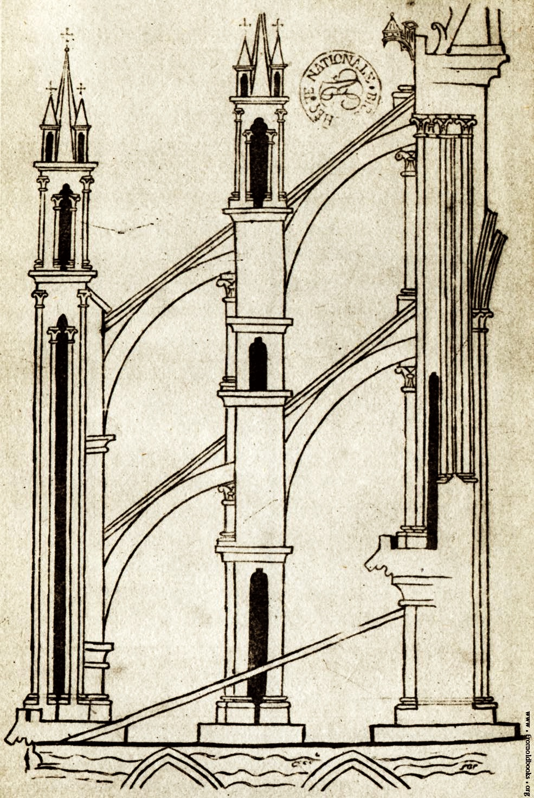
Relations of inductive support have a nonhierarchical structure.

Slide 24
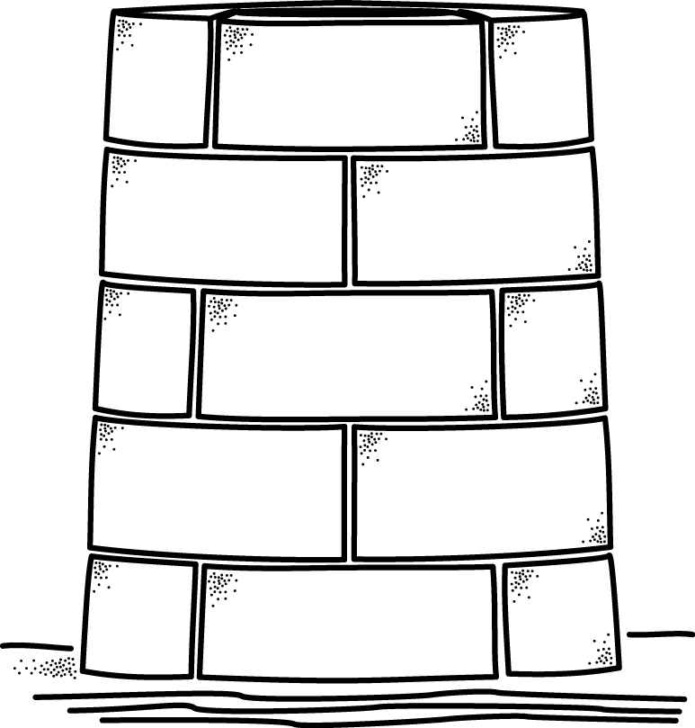
??? Hierarchical structure of inductive support ???
warranted by a proposition higher up
propositions of increasing generality
proposition here
can ONLY be supported by
propositions lower down.
observational bedrock

Slide 25
??? Hierarchical structure of inductive support ???
Continue ascent to construct the infinite regress.
warranted by proposition still higher up
propositions of increasing generality
warranting proposition
can ONLY be supported by
propositions lower down.
observational bedrock

Slide 26
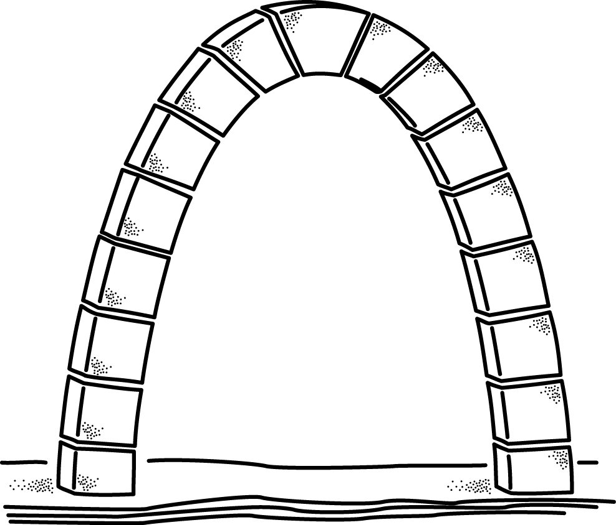
Non-hierarchical structure of inductive support
proposition here
warrant
somewhere else
supported by
propositions above
and
propositions of increasing generality
propositions below
observational bedrock

Slide 27
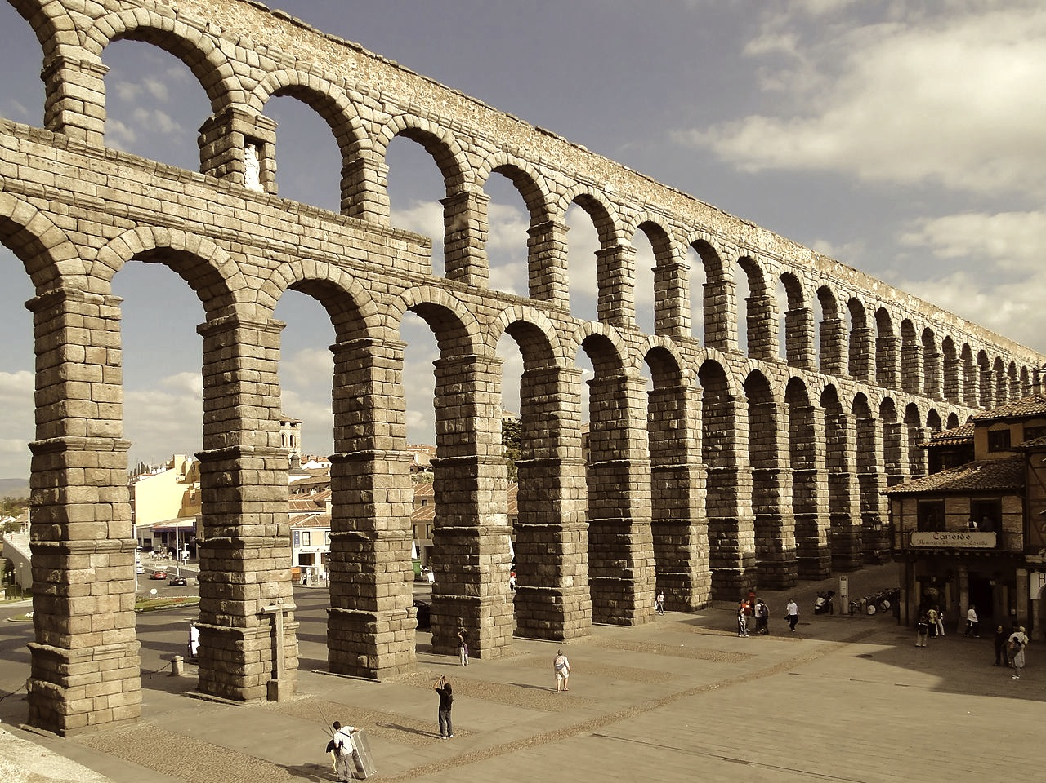
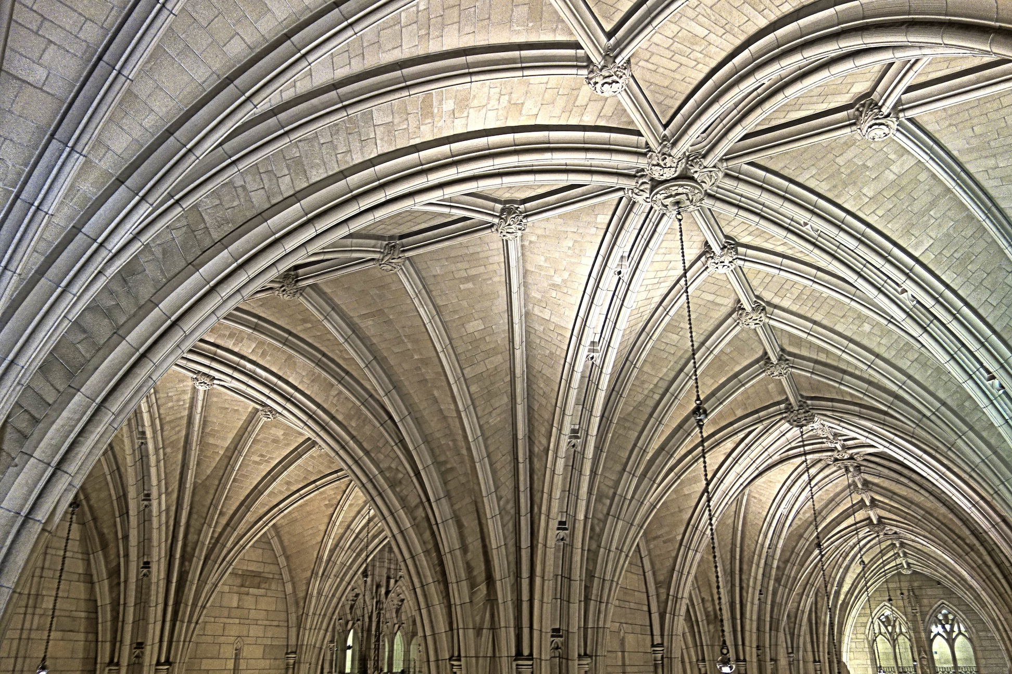

Slide 28
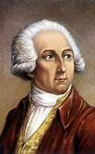

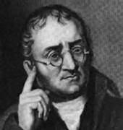
What actually happens
This sample of radium chloride is crystallographically monoclinic.
All samples of radium chloride are crystallographically monoclinic.
Haüy’s principle: generally, all samples of a pure crystalline substance belong to the same crystallographic family.
Lavoisier’s system of elements.
Geometry of packing solids, group theory.
Dalton’s atomic theory.

Slide 29
Is water HO or H₂O?
Early 19th c.
Dalton 1808 to Cannizzaro 1858
Molecular formulae of elements and compounds.
Weights of atoms of elements.
Avogadro’s hypothesis
Dulong-Petit law of specific heats
Mitscherlich’s law of isomorphism
Densities of element and compounds, gaseous and vaporized.
Heat capacities of solids and gases.
Crystalline structures of solids

Slide 30
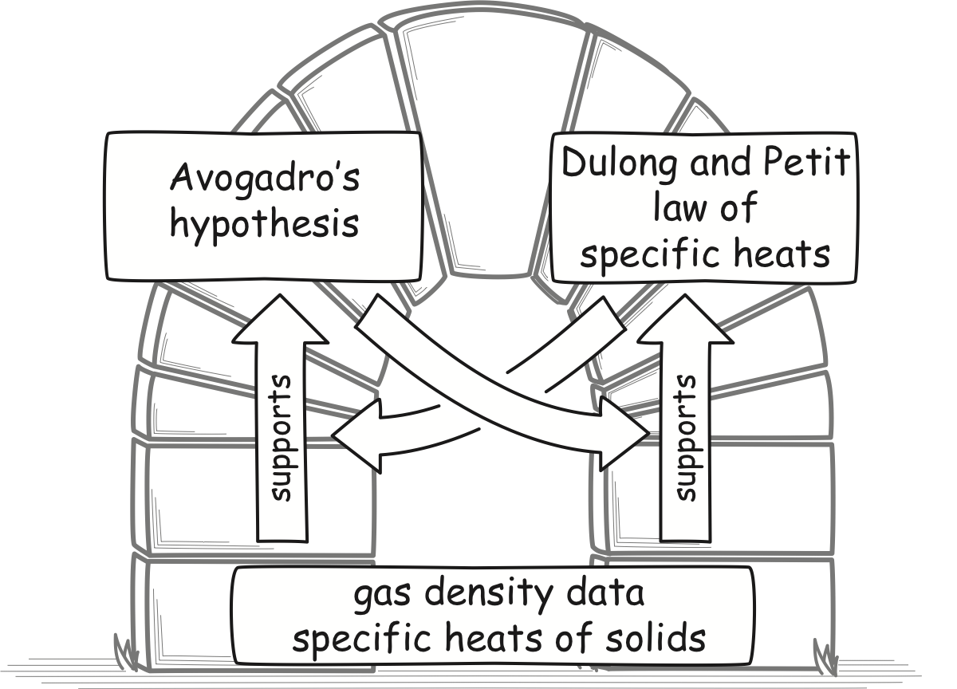
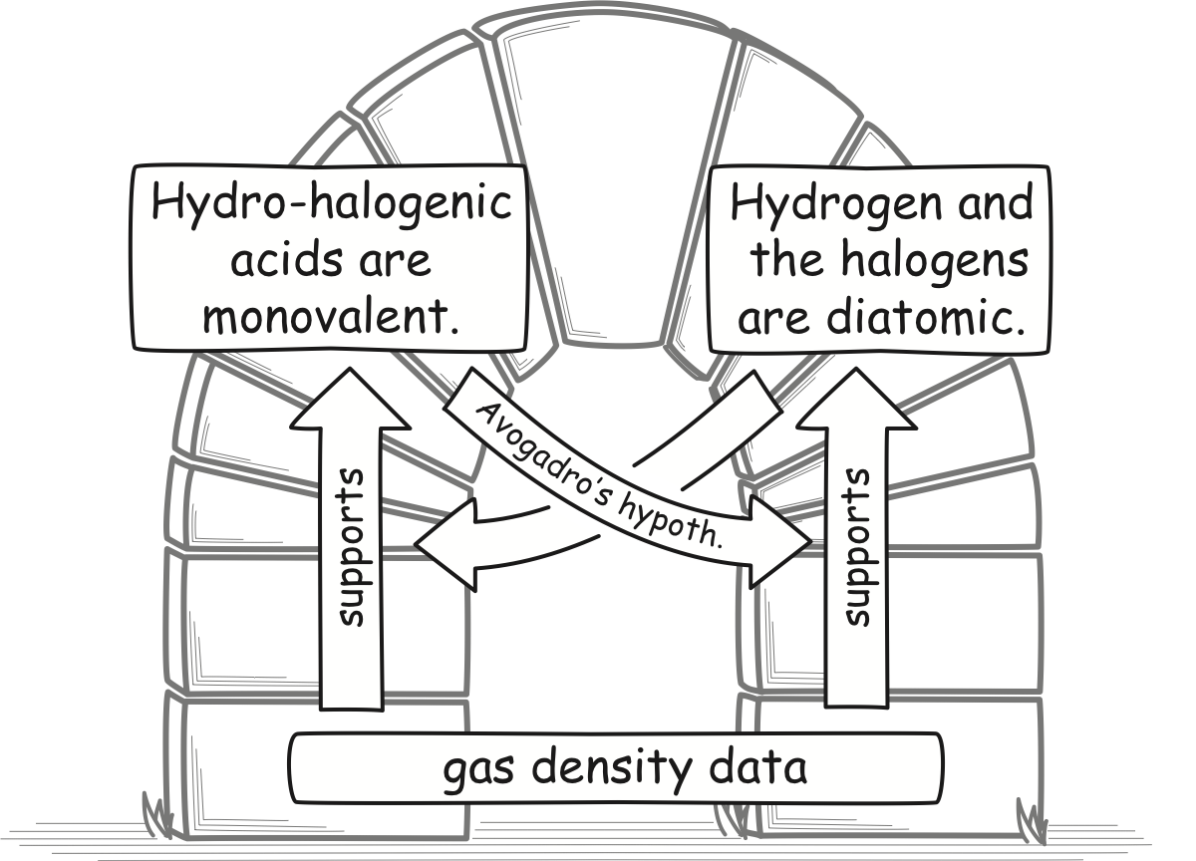
Many Arches
HCl
HBr
HI
H₂, Cl₂
Br₂, I₂
at a larger scale
at the smallest scale

Slide 31
Mutual Support Across Sciences
Chemistry and Physics
Thermal equilibrium:
molecules have same
mean kinetic energy
(1/2)mv²
Avogadro’s hypothesis
The chemists
Cannizzaro
Lothar Meyer
Krönig-Clausius
pressure formula
P = (1/3) nmv²
Any two entails the third.

Slide 32
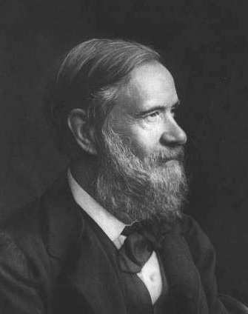
The Chemists
“…at the same time physicists, by considering the constitution of gases under a new point of view, have been brought, independently of chemical considerations, to the supposition of equal numbers of molecules in equal volumes of perfect gases, to which Avogadro and Ampère had previously been led by different modes of interpreting physical phenomena.
Who can fail to see in this long and unconscious march of the science, around and towards a fixed point, the decisive proof of the theory of Avogadro and Ampère?...”
Stanislao Cannizzaro, 1872
Lothar Meyer, 1892 “This is one of the most powerful arguments in support of Avogadro’s hypothesis. Its truth is now no longer disputed.”

Slide 33
Mutual Support Across Sciences
Chemistry and Physics
Thermal equilibrium:
molecules have same
mean kinetic energy
(1/2)mv²
Avogadro’s hypothesis
early physicists
Clausius 1858
Krönig-Clausius
pressure formula
P = (1/3) nmv²
Any two entails the third.

Slide 34
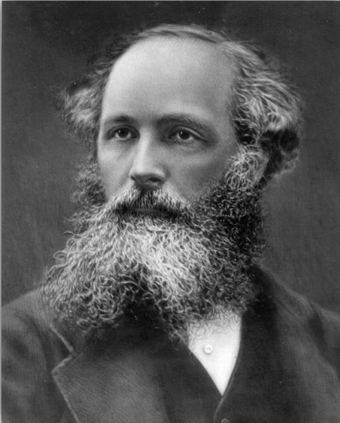
The Physicists
“The result of the kinetic theory, therefore, is to give us information about the relative masses of molecules considered as moving bodies. The consistency of this information with the deductions of chemists from the phenomena of combination, greatly strengthens the evidence in favour of the actual existence and motion of gaseous molecules.”
James Clerk Maxwell, 1875
on the fact that purely chemical arguments for Avogadro’s hypothesis yield the same result as physical arguments.

Slide 35


Regress Start

Slide 36
Adam’s first induction
… if we follow this backward direction, … the accreditational buck has to stop somewhere: it cannot be an inﬁnite chain … Even if we were to think, following Hume’s thought experiment, of the starting point being Adam making some initial observation, we know that nodes in the tree must contain, at some stage, universal claims—and so we would still have to account for some initial act (or acts) of generalization. And given that we want each node to be justiﬁed, we would seem to be back at the same old problem.

Slide 37
Adam’s first induction
Sun rose Monday.
Sun rose Tuesday.
Sun rose Wednesday.
Sun will rise for ever.
Adam has no warranting fact of sufficient generality.
Please stop doing fantasy anthropology!

Slide 38
Adam’s first induction
Sun rose Monday.
Sun rose Tuesday.
Sun rose Wednesday.
Sun will rise for ever.
Sun god returns each day to light up the hunt.
…
The sun is a big, hot rock that rolls around us.
…
???
Induction can start with hypotheses.
Return later to give them evidential support.

Slide 39
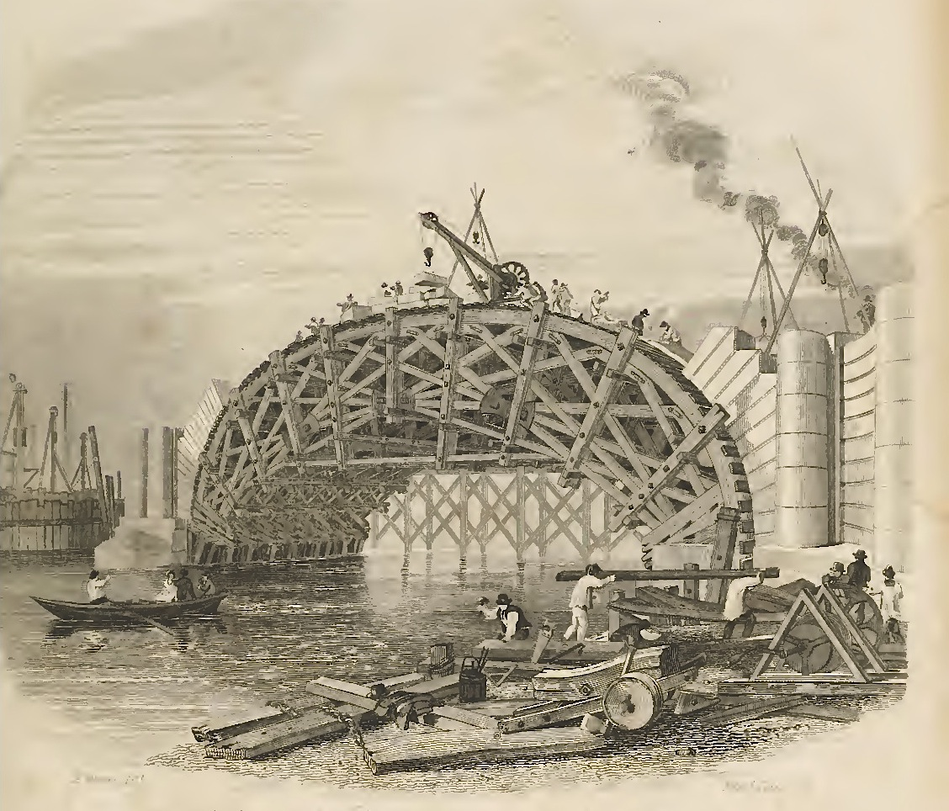
Hypotheses, initially without known support, are used to erect nonhierarchical structures.

Slide 40
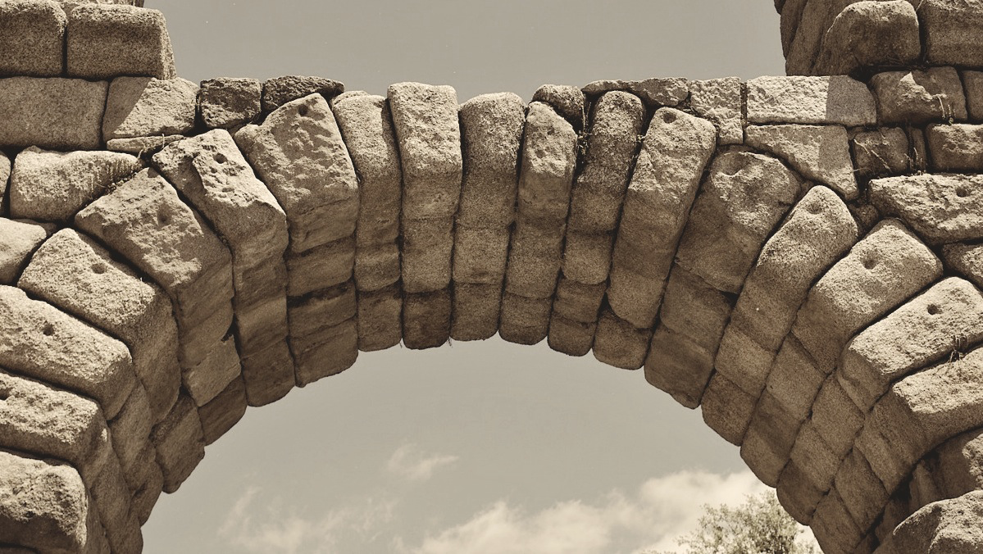
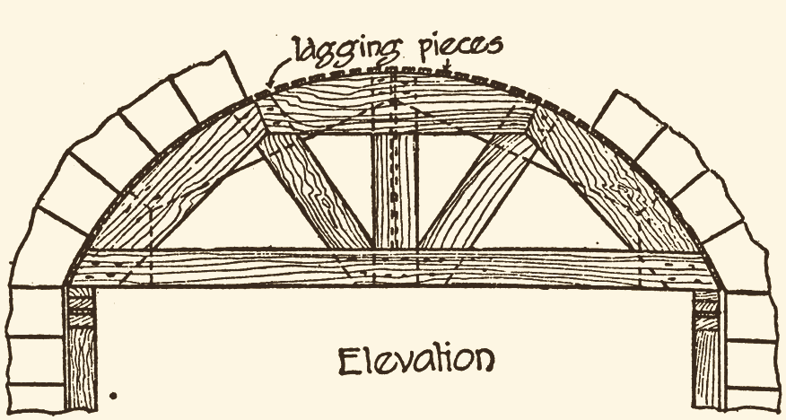
But How…?
How can an arch be constructed?
Not by
stacking stones.
Scaffolding “centring”

Slide 41
But How…?
How can inductively self-supporting structures be built?
Not by a linear chain of inferences.
Hypotheses
Introduced temporarily without proper inductive support.
Expectation is that inductive support will be provided as science proceeds.
NOT hypothetico-deductive confirmation. Inductive support from elsewhere in the science

Slide 42
Is water HO or H₂O?
Early 19th c.
Dalton 1808 to Cannizzaro 1858
Molecular formulae of elements and compound.
Weights of atoms of elements.
Insufficient known in 1808 to warrant induction.
Avogadro’s hypothesis is SUPPOSED. Inductions can start.
The hypothesis is later independently supported.
Avogadro’s hypothesis
Densities of element and compounds, gaseous and vaporized.
Heat capacities of solids and gases.
Crystalline structures of solids

Slide 43
Is water HO or H₂O?
Early 19th c.
Dalton 1808 to Cannizzaro 1858
Molecular formulae of elements and compound.
Weights of atoms of elements.
Avogadro’s hypothesis
Dulong-Petit law of specific heats
Mitscherlich’s law of isomorphism
Densities of element and compounds, gaseous and vaporized.
Heat capacities of solids and gases.
Crystalline structures of solids

Slide 44
Circularities

Slide 45
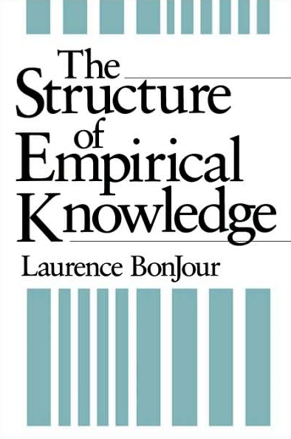
Circularities are routinely benign
Maxwell’s equations
(1/c)∂E/∂t = ▽xH
Left side
supports
Right side
supports
Left side
supports
Right side
supports
…
-(1/c)∂H/∂t = ▽xE
Coherentist epistemology is proudly circular.

Slide 46
Problems??
Circularities lead to…
Universal rule of induction
Material theory of induction
Conflicting evidence for particular result. Resolved by more investigation.
…Contradictions
x ≠ x
FAILURE
Rule is inadmissible
Geological age of earth vs evolutionary age of species
Particular result decided by further investigations.
or
Result is a non-factual, convention.
Dalton: water is HO, H₂0, HO₂ …?
…Indeterminacy
x = 2y
y = x/2
FAILURE
Rule is unspecified
Reichenbach’s conventionality of simultaneity, geometry.

Slide 47
Conclusion:
What Justifies Inductive Inference?

Slide 48
Conclusion: A distributed warrant for inductive inference
No general principle or law.
No principle of the uniformity of nature.
In a mature science…
each individual proposition
is well supported by the
other propositions in the science.
The totality of the science is well supported.

Slide 49
That’s all
there is to it!
THE END.

Slide 50
Appendices

Slide 51
The Problem of Induction:
Circularity Formulation
Universal rule of inductive inference
First deductive horn of dilemma
“Consider, then, any ampliative inference whatever. … We cannot show deductively that this inference will have a true conclusion given true premises. If we could, we would have proved that the conclusion must be true if the premises are. That would make it necessarily truth-preserving, hence, demonstrative. This, in turn, would mean that it was nonampliative, contrary to our hypothesis.
Thus, if an ampliative inference could be justified deductively it would not be ampliative. It follows that ampliative inference cannot be justified deductively.”
David Hume
Hans Reichenbach
Wesley Salmon

Slide 52
Popper’s
Anti-inductivism and the Infinite Regress Version of the Problem of Induction

Slide 53
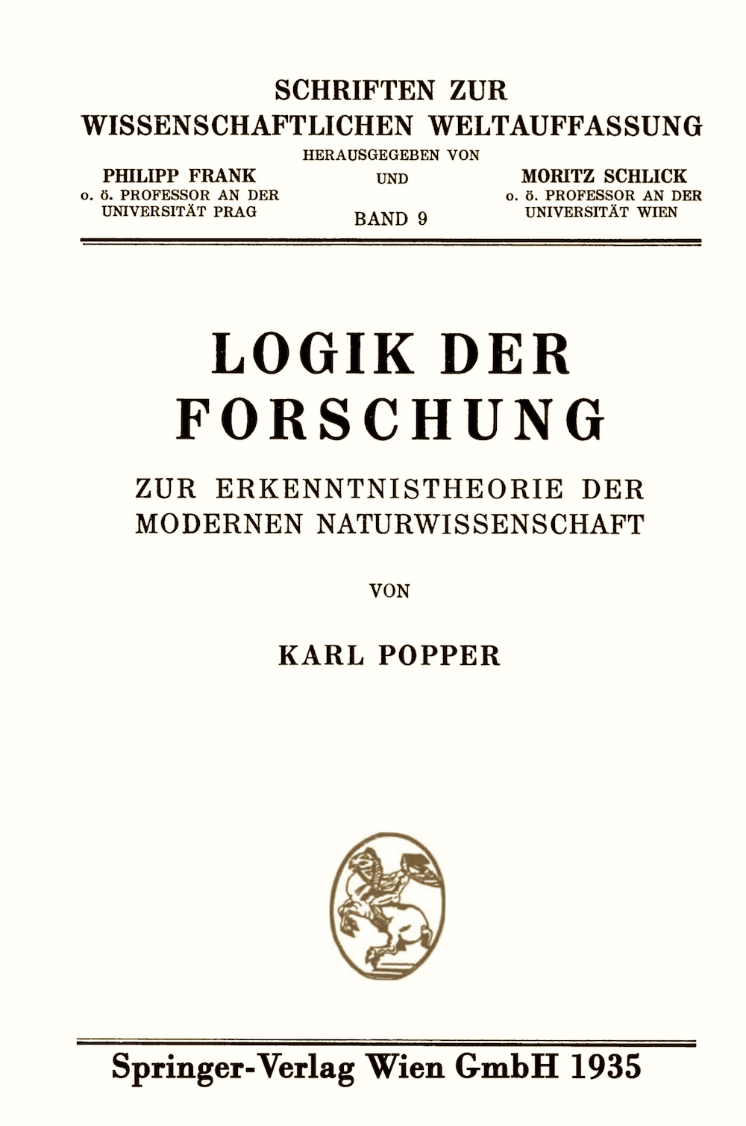
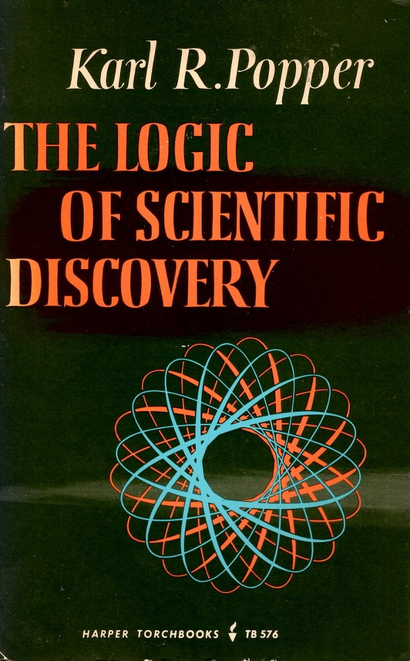

Slide 54
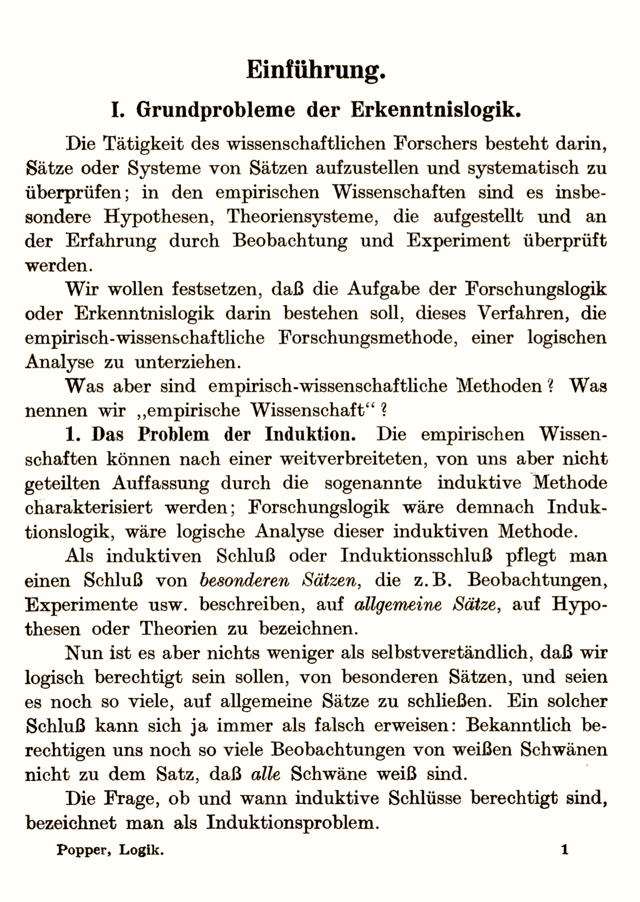
… a principle of induction is superﬂuous, and that it must lead to logical inconsistencies.
…
if we try to regard its truth as known from experience, then the very same problems which occasioned its introduction will arise all over again.
To justify it, we should have to employ inductive inferences; and to justify these we should have to assume an inductive principle of a higher order; and so on.
Thus the attempt to base the principle of induction on experience breaks down, since it must lead to an inﬁnite regress.

Slide 55
Why the Regress Formulation?

Slide 56
Why the Regress Formulation?
… concept of circular inference would be confronted here with certain logical objections …
…Russell…
… “No proposition can say anything about itself.” …

