Slide 1
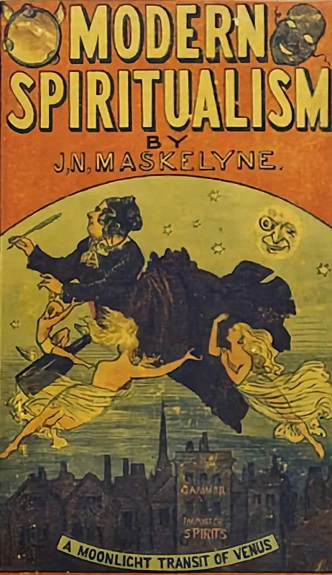
Why Falsifiability does not Demarcate Science from Pseudoscience John D. Norton Department of History and Philosophy of Science University of Pittsburgh

Slide 2

Good decision making in society should be guided by good science.
Vaccine safety
Climate change
Cold fusion energy
…

Slide 3
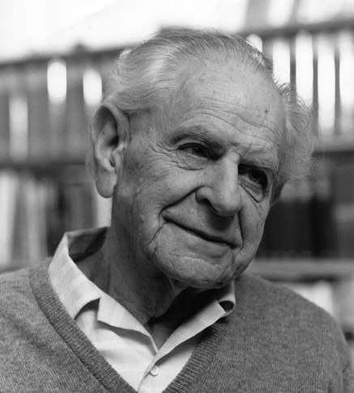
Falsifiability demarcates science from non-science.
Science
Non-science
Karl Popper
Wrong criterion

Slide 4

What distinguishes better science from worse science is the strength of support by the evidence.
Best supported
Worst
supported
?
Strength of evidential support provided by inductive inference.

Slide 5
Falsifiability is secured too cheaply.

Slide 6
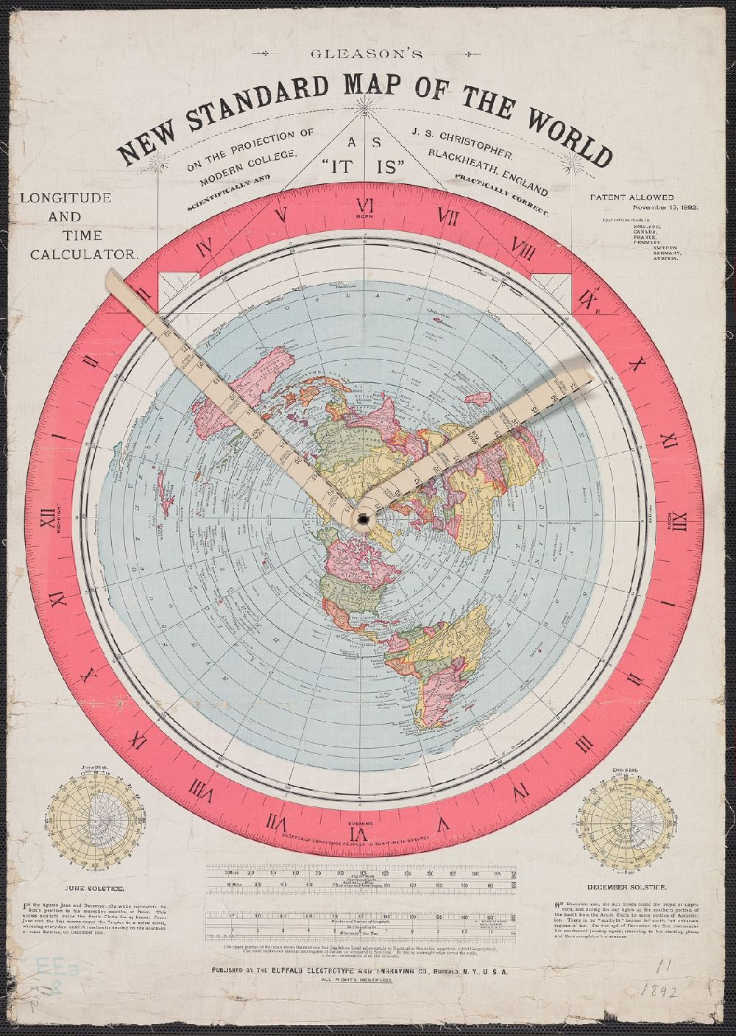

Flat earth theories persist today.
Falsifiable by measurements of distances in circumnavigation at Antarctic and equator.
19th century flat earth map

Slide 7
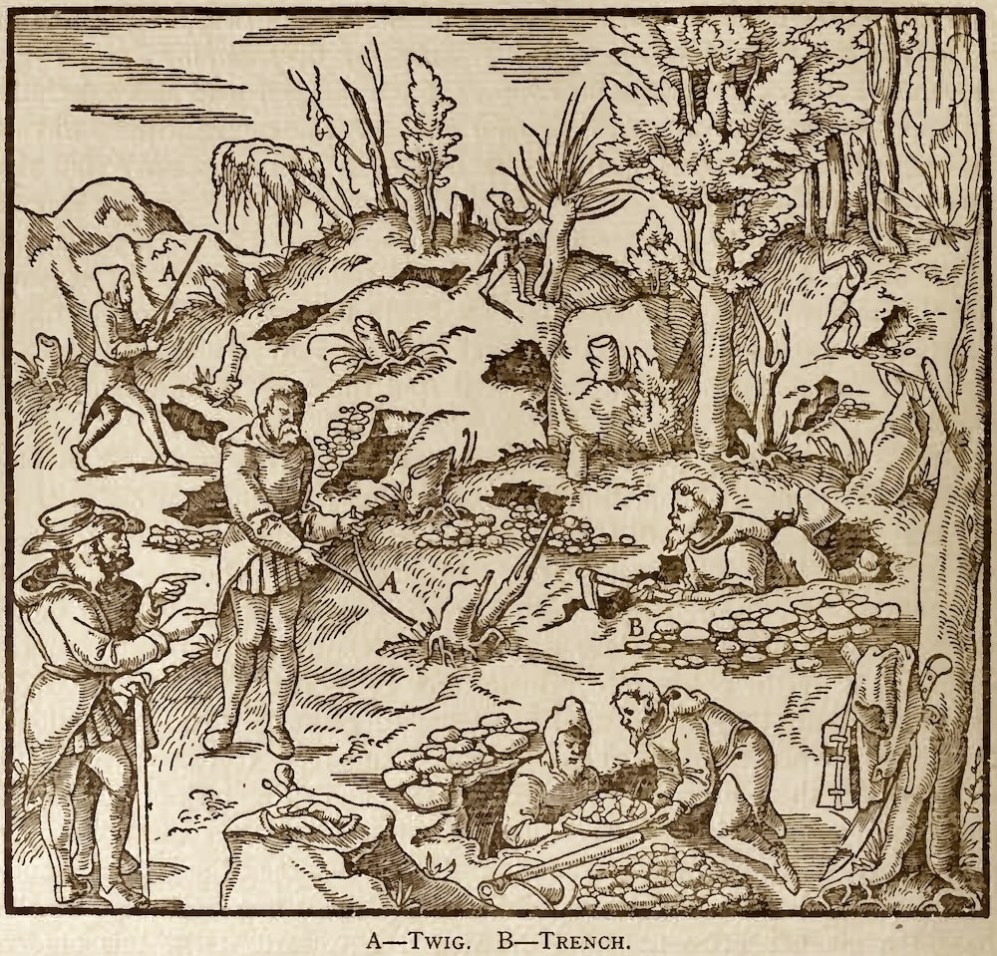
Dowsers detect underground minerals and water by the deflection of twigs.
Works by parapsychological forces between the dowser and underground water.
Falsifiable by blind testing of dowsers.

Slide 8
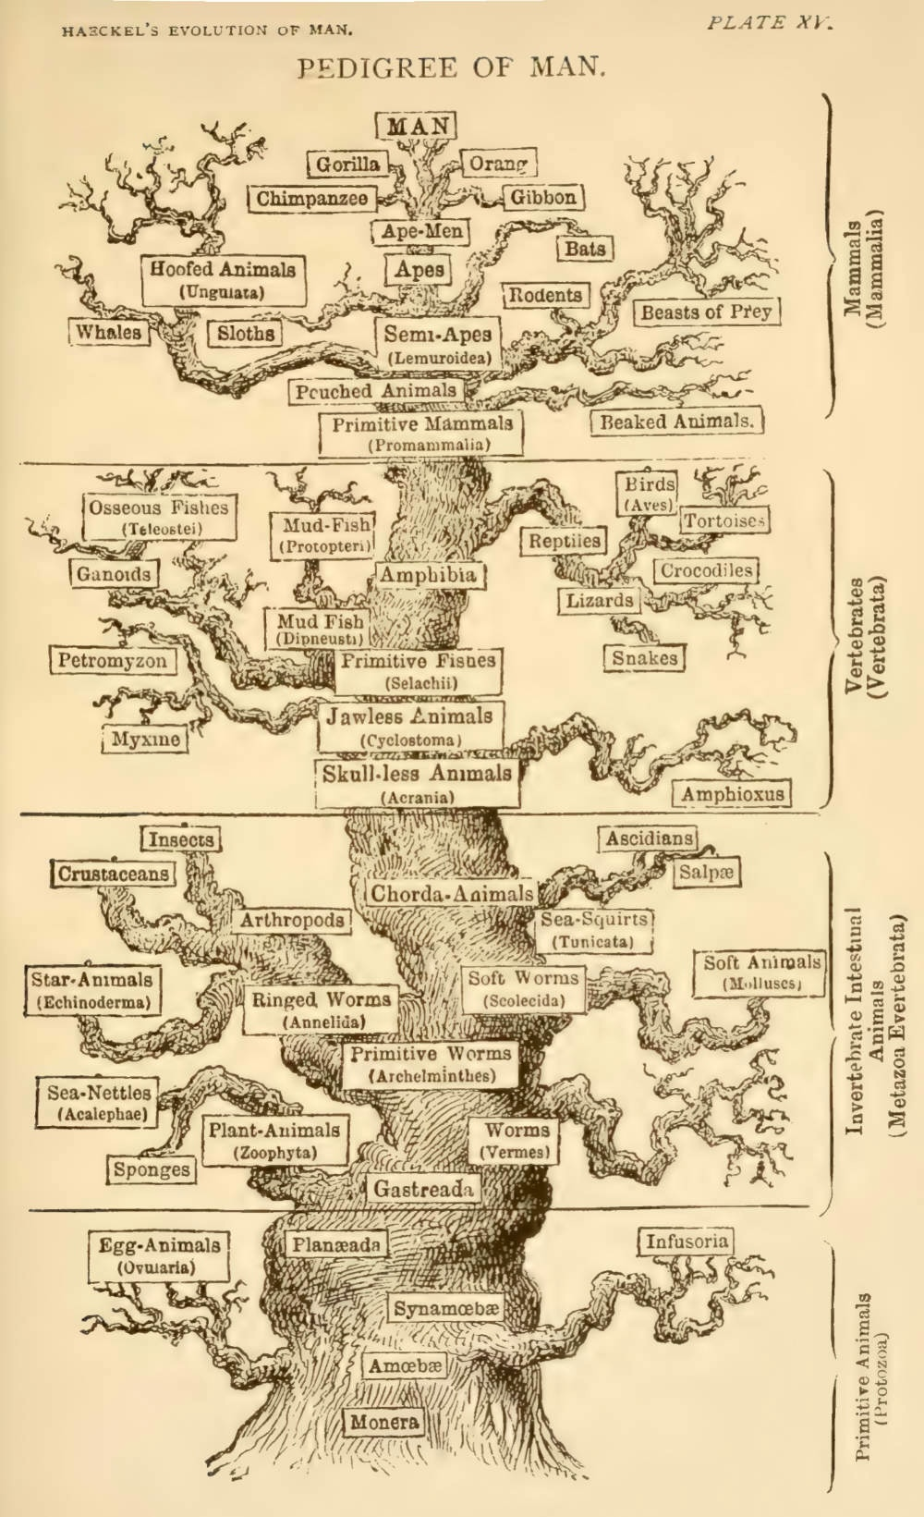
Scientific creationists propose an alternative to evolutionary theory.
They assert falsifiability via:
“Describe a realistic, continuously functional Darwinian pathway from [a] simple ancestor to [the] present [irreducibly complex, rotating] motor [of bacterial flagella].”

Slide 9
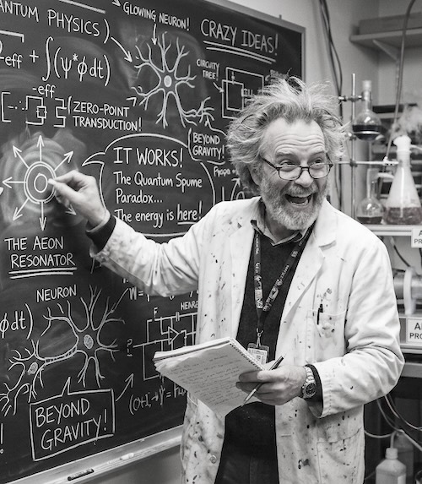
Shift of Burden of Proof
Falsifiability:
Prove me wrong!
Wrong question
Inductive inference:
What is the evidence for?
Right question

Slide 10
Falsifiability distorts what counts as good science

Slide 11
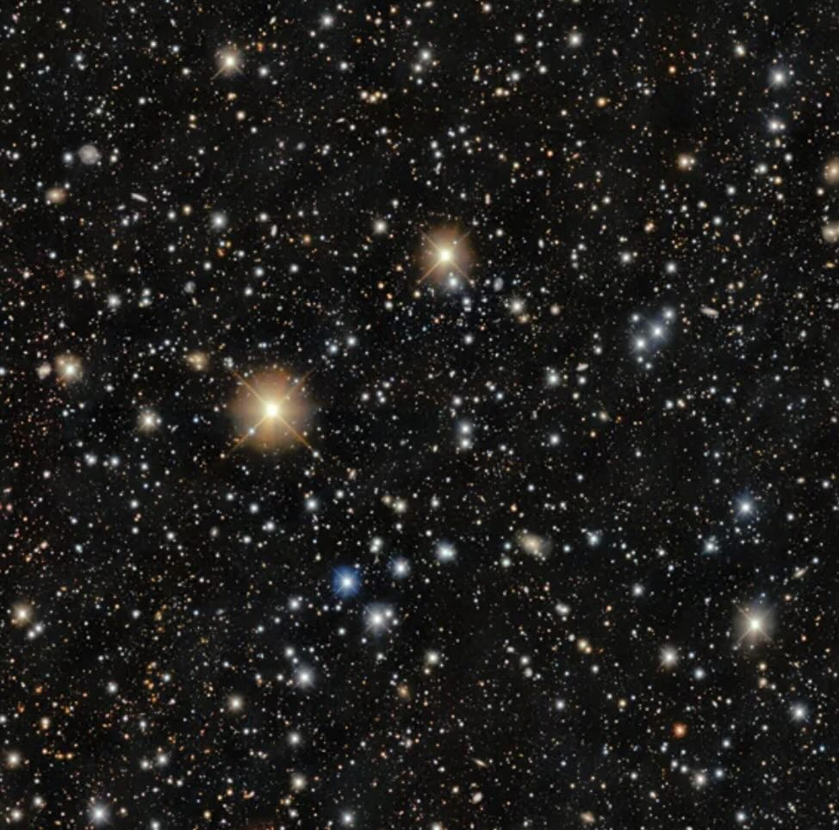
Unfalsifiable science
Cosmological principle …
"... broadly speaking ... the universe presents the same aspect from every point except for local irregularities."
Hermann Bondi, Cosmology. 2nd ed. Cambridge University Press, 1960 p. 11.
… is unfalsifiable.
That there is an extra element between Nitrogen and Oxygen.
Unfalsifiable.

Slide 12

Falsification of predictions has a smaller role in historical sciences (evolution, geology, archaeology).
National Academy of Sciences
Institute of Medicine
distorts their methodology to placate criticism that their science does not trade in falsifiable predictions.

Slide 13
Diagnostic utility of falsifiability

Slide 14


Unfalsifiable?
Symptom of a defect
in evidential support.
In 19th century ether theories, an ether wind blows over the earth.
BUT…
Objects contract, time slows and is dislocated such that no experiment can detect it.

Slide 15
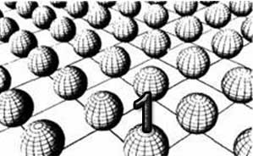
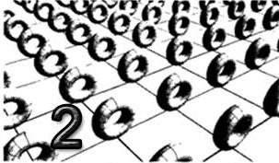
Unfalsifiable?
Symptom of defect
in evidential support.
Modern string theory requires 10 dimensions of spacetime.
BUT…
The extra 6 dimensions are invisible since they are wrapped up on themselves in immensely complicated tiny loops.

Slide 16
Unfalsifiable?
Symptom of defect
in evidential support.
19th century kinetic gas theory depicted gases as made of very many, very tiny molecules in collision.
BUT…
They are too small to be seen individually.

Slide 17
Historical origin of Popper’s obsession with falsifiability

Slide 18



Slide 19

Karl Popper
Hume’s problem of induction is insoluble.
NO
Laudably principled
but
fundamentally mistaken
Replace
inductive support of scientific theories
by
fully deductive cycle of
conjectures and
bold deductive refutations.
The advance of science depends on the possibility of refutation.
Unfalsifiable proposals obstruct the advance of science

Slide 20

meaningful
a proposition must be
verifiable.
To be
Vienna Circle manifesto 1929
scientific
a proposition must be
falsifiable.
To be
Popper, Logik, 1935

Slide 21
Technical critiques by Popper’s contemporary philosophers

Slide 22
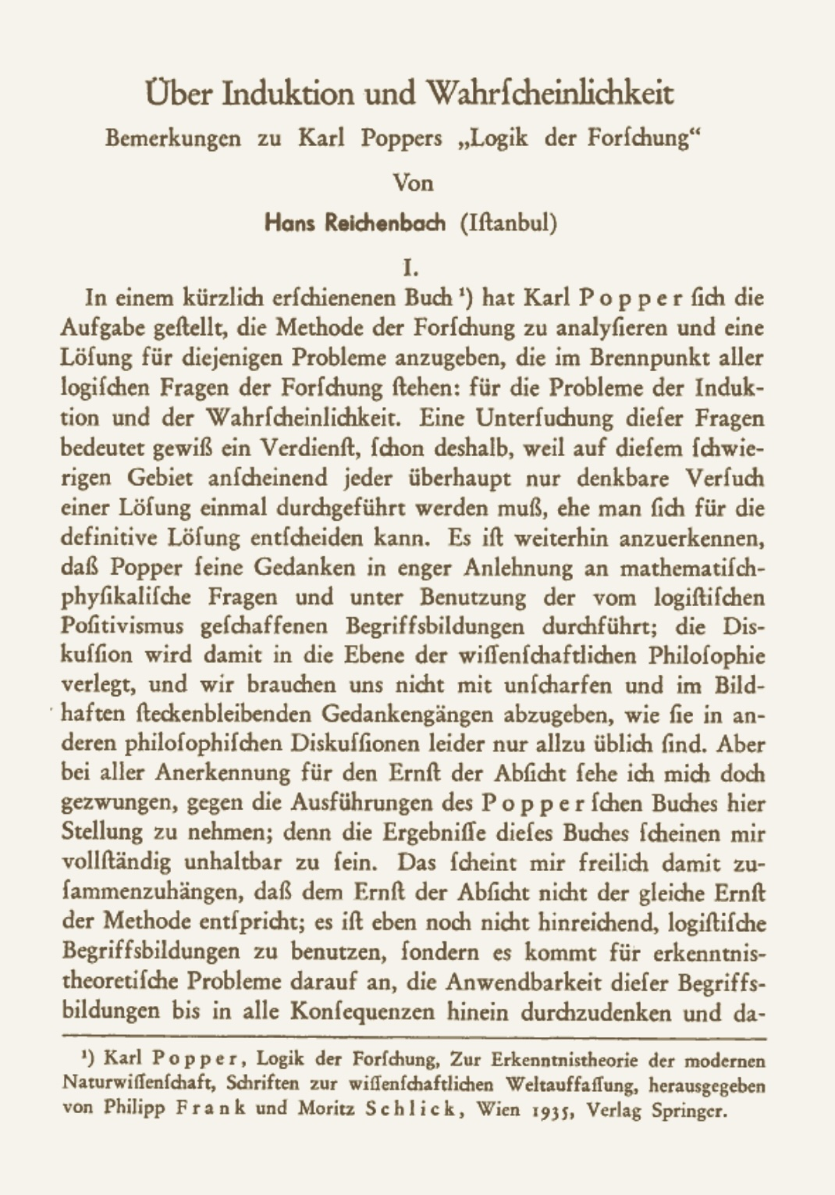
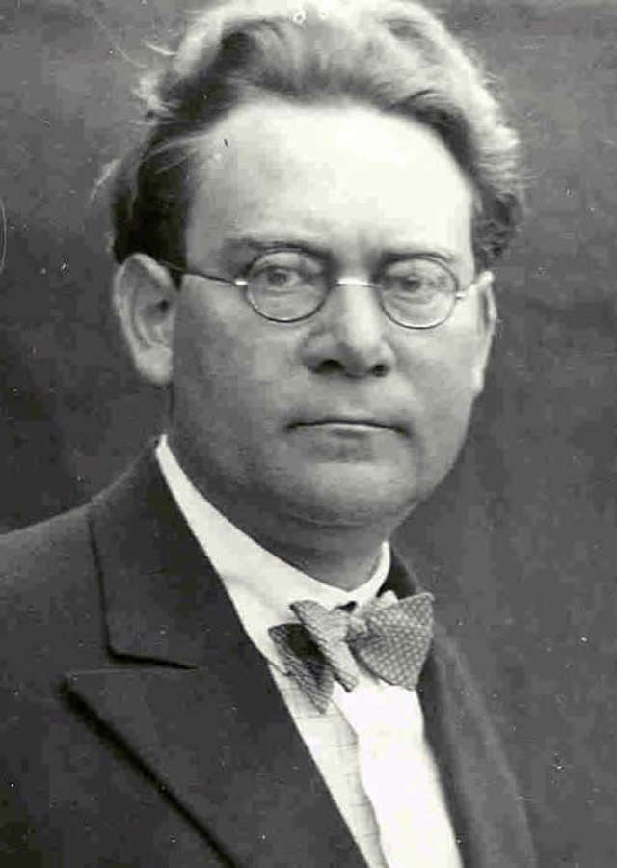
Hans Reichenbach
Inductive inference
is ineliminable from science.
Refutation requires empirical evidence
that can only be known inductively with some probability.
New conjectures are chosen for their promise
which requires inductive assessment of which are more promising.
Erkenntnis Vol. 5 (1935), pp. 267-284.

Slide 23
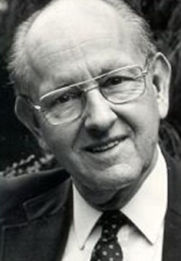
Wesley Salmon
Popper’s “corroboration” = hypothesis is not falsified in a severe test.
Hypothesis can support rational predictions.
“Severe test” checks a consequence of the hypothesis in a situation in which the consequence is not expected. It is an inductive notion.

Slide 24
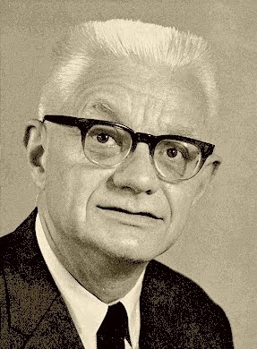
Carl Hempel
Being scientific
= being falsifiable
does not behave well under logical operations.
v & ~ ⊃

Slide 25
Negation
Falsifiable
All electrons are spin one half.
NOT
Not
falsifiable
There is an electron that is not spin one half.

Slide 26
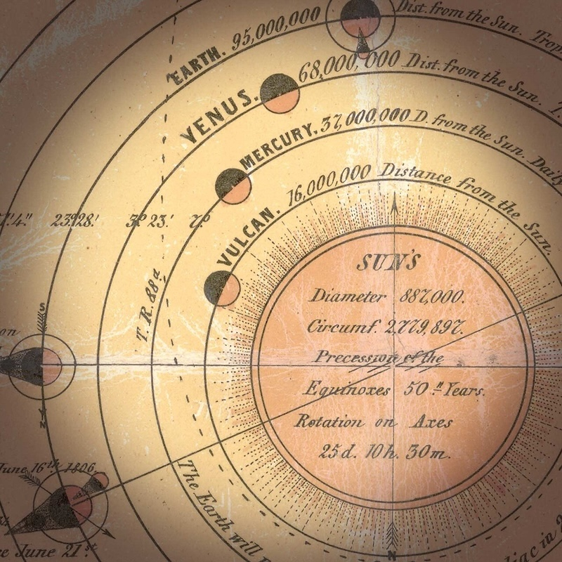
Implication
Falsifiable
The existence of the planet Vulcan allows Newtonian theory to account for the anomalous motion of Mercury.
implies
Not
falsifiable
?
There are ways that Newtonian theory can account for the anomalous motion of Mercury.

Slide 27
In sum…

Slide 28
What distinguishes better science from worse science is the strength of support by the evidence.
Best supported
Worst
supported
?
Strength of evidential support provided by inductive inference.

Slide 29

Read

Slide 30
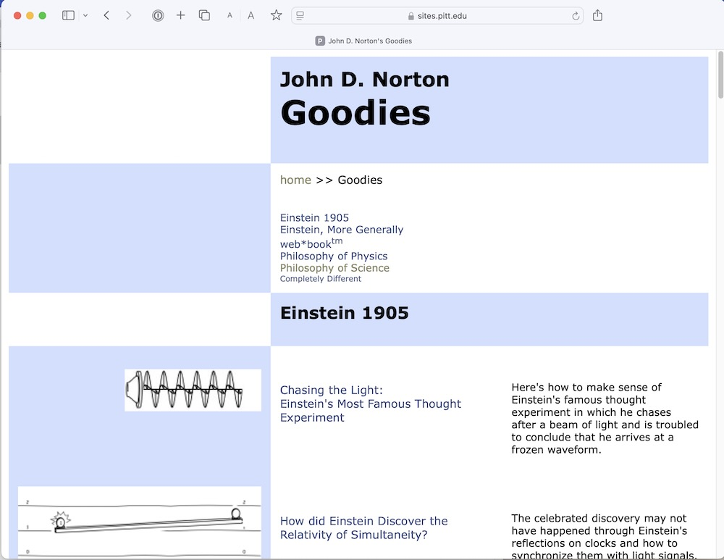
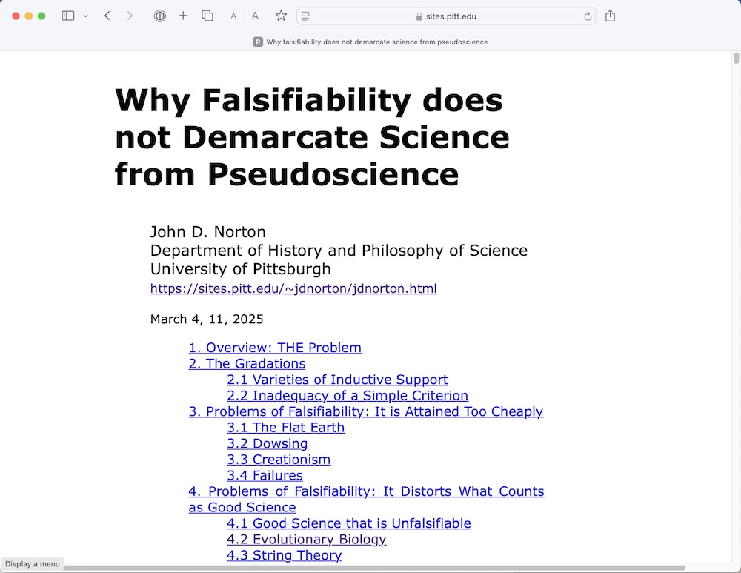
https://sites.pitt.edu/
~jdnorton/Goodies/
pseudoscience/pseudoscience.html

Slide 32



Slide 33


