Slide 1
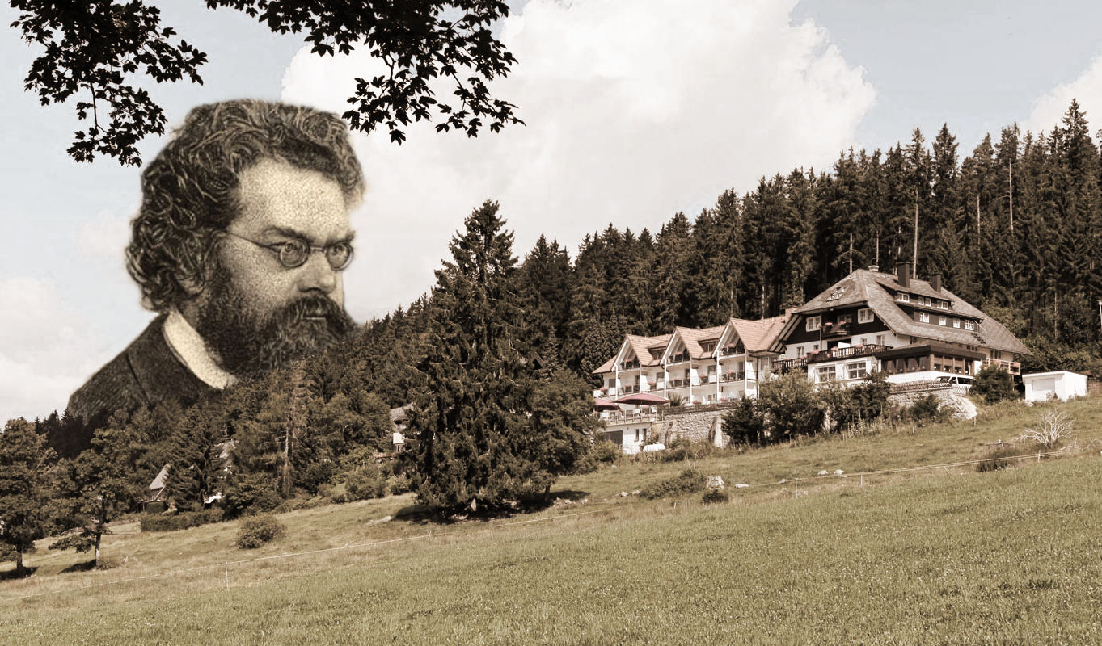
The Impossible Process Thermodynamic Reversibility John D. Norton Department of History and Philosophy of Science University of Pittsburgh
Summer School: The Nature of Entropy I
From thermodynamics to black holes
22 – 27 July 2019, Saig, Germany

Slide 2
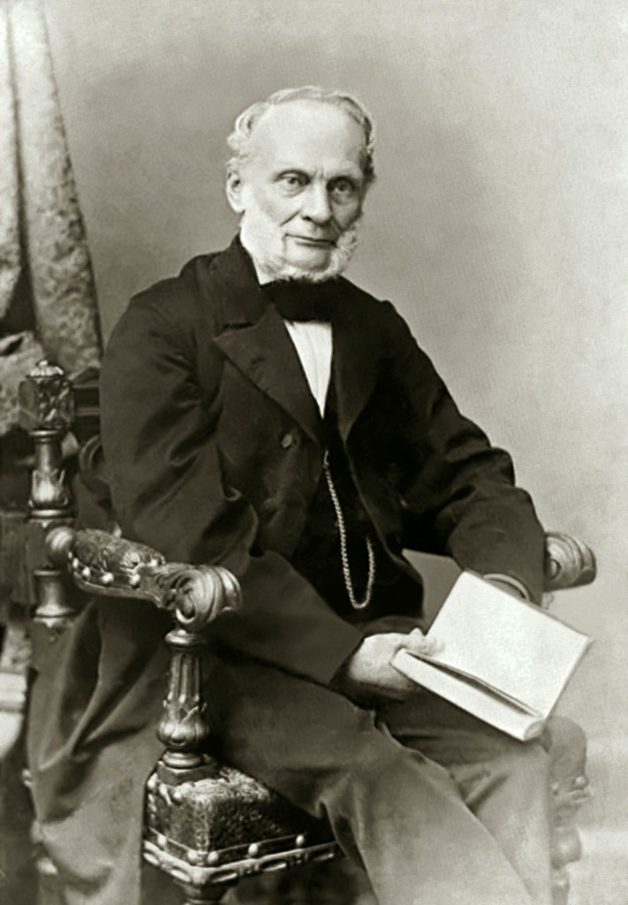
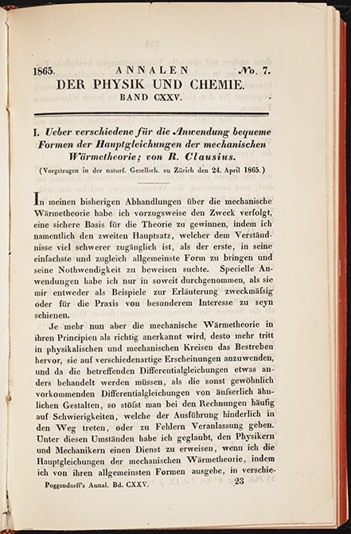

Rudolf Clausius
On Several Convenient Forms of the Fundamental Equations of the Mechanical Theory of Heat

Slide 3
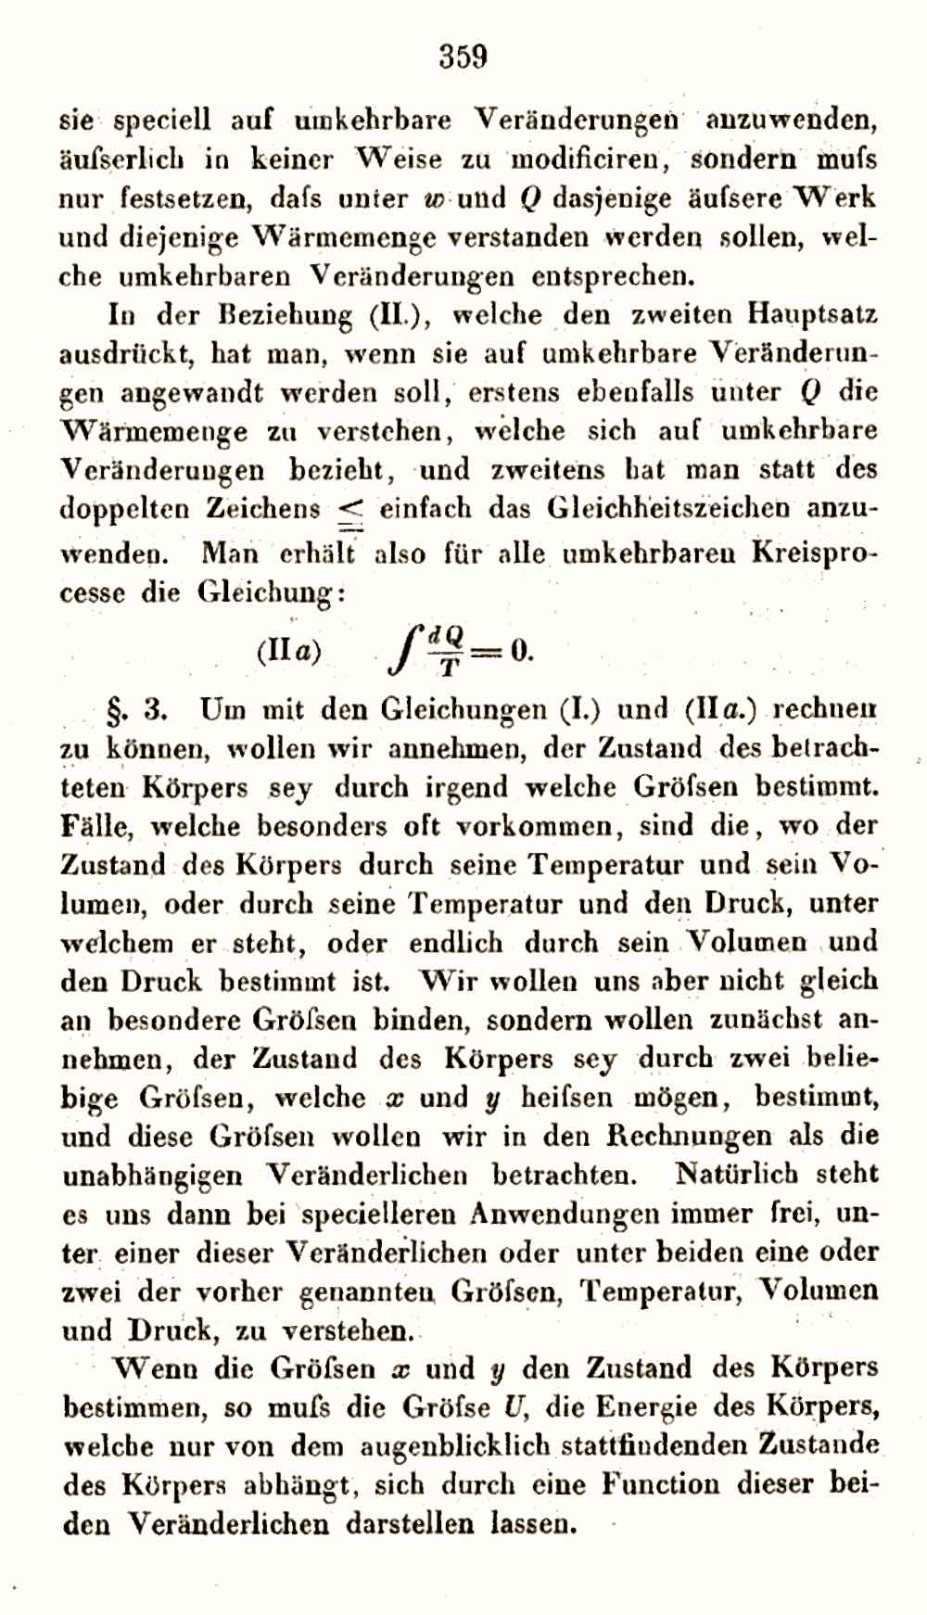
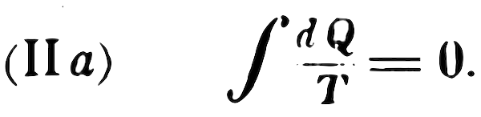
One obtains, therefore, for all reversible cyclic processes the equation

Slide 4
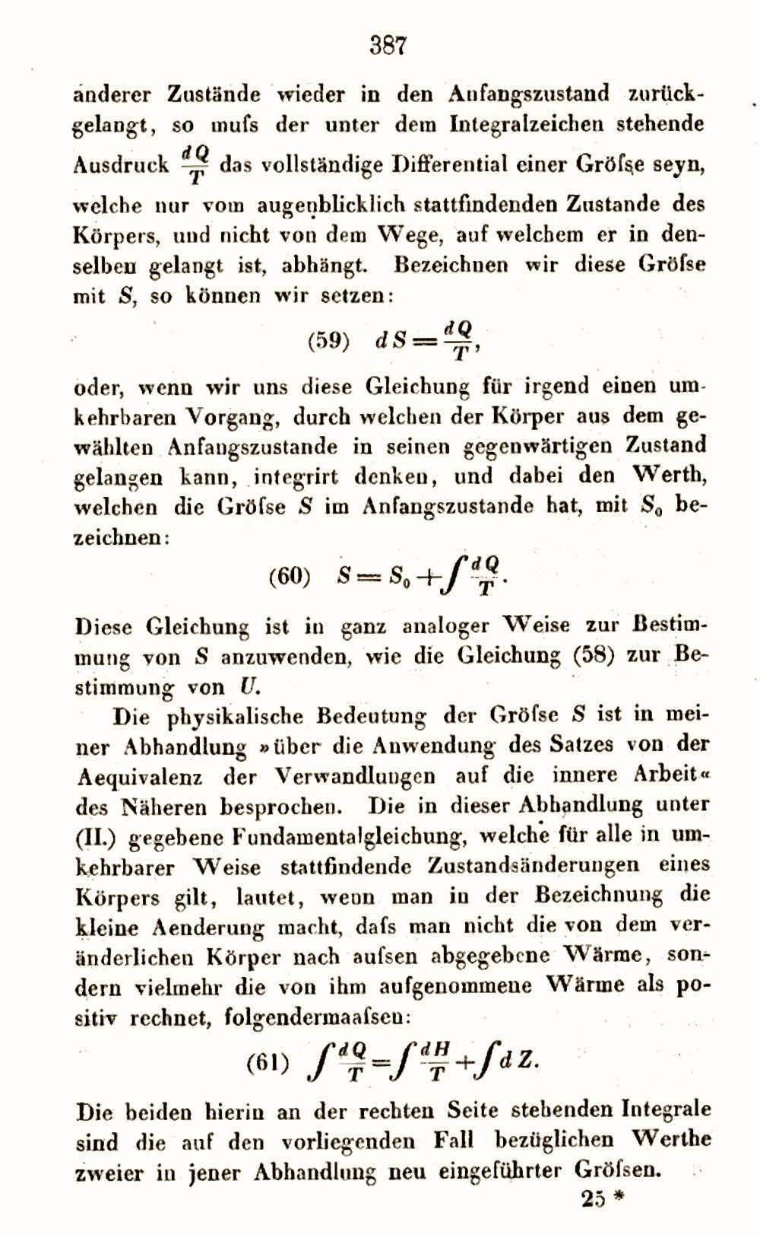

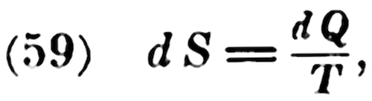
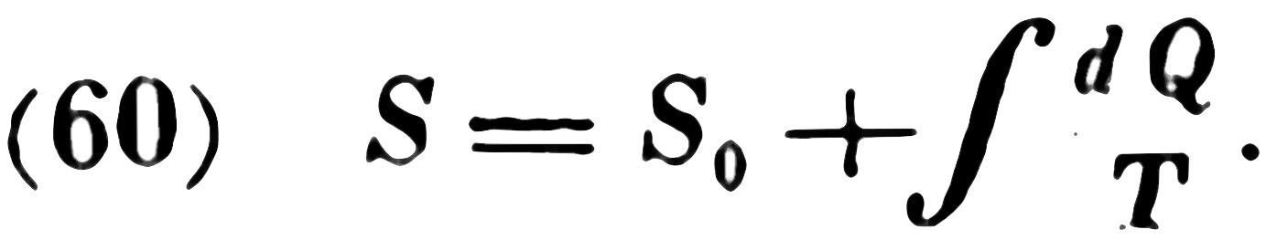
… the expression
must be a complete differential
... so we can set
… for any reversible process
... integrating...

Slide 5
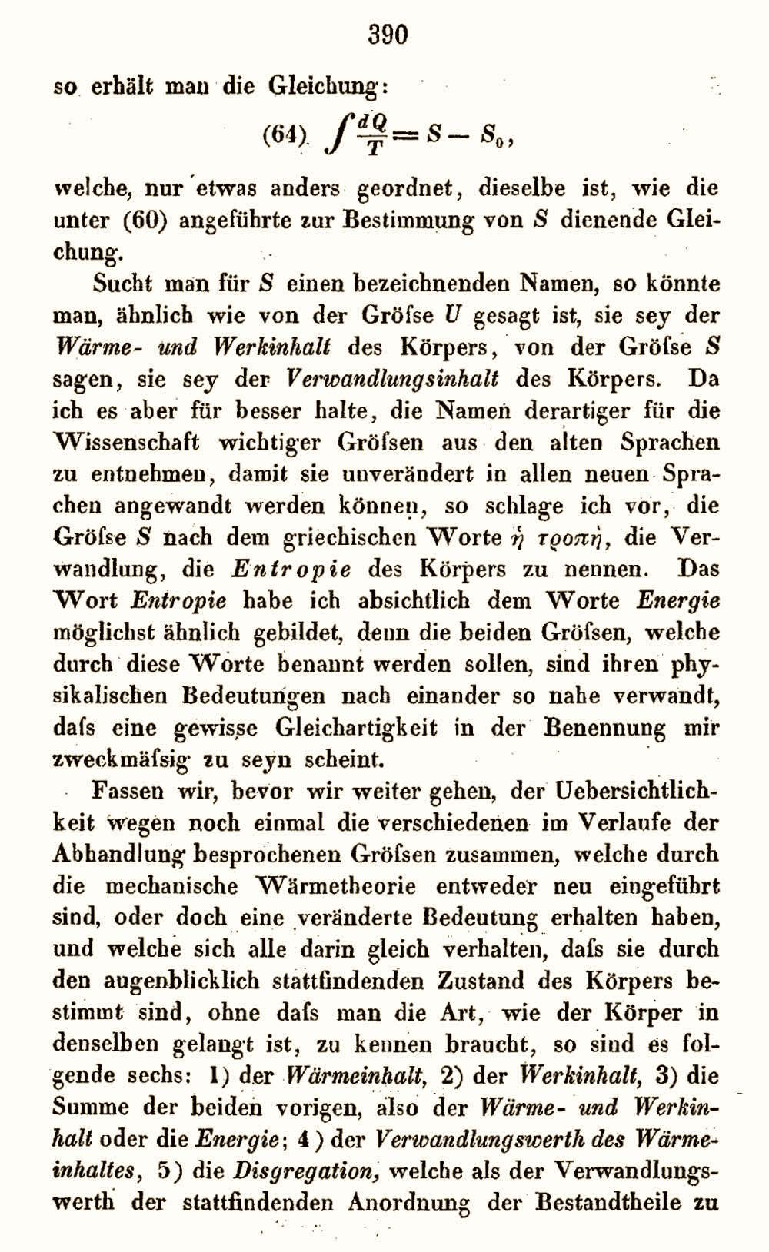
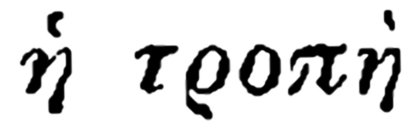
I propose to call the magnitude S the entropy of the body, from the Greek word
transformation.
I have intentionally formed the word entropy so as to be as similar as possible to the word energy.

Slide 6
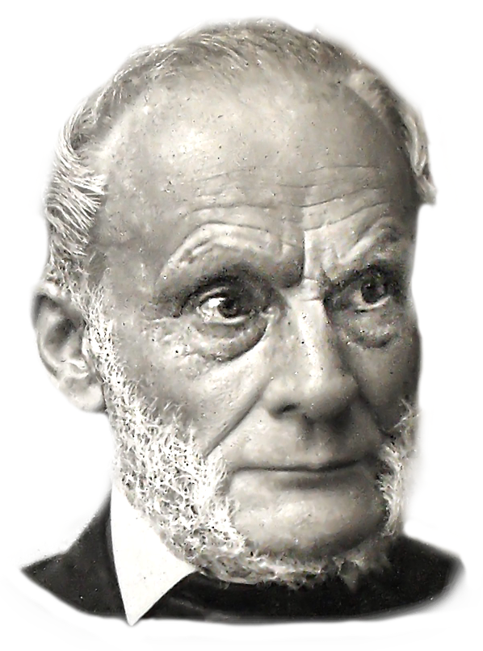
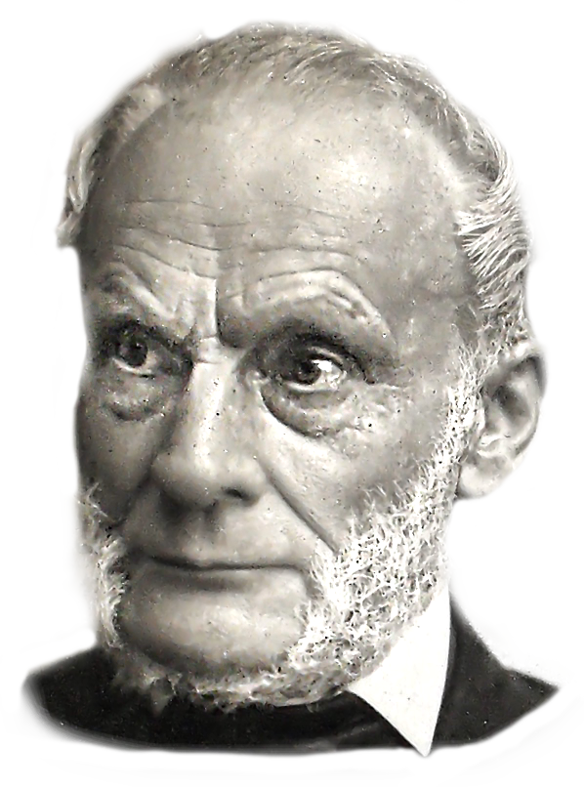
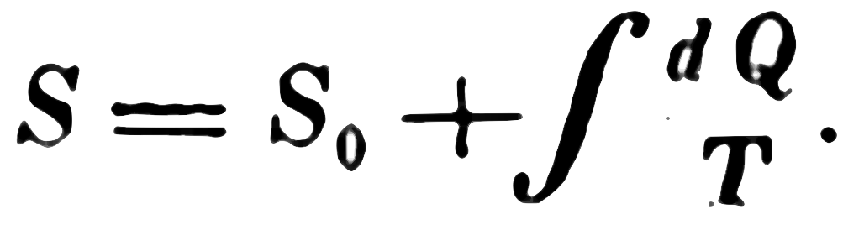
Clausius’ Definition of Entropy
For any
reversible
process

Slide 7

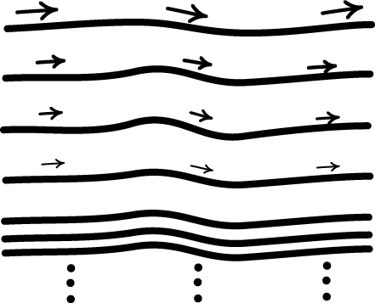
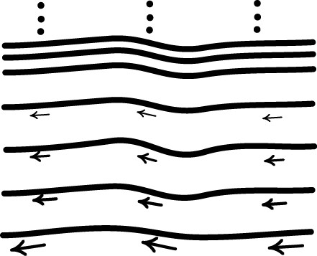
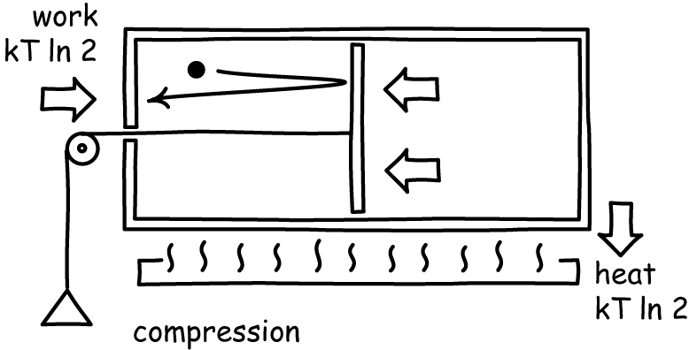
This Lecture
As much confusion over
thermodynamically reversible processes
thermodynamic entropy.
as over
Properties of thermodynamically reversible “process”
=
The limit properties
of a set of
irreversible processes.
Thermodynamically reversible processes
impossible on molecular scales.
are

Slide 8
Irreversible Processes

Slide 9


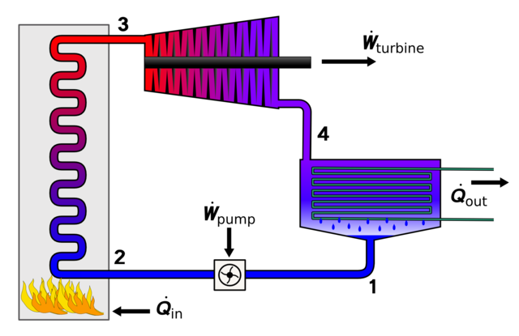
Irreversible heating
melting ice
Heat passes through a large temperature difference from hot to cold…
hot brick
… but does no work. The lost heat could have been used in an engine to create useful work.
https://commons.wikimedia.org/wiki/File:Rankine_cycle_layout.png

Slide 10

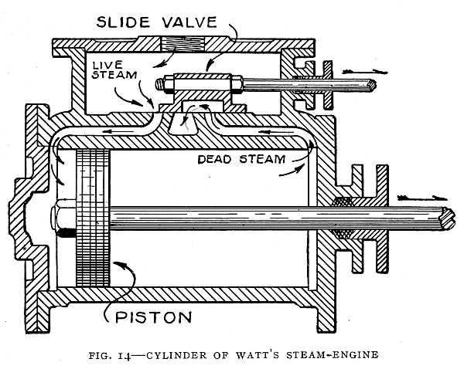
Irreversible expansion
Gas expands explosively, with its pressure unopposed.
The lost high pressure could have been used to do useful work.

Slide 11
Reversible Processes

Slide 12
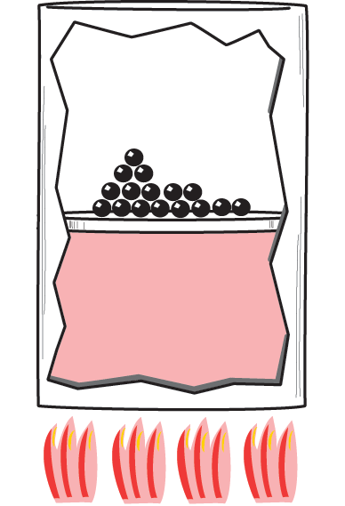
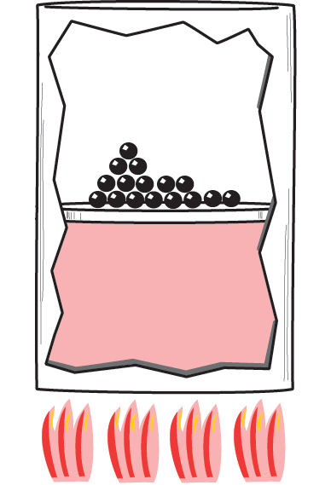
Reversible isothermal expansion of an ideal gas
Gas and surroundings at equilibrium.
Temperatures of gas and heat source match.
Pressure force balanced by weights.
Small weight removed.
Pressure force exceeds weight.
Heat from source reheats gas.
Gas expands slightly and cools. Work done in raising weights.

Slide 13
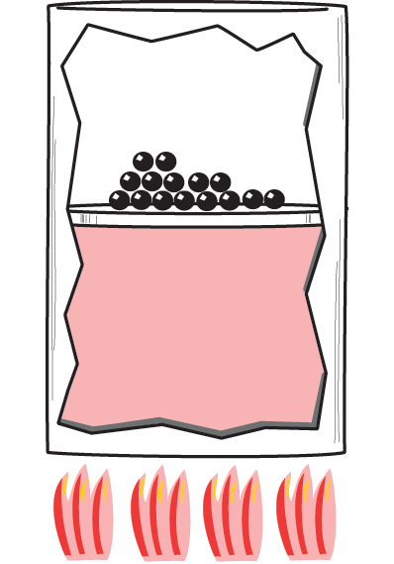



Why Reversible?
Gas expands
slight disturbance
remove small mass
Gas and surroundings at equilibrium
replace small mass
slight disturbance
Gas compresses

Slide 14
Work and Heat
Forward process
Reversed
process
= -
Work done
reversed
Work done
forward
Heat gained
forward
= -
Heat gained
reversed

Slide 15
A Thermodynamically Reversible Process …
...consists of states in:
First law of thermodynamics
dU = dQ – Σ_{i} X_{i} dx_{i}
near
perfect balance of thermodynamic forces
generalized force X_{i}
generalized displacement x_{i}
temperature differences
minutely removed from
pressure P
volume V
equilibrium with surroundings.
surface tension
area
magnetic field
magnetic dipole
electric field
electric dipole
…
…
Process proceeds very, very slowly.
Minute disturbances can reverse its direction.

Slide 16

Paradoxes

Slide 17

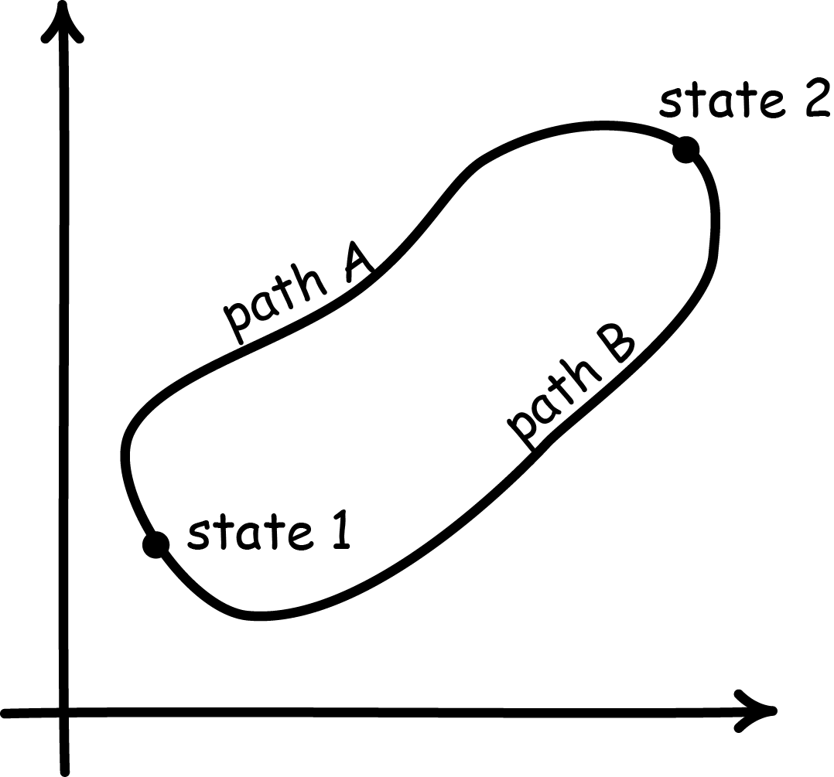
Equilibrium & NOT-Equilibrium
A thermodynamically reversible process consists of states in:
Eq
Attribute equilibrium properties to states:
uniform pressure, temperature, etc.
BUT no change with time.
perfect balance of thermodynamic forces
equilibrium with surroundings.
Forward and reverse processes trace out same curve in equilibrium state space.

Slide 18

Equilibrium & NOT-Equilibrium
A thermodynamically reversible process consists of states in:
Eq
Attribute equilibrium properties to states:
uniform pressure, temperature, etc.
BUT no change with time.
NOT-Eq
Imbalance or forces leads to process evolving with time.
BUT states are no longer in equilibrium.
near
perfect balance of thermodynamic forces
minutely removed from
equilibrium with surroundings.
Take the limit!!
NO driving force.
NO change.

Slide 19





“Infinitely slow process”
GO
STOP
1 sec
1 sec
1 sec
1 sec
1 sec
1 sec
1 sec
1 sec
2 sec
2 sec
2 sec
2 sec
2 sec
2 sec
2 sec
2 sec
slower
4 sec
4 sec
4 sec
4 sec
4 sec
4 sec
4 sec
4 sec
8 sec
8 sec
8 sec
8 sec
8 sec
8 sec
8 sec
8 sec
infinitely slow
∞
∞
∞
∞
∞
∞
∞
∞
Infinitely slow
no change
no process

Slide 20
190 Year History of Deflections Carnot 1824-now.

Slide 21

Candidate definitions
Existential supposition
Driving forces differ insensibly from zero
Processes reversed by very small changes of driving force
Processes that are infinitesimally removed from equilibrium
Infinitely slow processes
Process in which the initial state can be restored
Processes that are mechanically reversible
Quasi-static processes: the bare curve
Quasi-static processes: iterated equilibria

Slide 22

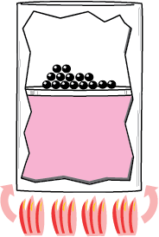
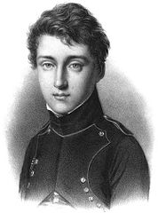
Infinitesimally removed from equilibrium
“A transformation is said to be reversible when the successive states of the transformation differ by infinitesimals from equilibrium states.”
Fermi (1937)
Also Lewis and Randall (1923), Porter (1931), …
?
“…if any stage the external pressure is increased even infinitesimally, then the piston will move in rather than out.”
Atkins (2010)
Smaller than any real number, but bigger than zero?
Smallest
non-zero displacement?
?
?
“It is thus that, in the differential calculus, it is sufficient that we can conceive the neglected quantities indefinitely reducible in proportion to the quantities retained in the equations, to make certain of the exact result.”
Carnot (1824)

Slide 23
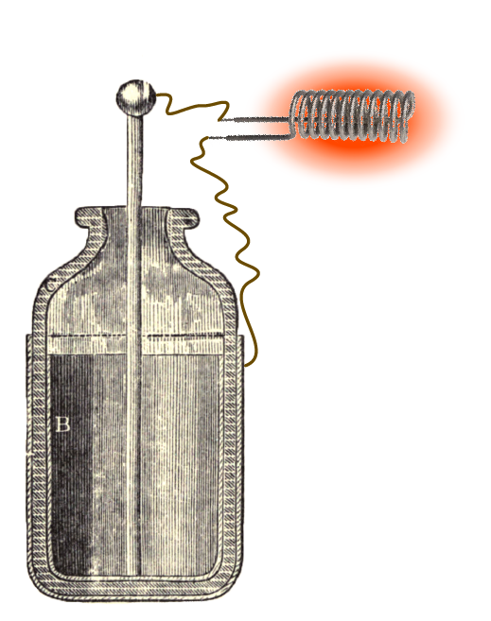

Infinitely slow
GO
∞
∞
∞
∞
∞
∞
∞
∞
STOP
“… thermodynamical processes which progress infinitely slowly, and which, therefore, consist of a succession of states of equilibrium.”
“…it can only be realized in an idealized sense, for it will take infinitely long time to achieve it...”
Planck (1887)
Lieb and Yngvason (1999)
BUT mere infinite slowness is not enough.
Capacitor discharges through a resistance.
Gas expands very slowly through a pinhole.
Sommerfeld (1956) and many others.

Slide 24
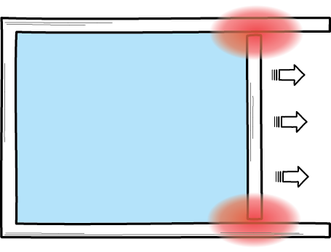
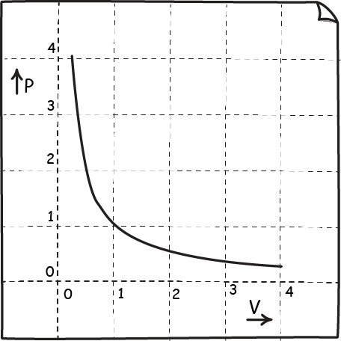
Quasi-static (abridged version)
“3. Quasi-static changes of state: These changes of state are very slow, infinitely slow in the limiting case, so that the intermediate states form a continuous sequence of equilibrium states.”
“… a sequence of equilibrium states …”
Redlich (1968)
Pauli (1973)
BUT
Reversible isothermal expansion and
irreversible expansion of an ideal gas
same set of equilibrium states
P=nRT/V

Slide 25
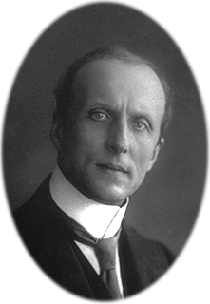
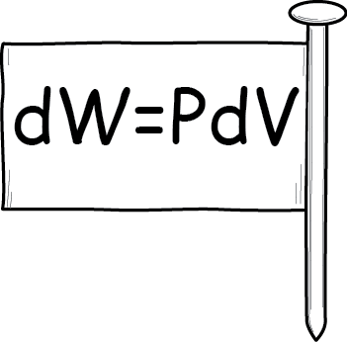
Quasi-static (original version)
Carathéodory (1909)
1
“A quasi-static, adiabatic change of state can thus be interpreted as a sequence of equilibrium points, and each quasi-static, adiabatic change of state corresponds to a specific curve in the space of [deformation coordinates] x_{i}.”
2
Pfaffian associated with curve
“Work”
Irreversible expansion excluded since no work is done.
DA = p₁dx₁ + p₂dx₂ + … + p_{n}dx_{n}
BUT
“… quite distinct from a real physical process, for a real process always involves nonequilibrium intermediate states having no representation in the thermodynamic configuration space.”
A(t) = “Work” not Work
since no force moves through a distance.
Callen (1985)

Slide 26
Equilibrium State Space Imperialism

Slide 27
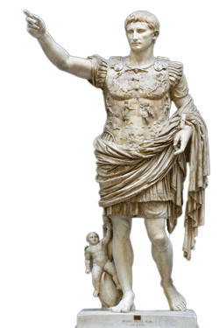
“Equilibrium thermodynamics”
= The study of the geometry of the space of equilibrium states.
take literally
Try to represent everything as structures in equilibrium state space.
“… quite distinct from a real physical process, for a real process always involves nonequilibrium intermediate states having no representation in the thermodynamic configuration space.”
Callen (1985) again

Slide 28
Perils of Taking Limits

Slide 29
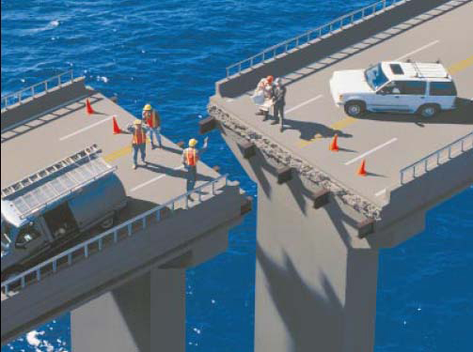
Limits behaving badly
System₁
Property₁
System₂
Property₂
System₃
Property₃
Limit
System
Limit
Property
Limit system may
not exist
Limit system and limit property may
not match.

Slide 30
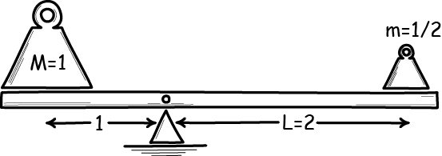
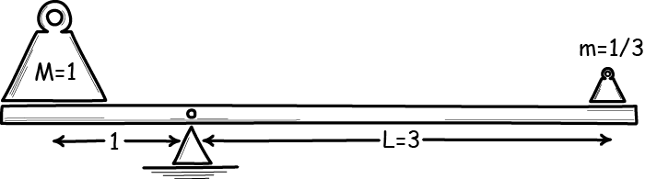
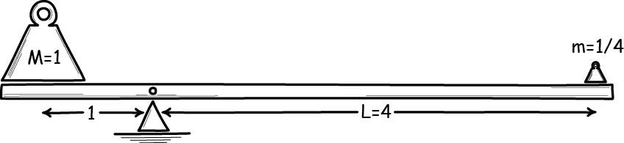
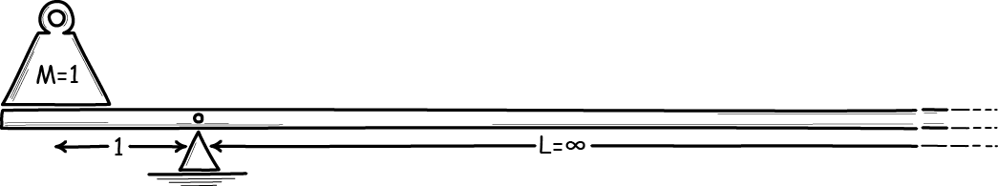
Infinite beam balance
Property
“balances”
“balances”
“balances”
take limit
“balances”
take limit
“does not
balance”

Slide 31
Limit of an “infinitely slow process”
GO
STOP
1 sec
1 sec
1 sec
1 sec
1 sec
1 sec
1 sec
1 sec
change
2 sec
2 sec
2 sec
2 sec
2 sec
2 sec
2 sec
2 sec
change
change
4 sec
4 sec
4 sec
4 sec
4 sec
4 sec
4 sec
4 sec
change
8 sec
8 sec
8 sec
8 sec
8 sec
8 sec
8 sec
8 sec
take limit
change
∞
∞
∞
∞
∞
∞
∞
∞
no change

Slide 32
Limit of an “infinitely slow process”
GO
STOP
1 sec
1 sec
1 sec
1 sec
1 sec
1 sec
1 sec
1 sec
irreversible processes carry all the properties of interest
2 sec
2 sec
2 sec
2 sec
2 sec
2 sec
2 sec
2 sec
4 sec
4 sec
4 sec
4 sec
4 sec
4 sec
4 sec
4 sec
8 sec
8 sec
8 sec
8 sec
8 sec
8 sec
8 sec
8 sec
Limit process has the wrong properties to describe real, slow processes.
∞
∞
∞
∞
∞
∞
∞
∞
Failed idealization

Slide 33

Limit of an “infinitely slow process”
GO
STOP
1 sec
1 sec
1 sec
1 sec
1 sec
1 sec
1 sec
1 sec
irreversible processes carry all the properties of interest
2 sec
2 sec
2 sec
2 sec
2 sec
2 sec
2 sec
2 sec
4 sec
4 sec
4 sec
4 sec
4 sec
4 sec
4 sec
4 sec
8 sec
8 sec
8 sec
8 sec
8 sec
8 sec
8 sec
8 sec
take limit
change
Approximation
Limit properties provide an inexact description of the real, slow processes

Slide 34
Thermodynamically reversible processes as Sets of irreversible processes

Slide 35
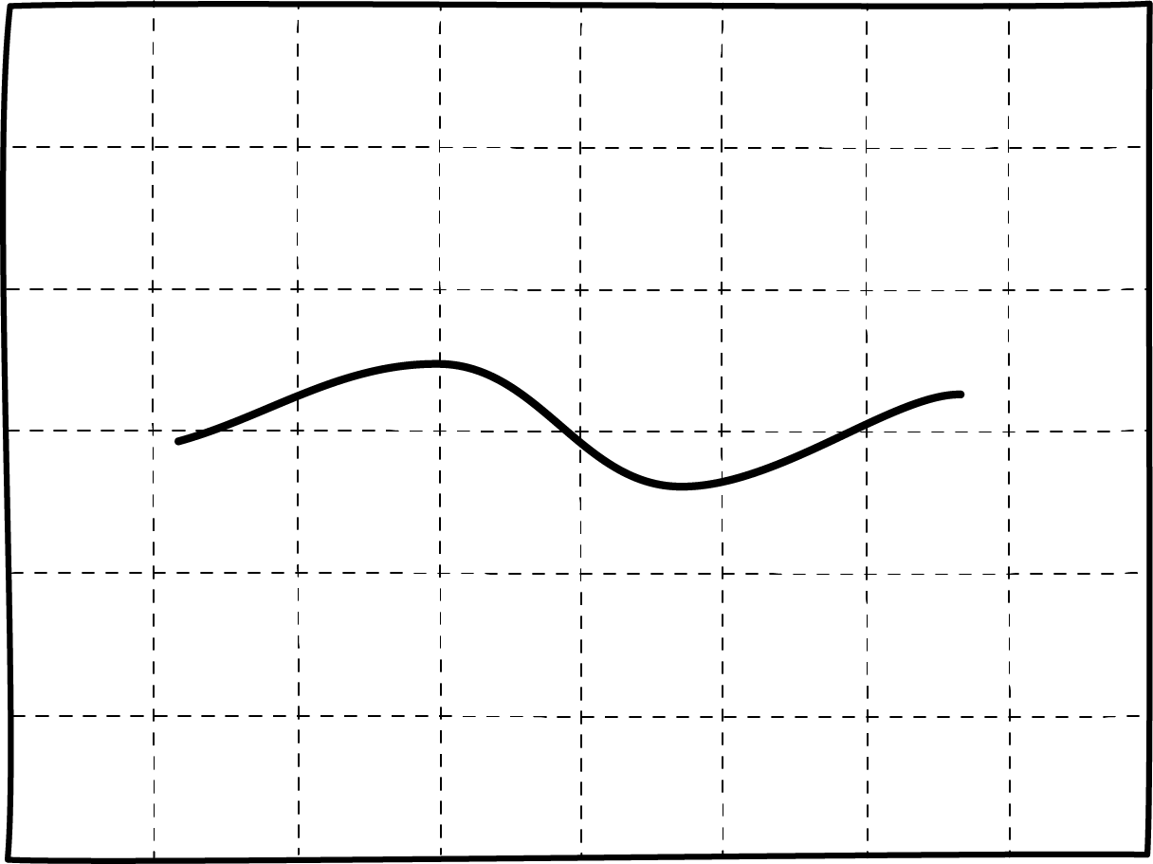
Equilibrium State Space
Quasi-static process
= set of equilibrium states forming a curve
merely serves to delimit the set of irreversible processes.

Slide 36
Non-Equilibrium and Equilibrium State Space
forward processes
heat gained Q
work done W
non-equilibrium states
limit
Q_{f}, W_{f}
Q_{f} = -Q_{r}
equilibrium states
W_{f} = -W_{r}
Q_{r}, W_{r}
non-equilibrium states
limit
heat gained Q
work done W
reverse processes

Slide 37
Non-Equilibrium and Equilibrium State Space
forward processes
heat gained Q
work done W
limit
Q_{f}, W_{f}
Q_{r}, W_{r}
limit
heat gained Q
work done W
reverse processes

Slide 38
Non-Equilibrium and Equilibrium State Space
No Idealization.
There is so single process that is reversible.
forward processes
heat gained Q
work done W
Properties attributed to reversible processes
are
the limit properties of this set of irreversible processes.
limit
Q_{f}, W_{f}
Approximation
Limit properties provide an inexact description of the irreversible processes.
Q_{r}, W_{r}
limit
heat gained Q
work done W
This set is the reversible process.
reverse processes

Slide 39
The Formal Prescription
Definition
A thermodynamically reversible process is a set of irreversible processes in a thermal system, delimited by the set of equilibrium states in (d) such that:
(a) Each process may exchange heat or work with its surroundings, because of imbalanced driving forces (temperature differences, generalized forces).
(b) The processes can be divided into a “forward” and a “reverse” set such that the total heat gained and the total work done have opposite signs in the two sets.
(c) In each set, there are processes in which the net driving forces are arbitrarily small. In the case of generalized forces, the net driving force is the difference between the generalized force and the force in the surrounding system that counteracts it.
(d) Under the limit of these net driving forces going to zero, the states of both forward and reverse processes approach the same set of equilibrium states and these states form a curve in equilibrium state space.
(e) The limiting values of heat gained and work done by the forward process are Qf and Wf; and by the reverse process Qr and Wr; and they satisfy Q_{f} = -Q_{r} and W_{f} = -W_{r}
(f) These limiting quantities of heat and work, computed at any stage of the process, correspond to those computed by integration of the relations (5) and (6) along the curves of the equilibrium states in equilibrium state space.

Slide 40

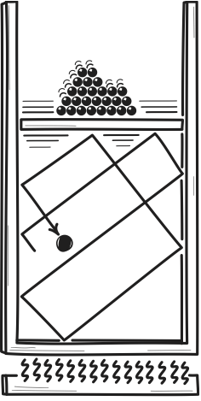
The Formal Prescription
So why care??
Existence
There is a thermodynamically reversible process for any curve in equilibrium state space.
Existence
depends on the hospitality of the background physics. It is not assured.
Existence fails
for molecular scale thermal systems!

Slide 41
Fluctuations

Slide 42
Macroscopic gas vs one atom gas
Macroscopic gas of
m monatomic atoms
Molecular scale gas of
one monatomic atom

Slide 43
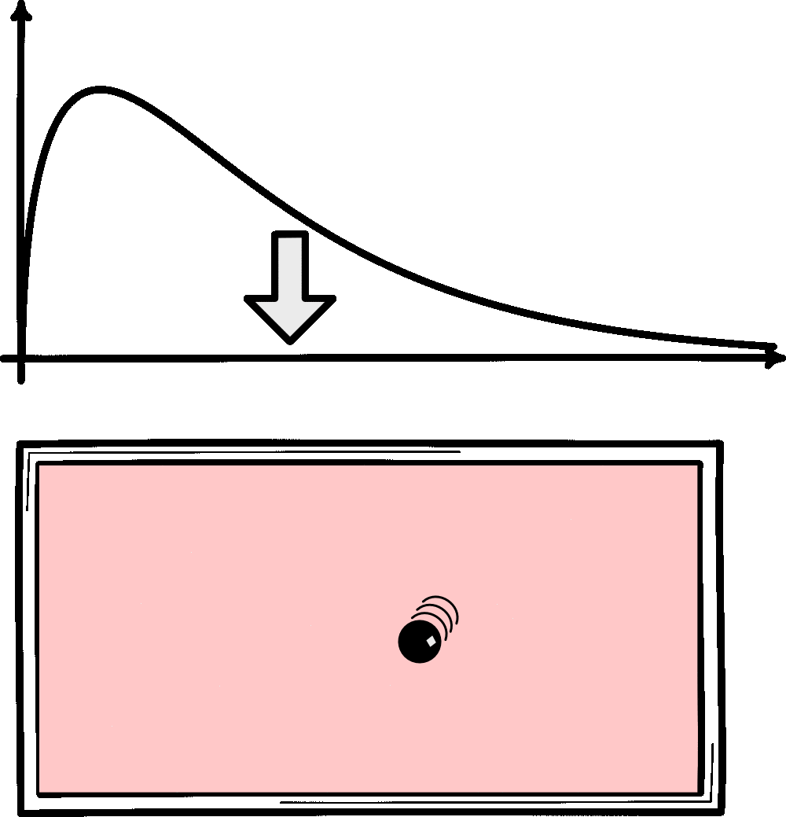
Molecular Scale Probabilities are Dynamic

Slide 44

Reversible Heating of Macroscopic Gas
ΔS = Qε/T²
→ 0 as ε→0
Q
Macroscopic gas of
m monatomic atoms
T
T+ε

Slide 45
Reversible Heating of One Molecule Gas Fails
20 times more likely to be in final state than in initial state.
Q=6kT
T
T+ε
2T
Molecular scale gas of
one monatomic atom

Slide 46
Molecular Scale Processes Complete Probabilistically
Probability of desired final state
W_{fin}
k log
= ΔS
Boltzmann’s
“S = k log W”
W_{init}
Probability of fluctuation to initial state
W_{fin} >> W_{init}
ΔS >> 0
ΔS = 0
W_{fin} = W_{init}

Slide 47
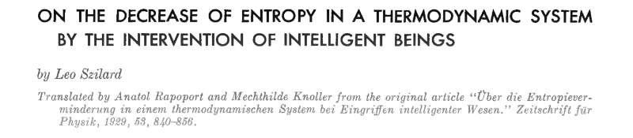

Slide 48
Conclusion

Slide 49
This Lecture
As much confusion over
thermodynamically reversible processes
thermodynamic entropy.
as over
Properties of thermodynamically reversible “process”
=
The limit properties
of a set of
irreversible processes.
Thermodynamically reversible processes
impossible on molecular scales.
are

Slide 50
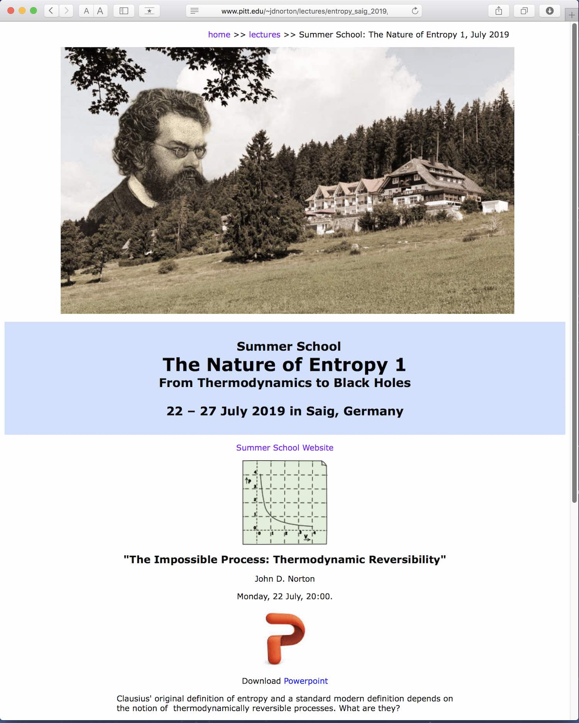


Slide 51

THE END

Slide 52
Appendices

Slide 53
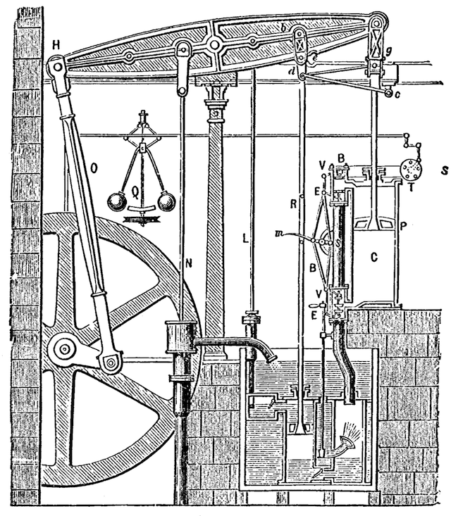
Thermodynamically Reversible Processes …
Least dissipative, most efficient processes.
Define entropy
heat gained in a reversible process
Bouton and Watt steam engine 1784
The principle of heat engine design
Bring processes closer to reversibility.
=

Slide 54
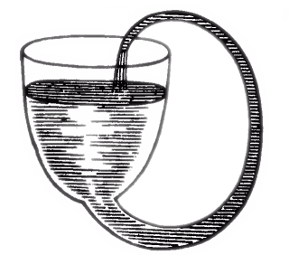
Suppose reversible processes exist
“A perfect thermodynamic engine is such that, whatever amount of mechanical effect it can derive from a certain thermal agency, if an equal amount be spent in working backwards, an equal reverse thermal effect will be produced.”
Thomson, 1849
Also Carnot (1824), Clapeyron (1837), Clausius (1851), …
Suppose we have perpetual motion machine.

Slide 55
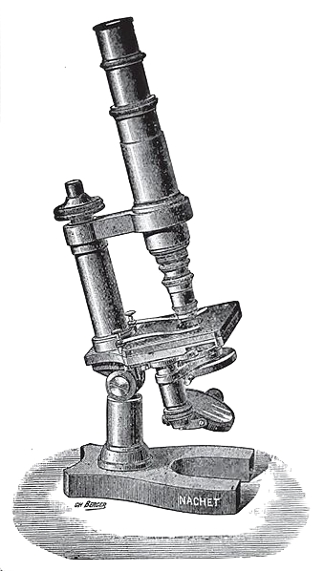
Driving forces…
“… excess may be supposed as slight as we please … without thereby destroying the exactness of the arguments.”
Carnot (1824)
“… small remaining differences of temperature may be neglected.”
?
Clausius 1879
?
“…never differ sensibly in temperature…”
?
“…pressure exerted … shall be sensibly equal to the load…”
Big enough to make a difference but too small to matter?
Poynting and J. J. Thomson
“… differences that fall “beneath the limit of observation.”
Carathéodory’s (1909)

Slide 56
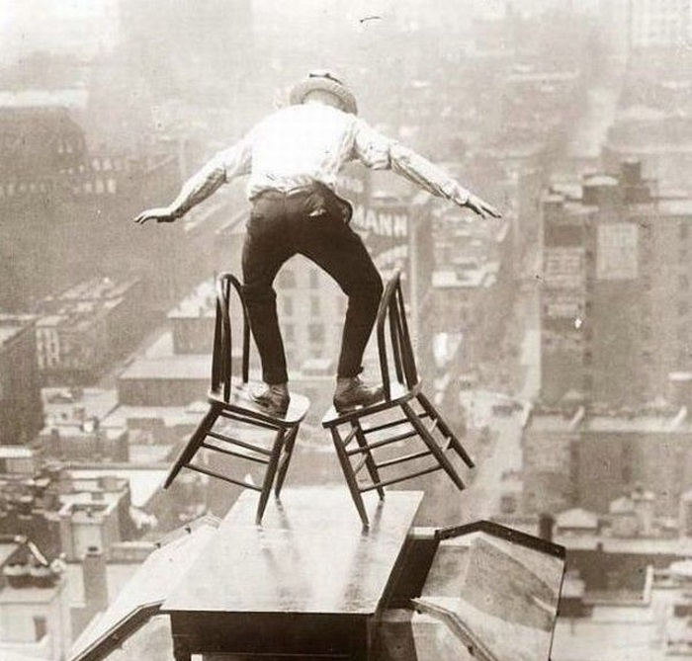
Reversal by very small change of driving forces
“... an exceedingly small alteration of the temperature will be sufficient to reverse the flow of heat …”
Maxwell (1879)
?
“A reversible process is defined as one which may be exactly reversed by an infinitesimal change in the external conditions.”
?
?
Pippard (1966)
Big enough to make a difference but too small to matter?
“… we can reverse the process (to within an arbitrarily good accuracy) by adding a tiny bit to the weight …”
Lieb and Yngvason (1998)

Slide 57
Restoration (variant of supposition)
“… a reversible process is one that is performed in such a way that, at the conclusion of the process, both the system and the local surroundings may be restored to their initial states, without producing any changes in the rest of the universe. A process that does not fulfill these stringent requirements is said to be irreversible.”
Zemansky (1968)
Planck (1897) and more.
Suppose we have perpetual motion machine.

Slide 58


Mechanical reversibility??
“... all perfectly periodic processes, e.g. an ideal pendulum or planetary motion, are reversible, for, at the end of every period, the initial state is completely restored. Also, all mechanical processes with absolutely rigid bodies and absolutely incompressible liquids, as far as friction can be avoided, are reversible. By the introduction of suitable machines with absolutely unyielding connecting rods, frictionless joints and bearings, inextensible belts, etc., it is always possible to work the machines in such a way as to bring the system completely into its initial state without leaving any change in the machines, for the machines of themselves do not perform work.”
Planck (1897)

Slide 59
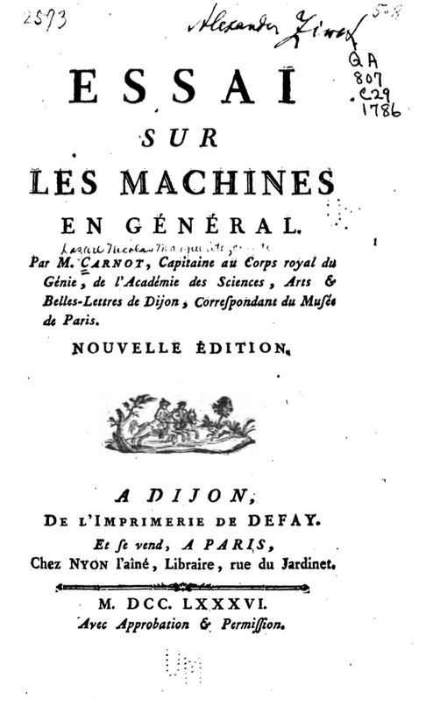
Mechanical reversibility
Thermodynamic reversibility
Results from reversal of
initial conditions
Results from reversal of
driving forces
Isolated from surroundings
usually.
Interacts with surroundings
usually.
Non-dissipative, elastic collisions
Dissipative processes, heat transfer
Sadi’s account akin to Lazare Carnot’s account of the efficiency of machines operating with inelastic collisions.

Slide 60
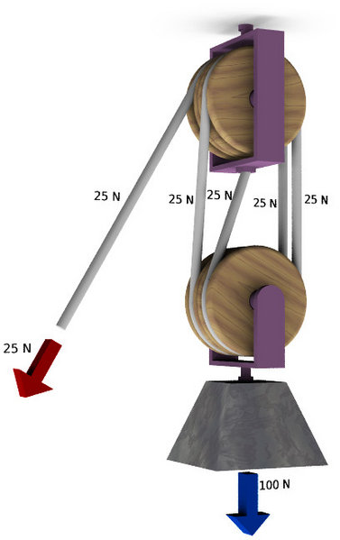
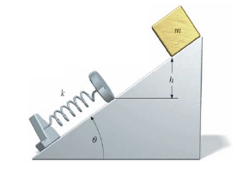
Thermodynamically reversible processes Idealizations made by Taking Limits
“… there are no reversible changes in nature. We must consider reversibility as an ideal limiting condition that may be approached but not actually attained when the processes are conducted very slowly.”
“… a reversible process is purely an ideal abstraction, extremely useful for theoretical calculations (as we shall see) but quite devoid of reality. … resembles … weightless strings, frictionless pulleys, and point masses.”
Zemansky (1968)
Goodenough (1911)
https://commons.wikimedia.org/wiki/File:Polispasto4.jpg

Slide 61
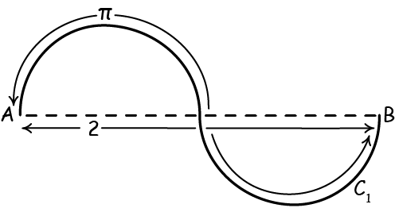
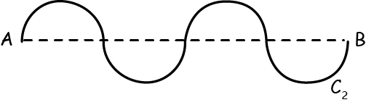
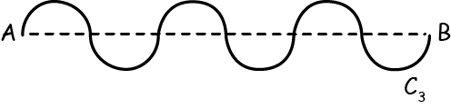



“Proof” that π = 2
Property
length = π
length = π
length = π
length = π
length = π
take limit
length = 2
length = π

Slide 62

Pierre Duhem
“This series of equilibrium states α, β, γ, δ, . . . which is passed over by no modification of the system is, in some sort [“as it were”], the common boundary of the real transformations that bring the system from the state 1 to the state 2 and of the real transformations that bring the system from state 2 to state 1; … this series of equilibrium states is called a reversible transformation.
Thus the reversible transformation is a continuous series of equilibrium states; it is essentially unrealizable; but we may give our attention to these equilibrium states successively either in the order from state 1 to state 2, or in the reverse order; this purely intellectual operation is denoted by these words: to cause a system to undergo the reversible transformation considered, either in the direction 1-2, or in the reverse direction.”
The only admissible account I found in 190 years of the literature.
Duhem, Pierre (1903) Thermodynamics and Chemistry:
A Non-Mathematical Treatise for Chemists and Students of Chemistry. Trans. G. K. Burgess.Nwe York: John Wiley & Sons. p. 70

Slide 63
Reconstructing Thermodynamics

Slide 64


Rederive results
reversible processes
as realizable processes
with special properties
properties of reversible processes
as unrealized limits
of the behavior of real processes.
Replace
with
ε
ε
ε
ε
Reversible heat engines are the most efficient.
All reversible heat engines have the same efficiency.
ε
ε
ε
ε
ε
ε
ε
ε
ε
ε
ε
ε
Thermodynamic temperature scale.
Clausius inequality
Entropy is a state function.

Slide 65



Reversible Heat Engines are the Most Efficient Standard Analysis
Suppose for reductio
η_{irr} > η
irrreversible
heat engine
reversible
heat engine
reversible
heat engine
operate in reverse
efficiency
efficiency
η_{irr} = W_{irr}/Q_{irr}
η = W/Q

Slide 66
Reversible Heat Engines are the Most Efficient Standard Analysis
Suppose for reductio
η_{irr} > η
set equal

Slide 67

Reversible Heat Engines are the Most Efficient Standard Analysis
Suppose for reductio
η_{irr} > η
ε
ε
ε
ε
ε
ε
ε
W
W
ε
η_{irr} =
>
= η
ε
ε
Q_{irr}
Q
ε
ε
ε
ε
ε
ε
ε
ε
ε
ε
Q – Q_{irr} > 0
ε
ε
ε
ε
Net effect is to pass a
positive amount of heat
from cold to hot.
Net effect is to pass heat
Q – Q_{irr}
from cold to hot.
Clausius form of the second law of thermodynamics is violated.
Suppose for reductio
η_{irr} > η

Slide 68
Reversible Heat Engines are the Most Efficient New Analysis
Suppose for reductio
η_{irr} > η
irrreversible
heat engine
many heat engines running forward
many heat engines running in reverse
This set is the reversible heat engine.
efficiency
η_{irr} = W_{irr}/Q_{irr}
In both directions, some come arbitrarily “ε” close in efficiency to the limiting efficiency
None achieve the limiting efficiency.
η = W/Q

Slide 69
Reversible Heat Engines are the Most Efficient New Analysis
Suppose for reductio
η_{irr} > η
W
W
η_{irr} =
>
- ε = η
Q_{irr}
Q
Select ε sufficiently small so that
Q – Q_{irr} > 0
Net effect is to pass a
positive amount of heat
from cold to hot
Irreversible engine runs reversed engine, operating within ε of η.
Clausius form of the second law of thermodynamics is violated.
η = W/Q - ε
Suppose for reductio
η_{irr} > η
69

