Slide 1
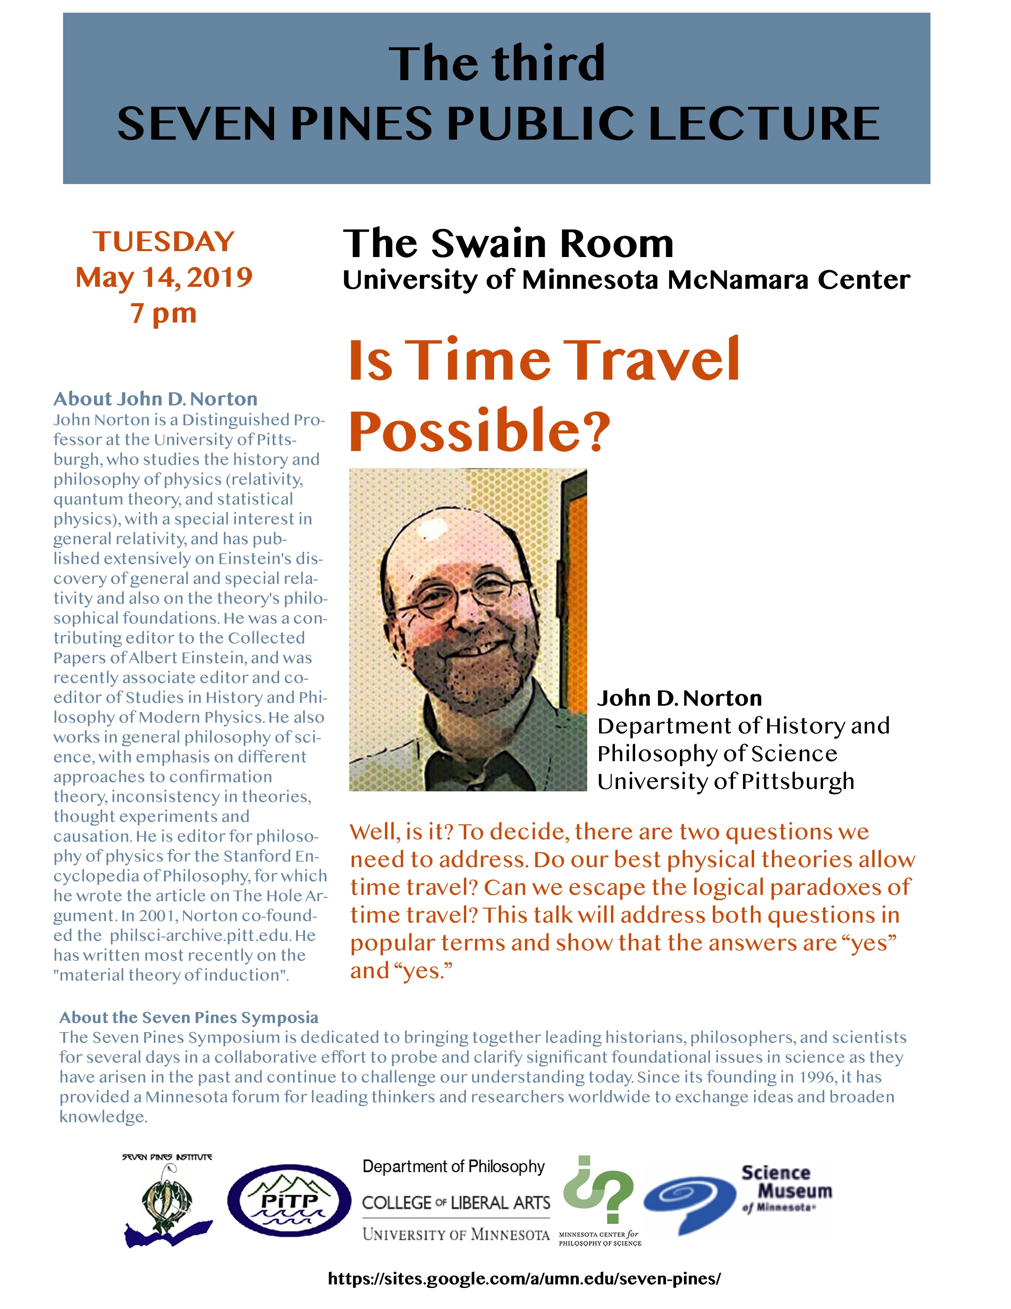
Is Time Travel Possible?
John D. Norton Department of History
and Philosophy of Science University of Pittsburgh

Slide 2
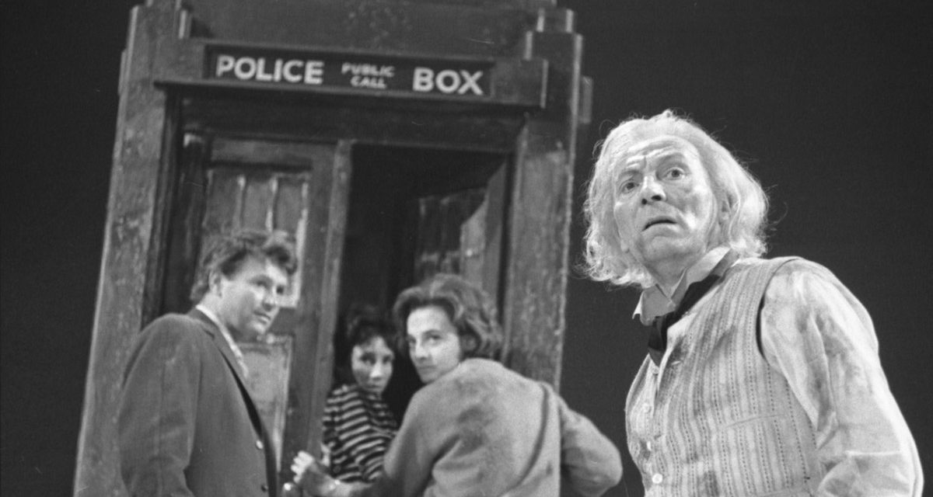

Slide 3
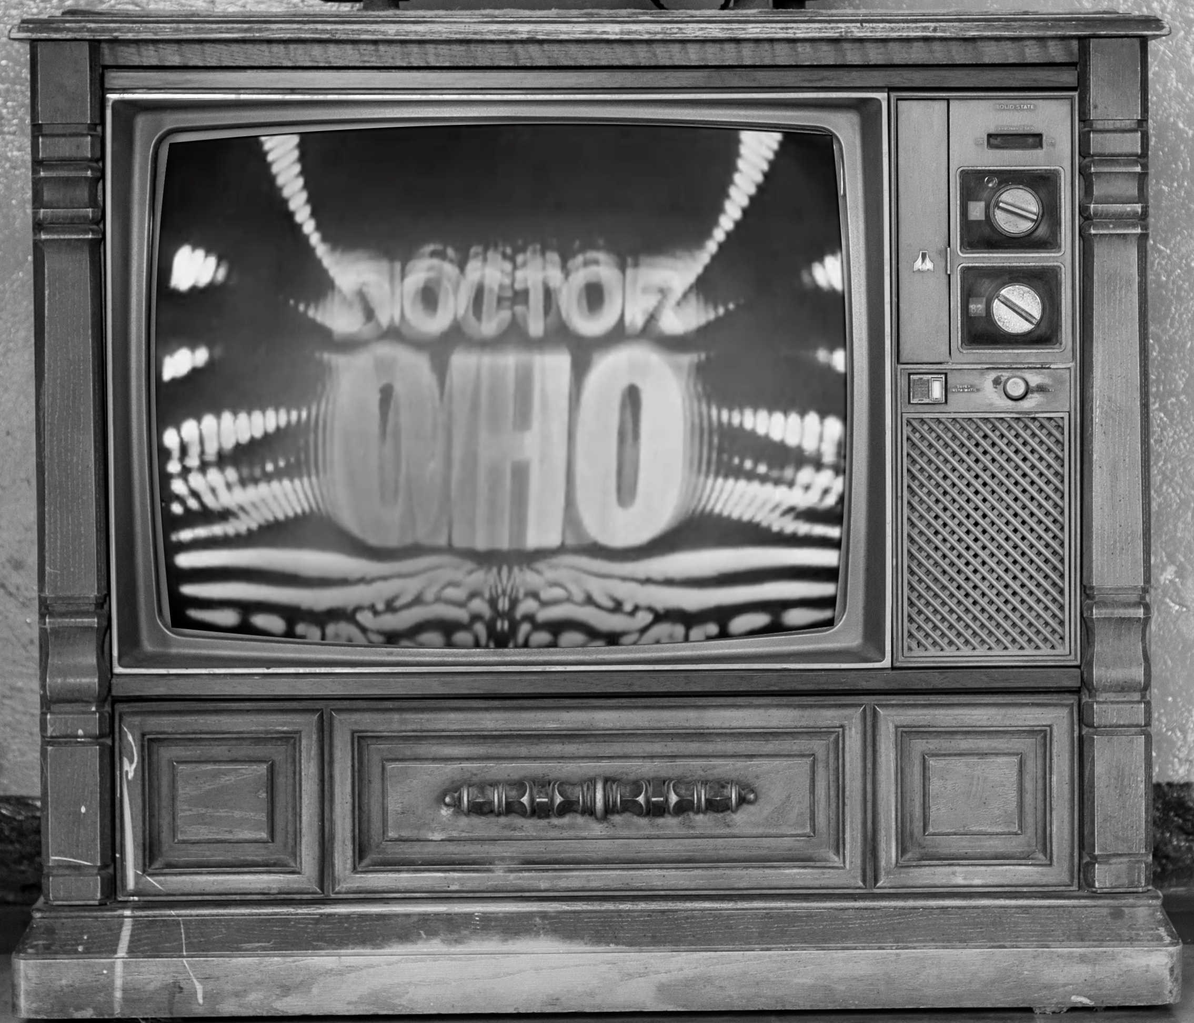

Slide 4
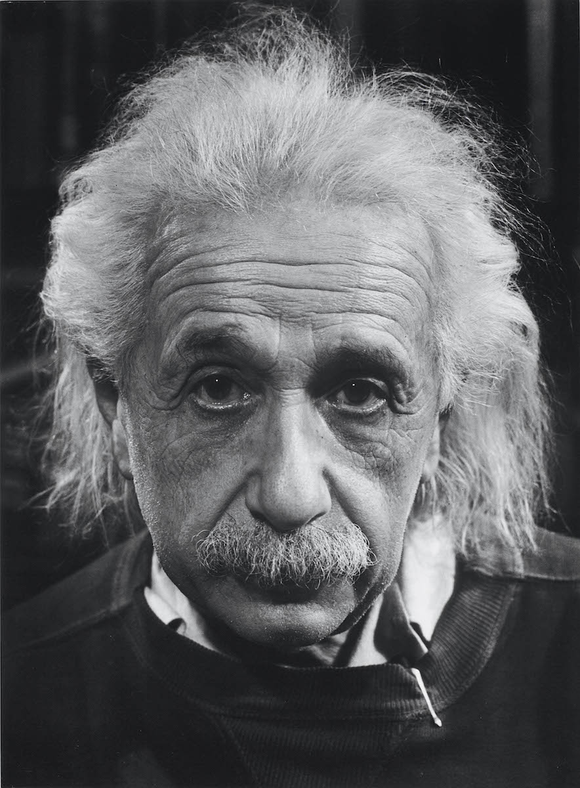
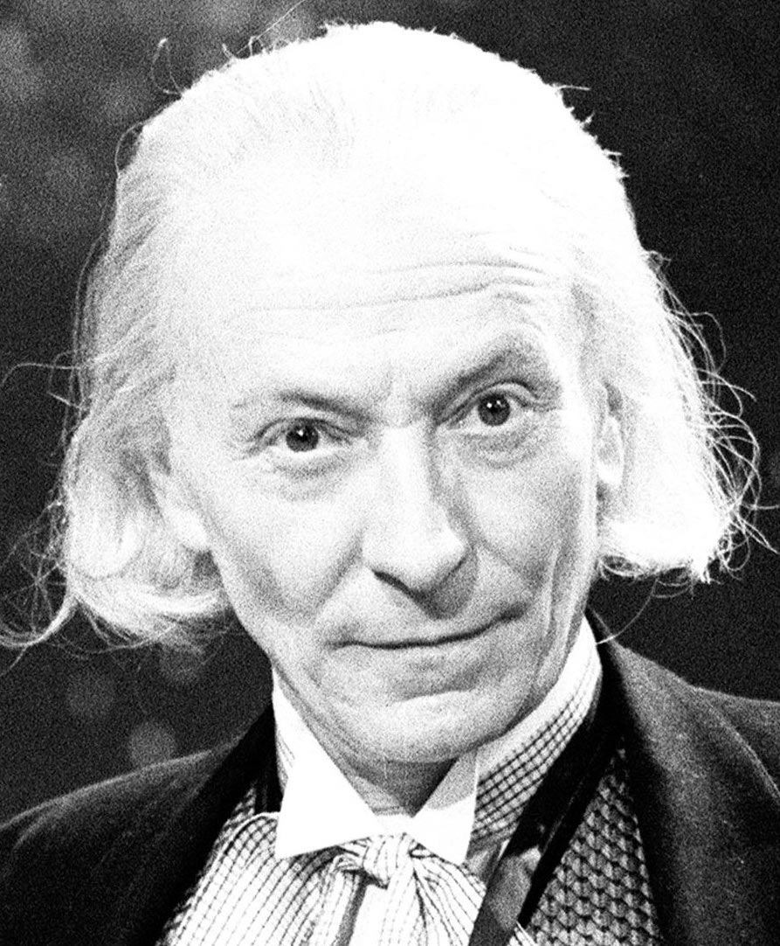
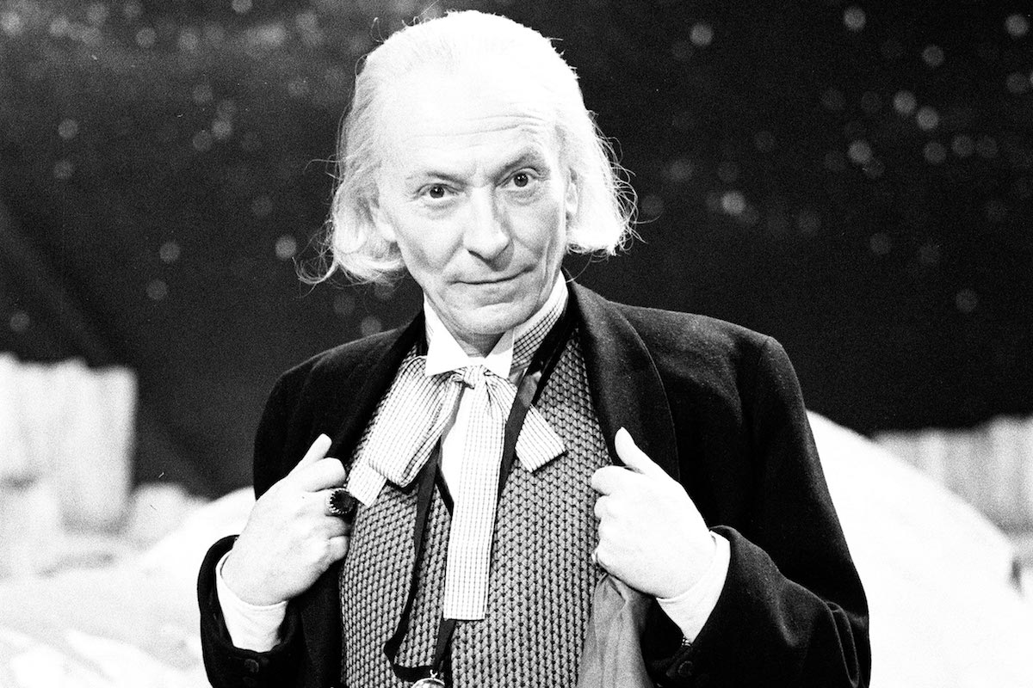

Slide 5
Einstein’s Two Theories of Relativity

Slide 6
Einstein’s two theories of relativity
Special relativity
General relativity
Possibility of tachyonic influences on the past.
Possibility of closed timelike worldlines.

Slide 7
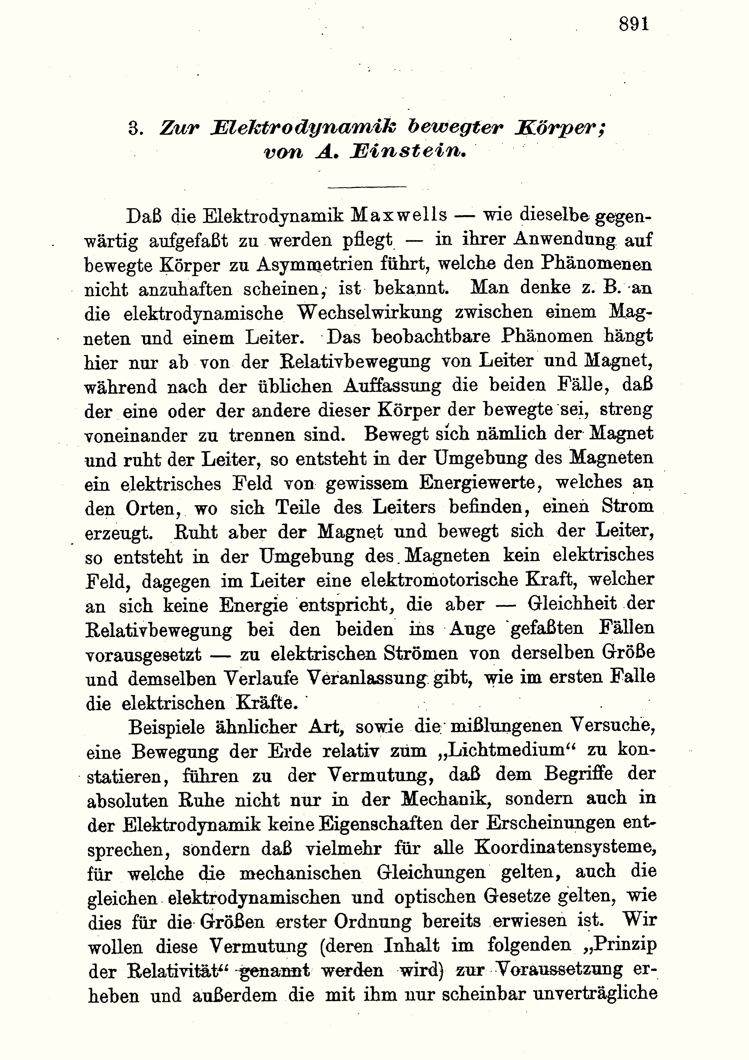
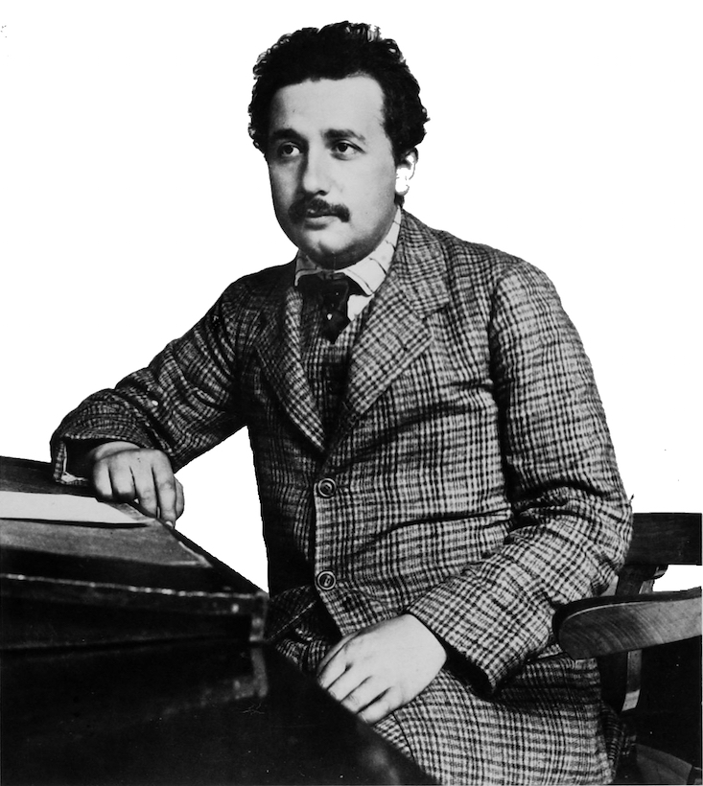
Special Relativity

Slide 8
How to assemble a spacetime

Slide 9
How to disassemble a spacetime
Relativity of simultaneity.
Observers in relative motion slice up the spacetime into different spaces.

Slide 10
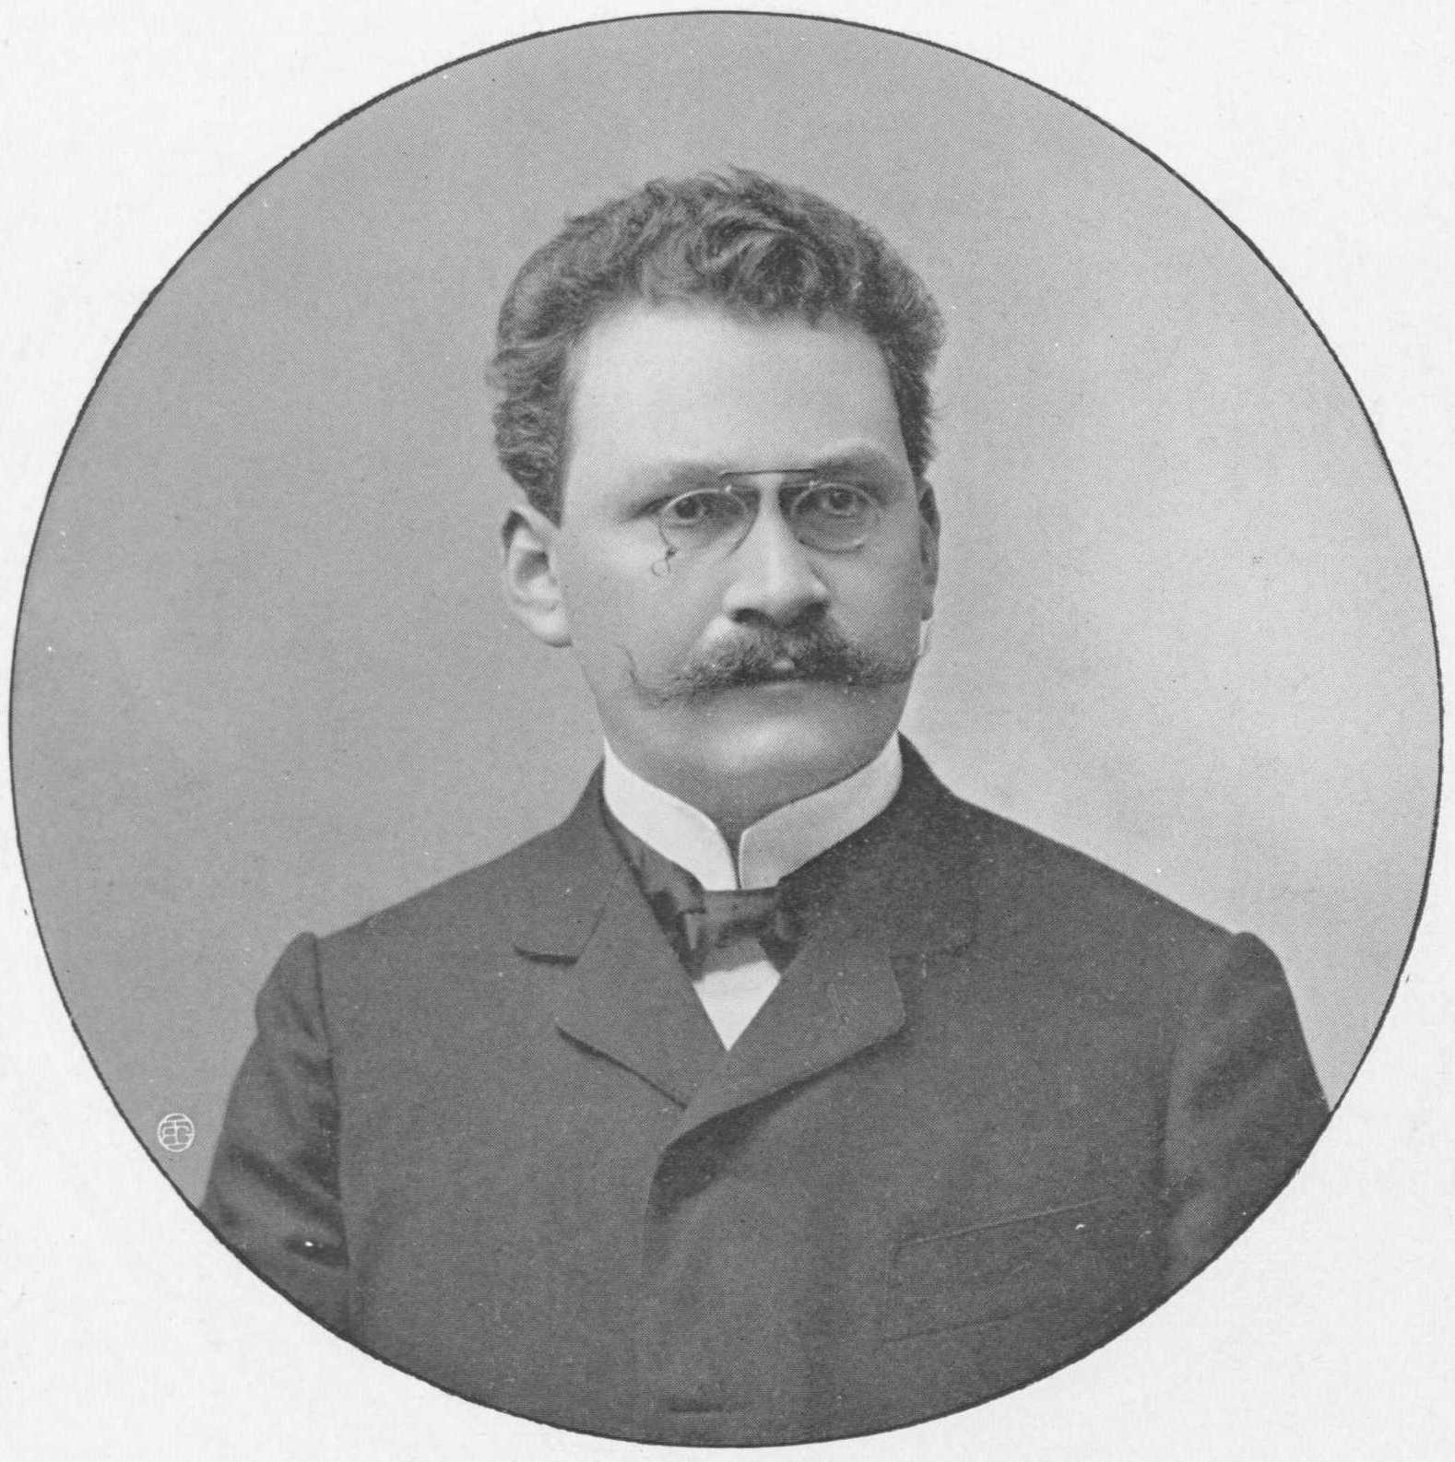
“The views of space and time which I wish to lay before you have sprung from the soil of experimental physics and therein lies their strength.
They are radical.
Henceforth space by itself and time by itself, are doomed to fade away into mere shadows,
and only a kind of union of the two will preserve an independent reality.”

Slide 11
Tachyons

Slide 12
Tachyons: Particles that move faster than light.
tachyon moves infinitely fast
chase after it
chase after
it, faster
tachyon moves backwards in time
redraw

Slide 13
A Tachyon Paradox

Slide 14
A Tachyon paradox
A robotically programmed spaceship…
…fires a tachyon into the past at time 2.
Tachyon is reflected back by a tachyon mirror.

Slide 15
A Tachyon paradox
Robot sensor detects the tachyon at time 1.
Triggers self-destruction.

Slide 16
A Tachyon paradox
There is no spaceship to fire the tachyon into the past at time 2.

Slide 17
A Tachyon paradox
There is no spaceship to fire the tachyon into the past at time 2.
The spaceship is not destroyed at time 1.

Slide 18
A Tachyon paradox
There IS a spaceship to fire the tachyon into the past at time 2.

Slide 19
A Tachyon paradox
There IS a spaceship to fire the tachyon into the past at time 2.
The spaceship IS destroyed at time 1.

Slide 20
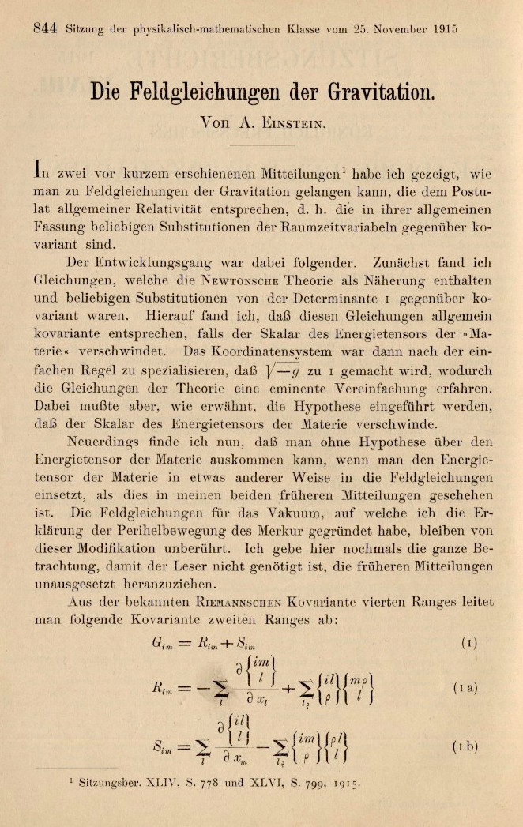
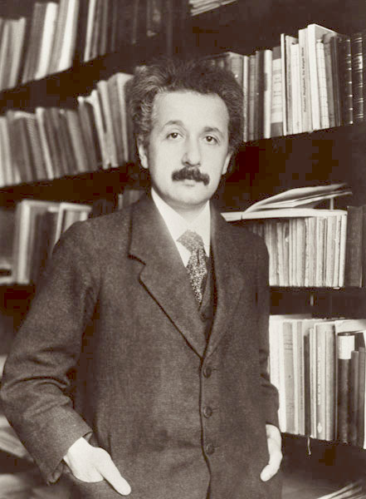
General Relativity

Slide 21
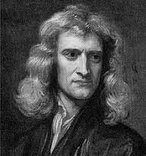
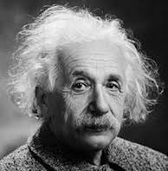
Gravity is a curvature of spacetime geometry
Newton: gravity is a deflecting force.
Einstein: free fall follows straight lines of curved geometry.

Slide 22
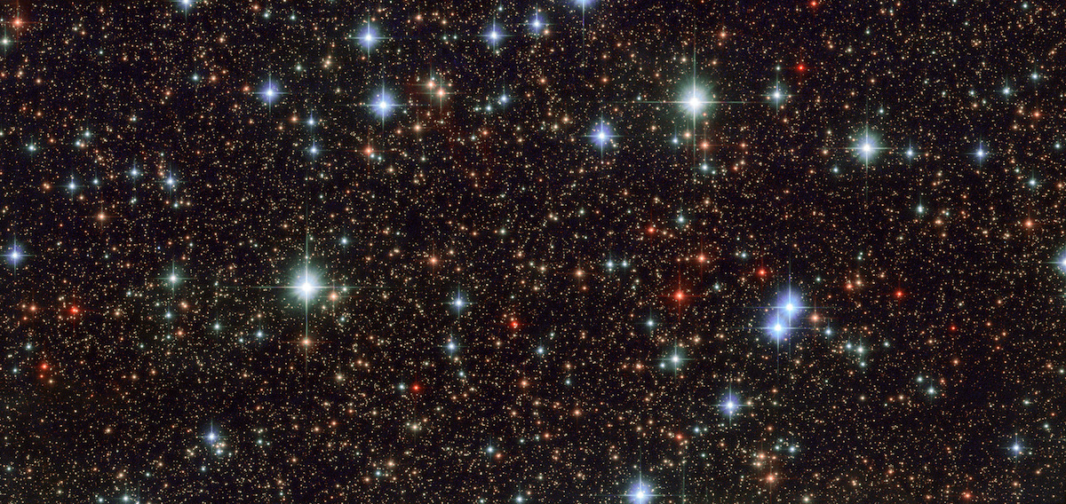
General relativity is a local theory
GR specifies how each local piece of spacetime must be:
curvature matches matter density
Any combination can be assembled as long as the edges match.

Slide 23
General relativity is a local theory
pieces of spacetime
spacetime

Slide 24
General relativity is a local theory
An easy case:
The spacetime is homogenous.
All the pieces are the same and fit together easily.

Slide 25
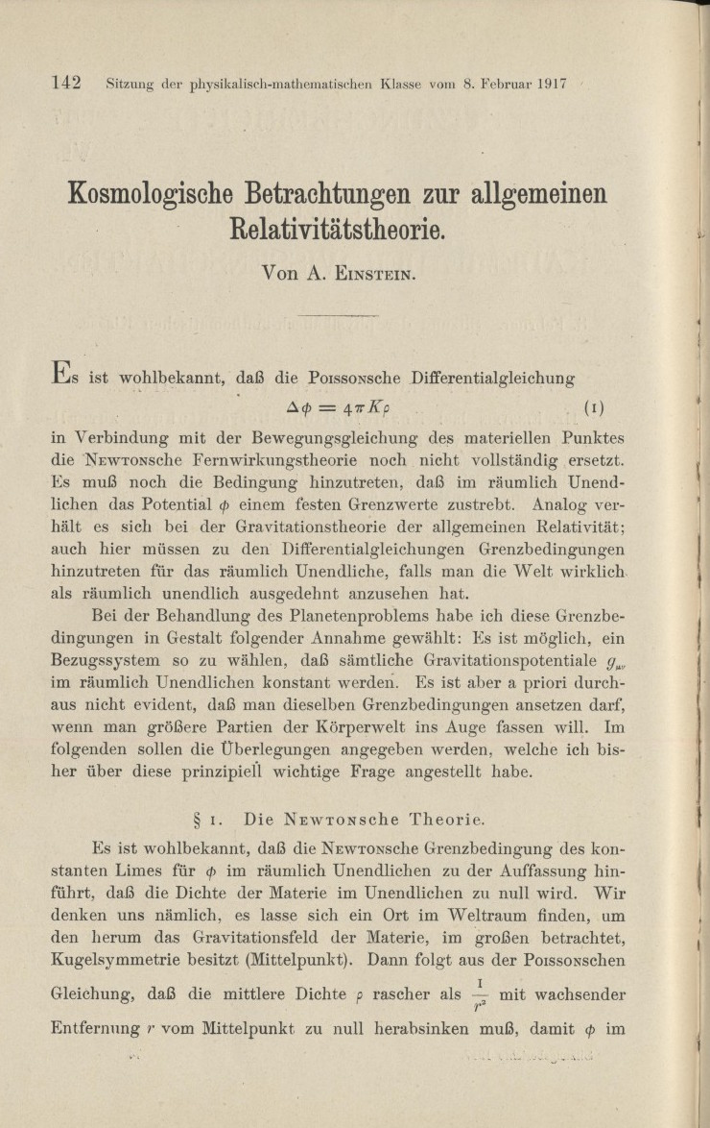
Closing space
Einstein’s cosmology paper of 1917 introduces the first relativistic cosmology, the “Einstein Universe.”

Slide 26
Closing space

Slide 27
Closing time?

Slide 28
“Closed timelike worldlines”
merely live long enough
meet your past self.

Slide 29
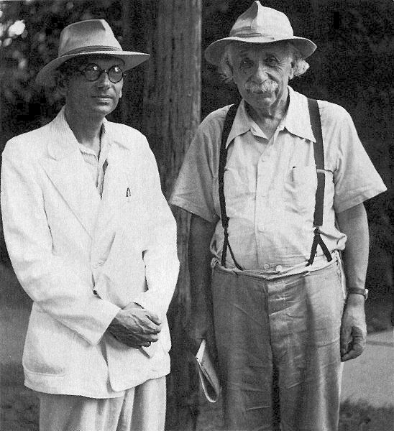
Gödel Spacetime

Slide 30
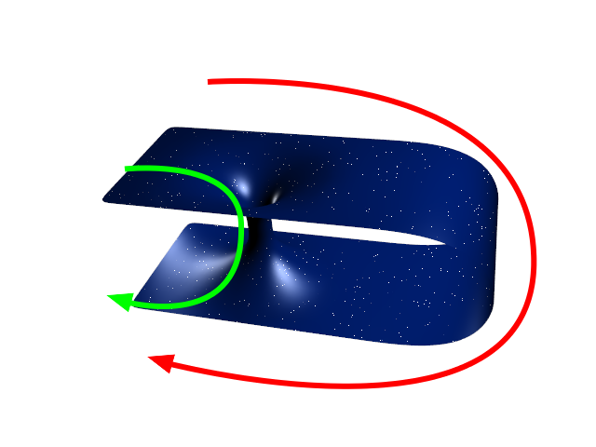
Wormholes

Slide 31
Grandfather Paradox

Slide 32
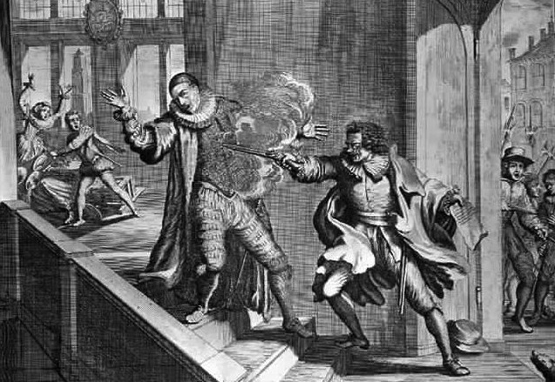
Grandfather paradox
Preferred variant:
You convince your grandfather to adopt a life of celibacy, helping the poor and unfortunate.
assassin succeeds
assassin fails
assassin succeeds
assassin fails
…

Slide 33

Paradox Busting

Slide 34
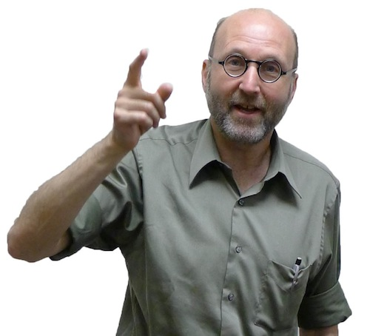
Basic principle
Only one thing happens
at one time.
Either
assassin succeeds
or
assassin fails
but not both.

Slide 35
Tachyon paradox (again)
Escape 1: There are no tachyons.
Principle of minimal mutilation.
Escape 2: We cannot control whether a tachyon is emitted.

Slide 36
Cannot control emission of tachyons?
Observer triggers an emission into the past.
Tachyon arrives from the past at the moment the trigger is pushed.
looks just like

Slide 37
Grandfather paradox
Universe without closed timelike worldlines.
Assemble universe subject only to local constraints.

Slide 38
Grandfather paradox
Universe with closed timelike worldlines.
We assemble universe subject to local constraints
AND
we need to match initial pieces.
Unfamiliar global constraints.
“Assassin must miss since he already has missed in the past, else he would not be here attempting the assassination now.”

Slide 39
Global Constraints: the “99” puzzle
1. Start at 0.
2. Add or subtract any even number in 2 to 10 until you get to 99.
+ 8 - 2
Locally, easily solved.
… 90 91 92 93 94 95 96 97 98 99
+ 4
Globally insoluble.
0 1 2 3 4 … 94 95 96 97 98 99
Golbally constrained to even numbers.

Slide 40
Only one thing happens at one time?

Slide 41
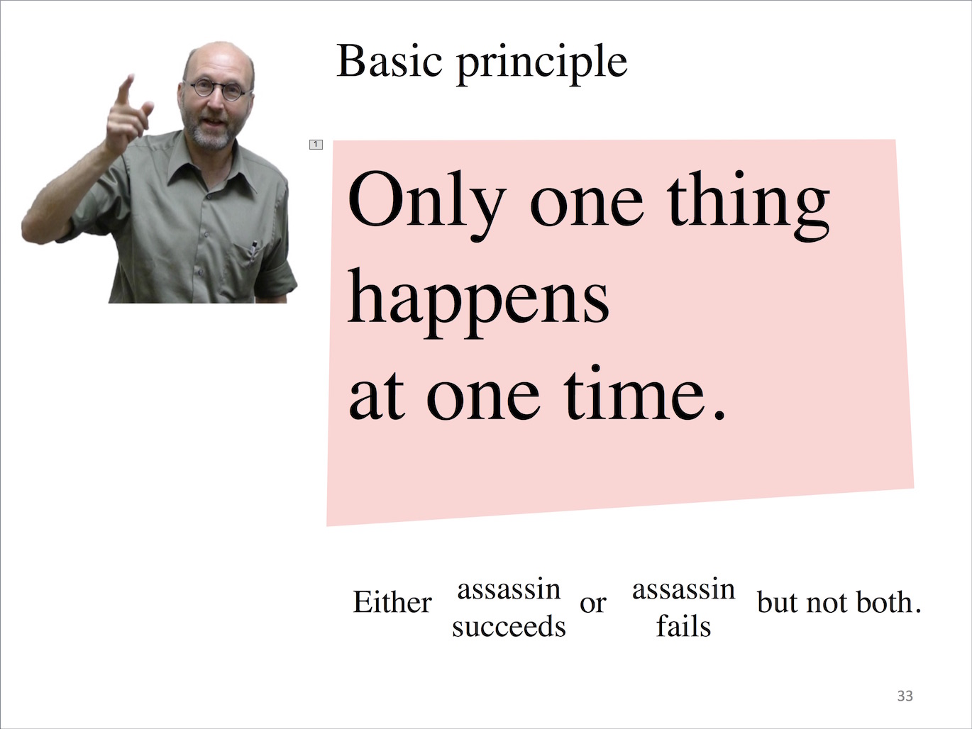
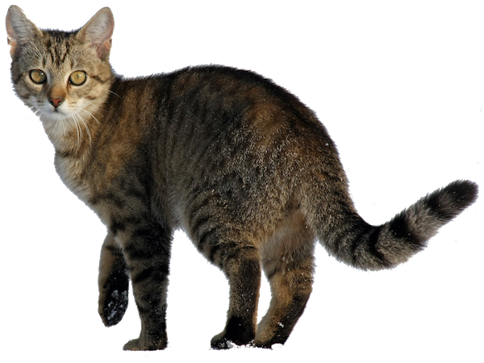
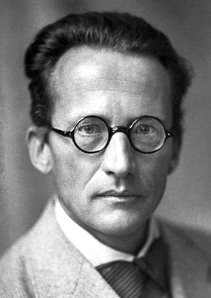
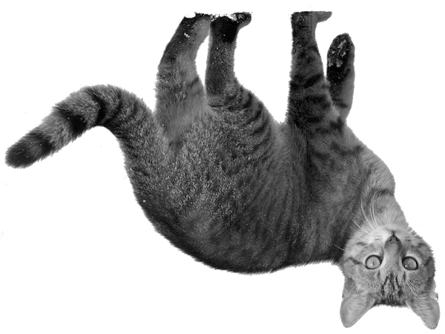
There’s that very strange business with the quantum cat.
+

Slide 42
A two state quantum system

Slide 43
Green → Red in a time travel universe

Slide 44
Red → Green in a time travel universe

Slide 45
Superposition of a two state quantum system
superposed
“added up”
System period

Slide 46
Green + Red → Green + Red in a time travel universe

Slide 47
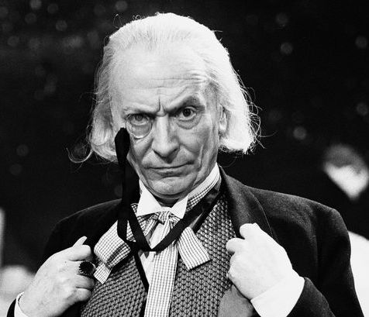
Really?

Slide 48
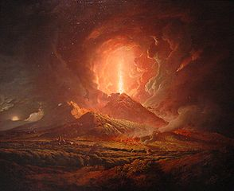
Global constraints still needed
Cosmic recurrence Time
Period of red-green system
Period of every other system
=
exactly
=
exactly

Slide 49
What is it like to be a quantum superposition?
What we wanted
What we have

Slide 50
Generic quantum systems are not exactly periodic.

Slide 51
Tell me more!

Slide 52
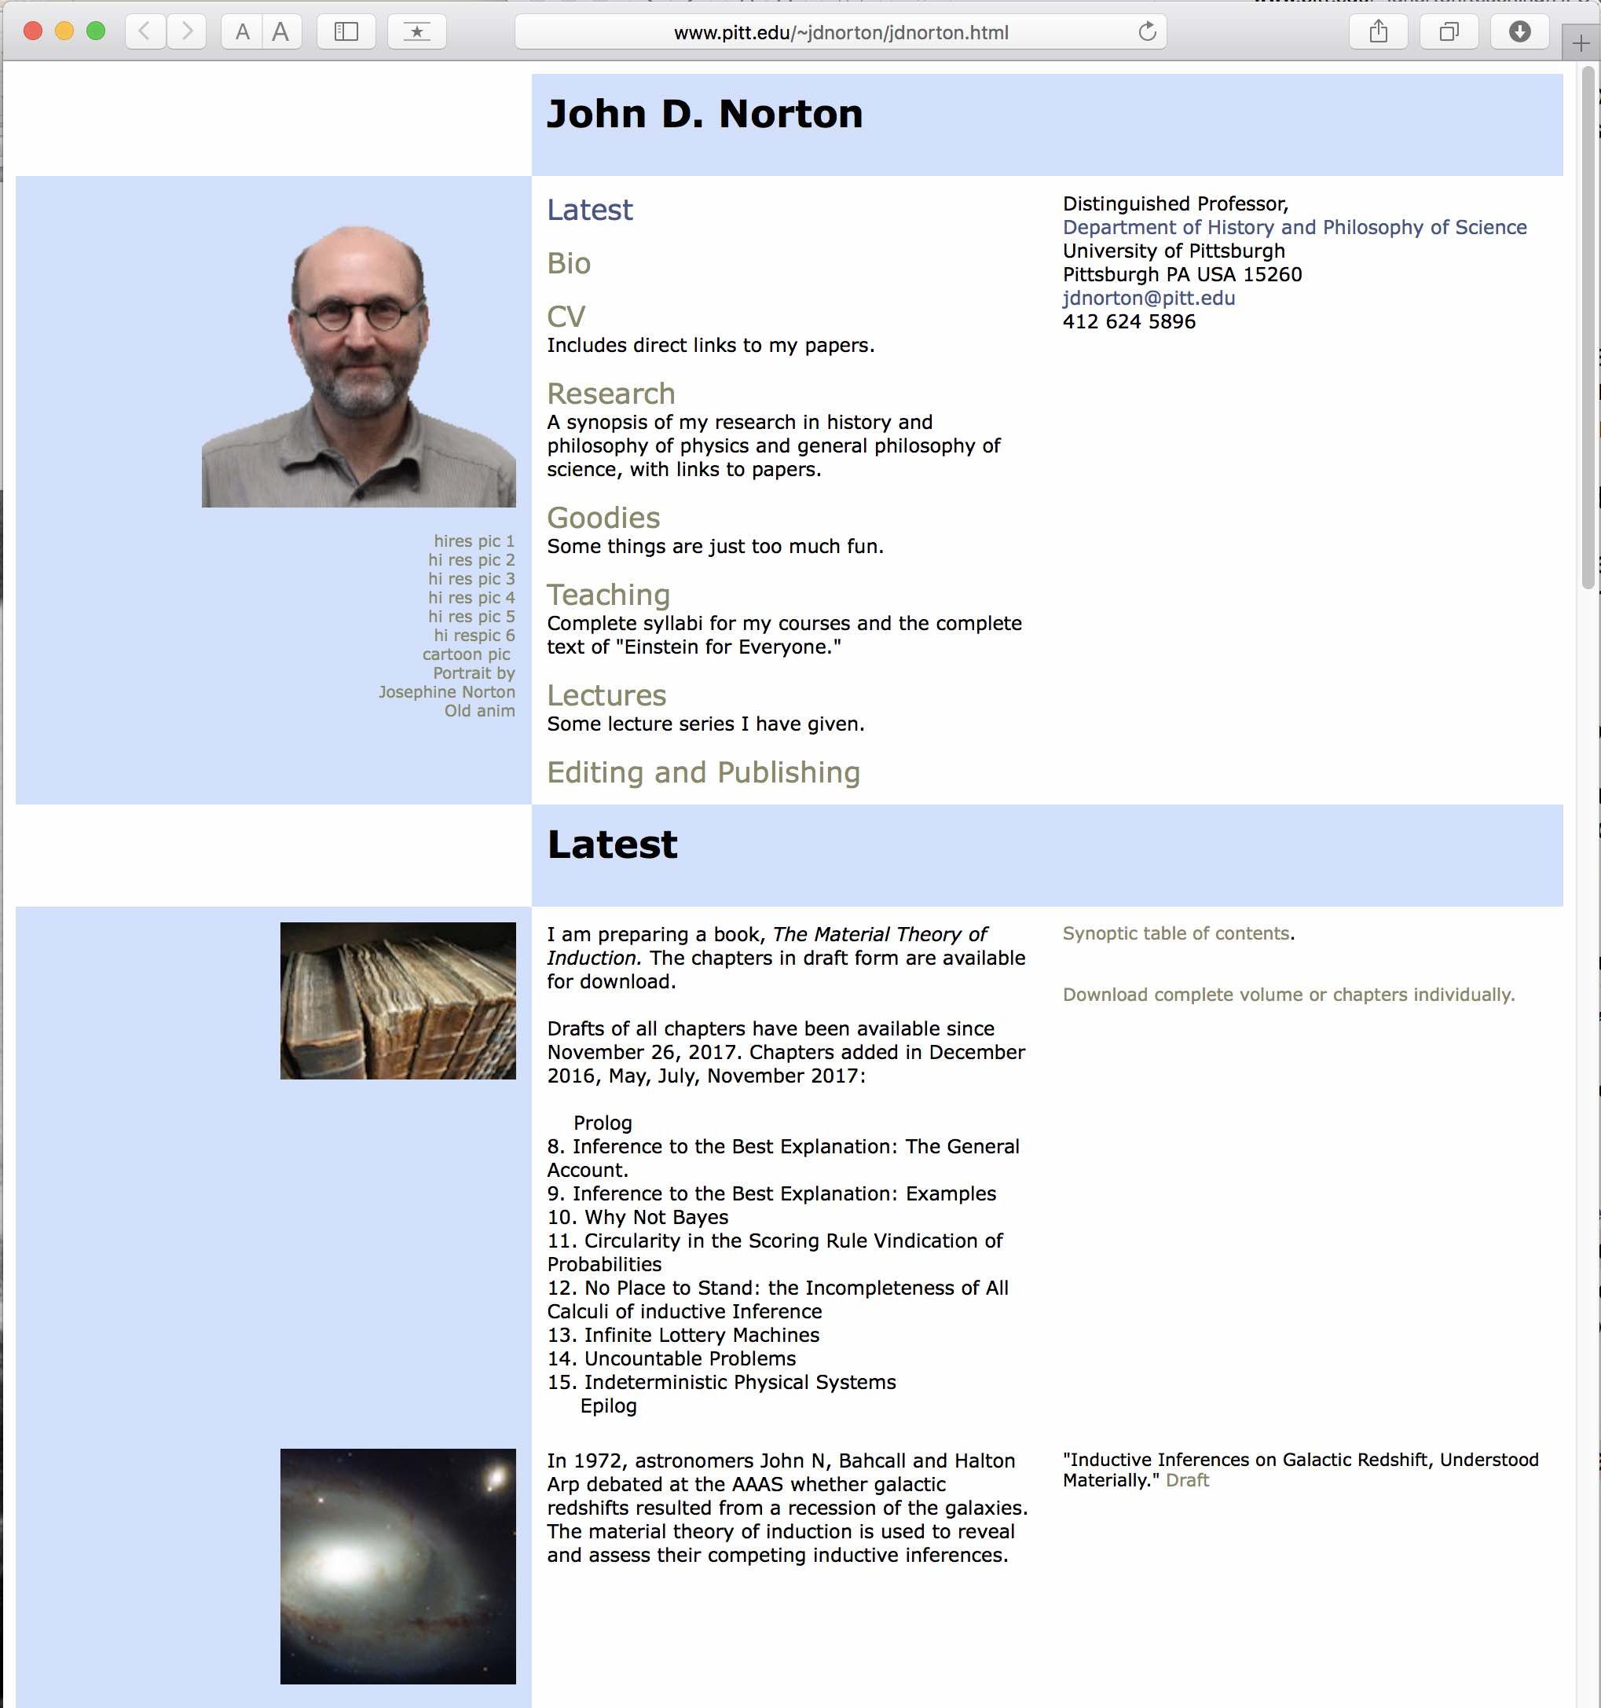

Slide 53
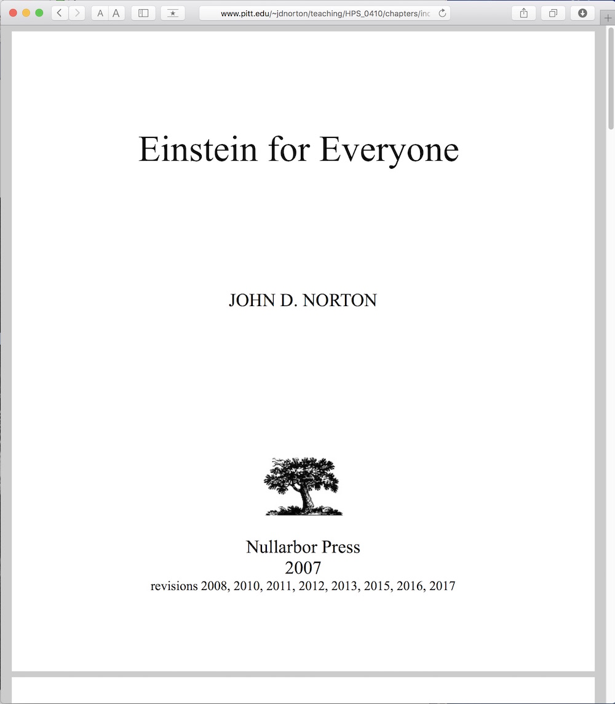
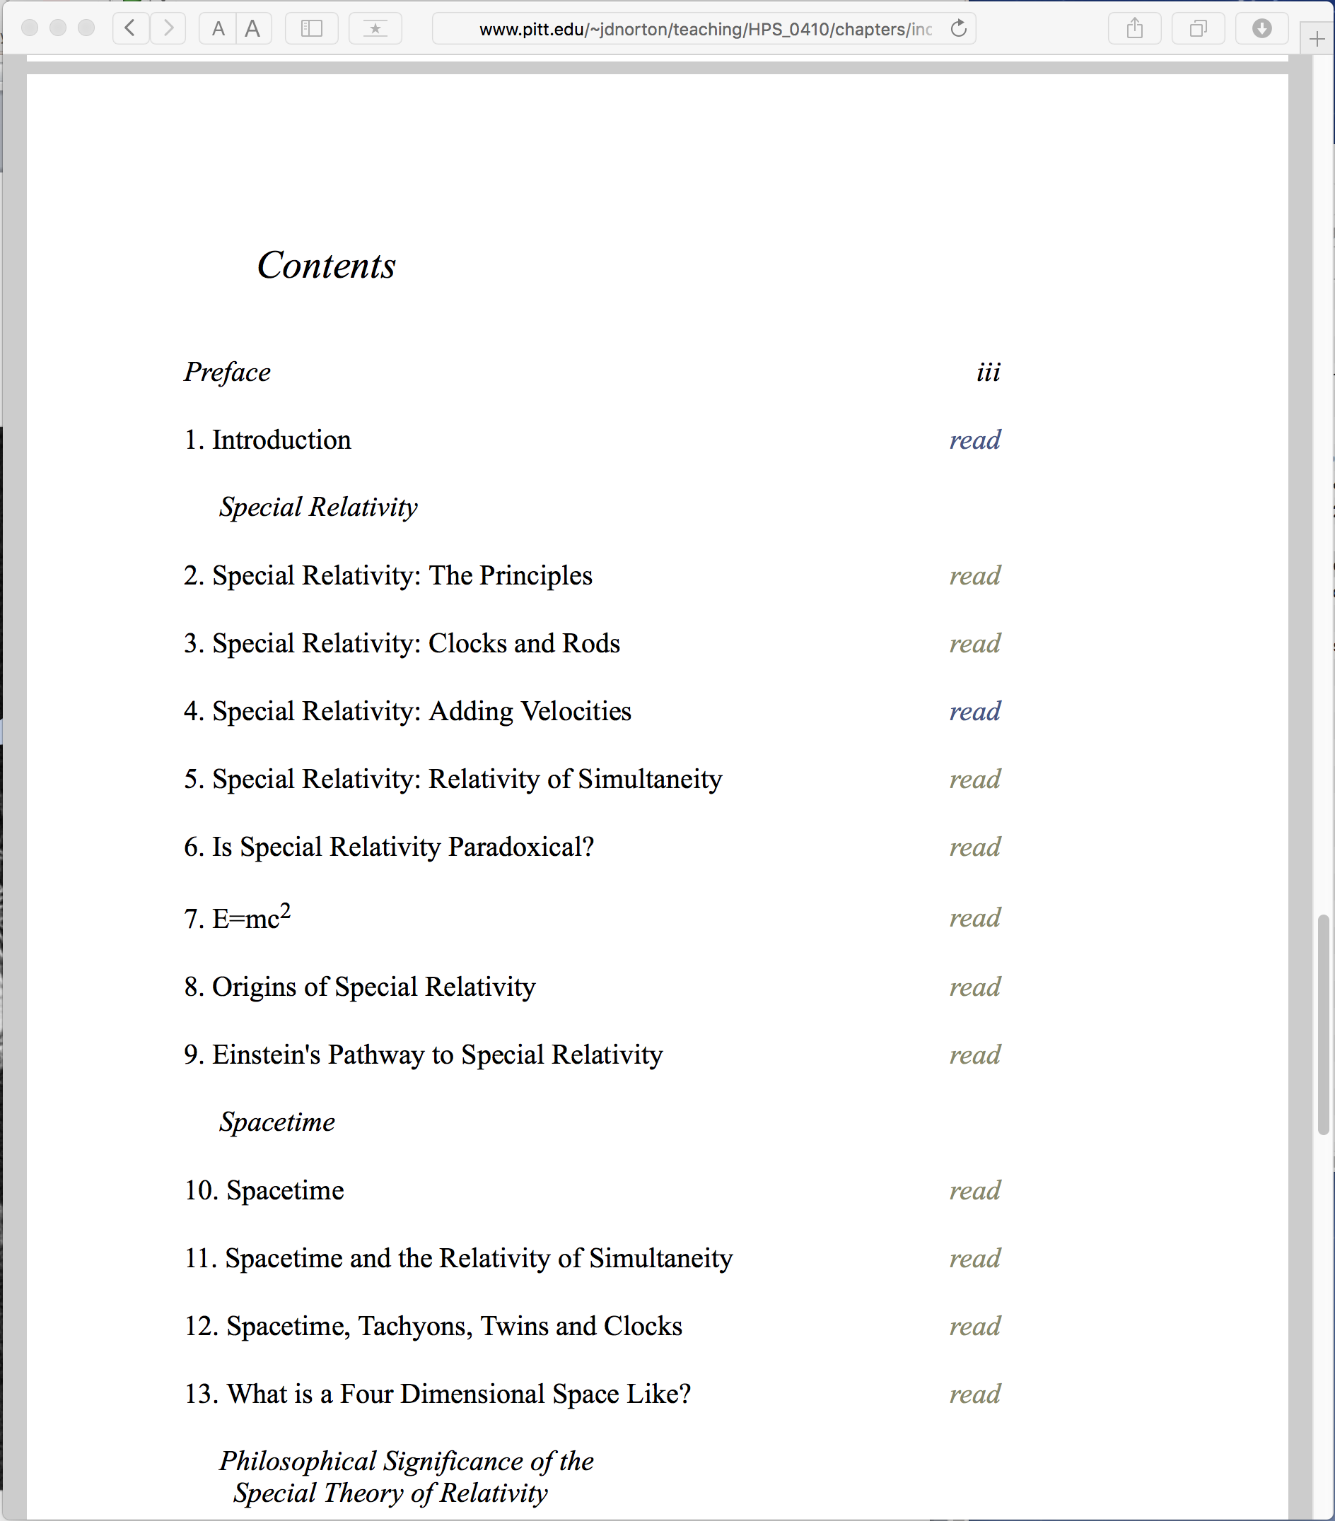
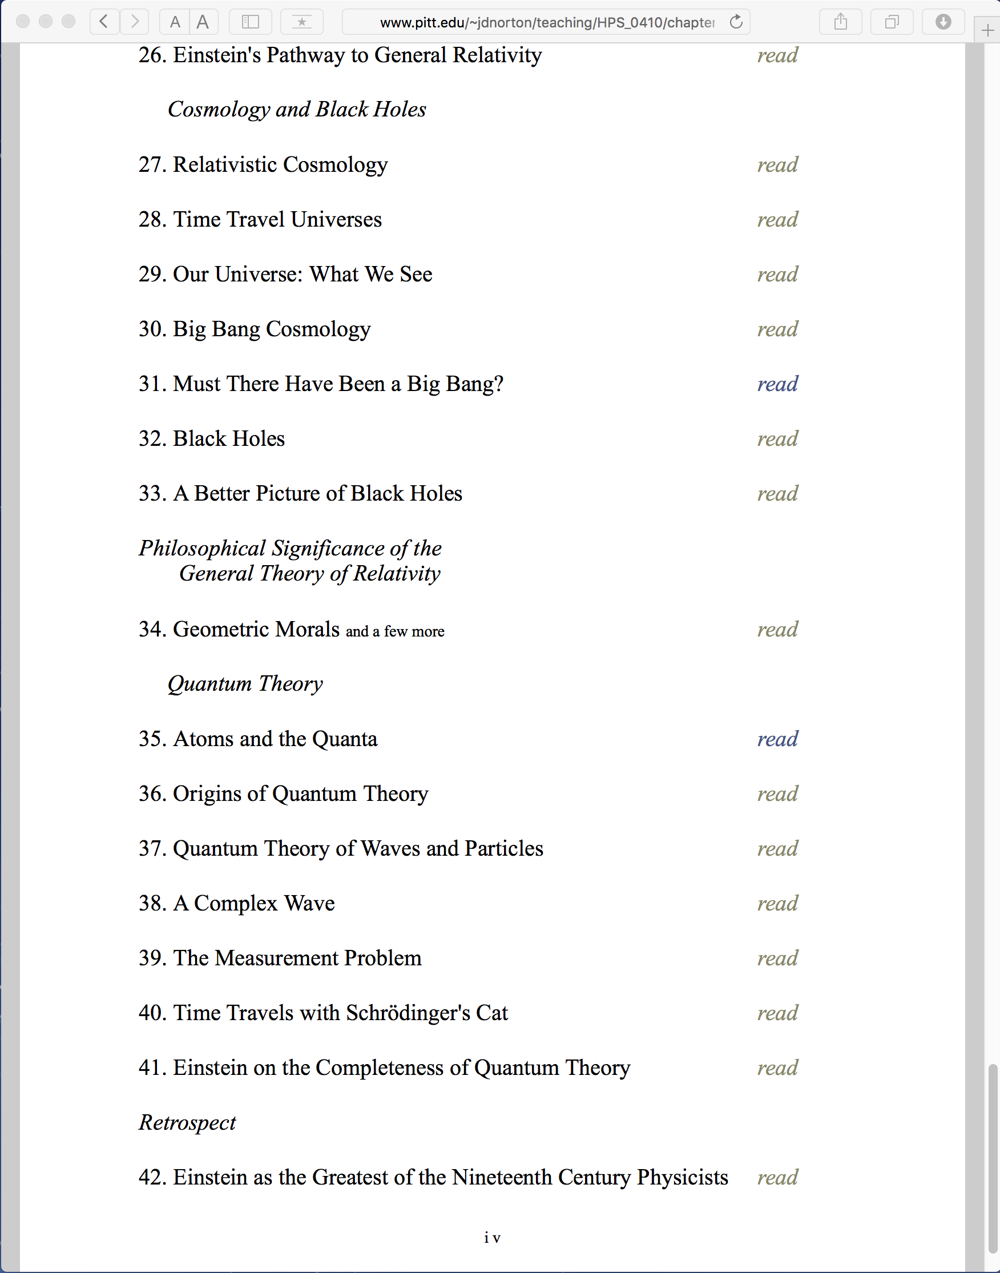

Slide 54
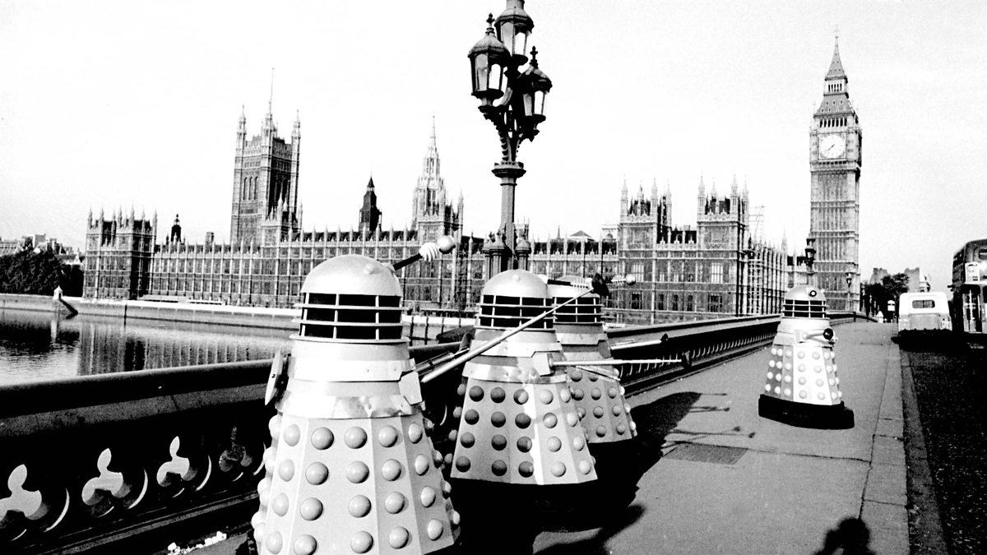
THE END

Slide 55
Why?
Constancy of the speed of light for all inertially moving observers.

Slide 56
Why?

