Slide 1
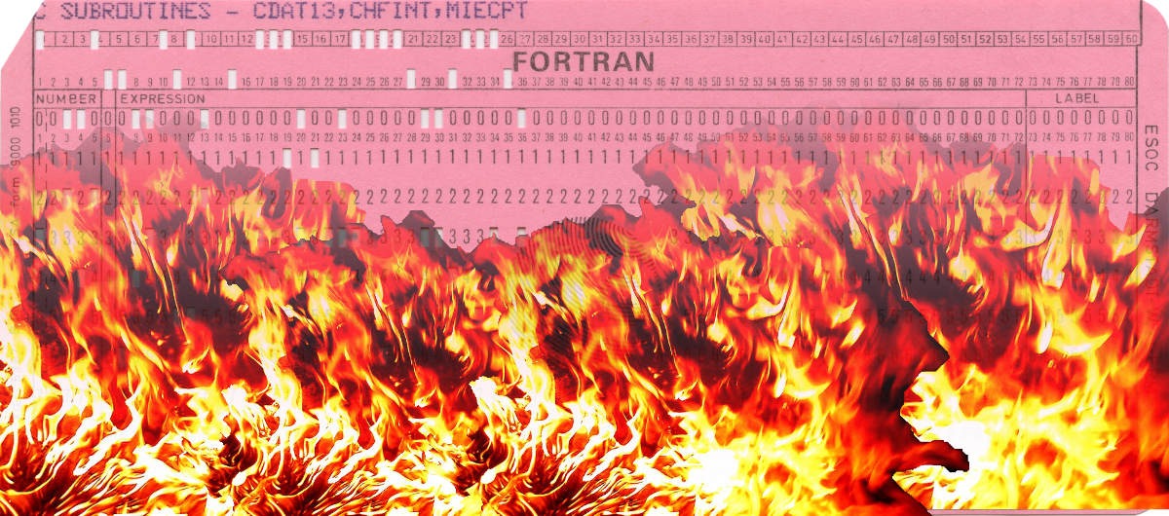
Uninformed Thermodynamics John D. Norton Department of History and Philosophy of Science University of Pittsburgh

Slide 2
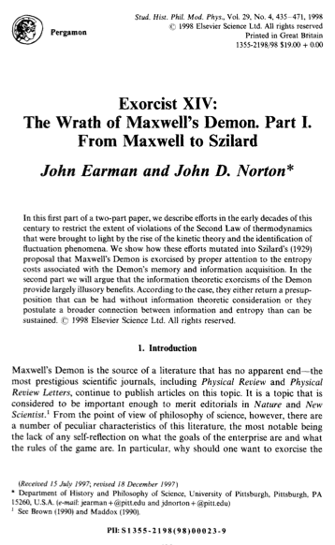

I made a mistake.

Slide 3





The Wrong Question
Is there a foundational link between
information-theoretic entropy (memory devices, computing) and thermodynamic entropy
(heat, steam engines)?
Best outcome is NEGATIVE:
Endless pointless debate over an entrenched foundational mistake.
!!??#!?!%!!?
The Right Question
Are there interesting thermodynamic/statistical mechanical results behind this debate that are independent of information-theoretic ideas?
Best outcome is POSITIVE: new and interesting results.

Slide 4
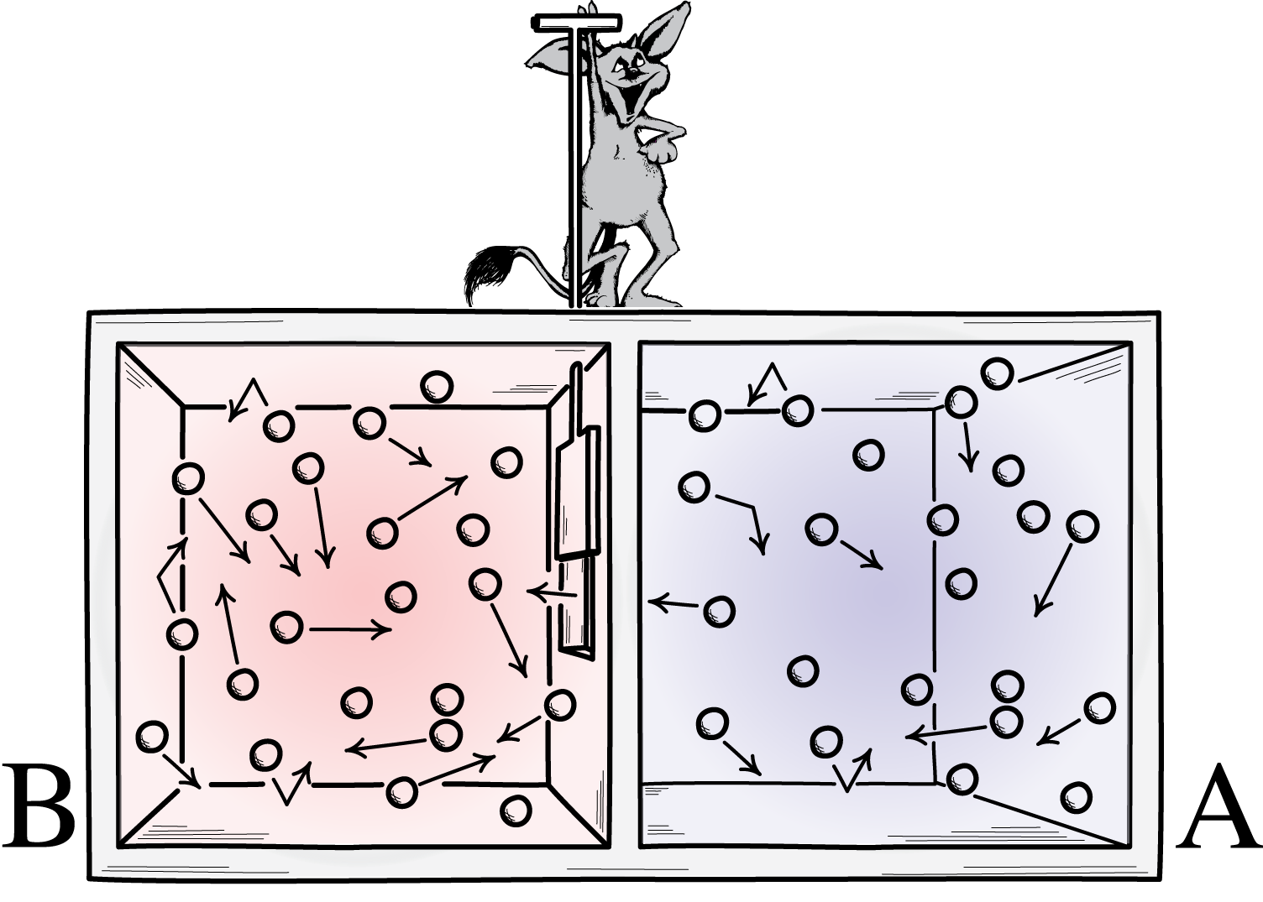
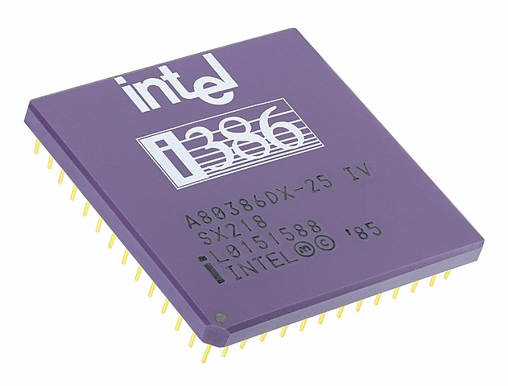
What are the limits imposed by thermodynamics and statistical mechanics on:
The possibility of a Maxwell’s demon?
Processes that converge states (“erase”)?
Minimum heat generation in any molecular scale process?

Slide 5
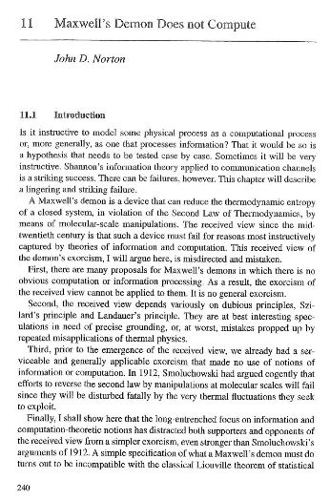

Slide 6
The Exorcism of Maxwell’s Demon

Slide 7

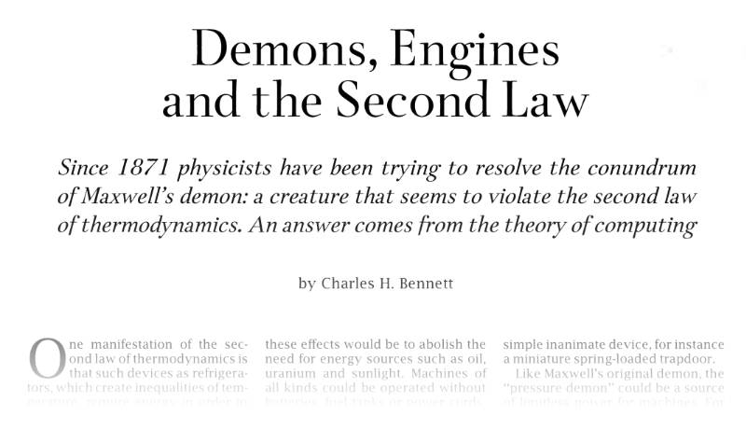
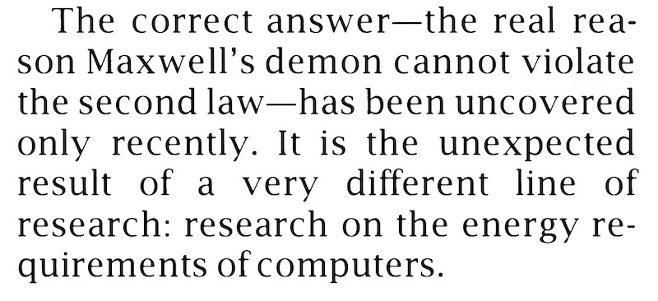

Slide 8
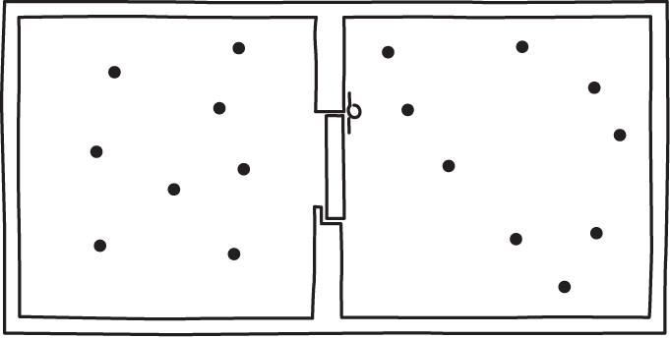
Problems
The computation-exorcism is inapplicable to demons who have no memories to erase.
Smoluchowski’s 1912 exorcism:
Attempts to exploit fluctuations to undo the second law are defeated by further fluctuations.

Slide 9

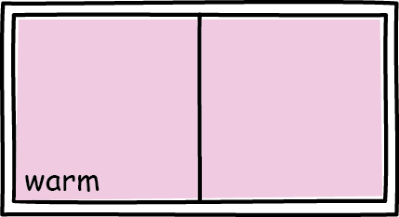
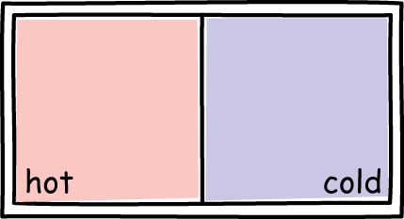
A Maxwell Demon Violates Liouville’s Theorem
No talk of information or computation is needed to exorcise Maxwell’s demon.
same demon state
What a naturalized demon must do.
demon
equilibrium system
out-of-equilibrium system
ψ
most of phase space
a tiny part of phase space
compressed to
Quantum demon violates quantum analog of Liouville theorem.
Impossible
in Hamiltonian mechanics

Slide 10
Convergence of States “Erasure”

Slide 11
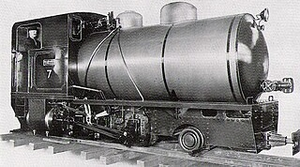
Purely thermodynamic result
Thermodynamic state
New thermodynamic state
Reversible, P
Reversible, P’
Least-dissipative processes are one-to-one.
Impossible, many-to-one
Reversible, P??

Slide 12

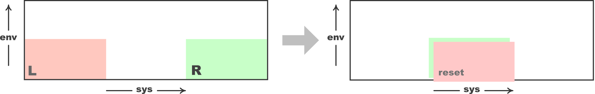
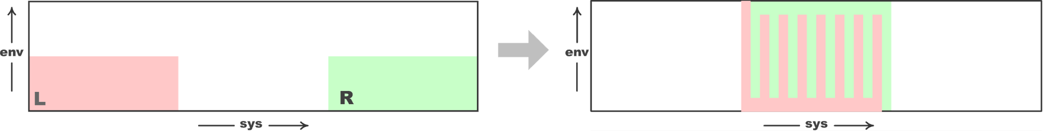

Phase Space Convergence?
L or R
reset
Violates
one-to-one mapping, Liouville theorem
Hamiltonian evolution
Coarse grain reset state
L or R
phase volume V
Reset phase volume at least 2V
ΔS ≥ k ln (2V/V) = k ln 2

Slide 13
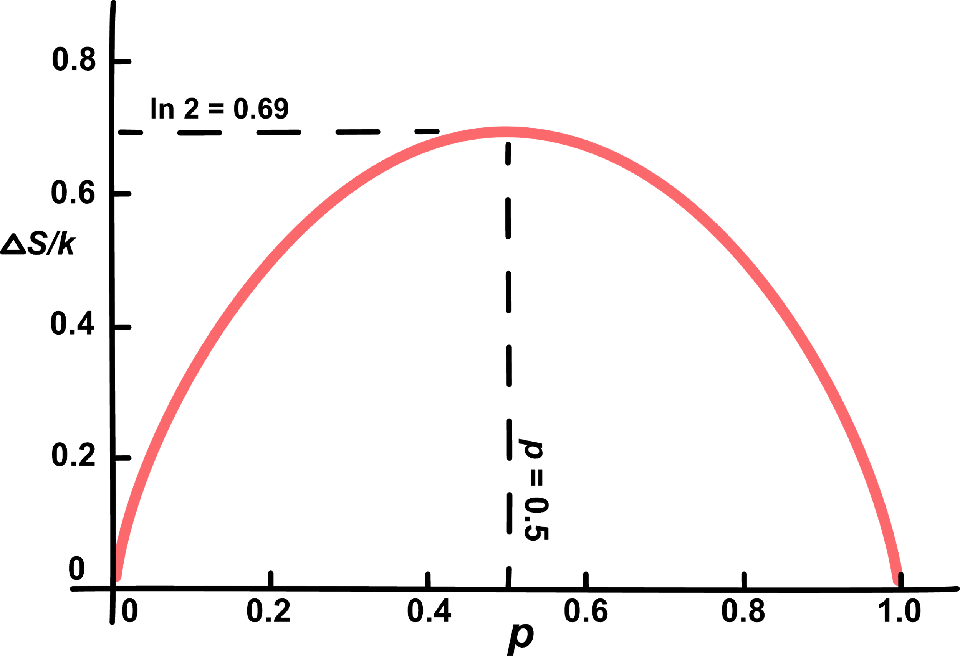
Convergence “Erasure”
Landauer’s Principle
vs
R
R
Mixed state (L or R) =
L
p
+ (1-p)
L
R
ΔS ≥ k ln 2
erase
Information entropy bounds dissipation.
R
ΔS ≥ – k [ p log p + (1-p) ln (1-p) ]
No procedure I could find in toy examples implements the smaller amounts.

Slide 14
Minimum heat generation in any molecular scale process

Slide 15
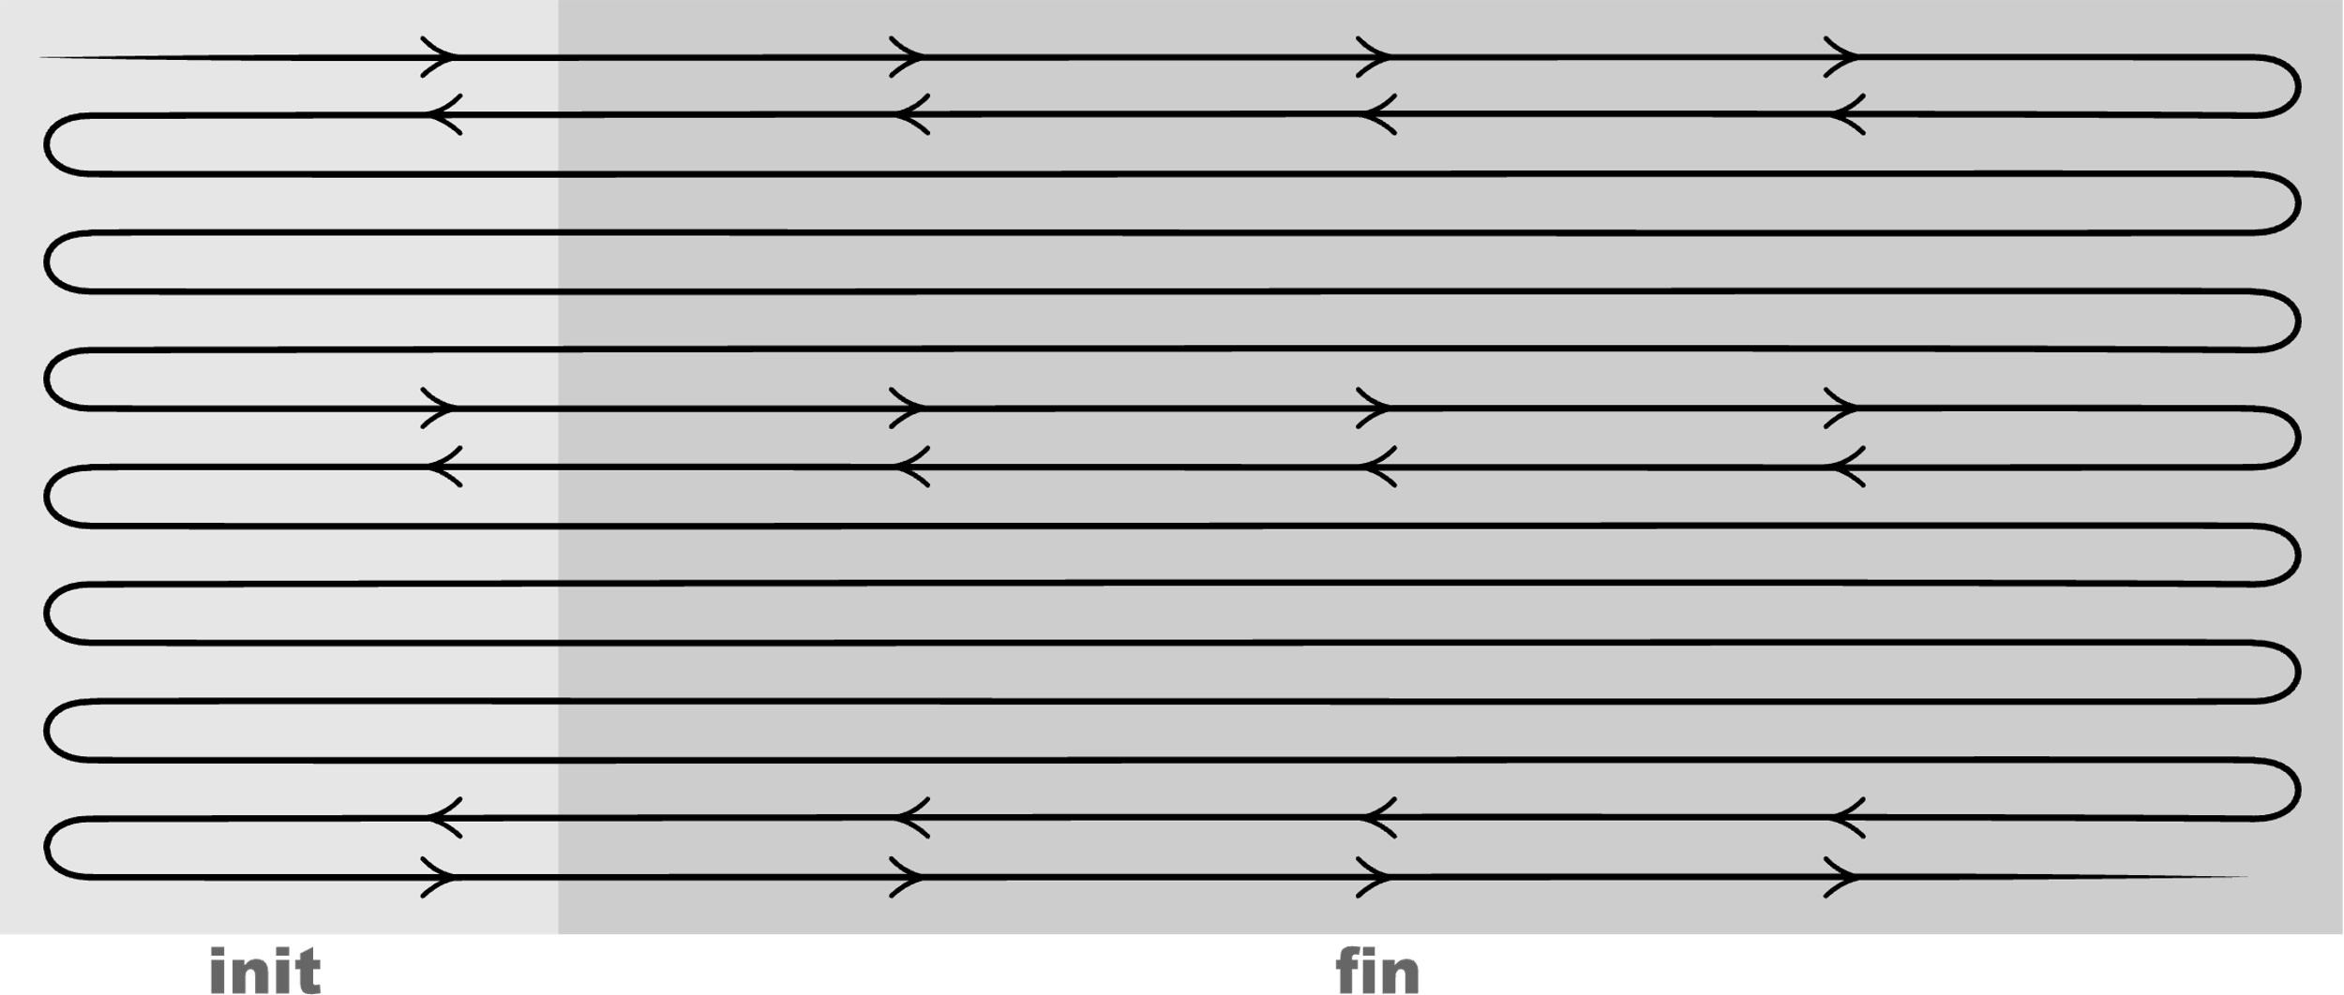
Probabilistic completion of molecular scale processes
Phase point explores phase space
Equal times in equal phase volumes V
P_{fin}
V_{fin}
Supress
fluctuations:
V_{fin} >> V_{init}
Fluctuation:
Probability system reverts to initial state.
=
P_{init}
V_{init}

Slide 16
Probabilistic completion of molecular scale processes
Phase point explores phase space
Entropy
S = k ln V
V = exp(S/k)
Completion favored
20 to 1
V_{fin}
P_{fin}
exp(ΔS/k) =
=
V_{init}
P_{init}
Entropy creation
ΔS = 3k

Slide 17
Minimum entropy, heat generation
number of steps
and probability of completion
set by
Any molecular scale process
STEP 1
probability of completion
ΔS₁
heat₁ = TΔS₁
STEP 2
probability of completion
ΔS₂
heat₂ = TΔS₂
STEP 3
probability of completion
ΔS₃
heat₃ = TΔS₃
…
STEP n
probability of completion
ΔS_{n}
heat_{n} = TΔS_{n}
Landauer’s principle
Minimum entropy cost of computation
logic implemented
details of implementation.
set by
NOT

Slide 18
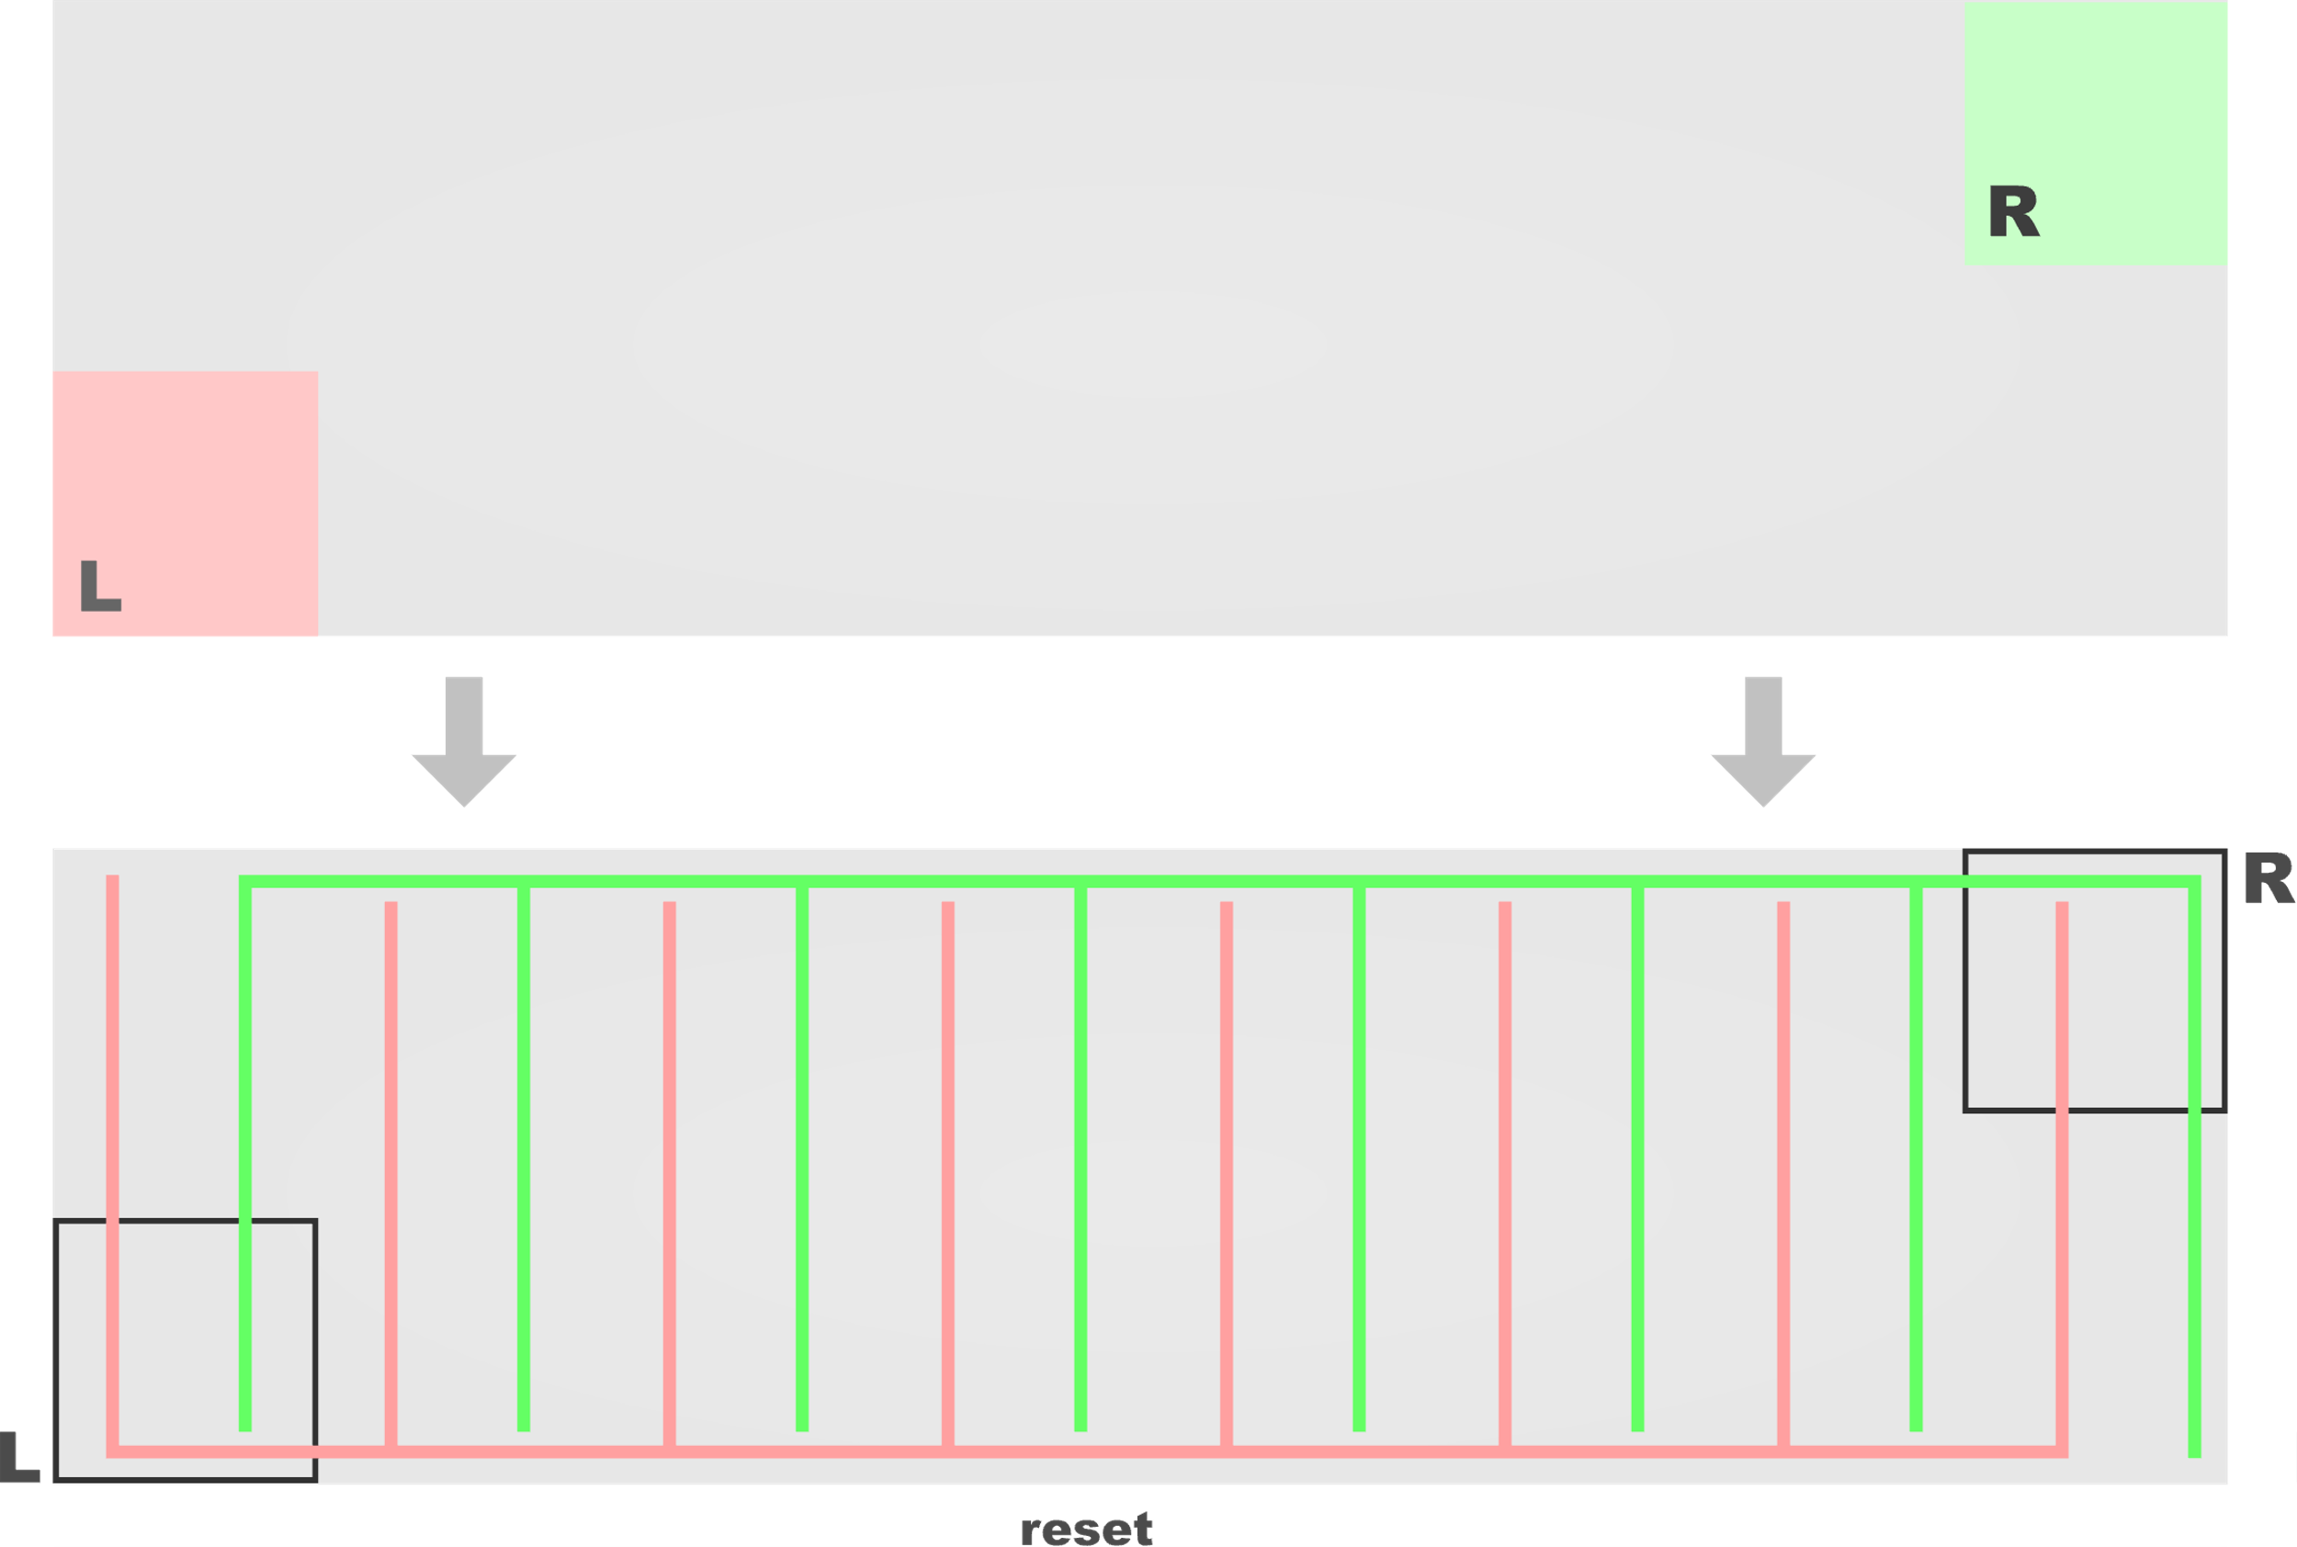
Suppressing fluctuations controls entropy creation in erasure.
P_{reset} / P_{L} = V_{reset} / V_{L} = 2
Expand reset phase volume:
P_{reset} / P_{L} = V_{reset} / V_{L} = 20
Minimum entropy creation
ΔS = 3k > k ln 2 = 0.69k

Slide 19
Conclusion
The possibility of a Maxwell’s demon
Processes that converge states (“erase”)
Minimum heat generation in any molecular scale process

