Slide 1
Lotteries, bookmaking and ancient randomizers: Local and global analyses of chance John D. Norton Department of History and Philosophy of Science University of Pittsburgh

Slide 3
The Puzzle

Slide 4
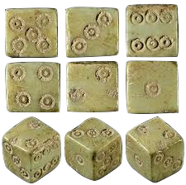
The puzzle
Physical randomizers were used extensively for many purposes in antiquity.
Ancient Roman dice
P₁=P₂=P₃=P₄=P₅=P₆=1/6
There was no theory of probability until 17th or 18th century.
?
?
Why did their users think they were fit for the purpose?

Slide 5
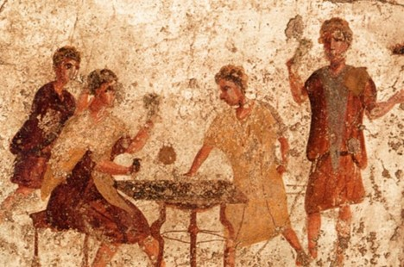
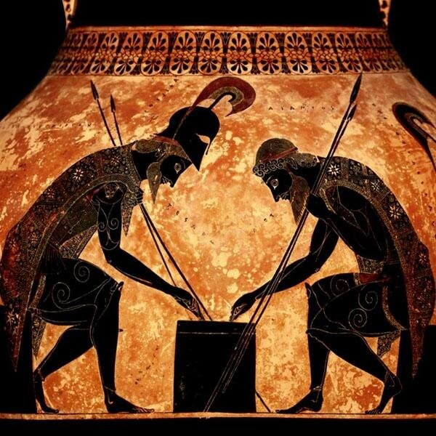
Gambling and other games

Slide 6
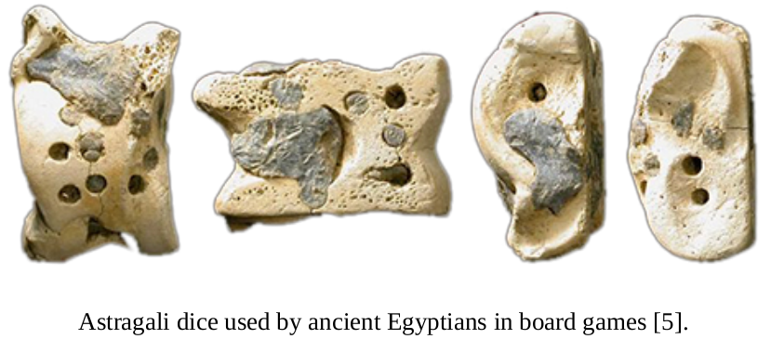
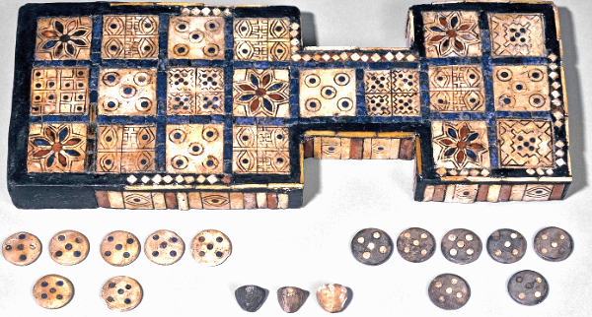
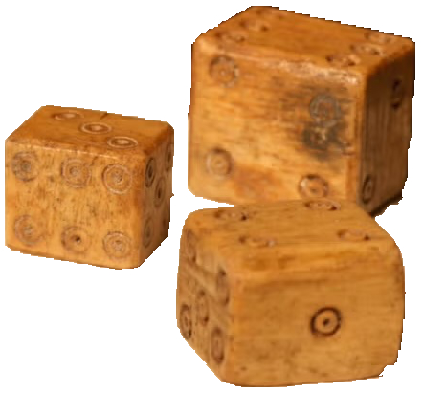
Gambling and other games
Roman dice
Lopsided Roman dice
Egyptian royal game of Ur used tetrahedral dice.

Slide 7
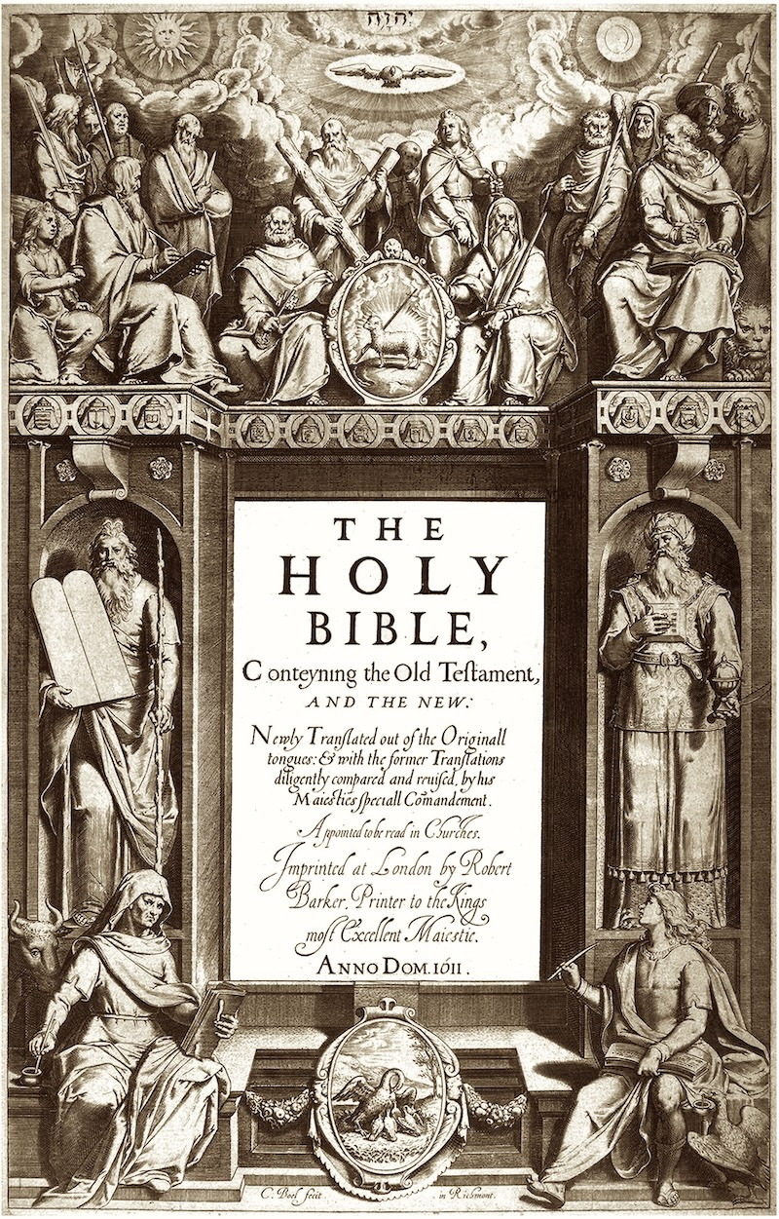
Casting of Lots

Slide 8
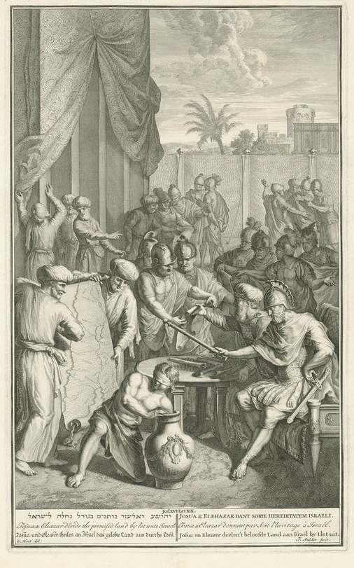
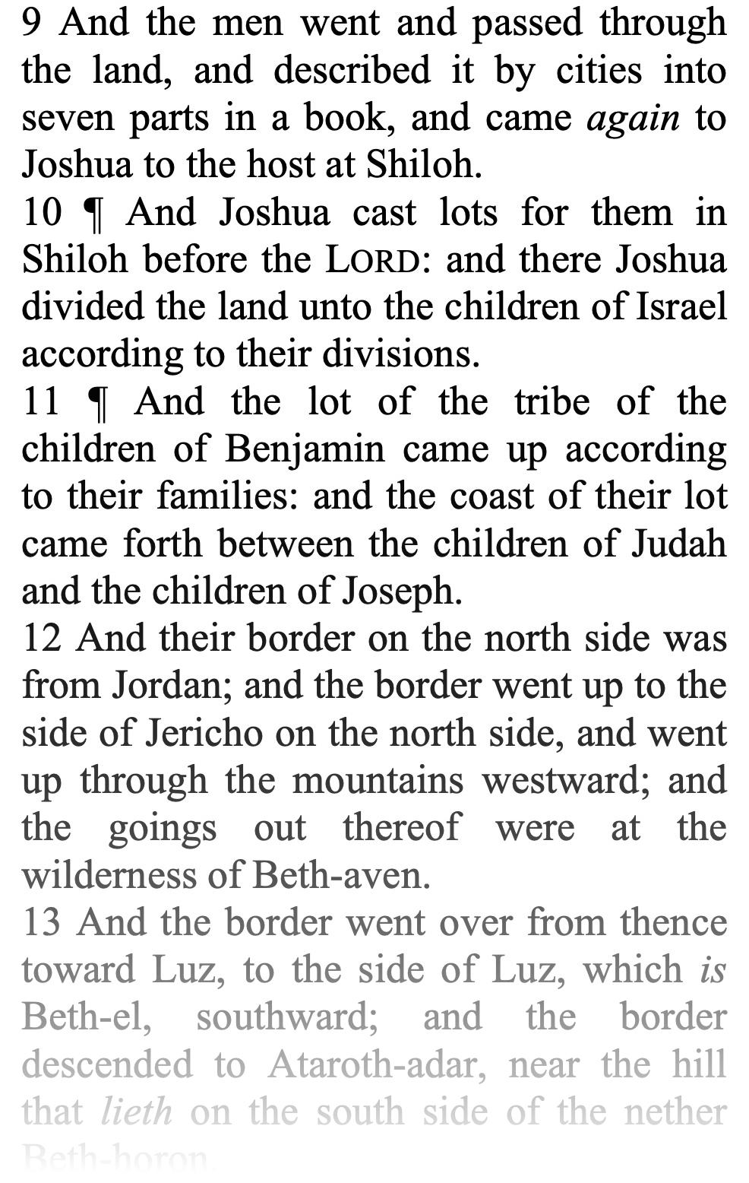
Casting of Lots
Joshua assisted by Eleazar casts lots and assigns to each of the tribes a certain part of Canaan.

Slide 9
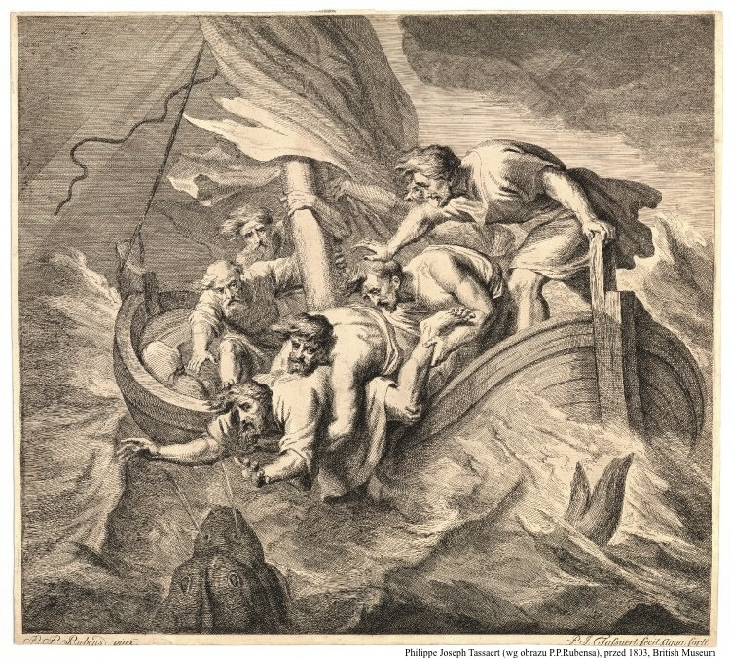
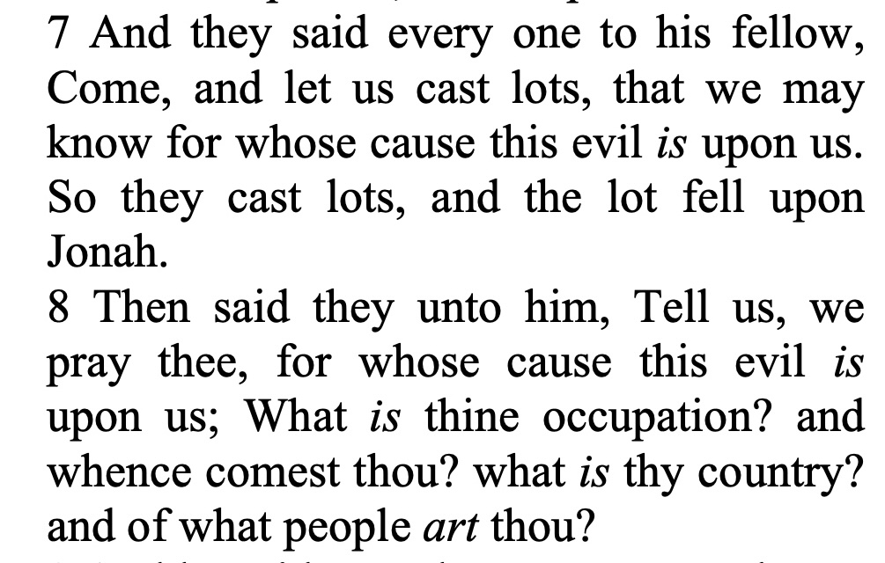
Casting of Lots

Slide 10
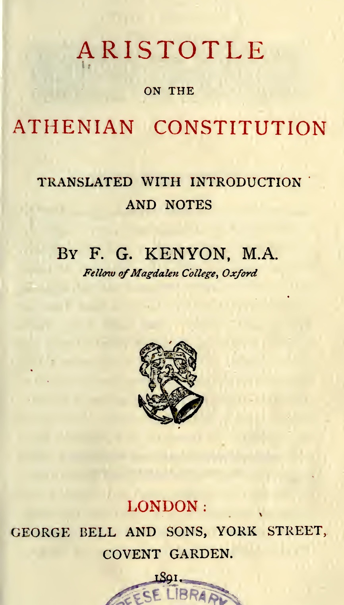
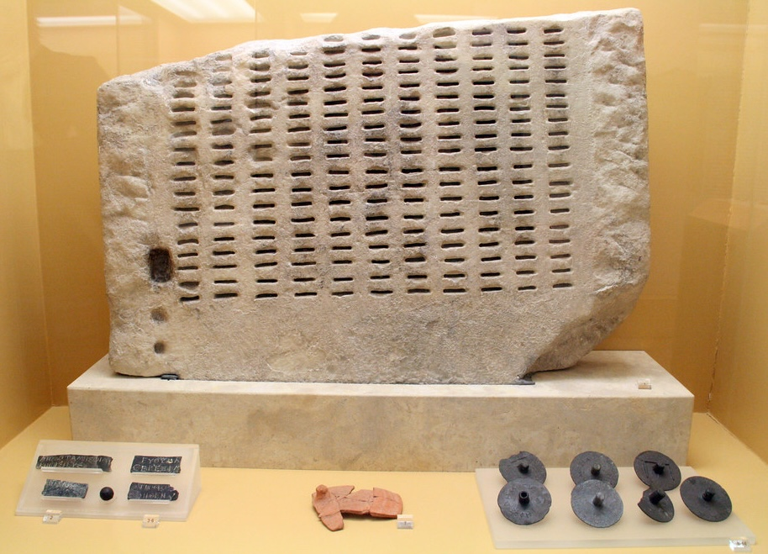
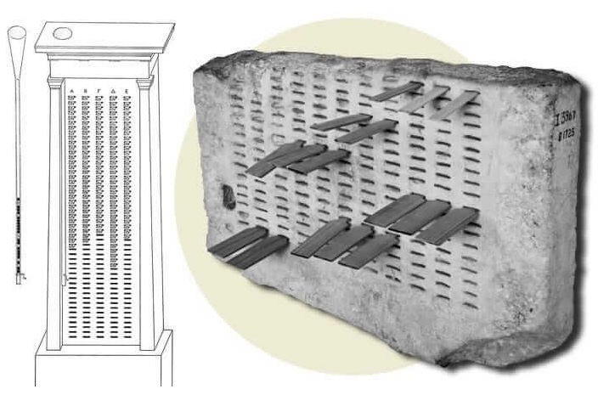
Sortition Selection of official appointments by lot
Kleroterion

Slide 11
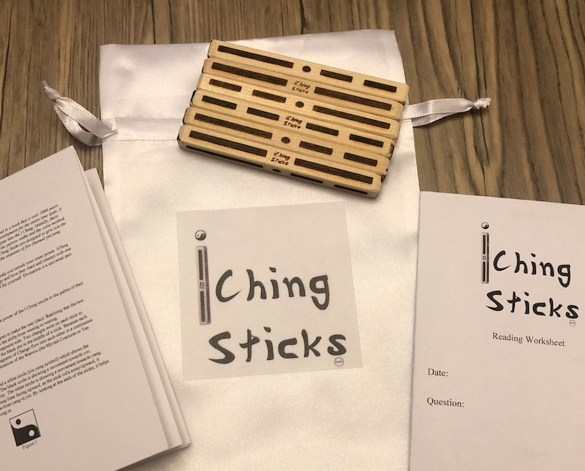
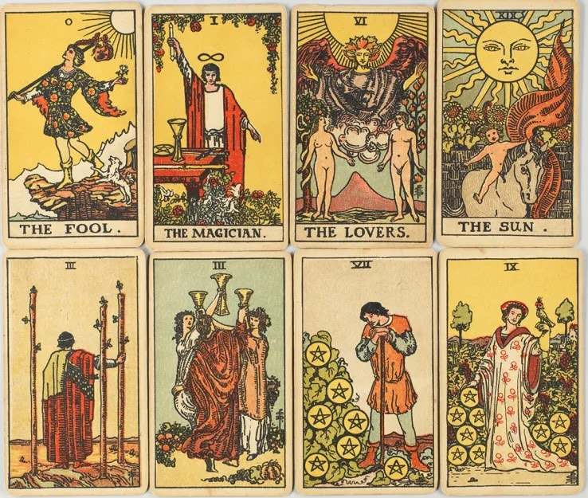
Divination modern versions

Slide 12
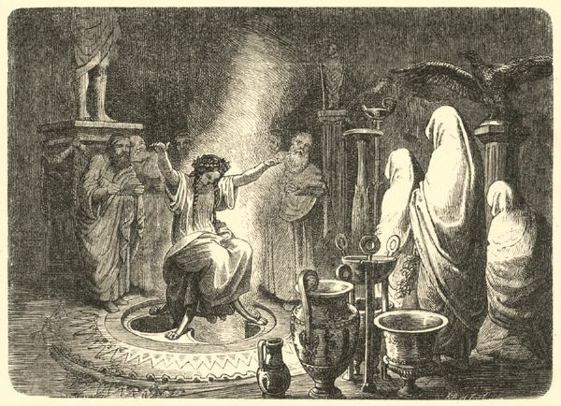
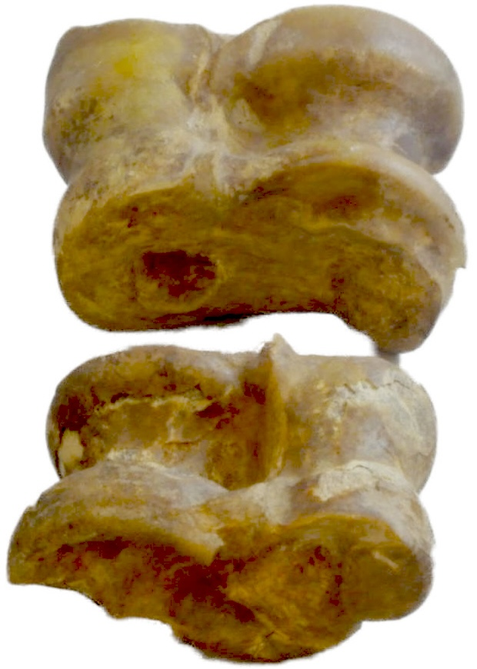
Divination (“cleromancy” or “sortilege”)
From 21 sites in Asia Minor, second century CE:
Five astragali are cast and their interpretation is read from a standard text, inscribed on stone monoliths.

Slide 13
Divination (“cleromancy” or “sortilege”)
From 21 sites in Asia Minor, second century CE:
Five astragali are cast and their interpretation is read from a standard text, inscribed on stone monoliths.
1,1,1,1,3 [sum to] 7 Athena Areia
If four Chians and one three are cast, the god signals:
By avoiding enmity and animosity, you will reach your prize;
you will arrive and the blue-eyed goddess Athena will save you.
The activity that you have in mind will turn out as you wish it.
1,1,1,1,4 [sum to] 8 Moirai
If one four and four Chians in a row are cast:
Don't do the business that you are engaged in; it will not turn out well.
It will be difﬁcult and impossible around someone who tires himself out.
But if you go abroad for some time, no harm will come from it.

Slide 14
The puzzle
Physical randomizers were used extensively for many purposes in antiquity.
Ancient Roman dice
P₁=P₂=P₃=P₄=P₅=P₆=1/6
There was no theory of probability until 17th or 18th century.
?
?
Why did their users think they were fit for the purpose?

Slide 15
What the ancient commentators said

Slide 16
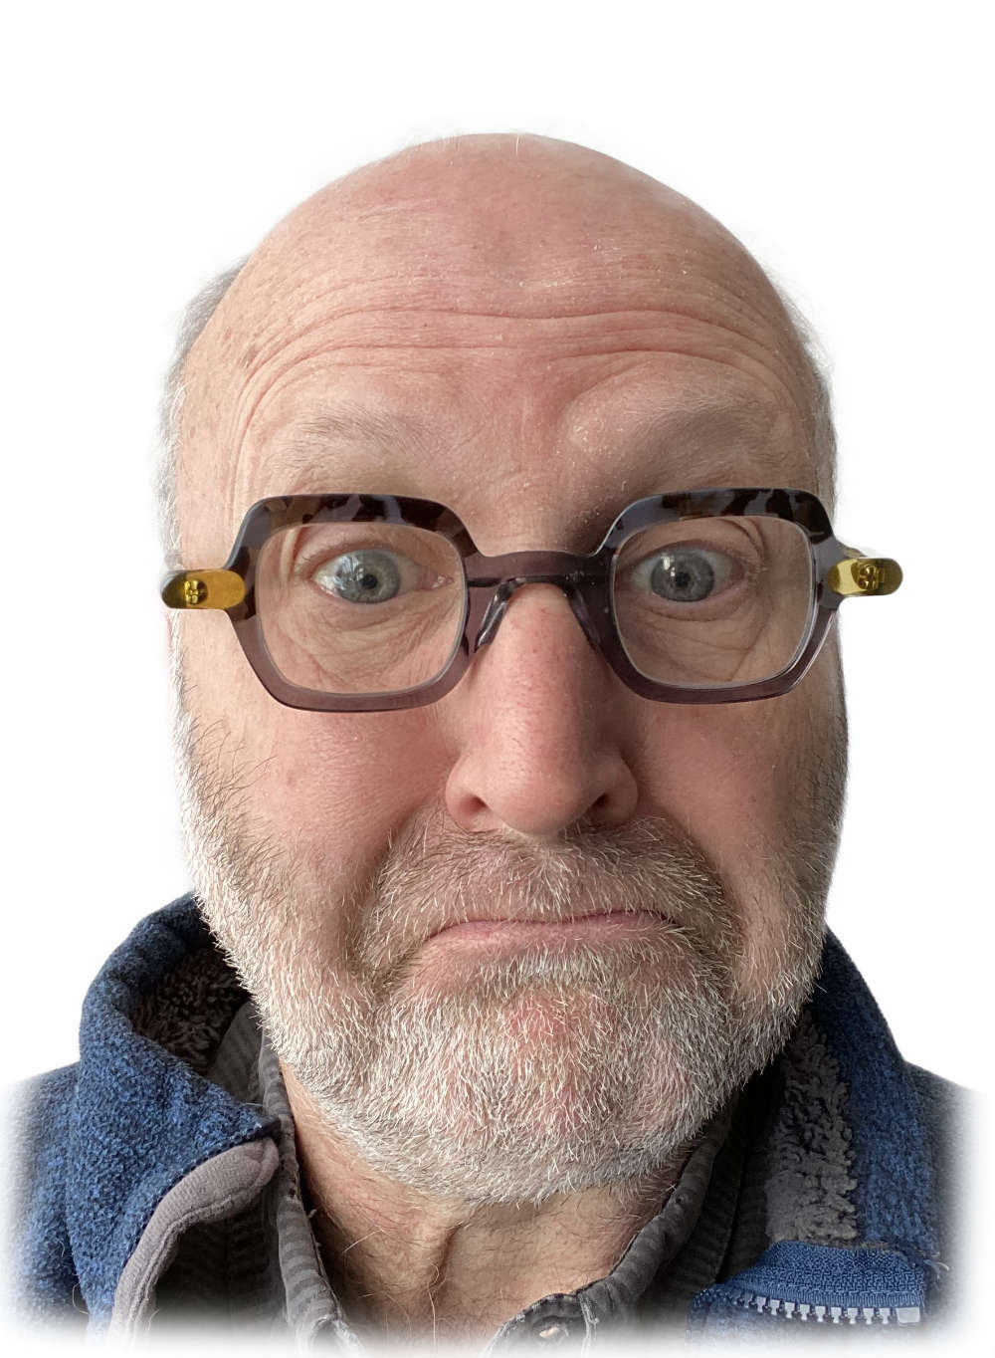

Slide 17
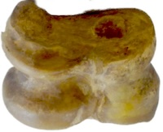
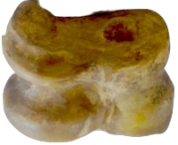
An Understanding of Physical Randomizers was so commonplace as to be usable to explain other things
Aristotle, de Caelo
(Book II, 292a30; Barnes, 1984, p. 481):
“To succeed often or in many things is difﬁcult. For instance, to throw ten thousand Chians [ones] with the astragali would be impossible, but to throw one or two is comparatively easy.
In action, again, when A has to be done to get B, B to get C, and C to get D, one step or two present little difﬁculty, but as the series extends the difﬁculty grows.”
1
1
1
1
1
1
1
1
1
1
1
Cicero
(Falconer, 1923, pp. 249–51):
‘Mere accidents,’ you say. Now, really is that so? Can anything be an ‘accident’ which bears upon itself every mark of truth? Four tali are cast and a Venus throw results—that is chance; but do you think it would be chance, too, if on one hundred casts you made one hundred Venus throws.
1
3
4
6

Slide 18
The Proposal

Slide 19

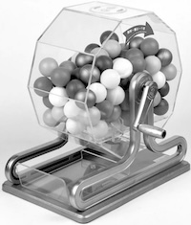
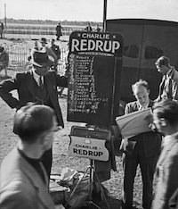
The Proposal
Local analysis:
Recover overall chance properties by accumulating chance properties of components.
P₁=P₂=P₃=P₄=P₅=P₆=1/6
P_{even}=P_{odd}
Global analysis
Chance properties investigated by considering the system as a whole.
lotteries
bookmaking

Slide 20
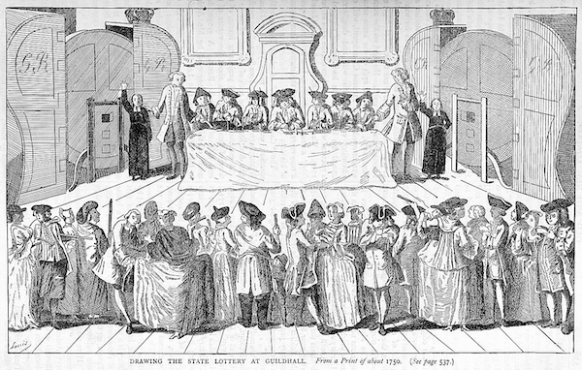
Lotteries Local Analysis
Port-Royal Logic
Arnauld and Nicole (1662, p. 385; 1996, p. 272)
“… there is an obvious injustice in the type of games called lotteries because, with the operator of the lottery usually taking a tenth for his share in advance, the whole group of players is duped in the same way as if someone made an equal wager, that is, where the likelihood of winning is as great as that of losing, of ten pistoles against nine. Now if this is disadvantageous to the whole group, it is also disadvantageous to each person in it, since from this it follows that the probability of loss exceeds the probability of winning by more than the advantage desired exceeds the disadvantage to which one is exposed, namely of losing what he has put in.”

Slide 21
Lotteries Global Analysis
Anonymous pamphlet, 1776
“... what Mode of raising Money could be so equitable, so just or so pleasing to the Subject, as that by Way of Lottery?
In raising Money by a Lottery, every Individual is at his free Option, whether or not he will contribute towards the Necessities of the State.”
Profit is assured if:
revenue from tickets sold
prizes paid out
>

Slide 22
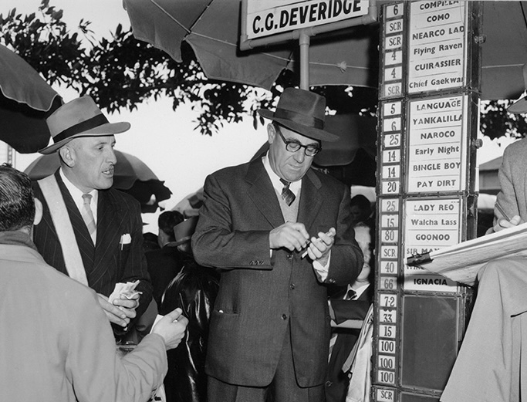
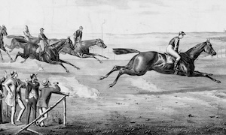
Bookmaking Local analysis (individual punters)
Determine, better than other punters, which horse has the greater probability of winning.

Slide 23
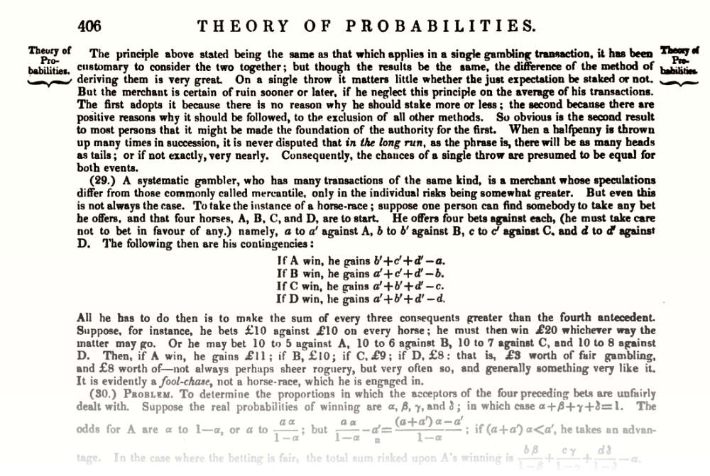
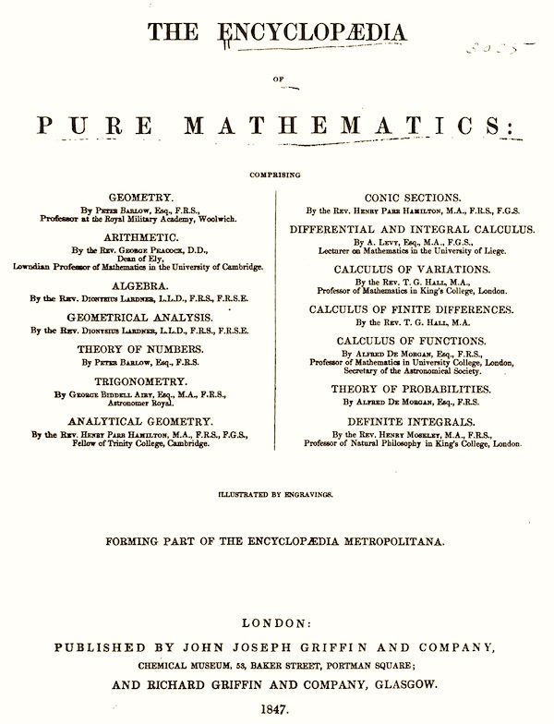
Bookmaking Global analysis (the bookie)
by Augustus De Morgan
Maintain a “balanced book.”
Combination of wagers such the bookie always makes a profit no matter which horse wins.

Slide 24
Application of global analysis to ancient randomizers

Slide 25
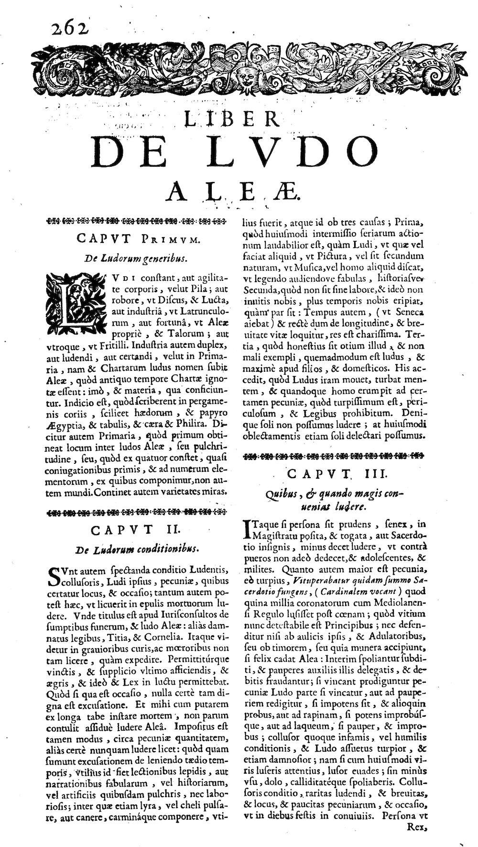
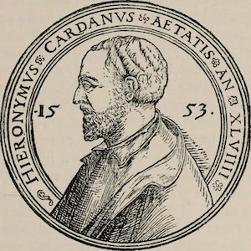
Equality
Each participant has identical opportunities and is governed by identical rules.
“Fundamental Principle of Gambling” (Cardano, 1663, p. 189):
The most fundamental principle of all in gambling is simply equal conditions, e.g. of opponents, of bystanders, of money, of situation, of the dice box, and of the die itself. To the extent to which you depart from that equality, if it is in your opponent’s favor, you are a fool, and if in your own, you are unjust.

Slide 26

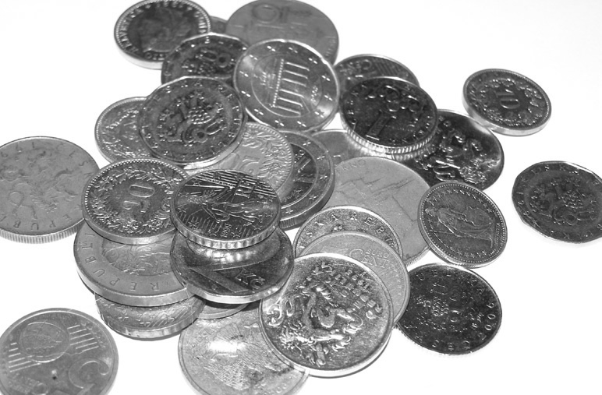

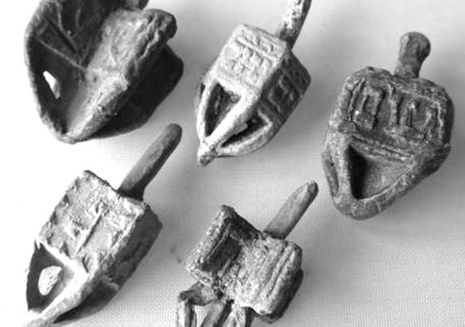
Channukah: dreidel game
Rules same for everyone even if dreidel has uneven sides.
(nun) do nothing
(gimel) take everything
(hei) take half
(shin) put one in

Slide 27
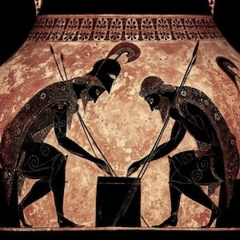
Other ancient versions played with astragali/tali
1
3
4
6
Most favorable: Aphrodite/Venus (all different)
Take all
1
1
1
1
Least favorable: dogs (ones)
Put in

Slide 28
Lack of control
This is how we know that the priestess is not feeding us an outcome. If the outcome is controlled by anything, it is by a power beyond her.
The operator of the physical randomizer has no control on the outcome.

Slide 29
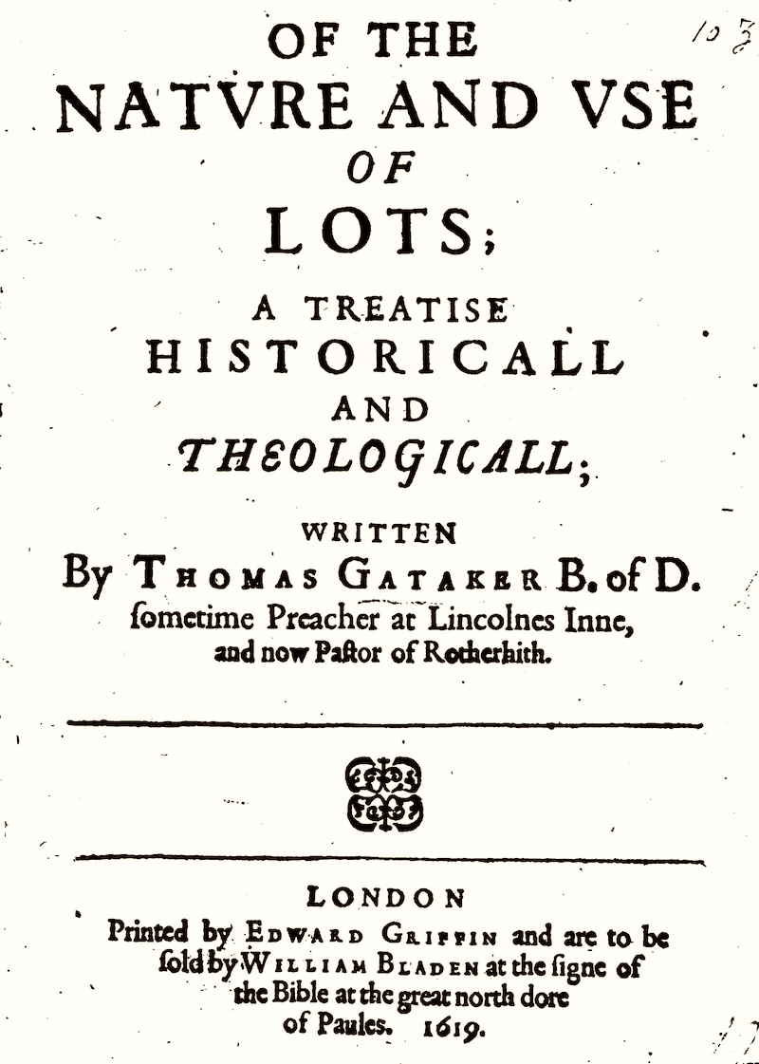

Thomas Gataker on lots (1619)
Prior to probability theory
Which scroll unrolls first in water?
“Whereas the matter of a Lot is euer some euent meerely casuall; as if a man to try whether his seruant be a theefe or no, shall put a scroll with his name in it, togither with others rolled vp seuerally into water, to see which will vnfold ﬁrst, and thereby to determine and iudge of the party suspected whether he be guilty or guiltlesse of that crime. To which purpose tend those sayings of good Authors, that To vse Loterie is to put a thing from skill and counsell to temeritie and casualty. that A Lot is the child of chance. that The issue of Lots is not in mans power, but is such as casualty casteth on vs. that In Lotery there is no certainty. that Lots are not carried by reason and iudgement, nor by counsell and aduice: but Chance and casualtie striketh the cheife stroke in them; if wee respect secondary causes.”

Slide 30
Wrong and right questions

Slide 31
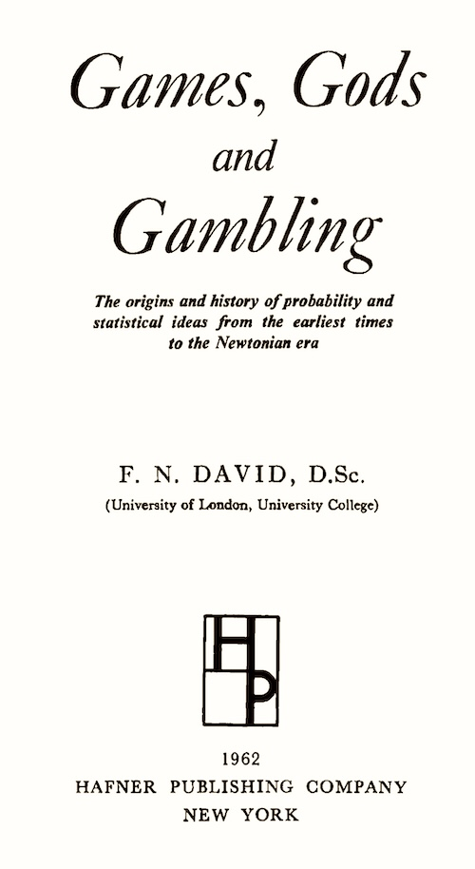
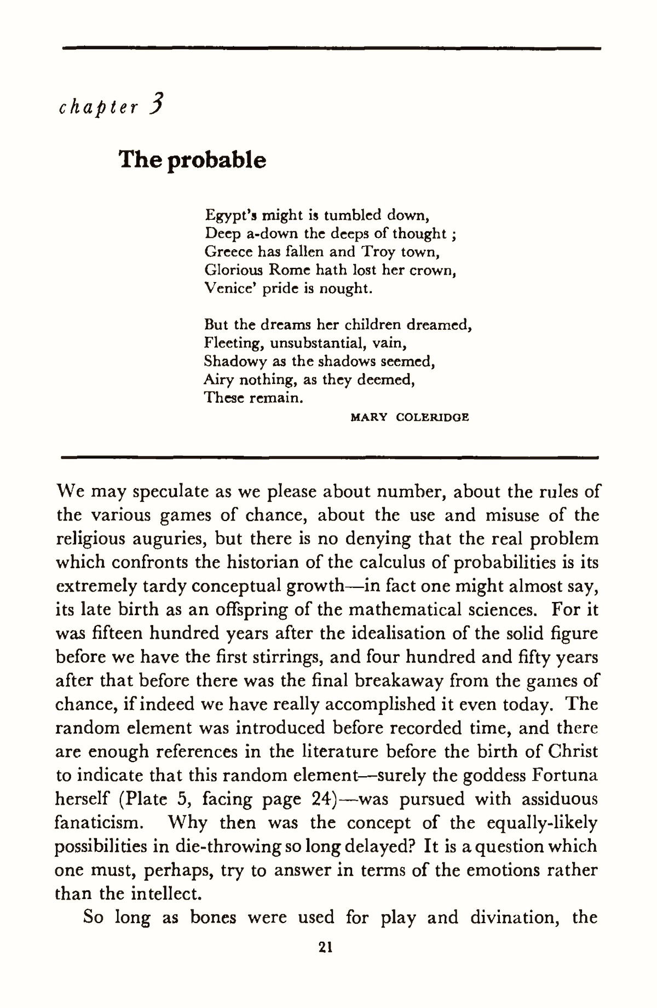
The wrong question
“… but there is no denying that the real problem which confronts the historian of the calculus of probabilities is its extremely tardy conceptual growth in fact one might almost say, its late birth as an offspring of the mathematical sciences.”

Slide 32
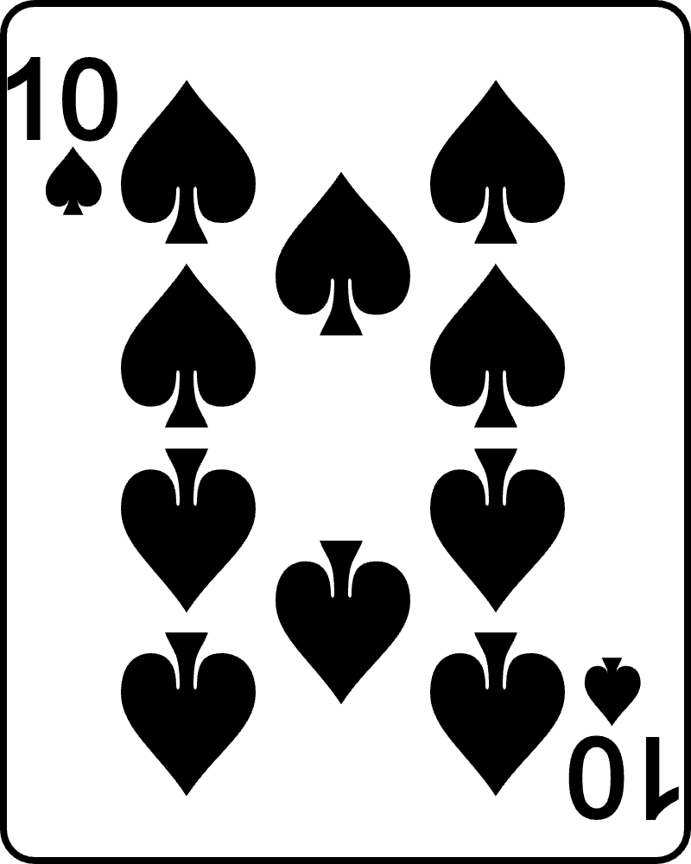
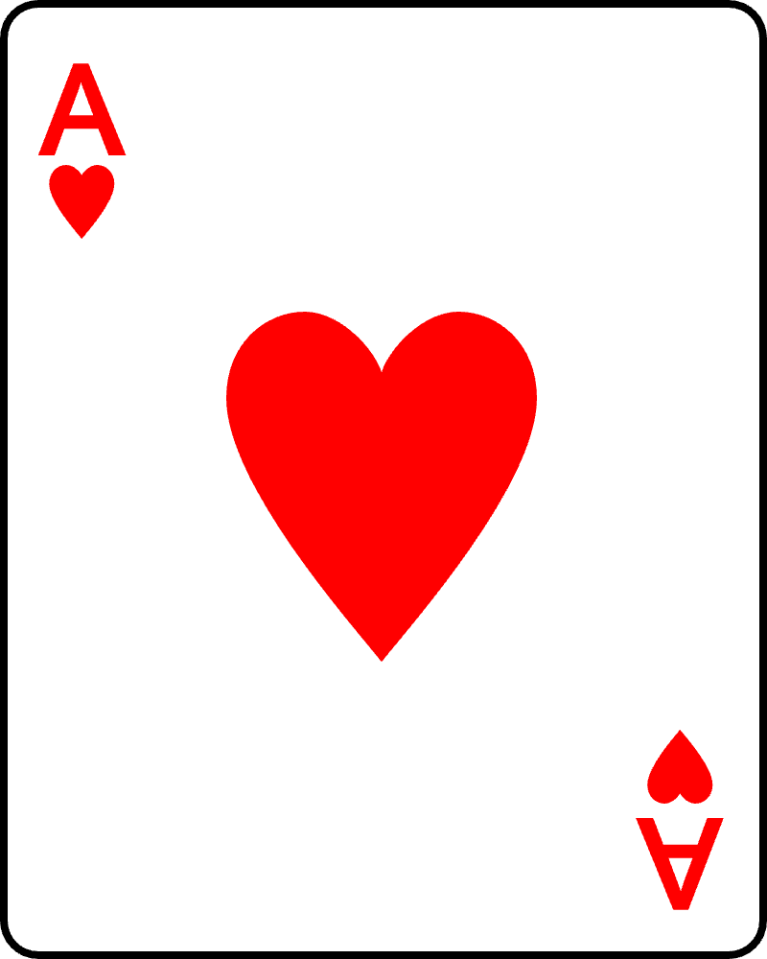


The right question
Why did we ever find probability theory?!
1. Chance marks the boundary of where regular theories can be deployed.
Why expect chancy things can be subject to regular laws?
2. Each physical randomizer is a distinct physical device and, in principle, requires its own chance theory.
Why expect a single theory for all chancy things?

Slide 33
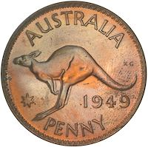
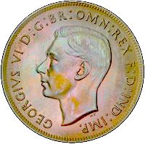
The right question
Why did we ever find probability theory?!
3. While the mathematics may be simple,
the concepts of probability theory are not.
3a. We must have the ability to count combinations correctly.
3b. We must formulate correctly the delicate connection between frequencies and chances.
P( ) = 1/2
One case or two?
Frequency( ) = 1/2

Slide 34
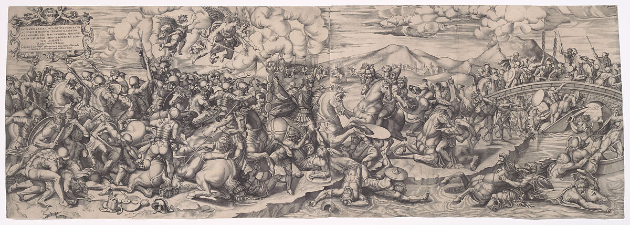
The right question
Why did we ever find probability theory?!
4. What exactly is probability?
Interpretations proliferate
5. Why expect probability to apply outside of games of chance?

Slide 35
Gems and Coals

Slide 36

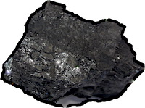




Gems and coals
Probability theory is not the only way to deal with chanciness.
Why are there no ancient sources accounting for the fitness for purpose of physical randomizers?
The puzzle that started me wondering about the history of probability.
Why have the opposite faces of die almost always summed to seven?
Faces of a die unfolded

