Slide 1
small-e empiricism
An Epistemology for Science
e
John D. Norton
Department of History and
Philosophy of Science
University of Pittsburgh

Slide 3

Empiricism: the Defining Idea
We can only learn contingent truths from experience.
The Project
Find a version well adapted to modern science.

Slide 4
Summary of small-e empiricism
e

Slide 5
Big-E Empiricism
small-e empiricism
We can only learn contingent truths from experience.
We can only learn contingent truths from experience.
Inductive pessimism
Inductive optimism
The only truths we can learn from experience is the content of the experience itself.
Experience can provide strong inductive support for contingent truths well beyond experience.

Slide 6

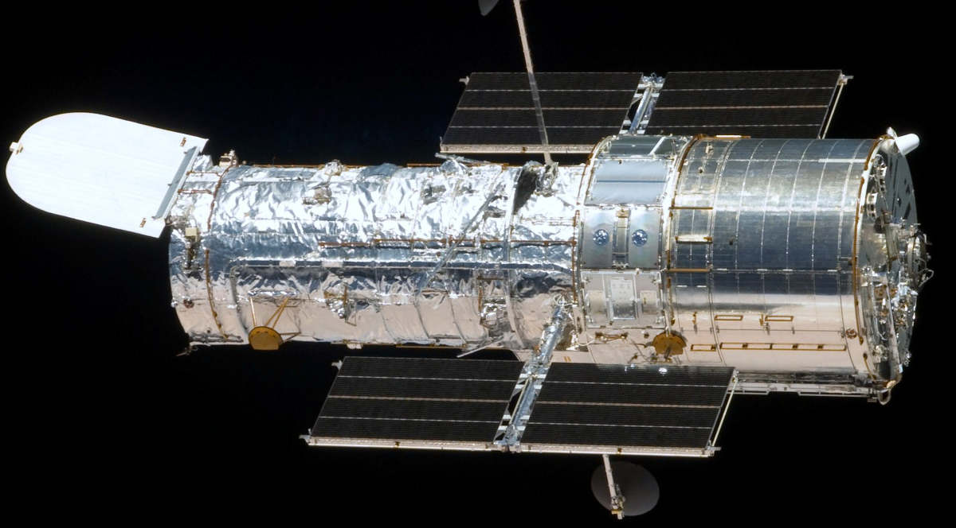
Big-E Empiricism
small-e empiricism
Experience includes
excitations
of human sense organs.
Experience is restricted to
propositions
such as appear in the scientific literature.
Hubble telescope
Processing includes
association of ideas by cognitive activities.
Processing is by inductive inference.

Slide 7
Experience in a scientific empiricism
1. Experience is propositional
2. Experience becomes instrumental
3. Experience is a process

Slide 8
1. Experience is propositional
2. Experience becomes instrumental
3. Experience is a process

Slide 9
“The Originall of them all [Thoughts of man], is that which we call SENSE (For there is no conception in a mans mind, which hath not at first, totally, or by parts, been begotten upon the organs of Sense.) The rest are derived from that originall.”
Hobbes, Leviathan, p. 3.
... after a repetition of similar instances, the mind is carried by habit, upon the appearance of one event, to expect its usual attendant, and to believe it will exist. This connexion, therefore, which we feel in the mind …from which we form the idea of power or necessary connexion.
Hume, Enquiry, p. 75

Slide 10
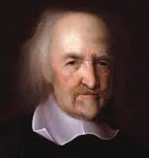
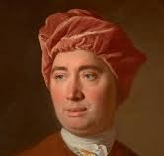
Operation of human sense organs
A respectable project for philosophers in the 17th and 18th centuries.
Habits of mind in associating ideas.
Now better treated by empirical physiology.
Now better treated by empirical psychology.

Slide 11
Identify a notion of experience in scientific empiricism that:
• only introduces philosophical problems peculiar to science; and
• conforms with how experience plays a role in scientific practice.
Part of the scientific discourse.
Publicly communicable among scientists.
Experience enters as propositions.

Slide 12
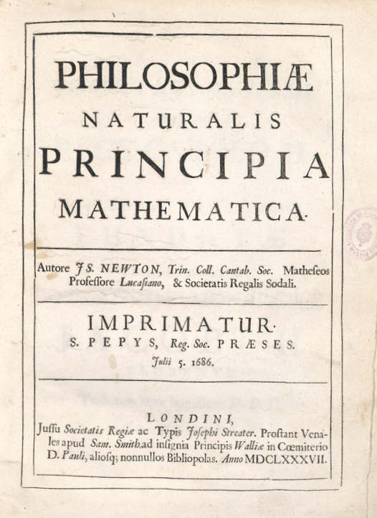
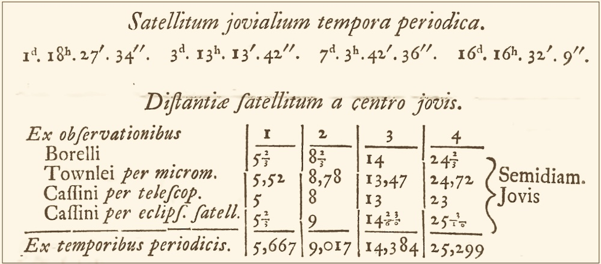
PHENOMENON I
The circumjovial planets, by radii drawn to Jupiter’s center, describe areas proportional to the times of description; and that their periodic times, the fixed stars being at rest, are as the 3/2th power of their distances from the centre.
Newton, Principia, System of the World

Slide 13
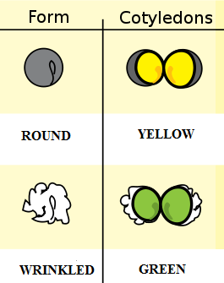
Captions: “1. Experiment, shape of the seeds, plant, round, angular;
2. Experiment, color of the albumen, yellow, green”

Slide 14
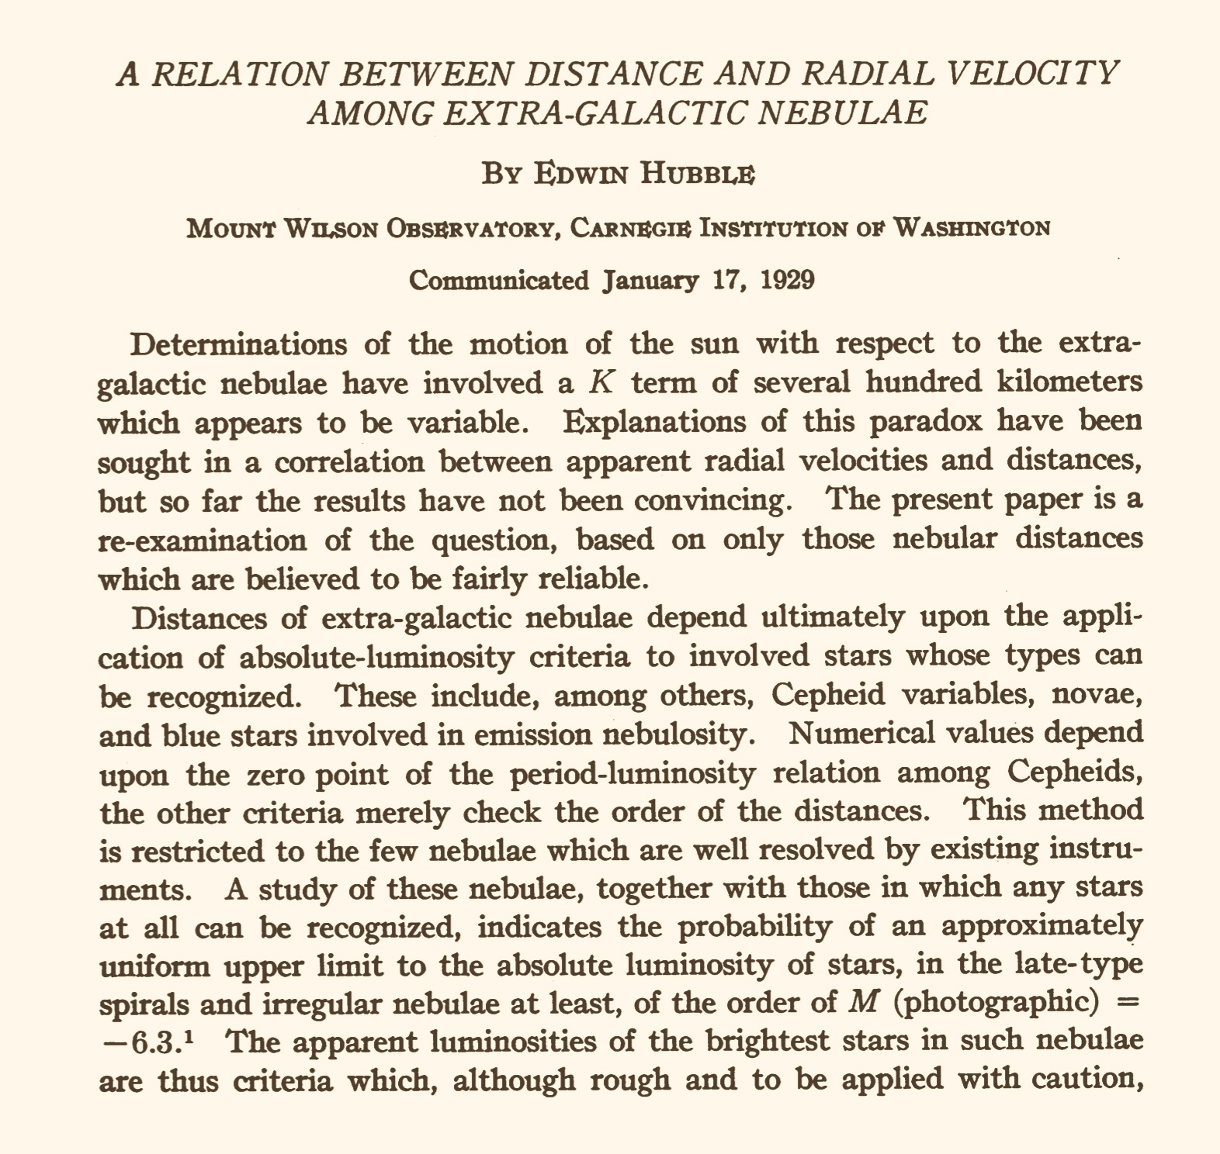
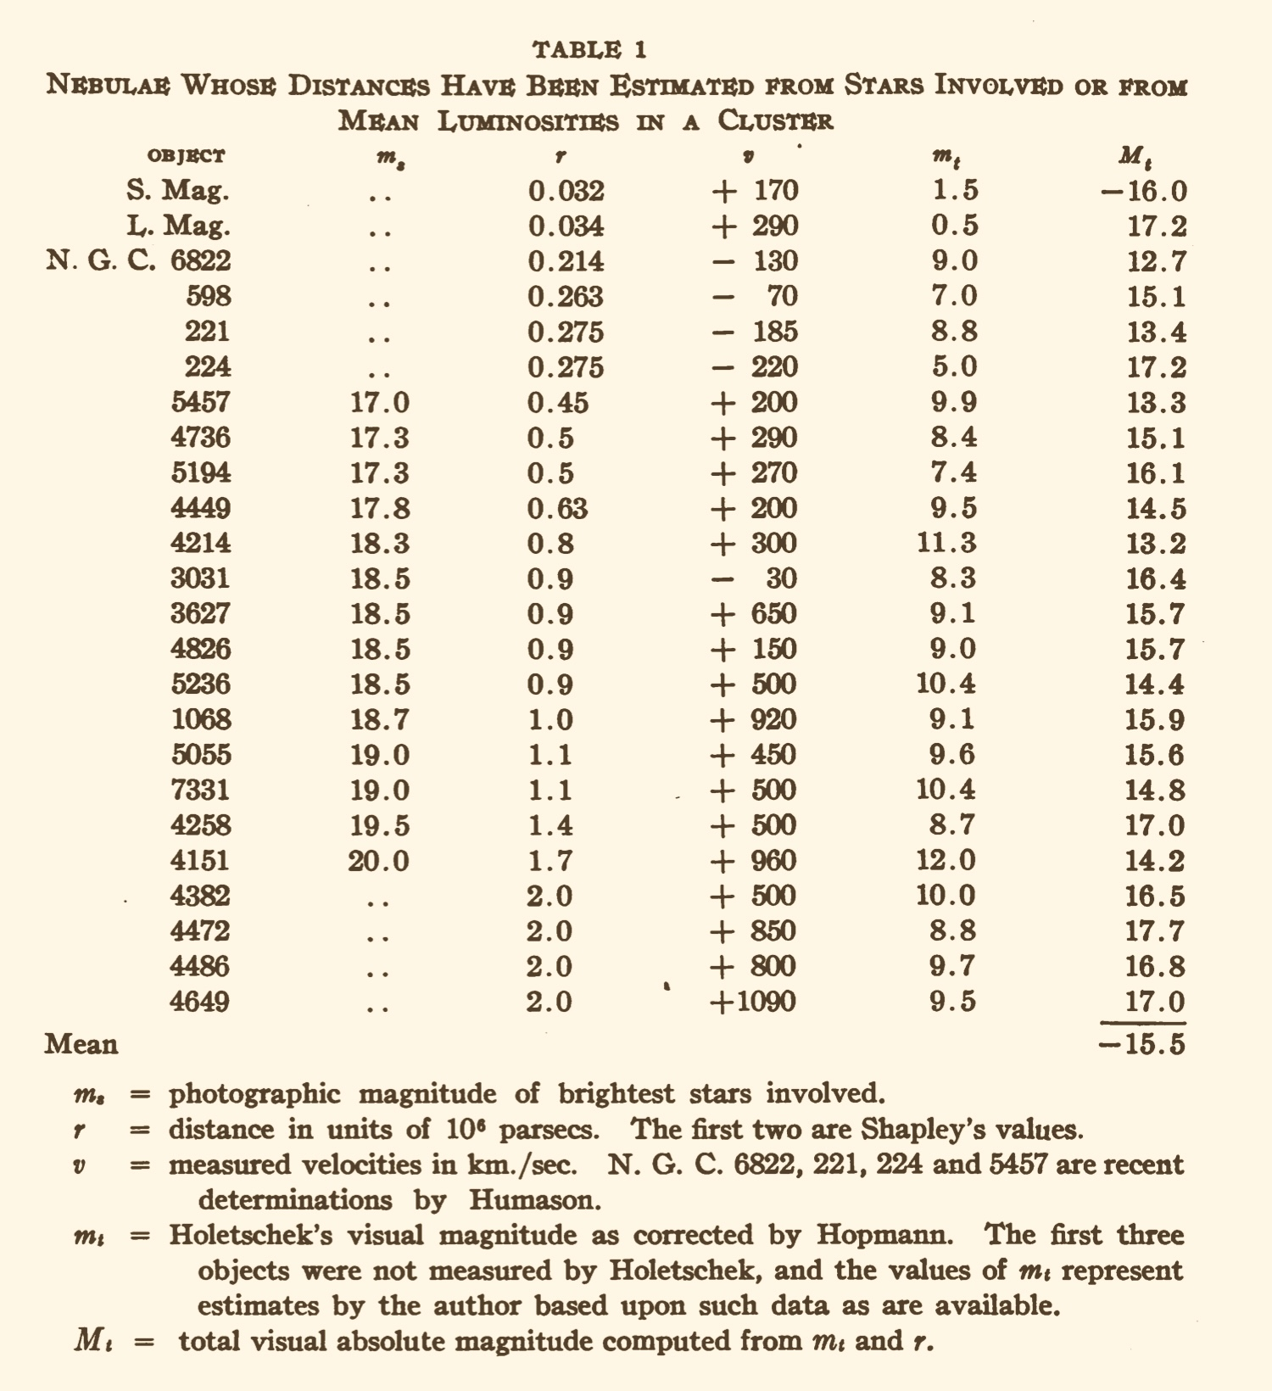
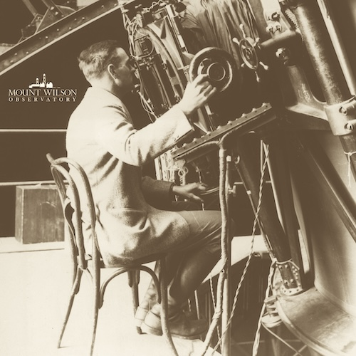

Slide 15
1. Experience is propositional
2. Experience becomes instrumental
3. Experience is a process

Slide 16

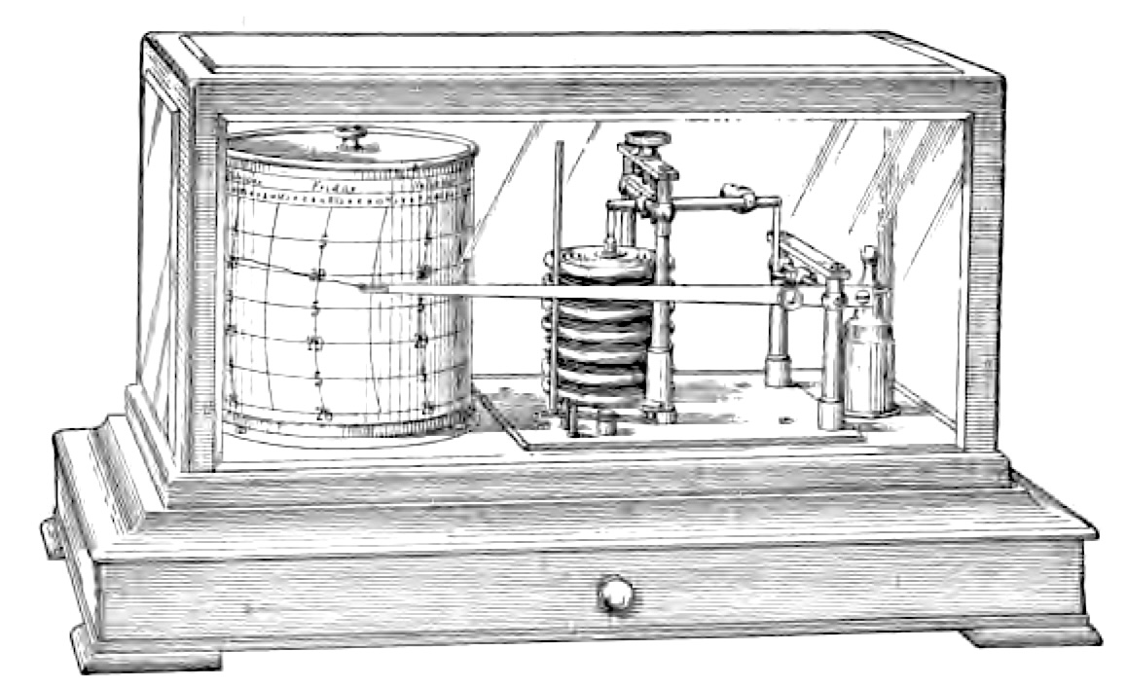
Tendency in most sciences
Experience as excitation of human sense organs.
Instrumental sensings and automatic record making.
replaced by

Slide 17
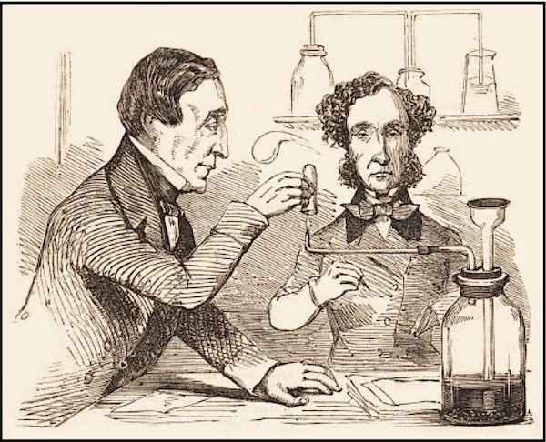

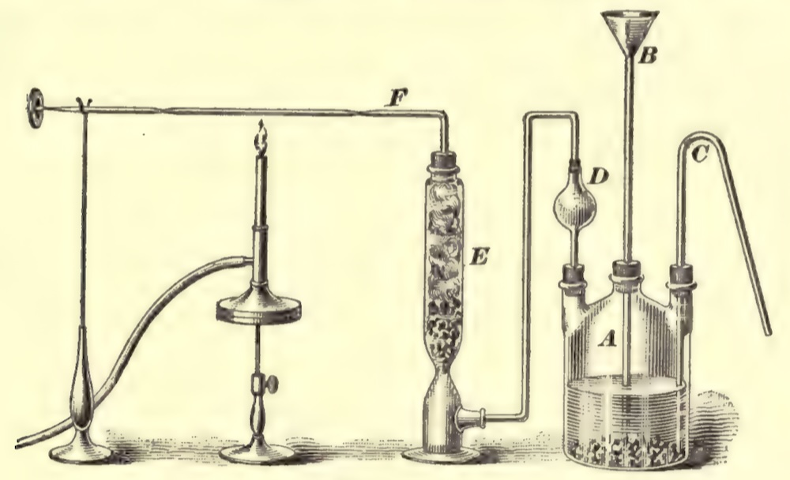

Chemical Analysis dependent on human senses …
James Marsh, 1836
Test for arsenic
“… holding a piece of cold window-glass opposite to and in contact with the flame, when a thin metallic film will be immediately deposited on its surface.”
Arsine gas burns with distinctive flame
Arsine gas evolved
“By directing the flame obliquely upon the inside of the tube, it strikes against the glass and deposits if the arsenic, the partly in the metallic state. In this case, if the tube, while still warm, be held to the nose, that peculiar odour, somewhat resembling garlic, which is one of the characteristic tests of arsenic, will be perceived.”
“Marsh’s apparatus”
Sample to be tested in sulfuric acid/zinc bath.

Slide 18
…replaced by fully instrumental analysis
Spectroscopy: divided into visible and ultraviolet molecular spectroscopy; infrared, near- infrared, and Raman spectroscopy; magnetic resonance spectroscopy; atomic absorption spectrometry; atomic emission spectroscopy; x-ray spectroscopy; mass spectrometry.
Chromatography: divided into gas chromatography; chromatography with liquid mobile phases; electroanalytical chemistry.
Thermal Analysis
Peaks indicate elements present
X-ray dispersion spectroscopy of a mineral crust on the vent shrimp Rimicaris exoculate.

Slide 19
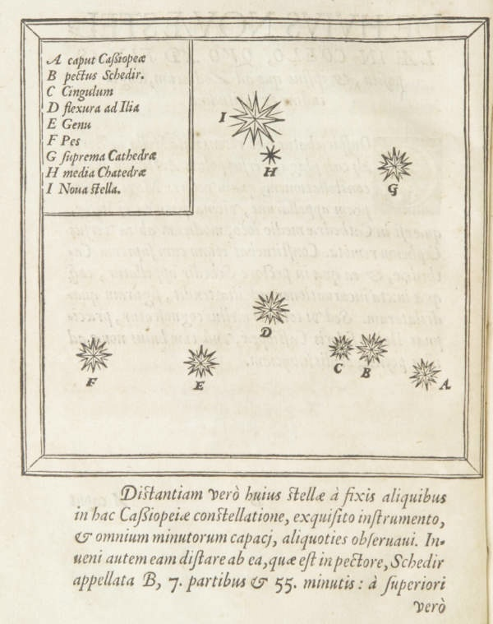
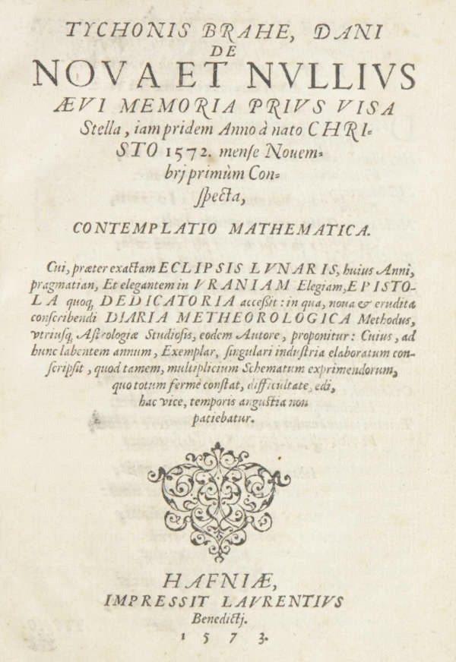
Naked eye detection of new celestial objects …
In November 1572, Tycho Brahe observed a new star in the constellation Cassiopeia.
“I. Nova stella”
Concerning the New Star, Seen Never Before in the Memory of Any Age, First Observed Lately in the Year of Our Lord 1572, in the Month of November.

Slide 20
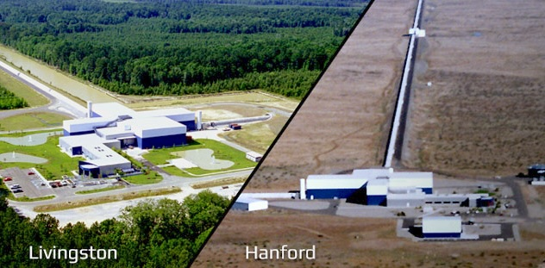
… replaced by fully instrumental detections
Laser
Interferometer
Gravitational Wave Observatory
Binary black hole merger detected in 2015 “GW150914”
Observation consists in
agreement in two strain curves
detected algorithmically

Slide 21
1. Experience is propositional
2. Experience becomes instrumental
3. Experience is a process

Slide 22
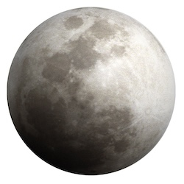
Experience is a continuous physical process that connects the system of interest with the observer
direction of physical process
System of interest
Observer
stages described in propositions
direction of inductive support
No principled division
Observational
vs
theoretical?
Terminal obsession escaped

Slide 23
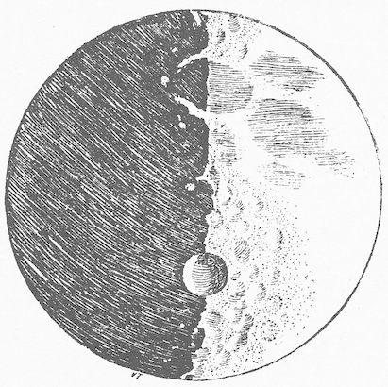
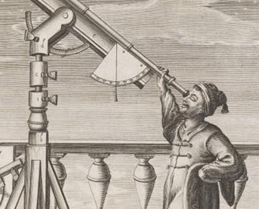
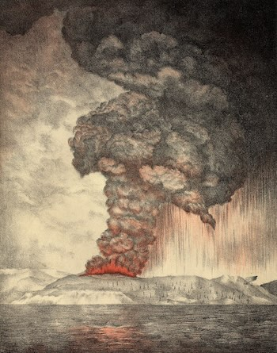

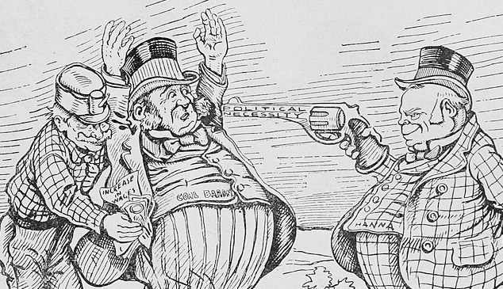
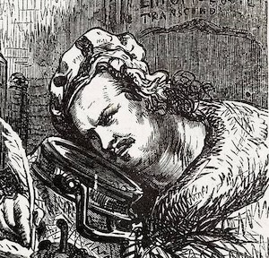
Examples of processes
light propagation
Galileo observes the moon
sound propagation
1883 eruption of Krakatoa heard in Western Australia
transport of matter
Chain of custody of sample from crime scene

Slide 24
Winding back
How to control the theory ladenness of observation.
For any troublesome item of theory:
System of interest
Observer
Description errs through presumption of faulty theory
Wind back through inductive inferences to stage prior to presumption

Slide 25
Winding back
Distances too small by up to a factor of 6 or 7.
Hubble’s 1929 estimates of distance to the nebulae (galaxies)
Andromeda, NGC 224
0.275 Mpc
Later corrected value
0.765Mpc

Slide 26

Winding back
Andromeda
erroneous distance to Andromeda corrected
period luminosity relation for Type II Cepheids gives distance
Hubble
erroneous distance to Andromeda 0.275 Mpc
period luminosity relation for Type I Cepheids gives distance
they are Type I Cepheid variable stars
period of variable stars in Andromeda measured
Oops!
They are Type II Cepheid variable stars

Slide 27
small-e empiricism
e

Slide 28
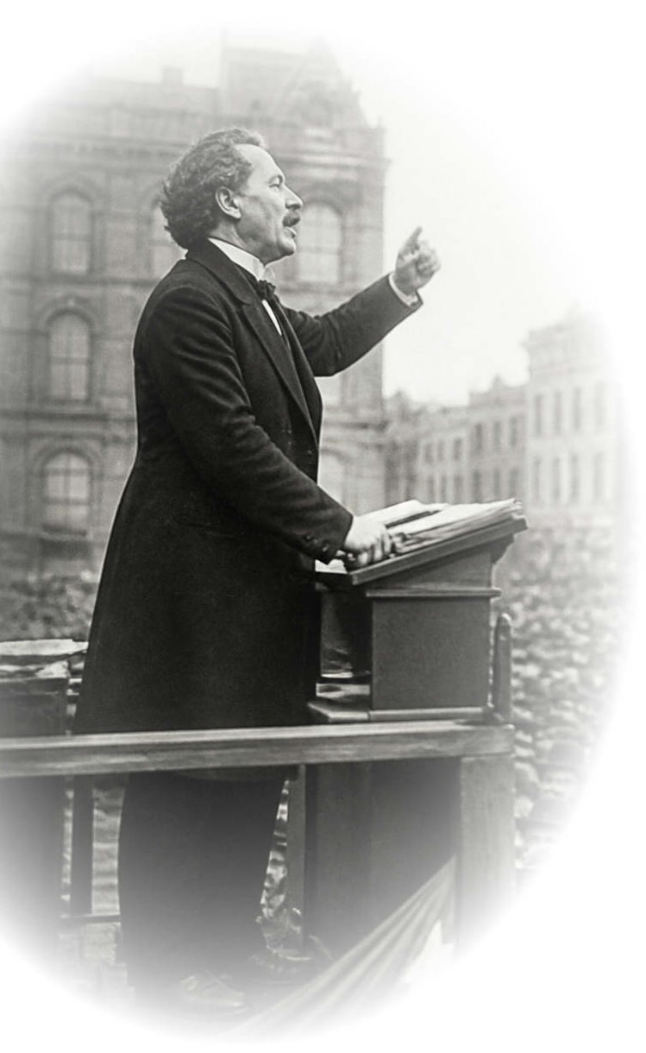
The doctrine
e
A continuous physical process connected to the system of interest.
Science is empirical.
The propositions of experience provide inductive support for the truth of the contingent propositions of science; …
(adequacy)
Induction conceived materially is native to small-e empiricism.
… and the inductive support of experience is the only means of providing support for these contingent propositions.
(exclusivity)

Slide 29
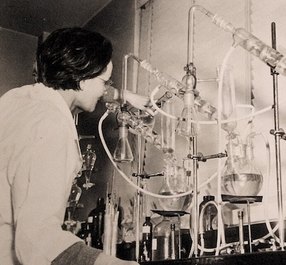
Conforms with…
e
Scientists’ conception of empirical science.
Science consists of observational and experimental reports and further results inferred from them.
The observational and experimental reports are the empirical evidence indispensable for science.
E
Skepticism of Big-E Empiricism is tacitly abandoned.

Slide 30
The argument for small-e empiricism
e

Slide 31
The Authority of Experience
e
small-e empiricism
The processes of experience connect continuously with the system of interest.
E
???
Big-E Empiricism
Strictly conceived, experience is a mental state associated with excited sense organs.

Slide 32
Adequacy of Experience
Efficacy of inductive inference
Strong support for contingent propositions is possible.
Authority of experience
Inductive skepticism is irrational
Whether attained in any particular science is decided case-by-case.
=
Refusal to accept the dictates of reason
The small-e empiricists’ ontology
Empirical evidence affirms the reality of processes comprising experience.
Electromagnetive waves
Sound waves
Material transport
Gravitational waves
…

Slide 33
Exclusivity of Experience
All other modes succeed only retrospectively.
Result already found empirically?
vs
Novel predictions?
Platonic insight
Innate or intuitive ideas
Oracular revelation
recovered with flourish
routinely fail
Priority of experience
other modes
Empiricism can self-correct via new experiences.
ıı
If
contradict experience …
… retract
… prevails
Opacity
No ontology comparable to small-e empiricism’s.
How do we access Plato’s world?
Why should intuition, conceivability inform us of contingent truths?
ıı

Slide 34
Applications of small-e empiricism
1. Induction is material
2. Inductive fallibilism
3. Small-r realism
4. Against metaphysics

Slide 35
1. Induction is material

Slide 36
Induction is Material
Inductive inference amplifies
what we know.
logically stronger
Conclusion
Premises
Empiricism: expansion must be authorized by experience.
Inductive inference is warranted by empirically secured facts.
material theory of induction
Example
Only works if
simplicity is a surrogate for background facts.
Infer to the simplest

Slide 37
2. Inductive Fallibilism
Gettier problem

Slide 38
Inductive Fallibilism
deductive inferences
inductive inferences
/
enhance
but do not assure
the truth of the conclusion.
Premises
assure
Inductive inference is fallible by definition.
Contingent results in science are known
if they are:
inductively well-confirmed
and
true ???
what empiricism provides
assurance of truth is unattainble
Inductive opacity of truth.

Slide 39

No basis for skepticism about science.
Today is not my last.
Today is not my last.
Today is not my last.
Today is not my last.
Today is not my last.
Today is not my last.
Today is not my last.
A 20-year-old can expect to live a further 55.63 years = 20,319 days.
Correct 20,318 times.
Wrong once.

Slide 40

Gettier problems
knowledge = justified true belief
of contingent propositions
provided by empiricism
unattainable independently of inductive justification
Opacity of truth evaded by omniscient narrator subterfuge.
Knowledge as justified belief
Belief is inductively well supported and…
true
support works as expected.
true
support fails to work as expected, but nonetheless true.
false
since inductive support is fallible.
Best
Saved from worst
= Gettier case
Worst
Gettier-like cases pervasively successes in history of science.
Bradley’s stellar aberration
Dalton’s atoms
Carnot’s thermodynamics
Thomson’s electron
Einstein’s general relativity
Hubble’s law

Slide 41
3. small-r realism

Slide 42
Realism, rescued
Big-R Realism
We have the means to determine the truth of contingent propositions in science.
We have succeeded in science for …
… structure??
manipulable entities??
explanatory successes??
(more)??
small-r realism
Experience can provide strong support for the contingent propositions of a science.
Success must be determined on a case-by-case basis for each science.
(no general principle)
small-r realism ≈ small-e empiricism

Slide 43
realism
empiricism

Slide 44
4. Against Metaphysics

Slide 45
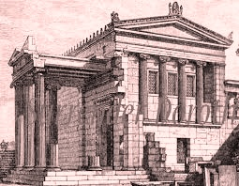
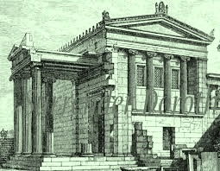
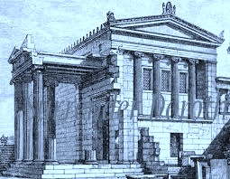
Against Metaphysics: debates languish
Non-empirical metaphysics
No means to settle debates. Results remain undecided.
Experience is the only way to assess the truth of contingent propositions.
Non-empirical decision criteria ??
simplicity
intuitive plausibility explanatory power
…
Succeed only indirectly when surrogates for background facts, determined empirically
Languishing debates
Possible world realism
Presentism vs eternalism

Slide 46
Against Metaphysics: fatal abstraction
Many systems have similar properties
General metaphysical principle remains.
General metaphysical principle remains.
NOTHING
abstract away particulars that distinguish different cases
Many systems interact in many ways
Principle of causality
abstract away particulars that distinguish different cases
NONE found
Many judgments of possibility and necessity
General metaphysics of modality
abstract away particulars that distinguish different cases
NONE viable
Empiricist conception:
possible = positively allowed by evidence
Necessary = compelled by evidence
Material theory of induction

Slide 47
Conclusion

Slide 48
Empiricism: the Defining Idea
We can only learn contingent truths from experience.
The Project
Find a version well adapted to modern science.

Slide 49
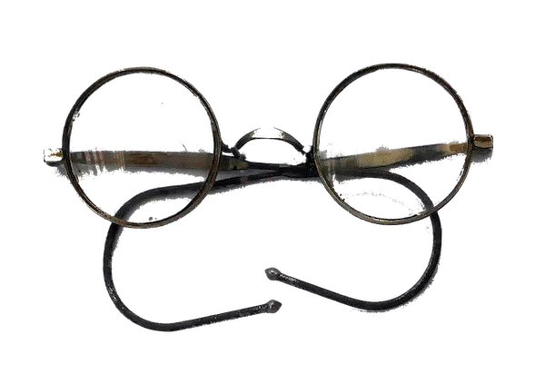
Read

Slide 51
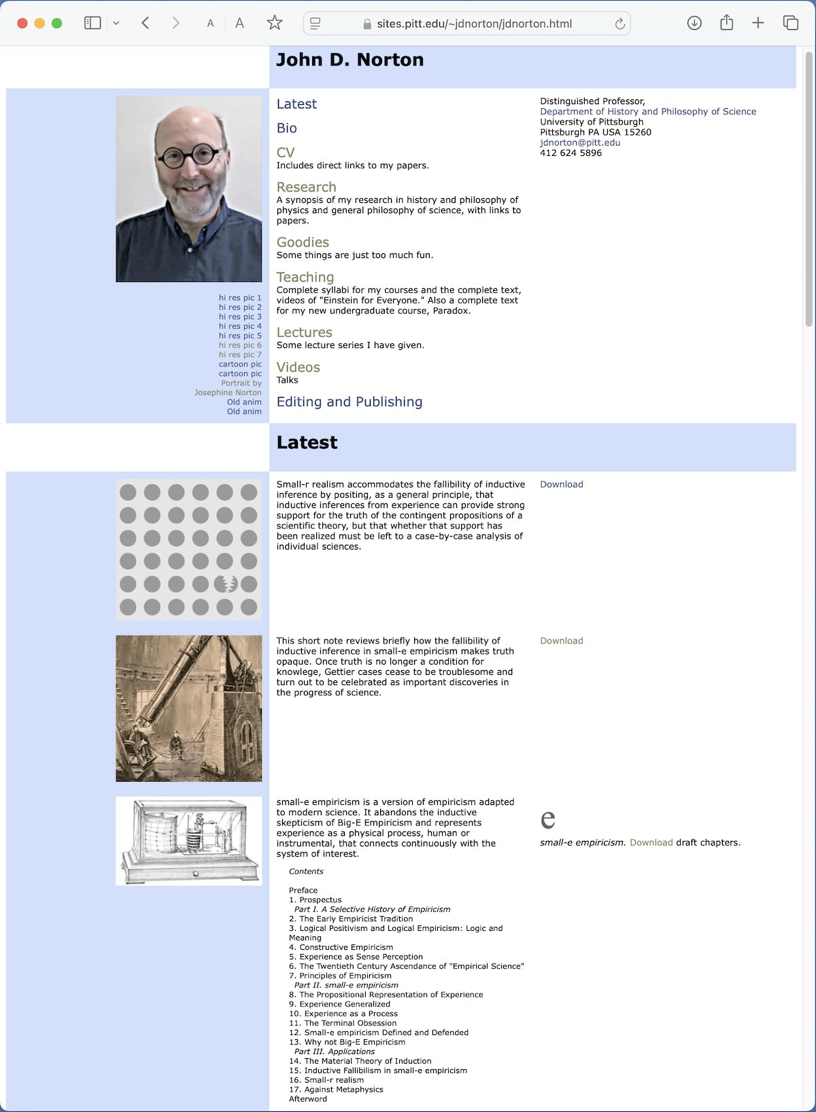

Slide 53

Image: Gemini Google

