Slide 1
small-e empiricism
Applications
e
John D. Norton
Department of History and
Philosophy of Science
University of Pittsburgh

Slide 2
They are…
1. Induction is material
2. Inductive fallibilism
3. Small-r realism
4. Against metaphysics

Slide 3
Summary of small-e empiricism
e

Slide 4
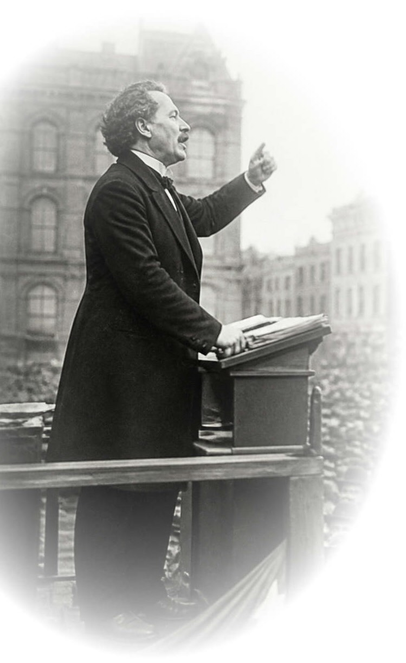
The doctrine
e
A physical process connects us continuously to the system of interest.
Science is empirical.
The propositions of experience provide inductive support for the truth of the contingent propositions of science; …
(adequacy)
Induction conceived materially is native to small-e empiricism.
… and the inductive support of experience is the only means of providing support for these contingent propositions.
(exclusivity)

Slide 5
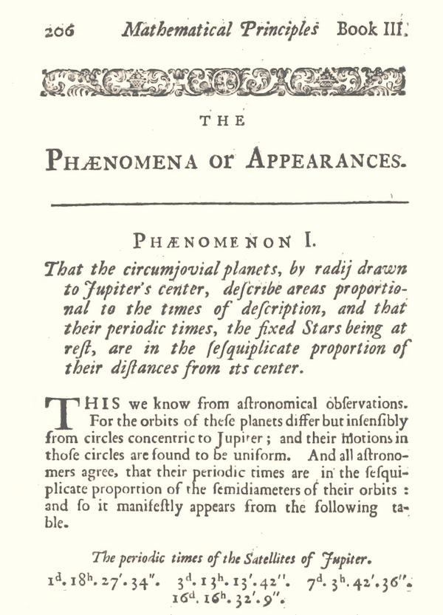
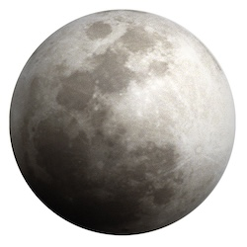
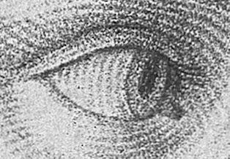
Experience in small-e empiricism
1. Experience is propositional
Laser Interferometer Gravitational Wave Observatory
2. Experience becomes instrumental
3. Experience is a process
System of interest
Observer

Slide 6
1. Induction is material

Slide 7
Induction is Material
Inductive inference amplifies
what we know.
logically stronger
Conclusion
Premises
Empiricism: expansion must be authorized by experience.
Inductive inference is warranted by empirically secured facts.
material theory of induction
Example
Only works if
simplicity is a surrogate for background facts.
Infer to the simplest

Slide 8
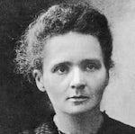
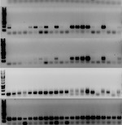
Inductive Inferences Warranted Exclusively by Background Facts
This sample of radium chloride is crystallographically monoclinic.
All samples of radium chloride are crystallographically monoclinic.
Haüy’s principle: generally, all samples of a pure crystalline substance belong to the same crystallographic family.
DNA of suspect and perpetrator match.
Very probable that suspect and perpetrator are the same person.
Distribution of DNA in the population. Subjects are chosen randomly. (Equal probability.)

Slide 9
2. Inductive Fallibilism
Gettier problem

Slide 10
Inductive Fallibilism
deductive inferences
inductive inferences
/
enhance
but do not assure
the truth of the conclusion.
Premises
assure
Inductive inference is fallible by definition.
Contingent results in science are known
if they are:
inductively well-confirmed
and
true ???
what empiricism provides
assurance of truth is unattainble
Inductive opacity of truth.

Slide 11

No basis for skepticism about science.
Today is not my last.
Today is not my last.
Today is not my last.
Today is not my last.
Today is not my last.
Today is not my last.
Today is not my last.
A 20-year-old can expect to live a further 55.63 years = 20,319 days.
Correct 20,318 times.
Wrong once.

Slide 12

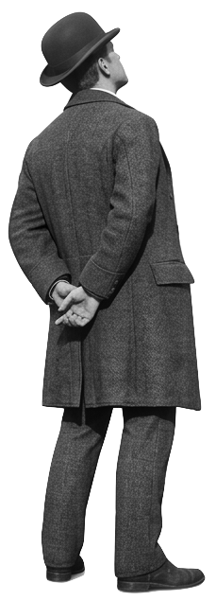
Gettier problems
BUT…
It is 12 noon.
The clock has been stopped all day on a reading of 12.
By mere chance…
It is 12 noon at this moment.
Does the man KNOW that it is 12 noon?

Slide 13

Gettier problems
knowledge = justified true belief
of contingent propositions
provided by empiricism
unattainable independently of inductive justification
Opacity of truth evaded by omniscient narrator subterfuge.
By chance, it just happens to be 12 noon at this moment.

Slide 14
Gettier problems
knowledge = justified true belief
of contingent propositions
provided by empiricism
unattainable independently of inductive justification
Opacity of truth evaded by omniscient narrator subterfuge.
Knowledge as justified belief
Belief is inductively well supported and…
true
support works as expected.
true
support fails to work as expected, but nonetheless true.
false
since inductive support is fallible.
Best
Saved from worst
= Gettier case
Worst
Gettier-like cases are pervasively successes in history of science.
Bradley’s stellar aberration
Dalton’s atoms
Carnot’s thermodynamics
Thomson’s electron
Einstein’s general relativity
Hubble’s law

Slide 15
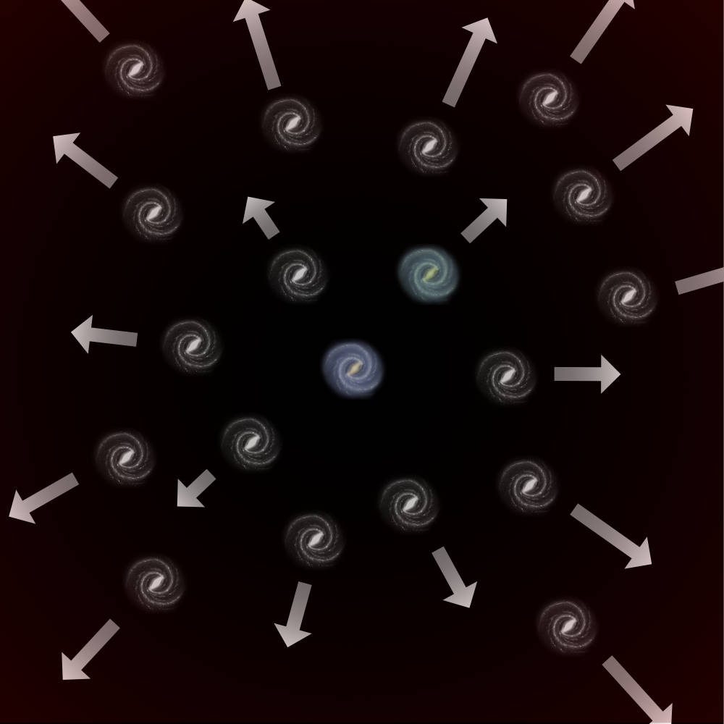
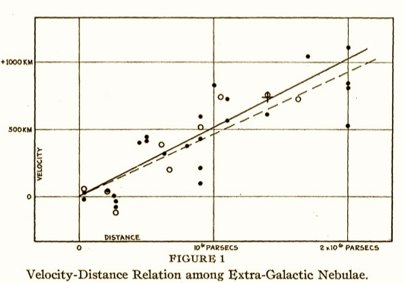
Hubble discovers Hubble’s Law in 1929 …
velocity of recesssion
distance to galaxy (nebula)
= constant x
500 km/sec/megaparsec

Slide 16
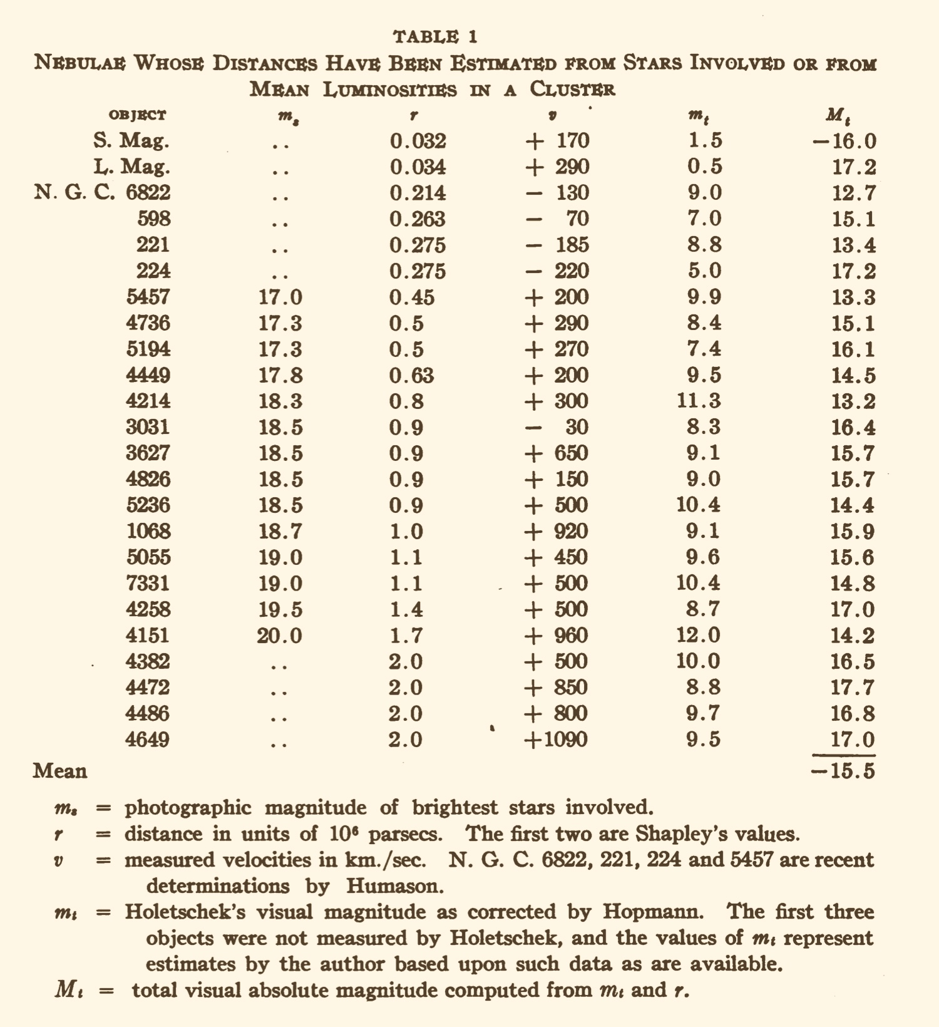
… based on faulty data
distances all too small by up to a factor of 6 or 7.
Replace Cepheid I by Cepheid II
Law survives through good fortune, unknown to Hubble.
Later correction by constant multiple
Linearity of 1929 law preserved.
New constant:
70 km/sec/megaparsec

Slide 17
3. small-r realism

Slide 18
Realism, rescued
Big-R Realism
We have the means to determine the truth of contingent propositions in science.
We have succeeded in science for …
… structure??
manipulable entities??
explanatory successes??
(more)??
small-r realism
Experience can provide strong support for the contingent propositions of a science.
Success must be determined on a case-by-case basis for each science.
(no general principle)

Slide 19
Antirealist Skepticism Escaped
We can be and have been in error in the judgment of the import of evidence.
We can have no confidence in our present best science.
Antirealism
Small-r realism
We can be and have been in error in the judgment of the import of evidence.
We should accept the import of our current best evidence for present sciences.

Slide 20
Selective Realisms cannot extend small-r realism
NON-
Structure or
Entities or
Explanatory essentials
Structure or
Entities or
Explanatory essentials
Assuredly?
Violates fallibility of inductive inference
are
real
are
not
real
Defeasibly?
Does not extend small-r realism

Slide 21
small-r realism ≈ small-e empiricism
realism
empiricism

Slide 22
4. Against Metaphysics

Slide 23
Against Metaphysics: debates languish
Non-empirical metaphysics
No means to settle debates. Results remain undecided.
Experience is the only way to assess the truth of contingent propositions.
Non-empirical decision criteria ??
simplicity
intuitive plausibility explanatory power
…
Succeed only indirectly when surrogates for background facts, determined empirically

Slide 24
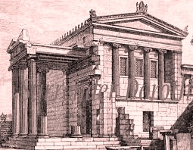
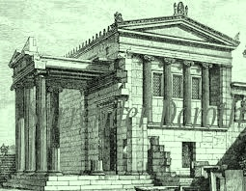
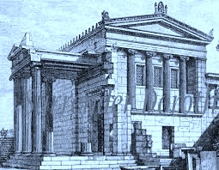
Possible world realism
Possible worlds are as real as the actual world.
Debate languishes since no empirical import for this sense of “real.”
David Lewis:
“… reduce the diversity of notions we must accept as primitive, and thereby to improve the unity and economy of the theory…”
Robert Stalnacker
“Even a philosopher who had no qualms about abstract objects … might balk at this proliferation of fullblooded universes …”

Slide 25
Presentism vs Eternalism
Presentist:
Only the present moment is real.
time
ı
No empirical import for this sense of “real.”
Eternalist:
All moments are equally real.
time
space

Slide 26
Against Metaphysics: fatal abstraction
Many systems have similar properties
General metaphysical principle remains.
General metaphysical principle remains.
NOTHING
abstract away particulars that distinguish different cases
Many systems interact in many ways
Principle of causality
abstract away particulars that distinguish different cases
NONE found
Many judgments of possibility and necessity
General metaphysics of modality
abstract away particulars that distinguish different cases
NONE viable
Empiricist conception:
possible = positively allowed by evidence
Necessary = compelled by evidence
Material theory of induction

Slide 27
Conclusion

Slide 28
Applications of small-e empiricism
1. Induction is material
An empirically founded account of inductive inference
2. Inductive fallibilism
Certain knowledge is unattainable. Gettier problems disappear.
3. Small-r realism
Small-e empiricism preserves the best of stricter realism and antirealism.
4. Against metaphysics
Non-empirical metaphysics fails to secure contingent facts.

Slide 29
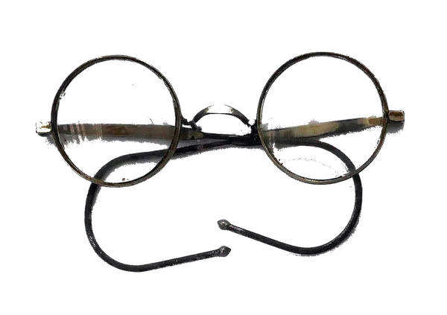
Read

Slide 31
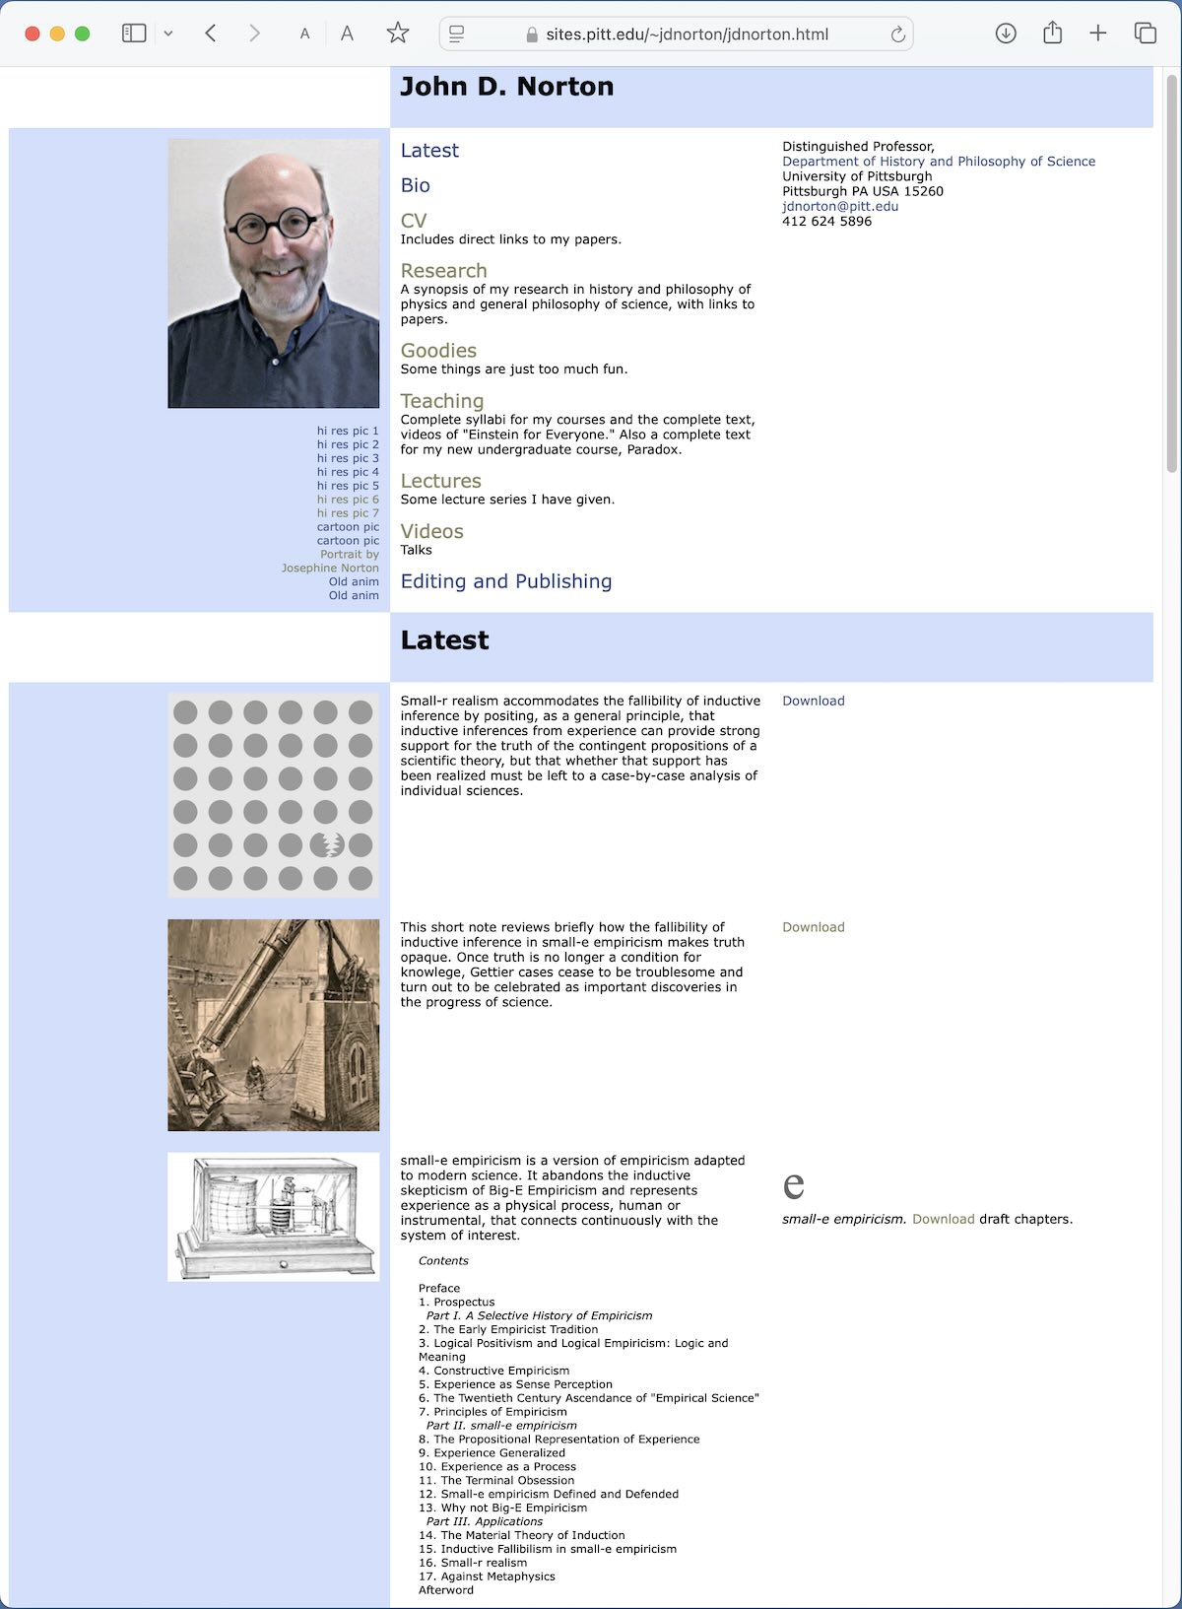

Slide 33

Image: Gemini Google

