Slide 1
small-e empiricism
An Epistemology for Science
e
John D. Norton
Department of History and
Philosophy of Science
University of Pittsburgh

Slide 3

Empiricism: the Defining Idea
We can only learn contingent truths from experience.
The Project
Find a version well adapted to modern science.

Slide 4
Summary of small-e empiricism
e

Slide 5
Big-E Empiricism
small-e empiricism
We can only learn contingent truths from experience.
We can only learn contingent truths from experience.
Inductive pessimism
Inductive optimism
The only truths we can learn from experience is the content of the experience itself.
Experience can provide strong inductive support for contingent truths well beyond experience.

Slide 6

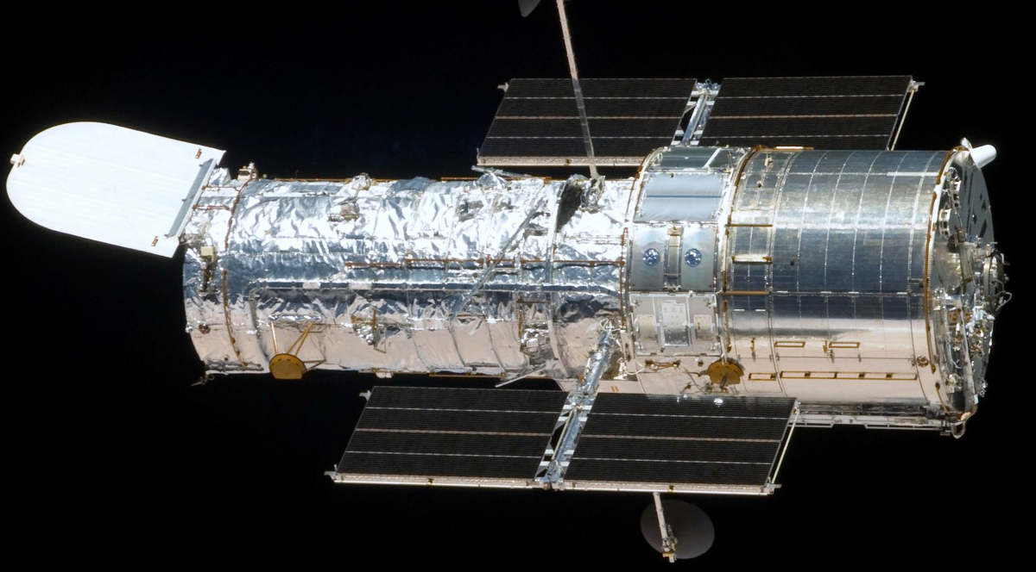
Big-E Empiricism
small-e empiricism
Experience includes
excitations
of human sense organs.
Experience is restricted to
propositions
such as appear in the scientific literature.
Hubble telescope
Processing includes
association of ideas by cognitive activities.
Processing is by inductive inference.
If p then probably q.

Slide 7
Experience in a scientific empiricism
1. Experience is propositional
2. Experience becomes instrumental
3. Experience is a process

Slide 8
1. Experience is propositional
2. Experience becomes instrumental
3. Experience is a process

Slide 9
“The Originall of them all [Thoughts of man], is that which we call SENSE (For there is no conception in a mans mind, which hath not at first, totally, or by parts, been begotten upon the organs of Sense.) The rest are derived from that originall.”
Hobbes, Leviathan, p. 3.
... after a repetition of similar instances, the mind is carried by habit, upon the appearance of one event, to expect its usual attendant, and to believe it will exist. This connexion, therefore, which we feel in the mind …from which we form the idea of power or necessary connexion.
Hume, Enquiry, p. 75

Slide 10
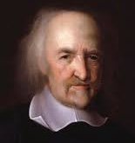
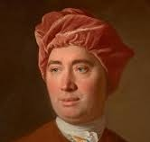
Operation of human sense organs
A respectable project for philosophers in the 17th and 18th centuries.
Habits of mind in associating ideas.
Now better treated by empirical physiology.
Now better treated by empirical psychology.

Slide 11
Identify a notion of experience in scientific empiricism that:
• only introduces philosophical problems peculiar to science; and
• conforms with how experience plays a role in scientific practice.
Part of the scientific discourse.
Publicly communicable among scientists.
Experience enters as propositions.

Slide 12
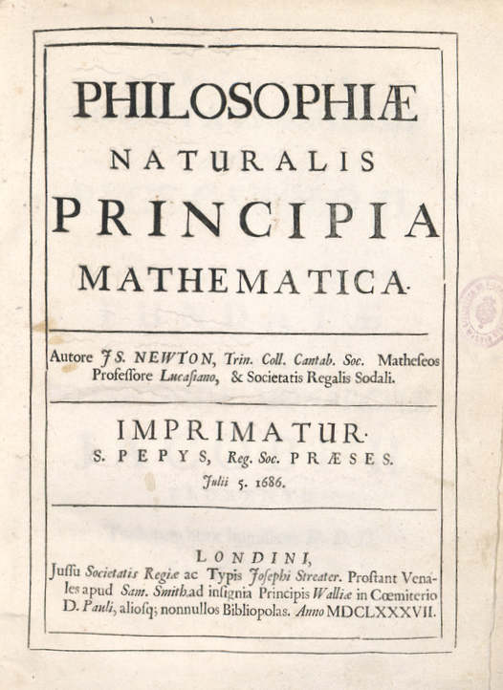
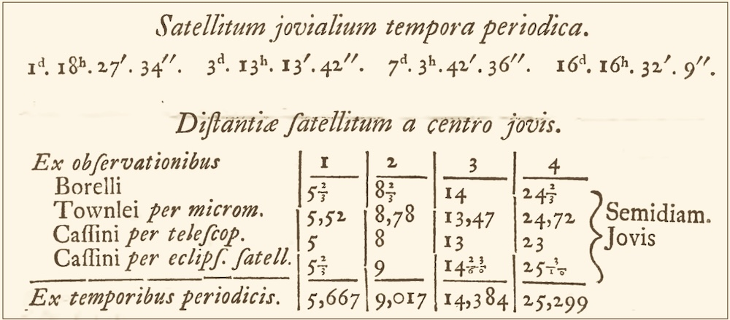
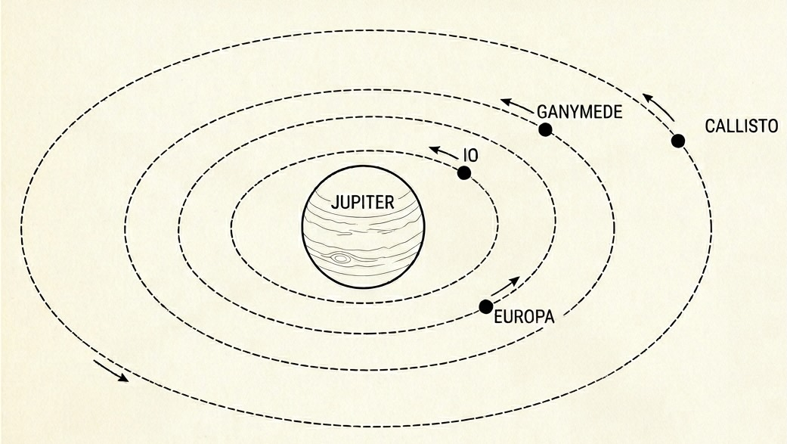
PHENOMENON I
The circumjovial planets, by radii drawn to Jupiter’s center, describe areas proportional to the times of description; and that their periodic times, the fixed stars being at rest, are as the 3/2th power of their distances from the centre.
Newton, Principia, System of the World

Slide 13
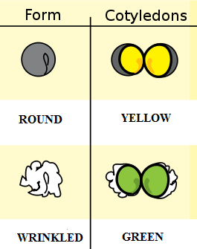
Captions: “1. Experiment, shape of the seeds, plant, round, angular;
2. Experiment, color of the albumen, yellow, green”

Slide 14
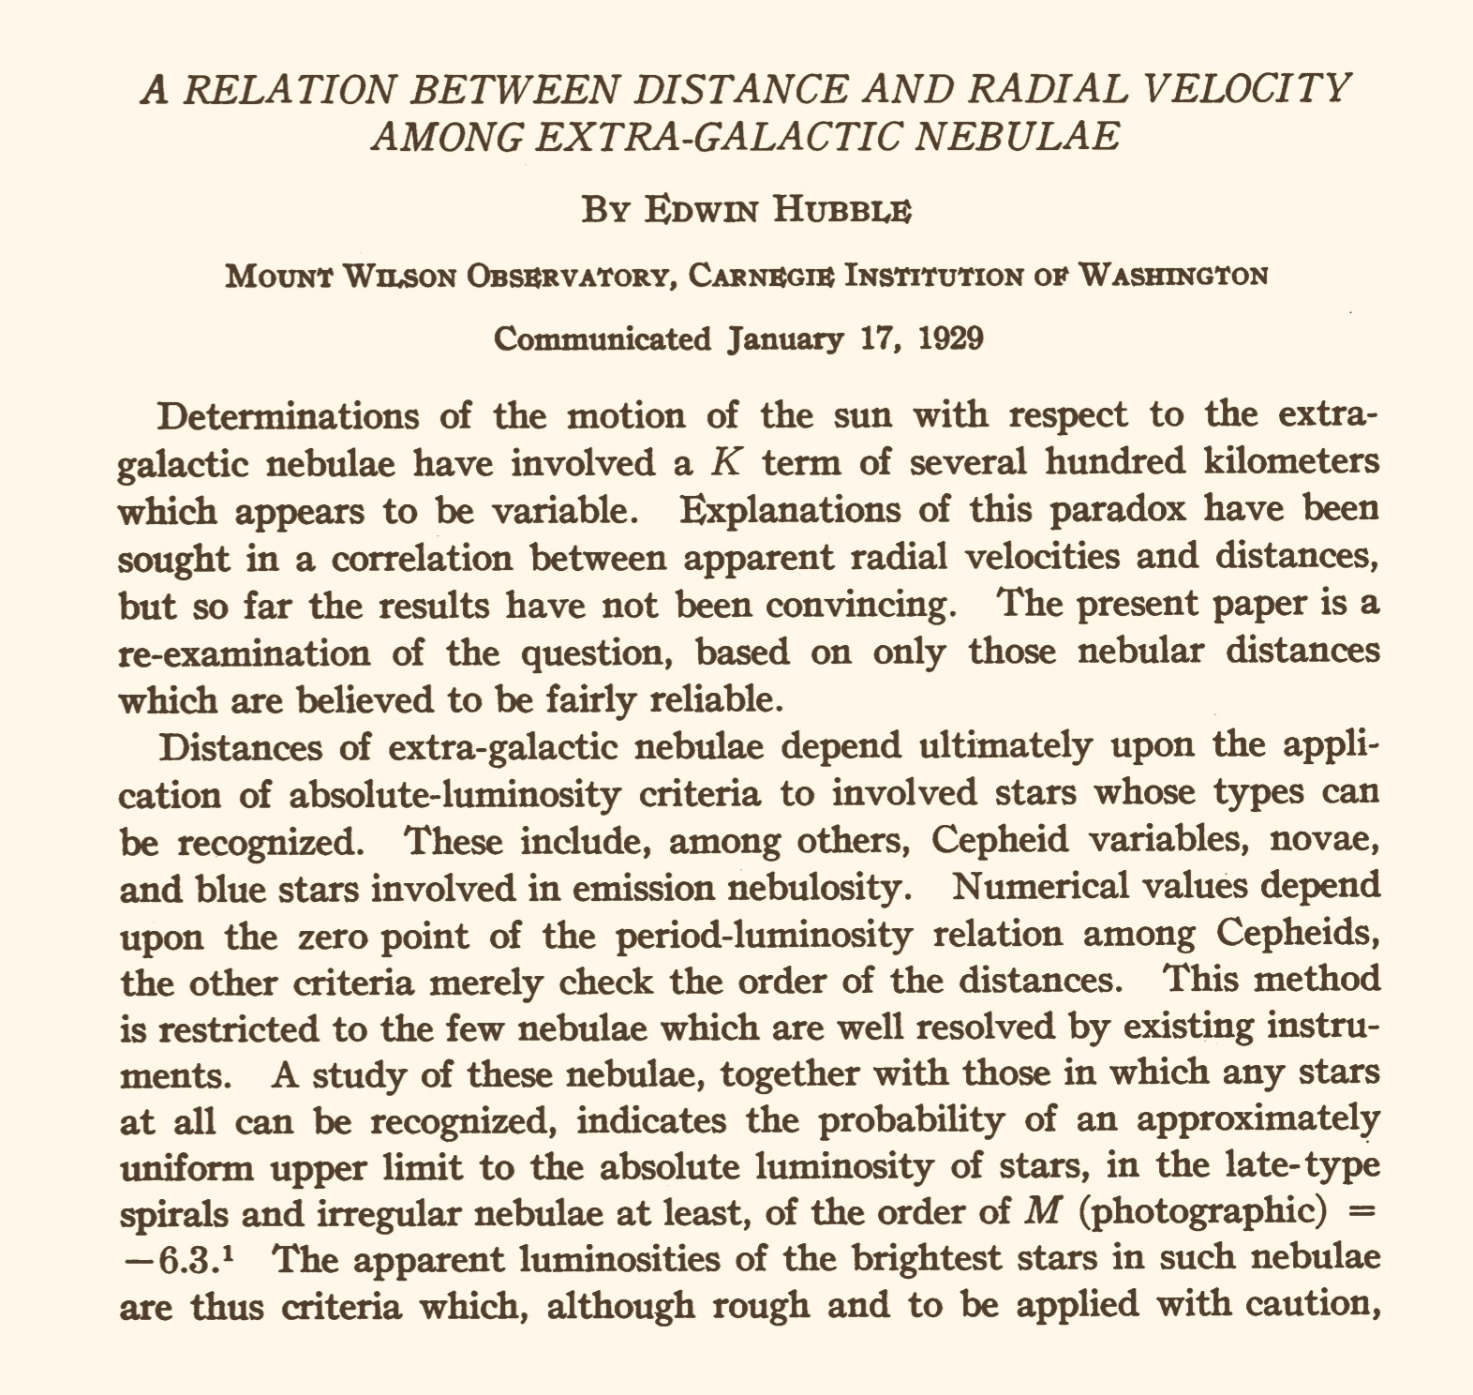
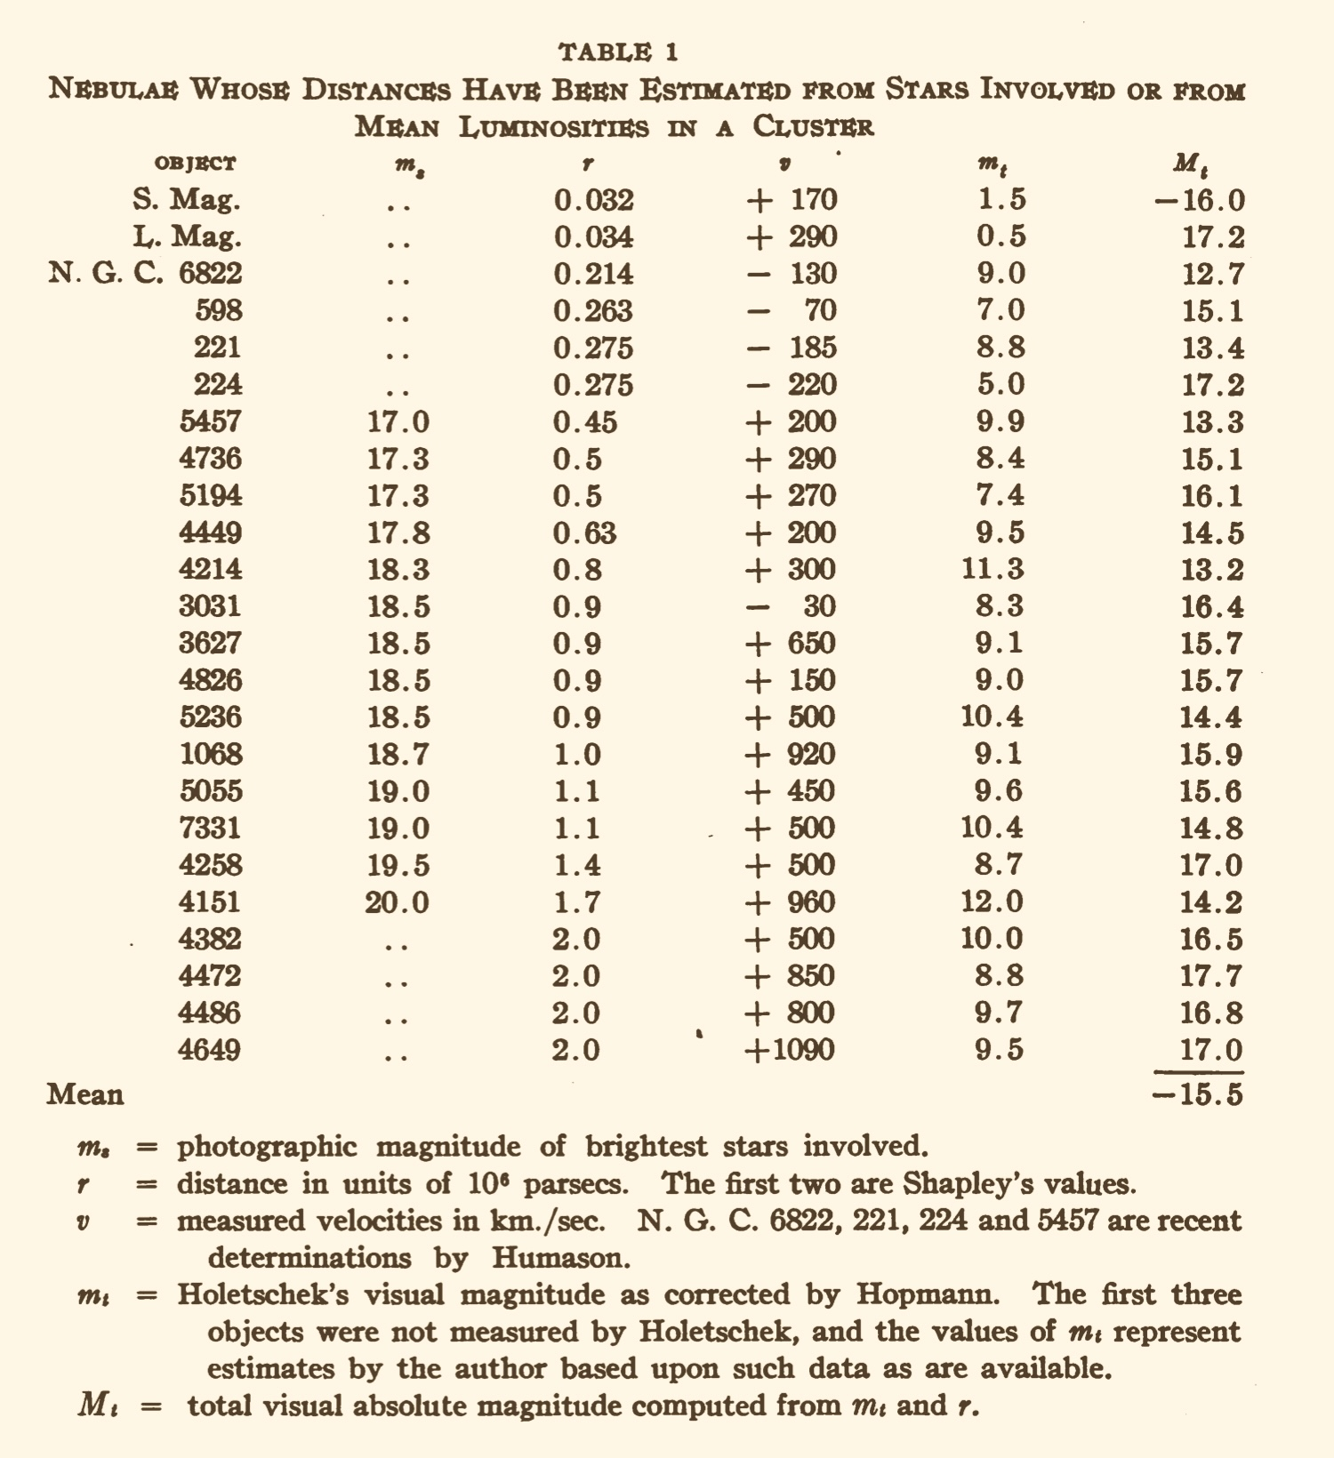
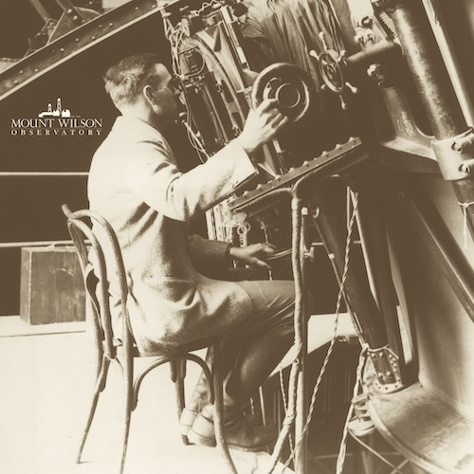

Slide 15
1. Experience is propositional
2. Experience becomes instrumental
3. Experience is a process

Slide 16

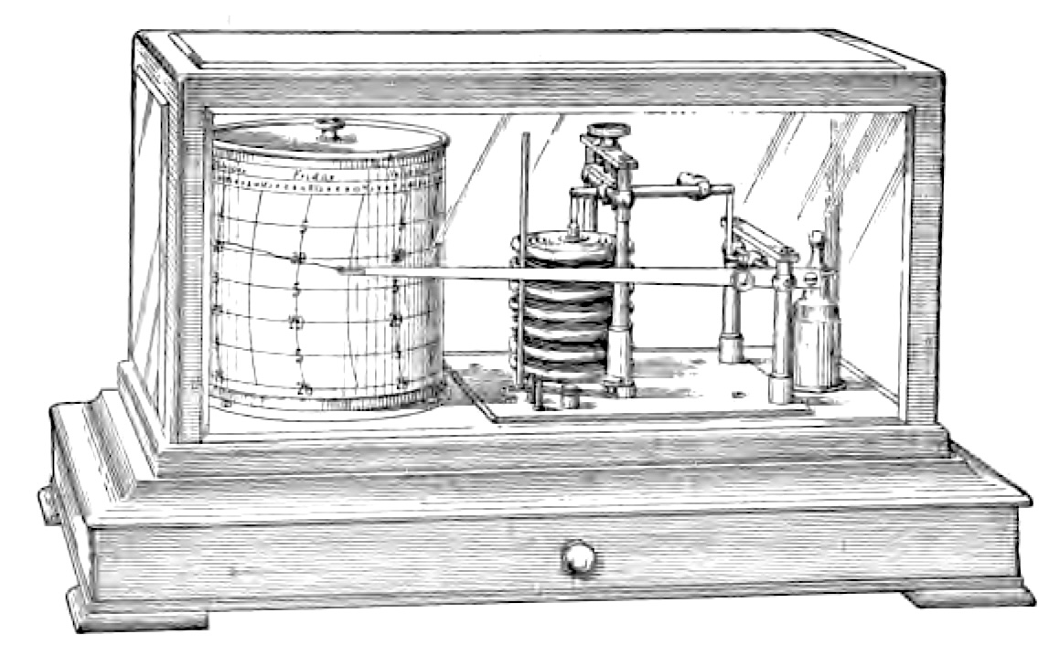
Tendency in most sciences
Experience as excitation of human sense organs.
Instrumental sensings and automatic record making.
replaced by

Slide 17
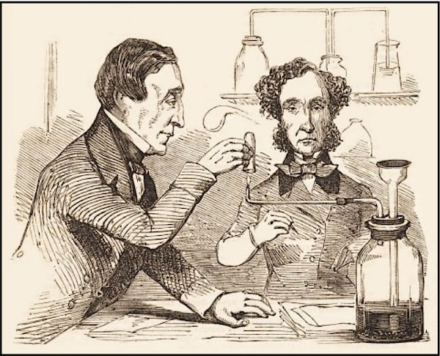

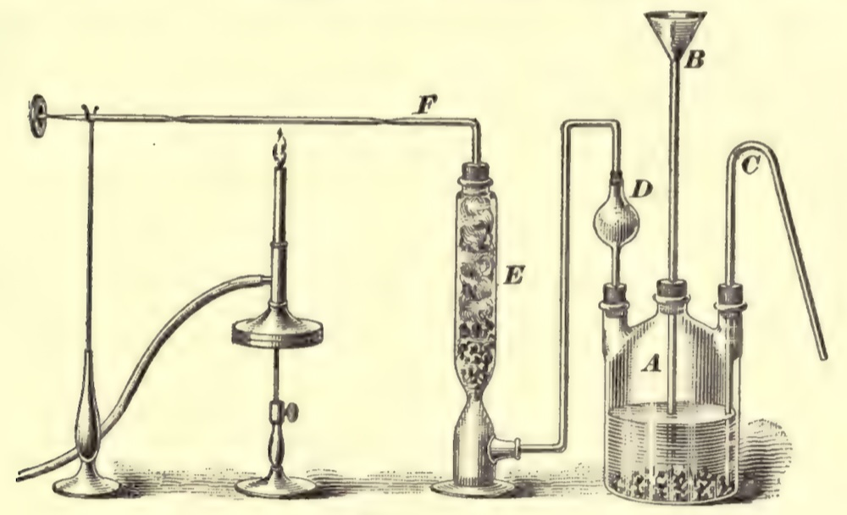

Chemical Analysis dependent on human senses …
James Marsh, 1836
Test for arsenic
“… holding a piece of cold window-glass opposite to and in contact with the flame, when a thin metallic film will be immediately deposited on its surface.”
Arsine gas burns with distinctive flame
Arsine gas evolved
“By directing the flame obliquely upon the inside of the tube, it strikes against the glass and deposits if the arsenic, the partly in the metallic state. In this case, if the tube, while still warm, be held to the nose, that peculiar odour, somewhat resembling garlic, which is one of the characteristic tests of arsenic, will be perceived.”
“Marsh’s apparatus”
Sample to be tested in sulfuric acid/zinc bath.

Slide 18
…replaced by fully instrumental analysis
Spectroscopy: divided into visible and ultraviolet molecular spectroscopy; infrared, near- infrared, and Raman spectroscopy; magnetic resonance spectroscopy; atomic absorption spectrometry; atomic emission spectroscopy; x-ray spectroscopy; mass spectrometry.
Chromatography: divided into gas chromatography; chromatography with liquid mobile phases; electroanalytical chemistry.
Thermal Analysis
Peaks indicate elements present
X-ray dispersion spectroscopy of a mineral crust on the vent shrimp Rimicaris exoculate.

Slide 19
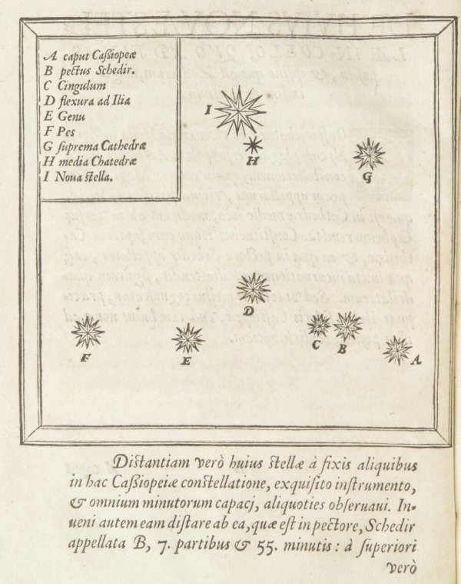
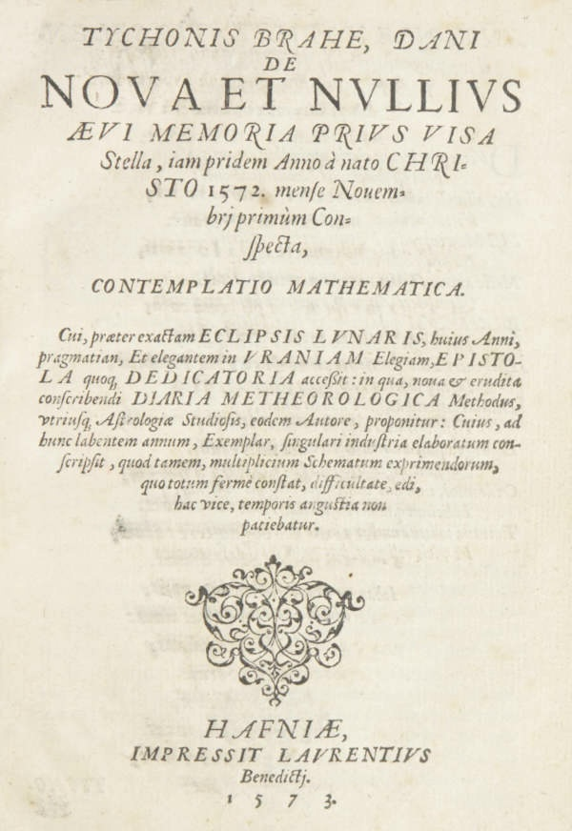
Naked eye detection of new celestial objects …
In November 1572, Tycho Brahe observed a new star in the constellation Cassiopeia.
“I. Nova stella”
Concerning the New Star, Seen Never Before in the Memory of Any Age, First Observed Lately in the Year of Our Lord 1572, in the Month of November.

Slide 20
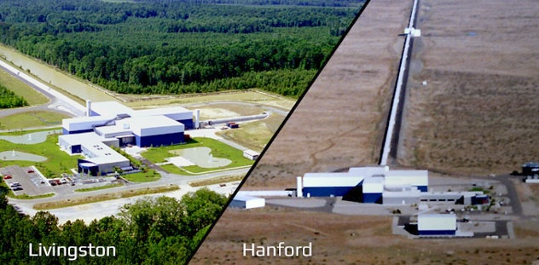
… replaced by fully instrumental detections
Laser
Interferometer
Gravitational Wave Observatory
Binary black hole merger detected in 2015 “GW150914”
Observation consists in
agreement in two strain curves
detected algorithmically

Slide 21
1. Experience is propositional
2. Experience becomes instrumental
3. Experience is a process

Slide 22

Experience is a continuous physical process that connects the system of interest with the observer
direction of physical process
System of interest
Observer
stages described in propositions
direction of inductive support

Slide 23
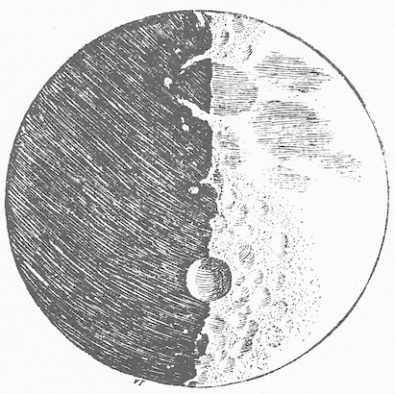
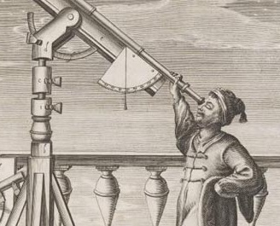
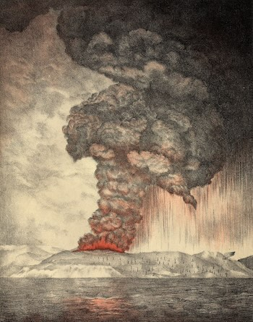

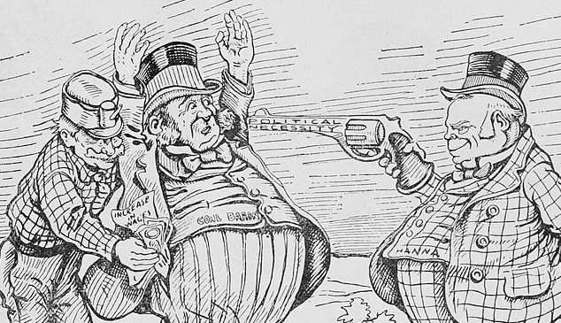
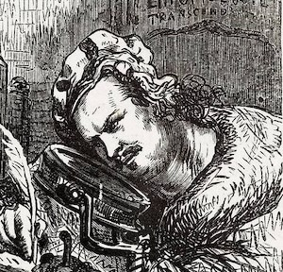
Examples of processes
light propagation
Galileo observes the moon
sound propagation
1883 eruption of Krakatoa heard in Western Australia
transport of matter
Chain of custody of sample from crime scene

Slide 24
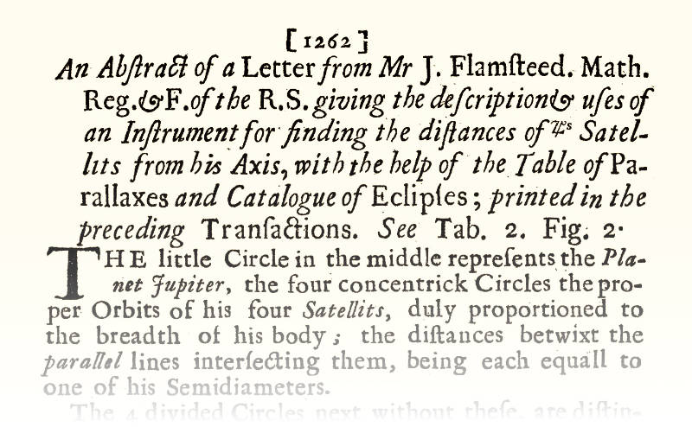
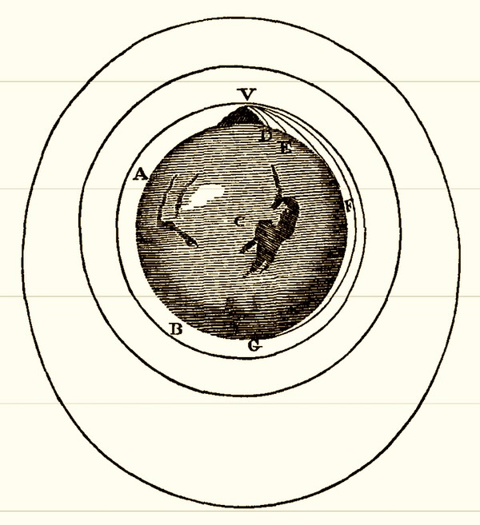
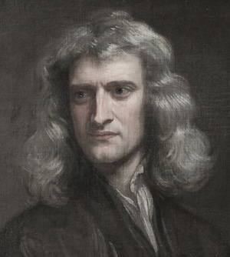
Observational vs Theoretical?
No Principled Division
Terminal obsession escaped.
System of interest
Observer
Philosophical Transactions, Vol. 15 (1685), pp. 1262-1265
PHENOMENON I
The circumjovial planets, by radii drawn to Jupiter’s center, describe areas proportional to the times of description; and that their periodic times, the fixed stars being at rest, are as the 3/2th power of their distances from the centre.
Newton, Principia, System of the World

Slide 25
Winding back
How to control the theory ladenness of observation.
For any troublesome item of theory:
System of interest
Observer
Description errs through presumption of faulty theory
Wind back through inductive inferences to stage prior to presumption

Slide 26
Winding back
Distances too small by up to a factor of 6 or 7.
Hubble’s 1929 estimates of distance to the nebulae (galaxies)
Andromeda, NGC 224
0.275 Mpc
Later corrected value
0.765Mpc

Slide 27

Winding back
Andromeda
erroneous distance to Andromeda corrected
period luminosity relation for Type II Cepheids gives distance
Hubble
erroneous distance to Andromeda 0.275 Mpc
period luminosity relation for Type I Cepheids gives distance
they are Type I Cepheid variable stars
period of variable stars in Andromeda measured
Oops!
They are Type II Cepheid variable stars

Slide 28
small-e empiricism
e

Slide 29
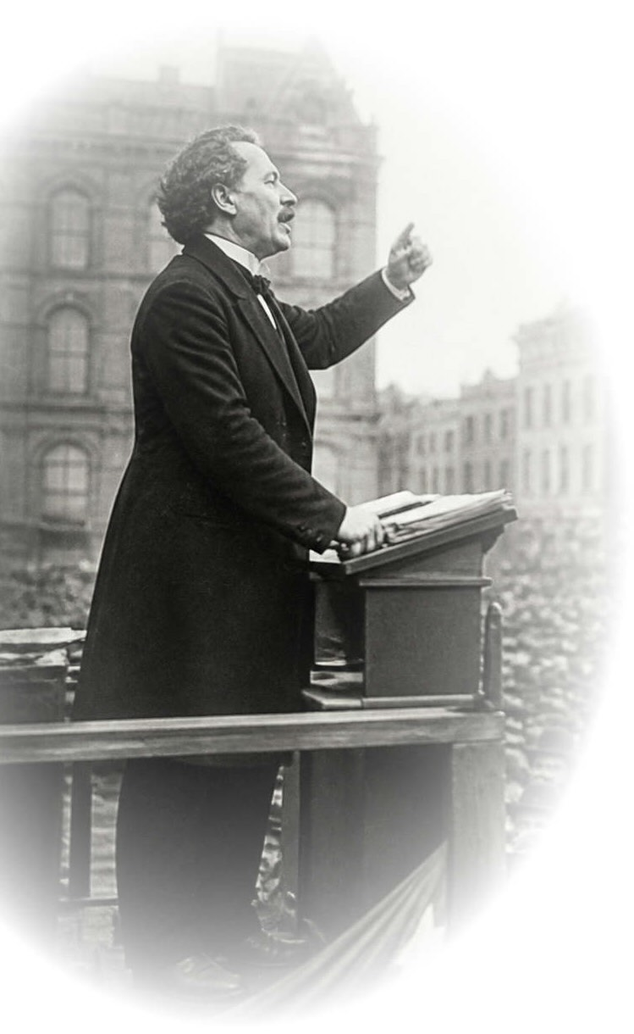
The doctrine
e
A physical process connects us continuously to the system of interest.
Science is empirical.
The propositions of experience provide inductive support for the truth of the contingent propositions of science; …
(adequacy)
Induction conceived materially is native to small-e empiricism.
… and the inductive support of experience is the only means of providing support for these contingent propositions.
(exclusivity)

Slide 30
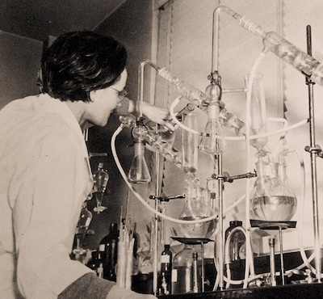
Conforms with…
e
Scientists’ conception of empirical science.
Science consists of observational and experimental reports and further results inferred from them.
The observational and experimental reports are the empirical evidence indispensable for science.
E
Skepticism of Big-E Empiricism is tacitly abandoned.

Slide 31
The argument for small-e empiricism
e

Slide 32
The Authority of Experience
e
small-e empiricism
The processes of experience connect continuously with the system of interest.
E
???
Big-E Empiricism
Strictly conceived, experience is a mental state associated with excited sense organs.

Slide 33
Adequacy of Experience
Efficacy of inductive inference
Strong support for contingent propositions is possible.
Authority of experience
Inductive skepticism is irrational
Whether attained in any particular science is decided case-by-case.
=
Refusal to accept the dictates of reason
The small-e empiricists’ ontology
Empirical evidence affirms the reality of processes comprising experience.
Electromagnetive waves
Sound waves
Material transport
Gravitational waves
…

Slide 34
Exclusivity of Experience
All other modes succeed only retrospectively.
Result already found empirically?
vs
Novel predictions?
Platonic insight
Innate or intuitive ideas
Oracular revelation
recovered with flourish
routinely fail
Priority of experience
other modes
Empiricism can self-correct via new experiences.
ıı
If
contradict experience …
… retract
… prevails
Opacity
No ontology comparable to small-e empiricism’s.
How do we access Plato’s world?
Why should intuition, conceivability inform us of contingent truths?
ıı

Slide 35
Conclusion

Slide 36
Applications of small-e empiricism
1. Induction is material
An empirically founded account of inductive inference
2. Inductive fallibilism
Certain knowledge is unattainable. Gettier problems disappear.
3. Small-r realism
Small-e empiricism preserves the best of stricter realism and antirealism.
4. Against metaphysics
Non-empirical metaphysics fails to secure contingent facts.

Slide 37
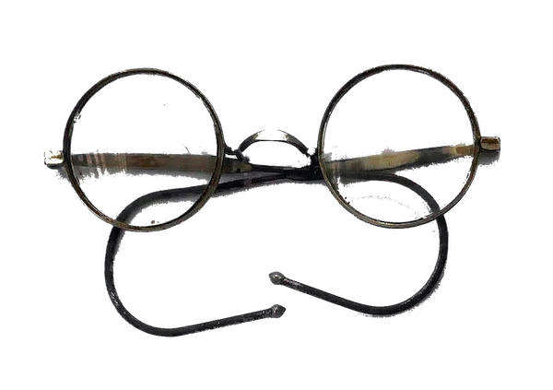
Read

Slide 39
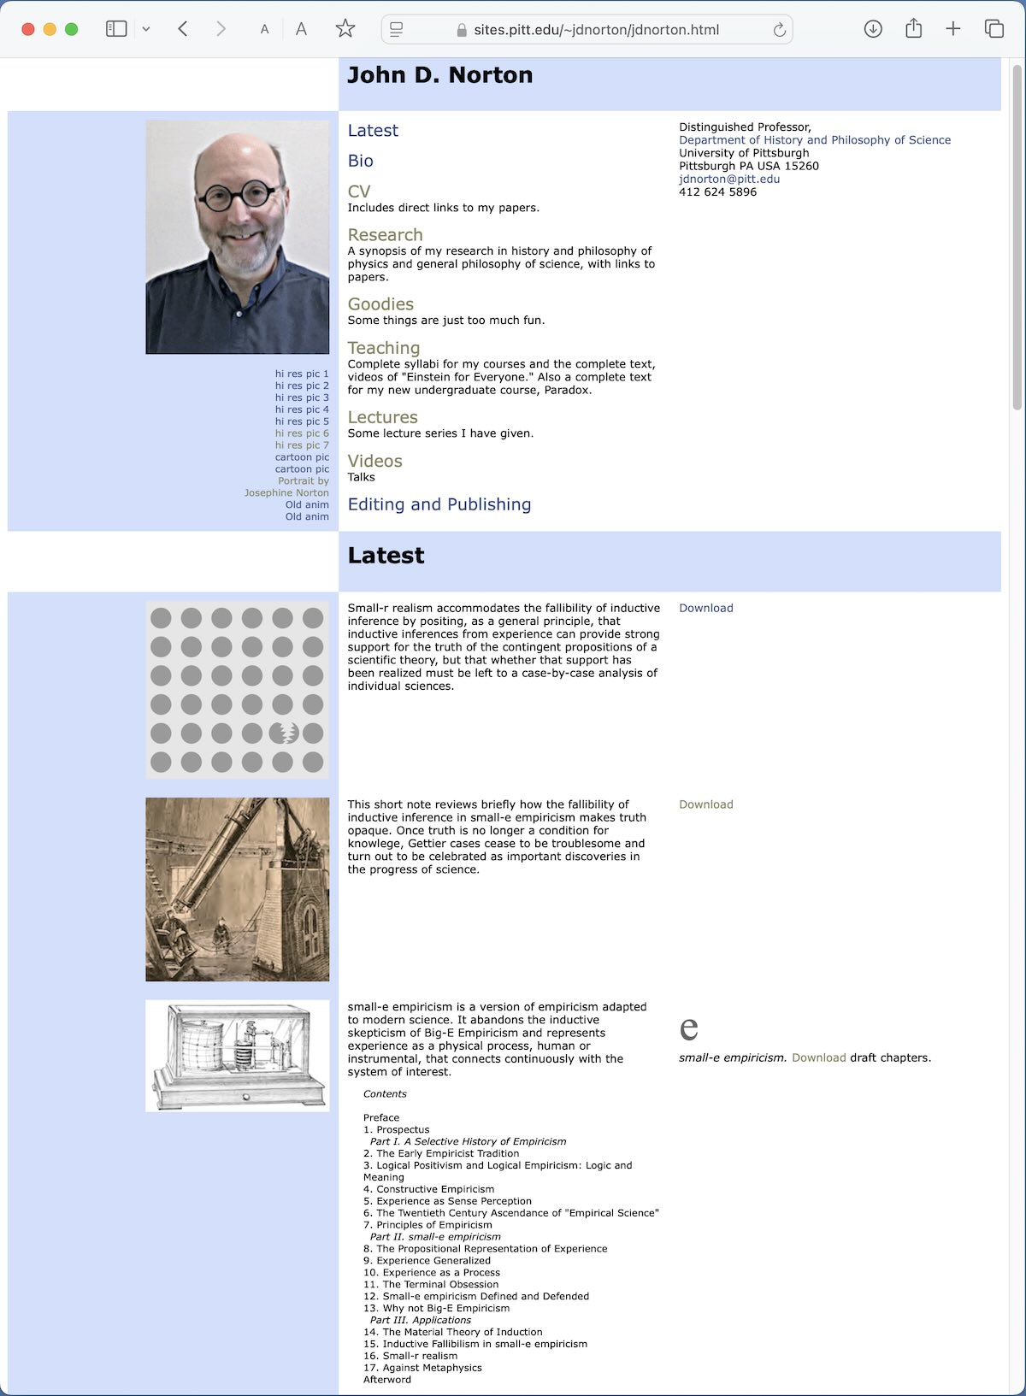

Slide 41

Image: Gemini Google

