Slide 1

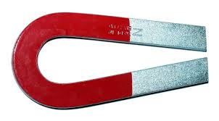
From transformations of the electromagnetic field to transformations of space and time: A qualitative thought experiment
John D. Norton
Department of History and Philosophy of Science
University of Pittsburgh

Slide 2
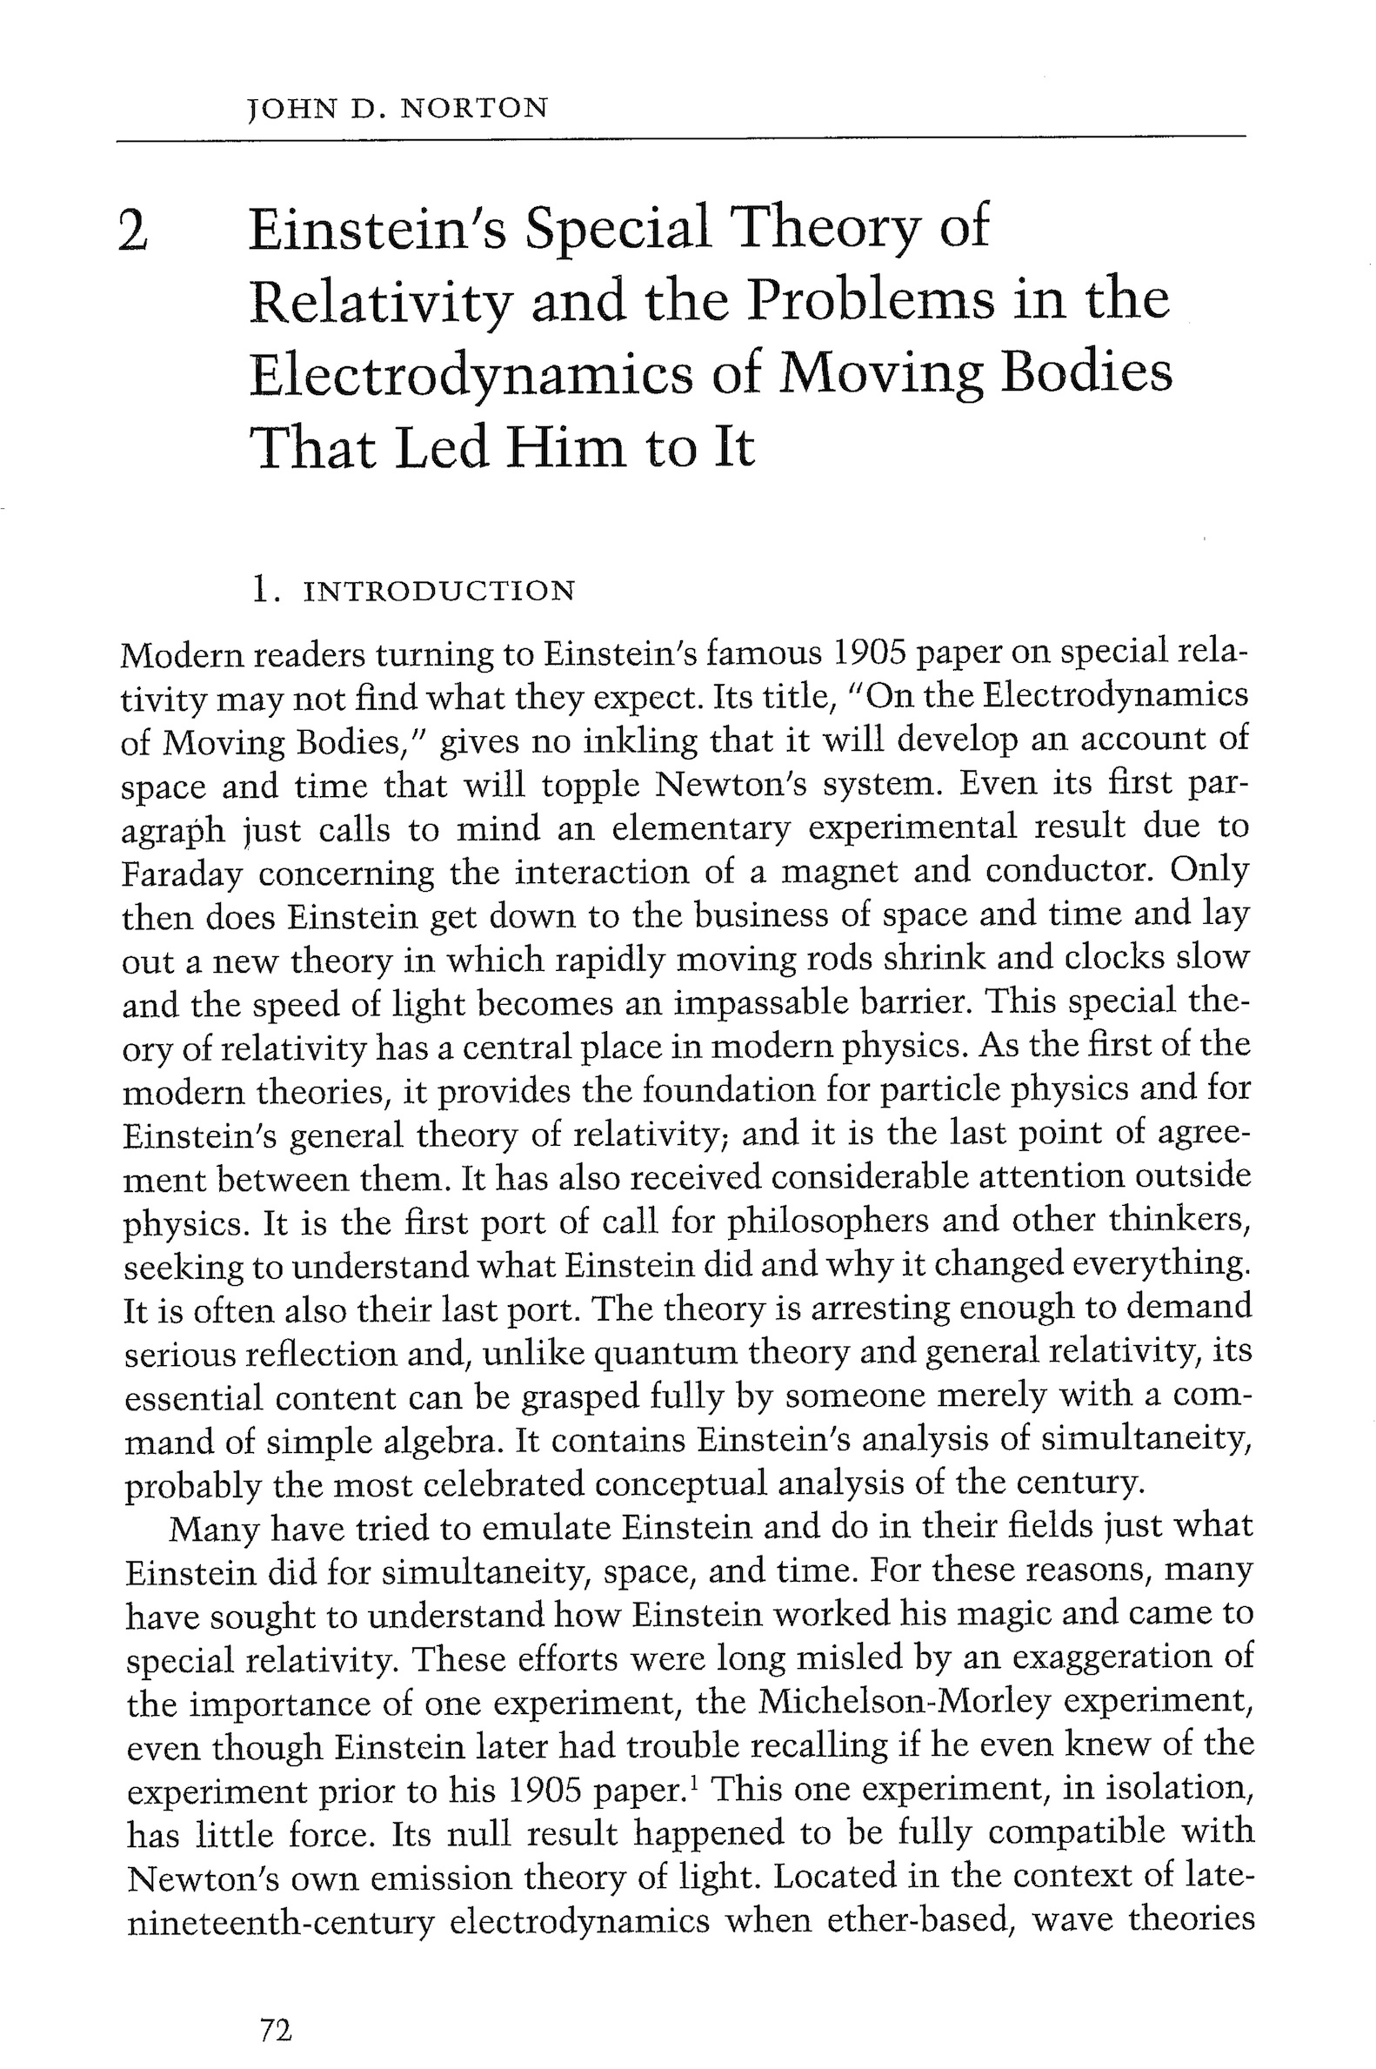
"Einstein's Special Theory of Relativity and the Problems in the Electrodynamics of Moving Bodies that Led him to it." pp. 72-102 in Cambridge Companion to Einstein, M. Janssen and C. Lehner, eds., Cambridge University Press.

Slide 3
Current in solenoid produces magnetic field H
Transit time for electrons in the top
=
Transit time for electrons in the bottom
The solenoid remains electrically neutral.

Slide 4
Current in solenoid produces magnetic field H
Electrons start simultaneously on one side.
Electrons arrive simultaneously on the other side.

Slide 5
View same solenoid in frame in which it moves
New electric field E is induced.
Lines of force must terminate in charges.
Electron charge density on top
>
Electron charge density on bottom

Slide 6
Conservation of charge entails…
Transit time for electrons in the forward direction
<
Transit time for electrons in the rearward direction
Electron charge density on top
>
Electron charge density on bottom

Slide 7
Conservation of charge entails…
Electrons start simultaneously on one side.
Electrons arrivals at the other side are no longer simultaneous.
Simultaneous events in the magnet’s rest frame…
… are not simultaneous events in the frame in which the magnet moves.

Slide 8
Relativity of simulataneity

