Slide 1
“BEYOND CASE STUDIES: HISTORY AS PHILOSOPHY” –Hasok Chang
Caitlin Mace
HPS 2103, Spring 2022

Slide 2
Focus
Has Chang’s case studies (i.e., temperature calibration, the Chemical Revolution) dissolved the issues he raises with using case studies? If so, how? If not, what can?

Slide 3
The Trouble with Case Studies
For Philosophy
Question-begging
Grand inductions from small samples
For History
Oversimplified
For HPS
What is the nature of the history-philosophy relationship?
By what method should history and philosophy interact?

Slide 4
Transcending the Dilemma
DILEMMA: “Without such a method [for the history-philosophy interaction] we are condemned to the dilemma between making unwarranted generalizations from historical cases and doing entire “local” histories with no bearing on an overall understanding of the scientific process” (110).
Beyond induction
History as particular
Philosophy as general

Slide 5
Transcending the Dilemma
DILEMMA: “Without such a method [for the history-philosophy interaction] we are condemned to the dilemma between making unwarranted generalizations from historical cases and doing entire “local” histories with no bearing on an overall understanding of the scientific process” (110).
Beyond induction to abstraction
History as particular concrete
Philosophy as general abstract
Produce an account of historical episode and articulate what was put into the account.
Episode is concrete instantiation of abstract concepts.
Abstract concepts are required for characterizing episode.
Episode contributes to articulation of abstract concepts.

Slide 6
Active Philosophical Function of History
HISTORY CONTRIBUTES TO PHILOSOPHY: “When there are no ready-made philosophical concepts through which a given historical episode can be properly understood, the historian [or philosopher] needs to craft new abstract philosophical concepts” (111).
DOING HISTORY AND PHILOSOPHY AT THE SAME TIME.
Demonstrate Cogency of Abstract Concept (Philosophy)
Abstract Consideration and Argumentation
Check Range of Applicability (History)
Confirmation and Generalization

Slide 7
Inventing Temperature
100
0
Boiling Water
Freezing Water
Assume that mercury rises halfway when it is 50°C
BUT…

Slide 8
Inventing Temperature
Problem of Nomic Measurement
To measure x (temperature), must infer it from y (mercury volume).
To do so, we need a law expressing that $x=x\left(y\right).$
But to discover the form of this function, we need to know the values of x and y.
But we are trying to measure the value of x.
How did scientists solve this problem (given the nonlinearity of mercury expansion with temperature)?
Notes:
Experimenter’s regress?

Slide 9
Inventing Temperature
Historiography provided a means for articulating philosophical concepts and frameworks:
Failure of Foundationalism
De Luc’s method of mixtures as foundation of thermometry
But this foundation had a groundless assumption about heat of water as constant
So, coherentism? (False Dilemma)
But how does validation via logical consistency between propositions bring about progress?
Epistemic Iteration & Progressive Coherentism

Slide 10
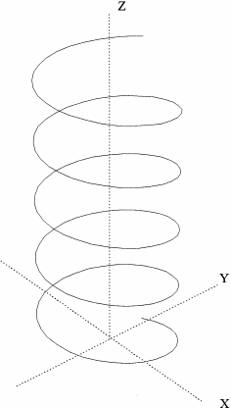
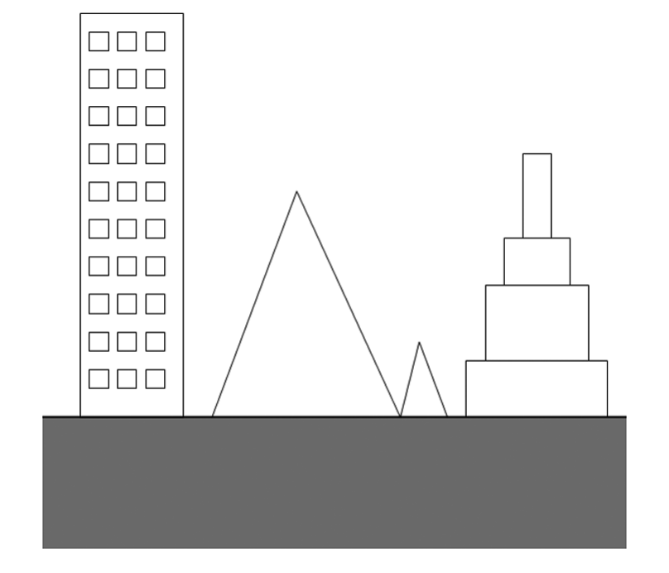
Inventing Temperature
Epistemic iteration
Progressive Coherentism
Progress
Inquiry
Refined and corrected starting assumption
Presume validity of method
Foundationalism: Progress on firm ground
Progressive Coherentism: sense of grounding, directionality
“we build on the earth […] because it is a large and dense body that attracts other things, and we happen to live on it” (116).

Slide 11
Is Water H₂O?
Were there good enough reasons to convert to Lavoisier’s new chemistry?
Agreement: | $$vital air + inflammable air → water$$
Lavoisier (water is a compound) | $$oxygen + hydrogen → water$$
Cavendish & Priestley (water is an element) | $$dephlogisticated water + phlogisticated water → water$$

Slide 12
Is Water H₂O?
Phlogiston theory was not:
refuted by empirical evidence,
inherently more complex than Lavoisier’s theory, nor
failing to make new predictions (any more than Lavoisier’s theory).
Moreover, other factors (e.g., “rhetoric, interests, ideology or fashion” (117)) only provide a partial explanation for converting to Lavoisier’s theory.
Rather, a difference in epistemic values explains the theory change—
Priestley pursued completeness and detail in the lab, whereas
Lavoisier pursued elegant theoretical uniformity.

Slide 13
Is Water H₂O?
Epistemic pluralism
Systems of practice
AGAINST MONISM: The values upheld by both Priestley and Lavoisier are respectable. Therefore, both theories should have lived.
FOCUS ON PRACTICE: epistemic activities—rather than theories—are the units of epistemic appraisal.
success > truth
know-how > know-that
SYSTEMS OF PRACTICE: coherent and interacting sets of epistemic activities.

Slide 14
Is Water H₂O?
Epistemic pluralism
Systems of practice
AGAINST MONISM: The values upheld by both Priestley and Lavoisier are respectable. Therefore, both theories should have lived.
FOCUS ON PRACTICE: epistemic activities—rather than theories—are the units of epistemic appraisal.
success > truth
know-how > know-that
SYSTEMS OF PRACTICE: coherent and interacting sets of epistemic activities.

Slide 15
History-Philosophy Interaction
Starting with existing philosophical framework
Starting with existing historiography
$→$Historical episode as a puzzle.
$→$ Search for new philosophical framework.
$→$ Use framework to understand episode.
$→$ Further develop framework.
$→$ Apply framework to other episodes.
$→$ Epistemic act or decision as a puzzle.
$→$ Search for better historiography.
$→$ Remove philosophical puzzle.
$→$ Complete historiography.
$→$ Reflect on other related history.
“In this business it is difficult to say whether a given investigator is working as a historian or A philosopher, BUT THAT IS JUST THE POINT” (122).

Slide 16
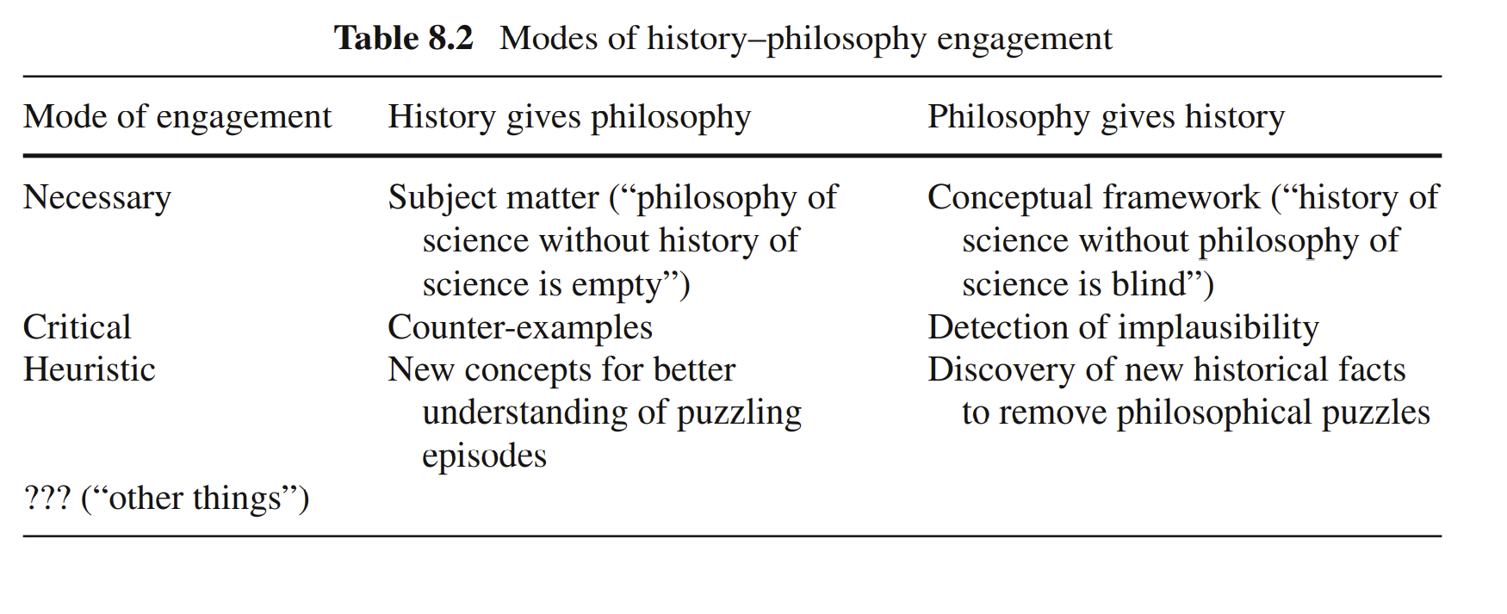
On Integration

Slide 17
GEMS 1. easy-to-grasp episodes 2. clear & concise 3. a true hps-er

Slide 18
Discussion Questions
Has Chang’s case studies (i.e., temperature calibration, the Chemical Revolution) dissolved the issues he raises with using case studies? If so, how? If not, what can?
Issues: question-begging, large inductions from small samples, oversimplification.
Do his case studies go beyond the inductive view? (Or can/will they?)
Has cogency and range of applicability been generated? (Or can/will they?)
What is the difference between HPS and integrated-HPS?

