Slide 1
Duhem: Physical theory and experiment
Caitlin Mace, HPS 2103 Spring 2022

Slide 2
The experimental testing of a theory does not have the same logical simplicity in physics as in physiology
Claude Bernard (Physiologist): experimental method depends on intellectual and moral conditions requiring freedom of mind, detachment, absence of animosity.
As opposed to those who seek to confirm their own or destroy others’ theories.
But in physics, theory-independence of observation is unachievable.
Concrete apparatus on which the physicist tests
Schematic and abstract apparatus on which the physicist reasons
Theory substitutes the latter for the former
Basis of Holism

Slide 3
An experiment in physics can never condemn an isolated hypothesis but only a whole theoretical group
Physicists implicitly accepts a theory complex when conducting or reporting on an experiment.
Experiments of application: experiment draws on theories
Experiments of testing: given a P, derive experimental predictions from P, bring about the experimental conditions which should bring about P. If the prediction fails, P is false.
Theory Complex (consisting of P₁… P_{n}) Observation
~Observation
_______________________________________________________________________________________________________________________________________________________
∴ ~P₄
Invalid
(Holist Underdetermination)

Slide 4
A “Crucial Experiment” is impossible in physics
Hypothesis 1 (H₁) or Hypothesis 2 (H₂)
H₁ Observation; H₂ ~Observation
Observation
∴ ~H₂
_________________________________________________________________________________________________
∴ H₁
Theory Complex 1 (C₁) or Theory Complex 2 (C₂)
More critically, “Shall we dare to assert that no other hypothesis is imaginable?” (265).
Problem of unconceived alternatives > contrastive underdetermination
Reduction to absurdity; crucial experiment showing H₁ to be an indisputable truth

Slide 5
Criticism of the Newtonian method
H₁ Observation₁; H₂ Observation₂; … H_{n} Observation_{n}
Observation₁, Observation₂, … Observation_{n} until certainty
∴ H_{1,} H_{2, …} H_{n} are laws (justified by observation) or mathematical corollaries deduced from laws
Via induction and generalization, derive principles.
_________________________________________________________________________________________________
∴ Theory complex (directly demonstrated)
But in the example, the principles are neither deduced from nor are inductive generalizations of the laws.
More critically, Kepler’s laws are approximate, permitting an infinity of translations from its symbolic form, and Newton’s theory is presupposed when translating Kepler’s laws.

Slide 6
Are certain postulates of physical theory incapable of being refuted?
Assertion in question (Édouard Le Roy): “Certain fundamental hypotheses of physical theory cannot be contradicted by any experiment, because they constitute in reality definitions, and because certain expressions in the physicist’s usage take their meaning only through them” (271).
So, given some law in which X is defined by O, if O is not observed, this entails either
The definition is right, but since O was not observed, we should reject the broader theory from which our definition is derived.
The link between our O and what was observed was not established, and the definition should be altered.
The second is more reasonable, but implies that some hypotheses are forever warranted, which the history of science tells us isn’t the case.

Slide 7
On hypotheses whose statement has no experimental meaning
Assertion in question (Poincaré): the principles of mechanics “ […] cannot be refuted by experiment because the operation which would claim to compare them with the facts would have no meaning” (274).
Such hypotheses are essential foundations of theories and have no meaning isolated from the theory they figure in.
E.g., ‘The center of gravity of an isolated system can have only a uniform rectilinear motion.’
But, again, when the day comes that the theory should be rejected, such principles will crumble alongside it.
“Hypotheses which by themselves have no physical meaning undergo experimental testing in exactly the same manner as other hypotheses” (277).

Slide 8
Good sense is the judge of hypotheses which ought to be abandoned
Given holism about theories under experimental examination, how are weak spots identified?
“No absolute principle directs this inquiry, which different physicists may conduct in very different ways without having the right to accuse one another of illogicality” (277), and further, “reasons of good sense do not impose themselves with the same implacable rigor that the prescriptions of logic do” (278).
Good sense requires moral conditions of impartiality and judgments made on good faith; thus, we are led back to the conclusions of Claude Bernard.

Slide 9
My analysis
Regarding Duhem’s Holism:
Regarding Duhem’s Holism:
“Hypotheses which by themselves have no physical meaning undergo experimental testing in exactly the same manner as other hypotheses” (277).
Might we think perhaps more risky hypotheses with physical meaning are under more serious analysis than secured auxiliary hypotheses?
Holism is too strong, but we should think that it is not easy to tell which part of a theory should be rejected.
Duhem addressed principles of reasoning that govern comparison of theory with facts:
Falsification
Reduction to absurdity
Observation and induction
(Holistic comparison)
These methods were shown to be mistaken (or invalid), yet might good sense require them?
Perhaps these are better ways of being irrational?

Slide 10
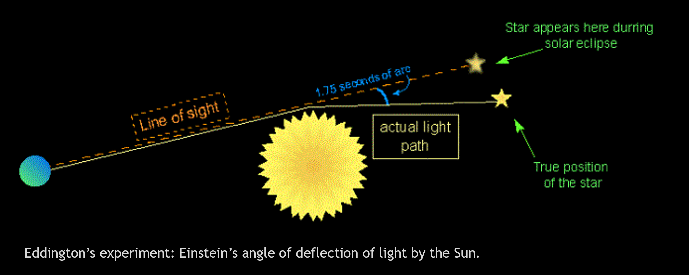
My analysis (Cont.)
Crucial Experiment:
Pretend the star did not appear to change position. What in Einstein’s theory would have been refuted? Just those parts unique to the theory? Would some scientists try to protect it nonetheless?
The experiment served as a confirmation; was it part of an eliminative inference refuting Newtonian mechanics?
Retrieved from: https://sciencemeetsfaith.wordpress.com/2018/05/29/arthur-s-eddington-and-the-bending-of-light/

Slide 11
Discussion GEMS
Is my analysis correct?
What is Duhem right about? Where might he be wrong?
Do Duhem’s concerns extend beyond physics? To what extent?
Integration of history and philosophy of science
Gives us holism, problem of underdetermination, and problem of unconceived alternatives all in simple terms.
Street cred

