Slide 1
How Einstein Did Not Discover
John D. Norton
Department of History and Philosophy of Science
Center for Philosophy of Science
University of Pittsburgh

Slide 2
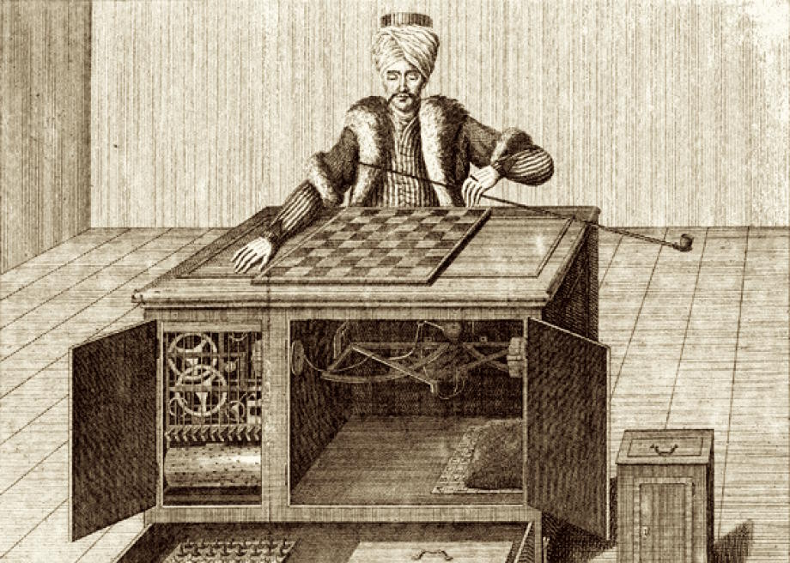
Mechanical Turk. Constructed 1770 by Wolfgang von Kempelen. Played a strong game of chess and performed the knight’s tour.

Slide 3
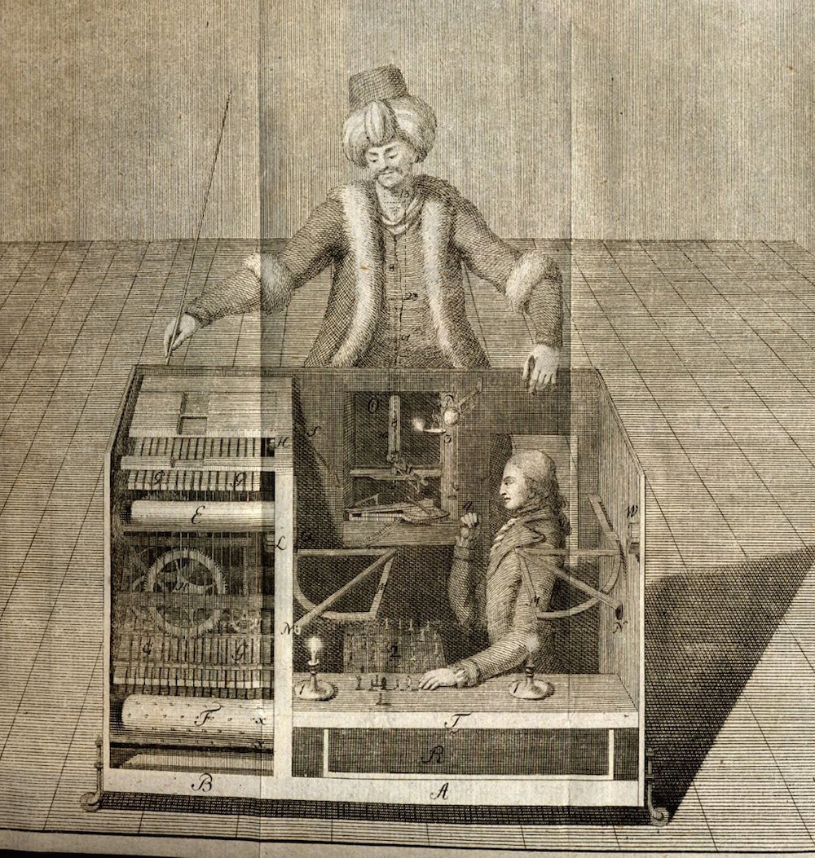
The secret was revealed in 1820.

Slide 4
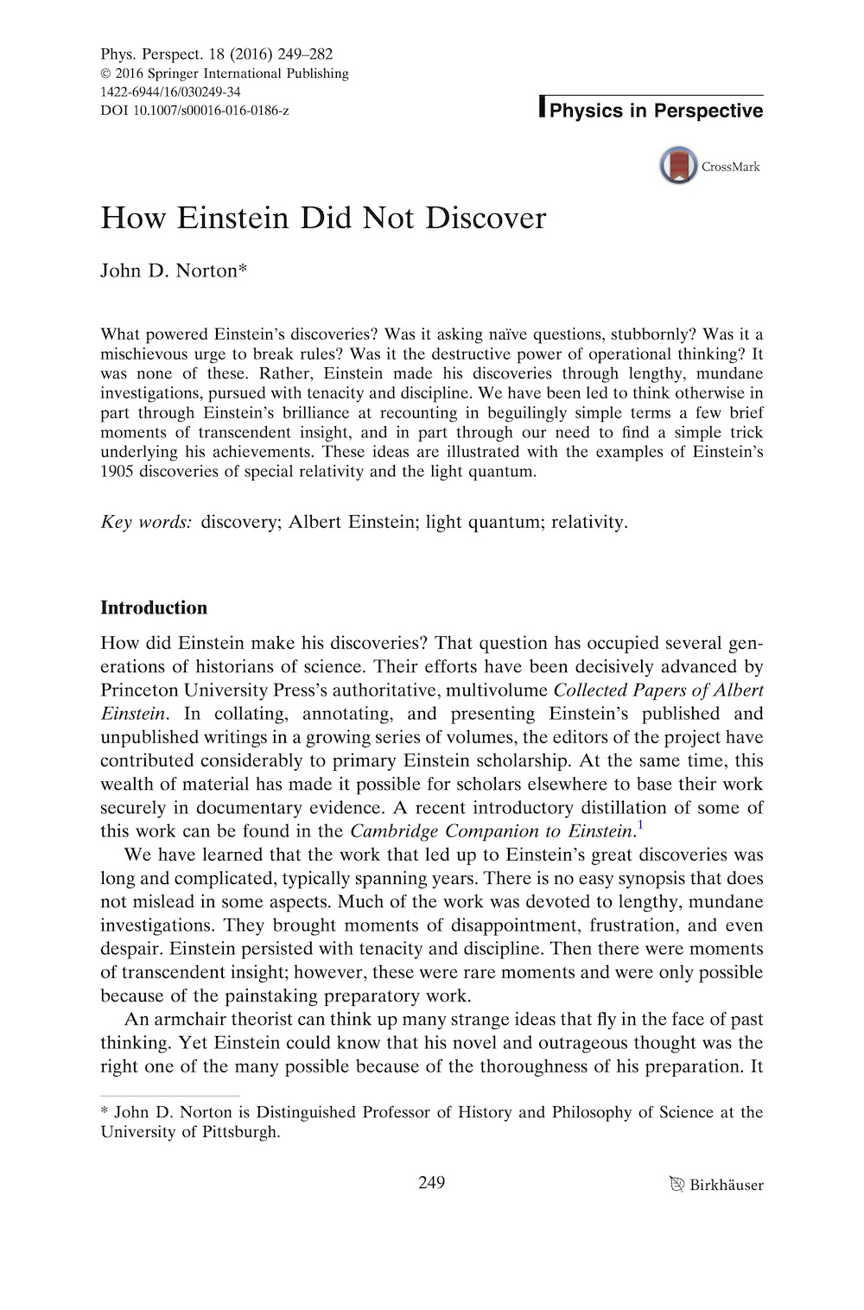

Slide 5
This Paper
Myths concerning how
Einstein discovered:
The Power of …
Case Studies
… Childish Thinking
Special Relativity
… Operational Thinking
… Breaking Rules
The Light Quantum
… a Single Experiment

Slide 6
The Power of Childish Thinking

Slide 7
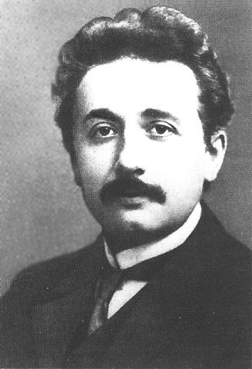
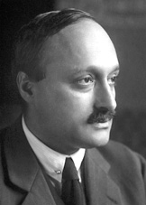
Einstein
as reported by James Franck
“The normal adult never bothers his head about space-time problems. Everything there is to be thought about it, in his opinion, has already been done in early childhood.
I, on the contrary, developed so slowly that I only began to wonder about space and time when I was already grown up.
In consequence I probed deeper into the problem than an ordinary child would have done.”
Seelig, Albert Einstein: A Documentary Biography. 1956, pp. 70-71.

Slide 8
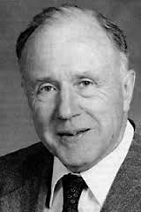
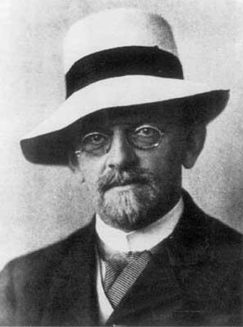
John A. Wheeler, David Hilbert
Many a man in the street thinks of Einstein as a man who could only make headway in his work by dint of pages of complicated mathematics; the truth is the direct opposite.
As Hilbert put it, “Every boy in the streets of our mathematical Gottingen understands more about four-dimensional geometry than Einstein. Yet, despite that, Einstein did the work and not the mathematicians.”
Time and again, in the photoelectric effect, in relativity, in gravitation, the amateur grasped the simple point that had eluded the expert.
John A. Wheeler, “Albert Einstein 1879-1955: A Biographical Memoir,”
National Academy of Sciences. Washington, DC, 1980.

Slide 9
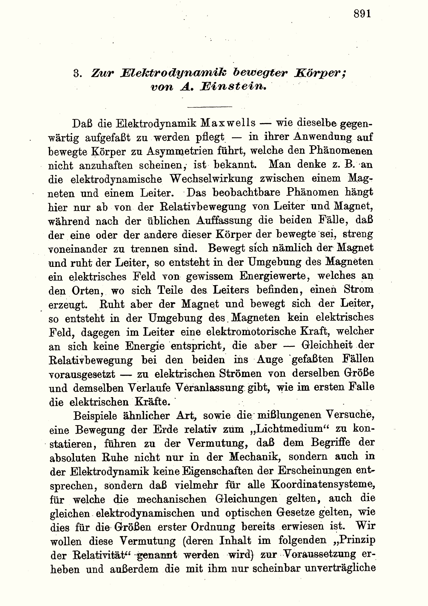
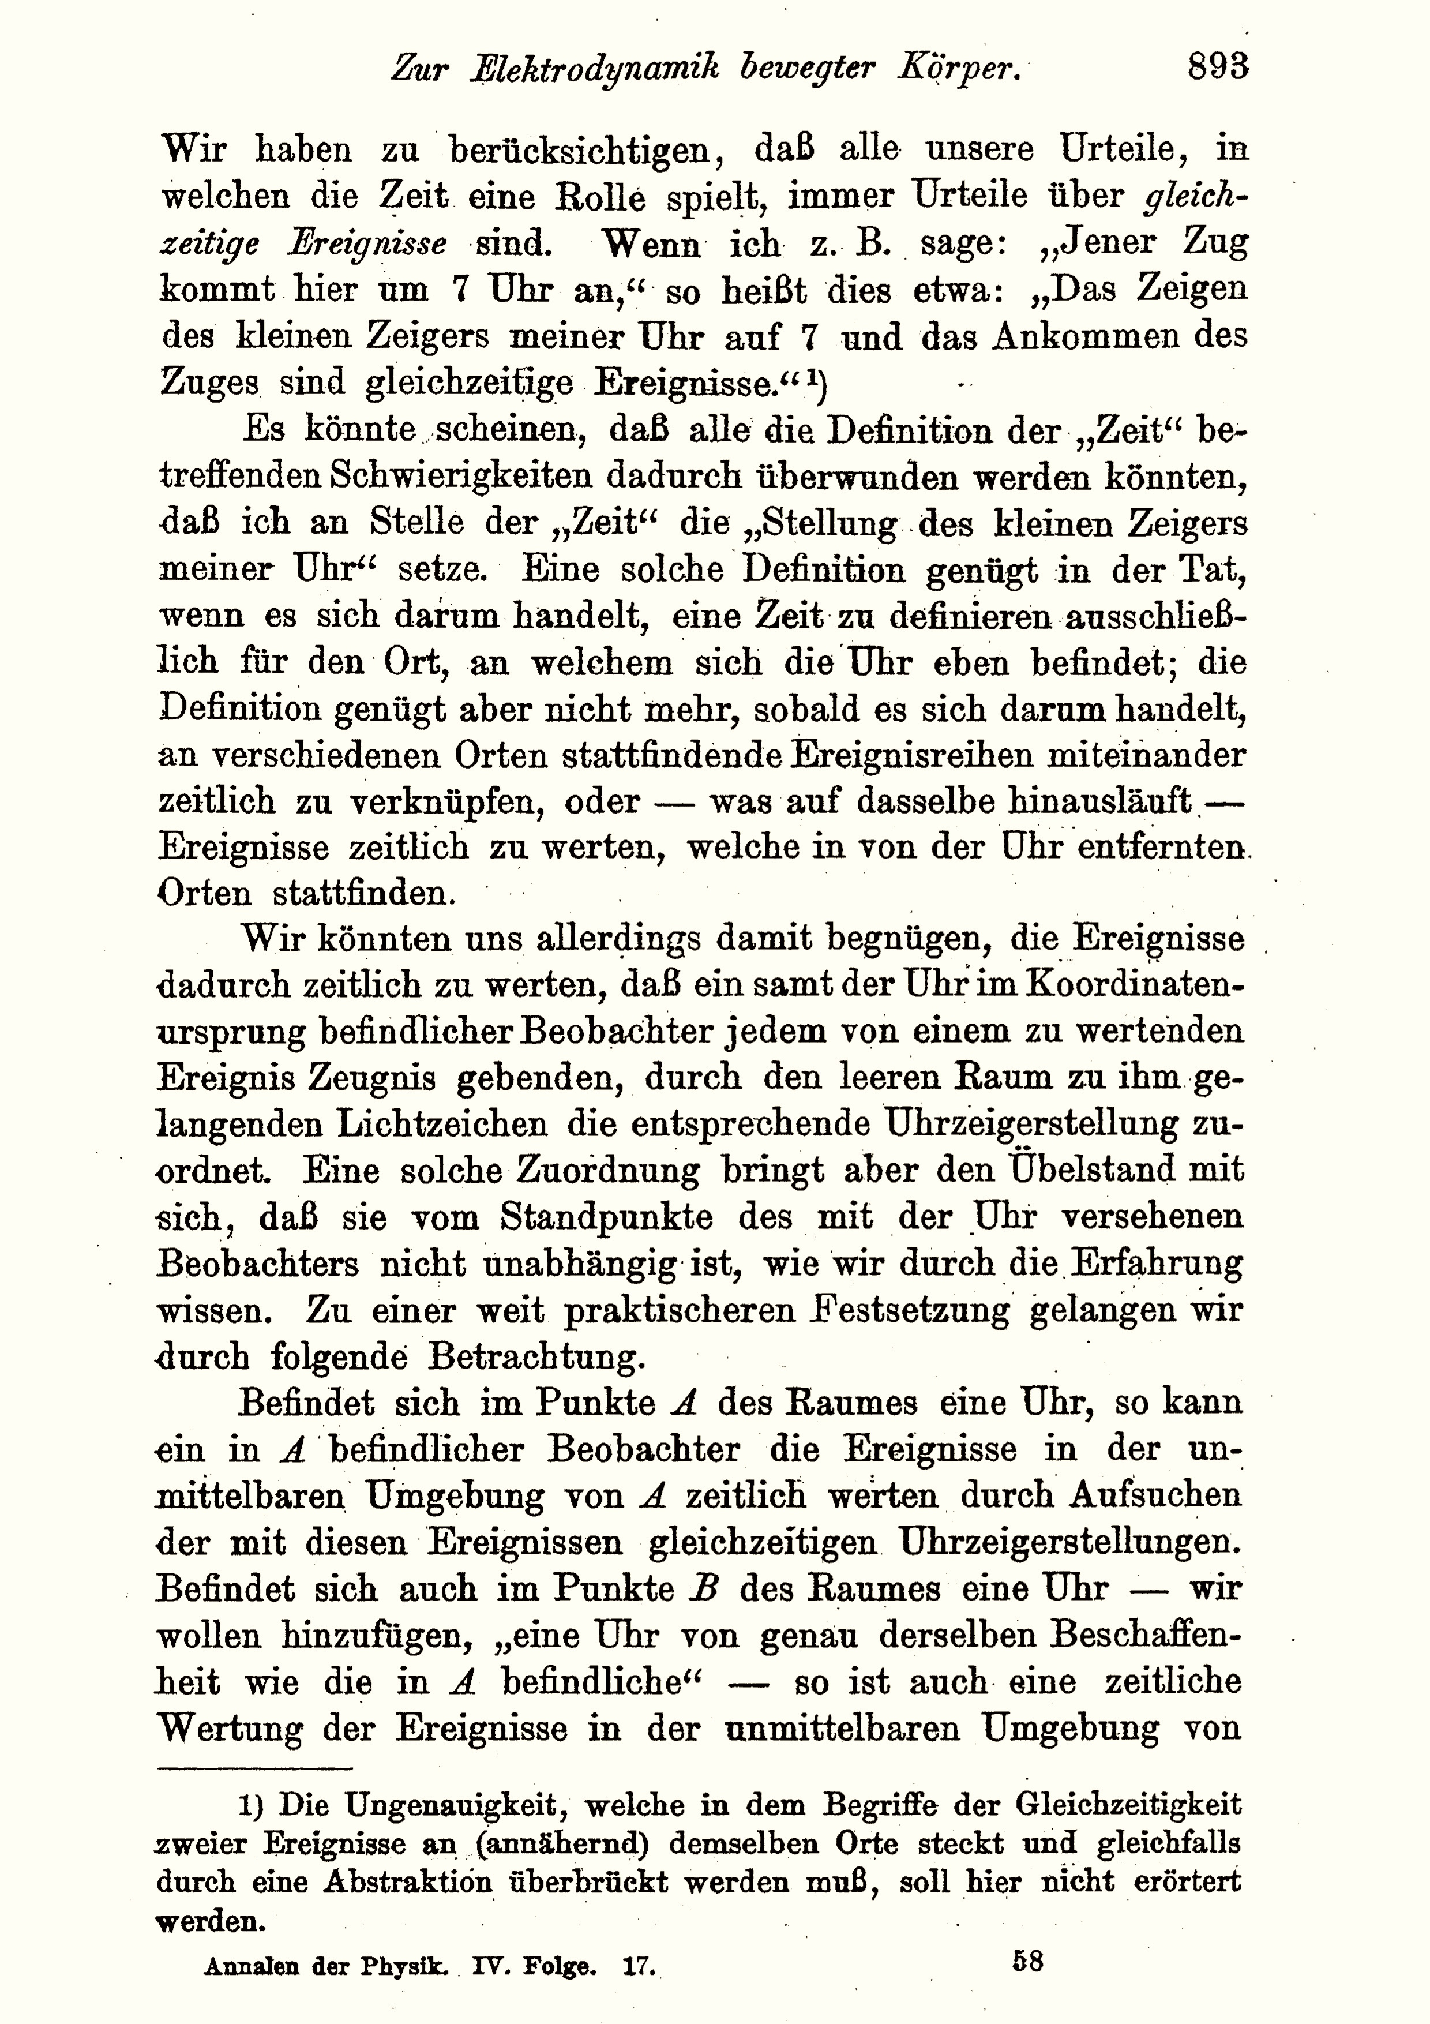
“On the Electrodynamics of Moving Bodies”

Slide 10
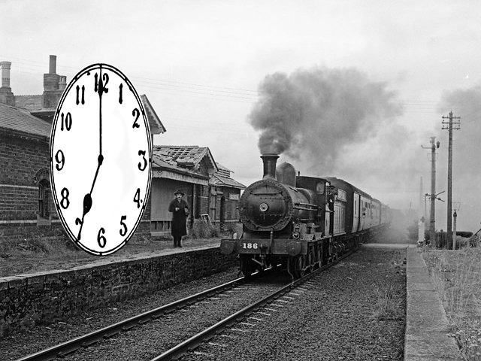
“On the Electrodynamics of Moving Bodies”
If, for instance, I say, “That train arrives here at 7 o’clock,” I mean something like this: “The pointing of the small hand of my watch to 7 and the arrival of the train are simultaneous events.”

Slide 11
How Einstein Discovered Special Relativity

Slide 12
1895-1905
1895
1896
1897
1898
1899
1900
1901
1902
1903
1904
1905
Sustained efforts to modify Maxwell’s electrodynamics to conform it with the principle of relativity.
A 16 year old Einstein imagines chasing a light beam.
“…the seven and more years that the development of the Special Theory of Relativity had been my entire life.”
“The step,” 5-6 weeks prior to submission of the paper.
Operational analysis of simultaneity.
Einstein’s tribute to A. A. Michelson, Dec. 19, 1952.

Slide 13
Ritz-style retarded potential theory as reported in Pauli’s 1921 Relativitätstheorie
Formulate electrodynamics in terms of scalar and vector potentials ϕ, A
E = − ∇ϕ - (1/c)∂A/∂t
H = ∇xA
“[…]” means a quantity is evaluated at event (x’, y’, z’, t’) where the retardation time t’is
t’ = t - r/c
$$φ\left(P,t\right)=\int{\frac{ρdV_{P′}}{{[r_{PP′}]}_{t^{′}=t−r/c}}}$$
$$A\left(P,t\right)=\int{\frac{\left(\frac{1}{c}\right)ρvdV_{P′}}{{[r_{PP′}]}_{t^{′}=t−r/c}}}$$
This time delay encodes the propagation of electromagnetic action at speed c in the ether.
propagating retardation time t’=t-r/c
a Galilean covariant, projected retardation time
t’=t-r/(c+v_{r})
v_{r}=speed of source in direction of point at r=(x,y,z).
Emission theory of light
v
c+v

Slide 14
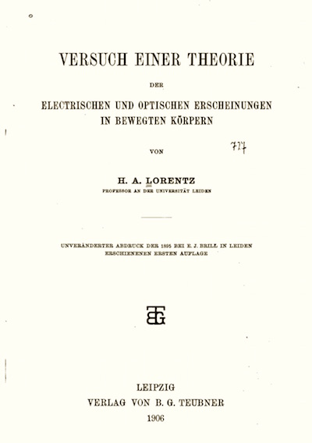
Nothing Works
Emission theory of light fails
Keep
Principle of relativity
Constancy of speed of light
AND
How?
Maxwell’s electrodynamics remains unchanged.
Reinterpret Lorentz’ theorem of corresponding states.
One needed only to realize that an auxiliary quantity that was introduced by H. A.
Lorentz and that he called “local time” can simply be defined as “time.”

Slide 15
The Truncated Story

Slide 16
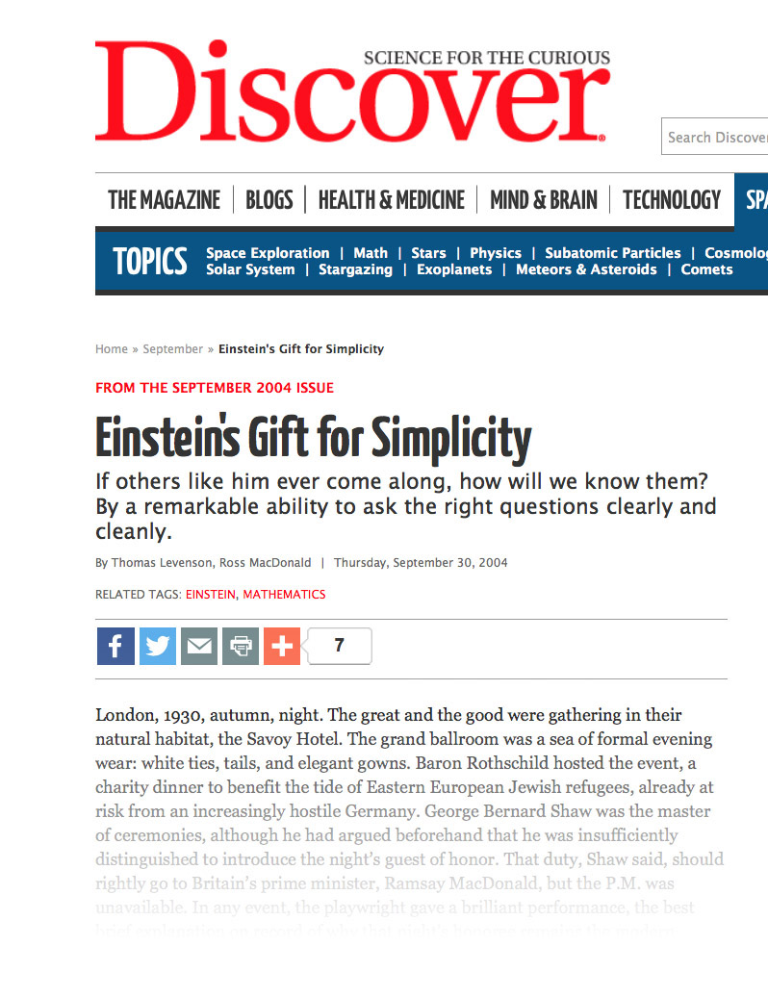
Discover Magazine, 2004
“Einstein used what were called thought experiments to achieve his radical simplifications.
Special relativity emerged from a line of thinking that began when Einstein asked what would happen if he could chase a ray of light.
His breakthrough realization of the relativity of time turned on a series of mental cartoons featuring trains and clocks.”

Slide 17
1895-1905
1895
1896
1897
1898
1899
1900
1901
1902
1903
1904
1905
Sustained efforts to modify Maxwell’s electrodynamics to conform it with the principle of relativity.
A 16 year old Einstein imagines chasing a light beam.
“…the seven and more years that the development of the Special Theory of Relativity had been my entire life.”
“The step,” 5-6 weeks prior to submission of the paper.
Operational analysis of simultaneity.
Einstein’s tribute to A. A. Michelson, Dec. 19, 1952.

Slide 18
More….
Einstein’s chasing a light beam thought experiment
Clocks, light signals and the power of operational thinking
The power of breaking rules
The power of a single experiment

Slide 19
Conclusion

Slide 20
How to Discover like Einstein
Be very smart.
Master all the science
that comes before you.
Work very hard
and tolerate many set backs.
Enjoy the fleeting moments
of transcendent insight these efforts bring.
Be brilliant at presenting
complex ideas simply.
Be just a little bit lucky:
your aptitudes match the problem to be solved.

Slide 21
How are the history of science and the philosophy of science integrated?
Philosophy of science
History of science
Popular but dubious claims about how great Einsteinian discoveries in science come about:
• The Power of Childish Thinking
• The Power of Operational Thinking
• The Power of Breaking Rules
• The Power of a Single Experiment.
Closer examination of the actual history.

Slide 22
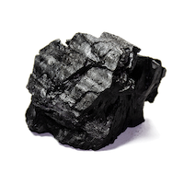
Gems and antigems
We are each relieved of weighty guilt of not being Einsteins
since we haven’t been thinking childishly enough and rampantly breaking enough rules.
The story behind Einstein’s chasing a light beam thought experiment has some nice historical detective work and some intriguing twists.
I still have a nagging worry: is my history the true history? What erroneous suppositions and myths are hidden in it?
This is a grumpy, scolding paper.
I still carry the guilt.

Slide 23
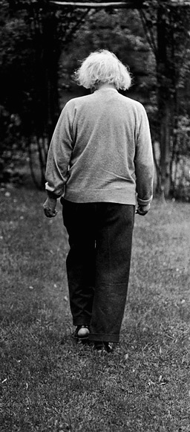
The End

Slide 25
Appendices

Slide 26
Chasing a Beam of Light

Slide 27
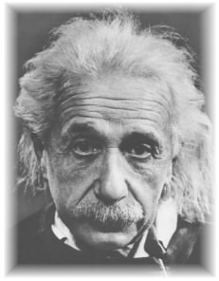
Einstein, Autobiographical Notes, 1946
“After ten years of reflection such a principle resulted from a paradox upon which I had already hit at the age of sixteen:
If I pursue a beam of light with the velocity c (velocity of light in a vacuum),
I should observe such a beam of light as an electromagnetic field at rest though spatially oscillating. There seems to be no such thing, however, neither on the basis of experience nor according to Maxwell’s equations.
From the very beginning it appeared to me intuitively clear that, judged from the standpoint of such an observer, everything would have to happen according to the same laws as for an observer who, relative to the earth, was at rest. For how should the first observer know or be able to determine, that he is in a state of fast uniform motion?
One sees in this paradox the germ of the special relativity theory is already contained.”

Slide 28
The Thought
A frozen waveform!
“no such thing … experience … Maxwell’s equations”

Slide 29
Craig Loehle, Becoming a Successful Scientist: Strategic Thinking for Scientific Discovery. Cambridge University Press, 2010.
“Those whom we note as outstandingly creative have often been described as possessing a childlike innocence or sense of wonder, and they ask seemingly naïve questions.
Einstein asking what would happen if you rode on a rocket at the speed of light and looked at a mirror held in front of you (he concluded that you would not be able to see your reflection), sounds like the ultimate naïve question, like the silly questions kids ask, but it turns out to be one with profound consequences. This attitude contributes to creativity by keeping the mind flexible.”

Slide 30
Craig Loehle, Becoming a Successful Scientist: Strategic Thinking for Scientific Discovery. Cambridge University Press, 2010.
“A major obstacle to discovery is not ignorance but knowledge.”

Slide 31
Problems
?
?
?
2.
Einstein did not know Maxwell’s theory in 1895-86.
He does not write of the thought experiment until 1946.
1.
The thought experiment does not work.
Ether theories predict frozen light for observers at c.
The thought experiment does succeed against the later emission theories of light. They predict frozen light.

Slide 32
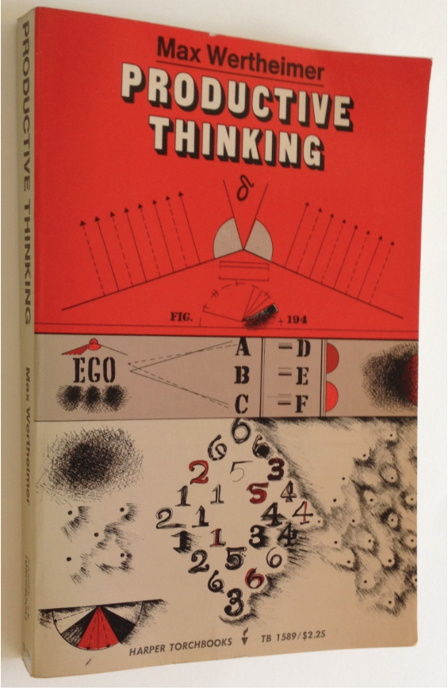
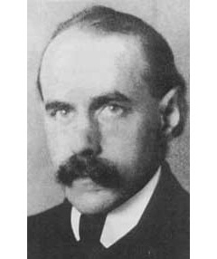
First written report Max Wertheimer interviews Einstein in 1916
“These were wonderful days, “beginning in 1916, when for hours and hours I was fortunate enough to sit with Einstein, alone in his study, and hear from him the story...”
active interrogation
“During these long discussions I questioned Einstein in great detail about the concrete events in his thought...”
no concrete result
“Back of all of this there had to be something that was not yet grasped, not yet understood. Uneasiness about this characterized young Einstein’s state of mind at the time.”

Slide 33
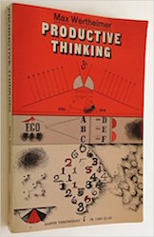
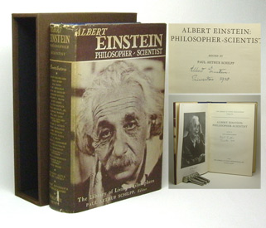
A Recovered Memory?
1943
Max Wertheimer sends Einstein’s drafts of the unpublished Productive Thinking. Einstein responds. Wertheimer dies.
1945
Productive Thinking is published posthumously.
1946
Einstein drafts his Autobiographical Notes. He recounts the chasing a light beam thought experiment. It is
recovered memories of his 16 year old self from the Wertheimer interviews
later use of the thought experiment to refute an emission theory of light
+
+ … ?

Slide 34
Clocks and Light Signals

Slide 35
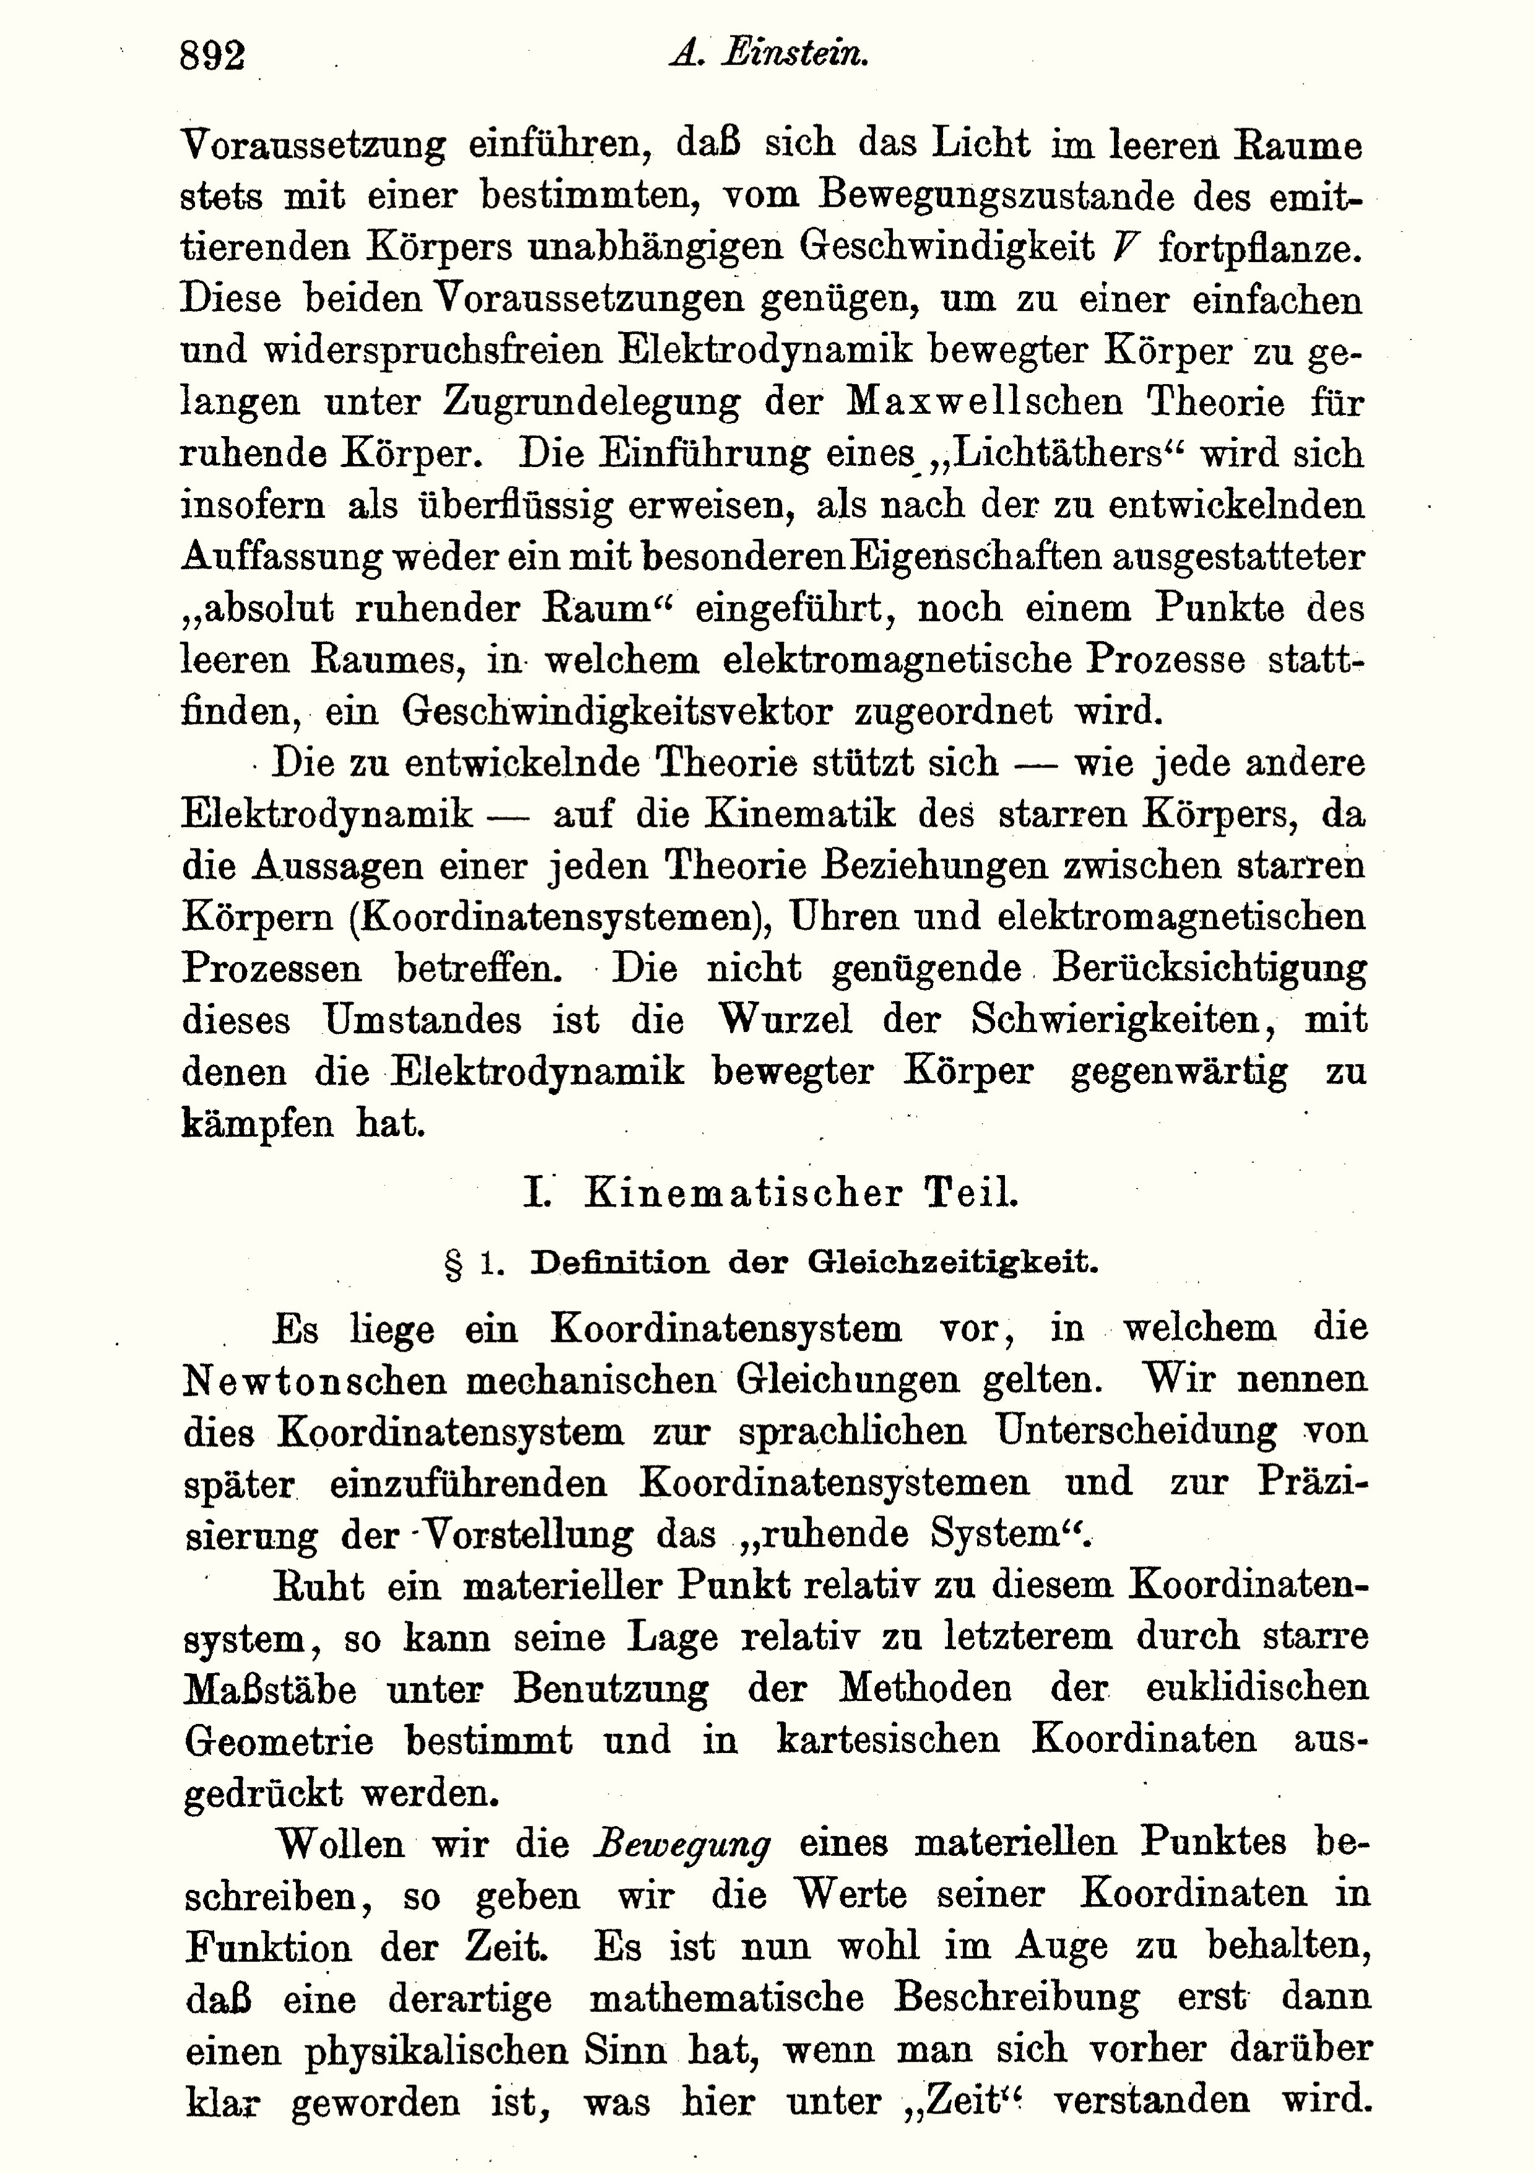
“On the Electrodynamics of Moving Bodies”
“I. Kinematical Part.
Definition of Simultaneity”

Slide 36
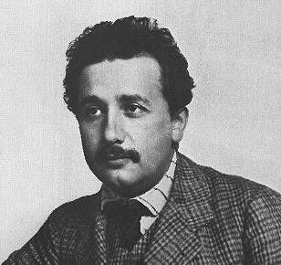
Operational Analysis of Simultaneity
How do we compare the timing of events at different places in space?
“So far we have defined only an “A-time” and a “B-time,” but not a common “time” for A and B.
The latter can now be determined by establishing by definition that the “time” required for light to travel from A to B is equal to the “time” it requires to travel from B to A.”

Slide 37
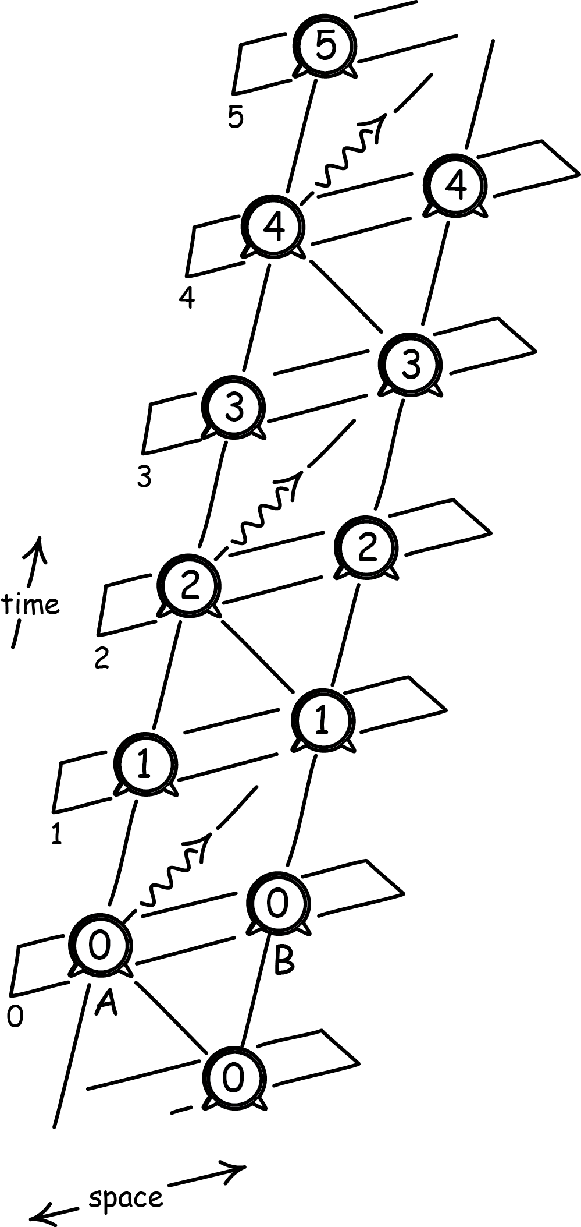
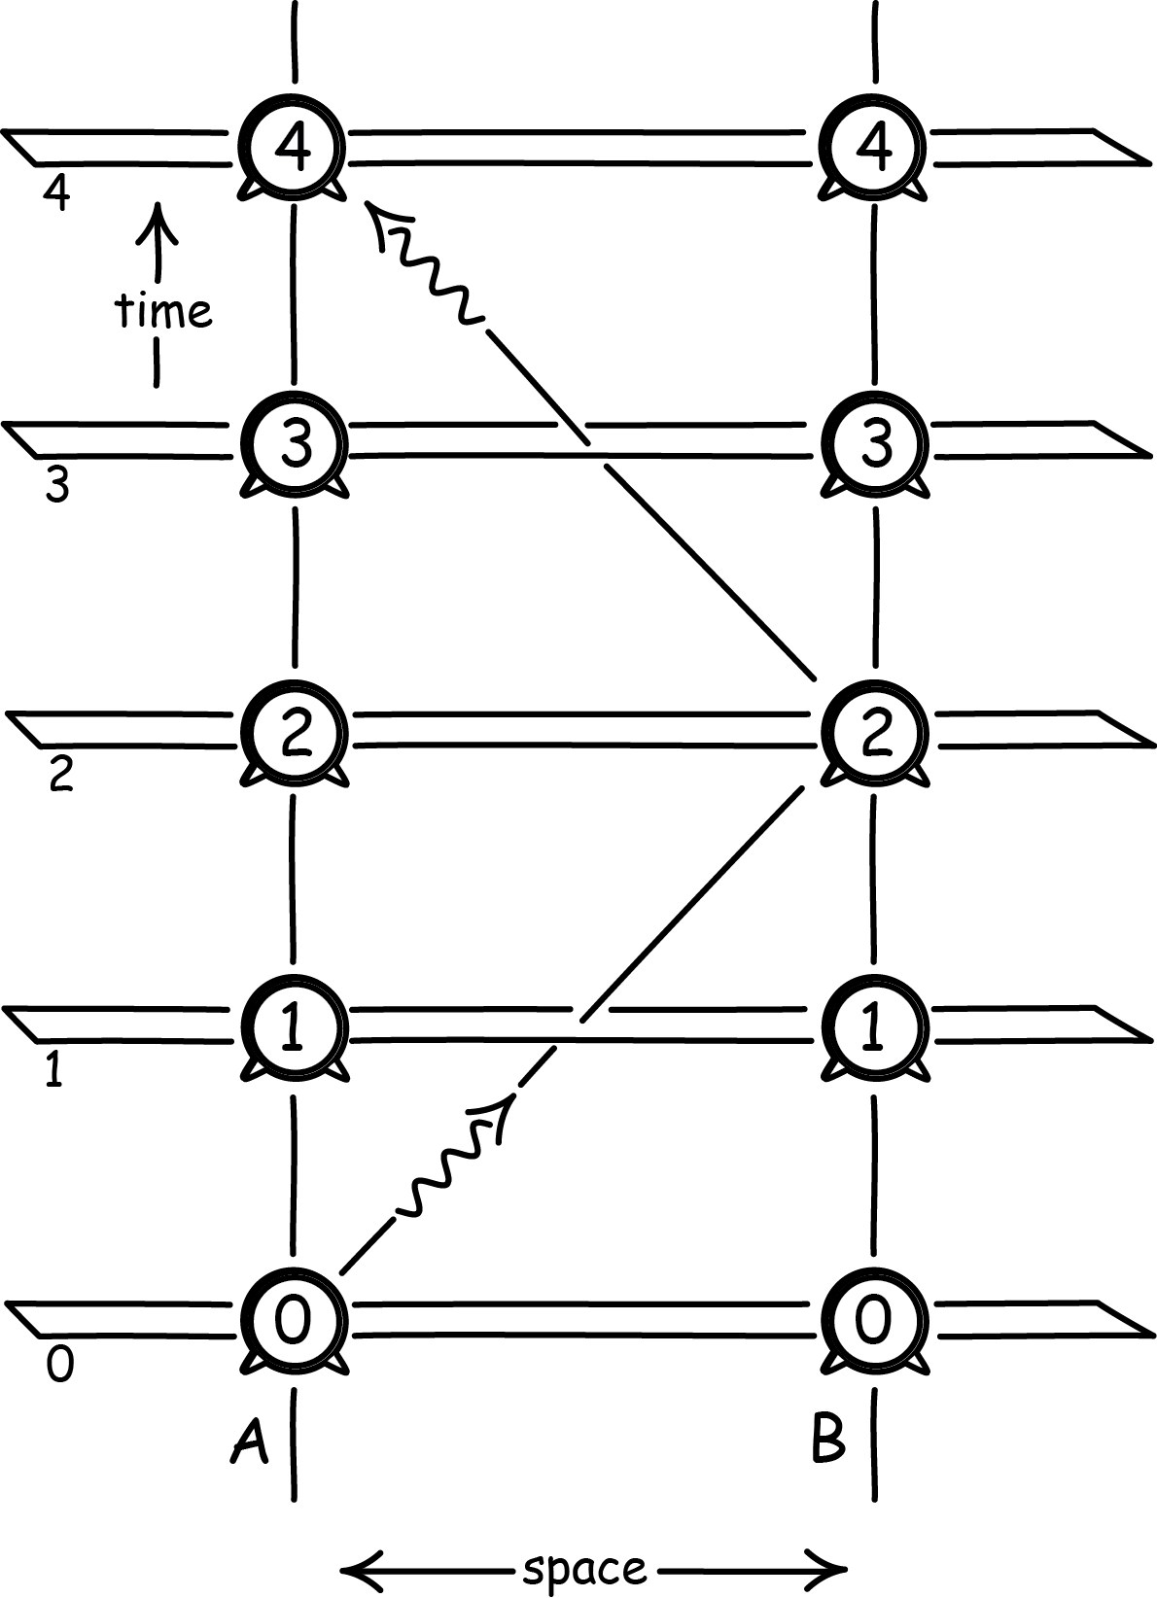
Relativity of Simultaneity
“resting frame”
“moving frame”

Slide 38
Relativity of Simultaneity
requires
Light Postulate
Light always propagates along 45º lines in the diagram.
Principle of Relativity
Judgments of simultaneity native to each inertial frame are equally good.
Without them,
nothing novel follows.

Slide 39
Nothing Works
Emission theory of light fails
Keep
Principle of relativity
Constancy of speed of light
AND
The rods and clocks thought experiments are a powerful expository means of convincing readers of results necessitated by his seven and more years of labor in electrodynamics.
How?
Maxwell’s electrodynamics remains unchanged.
Reinterpret Lorentz’ theorem of corresponding states.
One needed only to realize that an auxiliary quantity that was introduced by H. A.
Lorentz and that he called “local time” can simply be defined as “time.”

Slide 40
The Power of Operational Thinking

Slide 41
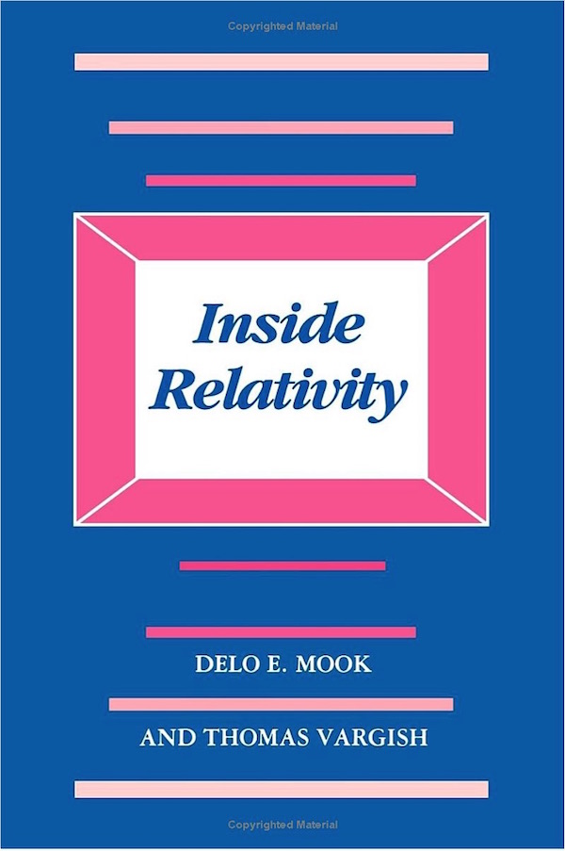
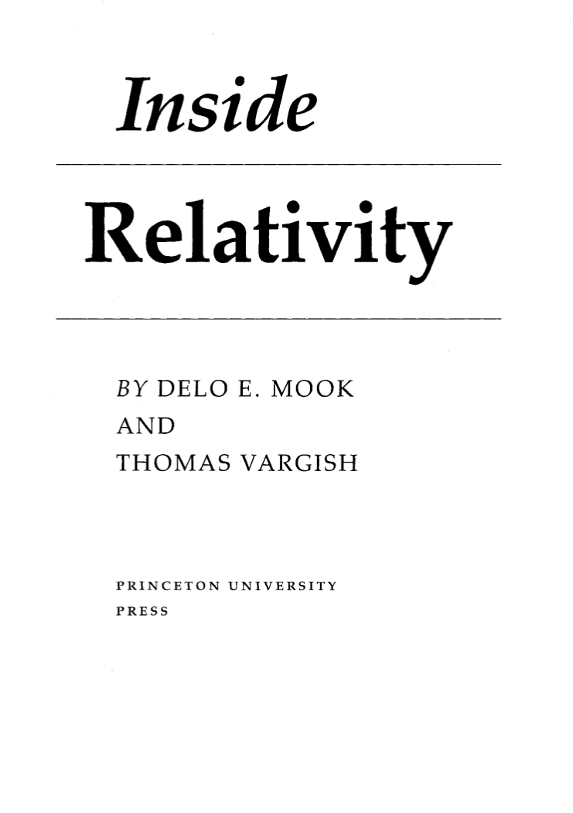
…mistaken as Einstein’s method of discovery.
“Albert Einstein’s work on relativity theory was guided by a series of simple even childlike questions.
He pursued the answers to these questions remorselessly, and in answering them he began to demolish the Newtonian foundations of physical science.
… they were questions of definition … of some of the basic terms used by scientists and others to describe the world, terms such as “space” or “time.”
… his definitions were so-called ‘operational definitions,’…”

Slide 42
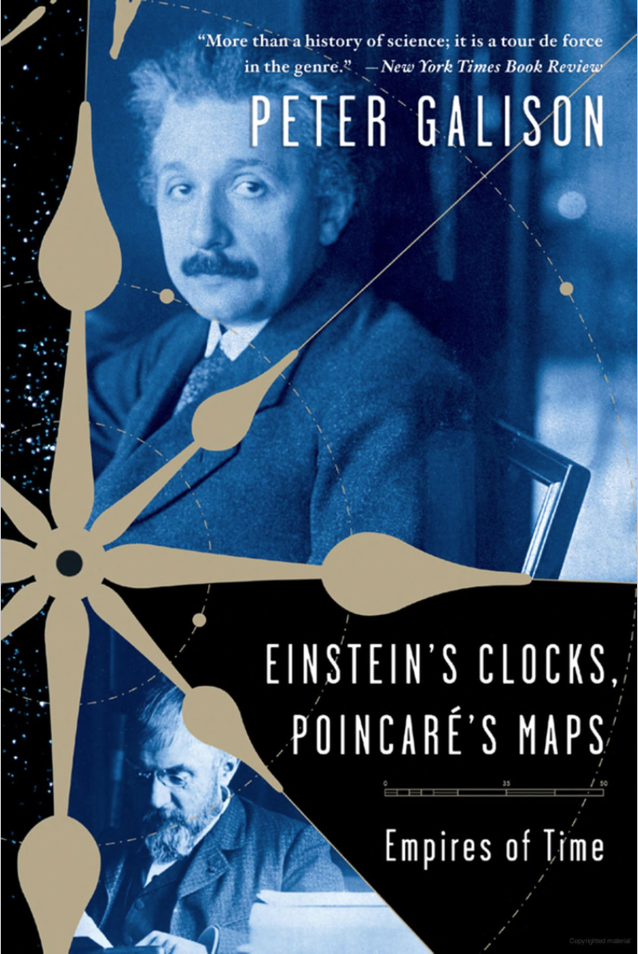
…What time is it down the line when the train pulls into Bern?
In posing such questions, Poincaré and Einstein seem, at first glance, to be asking questions of stunning simplicity.
… Their proposal: Send an electromagnetic signal from one clock to the other, taking into account the time the signal takes to arrive (as approximately the speed of light). …
Electric synchronization of clocks was a novel technology of great interest in 1905. Relevant patents passed through Einstein’s Bern patent office.

Slide 43
A simple idea of breathtaking consequences
for concepts of space and time,
for the new relativity theory,
for modern physics,
for the philosophy of conventionalism,
for a world- covering network of electronic navigation,
for our very model of secure scientific knowledge.
Electric synchronization of clocks was a novel technology of great interest in 1905. Relevant patents passed through Einstein’s Bern patent office.

Slide 44
The Power of Breaking Rules

Slide 45
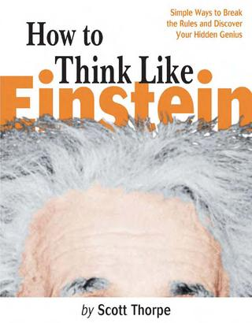
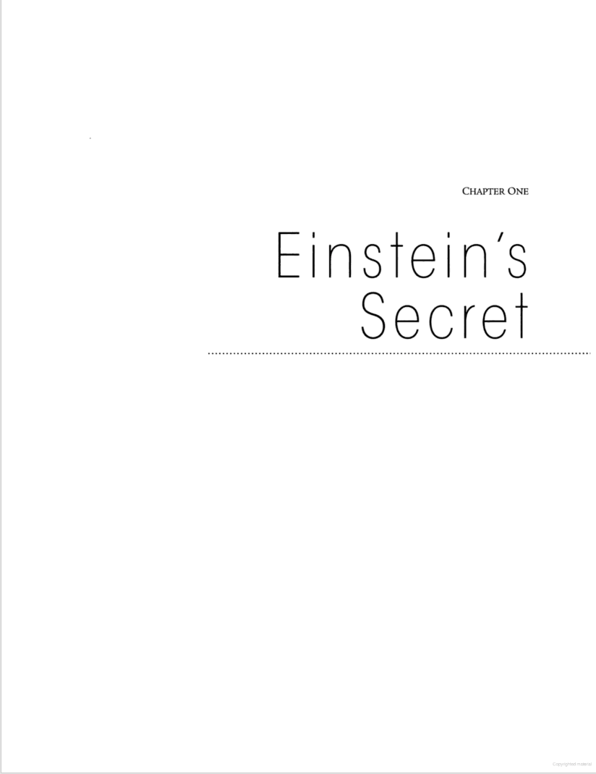
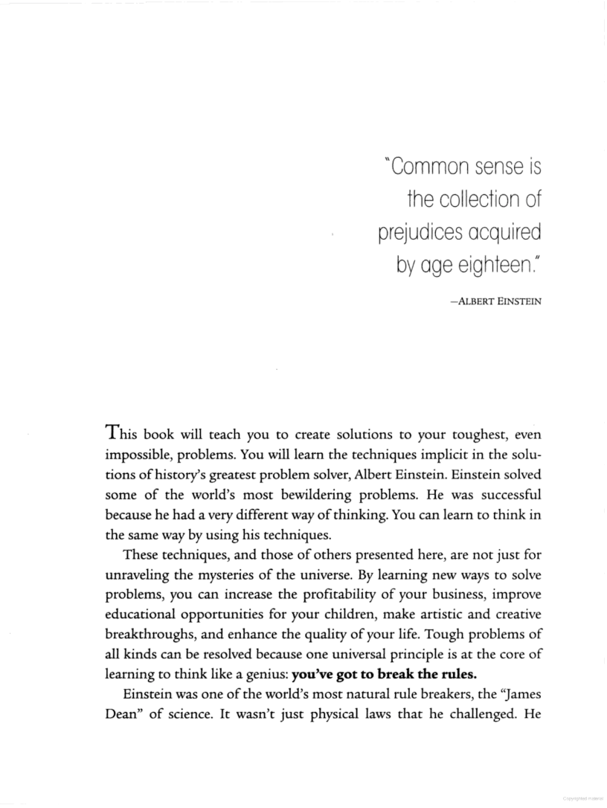
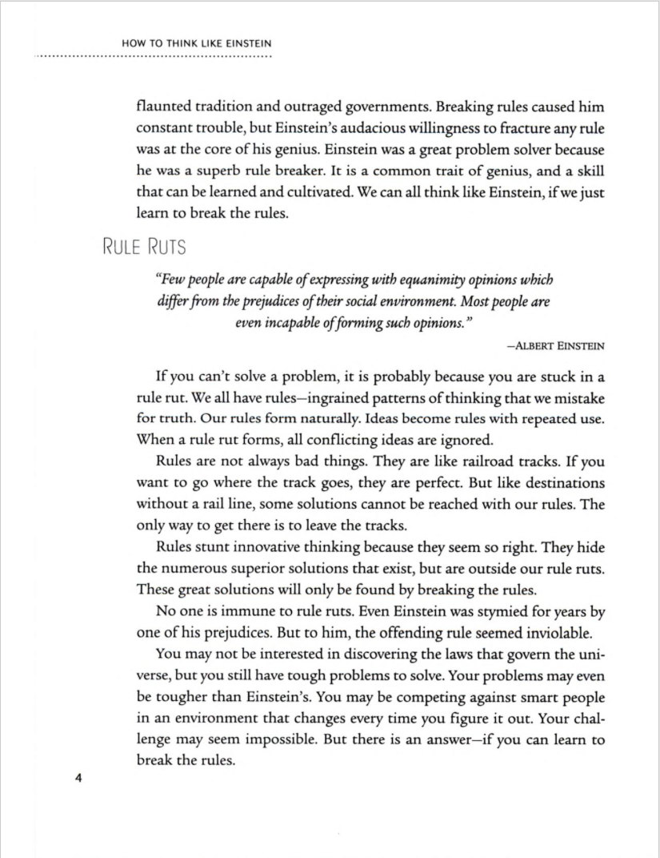
“We can all think like Einstein, if we just learn to break the rules.”
“… one universal principle … you’ve got to break the rules.”

Slide 46
The Power of a Single Experiment

Slide 47
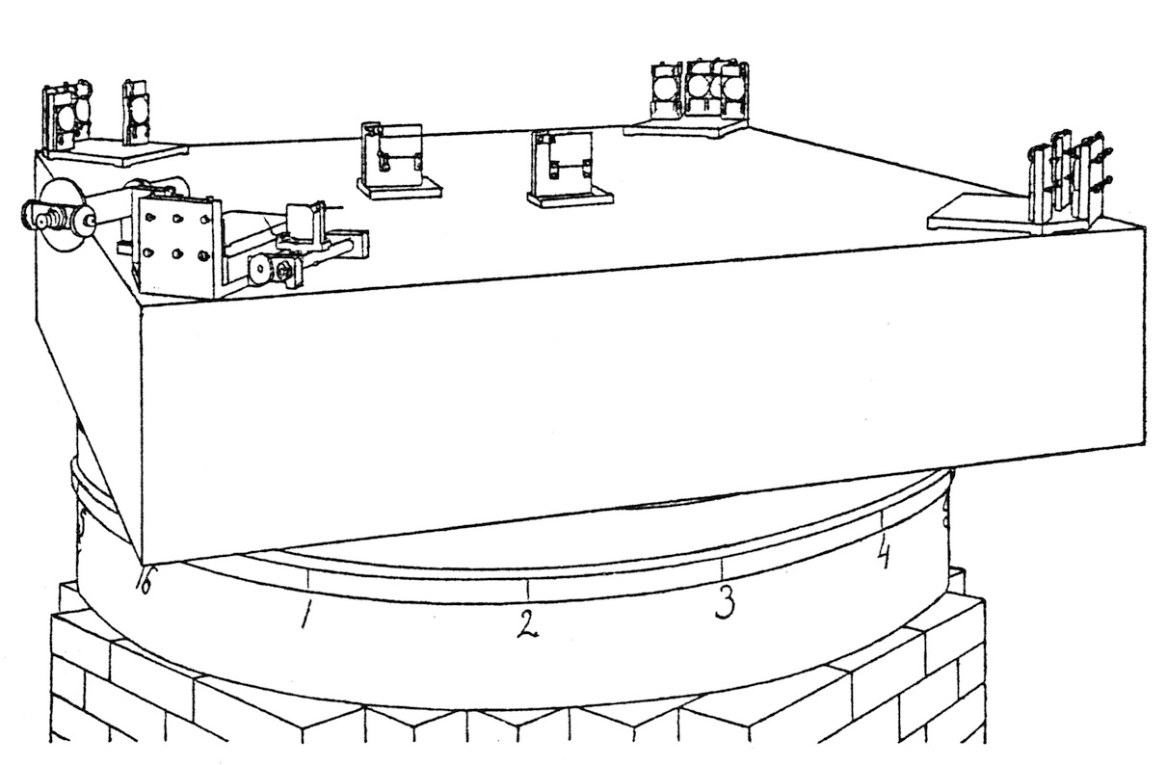
Michelson-Morley Experiment.
Gerald Holton, “Einstein, Michelson, and the ‘Crucial’ Experiment,” Isis, 60 (1969), pp. 132- 197.

Slide 48
The Light Quantum Hypothesis

Slide 49
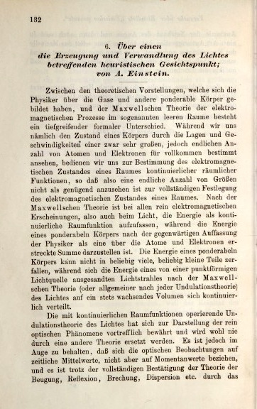
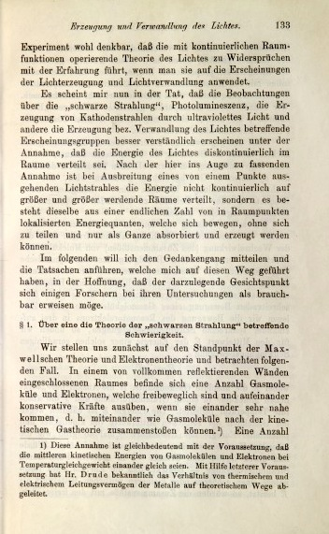
The Light Quantum Paper
"On a heuristic viewpoint concerning the production and transformation of light."
Annalen der Physik, 17(1905), pp. 132-148.(17 March 1905)

Slide 50
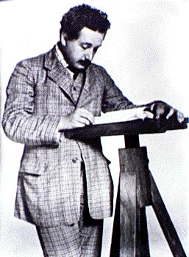
“very revolutionary”
Well, not always.
The great achievements of
19th century physics:
The wave theory of light;
Newton’s corpuscular theory fails.
Maxwell’s electrodynamics
and its development and perfection by Hertz, Lorentz…
"Monochromatic radiation of low density behaves--as long as Wien's radiation formula is valid [i.e. at high values of frequency/temperature]--in a thermodynamic sense, as if it consisted of mutually independent energy quanta of magnitude [hν]."
+
=
Synthesis: Light waves just are electromagnetic waves.

Slide 51
Millikan’s Critique

Slide 52
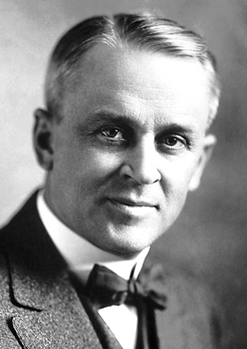
Rule Breaking. One Experiment.
“This hypothesis may well be called reckless
first because an electromagnetic disturbance which remains localized in space seems a violation of the very conception of an electromagnetic disturbance, and
second because it flies in the face of the thoroughly established facts of interference.
The hypothesis was apparently made solely because it furnished a ready explanation of one of the most remarkable facts brought to light by recent investigations, viz., that the energy with which an electron is thrown out of a metal by ultra-violet light or X-rays is independent of the intensity of the light while it depends on its frequency.”
Robert Millikan, “A Direct Photoelectric Determination of Planck’s ‘h’,” Physical Review, 7 (1916), pp. 355-388.

Slide 53
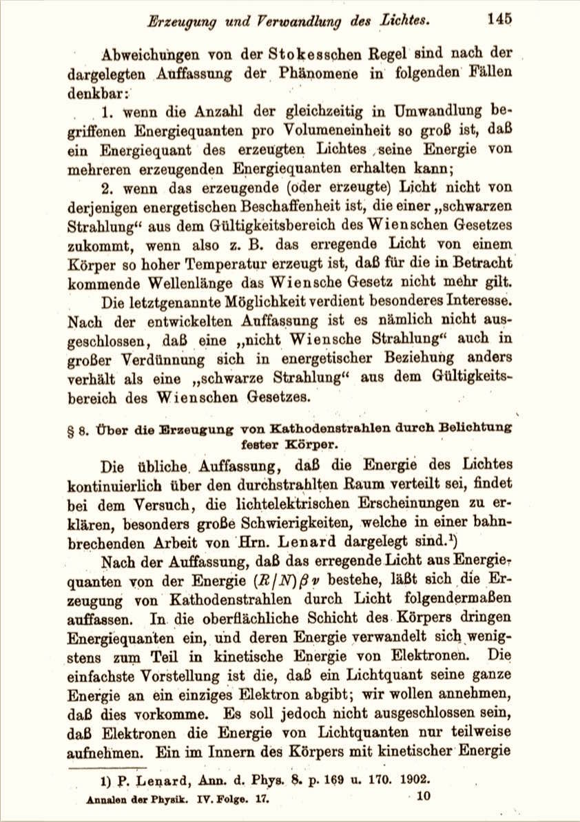
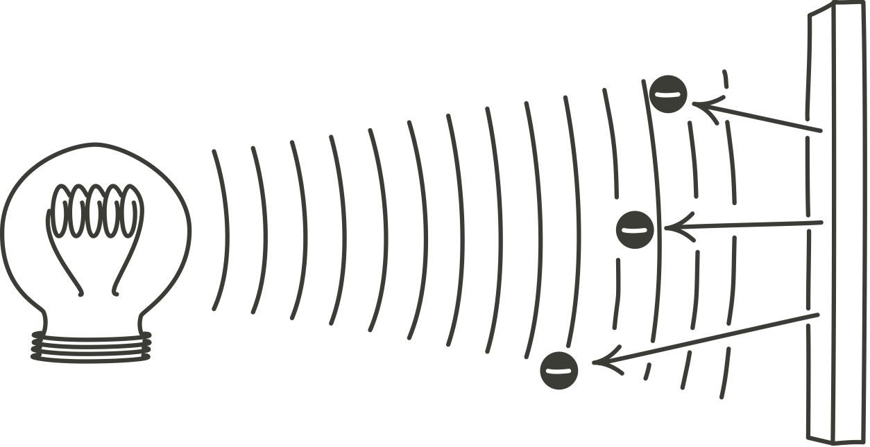
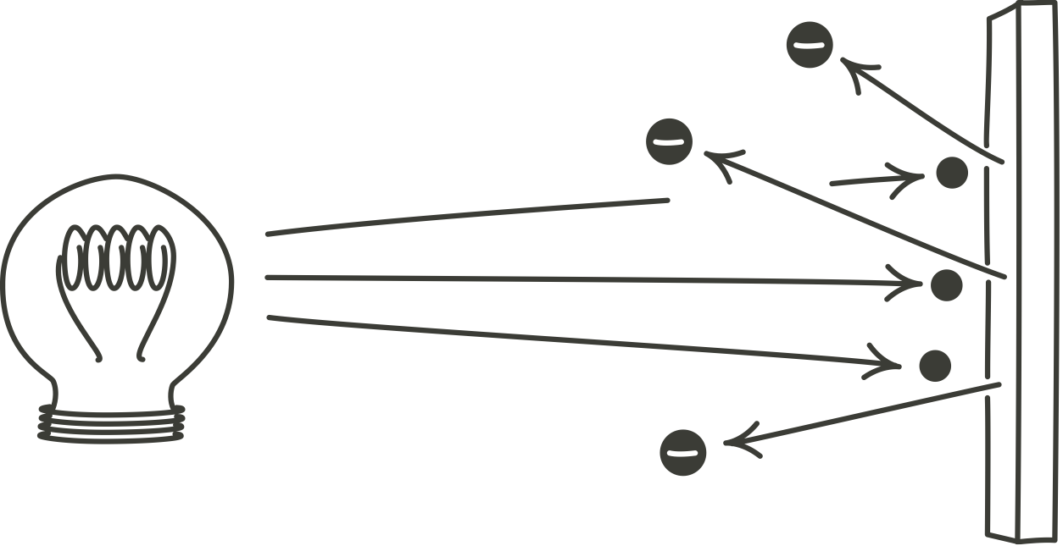
Photoelectric effect

Slide 54
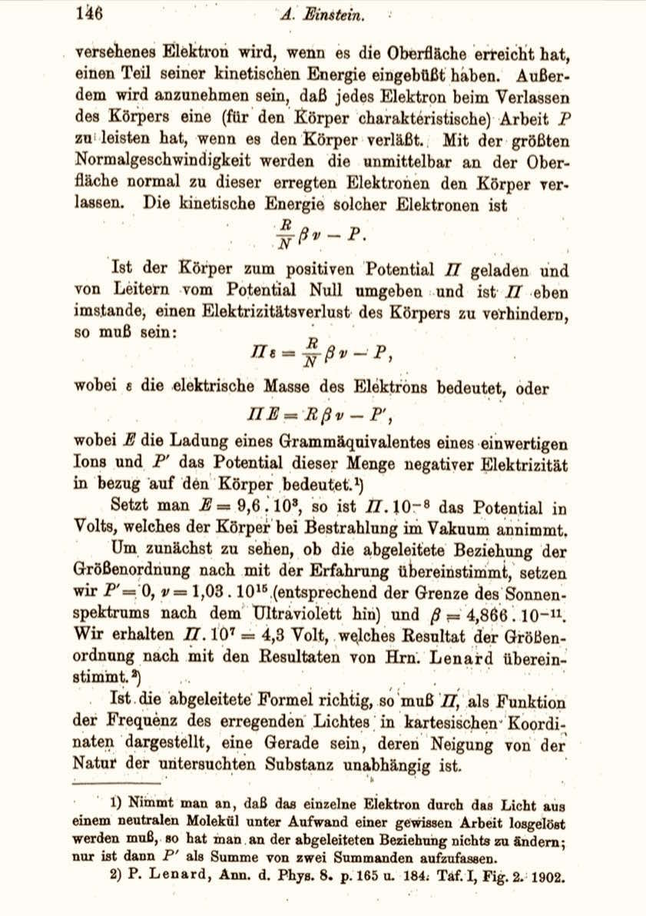
Photoelectric effect
Einstein predicts for photoelectric effect
Energy of ejected electrons Πε
= h x frequency
- constant
“If the formula derived here is correct, if drawn in Cartesian coordinates as a function of the frequency of the incident light, Π must be a straight line, whose slope is independent of the nature of the substance studied.”

Slide 55
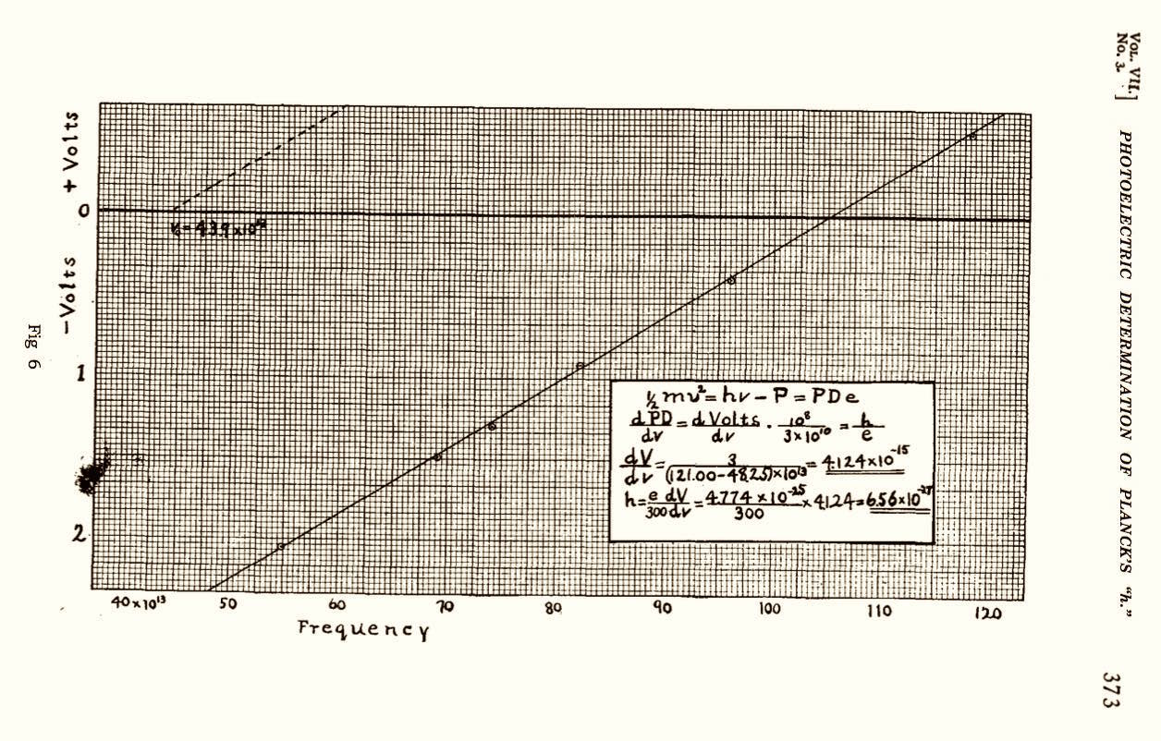
Millikan’s Experimental Confirmation
Robert Millikan, “A Direct Photoelectric Determination of Planck’s ‘h’,” Physical Review, 7 (1916), pp. 355-388.

Slide 56
The Miraculous Argument

Slide 57
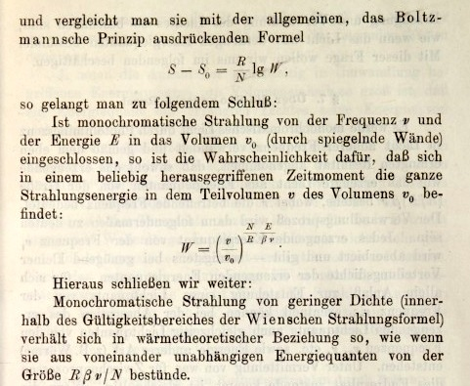
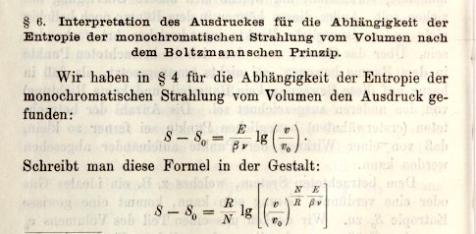
Section 6 of the Light Quantum Paper
measured entropy of high frequency radiation depends on the logarithm of volume
the light quantum hypothesis
S ~ n log V
system of n independent, spatially localized points

Slide 58
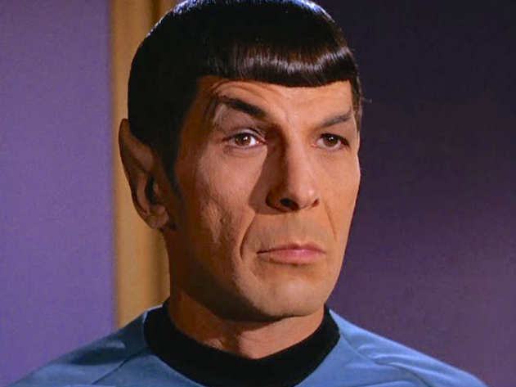
Can it really be this easy?

Slide 59
Macroscopic signatures of microscopic constitution
19th century
Systems of many independent points
Ideal gas law
PV = nRt
Reverse inference is a standard analytic tool.
Einstein’s earliest papers try to identify a molecular force law from capillarity and electrolytic potentials
1901-1902
equivalent
signatures
Einstein independently develops the Gibbs framework for statistical physics.
1902-1904
Einstein’s Doctoral dissertation, Brownian motion paper investigate the thermodynamics of …
1905
Systems of many independent points
S – S₀ = k n log
V
V₀

Slide 60
From measured properties to quanta
Measured entropy S of system of energy E of thermal radiation of volume V and high frequency ν
E
V
S – S₀ = k log
High frequency thermal radiation behaves thermodynamically like
hν
V₀
n =
E
hν
S – S₀ = k n log
V
independent, localized units (“quanta”) of energy.
V₀
Probabilities W and W₀ that n independent points are in volumes V and V₀
n
W
V
=
W₀
V₀
“Boltzmann’s Principle”: probability W that system fluctuates to state with entropy S
S – S₀ = k log
W
W₀

Slide 61
Myths created by our fascinations with…
The Power of …
The precocious child who makes great discoveries.
… Childish Thinking
… Operational Thinking
The most important conceptual analysis of the 20th c. (simultaneity).
… Breaking Rules
Our love of contrarianism.
… a Single Experiment
A simple pedagogic story.

