Slide 1
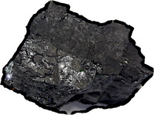
Large-Scale Structure
This account provides a novel role for hypotheses in philosophy of science.
The large-scale structure is complicated, but fits well with real cases in history of science.
The large-scale structure is complicated.

