Slide 1
Circularity
Chapter 3 in The Large-Scale Structure of Inductive Inference
John D. Norton
Department of History and Philosophy of Science
University of Pittsburgh http://www.pitt.edu/~jdnorton

Slide 2
The Worry: Large-scale relations of inductive support are full of circles of dependencies

Slide 3
The Worry: Large-scale relations of inductive support are full of circles of dependencies

Slide 4
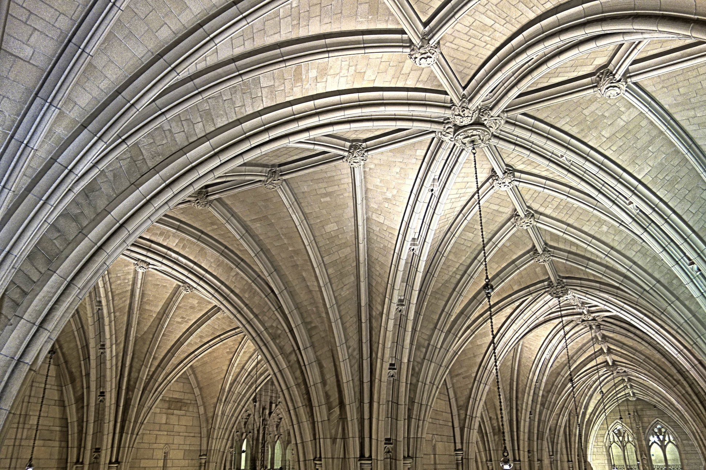
Molecular formulae of elements and compounds.
Weights of atoms of elements.
Avogadro’s hypothesis
Dulong-Petit law of specific heats
Mitscherlich’s law of isomorphism
Densities of element and compounds, gaseous and vaporized.
Heat capacities of solids and gases.
Crystalline structures of solids

Slide 5
horror circulorum

Slide 6
Summary
horror circulorum
Mistaken. No default supposition that circularities are fatal. Treat by cases.
1
Vicious circularity
Fatal if found. Structure containing it must be repaired.
Contradiction
2
Indeterminate circularity
Import of relations left open.
Further work needed. More evidence? Convention?
3
Benign circularity
Well-defined structure.
Goal of inductive analysis.

Slide 7
1 Vicious Circles
Bertrand Russell and foundations of set theory,
Russell’s paradox
The set of all sets that do not contain themselves.
contradiction
Failure of naïve set theory
Russell and Whitehead
“The Vicious-Circle Principle” … “Whatever involves all of a collection must not be one the collection.” (Russell and Whitehead, 1910, p. 40)
Huge literature in vicious circle paradoxes
Contradictions from self-reference becomes a major engine of proof.
Goedels’s theorems
Epimenides the Cretan says “All Cretans are liars.”

Slide 8
Contradictions in circles of inductive support?
Adjust propositions to eliminate them.
Einstein’s 1917 static cosmology.
contradicts Hubble’s 1929 expansion of the nebulae
Einstein abandons static cosmology. Adopts a dynamics cosmology.
Radiocarbon dating
contradicts historical dating.
Early carbon-14 levels adjusted to bring both into agreement.

Slide 9
Indeterminate circularities
“Begging the Question”
A standard in traditional logic texts
“… ‘petitio principii’ [“begging the question,”] takes place when a premiss, whether true or false, is either plainly equivalent to the conclusion, or depends on it for its own reception.”
Whately’s Elements of Logic (1856, p. 184)
Standard example:
A religious figure who proclaims his own infallibility.
The harm: The question is left unsettled.

Slide 10
Indeterminacies in circularities of inductive support are …
… ineliminable
Strong candidate for a convention. There is no fact to be determined.
“Thus we are faced with a circular argument. To determine the simultaneity of distant events we need to know a velocity, and to measure a velocity we require knowledge of the simultaneity of distant events. The occurrence of this circularity proves that simultaneity is not a matter of knowledge, but of a coordinative definition, since the logical circle shows that a knowledge of simultaneity is impossible in principle.” (Reichenbach)
Einstein-Reichenbach on distant simultaneity.
… eliminable
Then do so! Invitation for further investigation.
Dalton’s circularity among atomic weights and molecular formulae
Broken by later investigation

Slide 11

Benign Circularities: Elementary Examples
White = 1 – Black
Black = White
Black = White = 1/2
Sum = 1/2 + 1/4 + 1/8 + 1/16 + …
Therefore, 2 Sum = 1 + 1/2 + 1/4 + 1/8 + … = 1 + Sum
Solve Sum = 1

Slide 12
Extreme Example: Aczel’s non-wellfounded set theory
Ω is set that is its own sole member.
Ω = {Ω} = {{{{{{…}}}}}}
Axiom of foundation
∀x [x≠0 → ∃y (y∈x ∧ y∩x=0)]
Every non-empty set has an element which is disjoint from it.
Vicious Circle Principle fails.
VIOLATED

Slide 13
Intermediate example: Maxwell’s equations
Equations governing wave propagation
(1/c) ∂E/∂t = ∇xH
(1/c) ∂H/∂t = -∇xE

Slide 14
Circularities in inductive inference aspire to be benign
Seek to
• eliminate contradictions
• resolve circularities
(as conventions or by further evidence)
Benign self-supporting structures that are unique.
Is this possible?
… Next Chapter.

Slide 15
Summary
horror circulorum
Mistaken. No default supposition that circularities are fatal. Treat by cases.
1
Vicious circularity
Fatal if found. Structure containing it must be repaired.
Contradiction
2
Indeterminate circularity
Import of relations left open.
Further work needed. More evidence? Convention?
3
Benign circularity
Well-defined structure.
Goal of inductive analysis.

