Slide 1

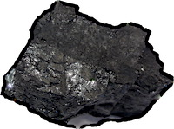
Circularity
I am liberated from horror circulorum.
Non-wellfounded set theory is really amazing.
The analysis looks bullet-proof, but it is hard to shake an ingrained sense that circularities are just bad.

