Slide 1
The Uniqueness of Domain-Specific Inductive Logics Chapter 4 in The Large-Scale Structure of Inductive Inference John D. Norton Department of History and Philosophy of Science University of Pittsburgh http://www.pitt.edu/~jdnorton

Slide 2
The Worry
Many, self-supporting systems
One, very extensive body of evidence
Inductive anarchy
Many competing systems of proposition, equally supported
Competing sciences, equally supported.
Competing inductive logics

Slide 3
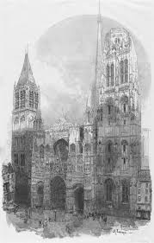
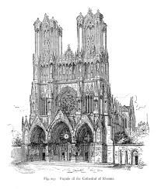
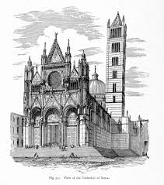

Slide 4
Summary: For Uniqueness
1. Our mature sciences are unique.
2. Competition among competing sciences is unstable.

Slide 5
Mature sciences are unique
Only one mature:
Geometry
Celestial mechanics
Chemistry
Biology
Geology
…
in their domains of application
The evidence fixes each uniquely.
Robustness of mature science over times, countries and cultures.
since
Scientists, politicians conspire to suppress alternatives.
Scientists are unimaginative and cannot see alternatives.
Huge professional rewards for scientists who see the missed alternative.
Can and does happen… but always?

Slide 6
Science is empirical
Science is empirical.
Two theories compete.
Do they disagree on some possible experience?
No empirical investigation can decide between them.
NO
Are they really factually distinct theories?
YES
Contents confirmed, even if indirectly, by experience.
Further empirical investigation can decide between them.

Slide 7
Advantages are amplified
Theory 1
vs
Theory 2
Material theory of induction:
Secure more facts.
Inductive reach extended.
New evidence favors Theory 1
Theory 1
strengthened
Theory 2
weakened

Slide 8
Illustrations
From Inference to the Best Explanation chapters of The Material Theory of Induction
Darwin’s Origin of Species
Lyell’s Principles of Geology
Thomson’s Cathode Rays
Einstein and the Anomalous Motion of Mercury
Big Bang and Steady State Cosmology
…
Chapter 13. Dowsing: The Instabilities of Evidential Competition
Chapter 14. Stock Market Prediction: When Inductive Logics Compete
New paper
Arp and Bahcall on the Origin of Galactic Red Shifts

Slide 9
Yes, but ….

Slide 10
“Unconceived Alternatives” Kyle Stanford
We have not identified the best supported theory, because we did not conceive it.
The best supported theory is not unique.

Slide 11
Underdetermination thesis
conjecture
Underdetermination Conjecture: any body of empirical evidence, no matter how extensive, will provide inductive support for multiple, mutually exclusive sets of propositions such that no one set is distinguished as enjoying the strongest support.
FAILS
No cogent demonstration within a well-developed logic of inductive inference.
All examples of observationally equivalent theories are contrived.

Slide 12
Summary: For Uniqueness
1. Our mature sciences are unique.
2. Competition among competing sciences is unstable.

