Slide 1

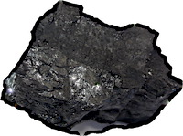
Uniqueness
This makes sense of the uniqueness of mature sciences in their domains.
So that’s what’s wrong with the underdetermination thesis!
Might some as yet unconceived new theory arise and be the new unique theory?
We need an explanation for why that doesn’t happen historically once maturity is achieved in some domain.

