Slide 1

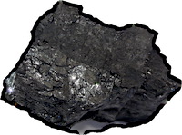
Inference to the Best Explanation
This account avoids the difficulty that we have no account of explantion adequate to power inductive inference.
The account was discovered inductively by examining real cases in history of science.
Inference to the better is vindicated, but to the best is less secure.

