Slide 1
Hempel’s Satisfaction Criterion of Confirmation
Anne S. Maquia Landin
Sept. 25th, 2024

Slide 2
Roadmap
Motivations
The Proposal
- Assumptions
- Criteria of adequacy the proposal must satisfy
- Key move: development of a hypothesis
- The Satisfaction Criterion of Confirmation (simplified)
3. A Worked Example
4. Defects
5. Gems & Coals
References

Slide 3
1. Motivations (Norton 2010, pp. 66-67):
Before: inductions can only be expressed through syllogistic logic (enumerative induction) or necessary/sufficient conditions (Mill)
Hempel uses predicate logic: expressing induction through predicate logic allows for more expressive power – in particular, it allows for a more general notion of an instance of a hypothesis

Slide 4
Why do we need more expressive power? One example: beam balance and transitivity
Hypothesis (Transitivity): For any three masses, if the first overbalances the second and the second overbalances the third, then the first overbalances the third.
- These observations present an instance of transitivity, and so intuitively inductively supports transitivity, yet cannot be fit into the schemes of enumerative induction and necessary/sufficient conditions.
Observations:
a overbalances b.
b overbalances c.
a overbalances c.
a overbalances d.
b overbalances d.
c overbalances d.

Slide 5
1. Motivations (Hempel 1945, pp. 4-5):
Before: “rules of induction”= “canons of scientific discovery”
Hempel: scientific discovery can’t be mirrored in a set of general rules of inductive inference
What we should be focused on is not how a hypothesis is arrived at, but whether it stands up when confronted with relevant observational data.
Alternatively: provide a counterpart to the criteria for valid deduction in formal logic for confirmation and disconfirmation (p. 2 and p. 9)
Notes:
”= “canons of scientific discovery”, i.e. rules which would allow us to infer from a given set of data the hypothesis which best accounts for it

Slide 6
1. Motivations
More precisely, Hempel’s goals are (1945, p. 5):
To define the meaning of “E confirms H” and “E disconfirms H”; and
To lay down criteria for either
defining a metrical concept of “degree of confirmation of H with respect to E” or
defining the two relational concepts “more confirmed than” and “equally well confirmed with” so that non-metrical comparison of hypothesis is possible.

Slide 7
2. The Proposal – Initial Assumptions
Language of science = L (essentially the lower functional calculus without the identity sign) – assume both hypothesis and evidence sentences are formulated in this language

Slide 8
Expressions in L are made up of the following:
Connectives: ~, v, . , $⊃$
Individual Constants: represent particular things that make up the object of some science -- denote by a, b, c, d, …
Variables: x, y, z, …
Predicate constants of finite degree: designate properties or attributes of the particular things in question -- P(x), Q(x), R(x, y), …
Universal and Existential quantifiers: e.g. (x)(Sx), (x)(Ey)R(x, y)
Rules of inference in L = those of lower predicate calculus w/o identity sign

Slide 9
Assume also there is a clearly delimited “observational vocabulary” in L consisting of (in principle) observable attributes of things/events (e.g. “black”, “taller than”) but no theoretical terms (e.g. “aliphatic compound”, “circularly polarized light”) (1945, p. 23).
Define: “Molecular sentence”= a sentence which is made of constants satisfying predicates and connectives, e.g. P(a) . Q(b)
Hempel’s goal reformulated (Hempel 1943, p. 126): how can we define confirmation as a relation between a molecular sentence M (representing a collection of observations) and a sentence S (representing the hypothesis)?

Slide 10
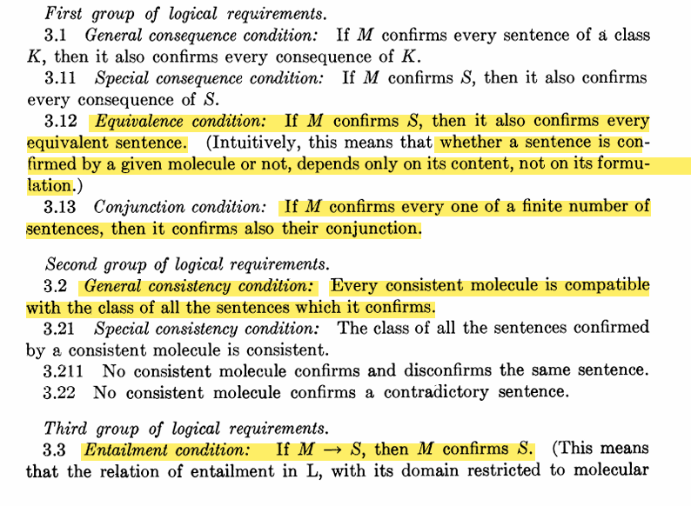
2. The Proposal – Conditions of Adequacy
Logical requirements (1943, pp. 128-129)
“Material” Requirement(s): the proposed criterion of confirmation should agree sufficiently with how the concept of confirmation is used in empirical science (p. 128)
Notes:
Can omit

Slide 11
2. The Proposal – Development of a Hypothesis
Definition (Norton 2010, p. 68): The development of the hypothesis H with respect to the class of individuals {a, b, c, …} is a sentence that asserts what H would say if a, b, c, … were the only individuals in the world.
Idea for the criterion of confirmation:
M of {a, b, c} confirms S if in a world containing exclusively the individuals a, b, and c, the sentence S would be true, according to the information contained in M (Hempel 1943, p. 130).

Slide 12
Example (Norton 2010, p. 69):
Hypothesis H: (x)Mass(x) (“all things have mass”)
Suppose we are observing only two physical objects a and b, so that the class of individuals defined by our observation is {a, b}
The development of H with respect to the class of individuals in our observations M ({a, b}) is then Mass(a) . Mass(b)

Slide 13
Hempel’s (first) formal definition of the development of a hypothesis (1943, p. 131)
Notes:
What is relevant is that this is a recursive definition, so that you can always find the development of a hypothesis wrt a class of individuals in M by bfinding the delevopment of its component parts wrt the same individuals

Slide 14
2. The Proposal
(Norton 2010, p. 70)
(Direct Confirmation) A collection of observations M directly confirms a hypothesis H if M entails the development of H for the class of objects mentioned in M
(Confirmation) A collection of observations M confirms a hypothesis H if H is entailed by a class of sentences directly confirmed by M.

Slide 15
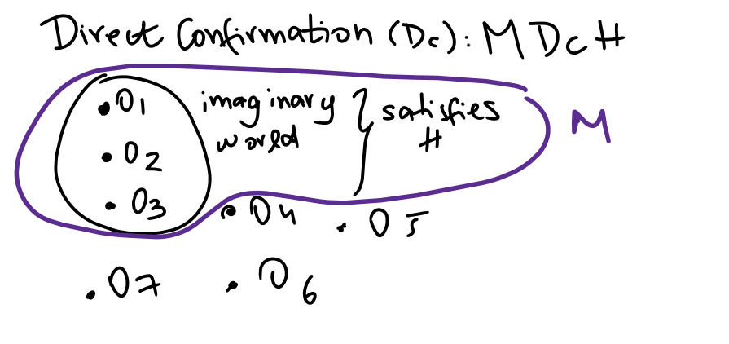

Slide 16
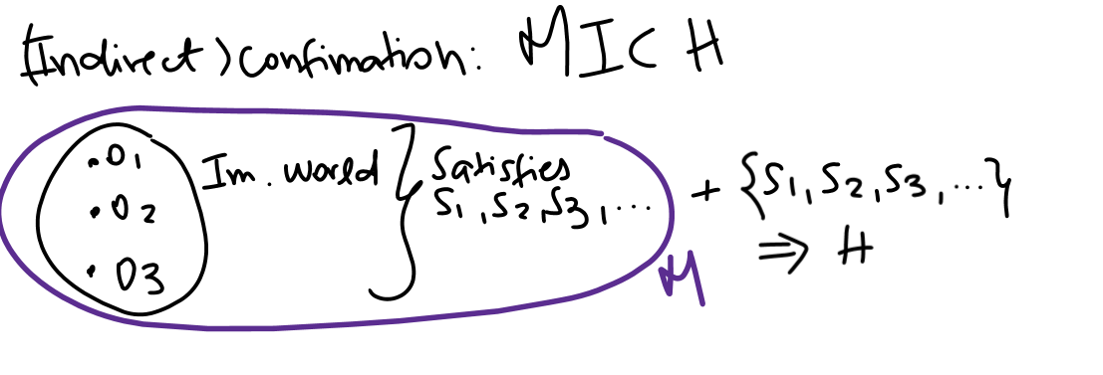

Slide 17
3. An Example -- (Norton 2010, p. 71)
Hypothesis H: (x)(Raven(x)$⊃$Black(x)) (“all ravens are black”)
Development of H with respect to a single object a: Raven(a)$⊃$Black(a)
What kind of evidence entails the development of H wrt. a?
Raven(a)⊃Black(a) is equivalent to ~Raven(a) v Black(a)
This is entailed, for instance by ~Raven(a)
It is also entailed by Black(a)
Thus, any black thing and any non-raven are evidence for H (coal?)
But Black(a) . Raven(a) is also evidence for H, as expected
This is because (Black(a) . Raven(a)) ⊃ Black(a) which in turn entails ~Raven(a) v Black(a)

Slide 18
3. An Example
Furthermore, because (x)(Raven(x)$⊃$Black(x)) entails
Black (b) . Raven (b), if we observe Black(a) . Raven(a), then we will have confirmation for Black (b) . Raven (b) by IC
This is good news! We have found that seeing one instance of a black raven is evidence for the next raven we see to be black too.

Slide 19
4. Major Defects
- Fails to allow for evidence expressed in the vocabulary of observation to confirm a hypothesis in the theoretical language
Observational language by definition does not include theoretical terms, so can’t entail theoretical statements
Solution(?): would need to define theoretical terms in terms of observational terms
Led to the “grue” emeralds problem (Norton 2010, p. 77) + Raven paradox

Slide 20
5. Gems & Coals
Recovers that seeing one instance of a black raven is evidence for the next raven we see to be black too
Does not account for how observations can confirm theoretical claims
Very hefty assumptions about the “scientific language” – e.g. why should this language obey classical logic? Why not non-monotonic logic?

Slide 21
References
Hempel, Carl G. "A purely syntactical definition of confirmation1." The Journal of Symbolic Logic 8.4 (1943): 122-143.
Hempel, Carl G. "Studies in the Logic of Confirmation (I.)." Mind 54.213 (1945): 1-26.
Norton, John D. "A survey of inductive generalization." (2010).

