Slide 1
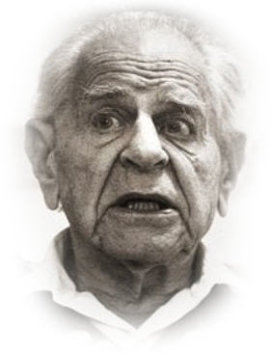
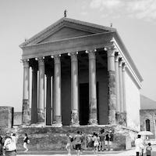
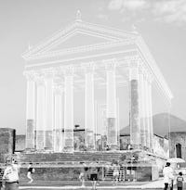
The Rise and Fall of
Karl Popper’s
Anti-inductivism
John D. Norton
Department of History and
Philosophy of Science
University of Pittsburgh

Slide 2


Overview
Russell,
Reichenbach: implausible work-arounds
Rise
Early 20th c.
Inductive inference cannot be justified.
Popper:
an account of science without induction.
Fall
Science is an inherently an inductive enterprise.
Popper’s anti-inductivism necessarily fails.

Slide 3
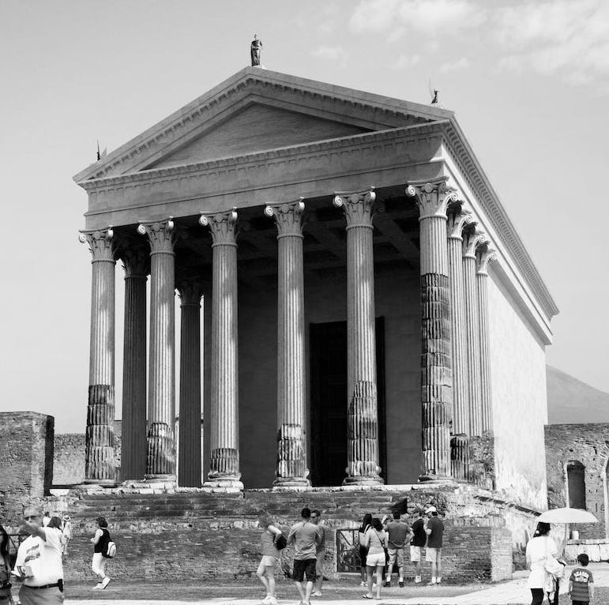
The Rise

Slide 4
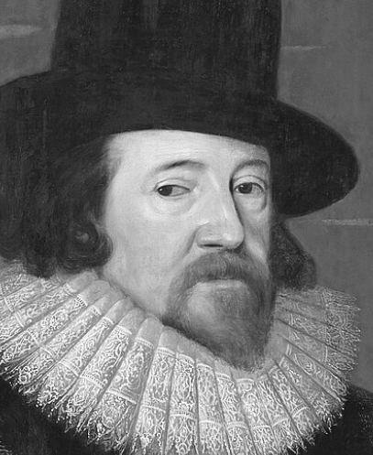
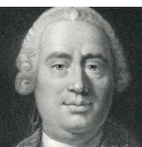
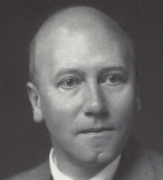
Inductive Anxieties
The induction which proceeds by simple enumeration is puerile, leads to uncertain conclusions, and is exposed to danger from one contradictory instance, deciding generally from too small a number of facts, and those only the most obvious.
Francis Bacon, 1620
It is impossible, therefore, that any arguments from experience can prove this resemblance of the past to the future; since all these arguments are founded on the supposition of that resemblance.
David Hume, 1777
May we venture to hope that when Bacon’s next centenary is celebrated the great work which he set going will be completed; and that Inductive Reasoning, which has long been the glory of Science, will have ceased to be the scandal of Philosophy?
C. D. Broad, 1926

Slide 5
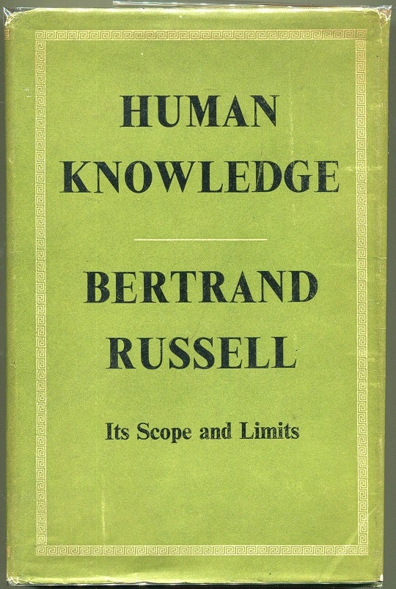
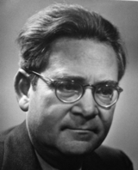
Responses to the Problem of Induction
Theory of causal lines.
“… the minimum assumptions, anterior to experience, that are required to justify us in inferring laws from a collection of data; and further, to inquire in what sense, if any, we can be said to know that these assumptions are valid.”
Assumed there is no action at a distance.
Bertrand Russell,
Human Knowledge
Pragmatic solution to the problem of induction. Nothing to lose.
“We are in the same situation as a man who wants to fish in an unchartered place of the sea. There is nobody to tell him whether or not there are fish in this place. Shall he cast his net? Well, if he wants to fish I would advise him to cast the net, at least to take the chance. It is preferable to try even in uncertainty than not to try and be certain of getting nothing.”
Hans Reichenbach
1936

Slide 6
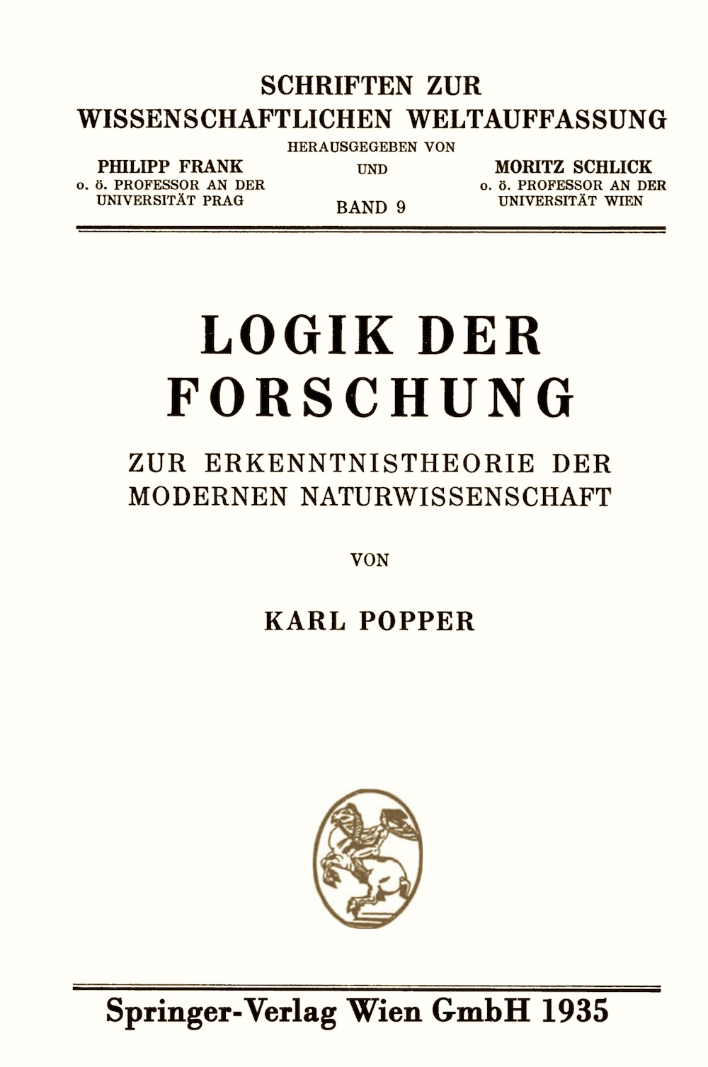
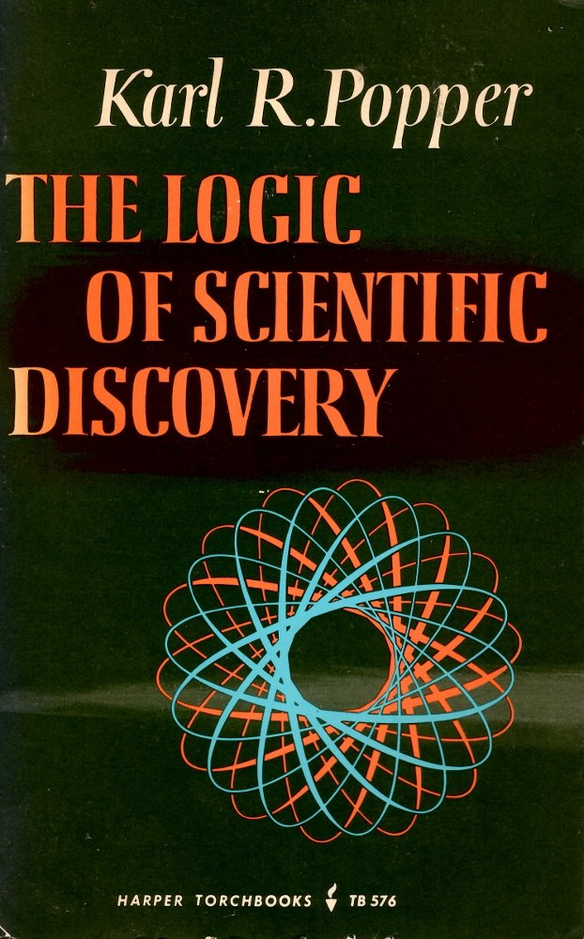

Slide 7
Google Scholar (August 25, 2024):
Kuhn’s Structure… cited 3,465 times.
Popper’s Logic… cited 42,111 times.

Slide 8
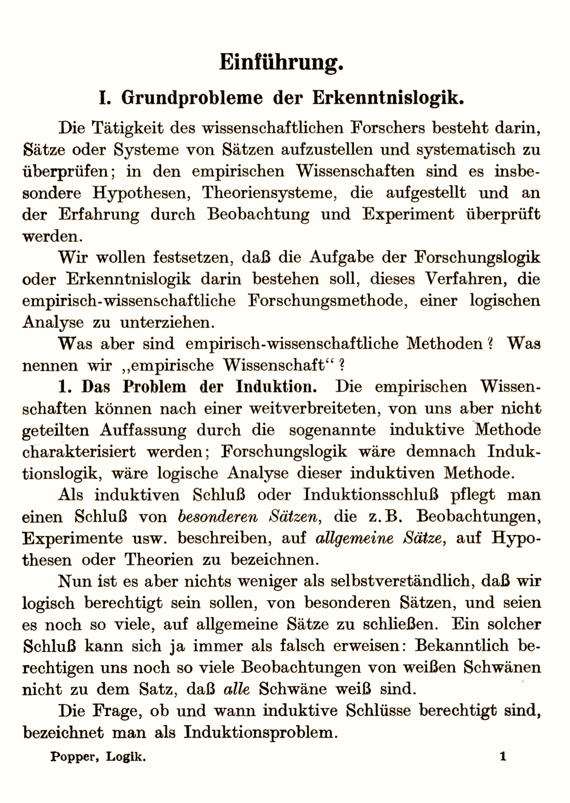
… a principle of induction is superﬂuous, and that it must lead to logical inconsistencies.
…
if we try to regard its truth as known from experience, then the very same problems which occasioned its introduction will arise all over again.
To justify it, we should have to employ inductive inferences; and to justify these we should have to assume an inductive principle of a higher order; and so on.
Thus the attempt to base the principle of induction on experience breaks down, since it must lead to an inﬁnite regress.

Slide 9
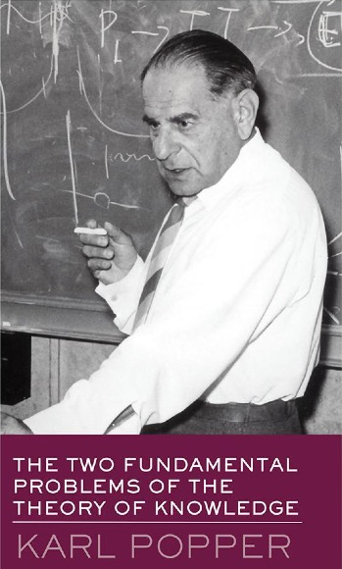
Why the Regress Formulation?

Slide 10
Why the Regress Formulation?
… concept of circular inference would be confronted here with certain logical objections …
…Russell…
… “No proposition can say anything about itself.” …

Slide 11

Popper’s Rigor
The theory to be developed in the following pages stands directly opposed to all attempts to operate with the ideas of inductive logic. It might be described as the theory of the deductive method of testing, …
induction

Slide 12
Conjectures and Refutation
Conjecture
Prediction
deduction
Verified?
New conjecture
Falsified?
(Refuted)
Corroboration

Slide 13
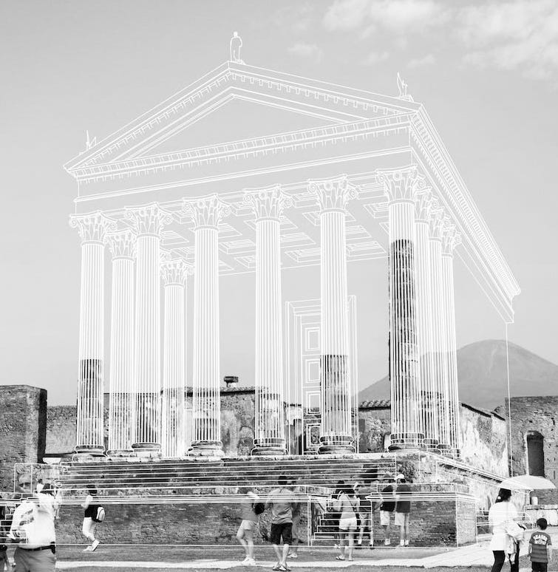
The Fall

Slide 14
Science is inherently inductive
Science is inherently inductive
And in a very complicated way...
… that purely deductive relations are not rich enough to capture.

Slide 15



Slide 16
Differences
A falsificationist
account is …
An inductive
analysis is …
… dynamic and
identifies our present best candidates among scientific theories by their place in a dynamic process of conjectures, testing of predictions and refutations.
…static. It supplies strengths of inductive support for theories and hypotheses on the evidence that are independent of the historical processes that led to the appraisal.

Slide 17
Differences
A falsificationist
account is …
An inductive
analysis is …
… denies that evidence can ever establish theories securely.
Popper (2005, p. 10): “I never assume that by force of ‘veriﬁed’ conclusions, theories can be established as ‘true’, or even as merely ‘probable’.”
… allows that, if the inductive support of the theory or hypothesis is strong enough, the theory or hypothesis will be taken to be established beyond reasonable doubt. It always allows the possibility of error in principle no matter the strength of the inductive support.

Slide 18
Problems of Falsificationism

Slide 19
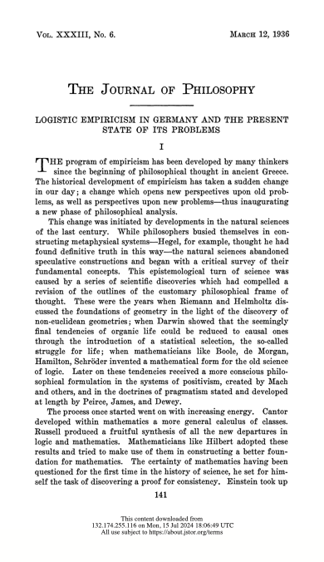
Deductivism
Induction persists in Popper’s account in:
Hans Reichenbach
No experience used to refute a hypothesis is known with certainty.
After a refutation, selection of a new hypothesis is guided by which the scientist thinks is most likely to be fruitful.

Slide 20
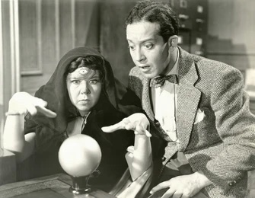
Deductivism
Accepting predictions drawn from a theory is only rational if we have grounds for accepting the truth of the theory.
Not supplied by corroboration.
“[Corroborations] should count only if they are the result of risky predictions; that is to say, if, unenlightened by the theory in question, we should have expected an event which was incompatible with the theory--an event which would have refuted the theory.”
Popper 1962.

Slide 21

Dynamicism
Popperian
Inductivist
“We’ve tried to refute it and failed. We’ll keep trying and let you know if we succeed.”
“The evidence supporting is strong; it is very likely.”
Should we take climate change seriously and take drastic action?
Ad hoc hypothesis
Whether it has merit depends on what you knew when you formulated it.
All that matters is whether it is well-supported by the evidence.

Slide 22
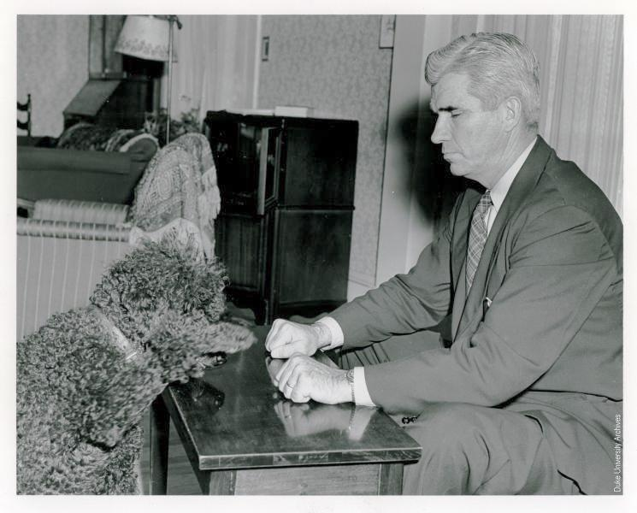

Demarcation
Falsifiability demarcates science from non-science.
Parapsychology is science since it makes falsifiable predictions.
Too permissive.
J.B. Rhine testing a dog
No predictions and thus no predictive testing in a fully explored archaeological site.
Too strict.

Slide 23
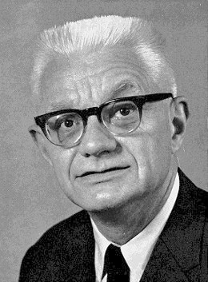
Demarcation
Scientific
(falsifiable)
Not scientific
(not falsifiable)
There are electrons that are not spin one half.
All electrons are spin one half.
Carl Hempel
1950
“Problems and Changes in the Empiricist Criterion of Meaning,”.
negation
Being scientific is not invariant under Boolean logical operations.
The planet Vulcan, with its suitably computed mass and orbit, allows Newtonian theory to account for the anomalous motion of Mercury.
There are ways that Newtonian theory can account for the anomalous motion of Mercury.
entailment

Slide 24


Demarcation??
The view of a generic inductivist.
Why the big fuss about handing out the label “scientific” like a prize at baking context?
“Scientific” or not, what matters is whether the proposal is well supported by the evidence.

Slide 25
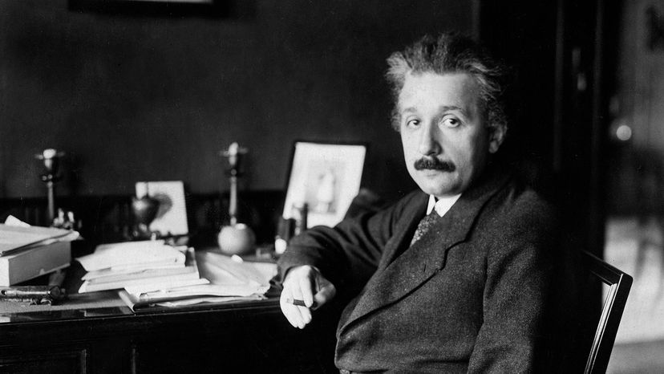
Einstein

Slide 26
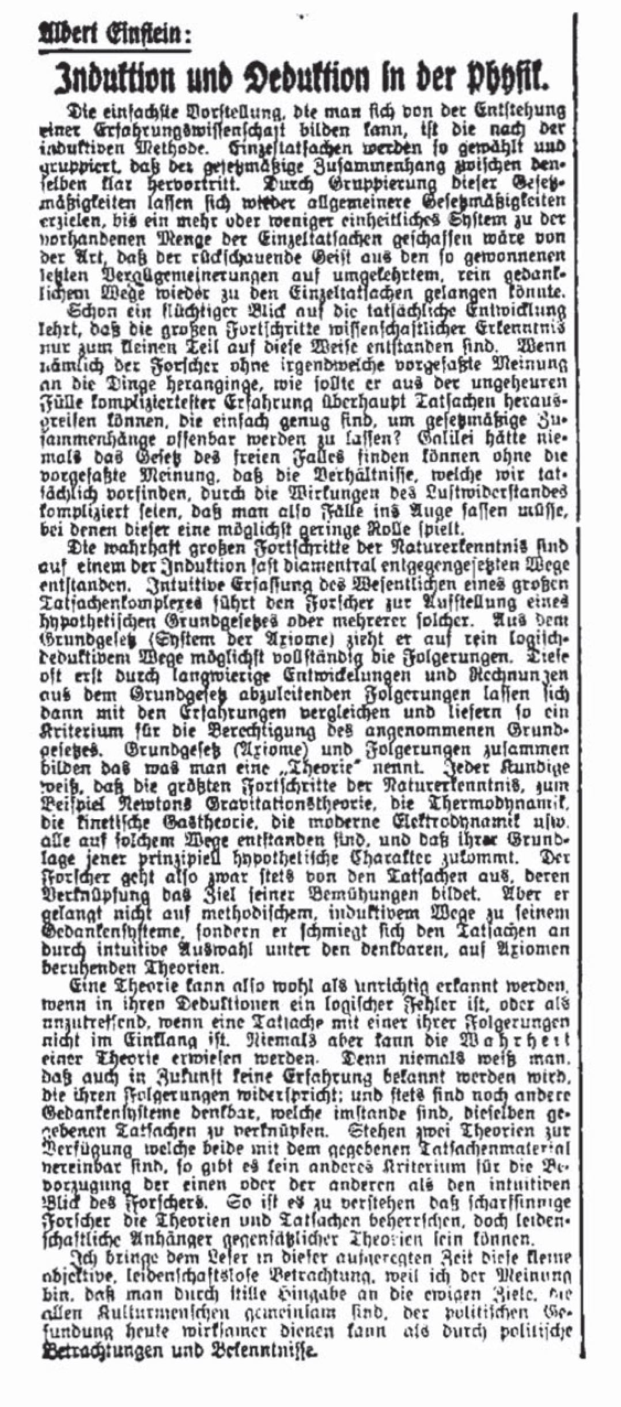
Einstein falsificationist?
“Induktion and Deduktion in der Physik,”
Berliner Tageblatt, 25 December, 1919.
“… while the researcher always starts out from facts, whose mutual connections are his aim, he does not find his system of ideas in a methodical, inductive way; rather, he adapts to the facts by intuitive selection among the conceivable theories that are based upon axioms.”
“Thus, a theory can very well be found to be incorrect if there is a logical error in its deduction, or found to be off the mark if a fact is not in consonance with one of its conclusions. But the truth of a theory can never be proven. For one never knows if future experience will contradict its conclusion; and furthermore there are always other conceptual systems imaginable which might coordinate the very same facts.”

Slide 27
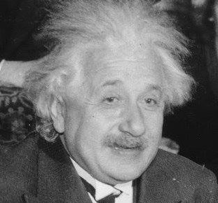
Einstein against falsification
Meh.
1913. Einstein and Michele Besso in private calculation: precursor to general relativity of 1913 gives the wrong prediction for the perihelion motion of Mercury.
Einstein in 1913
Einstein to Max Born.
May 12, 1952
“Even if there had been no deflection of light, no perihelion motion and no redshift, the gravitational equations would still be convincing because they avoid the inertial system (the phantom that affects everything but is not itself affected). It is actually rather curious that humans are mostly deaf to the strongest arguments, while they always tend to overestimate the accuracy of measurements

Slide 28
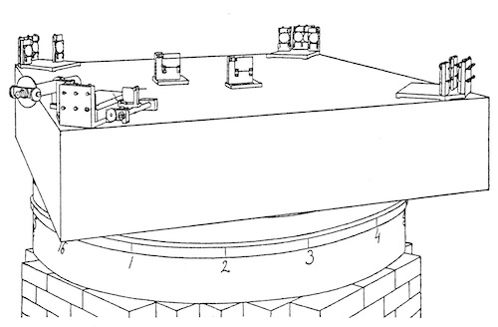
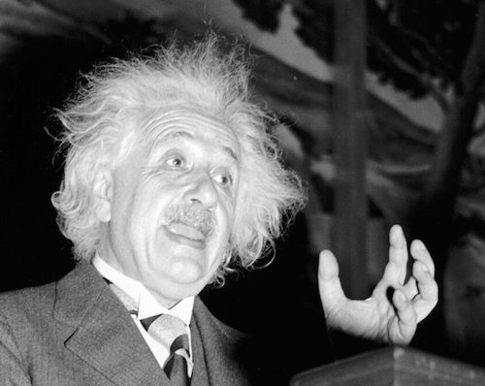
Einstein against falsification
1925. Dayton C. Miller repeats the Michelson-Morley experiment and finds a positive ether drift.
“In my opinion, there is as good as no probability at all [gar keine Wahrscheinlichkeit] that Herr Miller is correct.”
Einstein 1925, his emphasis.

Slide 29
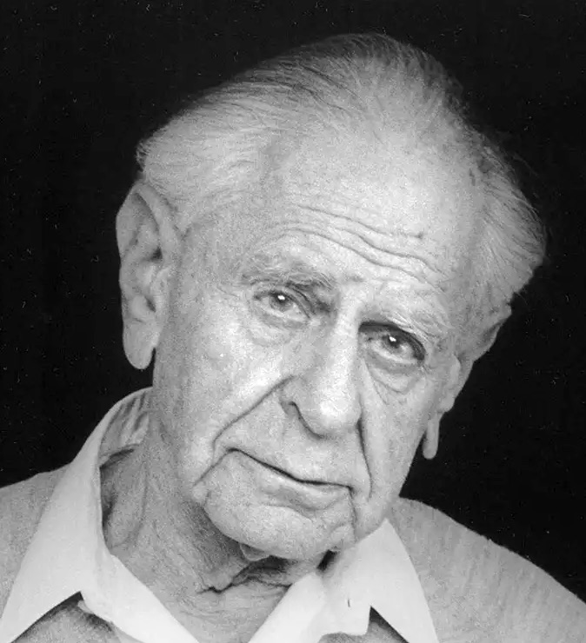
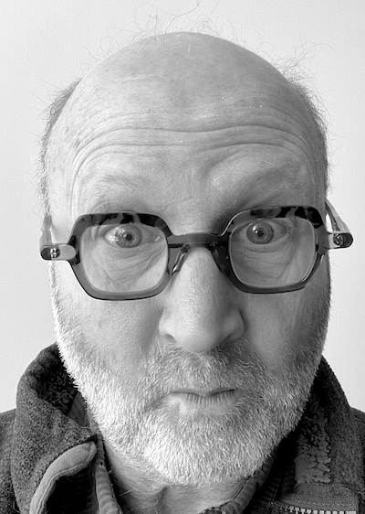
Popper on the Problem of Induction
This line of argument is the foundation of the critique of inductivism.
Karl Popper, Two Fundamental Problems of the Theory of Knowledge. London: Routledge, 2009. pp.4-5.
What if the problem of induction is dissolved?

Slide 30
Overview
Russell,
Reichenbach: implausible work-arounds
Rise
Early 20th c.
Inductive inference cannot be justified.
Popper:
an account of science without induction.
Fall
Science is an inherently an inductive enterprise.
Popper’s anti-inductivism necessarily fails.

Slide 31

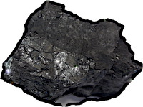
Gems and Coals
Popper’s analysis was unflinching,
where Russell and Reichenbach’s were not.
Popper’s falsificationism was a product of the brave, exuberance of the 1920s.
Exciting to see!
Popper’s falsificationism was a product of the brave, exuberance of the 1920s.
It has outlived its time.

