Slide 1

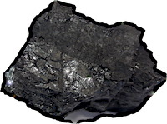
Uniqueness
It’s nice to see that apparently intractable problems can be solved.
The solution in involves nothing fancy.
Just elimination a key piece of the problem and its gone.
Have we overlooked something?
The problem of induction has a nasty habit of springing back into life like the arch villain in a horror movie.

