Slide 1

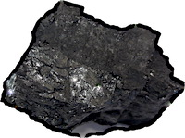
What is Inductive Inference?
Splitting induction into two separate notions, logical and psychological, is important.
Why can’t the epistemologist leave psychology to the psychologists?!
Tracing the history makes sense of the modern mess.

