Slide 1
How to Make Possibility Safe for Empiricists
John D. Norton
Department of History and Philosophy of Science
University of Pittsburgh
"How to Make Possibility Safe for Empiricists." pp. 129-159 in Rethinking the Concept of Laws of Nature: Natural order in the Light of Contemporary Science. ed. Yemima Ben-Menahem. Springer, 2022.
https://sites.pitt.edu/~jdnorton/homepage/cv.html#empiricist_possibility

Slide 2

ImageFX prompt
“How to Make Possibility Safe for Empiricists” https://aitestkitchen.withgoogle.com/tools/image-fx

Slide 3

This Talk
blah
blah
blah
An empiricist account of possibility
Empirical and logical possibility are the only well-founded notions of possibility.
Conceptual, metaphysical, nomic, physical and epistemic possibility add nothing
Properties of empirical possibility
Duality of possibility and necessity can fail.
~
~

Slide 4
The View, Briefly

Slide 5
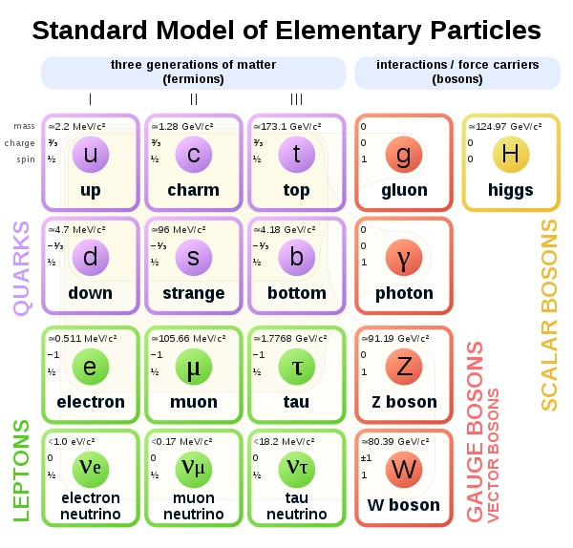
Empiricism?
e
Small-e empiricism
We can only learn contingent truths of the world from experiences of the world.
We can learn that there truly are quarks.
E
Big-E empiricism
The only contingent truths of the world we can learn are experiences of the world.
We cannot know that there truly are quarks.

Slide 6

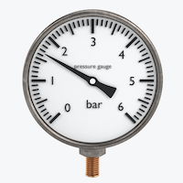
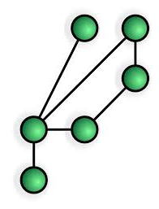
Empirical Possibility, briefly
Possible =
What our evidence positively allows.
Necessary =
What our evidence compels.
Evidence must be positively relevant, not merely compatible.
Relational:
all judgments related to some body of evidence.
Gradational:
possibility comes in degrees according to our account of inductive support.

Slide 7


Logical possibility, briefly
Possible =
Truth compatible with the meaning of terms in the proposition.
Necessary =
Truth follows inexorably from the meaning of terms in the proposition.
My tomato is red.
My tomato is a fruit.

Slide 8

The Quest

Slide 9
Quest: Notions of possibility that responsibly go beyond logical and empirical possibility
?
Candidates
Conceptual
Metaphysical
Nomic
Physical
Epistemic
Requirements
Possibilities and necessities must be
• in the world;
The empiricist perennial question: how do we know this?
• independent from how we use language;
• independent of our thoughts and beliefs.

Slide 10
Quest: Notions of possibility that responsibly go beyond logical and empirical possibility
Candidates
Conceptual
Metaphysical
Nomic
Physical
Epistemic
Same as logical possibility.
Same as empirical possibility
Laws are just contingent truths of very wide scope, learned empirically.

Slide 11
Metaphysical Possibility

Slide 12
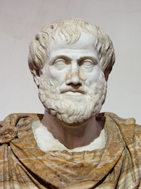
What is metaphysics?
“It is not easy to say what metaphysics is.”
Peter van Inwagen and Meghan Sullivan (2020) “Metaphysics,” The Stanford Encyclopedia of Philosophy
Aristotle:
“being qua being”
“…metaphysics is the study of ultimate reality.”
Peter van Inwagen, Metaphysics. 2009, p. 1
Metaphysical possibility “… is taken as the most basic conception of ‘how things might have been’.”
Tamar Szabó Gendler and John Hawthorne, “Introduction: Conceivability and Possibility,” Conceivability and Possibility. Oxford: Clarendon Press, 2002.
“… it would take more of a God to break a connection that was metaphysically necessary than one that was naturally necessary.”
Kit Fine, “Varieties of necessity.” (2002, p. 278)

Slide 13
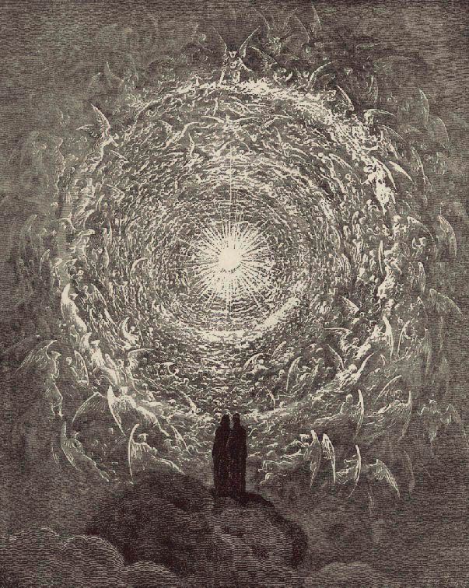
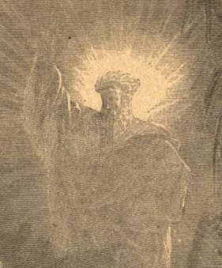
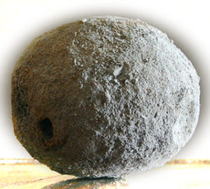

Type 1. Traditional metaphysics
Traditional Ontological argument
To exist is more perfect than not to exist.
The most perfect being necessarily exists.
“It would seem, therefore, that the long history of the ontological argument, from Saint Anselm to the present day, is at best inconclusive. Every version of the argument either contains some logical error or other or else depends upon a premise whose claim to truth we are unable to adjudicate.
Van Inwagen, Metaphysics, p. 141
Empiricist version
To be more perfect is to be less likely to exist.
The most perfect being is the least likely to exist.
Imperfect spheres
more likely to exist than
perfect spheres

Slide 14


Type 2. Necessity from Rigid Designation
“… ‘Heat is the motion of molecules,’ are not contingent truths but necessary truths, and here of course I don't mean just physically necessary, but necessary in the highest degree--whatever that means.”
Kripke, Naming and Necessity, p. 99.
“… necessity…. what I am concerned with here is a notion which is not a notion of epistemology but of metaphysics, in some (I hope) nonpejorative sense.”
Kripke, Naming and Necessity, p. 99.
“Water” is necessarily H₂O.
“Gold” is necessarily element 79.
An empirical fact:
Substances are best divided by atomic number.
Nothing compels nature to be so.
A convention of language:
We call matter with atomic number 79 “gold.”
What does “metaphysical” add?

Slide 15
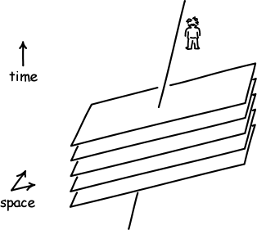
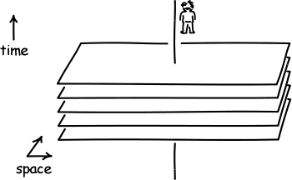

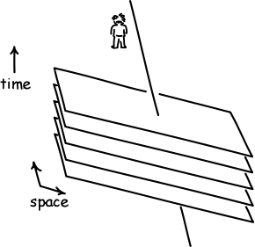

Type 3. Metaphysics from latest science
Example: metaphysics of space and time
No unique relation of the simultaneity across space, if space and time form a Minkowski spacetime of special relativity.
Good! ...
… until the empirical science is mixed with groundless metaphysical pronouncements.
Therefore (?), the future is as real as the present.
An empirical result supported by the evidence for special relativity.
Mere assignment of label “real.”
Nothing observable distinguishes a real future from an unreal future.

Slide 16
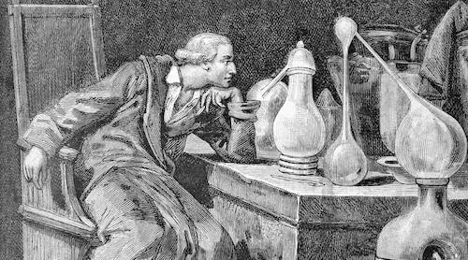
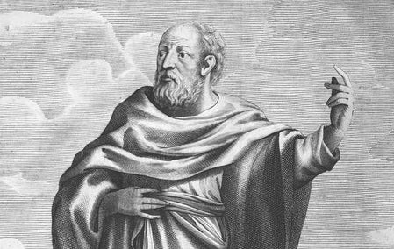
Empirical metaphysics
Non-Empirical metaphysics
vs
Conforms with empirical possibility
Must somehow anticipate all future science without empirical resources

Slide 17
Sider’s Examples of metaphysical impossibilities
“Examples might include:
the existence of a round square,
someone's being taller than himself,
someone's being in two places at once,
George W. Bush being a donkey,
there existing no numbers,
and there existing some water that is not made of H₂O.”
Sider, “Reductive Theories of Modality,” 2003, pp. 181-82
Ummmm……..
Logically impossible
Possible in quantum mechanics and common on atomic scales.
Language convention
Undecided in philosophy of mathematics.
Necessity by rigid designation, see earlier.

Slide 18
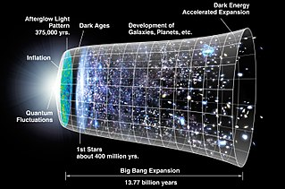
Round squares are possible and may be actual.
A
D
In spherical geometry, ABCD is both a circle and a square, center O.
O
B
C
If the geometry of our cosmos is spherical, then there exist large round circle-squares in our space.
Square: Four straight line sides, symmetric under 90º rotation.

Slide 19
Epistemic Possibility

Slide 20

Epistemic possibility
“A possibility is an epistemic possibility if we do not know that it does not obtain.”
Brian Weatherson and Andy Egan, “Introduction: Epistemic Modals and Epistemic Modality” in Epistemic Modality. Oxford: Oxford University Press, 2011.
Similar to empirical possibility. Both pertain to what we can know. But …
Epistemic possibility
Empirical possibility
Defined in terms of belief states, knowledge
Independent of thoughts and beliefs
“do not know”
Defined by a double negative
Requires positive evidence
“do not know that it does not obtain”
YES
NO
There is a magical wizard with powers of levitation in a parallel universe causally disconnected from our own.

Slide 21
Empirical Possibility, Less Briefly

Slide 22
Tenets
A contingent proposition is a possibility with respect to the propositions of a body of evidence just in case the evidence provides inductive support for the proposition to any extent, or, optionally, sufficient inductive support.
Empirical possibility is evidential support.
Empirical possibility comes in degrees or varying strengths.
This follows since empirical possibility is measured by inductive support, which comes in varying degrees or strengths that need not be numerical.
Empirical necessity is evidential compulsion.
A contingent proposition is empirically necessary with respect to the propositions of a body of evidence if its inductive support rises above some high but otherwise arbitrarily chosen threshold.
Empirical necessity includes logical necessity as a limiting case.
If the evidence deductively entails a contingent proposition then, by empiricist lights, it is supported in the strongest way.
Evidential actuality.
The relation of empirical possibility only employs bodies of evidence that report actual experiences.

Slide 23
Options
Optional possibility threshold.
A contingent proposition is empirically possible with respect to some specified body of evidence if its support rises above some low, but otherwise arbitrarily chosen threshold of support.
Optional threshold matching for duality relations.
The thresholds for empirical possibility and empirical necessity are set such that: (i) the negation of any empirically necessary proposition in not empirically possible, and (ii) the negation of any empirically possible proposition is not empirically necessary.

Slide 24
Modal Novelties

Slide 25
Duality of possibility and necessity fails
assuredly not
assuredly so
Energy conservation violated.
Earthsize planet with one moon near us
Conservation of energy. No perpetual motion machines.
~P
P
possibly ~P
necessarily P
Duality requires
P
~P
necessarily P = ~ possibly ~P
P
~
~
=
P

Slide 26
Binary possible vs necessary too coarse
assuredly not
assuredly so
Earthsized planet near us with duplicates of everything on earth
Earthsize planet with one moon near us
Earthsize planet somewhere else in our galaxy
Gradation of empirical possibility from very weak to very strong.
possible
necessary
Standard binary modalities

Slide 27
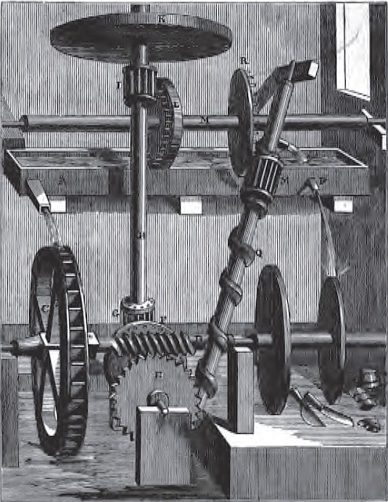
Possible worlds semantics fails
Necessarily P =
P true in all possible worlds
fails for this P
assuredly not
assuredly so
Energy conservation violated.
Earthsize planet with one moon near us.
Conservation of energy. No perpetual motion machines.
~P
P

Slide 28

Rescue possible world semantic?
Traditional possible world semantics
Set of possible worlds = all truth valuations for some set of propositions.
Each world is judged equally possible.
refine to eliminate coarseness
Which set of propositions?
Differential possibility for different worlds
which gauge?
Empirical possibility
Propositions that span everything for which there is some evidence, even if very weak.
More possible = more evidential support

Slide 29
The Influence of Formal Modal Logic

Slide 30
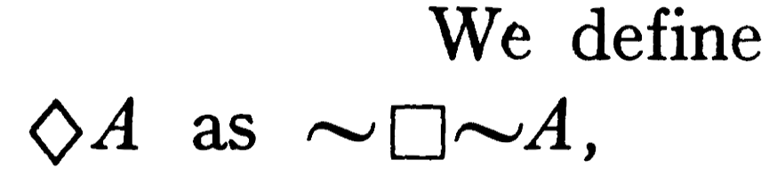

Slide 31
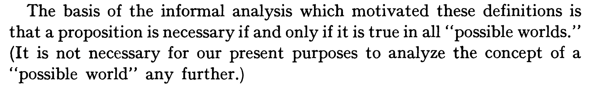
Truth in modal logic S5^{*=} is defined.

Slide 32

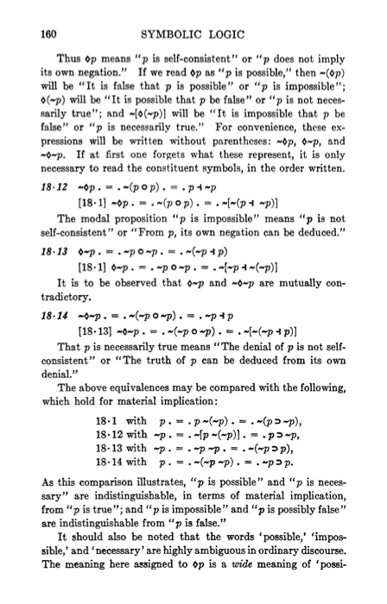
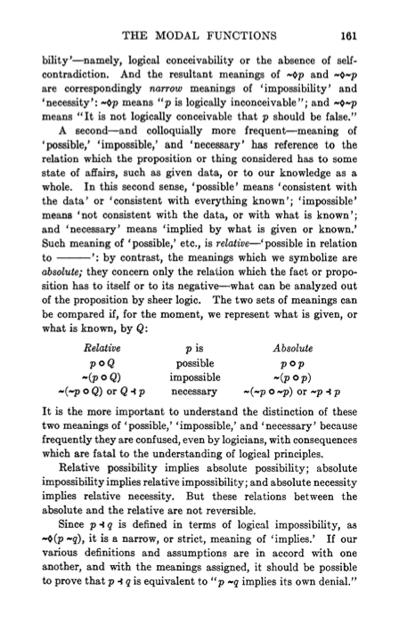
Two meanings for “possible”
1932 1st ed./1959 2nd ed.

Slide 33
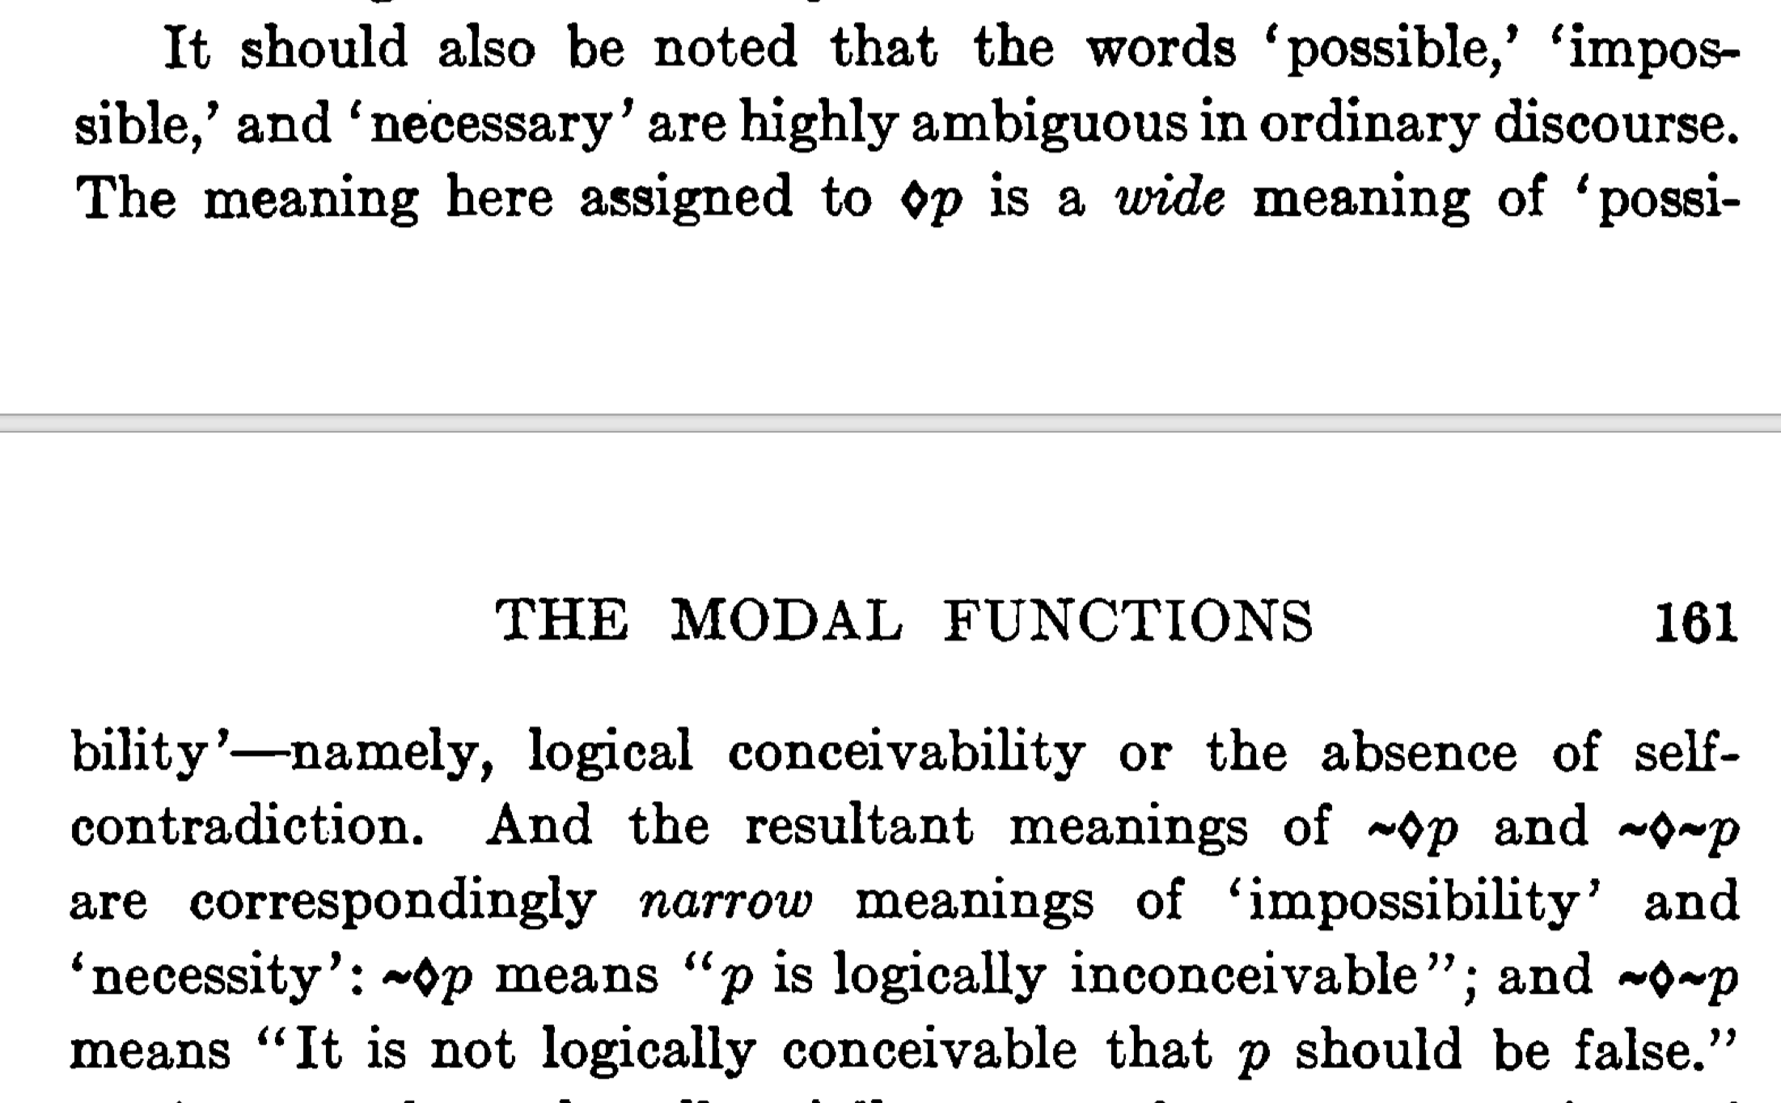
Absolute, purely logical meaning

Slide 34
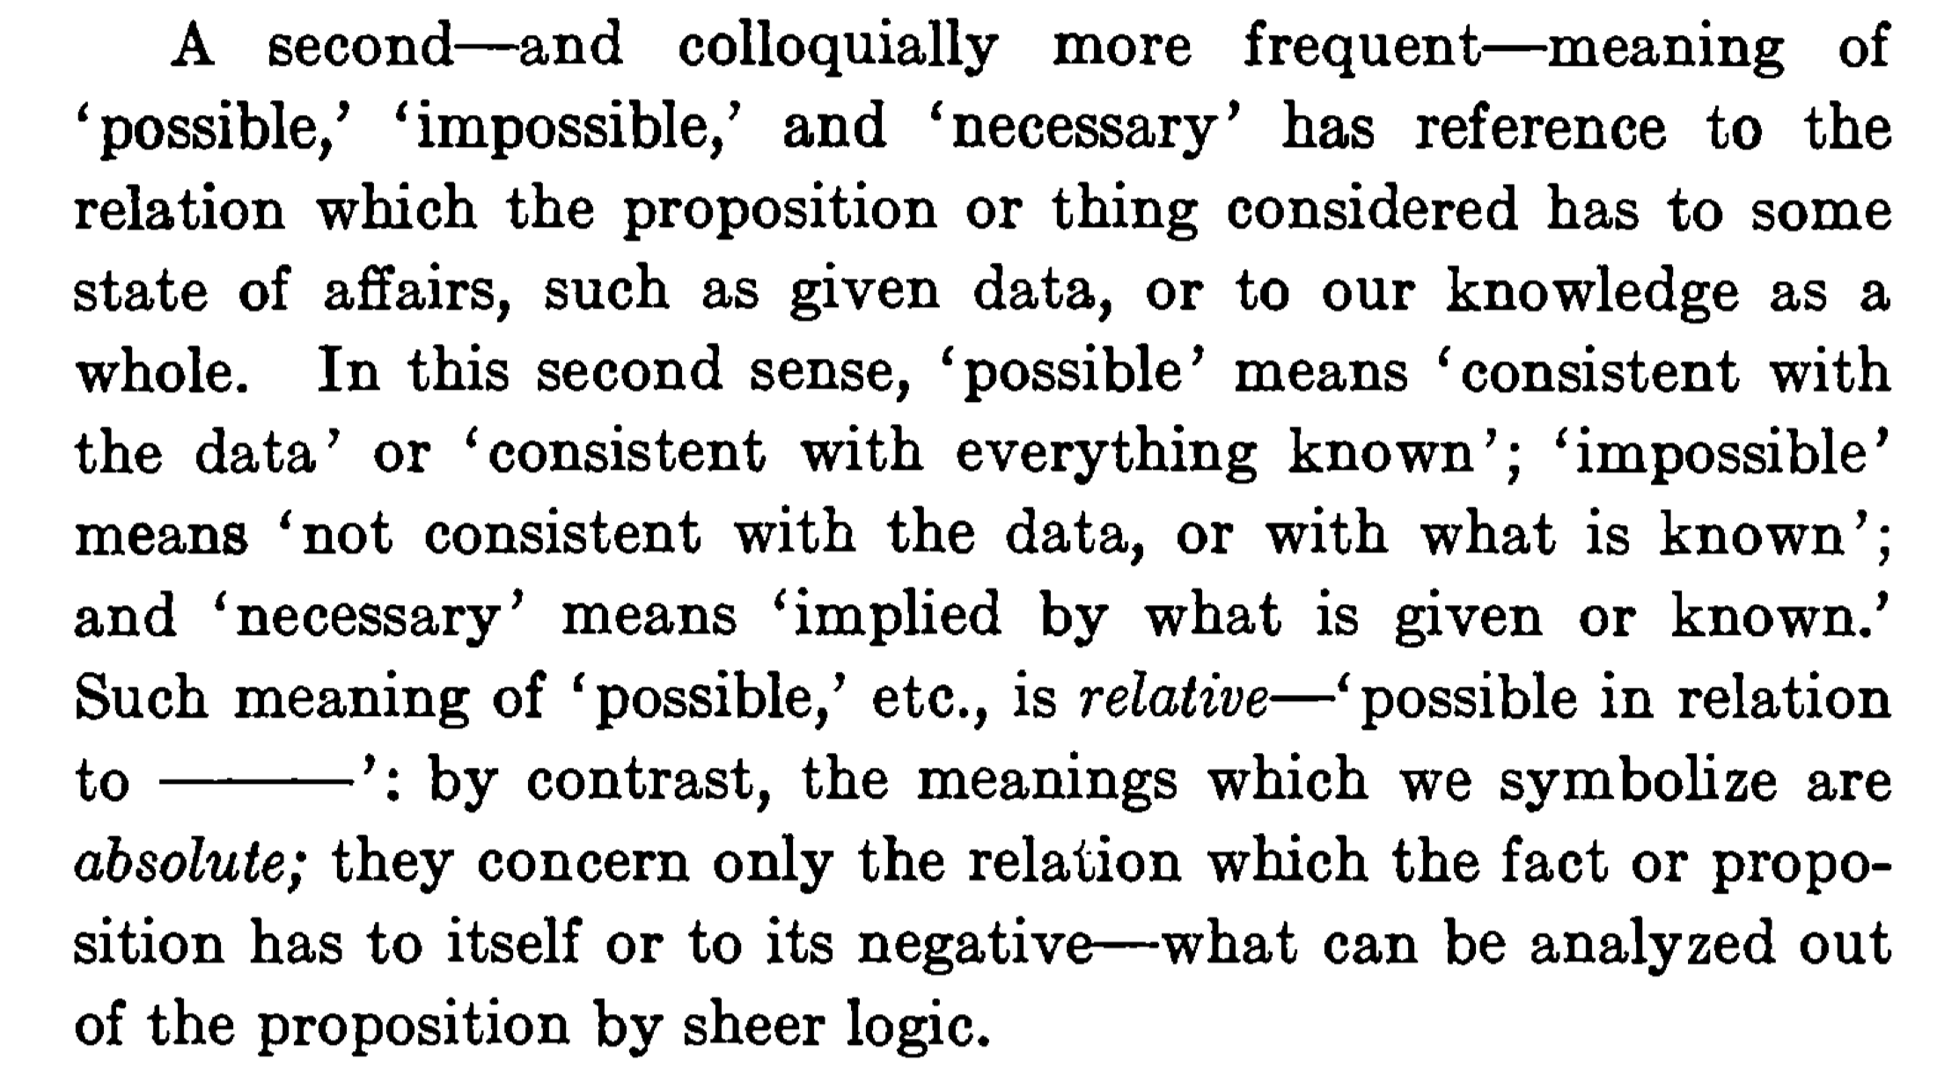
NOT Relative, significance outside formal logic

Slide 35
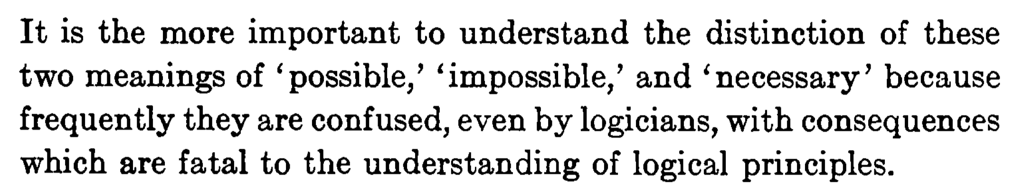

Slide 36
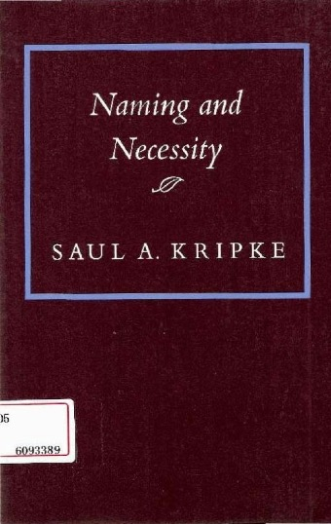
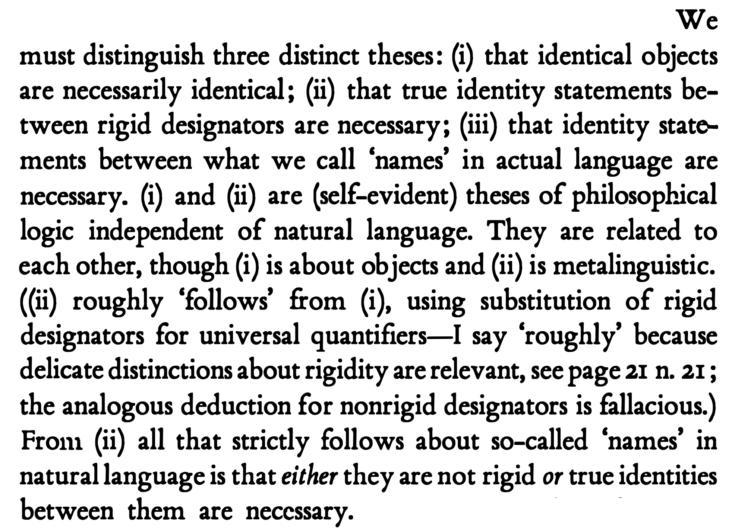
p. 3
p. 4

Slide 37
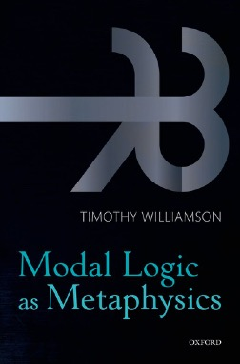
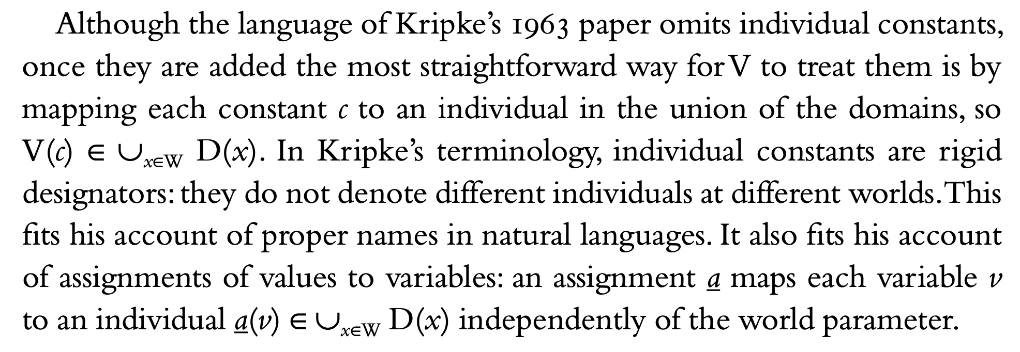
p. 120

Slide 38
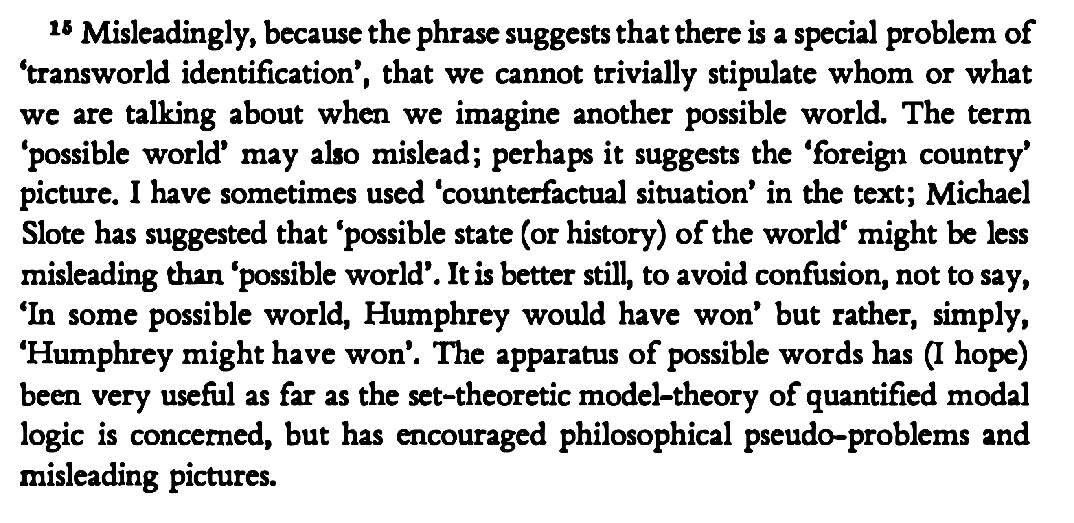
p. 48

Slide 39
Conveniences of formal logic
Necessary = true in all possible worlds.
Coarseness of mere possibility and necessity
Duality of possibility and necessity.
Hence prove completeness.
Binary notions keeps symbolic logic tractable.
Familiar, mimics duality of “for all” and ”there exists”
Founding truths of modal metaphysics
“…metaphysics is the study of ultimate reality.”

Slide 40
Conclusion

Slide 41
This Talk
blah
blah
blah
An empirical account of possibility
Empiricist and logical possibility are the only well-founded notions of possibility.
Conceptual, metaphysical, nomic, physical and epistemic possibility add nothing
Properties of empiricist possibility
Duality of possibility and necessity can fail.
~
~

Slide 42


Slide 43

Catharsis. I no longer believe I am mentally deficient because of my inability to understand “metaphysical possibility.”
Small-e empiricists can learn deeper truths of the world from experience. Why call that metaphysics?
That logicians have axioms and theorems does not mean that they have access to deeper truths of the world.

Slide 44



