Slide 1
Bayes’ Theorem
James Joyce
Stanford Encyclopedia of Philosophy

Slide 2
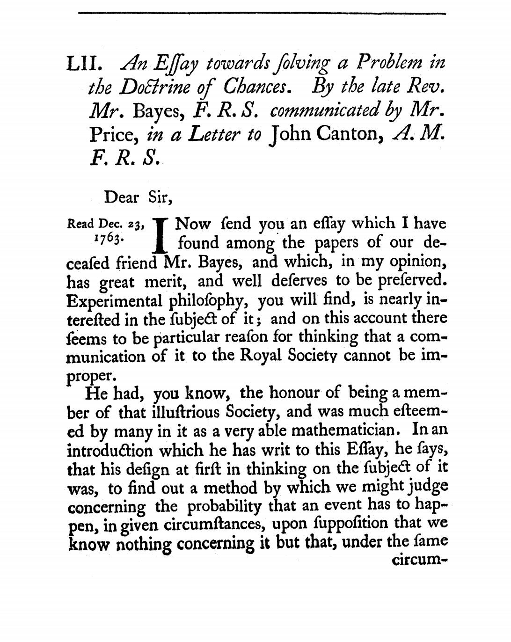
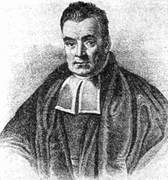
Bayes’ Theorem
“An Essay Toward Solving a Problem in the Doctrine of Chances” (1763)
British cleric Thomas Bayes (1701-1761)

Slide 3
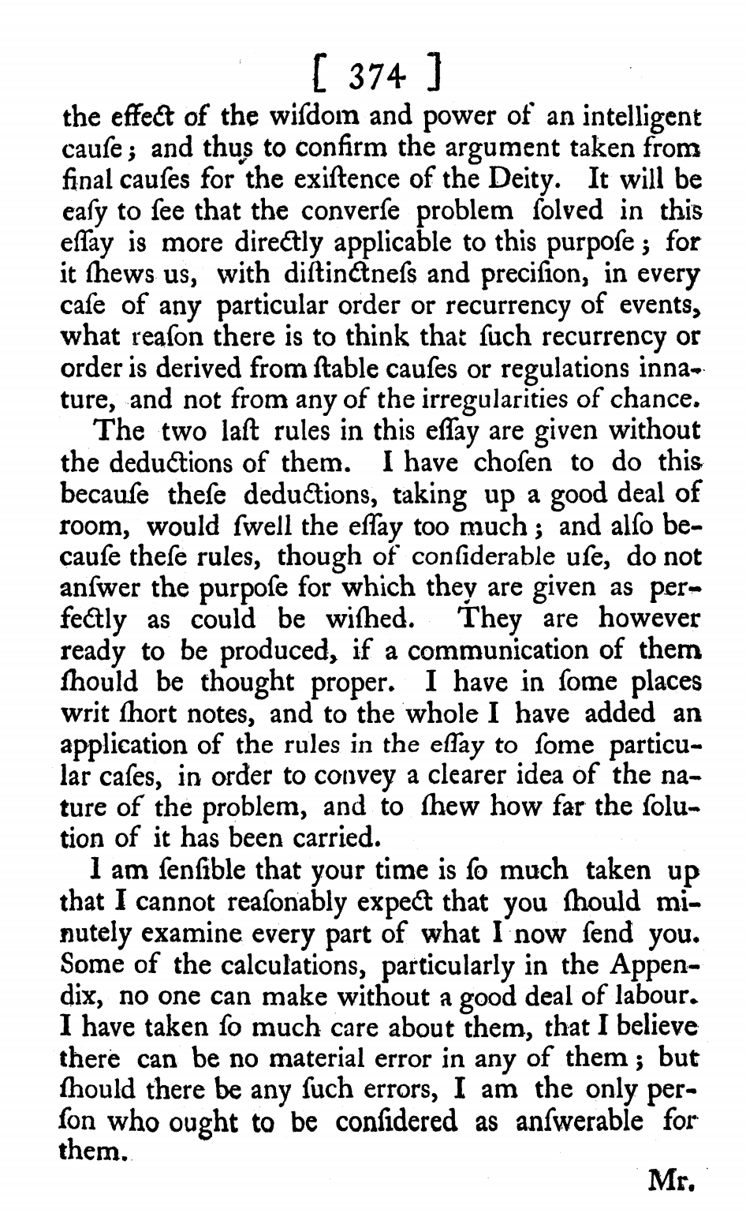
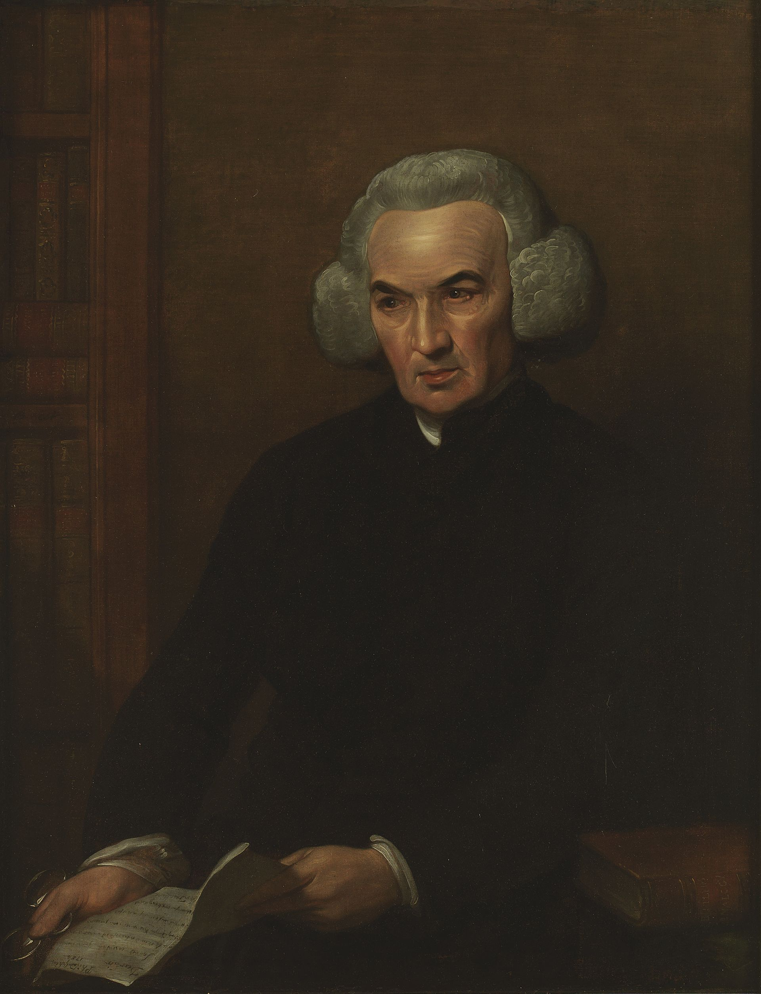
Bayes’ Theorem
Richard Price discovered this essay and the Bayes’ Theorem result. He believed it proved the existence of God.

Slide 4
Bayes’ Theorem
“Bayes’ Theorem” is a preliminary result within a much broader inferential problem
A man is trying to guess the ratio of losing to winning lottery tickets.
Answer: for m winners and n losers
After observing 10 losers and one winner, the chance of a 10:1 ratio is 7.7%. After watching 10,000 losers and 1,000 winners, the chance of a 10:1 ratio is 97%.
He watches one winning ticket and ten losing tickets get pulled from the barrel.
Question: what are the odds that the ratio of losing to winning lottery tickets lies between 11:1 and 9:1?
Frequentism!

Slide 5
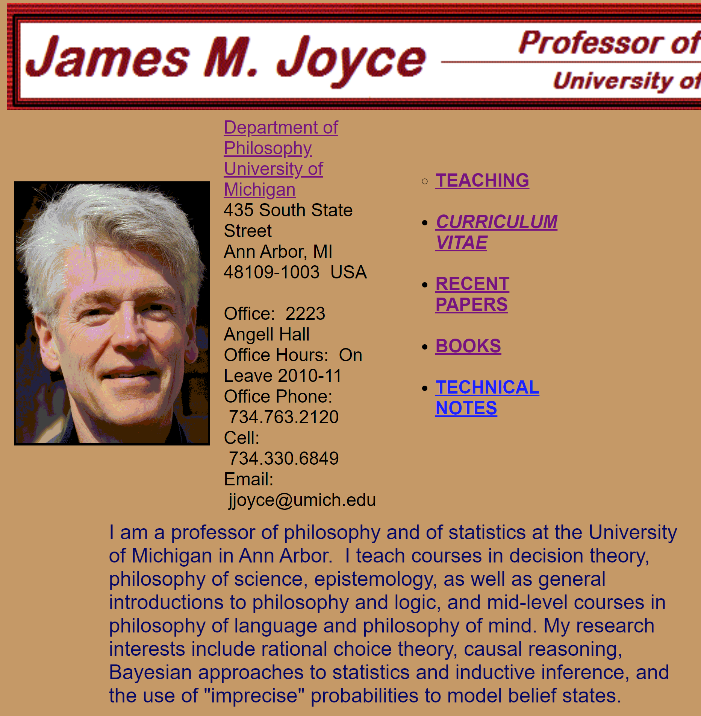
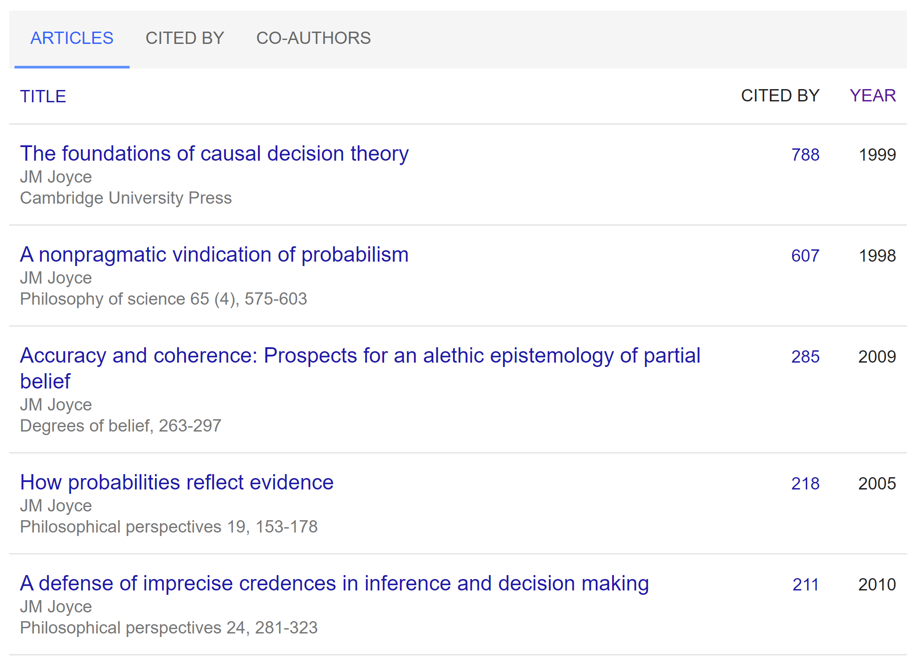
JM Joyce’s SEP article

Slide 6
JM Joyce’s SEP article
Reviews the formalism of conditional probabilities in great depth
Connects conditional probabilities and Bayes’ Theorem to the Subjectivist account of evidence
Explains the tenets of Bayesian Confirmation Theory
Compares Subjectivism with “Likelihoodism” and argues the two views can agree on the Weak Likelihood Principle
Reviews the Subjectivist account of learning
My interest: problems with probability in stat mech/thermo and quantum mechanics.
Everettian quantum theory and decision theory → probability as a primitive

Slide 7
Gems
The article presents a large amount of formalism without being bogged down by it; the Jane Doe example is particularly helpful in demonstrating probabilistic concepts.
Acknowledgement that Bayes’ Theorem is mathematically trivial, yet conceptually powerful. Joyce highlights the simple significance of Bayes’ Theorem and keeps coming back to it over and over again.
ANTI-
The meaning of the subjectivism/likelihoodism divide is confusing to me. Are likelihoodists still considered Bayesians? I think so?
ANTI-
Lack of examples from science; or lack of discussion of what scientists do in practice

Slide 8
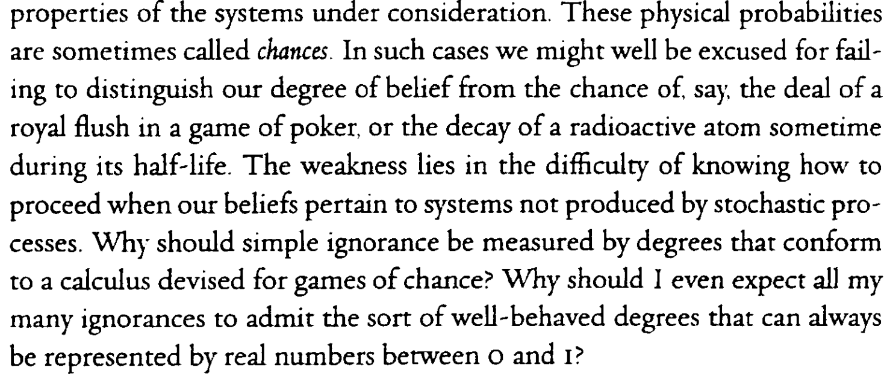
Discussion
What additions, omissions or other changes would have improved this SEP entry?
Which view of Bayesianism do you prefer; subjectivism or likelihoodism? Or is it all abhorrent?
Is the Bayesian view of evidential support connect to realism or anti-realism? Neither/both?
How can we best respond to Thagard’s critique of Bayesianism?
“Unlike hypothetico-deductive and Bayesian models of theory evaluation, the best-explanation view gives an integrated account of the nature and importance of simplicity, ad-hocness, analogy, and variety of instances.”
How can we best repond to Norton’s critique of Bayesianism?

Slide 9
Bayes’ Theorem (first form)
Bayes’ Theorem relates the direct probability to the inverse probability:
$$P_{E}\left(H\right)=\left[\frac{P\left(H\right)}{P\left(E\right)}\right]P_{H}\left(E\right)$$
The degree to which the evidence E predicts the hypothesis H
The degree to which hypothesis H predicts the evidence E
Subjective/unconditional probability functions
“Indeed, the Theorem's central insight — that a hypothesis is confirmed by any body of data that its truth renders probable — is the cornerstone of all subjectivist methodology.”

Slide 10
Subjectivism
Beliefs come in varying gradations of strength, and an ideally rational person’s graded beliefs can be represented by a subjective probability function $P$.
For a hypothesis H, $P(H)$ measures her degree of belief in H’s truth.
Conditional beliefs are represented by conditional probabilities, so that $P_{E}(H)$ measures the persons’ confidence in hypothesis H given a fact E.
Account of evidential support: Bayesian Confirmation Theory

Slide 11
Conditional probability
The probability of a hypothesis H conditional on a given body of data E:
Probability of conjunction
$$P_{E}\left(H\right)=\frac{P\left(H \& E\right)}{P\left(E\right)}$$
Probability of data alone
$$=P(H|E)$$
The probability of H obtaining, given that E obtains

Slide 12
Conditional probability
Example: Jane Doe
Hypothesis: Jane Doe dies in 2000
$$P\left(H\right)= \frac{Americans who died in 2000}{Total number of Americans alive 1 Jan 2000}=\frac{2.4 million}{275 million}=0.00873$$
Evidence: Jane Doe is a senior citizen
Unconditional probability
$$P\left(E\right)=\frac{Population of senior citizens}{Total number of Americans alive 1 Jan 2000}=\frac{16.6 million}{275 million}=0.06036$$
$$P\left(H \& E\right)=\frac{Senior citizens who died in 2000}{Total number of Americans alive 1 Jan 2000}= \frac{1.36 million}{275 million}=0.00495$$
$$P_{E}\left(H\right)=\frac{P\left(H \& E\right)}{P\left(E\right)}=\frac{0.00495}{0.06036}=0.082$$
Conditional probability
$$P_{J. Doe is a senior citizen}\left(J. Doe dies during 2000\right)=\frac{P(J. Doe is a senior citizen who dies in 2000)}{P\left(J. Doe is a senior citizen\right)}$$

Slide 13
Direct and Inverse probability
Example: Jane Doe
Direct probability
Inverse probability
$$P_{E}\left(H\right)=\frac{P\left(H \& E\right)}{P\left(E\right)}=\frac{0.00495}{0.06036}=0.082$$
The degree to which the evidence E predicts the hypothesis H
The proportion of seniors who died in 2000
$$P_{H}\left(E\right)=\frac{P\left(H \& E\right)}{P\left(H\right)}=\frac{0.00495}{0.00873}=0.57$$
The degree to which hypothesis H predicts the evidence E
The proportion of deaths in the total population that occurred among seniors
(The prediction term)

Slide 14
Bayes’ Theorem (first form)
Direct probability
Inverse probability
$$P_{E}\left(H\right)=\frac{P\left(H \& E\right)}{P\left(E\right)}$$
$$P_{H}\left(E\right)=\frac{P\left(H \& E\right)}{P\left(H\right)}$$
Bayes’ Theorem relates the direct probability to the inverse probability:
$$P_{E}\left(H\right)=\left[\frac{P\left(H\right)}{P\left(E\right)}\right]P_{H}\left(E\right)$$

Slide 15
Bayes’ Theorem (first form)
Direct probability
Inverse probability
$$P_{E}\left(H\right)=\frac{P\left(H \& E\right)}{P\left(E\right)}$$
$$P_{H}\left(E\right)=\frac{P\left(H \& E\right)}{P\left(H\right)}$$
And also shows how learning E affects belief in H:
$$P_{E}\left(H\right)=\left[\frac{P_{H}\left(E\right)}{P\left(E\right)}\right]P\left(H\right)$$

Slide 16
Bayes’ Theorem (first form)
Example: Jane Doe
Bayes’ Theorem relates the direct probability to the inverse probability:
$$P_{E}\left(H\right)=\left[\frac{P\left(H\right)}{P\left(E\right)}\right]P_{H}\left(E\right)$$
Hypothesis: Jane Doe dies in 2000
$P\left(H\right)=0.00873$
Evidence: Jane Doe is a senior citizen
Inverse probability:
Direct probability
$$P_{E}\left(H\right)=\left[\frac{0.00873}{0.06036}\right]0.57=0.082$$
$$P\left(E\right)=0.06036$$
$$P_{H}\left(E\right)=0.57$$

Slide 17
Bayes’ Theorem (first form)
Bayes’ Theorem relates the direct probability to the inverse probability:
$$P_{E}\left(H\right)=\left[\frac{P\left(H\right)}{P\left(E\right)}\right]P_{H}\left(E\right)$$
The degree to which the evidence E predicts the hypothesis H
The degree to which hypothesis H predicts the evidence E
“Though a mathematical triviality, Bayes’ Theorem is of great value in calculating conditional probabilities because inverse probabilities are typically both easier to ascertain and less subjective than direct probabilities.”
“Bayes’ Theorem then ensures that any dispute about the significance of the experimental results can be traced to “subjective” disagreements about the unconditional probabilities of H and E.”

Slide 18
Bayes’ Theorem (first form)
Bayes’ Theorem relates the direct probability to the inverse probability:
$$P_{E}\left(H\right)=\left[\frac{P\left(H\right)}{P\left(E\right)}\right]P_{H}\left(E\right)$$
The degree to which the evidence E predicts the hypothesis H
The degree to which hypothesis H predicts the evidence E
“Indeed, the Theorem's central insight — that a hypothesis is confirmed by any body of data that its truth renders probable — is the cornerstone of all subjectivist methodology.”

Slide 19
Odds and likelihoods
The probability ratio
The odds and odds ratio of hypothesis H:
The likelihood ratio of hypothesis H:
$$PR\left(H,E\right)=\frac{P_{E}(H)}{P(H)}$$
The degree by which knowing E makes H more or less predictable
$$O\left(H,H^{∗}\right)=\frac{P(H)}{P(H^{∗})}$$
$$OR\left(H,E\right)=\frac{O_{E}(H)}{O(H)}$$
When H* = ~H, the odds of a hypothesis is its probability divided by the probability of its negation.
$$LR\left(H,H^{∗};E\right)=\frac{P_{E}(H)}{P_{E}(H^{∗})}$$
When H* = ~H, the likelihood ratio is the degree to which the hypothesis H surpasses its negation as a predictor of the evidence E.

Slide 20
Special Forms of Bayes’ Theorem
Formula:
Conditional probability = unconditional probability X predictive power
“The various versions of Bayes’ Theorem differ only with respect to the functions used to express unconditional probabilities and predictive power.”
Form | Unconditional Probabilities | Predictive Power
Probability Ratio Rule $$PR\left(H, E\right)=PR(E,H)$$ | Probability function $$P(H)$$ | Probability ratio $$PR(E,H)$$
Odds Ratio Rule $$OR\left(H, E\right)=P_{H}(E)/P_{\sim H}(E)$$ | Odds function $$O(H)$$ | Likelihood ratio $$LR(H,E)$$
General Form $$BR\left(H, H^{∗};E\right)=LR(H, H^{∗};E)$$ | Relative probability function $$B\left(H\right)$$ | Likelihood ratio $$LR(H, H^{∗};E)$$

Slide 21
Special Forms of Bayes’ Theorem
“They have a special relevance for subjectivist or “Bayesian” approaches to statistics, epistemology, and inductive inference. Subjectivists lean heavily on conditional probabilities in their theory of evidential support and their account of empirical learning.”
Form | Unconditional Probabilities | Predictive Power
Probability Ratio Rule $$PR\left(H, E\right)=PR(E,H)$$ | Probability function $$P(H)$$ | Probability ratio $$PR(E,H)$$
Odds Ratio Rule $$OR\left(H, E\right)=P_{H}(E)/P_{\sim H}(E)$$ | Odds function $$O(H)$$ | Likelihood ratio $$LR(H,E)$$
General Form $$BR\left(H, H^{∗};E\right)=LR(H, H^{∗};E)$$ | Relative probability function $$B\left(H\right)$$ | Likelihood ratio $$LR(H, H^{∗};E)$$

Slide 22
Subjectivism
Beliefs come in varying gradations of strength, and an ideally rational person’s graded beliefs can be represented by a subjective probability function $P$.
For a hypothesis H, $P(H)$ measures her degree of belief in H’s truth.
Conditional beliefs are represented by conditional probabilities, so that $P_{E}(H)$ measures the persons’ confidence in hypothesis H given a fact E.
Account of evidential support: Bayesian Confirmation Theory

Slide 23
Bayesian Confirmation Theory
Confirmational Relativity: Statements about evidentiary relationships should always make implicit reference to people and their degrees of belief.
Evidence Proportionism: A subject’s level of confidence in H should vary directly with the strength of her evidence in favor of H’s truth.
Incremental Confirmation: An item of data provides a subject with incremental evidence for/against a hypothesis to the extent that receiving the data increases/decreases her total evidence for the truth of the hypothesis.
Note: no use of the words ignorance or uncertainty yet

Slide 24
Comparative Account of Incremental Evidence
Relative to a subjective probability function P,
E incrementally confirms H iff $P_{E}\left(H\right)>P\left(H\right)$
H receives a greater increment of evidential support from E than from E* iff $P_{E}\left(H\right)>P_{E^{∗}}\left(H\right)$

Slide 25
Comparative Account of Incremental Evidence
If E incrementally confirms H, then H incrementally confirms E. (Mutual reinforcement)
If E incrementally confirms H, the E incrementally discomfirms ~H. (Truth/falsity)
If H entails E, then E incrementally confirms H.(Hypothetico-deductive model of confirmation)
When the value of the inverse probability is held fixed, E’s incremental confirming power relative to H varies inversely with E’s unconditional probability. (Surprising evidence)
Weak Likelihood Principle: E provides incremental evidence for H iff $P_{H}\left(E\right)>$ $P_{\sim H}\left(E\right)$. Core message of Bayes’ Theorem.
(d) a response to Thagard?

Slide 26
Likelihoodism (non-Bayesian view?)
Rejects Evidence Proportionism: a person’s subjective probability for a hypothesis merely reflects her degree of uncertainty about its truth. It is not tied in any way to the amount of evidence she has.
Evidential relations are essentially comparative. $LR(H,H^{∗};E)$ measures the balance of evidence E provides for H over H*. Neither $P$ nor $O$ measure total evidence because they are not comparative.
The scientifically meaningful evidential relations are likelihood ratios, not unconditional probabilities, because likelihoods are more objective than unconditional probabilities.
The Law of Likelihoods: If H implies that the probability of E is x, while H* implies that the probability of E is x*, then E is evidence supporting H over H* iff x exceeds x*, and the likelihood ratio x/x* measures this support.

Slide 27
Weak Likelihood Principle
Something subjectivists and Likelihoodists can agree on!
In terms of probabilities:
E provides incremental evidence for H iff $P_{H}\left(E\right)>$ $P_{\sim H}\left(E\right)$.
In terms of likelihood ratios:
If $LR\left(H,H^{∗};E\right)≥1 and LR\left(\sim H,\sim H^{∗};\sim E\right)≥1$, with one inequality strict, then E provides more incremental evidence for H than H* and ~E provides more incremental evidence for ~H than for ~H*.

Slide 28
Subjectivist models of learning
Process: Belief revision. A subject’s prior subjective probability P is replaced by a posterior probability Q, which incorporates newly acquired information.
Stage 1: Some of the subject’s probabilities are directly altered by experience, intuition, memory, or some other non-inferential learning process.
Independent of subject’s prior state of opinion
Stage 2: The subject updates the rest of her opinions to bring them in line with her newly acquired knowledge. Inferential.
Immediate belief changes impose constraints of the form “Q has such-and-such properties”
Given a constraint, how do we connect prior beliefs to a choice of a particular posterior probability?
No jumping to conclusions requirement

Slide 29
Subjectivist models of learning
Simple Conditioning: If a rational believer with prior $0<P\left(E\right)<1$ learns for certain that E is true, the immediate effect is $P\left(E\right)=1$, and her posterior for any proposition H should be conditioned on E: $Q\left(H\right)=P_{E}(H)$
Problem: absolute certainty required
Jeffrey Conditioning: If a rational believer with prior $0<P\left(E\right)<1$ has a learning experience whose immediate effect is to set $P\left(E\right)=q$, then her posterior for any H should be $Q\left(H\right)={qP}_{E}\left(H\right)+(1−q)P_{\sim E}(H)$
More realistic
Claim: conditioning is the only belief revision rule that allows learners to correctly proportion their posterior beliefs to the new evidence they receive.

Slide 30
Subjectivist models of learning
Justification: Weak Evidence Principle + Weak Likelihood Principle
Weak Evidence Principle: A subject should retain her views relative to the probability of two hypothesis when she acquires evidence that supports the more probable hypothesis.
Weak Likelihood Principle: Hypotheses that are uniformly better predictors of the data are better supported by the data.

Slide 31
Gems
The article presents a large amount of formalism without being bogged down by it; the Jane Doe example is particularly helpful in demonstrating probabilistic concepts.
Acknowledgement that Bayes’ Theorem is mathematically trivial, yet conceptually powerful. Joyce highlights the simple significance of Bayes’ Theorem and keeps coming back to it over and over again.
ANTI-
The meaning of the subjectivism/likelihoodism divide is confusing to me. Are likelihoodists still considered Bayesians? I think so?
ANTI-
Lack of examples from science; or lack of discussion of what scientists do in practice

Slide 32
Discussion
What additions, omissions or other changes would have improved this SEP entry?
Which view of Bayesianism do you prefer; subjectivism or likelihoodism? Or is it all abhorrent?
Is the Bayesian view of evidential support connect to realism or anti-realism? Neither/both?
How can we best respond to Thagard’s critique of Bayesianism?
“Unlike hypothetico-deductive and Bayesian models of theory evaluation, the best-explanation view gives an integrated account of the nature and importance of simplicity, ad-hocness, analogy, and variety of instances.”
How can we best repond to Norton’s critique of Bayesianism?

