Slide 1
A Model-Theoretic Account of Representation
Steven French
(and Erin Sheridan)

Slide 2
Examine three claims:
Isomorphism is not sufficient for representation
Isomorphism is not necessary for representation
Models denote and do not resemble

Slide 3
Argument:
While intention is required for representation in art, it is not required for scientific representation
A modified form of isomorphism can underpin representation in both the arts and in science

Slide 4
Gems:
Face in sand vs. equations in sand example
Artistic examples make for an enjoyable read
The paper is concise and digestible
That being said….

Slide 5
Gems:
Face in sand vs. equations in sand example
Artistic examples make for an enjoyable read
The paper is concise and digestible
That being said….I’m not convinced

Slide 6
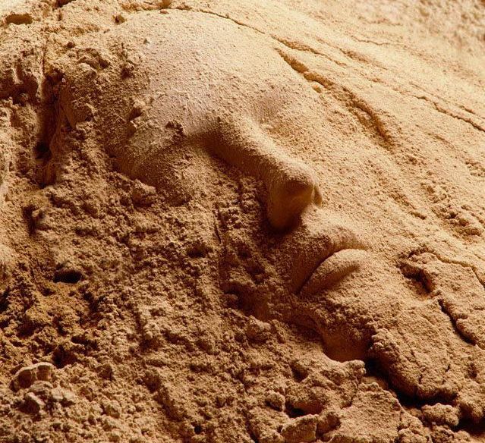
A face in the sand
Must intention be involved in order for the face to represent?

Slide 7
Damien Hirst’s rubbish installation (London, 2001)

Slide 8
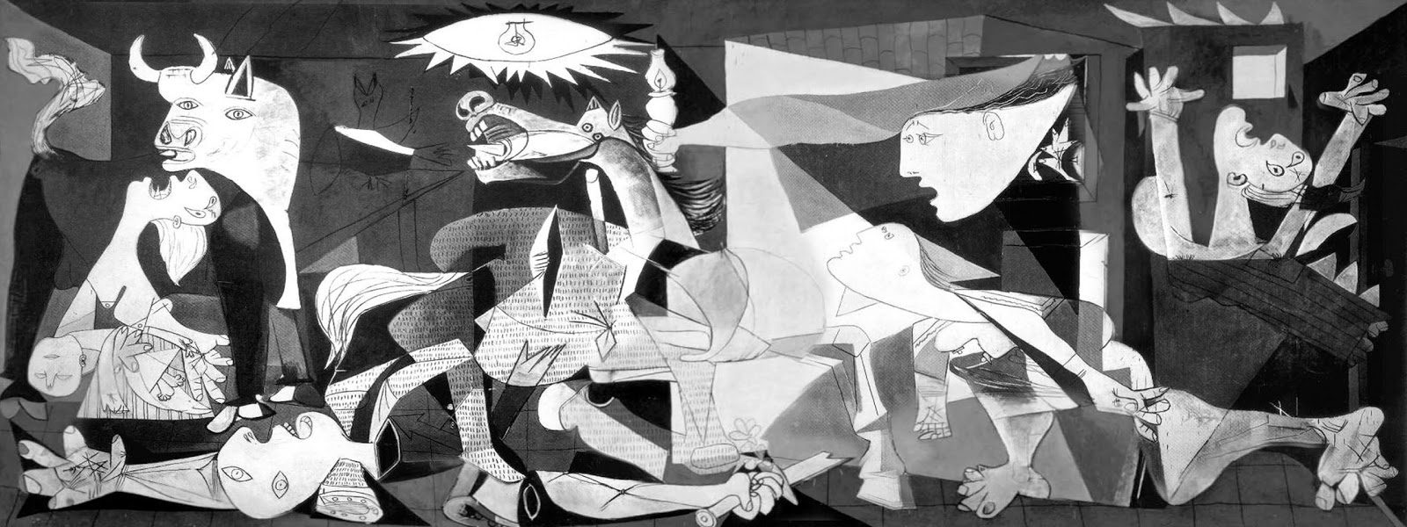
Picasso’s Guernica (1937)
Represents multiple things

Slide 9
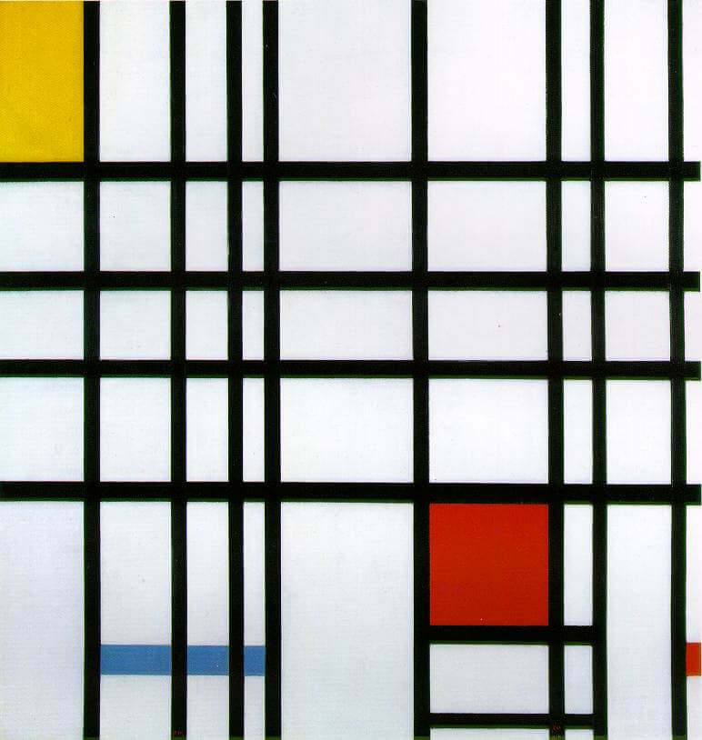
Mondrian’s
Composition with Red, Yellow and Blue (1942)
Represents…nothing?

Slide 10
Circle and ellipse
abstract away distance
visual world
visual field

Slide 11
Circle and ellipse
Isomorphism between structure of the surface of the circle and the relevant visual field
visual world
visual field

Slide 12
Holbein’s The Ambassadors (1533)
Representation consists in the perceived isomorphism of structure

Slide 13
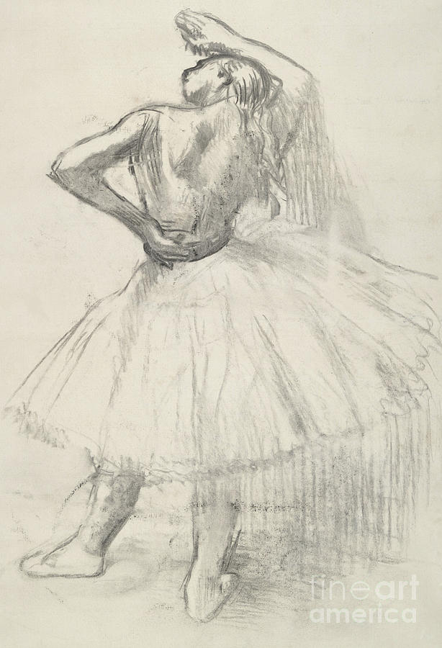
Degas’s Standing girl, right arm raised (1891)
The visual field representation can lack features or have extra features

Slide 14
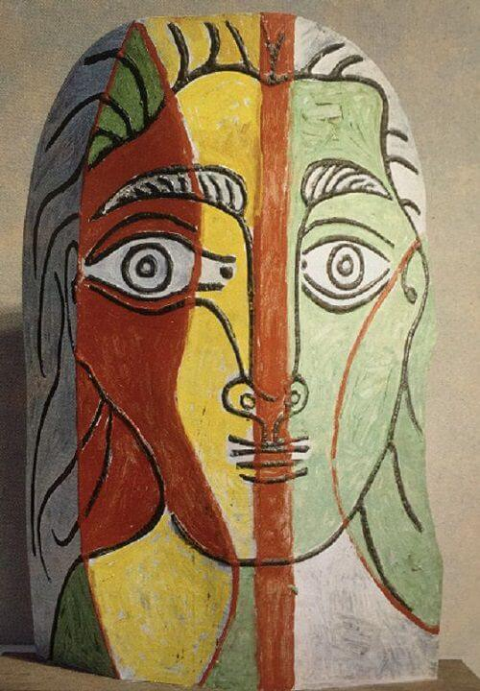
Picasso’s Head of a Woman (1961)
In general, we abstract from certain details of the picture surface

Slide 15
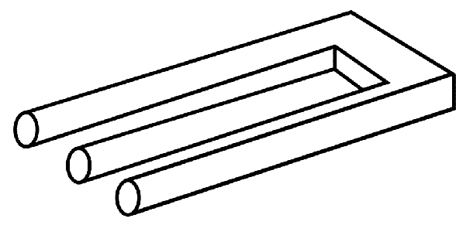
Escher’s tuning fork
Two incompatible isomorphisms

Slide 16
The Bohr atom
Two mutually inconsistent theories
Internally inconsistent
Requires interpretation?

Slide 17
The Bohr atom
Escher’s tuning fork
In both cases: two incompatible isomorphisms!

Slide 18
Argument:
While intention is required for representation in art, it is not required for scientific representation
A modified form of isomorphism can underpin representation in both the arts and in science

