Slide 1
The History of Science and Its Rational Reconstructions
Imre Lakatos (1971)
Presented by Clara Bueno
Philosophy of Science
Fall 2020

Slide 2
Main theses
General thesis
Necessary interplay between history and philosophy of science
Lakatos
“Philosophy of science without history of science is empty; history of science without philosophy of science is blind” (p. 91)
Kant
“Thoughts without content are empty; intuitions without concepts are blind”
(The Critique of Pure Reason, 1781)
Specific theses
1. Philosophy of science provides normative methodologies in terms of which the historian reconstructs the history of science
2. Competing methodologies can be evaluated with the help of (normatively interpreted) history
3. Any rational reconstruction of history needs to be supplemented by an empirical (socio-psychological) external history

Slide 3
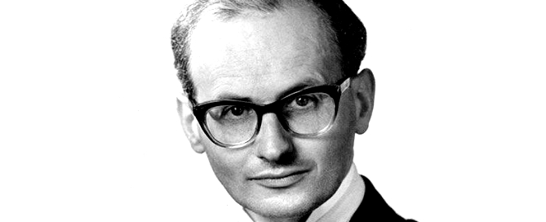
Outline
1. Rival methodologies of science
Inductivism
Conventionalism
Falsificationism
Methodology of Scientific Research Programs
Internal and external history
2. Critical comparison of methodologies
Falsificationism as a metacriterion
New metacriterion
Against aprioristic and antitheoretical approaches
Conclusion
3. Gems
4. Clara’s takes
Imre Lakatos (1922 − 1974)
Born in Debrecen, Hungary to a Jewish family
Received a degree in physics, mathemathics and philosophy from the University of Debrecen in 1944
Prosecuted by nazis during WWII
Active communist. Imprisoned from 1950 to 1953
Fled to Vienna, and then to England, in 1956
Received a PhD in philosophy from the University of Cambridge in 1961
Became a professor at the London School of Economics
📢 Hear Lakatos speak here: https://www.lse.ac.uk/philosophy/lakatos/

Slide 4
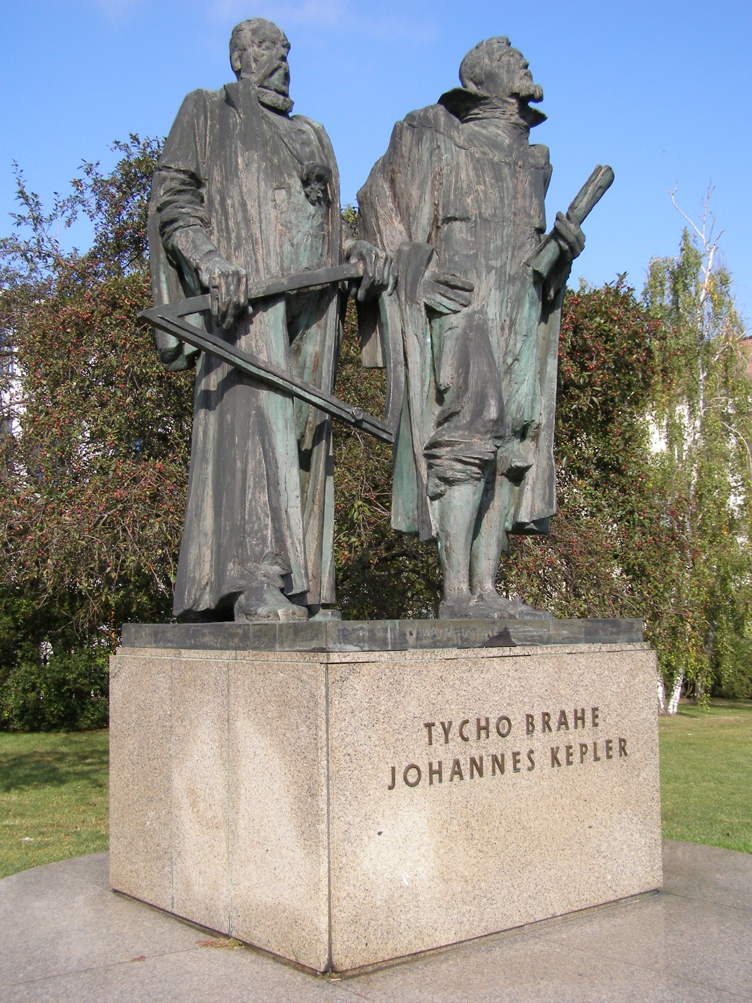
Inductivism
Internal history
Factual discoveries
Inductive generalizations
Key feature: truth
Scientific revolutions: unmasking errors which are exiled from the history of science into the history of pseudoscience
Examples:
Kepler’s laws of planetary motion
Newton’s law of gravitation
Ampère’s circuital law
Problems:
Selection of the facts
False consciousness
Outline
1. Rival methodologies
Inductivism
Conventionalism
Falsificationism
MSRP
Int/Ext history
2. Critical comparison
Falsificationism as a metacriterion
New metacriterion
Against aprioristic & antitheoretical approaches
Conclusion
3. Gems
4. Clara’s takes

Slide 5
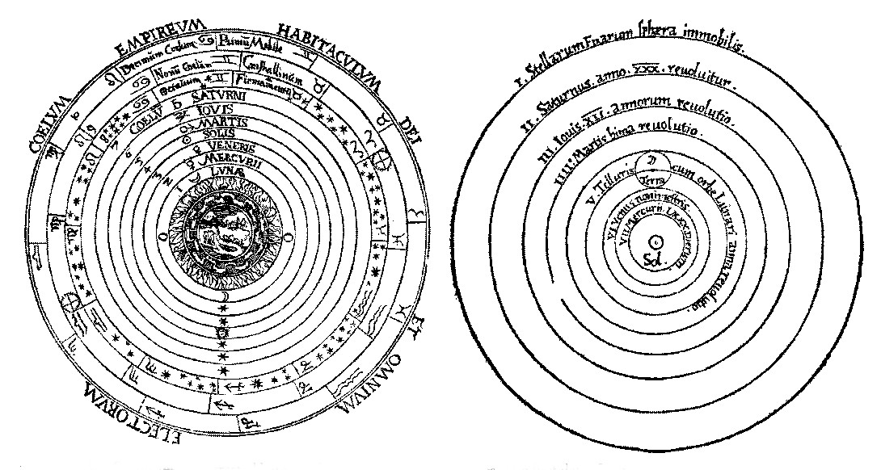
Conventionalism
Internal history:
Factual discoveries
Pigeonhole systems that organize the facts into a coherent whole
Key feature: simplicity
Scientific revolutions: replacement of complicated pigeonhole systems by simpler ones
Examples: Copernican, Lavoisier’s and Einstein’s revolutions
Problems: same as inductivism
Outline
1. Rival methodologies
Inductivism
Conventionalism
Falsificationism
MSRP
Int/Ext history
2. Critical comparison
Falsificationism as a metacriterion
New metacriterion
Against aprioristic & antitheoretical approaches
Conclusion
3. Gems
4. Clara’s takes

Slide 6
Falsificationism
Takes elements from inductivism and conventionalism
Internal history: conjectures, improvements, crucial experiments
Key features:
Falsification: a theory is scientific only if it can be made conflict with a basic statement
Novelty: a theory is scientific only if it is able to predict novel facts
Scientific revolutions: falsification of theories by means of crucial experiments
Examples:
Outline
1. Rival methodologies
Inductivism
Conventionalism
Falsificationism
MSRP
Int/Ext history
2. Critical comparison
Falsificationism as a metacriterion
New metacriterion
Against aprioristic & antitheoretical approaches
Conclusion
3. Gems
4. Clara’s takes
Newton’s and Maxwell’s theories
Radiation formulas of Rayleigh, Jeans and Wien
Crucial experiments such as the Michelson-Morley experiment, Eddington’s eclipse experiment, and the experiments of Lummer and Pringsheim
Problems: same as inductivism and conventionalism

Slide 7
MSRP
Takes elements from conventionalism and falsificationism
Internal history: research programs that can be evaluated in terms of progressive and degenerative problemshifts
Progressive/degenerative problemshifts
A research program is said to be progressing if its theoretical growth anticipates its empirical growth
A research program is said to be degenerating if its theoretical growth lags behind its empirical growth
Scientific revolutions happen when a research program supersedes another. But, no advantage for a research program can be ever regarded as conclusive.
Outline
1. Rival methodologies
Inductivism
Conventionalism
Falsificationism
MSRP
Int/Ext history
2. Critical comparison
Falsificationism as a metacriterion
New metacriterion
Against aprioristic & antitheoretical approaches
Conclusion
3. Gems
4. Clara’s takes
Protective
belt
Newtonian research program of 18th century physics
Hard core: Newton’s Three laws of motion and his gravitational law
Protective belt: ideas about matter, the structure of the universe, etc.
Hard core

Slide 8
Int/Ext history
 | Internal history | External history
Inductivism | hard facts, inductive generalizations | Multiple
Conventionalism | factual discoveries, pigeonhole systems
Falsificationism | conjectures, improvements, crucial experiments
MSRP | rivarly between research programs, progressive and degenerating problemshifts
Outline
1. Rival methodologies
Inductivism
Conventionalism
Falsificationism
MSRP
Int/Ext history
2. Critical comparison
Falsificationism as a metacriterion
New metacriterion
Against aprioristic & antitheoretical approaches
Conclusion
3. Gems
4. Clara’s takes
Need of external theories to explain the residual non-rational factors
External history is always secondary
Theoretical bias is inevitable: “what a historian regards as an external problem is often an excellent guide to the implicit methodology” (p. 107)
One of the most interesting problems of external history is to specify the psychological and social conditions that are necessary (but not sufficient) to make scientific progress possible

Slide 9
Falsificationism as a metacriterion
Metacriterion: “if a demarcation criterion is inconsistent with the basic appraisals of the scientific elite, it should be rejected” (p. 111)
The application of this metacriterion leads to the rejection of Popper’s demarcation criterion
Outline
1. Rival methodologies
Inductivism
Conventionalism
Falsificationism
MSRP
Int/Ext history
2. Critical comparison
Falsificationism as a metacriterion
New metacriterion
Against aprioristic & antitheoretical approaches
Conclusion
3. Gems
4. Clara’s takes
Strong version: scientists must specify in advance what observable situations, if observed, mean that a theory is refuted
Counterexample: Newtonian science
Weak version: applicable only to systems of theories. Counterexamples:
Scientists’ proposals of ad hoc solutions to anomalies (e.g. Mercury’s anomalous perihelion and Newtonian theory)
Scientists’ work on inconsistent systems (e.g. infinitesimal calculus)
Purported crucial experiments (e.g. Lavoisier’s experiments and phlogiston theory)
Most rival theories are simultaneously infected by anomalies
Falsificationist historiography is falsified

Slide 10
New metacriterion
Two-stage proposal
Slight amendment: if there is a clash between a universal rule and a particular normative judgment, we should give time to the scientific community to ponder the clash
New metacriterion: a framework is to be rejected only if we have a better one that represents a progressive shift in the sequence of research programs.
Outline
1. Rival methodologies
Inductivism
Conventionalism
Falsificationism
MSRP
Int/Ext history
2. Critical comparison
Falsificationism as a metacriterion
New metacriterion
Against aprioristic & antitheoretical approaches
Conclusion
3. Gems
4. Clara’s takes
More episodes in the history of science can be seen as rational
Remaining anomalies will have to be explained either by some better rational reconstruction or by some external theory

Slide 11
Against aprioristic & antitheoretical approaches
Two methodological approaches
Aprioristic (‘Euclidean’) approaches: lay down a priori general rules for scientific appraisal (e.g. Popper’s demarcation criterion)
Antitheoretical approaches: deny the possibility of any valid demarcation criterion — case by case basis (e.g. Polanyi, Oakeshott)
Lakatos: middle way — MSRP implies a pluralistic system of authority in which the philosopher of science learns from the historian of science and vice versa
Note: aprioristic approaches are more important when a tradition degenerates (e.g. modern particle physics) or a new bad tradition is founded (e.g. modern psychology)
Outline
1. Rival methodologies
Inductivism
Conventionalism
Falsificationism
MSRP
Int/Ext history
2. Critical comparison
Falsificationism as a metacriterion
New metacriterion
Against aprioristic & antitheoretical approaches
Conclusion
3. Gems
4. Clara’s takes

Slide 12
Conclusion
Outline
1. Rival methodologies
Inductivism
Conventionalism
Falsificationism
MSRP
Int/Ext history
2. Critical comparison
Falsificationism as a metacriterion
New metacriterion
Against aprioristic & antitheoretical approaches
Conclusion
3. Gems
4. Clara’s takes
1. Philosophy of science provides normative methodologies in terms of which the historian reconstructs the history of science
2. Competing methodologies can be evaluated with the help of (normatively interpreted) history
3. Any rational reconstruction of history needs to be supplemented by an empirical (socio-psychological) external history

Slide 13
Gems
Outline
1. Rival methodologies
Inductivism
Conventionalism
Falsificationism
MSRP
Int/Ext history
2. Critical comparison
Falsificationism as a metacriterion
New metacriterion
Against aprioristic & antitheoretical approaches
Conclusion
3. Gems
4. Clara’s takes
Remarkable opening quote: “philosophy of science is empty, history of science without philosophy of science is blind”
Master knowledge of the history of science: wide variety of case-studies of episodes across the history of science
Turns Popper against himself: falsifies Popper’s demarcation criterion by using his own criterion
Lack of clear distinction between internal and external history

Slide 14
Clara’s takes
Lakatos’ views on the relationship between history of science and philosophy of science seems odd to me. I agree with his argument that historical episodes should be used to assess philosophical views on science. But he also says that we should write “rational reconstructions” of historical episodes, in which scientific decisions come out looking as rational as possible. I feel no one in the history/philosophy of science has paid enough attention to this idea
Lakatos’ metacriterion for theories of scientific rationality threatens to deprive the philosophy of science of any critical bite. Will not the best philosophy of science simply say that whatever scientists do is rational that the best methodology is simply “Anything goes”?
Lakatos seems to be saying that no theory should be abandoned, unless there is a better one in existence. Does this mean that no research program should be given up in the absence of an alternative, no matter how degenerate it might be?
Lakatos regards research programs as sets of theories. But, is it appropriate to describe, let’s say, Newton’s development of his increasingly planetary models as formulations of new theories? It seems more accurate to say that Newton was articulating different versions of the same theory
Is it clear how to reconstruct the hard core and the protective belt of actual research programs?
Outline
1. Rival methodologies
Inductivism
Conventionalism
Falsificationism
MSRP
Int/Ext history
2. Critical comparison
Falsificationism as a metacriterion
New metacriterion
Against aprioristic & antitheoretical approaches
Conclusion
3. Gems
4. Clara’s takes

