Slide 1
Objectivity, Value Judgement, and Theory Choice by Thomas Kuhn
Presented by Brett Park

Slide 2
Two Theses
Thesis 1: there is always subjective elements to theory choice, or, there is no single objective and rational algorithm for theory choice
Thesis 2: Subjectivity in theory choice is an essential part of science

Slide 3
Overview
Review of Kuhn and his critics
First Thesis
Second Thesis
Epilogue
Gems

Slide 4
The Structure of Scientific Revolutions
Science alternates between periods of normal and revolutionary science
Normal science is highly dogmatic by operating within a paradigm, and its primary operation is “puzzle solving”
Eventually, enough unsolved puzzles, or anomalies accumulate, and a period of revolutionary science begins
Revolutionary science is undogmatic as new paradigms are considered
However, Kuhn does not think that choosing a new paradigm is entirely rational
Justification is circular
Paradigms are incommensurable

Slide 5
Criticisms of Kuhn
Leads to “relativism” – Dudley Shapere, p. 393
Makes theory choice “a matter of mob psychology ” – Imre Lakatos, p. 178
Acceptance by social scientists as evidence of the Strong Programme

Slide 6
First Thesis
Thesis 1: there is always subjective elements to theory choice, or, there is no single objective and rational algorithm for theory choice

Slide 7
Five (non-exhaustive) Criteria for Theory Choice
Accurate: agreement between consequences of a theory and observation
Consistent: not to contradict itself or other accepted theories
Broad in Scope: extends beyond what it was initially designed for
Simple: unifying disparate phenomena with few posits
Fruitful: disclose new phenomena, opens new areas of research

Slide 8
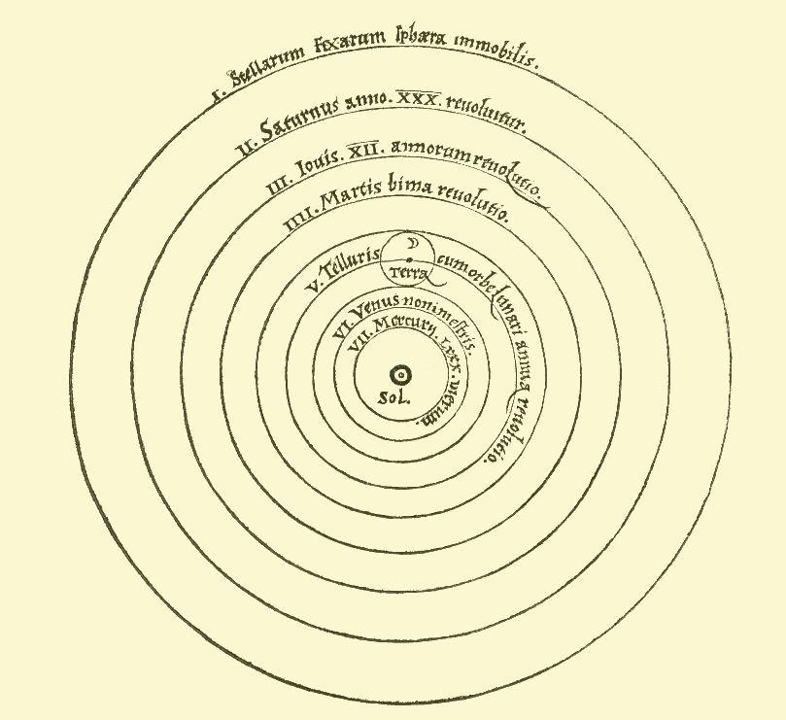
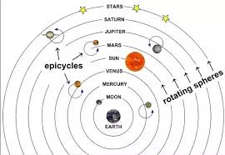
Difficulty 1: Criteria Individually Imprecise
There is disagreement about how to apply an individual criteria in specific cases
Ex. Only certain notions of Simplicity favored Copernicus over Ptolemy
Ptolemaic Model
Copernican Model

Slide 9
Difficulty 2: Criteria Conflict with Each Other
Disagreement about how to weigh different criteria
Ex. Ptolemaic model was more consistent with existing science, while Copernican model was (arguably) simpler
Ptolemaic Model
Copernican Model

Slide 10
Focus on Historical Details on Individual Scientists
In order to understand why scientists choose one theory over another, historical details of individual scientists need to be examined
How entrenched was a scientists in the old theory?
Had they seen success advancing the old theory?
Did that success depend on concepts and techniques challenged by the new theory?
How did other philosophical/non-scientific commitments affect their readiness to accept the new theory?
Ex. Kepler’s adoption of Copernican model
Notes:
Kepler’s immersion in German Romanticism predisposed him to accept energy conservation

Slide 11
No Decision Algorithm
Kuhn’s point is merely that there are both objective and subjective factors in theory choice
Alternatively, there is no single decision algorithm which would rationally constrain theory choice to a single answer in every situation
No unambiguous and exhaustive criteria
No single correct weights for those criteria

Slide 12
Contexts of Discovery/Justification
Distinction between the creation of new ideas and the justification of those ideas
Critic: Contexts of discovery have Kuhn’s subjective elements, but the context of justification is objective
Kuhn: Reject this distinction as a good idealization
We cannot trust scientific pedagogy, or “textbook science”, to give us an accurate account of the context of justification better than the context of discovery
Notes:
Radical claim: philosophers and historians of science can understand this aspect of a science better then the scientists working in that field

Slide 13
Second Thesis
Thesis 2: Subjectivity in theory choice is an essential part of science

Slide 14
Value Theory
Values and norms often conflict, and rational people committed to the same values can disagree
No decision algorithm ex. William David Ross
Not a cause for abandonment of values
Criteria of choice are just another set of values

Slide 15
If We Had a Decision Algorithm...
All scientists would arrive at the same conclusion
Set the bar for new theories too low, and we have constant revolutions
Set the bar too high, and new theories are never attempted
The heterogeneity of criteria application encourages a healthy amount of novelty

Slide 16
Epilogue
Clarifications on:
Value Invariance
Partial Communication

Slide 17
Value Invariance
Assumed that values/criteria of choice remains fixed over time
Rather, those values gradually evolve as science progresses
Adding new values
Different application of values
Weights associated with them
Notes:
Accuracy was not expected or sought outside of astronomy
Scientific advances have repeatedly sacrificed scope, and its weight has diminished accordingly

Slide 18
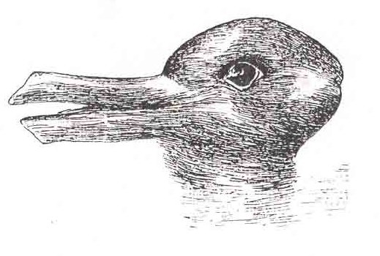
Partial Communication
Assumed that communication between holders of different theories is unproblematic
In Structure, he calls them ‘conversions’ rather than choices
Like a gestalt switch, we cannot hold both theories in mind at a single time
Further reinforces the message of the paper
Duck Rabbit

Slide 19
Gems
Illustrates a specific purpose for history/philosophy of science
Uses historical examples
Interesting paper structure – assume opponents’ framing, then reinterpret

