Slide 1
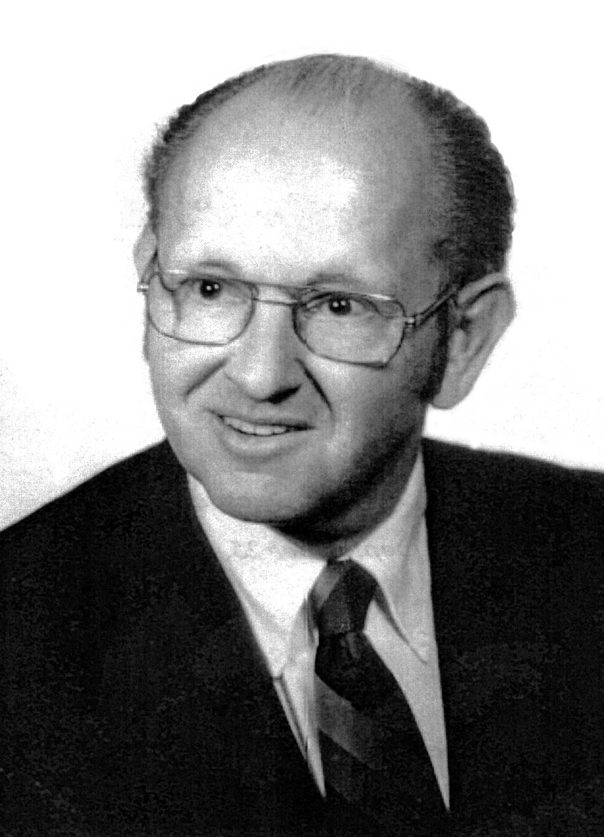
DN, DS, IS and SR models of explanation
By Wesley C. Salmon
Presented by Clara Bueno
Philosophy of Science
Fall 2020

Slide 2
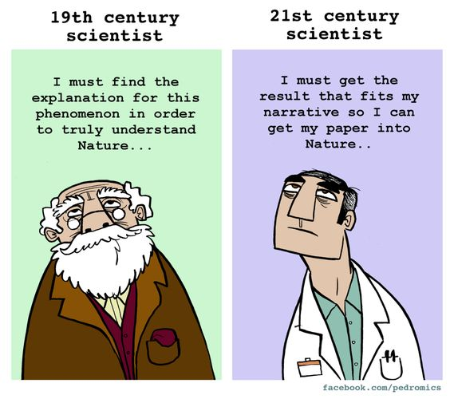
Outline
Preliminary remarks
Four models of explanation
D-N model of explanation
D-S model of explanation
I-S model of explanation
S-R model of explanation
Conclusion
Gems
Discussion questions

Slide 3
Preliminary remarks
Scientific explanation consists in explaining why a particular phenomenon occurs
Confirmation consists in giving reasons for believing that a particular phenomenon occurs
Some kinds of explanation are not scientific: explanations of how, explanations of what, explanations of artworks, explanations of mathematical proofs
Some why-questions look for things other than scientific explanation, such as justification
Some scientific explanations may take a how-actually form
Any explanation consists of two parts: the explanandum (the fact that is to be explained) and the explanans (which it does the explaining)
The received view regards all explanations as arguments, which can be deductive or inductive.

Slide 4
Preliminary remarks
Deduction
Induction
Nonampliative
Necessarily truth-preserving
Erosion-proof
All-or-nothing matter
Ampliative
Not necessarily truth-preserving
Not erosion-proof
Different degrees of strength
The fact has science can furnish explanations has not always been widely accepted. Some philosophers and scientists have claimed that science must “stick” to the facts, and consequently answer only answer questions about what. According to Salmon, this stems from the belief that all aspects of nature should be explained in human terms (anthropomorphism)
Scientific explanation does not consist in reducing the unfamiliar to what is familiar (e.g. Olber’s paradox and the explanation of the darkness of the sky)

Slide 5
The received view
(Hempel & Oppenheim)
Inferential conception of scientific explanation

Slide 6
D-N model of explanation
Concept: deductive explanation of an explanandum-fact under a general law
Conditions of adequacy:
(1) The explanandum must be a logical consequence of the explanans
(2) The explanans must contain at least one general law that is required for the derivation of the explanandum
(3) The explanans must have empirical content
(4) The sentences constituting the explanans must be true
Potential explanation
True explanation
Two types: explanations of particular facts and explanations of general laws

Slide 7
Explanation of particular facts: skater’s rotation
(P1) The angular momentum of any body (whose rate of rotation is not being increased or decreased by external forces) remains constant.
(P2) The skater is not interacting with any external object in such a way as to alter her angular velocity
(P3) The skater is rotating (her angular momentum is not zero)
(P4) The skater reduces her moment of inertia by drawing her arms in close to her body
-------------------------------------------------------------------------------------------------------------------------------
(C) The skater’s rate of rotation increases
This argument meets all the adequacy conditions, and therefore is a true explanation

Slide 8
Explanation of general laws: Newtonian mechanics
(P1) F = ma (Newton’s second law)
(P2) For every action there is an equal and opposite reaction (Newton’s third law)
-------------------------------------------------------------------------------------------------------------------------------
(C) In every interaction, the total linear momentum of the system of interacting bodies remains constant (law of conservation of linear momentum)
This argument meets all the adequacy conditions, and therefore is a true explanation
Problem: inability to distinguish pseudoexplanations from genuine explanations of laws
(P1) Kepler’s laws of planetary motion K ^ Boyle’s law of gases B
-------------------------------------------------------------------------------------------------
(C) Kepler’s laws of planetary motion K
This argument also meets all the adequacy conditions, but is a pseudoexplanation

Slide 9
Counterexamples to the D-N model
Category 1: illegitimate explanations that meet the D-N requirements
Category 2: legitimate explanations that do not meet the D-N requirements
Drop in the reading of a barometer
Occurrence of a storm
Not getting pregnant
Bottle failing off of the desk
Being a man
Bumping of the ink bottle with the elbow
Drop in barometric pressure
The barometer and the storm
The man and the pill
The ink stain
Moral: we cannot explain one effect by means of the other
Moral: it is possible to construct arguments with true irrelevant premises
Moral: it is possible to have perfectly good explanations without any laws

Slide 10
D-S model of explanation
Concept: explanation of statistical regularities by deduction from more comprehensive statistical laws
Example: radiocarbon dating technique
(P1) Every C¹⁴ atom (that is not exposed to radiation) has a probability of ½ of disintegrating within any period of 5730 years
---------------------------------------------------------------------------------------------------------------------------------------
(C) In any large collection of C¹⁴ atoms (that are not exposed to radiation) approximately ¾ will very probably decay within 11,460 years
Problem: same than the D-N model — inability to distinguish pseudoexplanations from genuine statistical explanations

Slide 11
I-S model of explanation
Concept: explanation of a particular event under a statistical law
Example: streptococcus infection
(P1) Almost all cases of streptococcus infection clear up quickly after the administration of penicillin
(P2) Jane Jones had a streptococcus infection
(P3) Jane Jones received a treatment with penicillin
(C) Jane Jones recovered quickly
r

Slide 12
Counterexamples to the I-S model
Vitamin C and the common cold
(P1) Most colds disappear quickly after taking large doses of vitamin C
(P2) Sean had a cold and took large doses of vitamin C
(C) Sean’s cold disappeared quickly
Moral: only relevant information should be included in I-S explanations
Syphilis and paresis
(P1) Paresis is a form of syphilis contracted by victims of untreated latent syphilis
(P2) Jack suffers from paresis
(C) Jack is a victim of untreated latent syphilis
Moral: there are legitimate I-S explanations in which the explanans does not render the explanandum highly probable
r
r

Slide 13
S-R model of explanation
Concept: explanations are not arguments with premises and conclusions
Example: vitamin C and the common cold
C = having a cold
R = recovering
V = taking vitamin C
Prior probability of recovery of people who have a cold: Pr (R/C)
Probability of recovery of people who have a cold and take vitamin C: Pr (R/N$^$V)
If Pr (R/N$^$V) > Pr (R/C), then taking vitamin C is positively relevant to recovery
If Pr (R/N$^$V) < Pr (R/C), then taking vitamin C is negatively relevant to recovery
If Pr (R/N$^$V) ) Pr (R/C), then taking vitamin C is irrelevant to recovery
Problem: S-R model is focused on statistical relevance rather than causal relevance. This fosters a confusion between causes and correlations

Slide 14
Conclusion
Unification approach
Causal-mechanical approach
Thesis: the value of explanation lies in fitting things into a universal pattern, or a pattern that covers major segments of the universe
Example: Newtonian synthesis, which explains Kepler’s laws, Galileo’s laws and many other regularities
Problem: explanation of laws
Thesis: the value of explanation lies in discovering the hidden mechanisms that bring about the facts that we try to understand
Example: explaining the transmission of traits from parents to offspring by appealing to the DNA structure
Problem: nature of causality
Both approaches furnish valuable explanatory information
Pragmatic considerations might dictate the choice or one rather than the other in a given context

Slide 15
Gems
Outstanding organization. The paper is clearly written and organized into well-divided sections. This makes the author’s main line of thought easy to follow.
Precise definition of “scientific explanation”. Instead of talking directly about the different models of scientific explanation, Salmon spends several sections specifying what he means by scientific explanation, and separating it from other kinds of explanations and related concepts. I believe that every philosophy paper should start like this.
Lovely final example. In the last section, Salmon uses the friendly physicist little story as an excuse to highlight his pluralistic attitude towards scientific explanation. I found this story to be particularly illuminating.

Slide 16
Discussion questions
Why were the logical empiricists philosophers of science who defended the D-N model so willing to accept the idea that science provides “explanations”, given the tendency of many earlier writers in the positivist tradition to think of explanation as a rather “subjective” matter, and to contrast it with “descriptions”, which were regarded as a more legitimate goal for empirical science?
Are there any fundamental differences between explanations in the natural sciences and explanations in the social sciences?
What is the link between explanation and other goals of inquiry, such as evidential support, prediction, or simplicity?

