Slide 1
Bayesian Philosophy of Science
Sprenger & Hartmann

Slide 2
Gems
Sets up conditions of adequacy and corresponding representation theorems for measures of confirmation
Motivates the Bayesian view well; includes convincing examples that show how Bayesian Confirmation Theory can be used by both historians of science and practicing scientists (descriptive and normative), and solves well-known paradoxes of induction
Embraces confirmational pluralism and an understanding of the limitations of Bayesian confirmation; compatible with a Material Theory of Induction

Slide 3
Motivating a probabilistic confirmation theory
Probability is a guide to life, and confirmation is a guide to probability
Ex. Beach trip depends on probability of rain
Probability is the preferred tool for expressing uncertainty in science
Ex. Gaussian noise distribution
3. Statistics is formulated in terms of probability
Ex. de Finetti’s representation theorem

Slide 4
Bayesian Confirmation Theory
BCT: confirmation judgements are functions of a rational agent’s conditional and unconditional degrees of belief.
Degree of confirmation that a piece of evidence $E$confers on a hypothesis $H$: $c\left(H,E\right)$
How to proceed in defining Bayesian confirmation measures:
Set up Adequacy Conditions
Put forth a Representation Theorem that satisfies these constraints
“This approach allows for a sharp demarcation and mathematically rigorous characterization of the explicandum, and at the same time a philosophically informed discussion”

Slide 5
Bayesian Confirmation Theory
Prior-Posterior Dependence
Final Probability Incrementality
Qualitative-Quantitative Bridge Principle

Slide 6
Prior-Posterior Dependence
There is a real-valued, continuous function $f:\left[0;1\right]2→ℝ$such that for any hypothesis $H∈ℋ$ and piece of evidence $E∈ℰ$ with probability distribution $p: ℋ×ℰ→[0;1]$, the degree $c(H,E)$ of confirmation that $E$confers on $H$can be represented as
$$c\left(H,E\right)=f(p\left(H | E\right),p\left(H\right))$$
where $f$ is non-decreasing in the first argument and non-increasing in the second argument.
We define degree of confirmation as a function of how observing $E$ affects the probability of $H$, that is, our belief that $H$ is true.
Reminder: Bayes’ Theorem
$$p\left(H|E\right)=\left[\frac{p(E|H)}{p\left(E\right)}\right]p\left(H\right)$$

Slide 7
Final Probability Incrementality
For any hypothesis $H∈ℋ$ and possible observations $E, E′∈ℰ$ with probability distribution $p: ℋ×ℰ→[0;1]$
$$c\left(H,E\right)>c\left(H,E′\right) iff p\left(H | E\right)>p\left(H | E′\right).$$
E confirms H more than E’ does iff it raises the probability of H to a higher level.

Slide 8
Qualitative-Quantitative Bridge Principle
There is a real number $t∈ℝ$such that for any hypothesis $H∈ℋ$ and piece of evidence $E∈ℰ$ with probability distribution $p: ℋ×ℰ→\left[0;1\right]:$
$E$ confirms/supports $H$ iff $c\left(H,E\right)>t;$
$E$ undermines/disconfirms $H$ iff $c\left(H,E\right)<t;$
$E$ is confirmationally neutral/irrelevant to $H$ iff $c\left(H,E\right)=t$
A measure of degree of confirmation should guide our qualitative confirmation in the sense that there is a numerical threshold for telling positive confirmation from disconfirmation.

Slide 9
Bayesian Confirmation Theory
Prior-Posterior Dependence
Final Probability Incrementality
Qualitative-Quantitative Bridge Principle
Confirmation as firmness of belief
Confirmation as increase in firmness of belief

Slide 10
Bayesian Confirmation Theory
Prior-Posterior Dependence
Final Probability Incrementality
Qualitative-Quantitative Bridge Principle
Confirmation as firmness of belief
Local Equivalence
Requirement of Total Evidence
?
Theorem 1.1: Confirmation as firmness

Slide 11
Local Equivalence
If $H$ and $H^{′}$ are logically equivalent given $E$, then
$$c\left(H,E\right)=c\left(H′,E\right)$$
When two hypotheses are indistinguishable, $E$ confirms them to an equal degree.
Example: soccer championship
Hypothesis $H$: Inter will win the championship
Hypothesis $H$’: Roma will be the runner-up

Slide 12
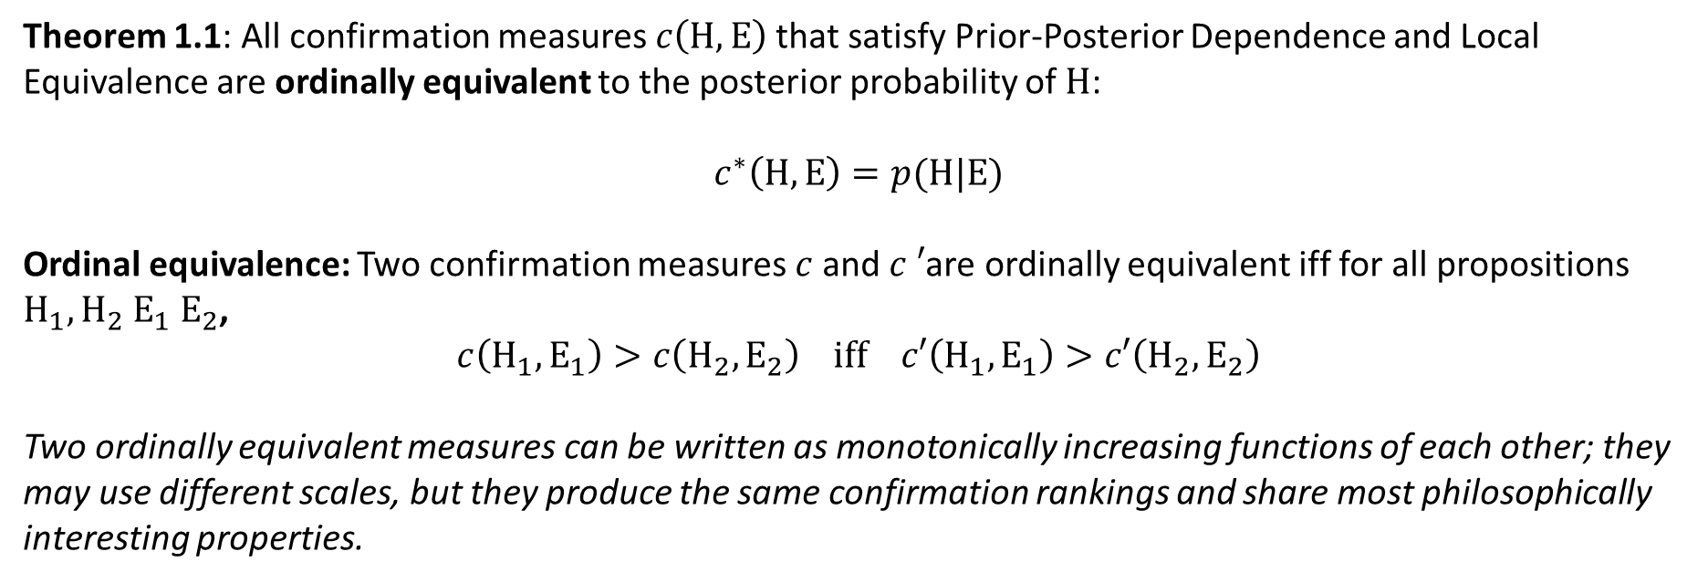
Confirmation as firmness
Theorem 1.1: All confirmation measures $c\left(H,E\right)$that satisfy Prior-Posterior Dependence and Local Equivalence are ordinally equivalent to the posterior probability of $H$:
$$c^{∗}\left(H,E\right)=p(H|E)$$
Ordinal equivalence: Two confirmation measures $c$and $c ′$are ordinally equivalent iff for all propositions $H_{1},H_{2}$ $E_{1}$ $E_{2}$,
$$c\left(H_{1},E_{1}\right)>c\left(H_{2},E_{2}\right) iff c′\left(H_{1},E_{1}\right)>c′\left(H_{2},E_{2}\right)$$
Two ordinally equivalent measures can be written as monotonically increasing functions of each other; they may use different scales, but they produce the same confirmation rankings and share most philosophically interesting properties.

Slide 13
Confirmation as firmness
Theorem 1.1: All confirmation measures $c\left(H,E\right)$that satisfy Prior-Posterior Dependence and Local Equivalence are ordinally equivalent to the posterior probability of $H$:
$$c^{∗}\left(H,E\right)=p(H|E)$$
Ordinal equivalence: Two confirmation measures $c$and $c ′$are ordinally equivalent iff for all propositions $H_{1},H_{2}$ $E_{1}$ $E_{2}$,
$$c\left(H_{1},E_{1}\right)>c\left(H_{2},E_{2}\right) iff c′\left(H_{1},E_{1}\right)>c′\left(H_{2},E_{2}\right)$$
It follows that $E$ confirms $H$ iff $p(H|E)≥t$ for some $t∈\left[0;1\right]$, i.e., that we call some hypothesis confirmed when the conditional probability exceeds a particular, perhaps context-related, threshold.

Slide 14
Paradox of tacking by conjunction
Hypothetico-deductive model of confirmation: hypotheses are confirmed if they make a prediction and this prediction comes true. A piece of evidence $E$ H-D confirms $H$ if $H$ entails $E$($p\left(E | H\right)=1$)
_______________________________________________________________________________________
Paradox of tacking by conjunction: If $E$ H-D confirms $H$, then $E$ also confirms $H∧X$ for an arbitrary hypothesis $X$, even if $X$ is total nonsense, such as “the star Sirius is a giant light bulb”
H-D confirmation is too permissive. It allows confirmation to spread in an uncontrolled way.
Paradox resolved by the Bayesian account of confirmation as firmness: for any irrelevant $X$, it will be the case that
$$p\left(H∧X | E\right)≤p\left(H | E\right).$$
The conjunction is confirmed to a lower degree than the original hypothesis, especially for far-fetched $X$. The paradox is mitigated by decreasing the amount of confirmation.

Slide 15
Requirement of Total Evidence
Inductive inference and the assessment of degree of confirmation at time $t$ should be based on the totality of evidence available at time $t$.
Problem: In the history of science and modern scientific practice, the confirmatory strength of a piece of evidence is evaluated on the basis of whether it is statistically significant in a particular experiment, independent of the epistemic standing of the hypothesis.
Example: Einstein’s General Theory of Relativity
The Requirement of Total Evidence should be relaxed
According to Confirmation as Firmness, evidence that lowers the probability of $H$ still confirms it, as long as $p(H|E)≥t$
Solution: Confirmation as Increase in Firmness (in particular contexts)

Slide 16
Bayesian Confirmation Theory
Prior-Posterior Dependence
Final Probability Incrementality
Qualitative-Quantitative Bridge Principle
Confirmation as firmness of belief
Confirmation as increase in firmness of belief
Disjunction of Alternative Hypotheses
Local Equivalence
Requirement of Total Evidence
Law of Likelihood
Modularity
Contraposition/Commutativity
?
Theorem 1.1: Confirmation as firmness
Log-ratio measure
Log-Likelihood &
Kemeny-Oppenheim measures
Difference measure
Generalized entailment measure

Slide 17
Confirmation as increase in firmness
For two propositions $H$ and $E$,
The evidence $E$ confirms/supports hypothesis $H$ iff $E$ raises the probability of $H:$
$$p\left(H|E\right)>p\left(H\right)$$
2. The evidence $E$ disconfirms/undermines hypothesis $H$ iff $E$ lowers the probability of $H$:
$$p\left(H|E\right)<p(H)$$
The evidence $E$ is neutral with respect to $H$ iff $E$ leaves the probability of $H$unchanged:
$$p\left(H|E\right)=p(H)$$
$E$ confirms $H$ iff $E$ raises a subject’s degree of belief in $H$.
Statistical-relevance accounts of confirmation: Measure the evidential support that $H$receives from $E.$ The neutral point is determined by the statistical independence of $H$ and $E$.
H-D confirmation emerges as a special case

Slide 18
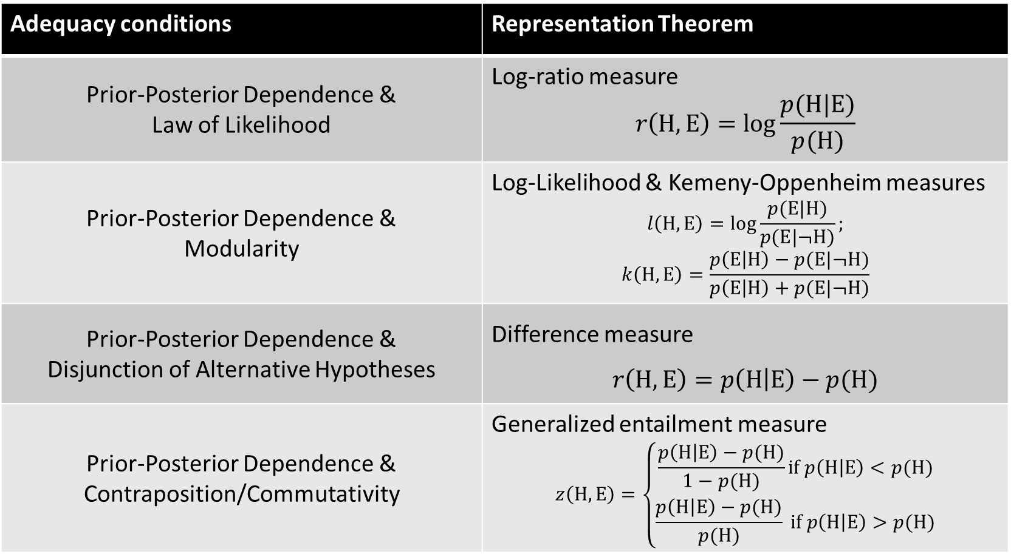
Confirmation as increase in firmness
Adequacy conditions | Representation Theorem
Prior-Posterior Dependence & Law of Likelihood | Log-ratio measure $$r\left(H,E\right)=log\frac{p(H|E)}{p(H)}$$
Prior-Posterior Dependence & Modularity | Log-Likelihood & Kemeny-Oppenheim measures $$l\left(H,E\right)=log\frac{p(E|H)}{p(E|¬H)};$$ $$k\left(H,E\right)=\frac{p\left(E | H\right)−p(E|¬H)}{p\left(E | H\right)+p(E|¬H)}$$
Prior-Posterior Dependence & Disjunction of Alternative Hypotheses | Difference measure $$r\left(H,E\right)=p\left(H | E\right)−p(H)$$
Prior-Posterior Dependence & Contraposition/Commutativity | Generalized entailment measure $$z\left(H,E\right)=\left\{\begin{aligned}\frac{p\left(H | E\right)−p(H)}{1−p(H)}if p\left(H | E\right)<p(H) \\ \frac{p\left(H | E\right)−p(H)}{p(H)} if p\left(H | E\right)>p(H)\end{aligned}\right.$$

Slide 19
Confirmation as increase in firmness
We are left with a choice between several confirmation measures of confirmation as increase in firmness. Which should we choose?
Confirmational monism: There is a definite answer to this question. Despite the plurality of confirmation measures, there is one that outperforms its competitors.
Confirmational pluralism: Which measure performs best depends on a specific context or goals of inquiry. The choice between measures may also depend on empirical findings.
“The idea that there is ‘one true measure of confirmation’ is therefore problematic […] there are different senses of degree of confirmation that correspond to different explications.”

Slide 20
Paradox of the ravens
Problem:
Let $H=∀x:\left(Rx →Bx\right)$ (all ravens are black) and $H′=∀x:\left(¬Bx →Rx\right)$ (no non-black object is a raven).
$H$ and $H′$ are logically equivalent.
There is a tension between the following statements:
Nicod’s Condition (Confirmation by instances): Universal conditionals are confirmed by their instances.
Equivalence Condition: Logically equivalent hypotheses are confirmed equally by given evidence.
A white shoe is an instance of $H′$, so it confirms $H^{′}$ and $H$… it confirms all ravens are black!
3. Ravens Intuition: Observation reports of a white shoe, or other non-black non-raven objects, do not confirm $H$.
Bayesian Solution: Bayesian confirmation as firmness/increase in firmness has shown us that not all instances of universal conditionals raise their probability. We have to throw out Nicod’s Condition.

Slide 21
Paradox of the ravens
Bayesian Solution: Bayesian confirmation as increase in firmness has shown us that not all instances of universal conditionals raise their probability. We have to throw out Nicod’s Condition.
I.J. Good’s Counter example:
 | World 1 | World 2
Black ravens | 100 | 1,000
Non-black ravens | 0 | 1
Other objects | 1,000,000 | 1,000,000
$$p\left(Ra∧Ba | W_{1}\right)= \frac{100}{1,000,100} < p\left(Ra∧Ba | W_{2}\right)= \frac{1000}{1,001,001}$$
$$⇒p\left(H | Ra∧Ba\right)<p(H)$$
Observing a black raven lowers the probability of the hypothesis that all ravens are black!

Slide 22
Paradox of the ravens
Another problem: concrete instances of black ravens do sometimes confirm $H$, and in these cases we can’t throw out Nicod’s Condition.
Hempel’s Solution: Reject the Ravens Intuition.
Bayesian Solution: Same as Hempel.
Separate out the qualitative question (does a white shoe confirm the raven hypothesis?) and the comparative question (does the observation of a black raven confirm the raven hypothesis more than the observation of a white shoe?)
If one makes “plausible assumptions,” $Ra∧Ba$ confirms $H$ to a higher degree than $¬Ba ∧¬Ra.$

Slide 23


Goodman’s Grue paradox
Problem: Two incompatible hypotheses confirmed by the same piece of evidence
Goodman’s Solution: Restrict confirmation to generalizable, projectible predicates which have a successful prediction history
Bayesian Solution:
Abandon the idea that evidence cannot confirm incompatible hypotheses.
The prior probability of green is higher than that of grue, so for confirmation as both firmness and as increase in firmness, green is confirmed to a higher degree than grue
That being said…
$$Observation at t=t_{1}:emerald e_{1}is green$$
$$Observation at t=t_{2}:emerald e_{2}is green$$
$$Observation at t=t_{3}:emerald e_{3}is green$$
:
$$\underline{Observation at t=t_{n}:emerald e_{n}is green }$$
$$General hypothesis:All emeralds are green$$
$$Observation at t=t_{1}:emerald e_{1}is grue$$
$$Observation at t=t_{2}:emerald e_{2}is grue$$
$$Observation at t=t_{3}:emerald e_{3}is grue$$
:
$$\underline{Observation at t=t_{n}:emerald e_{n}is gr\text{ue} }$$
$$General hypothesis:All emeralds are grue$$

Slide 24
Goodman’s Grue paradox
That being said…
“Goodman shows a general problem for formal reasoning about confirmation and evidence” there is no viable complete theory of inductive support (see also Norton forthcoming).”
Here, the choice of prior probabilities cannot come from Bayesian reasoning itself. They come from scientific reasoning, and BCT can’t tell you which prior degrees of belief are reasonable.

Slide 25
Gems
Sets up conditions of adequacy and corresponding representation theorems for measures of confirmation
Motivates the Bayesian view well; includes convincing examples that show how Bayesian Confirmation Theory can be used by both historians of science and practicing scientists (descriptive and normative)
Embraces confirmational pluralism and an understanding of the limitations of Bayesian confirmation; compatible with a Material Theory of Induction

Slide 26
Discussion
Validity of the Bayesian resolutions to:
paradox of tacking by conjunction
black raven paradox
grue paradox
Has the Bayesian view of confirmation been redeemed?
Bayesian Confirmation Theory and a Material Theory of Induction

