Slide 1
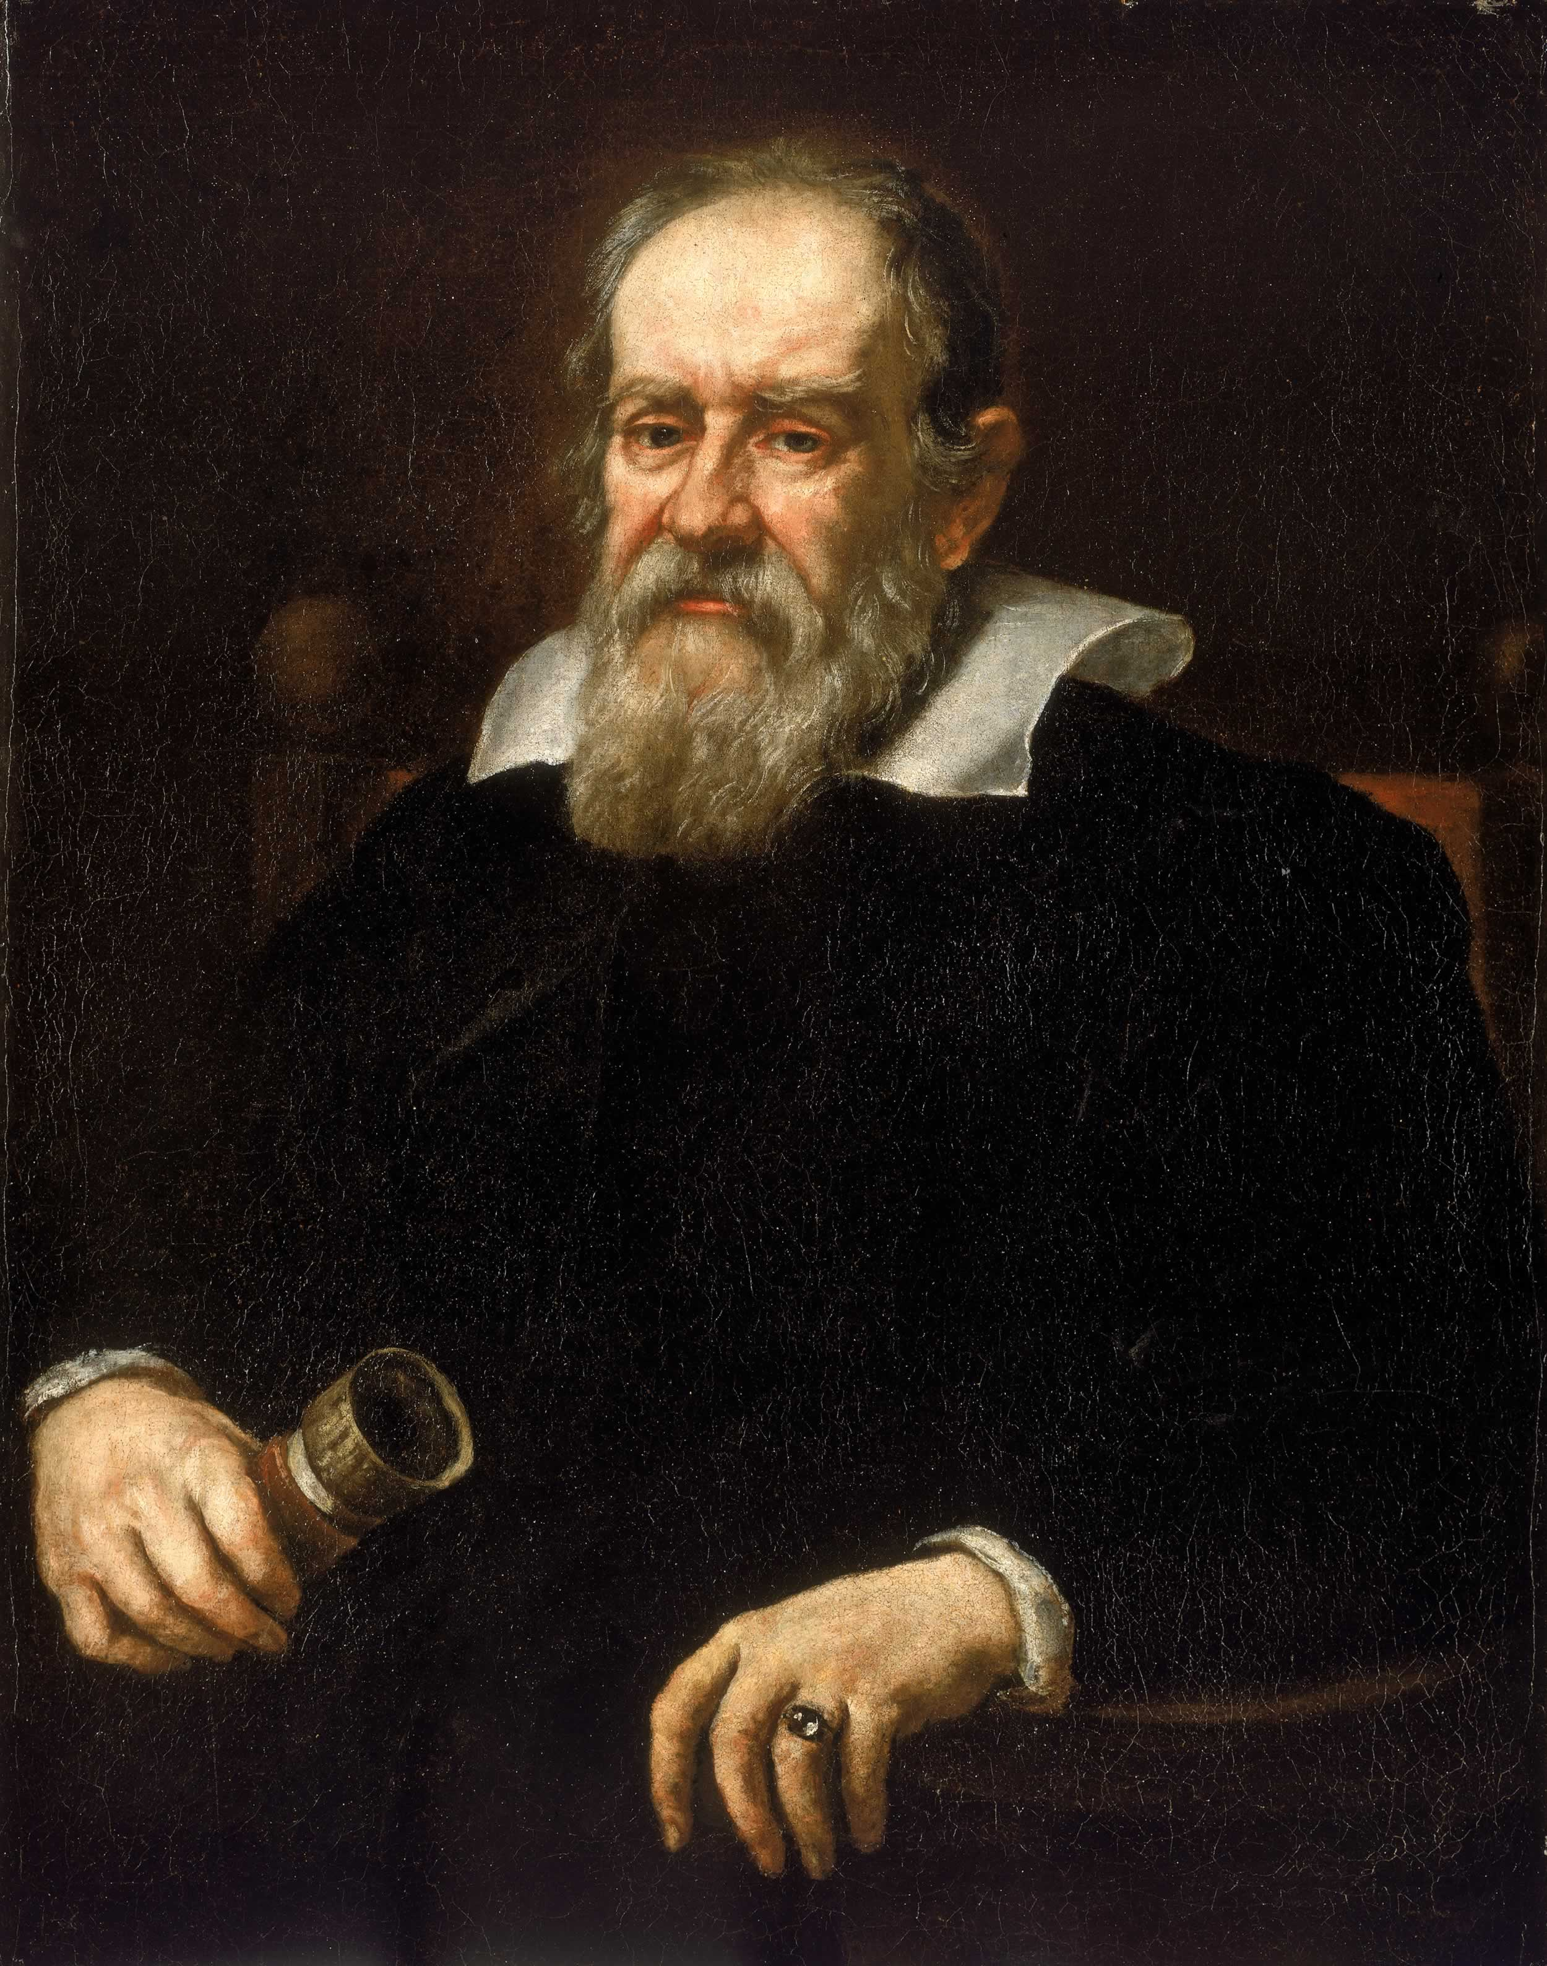
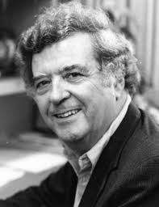
Ernan McMullin: “Galilean Idealization”

Slide 2
Idealization is “a deliberate simplifying of something complicated (a situation, a concept, etc.) with a view to achieving at least a partial understanding of that thing.”

Slide 3
McMullin’s Motivation: Nancy Cartwright’s book, How the Laws of Physics Lie
A skeptical attack on idealization in science
Claims idealized scientific laws are false
Claims idealization in science is not truth-producing
Idealization glosses over the “richness and variety of the concrete and particular”
Notes:
Cartwright thinks idealization in science is a PROBLEM—it is misleading, it leads science away from the truth
We learn more about her view near the end of the paper

Slide 4
McMullin’s Goal:
Systematize types of Galilean idealization
In so doing, defend idealization as truth-producing
Notes:
McMullin will try to JUSTIFY each type of Galilean idealization as truth-producing; his method will be to show that its purported weaknesses are really strengths

Slide 5
Background:
Platonic idealization:
Purpose is “to escape from the irregularity of the real world into the intelligible order of Form”
Aristotelian idealization:
Purpose is “to make use of this order in an attempt to grasp the real world from which the idealization takes its origin”
But Aristotelians in Galileo’s time distrusted idealization, mathematics in physics
Methods of idealization played a distinctive role in the origins of the “new science” that replaced Aristotelianism—hence, “Galilean” idealization
Notes:
Galileo obviously a leading figure in the development of modern science, and McMullin thinks idealization played an important role
McMullin says that this distinction in the purpose of idealization is really a difference between the Platonic and Aristotelian traditions
Casts doubt on whether Aristotle himself would have opposed Galilean idealization, but thinks it’s a fair interpretation of the attitudes of Aristotelians contemporary to Galileo (who he suggests were influenced by Neo-Platonism)

Slide 6
Galilean Idealization
Construct Idealization
Causal Idealization
Formal Idealization
Material Idealization
Experimental Idealization
Subjunctive Idealization
Notes:
I am uncertain how to fit MATHEMATICAL IDEALIZATION on this chart: is construct idealization a type of mathematical idealization? Are both construct and causal idealization types of mathematical idealization? Is it a category of its own?

Slide 7
Preliminary: Mathematical Idealization
Galileo: “The Book of Nature is written in the language of mathematics”
Objection 1: Geometry is an abstraction; mathematical spheres and planes do not exist in the real world. Mathematical idealization will lead to errors!
Response: A good scientist can account for the errors incurred by idealization and correct them.
Notes:
McMullin says (251) this argument has INDUCTIVE support: science has proven many times that it can make profitable use of mathematical idealizations

Slide 8
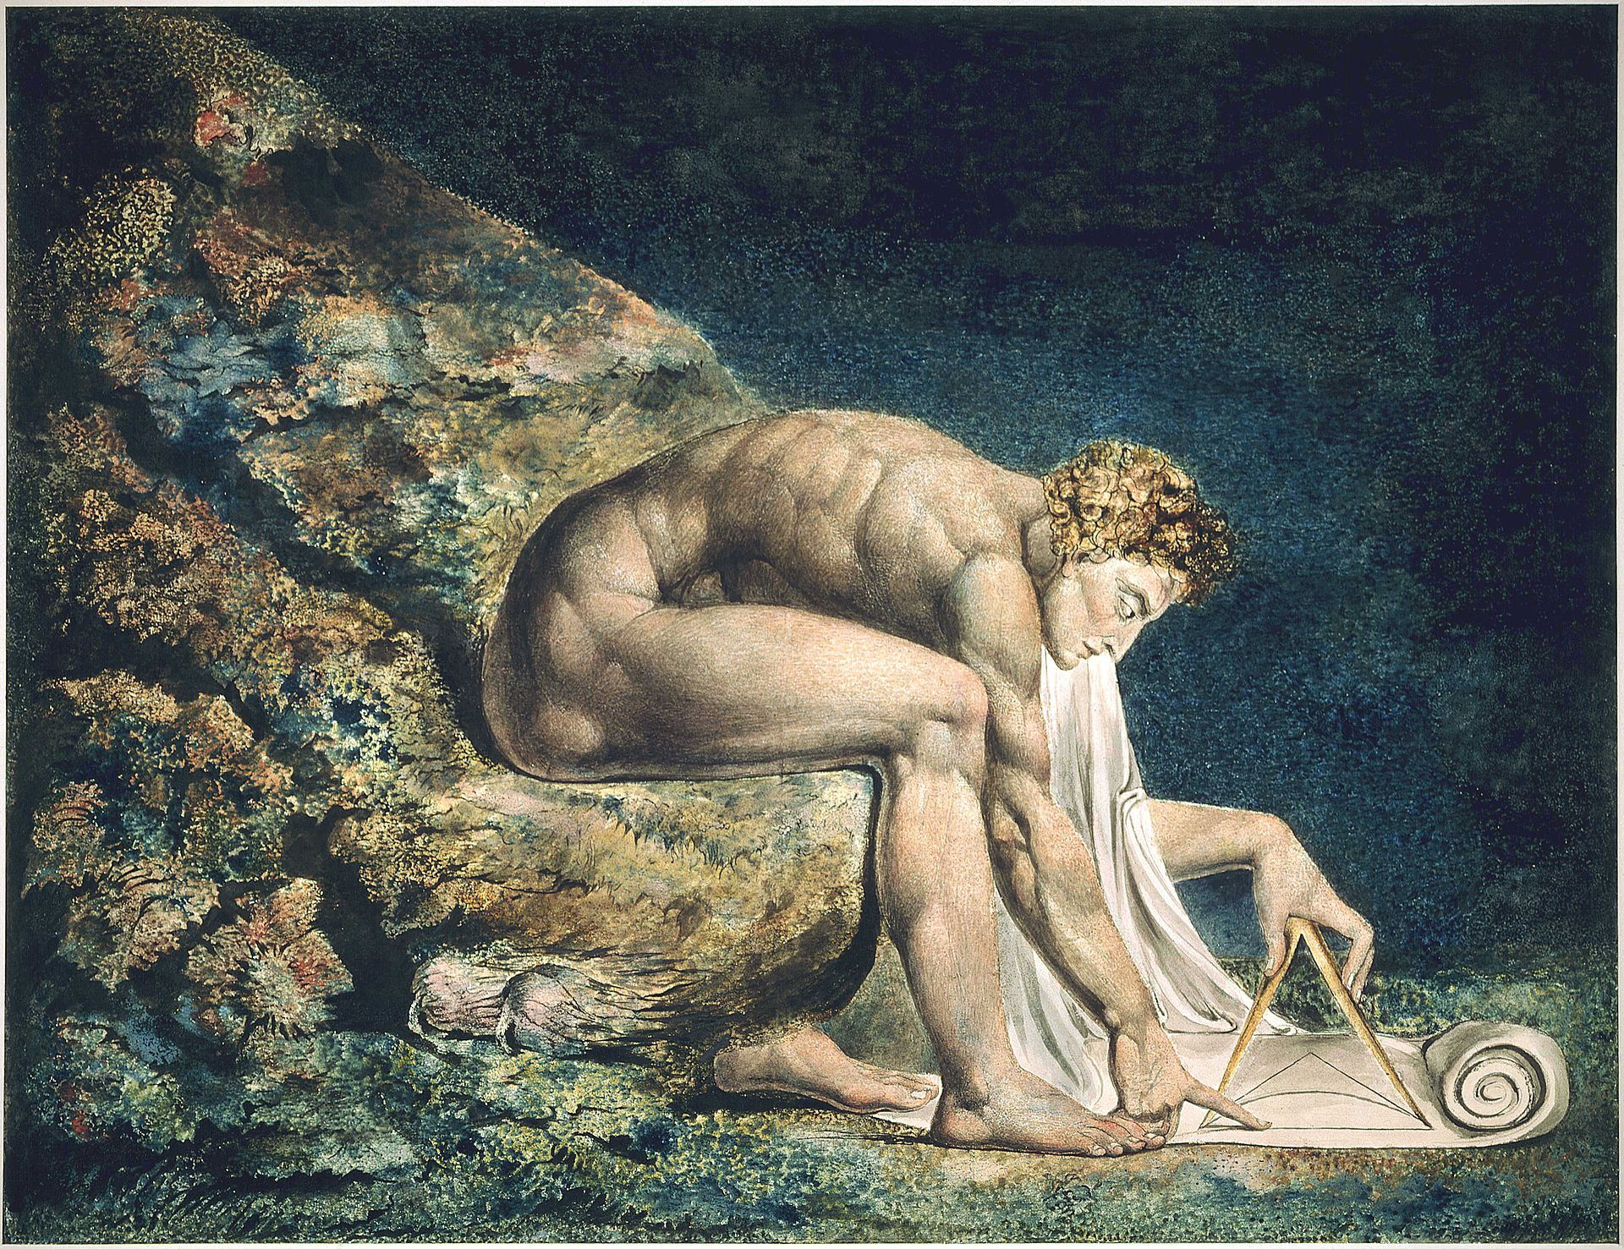
Galileo: “The Book of Nature is written in the language of mathematics”
Objection 2: Why should we think there is a fit between our mathematics and nature? After all, Galileo assumed that Euclidean geometry was adequate to mathematize space and time. Relativity disabused us of that.
Response: We do not reduce physics to our mathematics; we enlarge our mathematics to accommodate our understanding of physics.
Notes:
The syntax of the Book of Nature is written in the language of mathematics, but the semantics is not.
i.e. The grammar is mathematical, but the content is physical (chemical, biological, etc.). Mass and energy are not mathematical, but m and E can be manipulated algebraically.
Another appeal to INDUCTION: mathematical idealization has worked well, hasn’t held us back.
McMullin lays his cards on the table: this argument has presupposed SCIENTIFIC REALISM. This is a peripheral theme that will reappear

Slide 9
Galilean Idealization
Construct Idealization
Causal Idealization
Formal Idealization
Material Idealization
Experimental Idealization
Subjunctive Idealization
Notes:
We now turn to construct idealization

Slide 10
Construct Idealization
Simplification in the conceptual representation of an object
i.e. simplification in a scientific model
These lines are not really parallel:
they converge at the center of the earth.

Slide 11
Galilean Idealization
Construct Idealization
Causal Idealization
Formal Idealization
Material Idealization
Experimental Idealization
Subjunctive Idealization
Notes:
Construct idealization comes in two flavors. First, Formal idealization

Slide 12
Formal Idealization
“Features that are known (or suspected) to be relevant to the kind of explanation being offered are simplified or omitted to obtain a result.”
Examples:
Newton treating the sun as an infinite mass
Ignoring the volume and mutual attraction of molecules when deriving the ideal gas law
Bohr’s model of the Hydrogen atom
Treated nucleus as immobile (rather than moving around center of mass of atom)
Treated electron orbit as circular (rather than ellipsoid)
Ignored relativistic effects of the motion of the electron
Notes:
McMullin points out that all of these simplifications are useful in deriving general laws, and can then be CORRECTED by later refinements (e.g. Van der Waal’s equation for gasses)
In addition, these deliberate omissions can DIRECT scientific research programs: Bohr’s model of the H atom pointed toward further refinements
“models can be made more specific by eliminating simplifying assumptions and ‘de-idealizing’” “The model then serves as the basis for a continuing research program.” (261)
I.E. The simplicity is an ADVANTAGE, not an impediment, to getting at the truth

Slide 13
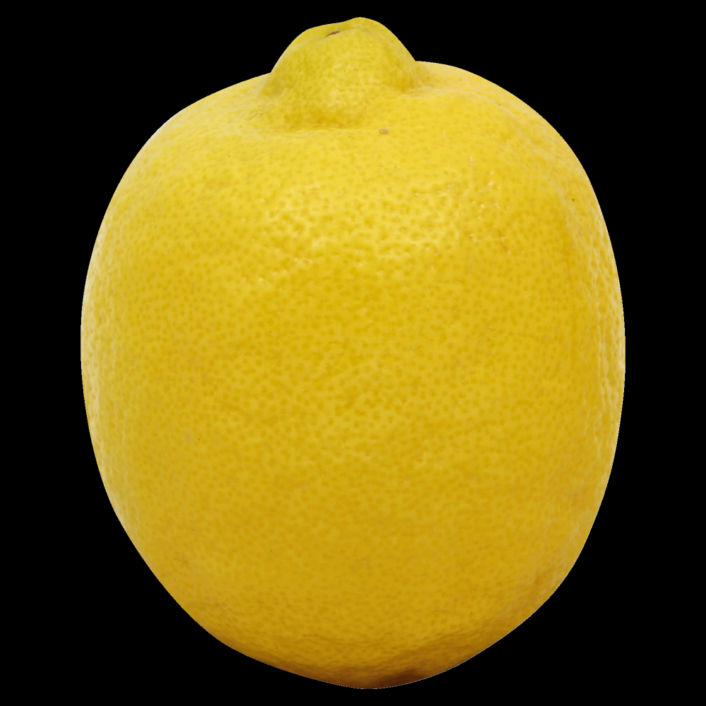
Formal Idealization
Objection: what about when ad hoc corrections are needed to make a formal model work? Doesn’t that show that the idealization is problematic?
Response: Yes! But such cases are useful, because they motivate scientists to either find a theoretical justification for the correction, or to replace the model with a better one.
Notes:
Ad hoc corrections: when a formal model isn’t giving the right answers, so a theoretically unmotivated constant is pulled out of nowhere to make it work.
Deliberate simplifications give us expectations about how to refine models to improve predictive accuracy
When these expectations are borne out, the model (and underlying REALITY of the thing modeled) is validated

Slide 14
Galilean Idealization
Construct Idealization
Causal Idealization
Formal Idealization
Material Idealization
Experimental Idealization
Subjunctive Idealization
Notes:
Next, Material idealization

Slide 15
Material Idealization
When a model leaves features unspecified that are deemed irrelevant to the inquiry at hand
Or: “Where the notion of formal idealization signifies that aspects of the real object are being left aside in the interests of furthering a better understanding, the notion of material idealization is intended to bring out the fact that further specifications of the construct are, for the moment, being laid aside for the same reason.”
Examples:
Rutherford nuclear model of the atom: “blank” nucleus left unspecified
Absence of electron spin in Bohr model of atom
Notes:
Where the notion of formal idealization signifies that aspects of the real object are being left aside in the interests of furthering a better understanding, the notion of material idealization is intended to bring out the fact that further specifications of the construct are, for the moment, being laid aside for the same reason

Slide 16
Material Idealization
Objection: Wait a minute! Bohr didn’t deliberately omit spin; nobody had thought of it yet! Spin eventually had to be introduced to explain cases that the Bohr model couldn’t explain.
Response: Exactly! See how fertile the model was, not despite but because of its limitations? The model helped science self-correct. “The model operated here not as a starting-point for strict inference but as a source of suggestion.”
Notes:
What models get wrong teaches us as much as what they get right
The fertility of these models is, again, an argument for REALISM
McMullin concedes that cases of ad hoc self-correction are problematic, but they are not the majority (as Cartwright apparently thinks)

Slide 17
Galilean Idealization
Construct Idealization
Causal Idealization
Formal Idealization
Material Idealization
Experimental Idealization
Subjunctive Idealization
Notes:
Next, Causal idealization

Slide 18
Causal Idealization
“The unordered world of Nature is a tangle of causal lines;” … Galileo’s “insight was that complex causal situations can only be understood by first taking the causal lines separately and then combining them.”
The most distinctly “Galilean” form of idealization
Where he really diverged from Aristotle
Notes:
Aristotle’s notion of causes as definitive of the normal course of nature; idealizing them is hence suspect

Slide 19
Galilean Idealization
Construct Idealization
Causal Idealization
Formal Idealization
Material Idealization
Experimental Idealization
Subjunctive Idealization
Notes:
Next, Causal idealization

Slide 20
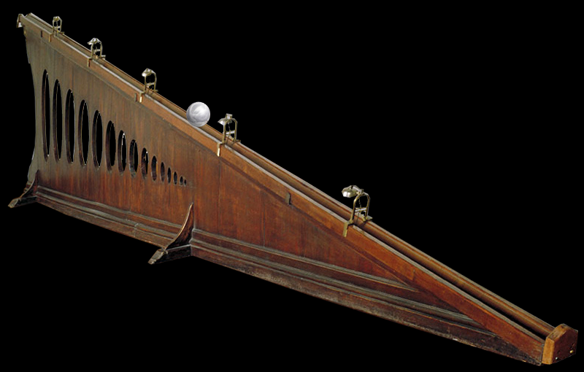
Experimental Idealization
Use of an experimental setup to artificially isolate the effects of a single causal factor
Examples include Galileo’s inclined plane experiments, his falling body experiments, etc.
“What he wanted to discover was the ‘downward tendency which (body) has from its own heaviness,’ in the absence of all other causes [such as friction or air resistance]”
Complex situations understood as composition of causes
Notes:
“This is a new understanding of “natural motion”. It is not, as it was for Aristotle, motion as it occurs in the normal course of affairs. It is “natural” in the sense that it defines what the body would do on its own, apart from the effects of causes (like the resistance of air) external to it.”
Aristotle thought a vacuum is impossible, so accounting for air resistance is necessary to understanding motion in nature

Slide 21
Experimental Idealization
Objection: what about experiments in the behavioral sciences? Haven’t they been shown to distort the behavior they’re meant to observe?
Response: Yes … but we’re only here to talk about Galileo’s “new science” of mechanics!
Notes:
A disappointing part of the paper; I thought all of this was supposed to be about more than just Galileo’s mechanics

Slide 22
Galilean Idealization
Construct Idealization
Causal Idealization
Formal Idealization
Material Idealization
Experimental Idealization
Subjunctive Idealization
Notes:
Next, Causal idealization

Slide 23
Subjunctive Idealization
Thought-experimental idealization
“What would happen if …”
Important because “scientific laws are never asserted categorically”; they assert what would happen in the absence of impeding circumstances
Examples of Galilean thought experiments:
What would happen if two falling bodies were tied together?
What happens in the absence of atmospheric or frictional impediments?
Dropping a stone from the mast of a moving ship
Decomposition of parabolic motion into horizontal and vertical vectors

Slide 24
Conclusion
McMullin has argued that idealization is truth-producing in the following way:
First, scientists idealize: they simplify a model of reality, or isolate causes in complex situations
Then, they systematically “add back” what has been idealized away, or they re-composit causes
This method has proven successful in generating increasingly accurate models
According to McMullin, Cartwright doesn’t trust that this process works, she is suspicious of the method of composition of causes.
McMullin agrees that if the method of composition of causes is suspect, then so is Galilean idealization—but he doesn’t think Cartwright has shown that it is.
Notes:
McMullin notes that Cartwright says her views are Aristotelian, but he thinks they are closer to Platonism
I would have liked a slightly fuller account of Cartwright’s arguments

Slide 25
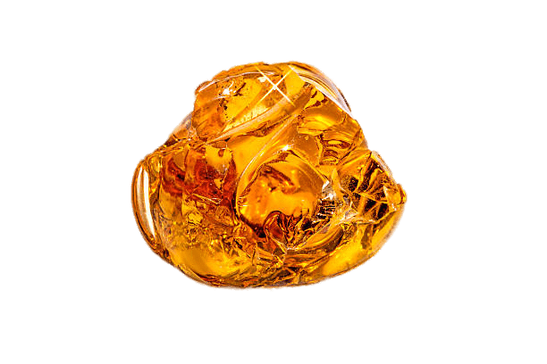
Gems:
Historical framing: I loved the way McMullin situated his subject in a distinction between Platonism and Aristotelianism, and in the origins of modern science.
Turning the tables: McMullin’s strategy of arguing, in case after case, how the apparent weakness of idealization—its departure from truth—is ultimately a strength that brings us closer to the truth, is compelling.
Interwoven themes: There were several elegantly interconnected running themes in this article, including
Platonic vs. Aristotelian traditions
“Self-correction” in science
Scientific realism
Notes:
I would have liked a slightly fuller account of Cartwright’s arguments

