Slide 1
Wesley Salmon: Rational Prediction
Philosophy of Science Core Seminar (HPS 2101)
September 2022

Slide 2
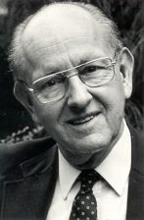
Wesley Salmon (1925-2001)
University of Pittsburgh: 1981 - 1999
He was a realist about causality in scientific explanation and proposed that scientific explanation's manner is actually causal/mechanical explanation.

Slide 3
The Main Thesis
Popper’s account does not provide a basis for rational prediction in practical matters.
Popper’s claim of solving the problem of induction is unacceptable.

Slide 4
Problem of Induction

Slide 5
Popper’s Solution for the Problem of Induction
Negative instances provide rational grounds for rejecting generalisations.
Positive instances do not provide confirmation or inductive support for any unrefuted generalization.
Corroboration statements hold no predictions with respect to future performance.
It is a central thesis in Popper’s philosophy.

Slide 6
But How to Choose among Unrefuted Theories for the Purpose of Prediction?
Popper: We should prefer those theories that are highly informative and which so far have stood up to eliminative criticism
Salmon: It depends on the type of prediction

Slide 7
Three Reasons for Making Predictions
To satisfy the curiosity about future events
To test a theory
To base practical decisions

Slide 8
Types of Preference
Theoretical Preference
Practical Preference

Slide 9
Watkins: “it would be rational for him to choose the better corroborated one, the one which has withstood the more severe criticism, since he has nothing else to go on”
Salmon: He could flip a coin!

Slide 10
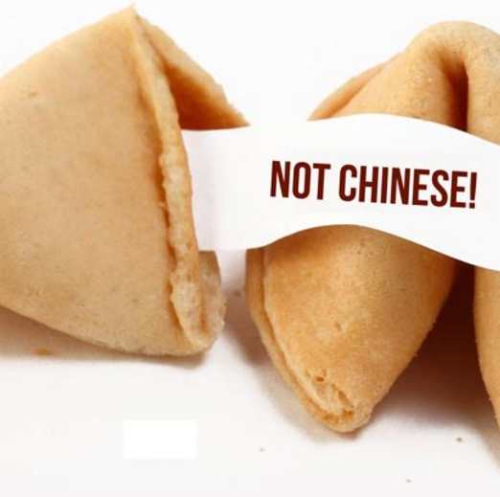
Popper: “there is no alternative method which might be said to be more rational”
Salmon: You missed the point! It’s like saying a pragmatic belief in the predictions found in Chinese fortune cookies is not irrational, for there is nothing more rational.

Slide 11
Popper: Deciding to criticize a practical proposal from the standpoint of modern medicine is itself a kind of 'practical' decision which can withstand severe criticism better than the alternatives.
Salmon: What I am doing is exactly refuting such methodological recommendation.

Slide 12
Predictive Content vs. Predictive Import
A rule or imperative like “no smoking” doesn’t have predictive content but has predictive import
Similarly, corroboration statements do not have predictive content but have predictive import

Slide 13
Popper’s Realism
Popper: when we think we have found an approximation to the truth in the form of a scientific theory which has stood up to criticism and to tests better than its competitors, we shall, as realists, accept it as a basis for practical action, simply because we have nothing better (or nearer to the truth)
Is this really a new solution?
Could Popper’s recollection of his views be inaccurate?

Slide 14
Gems and Coals
The distinction between predictive content and predictive import
Salmon tries to assure that his argument is not based on misrepresentation and purely verbal disputes
He writes very clearly but there are some repetitions and jumps

