Slide 1
The Material Theory of Induction
HPS 2101/Phil 2600 Philosophy of Science Fall 2022
John D. Norton
Department of History and Philosophy of Science
University of Pittsburgh

Slide 2
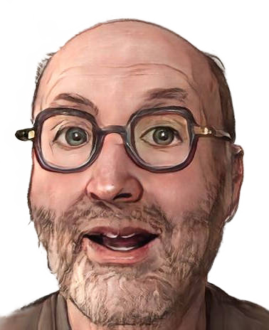
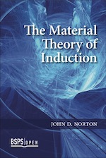

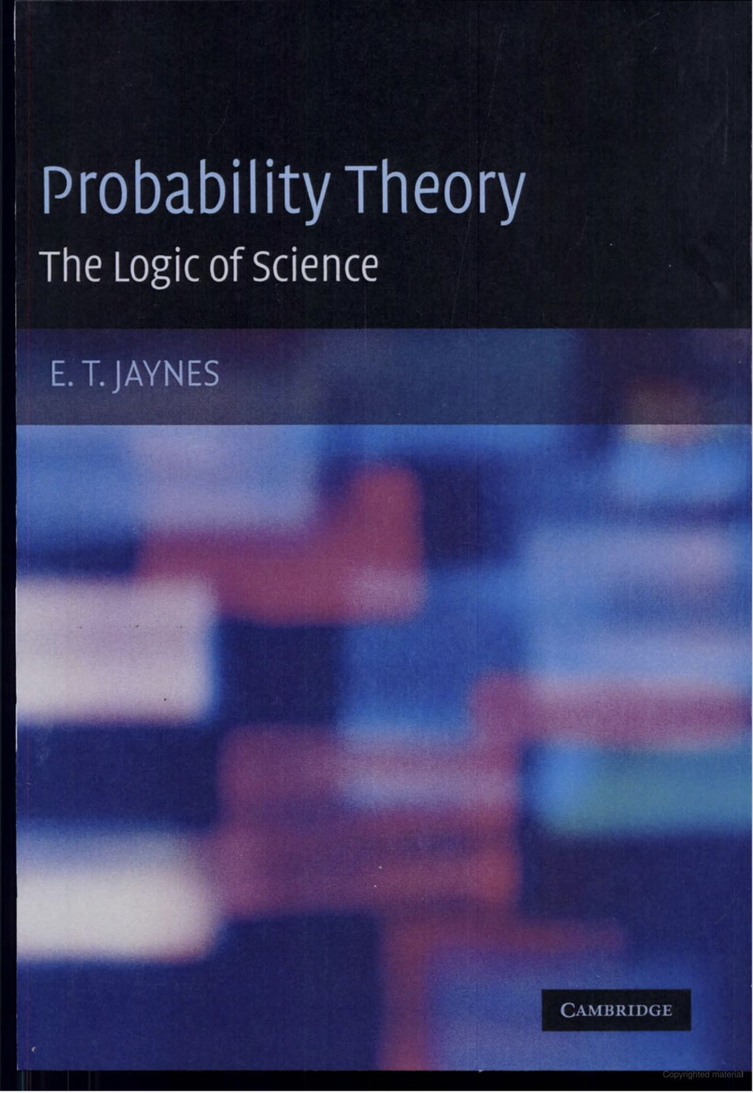
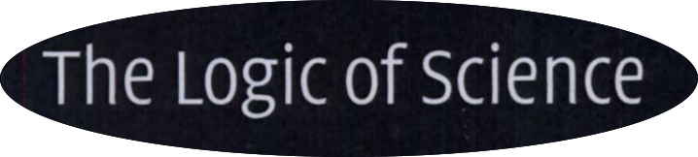
Claims
There are no universal rules of inductive inference.
All inductive inferences are warranted by facts that obtain locally only.
Probability calculus is NOT the default, universally applicable rule of inductive inference.
Positive obligation in each case to show that probabilities are warranted by background fact of the domain.

Slide 3
An Example

Slide 4
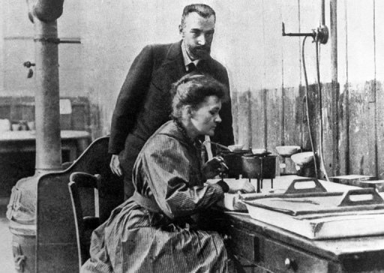

Slide 5
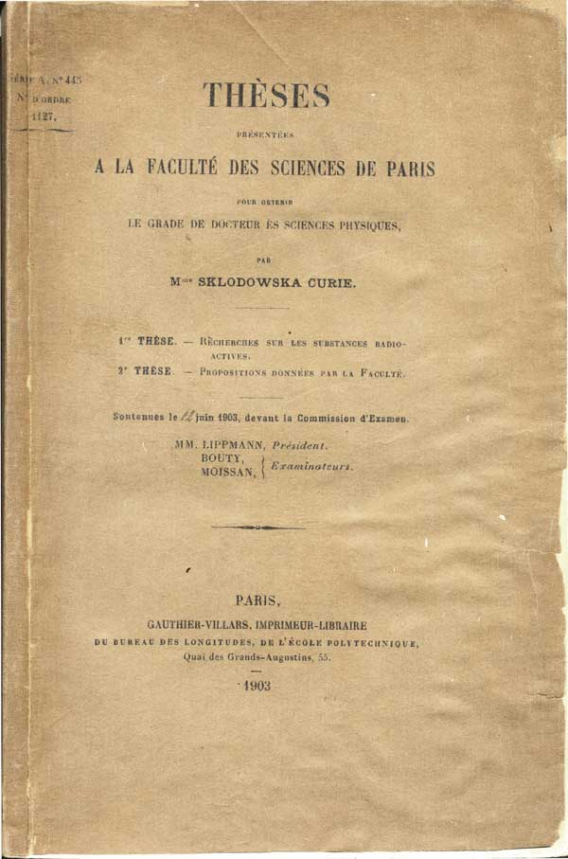

Slide 6
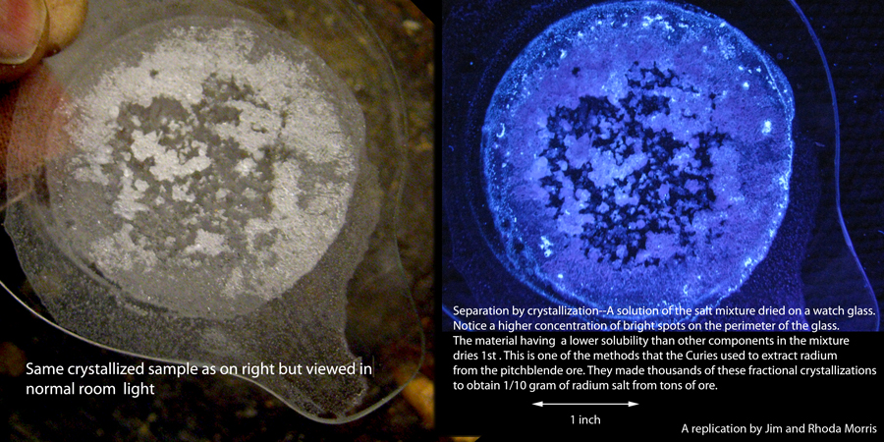
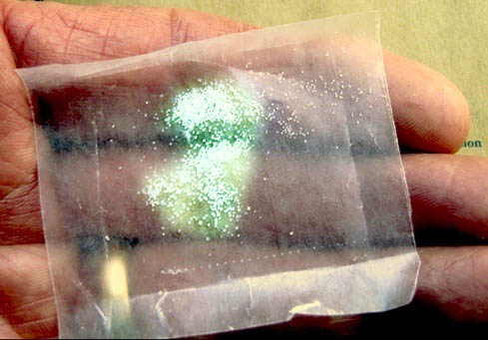
Sample isolated is 1/10 gram
…from tons of pitchblende ore, over more than three years.
this much
Images from “A Personal Interview with Marie Curie.”Jim and Rhoda Morris. http://scientificscience.org/Marie_%20Curie/index.htm

Slide 7
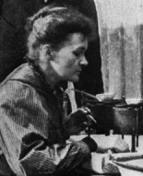
Its crystalline properties declared
The crystals, which form in very acid solution, are elongated needles, those of barium chloride having exactly the same appearance as those of radium chloride.
(Dissertation, 1903)
In chemical terms radium differs little from barium; the salts of these two elements are isomorphic.
(Nobel Prize Address, 1911)

Slide 8
The Inference Justified Formally
This sample of Radium Chloride
crystals just like Barium Chloride
Some A’s are B.
has
All A’s are B.
All samples of Radium Chloride
crystals just like Barium Chloride
have
enumerative induction
BUT…
This sample of Radium Chloride …
… appears colorless.
… weighs less that 1/5g.
Must all samples be so?
… has crystals smaller than 1mm.
… is at temperature 25C.
… is in Paris.
… prepared by Marie Curie.

Slide 9
??Repair??: Augment Schema with Domain Specific Facts.
Some A’s are B.
All A’s are B.
Restrict to things that can carry projectable properties.
Restrict to projectable properties.
Properties without spatiotemporal limits?
Things in dishes in Curie’s lab?
Crystallized things
in dishes in Curie’s lab?
Shapes?
(of the right sort?)
Colors or lack of?
Pure chemical compounds in dishes in Curie’s lab?
etc.
Sizes?
etc.
Probabilities to the rescue?
No. Must first figure out what is projectable and then encode that in priors, likelihoods.

Slide 10

Add more domain specific facts
The induction is more secure. The facts do the work.
The formal schema contributes less.

Slide 11
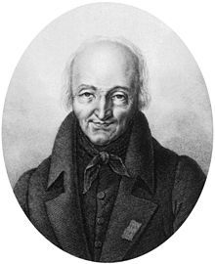
The Inference Justified by Facts.
This sample of Radium Chloride
crystals just like Barium Chloride
has
Haüy’s principle
René
Just Haüy
1743-1822
All samples of Radium Chloride
crystals just like Barium Chloride
have
Haüy’s principle
Generally, each crystalline substance has a single characteristic crystallographic form.
Isomorphous groups.
Crystalline substances tend to come in groups with analogous chemical compositions and closely similar crystal forms.

Slide 12
The Inference Justified by Facts.
This sample of Radium Chloride
crystals just like Barium Chloride
has
Haüy’s principle
René
Just Haüy
1743-1822
All samples of Radium Chloride
crystals just like Barium Chloride
have
Haüy’s principle
Generally, each crystalline substance has a single characteristic crystallographic form.
Isomorphous groups.
Crystalline substances tend to come in groups with analogous chemical compositions and closely similar crystal forms.
“Generally” makes the inference inductive.
Inductive risk of polymorphism
= multiple crystal forms for same substance.
e.g. Dimorphism
Carbon = graphite and diamond.
Calcium carbonate = calcite and aragonite.
Iron sulphide = pyrite and marcasite

Slide 13
Cascade of Warrants.
This sample of Radium Chloride
crystals just like Barium Chloride
has
warrants
All samples of Radium Chloride
crystals just like Barium Chloride
have
Some A’s are B.
if
A = pure crystalline substance
B = one of seven crystallographic forms
All A’s are B.
warrants
Haüy’s principle

Slide 14
Generalizing…
The Material Theory of Induction

Slide 15
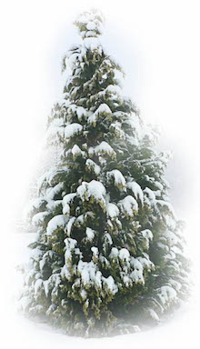
Deduction
Winters past
have been snowy.
AND
Winters future will be snowy.
warrant within the premises
Winters past
have been snowy.
(meaning of AND)
Conclusion merely restates part of premises.
A
B
AND
“AND” does all the work.
A universal schema is possible.
A

Slide 16
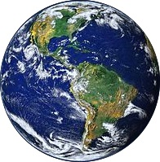
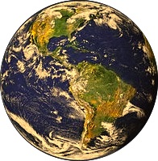
Induction
Winters past
have been snowy.
warrant outside the premises
Winters past
have been snowy.
AND
Winters future will be snowy.
FACT: our world is hospitable to this inductive inference.
Conclusion asserts
more than premises.
Hospitable:
World without climate change.
Inhospitable:
World with warming climate change.
vs
Cascade
of warrants
Whether a schema applies in some domain depends on the facts prevailing in the domain.

Slide 17
General Argument

Slide 18
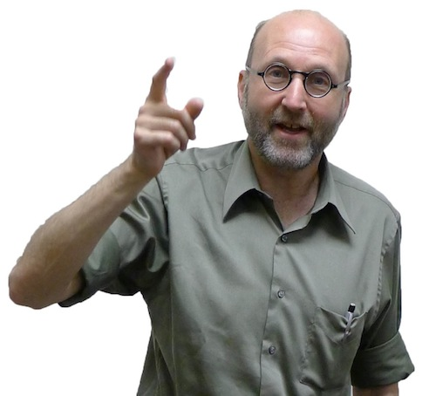


The General Argument
There are no universal, inductive inference schemas.
All inductive inferences are warranted by facts.
(The conclusion so far.)
There are no universal warranting facts.
(No non-vacuous, factual principle of the uniformity of nature.)
All induction is local.
Each domain has its own inductive logic, according to the background facts that prevail there.

Slide 19
The Project:
Recover the material foundation of all recognized schemes for inductive inference

Slide 20
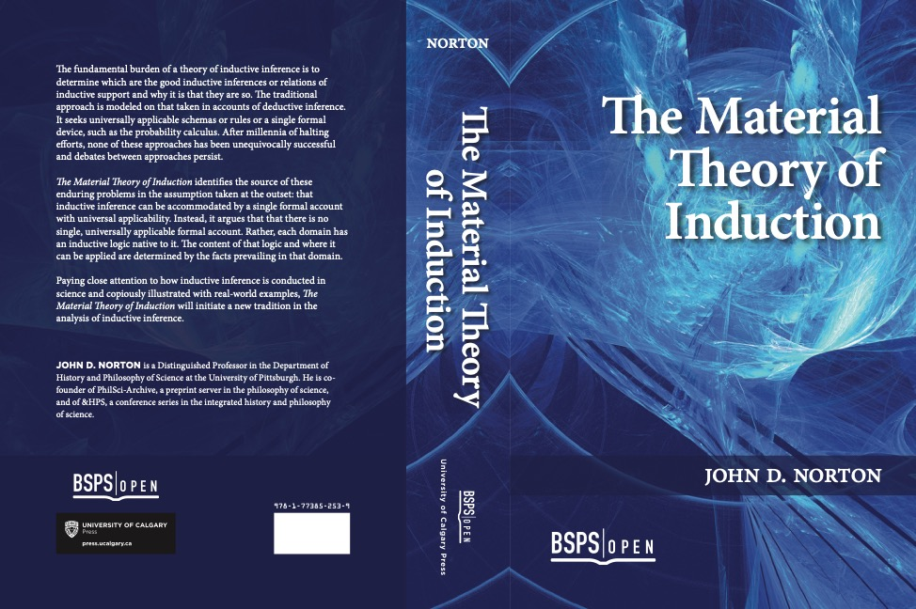
Material Theory of Induction

Slide 21
Simplicity
Enumerative induction
Replicability
IBE Inference to the best Explanation
Analogy

Slide 22
Material Theory of Induction

Slide 23
Why Not Bayes

Slide 24
Main Claim
Probabilism: All cases of indefiniteness and uncertainty can be treated BY DEFAULT by probabilities.
Bayesian analysis can be applied everywhere.
There is a POSTIVE OBLIGATION to show that probabilities apply in each case. Without it, they cannot be applied.
Bayesian analysis does not apply universally.

Slide 25
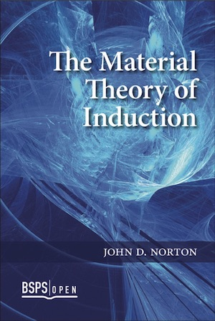
Four Supporting Claims
1.
Inductive inference is ampliative. Therefore, it only succeeds in environments factually hospitable to it.
2.
There are cases to which probabilistic analysis is demonstrably inapplicable.
3.
All arguments for probabilism are circular.
Elsewhere
4.
A general result: all calculi of inductive inference are incomplete.

Slide 26
Inductive inference is ampliative.
Therefore, it only succeeds in environments factually hospitable to it.
1

Slide 27
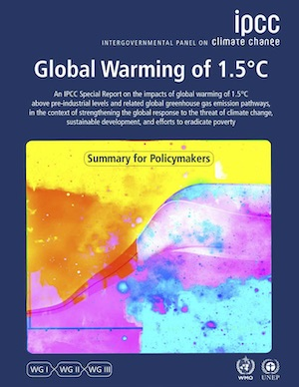
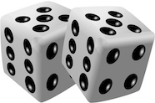
Probabilistic Success
Present climate and related terrestrial processes.
warrant outside the premises
P( )
warming climate
is high.
FACT: our world is hospitable to this inductive inference.
Conclusion asserts
more than premises.
Warranting facts in the detailed climate models.
Includes warrant for probabilities.
e.g. chaotic processes are pseudo-random.

Slide 28
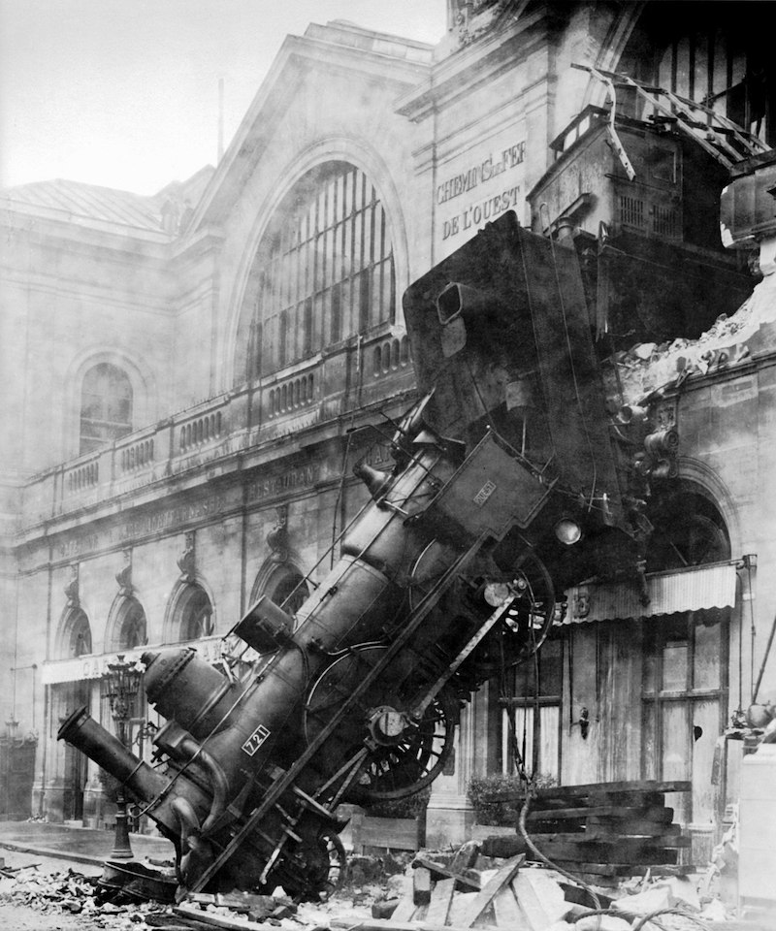
What can go wrong?

Slide 29
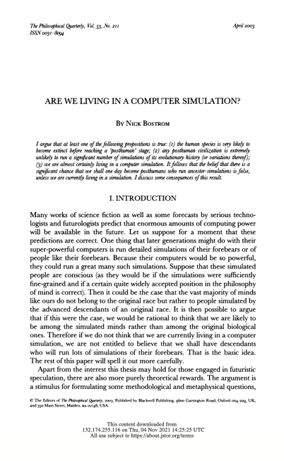
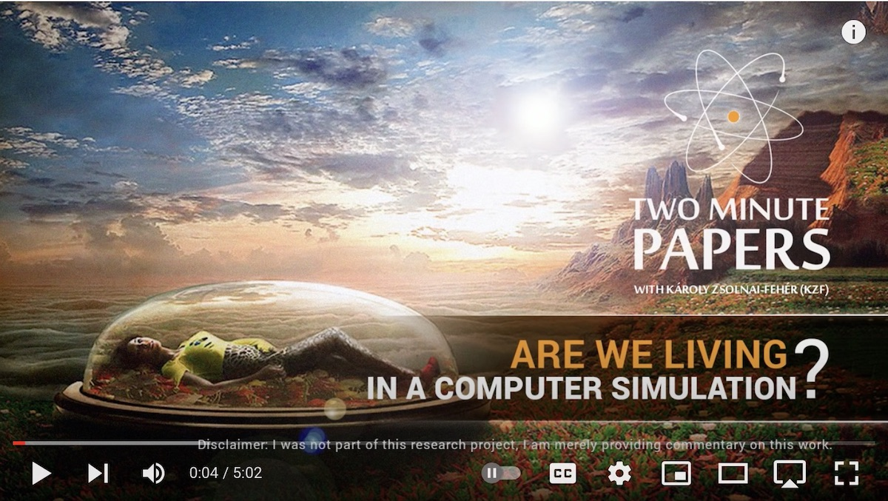
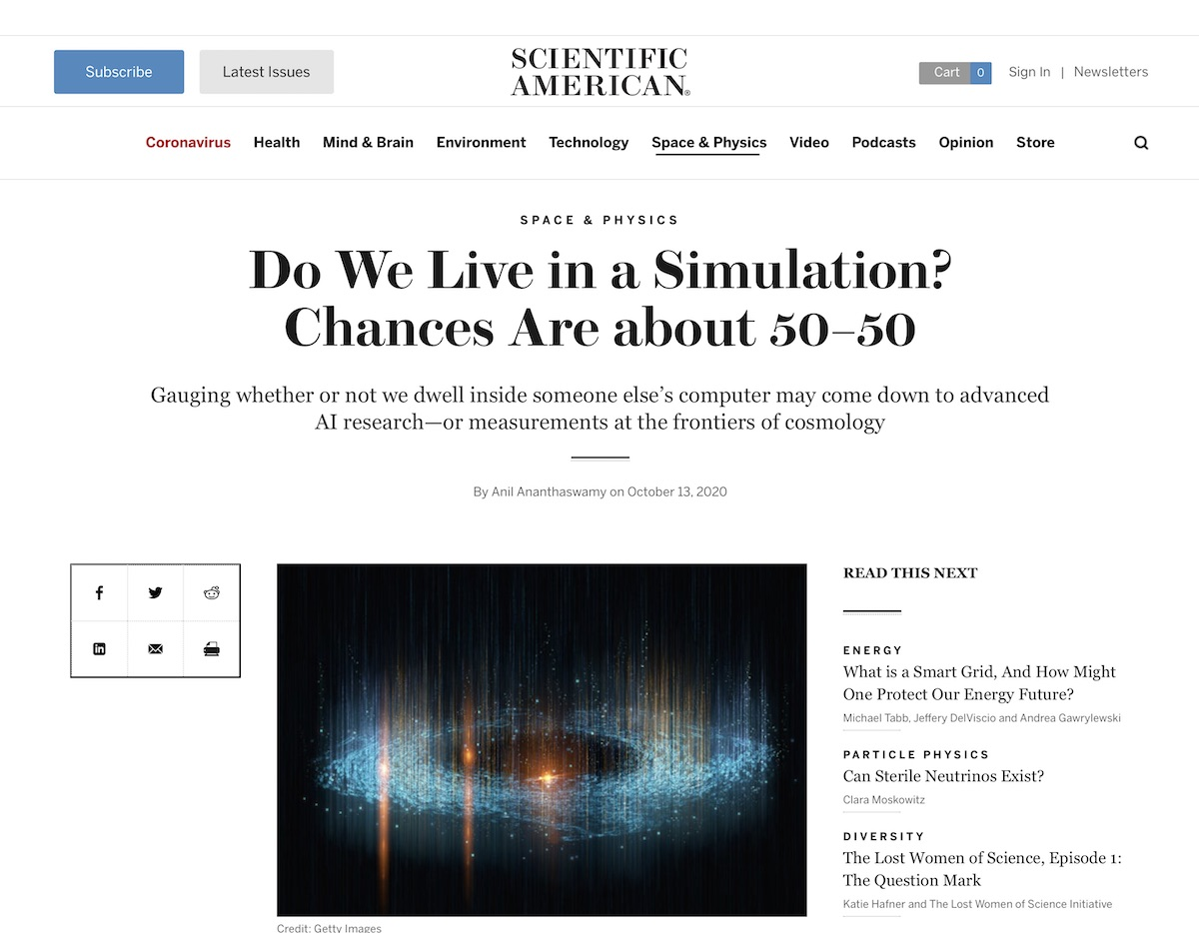

Slide 30

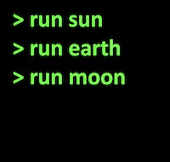
The Fallacy
Relatively few real worlds are possible.
Very many more simulated worlds are possible.

Slide 31
The Fallacy
We do not know which is ours.
Distribute probabilities roughly uniformly over all cases.
Very probably, we are in a computer simulation.
“Inductive disjunctive fallacy”
No background facts authorize probabilities.

Slide 32
Conclusion

Slide 33
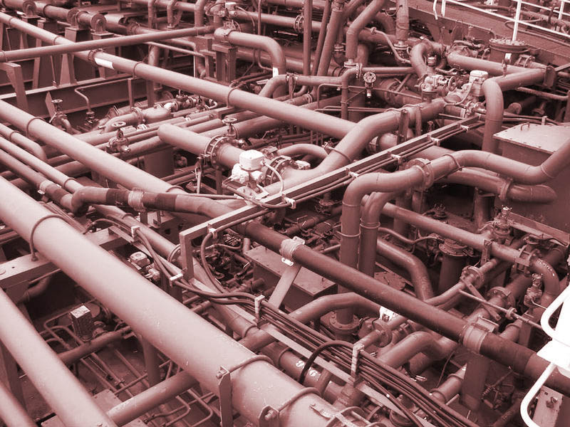
Dualist view of inductive inference
Active schema guide passive facts
as
pipes guide water.

Slide 34
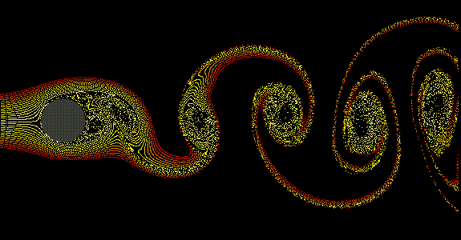
Monist view of inductive inference
Facts organize themselves into inferential structures
as
fluid systems organize themselves into stable structures.

Slide 35


Slide 36
Appendices

Slide 37
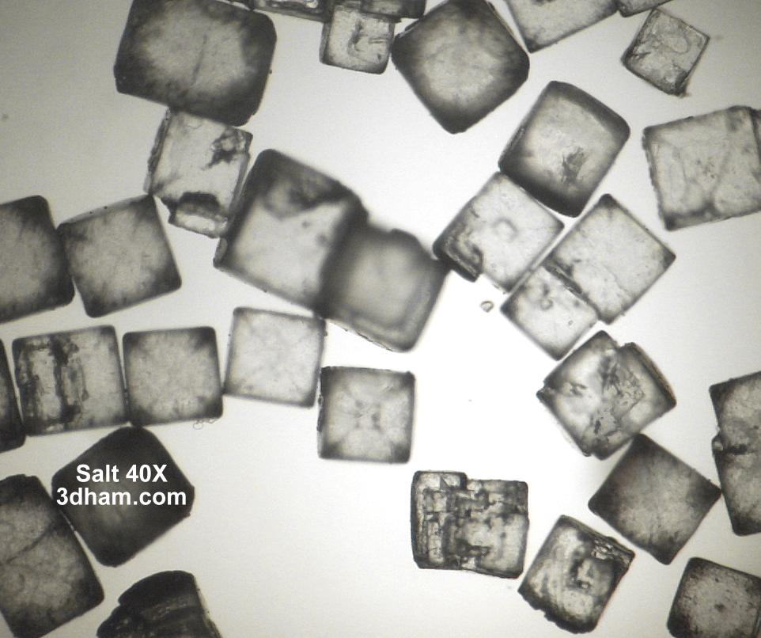
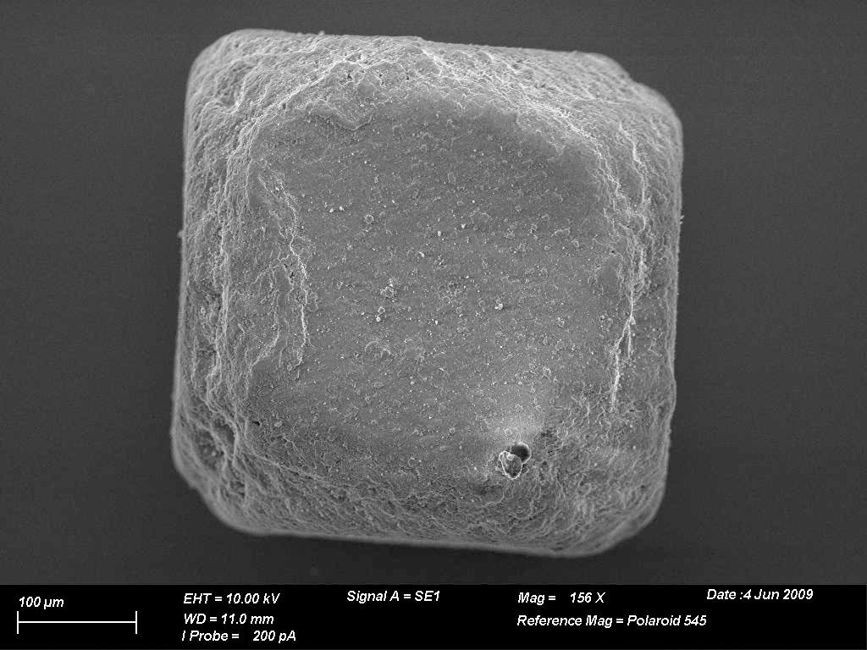
The very hard problem:
Which properties are projectable?
Common salt NaCl belongs to the cubic family
Electron micrograph of a single salt crystal.

Slide 38
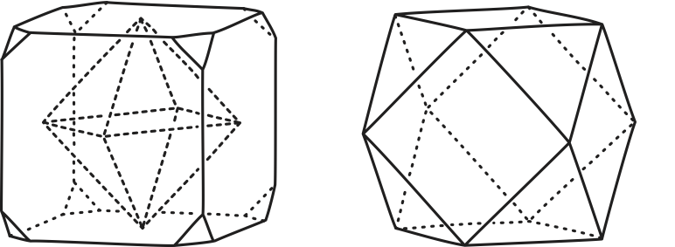
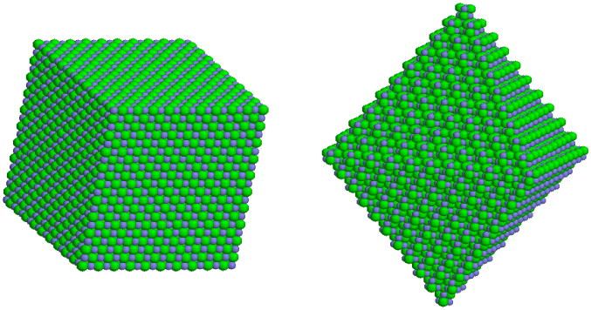
The very hard problem:
Which properties are projectable?
Cube as primitive form
Many shapes possible for crystals

Slide 39
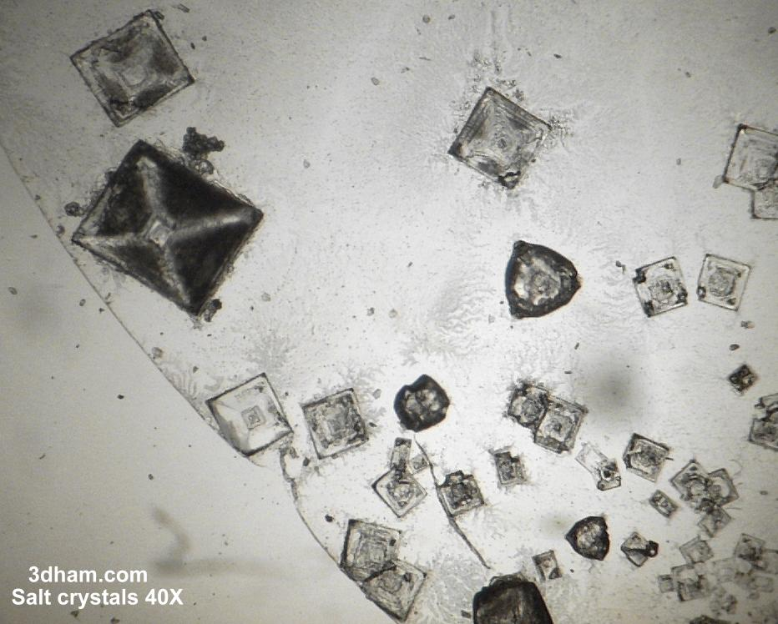
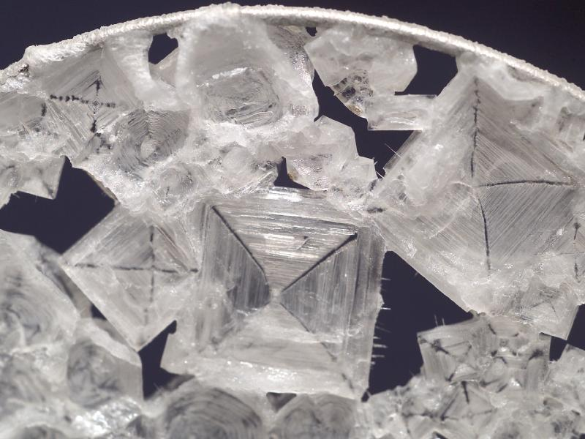
The very hard problem:
Which properties are projectable?
octahedral salt crystals grown in space

Slide 40
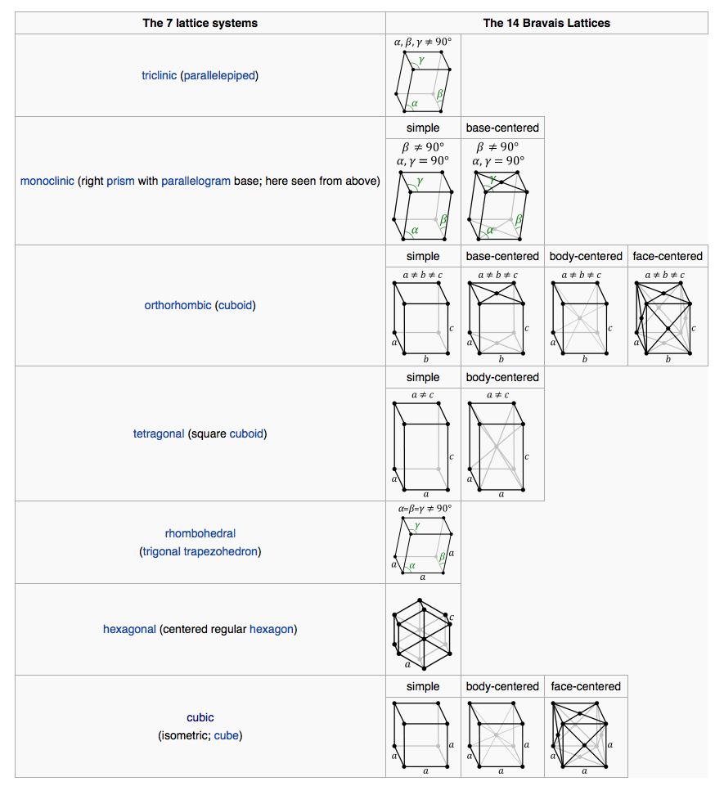
Barium Chloride
Radium Chloride
from wikipedia

Slide 41
There are cases to which probabilistic analysis is demonstrably inapplicable.
2

Slide 42
Material Theory of Induction

Slide 43
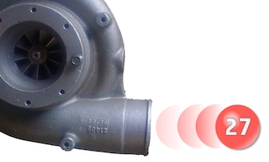
Complete neutrality, indifference
Invariances under redescription, negation preclude probabilities.
Physical cases of spontaneous excitation
Physical properties preclude probabilities.
Infinite lottery machines
Invariance induce a non-probabilistic inductive logic.
Entangled quantum spin systems
Inductive support represented by density matrices.

Slide 44
All arguments for probabilism are circular.
3

Slide 45
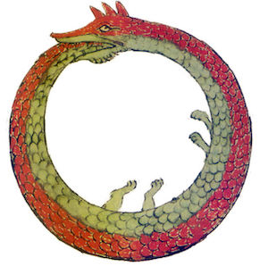
Arguments for Probabilism
Premises
contingent…
… and logically at least as strong as the conclusion.
deduction
Dominance:
Least risk lies in positing the conclusion directly.
Conclusion of the necessity of probabilities
contingent

Slide 47





Accuracy/Scoring Rules
Choose accuracy dominating credences under Brier score/ strictly proper score.
Use of these scoring rules encodes probabilities.
deduction
Most scoring rules give different calculi.
Credences must be probabilities

Slide 48
Alternative Scoring Rules
For credences x₁, …, x_{r}, on r outcomes, when the i-th outcome obtains:
Brier score: L_{i} = x₁² + … + (1-x_{i})² + … + x_{r}²
n-power score: L_{i} = x₁^{n} + … + (1-x_{i})^{n} + … + x_{r}^{n}
superadditive
additive
subadditive
sum of r dominating credences for equal credence outcomes
n

Slide 49
Regress of Reasons
…
Premises
Premises
Premises
Premises
Premises
Premises
Contingent, therefore more reasons needed.
Premises
Contingent, therefore more reasons needed.
deduction
Conclusion of the necessity of probabilities

Slide 50
All calculi of inductive inference are incomplete.
4

Slide 51
The Bayesian Lacuna
P(H)
We want “informationless,” “vacuous” priors.
But priors always add inductive content.
No computation is inductively self-contained.
“incompleteness”
…
conditionalize on E_{n-2}
Is there another, generalized, modified calculus that is complete?
P(H|E_{n-2}…)
conditionalize on E_{n-1}
P(H|E_{n-1}&E_{n-2}…)
NO
conditionalize on E_{n}
P(H|E_{n}&E_{n-1}&E_{n-2}…)

Slide 52
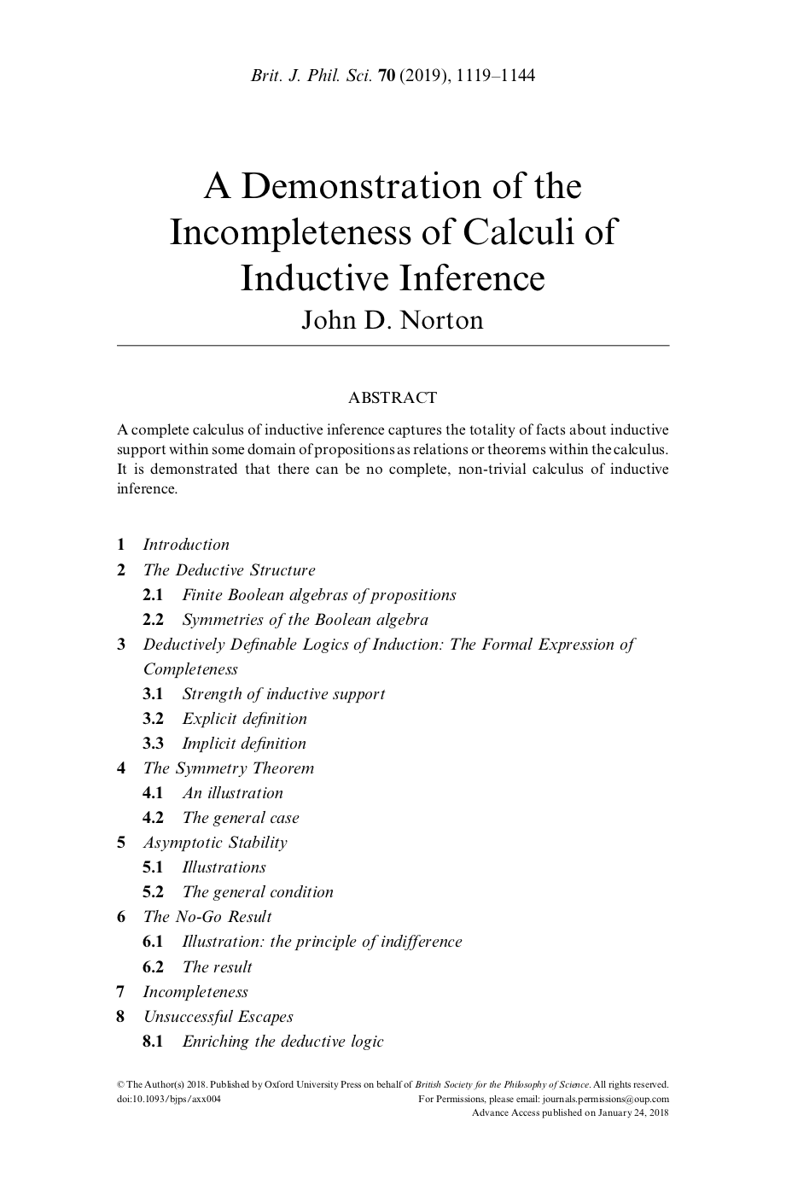

Slide 53
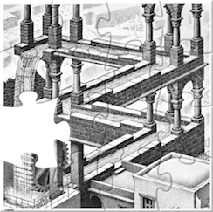
Incompleteness sketched
Deductive Definability
Inductive strength [A|B] defined implicitly or explicit by deductive relations among propositions of a Boolean algebra.
Symmetry of Boolean algebras.
Triviality
All strengths have the same value.
Asymptotic Stability
Principle of indifference reasoning in the extreme.
Inductive strength [A|B] for some fixed propositions eventually stabilize to unique values as the propositions are embedded in larger algebras of propositions.

Slide 54
Completely Neutral Support

Slide 55
Cosmic parameter h over which we are completely ignorant (completely neutral support)
I
I
I
I
I
h
0
1
2
3
4
5
I. Invariance under redescription
(= principle of indifference reasoning)
Ignorance over h: equal intervals have equal support
=
Ignorance over h’ = f(h): equal intervals have equal support
=
II. Invariance under negation
e.g. A = “h lies in [0,1].”
Support for proposition A concerning h
Support for proposition not-A concerning h
I
Invariance under
h’ = f(h) = 1/h
II

Slide 56
Invariance under h’=1/h
I
I
I
I
I
h
0
1
2
3
4
5
Assume smaller interval cannot have greater support.
relabel h to 1/h
I
I
h
0
1
2
3
4
5
Additivity fails
support in
h in [1,2]
support in
h in [1,2] OR
h in [2, ∞]
=

Slide 57
Completely Neutral Support
[A|B] = support
A accrues from B
[ |B] = I
“indifference”
“ignorance”
any contingent proposition
I
I
I
I
I
h
0
1
2
3
4
5
I
I
I

Slide 58
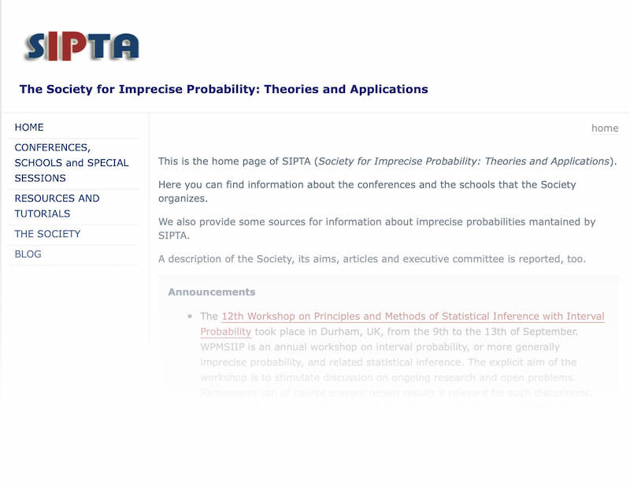


Imprecise
Probabilities?
Main argument applies.
Inferences using imprecise probabilities
Evidence
Results
Results assert more than the conclusion.
Requires an hospitable context.
Problem context calls for
A new logic
Simulate it within the old logic?
NO
Mistaken approach
Recognize the new logic?
YES

Slide 59
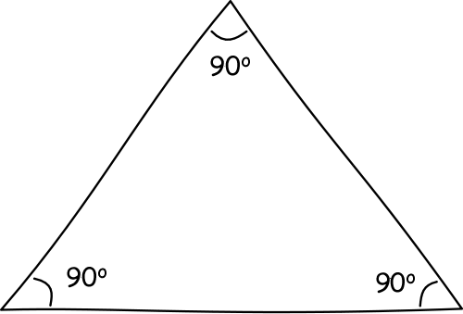
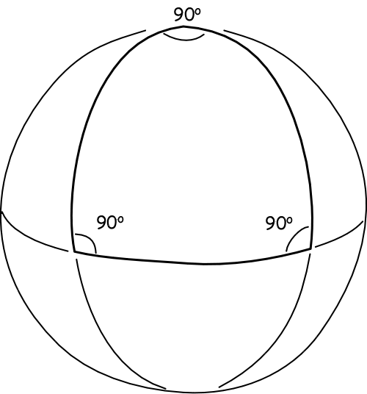
“Surface Logic” Analogy in Geometry
We can simulate virtually any non-Euclidean geometry …
…by embedding the surface in a higher dimensioned Euclidean space.
That does not make Euclidean geometry the One True geometry.

