Slide 1


Slide 2
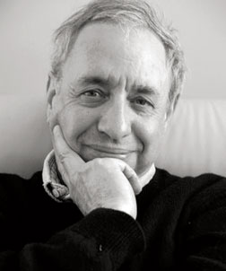
Accounts of causation
Regularity accounts: Mackie’s INUS, Probability raising
Counterfactual Theories: Lewis’ possible worlds semantics
Interventionist Theories: Woodward’s account

Slide 3
Type- versus Token-Causal Claims
Preferred by philosophers of science
Type causation
Smoking causes lung cancer.
Token causation
Jones ’s smoking caused his lung cancer.
Preferred by general philosophers

Slide 4

Regularity accounts
(Difference-making)
The basic idea of difference-making (DM) accounts is that causes “make a difference” to their effects.
Mackie’s (1974) INUS condition account:
C causes E
if and only if
C is a nonredundant part
(where C is typically but not always
by itself insufficient for E)
of a sufficient
(but typically not necessary)
condition for E.
e.g lit match causes fire.
INUS: INsufficient but non-redundant part of a condition which is itself unnecessary but SUfficient for the result.

Slide 5
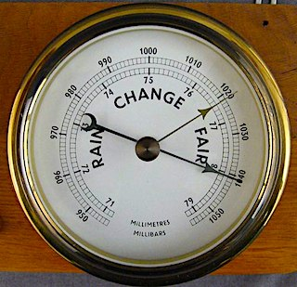

Regularity accounts
(Difference-making)
The basic idea of differ (DM) accounts is that causes “make a difference” to their effects.
Probabilistic version
C causes E
iff
Pr (E / C.K ) > Pr (E / −C.K )
Problems
Cannot distinguish causation from correlation.
Regularities must occur.
Causal relations underdetermined.

Slide 6
Counterfactual Theories (Lewis)
e counterfactually depends on event c
If c were to occur, e would occur
and
if c were not to occur, e would not occur.
iff
there is a causal chain from c to e:
a finite sequence of events c, d, f, . . . e such that d causally depends on c, f on d, . . . and e on f.
c causes e
iff
c → d →f → … → e

Slide 7






Counterfactual Theories (Lewis)
The possible worlds in which c and e are the case are “closer”
or more similar to the actual world than any possible world in which c is the case and e is not.
“If c were the case, e would be the case.”
iff
Similarity measure
(S1) It is of the first importance to avoid big, widespread, diverse violations of law.
(S2) It is of the second importance to maximize the spatiotemporal region throughout which perfect match of particular fact prevails.
(S3) It is of the third importance to avoid even small, localized simple violations of law.
(S4) It is of little or no importance to secure approximate similarity of particular facts, even in matters that concern us greatly.

Slide 8



Counterfactual Theories (Lewis)
“Lewis’s justification for his similarity measure is (at least in large part) simply that it reproduces our ordinary judgments reasonably well.”
“…many features of Lewis’s theory are … of considerable interest when construed as psychological theses. As an empirical matter, both adults and children do readily associate causal claims and counterfactuals in something roughly like the way that Lewis’s theory suggests.”

Slide 9

Interventionist Theories
The core idea … potentially exploitable for purposes of manipulation and control.
Roughly speaking,
if C causes E,
then
if we (or nature) were able to manipulate C
in the right way,
there would be
some associated change in E.

Slide 10

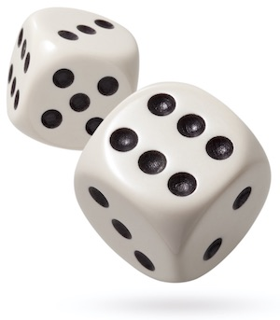
Interventionist Theories
(TC) C
(a variable representing the putative cause)
causes E
(a variable representing the effect)
in background circumstances B
there is some possible intervention that changes the value of C such that
(ii) if that intervention were to occur in B,
there would be an associated change in the value of E
or
in the probability distribution P(E) of those values.
iff
Probabilistic version of theory.

Slide 11


Interventionist Theories
NO change here
manipulate here
change here
yellow fingers
lung cancer
manipulate here
NO change here
smoking

Slide 12
Interventions defined
(IV): I is an intervention variable for X with respect to Y iff
IV1. I causes X.
IV2. I acts as a switch for all the other variables that cause X. This is, certain values of I are such that when I attains those values, X ceases to depend on the values of other variables that cause X and instead depends on the value taken by I.
IV3. Any directed path from I to Y goes through X. That is, I does not directly cause Y and is not a cause of any causes of Y that are distinct from X except, of course, for those causes of Y, if any, that are built into the I-X-Y connection itself; that is, except for (a) any causes of Y that are effects of X (i.e., variables that are causally between X and Y) and (b) any causes of Y that are between I and X and have no effect on Y independently of X.
IV4. I is (statistically) independent of any variable Z that causes Y and that is on a directed path that does not go through X.

Slide 13

defined by
Interventions
Causality
Circularity!!
defined by
“(TC) is not a reductive account of causation: it does not explain “X causes Y” entirely in terms of notions that are themselves purely non-causal.”
“(TC) can be illuminating and not viciously circular even if not reductive.”

Slide 14

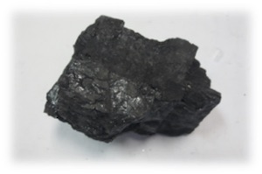

Slide 15
Interventionist account justified by the pragmatic value of the relation defined.

Slide 16

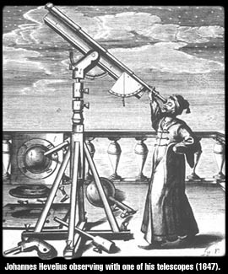
“…many features of Lewis’s theory are … of considerable interest when construed as psychological theses.”
Investigating how we think
Discovering factually how the world is.
vs

Slide 17
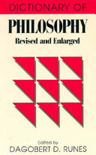
Causal fundamentalism:
Nature is governed by cause and effect;
and
the burden of individual sciences is to find the particular expressions of the general notion in the realm of their specialized subject matter.
We are really proposing new definitions. The world has no obligation to instantiate them.
We pretend we are discovering a deep truth.

Slide 18
