Slide 1
That D*mn Dome John D. Norton Department of History and Philosophy of Science University of Pittsburgh
SWC Scientific World Conceptions
University of Vienna
Summer School
July 2 to July 13, 2018

Slide 2
This lecture…
1. The Indeterminism
2. What about Newton’s First Law?
3. What’s New?
4. What’s Wrong?
4a. Incomplete Formulation of Newton’s Laws?
4b. “Unphysical”
4c. Inadmissible Idealizations
5. When Determinism is Exceptional and Generic
6. Conclusion

Slide 3
1. The Indeterminism
1. The Indeterminism
2. What about Newton’s First Law?
3. What’s New?
4. What’s Wrong?
4a. Incomplete Formulation of Newton’s Laws?
4b. “Unphysical”
4c. Inadmissible Idealizations
5. When Determinism is Exceptional and Generic
6. Conclusion

Slide 4
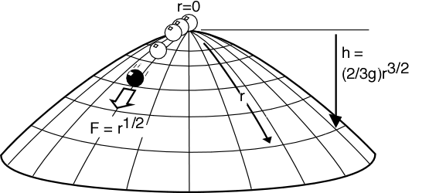
The Arrangement
A unit mass sits at the apex of a dome over which it can slide frictionless. The dome is symmetrical about the origin r=0 of radial coordinates inscribed on its surface. Its shape is given by the (negative) height function h(r) = (2/3g)r^{3/2}.
The mass experiences an outward directed force field
F = (d/dr) potential energy = (d/dr) gh = r^{1/2}.
The motion of the mass is governed by Newton’s “F=ma”:
d²r/dt² = r^{1/2}.

Slide 5
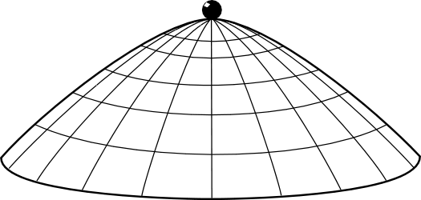
Possible motions: None
r(t) = 0
solves Newton’s equation of motion since
d²r/dt² = d²(0)/dt² = 0 = r^{1/2}.

Slide 6
Possible motions: Spontaneous Acceleration
The mass remains at rest until some arbitrary time T, whereupon it accelerates in some arbitrary direction.
r(t) = 0, for t≤T and
r(t) = (1/144)(t–T)⁴, for t≥T
solves Newton’s equation of motion
d²r/dt² = r^{1/2}.
For t≤T, d²r/dt² = d²(0)/dt² = 0 = r^{1/2}.
For t≥T
d²r/dt² = (d² /dt²) (1/144)(t–T)⁴
= 4 x 3 x (1/144) (t–T)²
= (1/12) (t–T)²
= [(1/144)(t–T)⁴]^{1/2} = r ^{1/2}

Slide 7
The computation again
For t≤T, d²r/dt² = d²(0)/dt² = 0 = r^{1/2}.
For t≥T
d²r/dt² = (d² /dt²) (1/144)(t–T)⁴
= 4 x 3 x (1/144) (t–T)²
= (1/12) (t–T)²
= [(1/144)(t–T)⁴]^{1/2} = r ^{1/2}

Slide 8
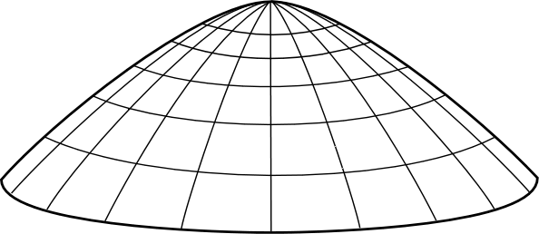
Without Calculus
Imagine the mass projected from the edge.
Close…

Slide 9
Without Calculus
Imagine the mass projected from the edge.
Closer…

Slide 10
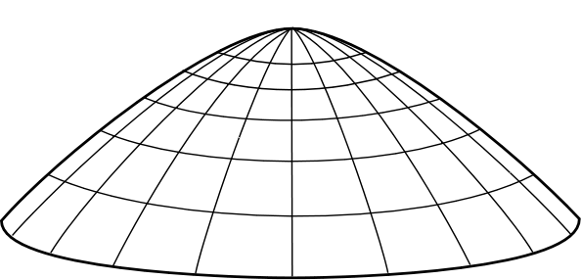
Without Calculus
Imagine the mass projected from the edge.
BINGO!
Now consider the time reversal of this process.
Spontaneous motion!
BUT there is a loophole. Spontaneous motion fails for a hemispherical dome. How can the thought experiment fail in that case?

Slide 11
2. What about Newton’s First Law?
1. The Indeterminism
2. What about Newton’s First Law?
3. What’s New?
4. What’s Wrong?
4a. Incomplete Formulation of Newton’s Laws?
4b. “Unphysical”
4c. Inadmissible Idealizations
5. When Determinism is Exceptional and Generic
6. Conclusion

Slide 12
Newton’s First law
“Every body continues in its state of rest, or of uniform motion in a right line, unless it is compelled to change that state by forces impressed upon it.”
There is no net external force at r=0.
So how can the mass accelerate at r=0?
The law is respected.
The acceleration a(t) is:
For t<T, a(t) = 0
For t=T, a(t) = 0
For t > 0, a(t) = (1/12) (t–T)²
At t=T, there is no net force on the mass and its acceleration vanishes.

Slide 13
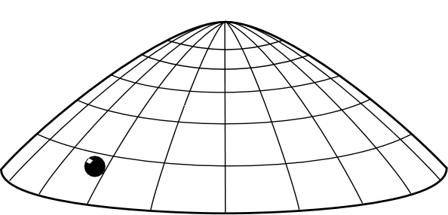
There has to be a cause that sets the mass into motion at t=T! No First Cause?
“… unless it is compelled to change…”
There is no “first moment of motion” at which the first cause would act.
t=T is the last moment at which the mass is at rest.
There is no first moment at which the mass moves.
For any t>T, there is always an earlier moment at which the mass is moving.
And why must every process have a first cause?

Slide 14
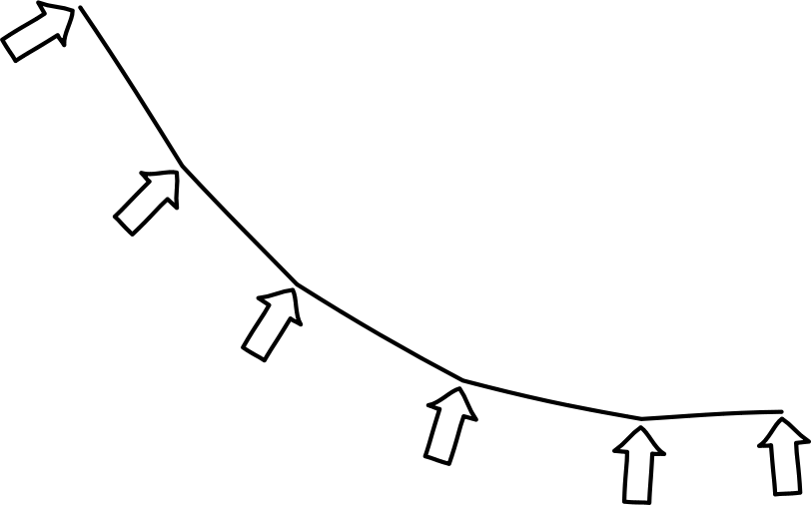
Newton’s Original Formulation of his Laws…
Law 1. Every body continues in its state of rest, or of uniform motion in a right line, unless it is compelled to change that state by forces impressed upon it.
Law 2. The change of motion is proportional to the motive force impressed; and is made in the direction of the right line in which that force is impressed.
…is adapted to the polygonal trajectories he analyzed in Principia
First law applies to inertial segments.
For these trajectories, changes of motion always have first causes, the impulsive forces that coincide with the kinks.
Second law “change of motion” applies to the impulsive forces that create kinks.

Slide 15
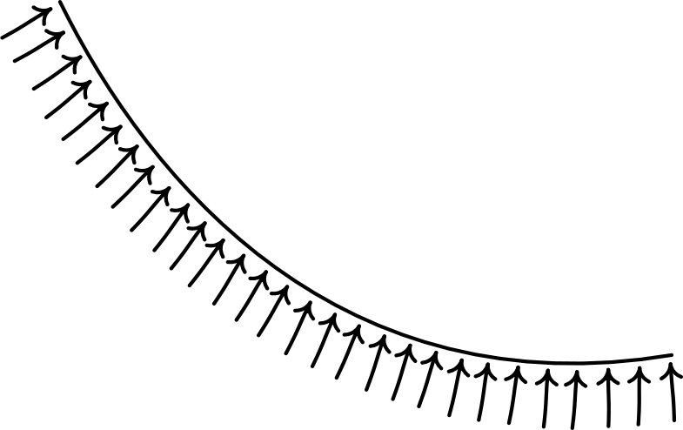
A Modern Formulation of Newton’s Laws…
Law 2. F = ma
The first law is logically entailed by the second.
…is adapted directly to motion governed by continuous forces.
For these trajectories, periods in which motion changes may have no first instant and thus no instant at which the first cause can act.

Slide 16
Newton’s formulation is compatible with continuously varying forces if:
Bruce Pourciau (2006) “Newton’s Interpretation of Newton’s Second Law,” Archive for History of Exact Sciences, 60, pp. 157-207.
“Change of motion”
change of position of the body that accumulates over some non-zero time
Change of position in non-zero time interval t=T to t=T+Δt is motion from
r=0 to r=(1/44)(Δt)⁴.
=
“Motive force impressed”
= …
Motive force impressed is the accumulated effect of the instantaneous forces acting on the mass in the spatial interval
0<r<(1/44)(Δt)⁴.

Slide 17
3. What’s New?
1. The Indeterminism
2. What about Newton’s First Law?
3. What’s New?
4. What’s Wrong?
4a. Incomplete Formulation of Newton’s Laws?
4b. “Unphysical”
4c. Inadmissible Idealizations
5. When Determinism is Exceptional and Generic
6. Conclusion

Slide 18
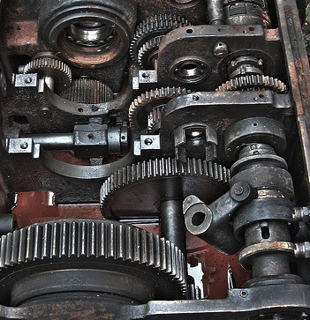
Varieties of Newtonian Indeterminism
Supertask,
space invader
indeterminism
Individual components are locally well-behaved.
Each only changes its motion if struck, pushed or pulled.
Indeterminism arises from assembling individually well-behaved parts.
Dome indeterminism
The mass changes it motion locally without any change in its surroundings.
Indeterministic process cannot be decomposed into locally well-behaved parts.
No way to “pop the hood” and find an engine with well-behaved parts behind the dome.

Slide 19
4. What’s Wrong?
1. The Indeterminism
2. What about Newton’s First Law?
3. What’s New?
4. What’s Wrong?
4a. Incomplete Formulation of Newton’s Laws?
4b. “Unphysical”
4c. Inadmissible Idealizations
5. When Determinism is Exceptional and Generic
6. Conclusion

Slide 20
The dome is not really licit in Newtonian theory because…
…it uses an incomplete formulation of Newton’s law.
…it is “unphysical.”
…it uses inadmissible idealizations.

Slide 21
4a. Incomplete Formulation of Newton’s Laws?
1. The Indeterminism
2. What about Newton’s First Law?
3. What’s New?
4. What’s Wrong?
4a. Incomplete Formulation of Newton’s Laws?
4b. “Unphysical”
4c. Inadmissible Idealizations
5. When Determinism is Exceptional and Generic
6. Conclusion

Slide 22
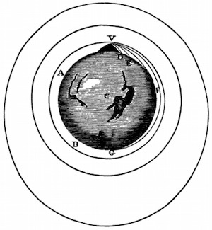
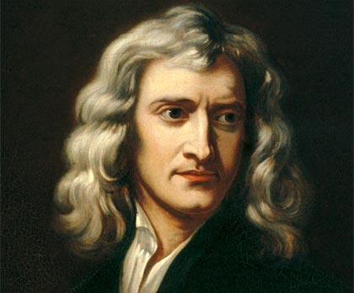
Incomplete Formulation of Newton’s Laws?
Bodies at rest were presumed to stay put!
Intent of Newtonians was that their theory is deterministic.
Canonical examples of Newtonian systems are all deterministic.
The intent of the theorists does not fix the content of the theory.
The theory is not strong enough to enforce determinism in all systems.

Slide 23
Complications
Just which fourth law are we to add to Newton’s three laws?
Merely stipulating determinism is too weak. Which of the many indeterministic motions in the Right One?
Stronger modifications may rule out good behaviors; or be too narrowly tailored to one example.
What is Newtonian theory?
Not decided by experiment; theory is false.
Not decided as a theorem of a bigger system.
Best? Declared by agreement among physicists?
if so
The community…
…may declare a new four-law formulation of Newtonian theory.
…may NOT decree that the standard three law formulation never was a proper formulation.

Slide 24
4b. “Unphysical”
1. The Indeterminism
2. What about Newton’s First Law?
3. What’s New?
4. What’s Wrong?
4a. Incomplete Formulation of Newton’s Laws?
4b. “Unphysical”
4c. Inadmissible Idealizations
5. When Determinism is Exceptional and Generic
6. Conclusion

Slide 25
“Unphysical”
Newtonian theory is approximately true of ordinary things.
Ordinary objects do not launch themselves into motion without being pushed.
The dome is not exploring the properties of the actual world.
The dome is exploring the properties of a false theory; we should expect that exploration to reveal behaviors not realized in the world.

Slide 26
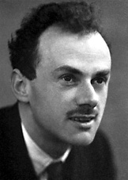
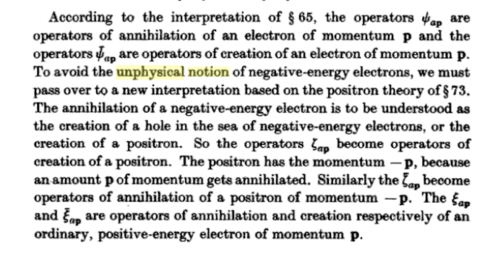
“Unphysical”
A notion of
possibility of great importance to physicists but neglected by philosophers interested in modality.
Paul A. M. Dirac, The Principles of Quantum Mechanics, 4th ed., 1958, p. 293,

Slide 27
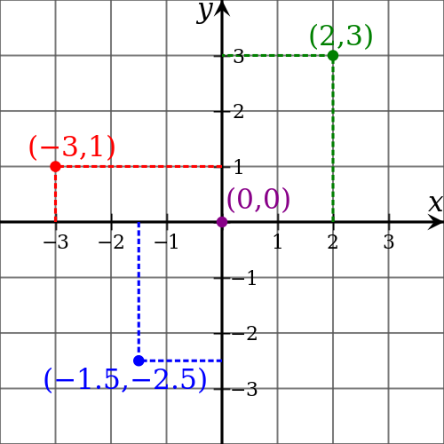
Four notions of “unphysical”
1
Unphysical = cannot obtain in the real world.
Notion: Unphysical as gauge (overdescription).
Relevance:
NOT notion at issue, since indeterministic motions not due to arbitrary descriptive conveniences.
Example: Origin of coordinate system in Euclidean space.
Remedy: Do nothing, just remember it’s unphysical.

Slide 28
Four notions of “unphysical”
2
Unphysical = cannot obtain in the real world.
Notion: Unphysical as false. Unphysical predictions are just wildly off what we see in the world.
Relevance:
Does not license excision of dome, but full rejection of the theory.
Probably NOT notion since the dome cannot be realized in actual world.
Example: “Ultraviolet catastrophe” of classical electrodynamics.
The theory predicts infinite energy densities; we see finite energy densities.
Remedy: Reject theory as false at least in this domain.
Atomic nature of matter precludes building exact shape of dome.
Quantum theory prohibits placing a mass exactly at rest exactly at the apex of the dome.

Slide 29
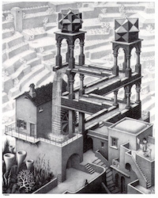
Four notions of “unphysical”
3
Unphysical = cannot obtain in the real world.
Notion: Unphysical as pathological.
Physical theory
+
other assumptions
contradiction
Example: “Ultraviolet catastrophe” of classical electrodynamics.
Electrodynamics posits FINITE E and B fields everywhere.
Electrodynamic field achieves thermal equilibrium.
INFINITE E and B fields everywhere.
+
Singularities in general relativity.
Relevance:
Assumptions in the dome do not contradict Newtonian theory.
They contradict default expectations.
Remedy: Reject theory or other assumptions or both.

Slide 30
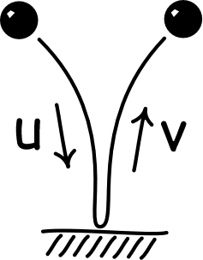
Four notions of “unphysical”
4
Unphysical = cannot obtain in the real world.
Notion: Unphysical as underdescription. Spurious solutions admitted by incompleteness in theory.
Relevance:
Closest to notion sought since it permits excision of consequences.
Example: Bouncing ball
Energy conservation entails
u²=v²
which has solutions
u=v and u=-v
BUT inapplicable, since we have no independent access to the target system.
NO basis to sort spurious from proper solutions.
Dome exists solely as idealization of theory.
Eliminate as
unphysical since the surface is impenetrable
Atomic nature of matter precludes building exact shape of dome.
Quantum theory prohibits placing a mass exactly at rest exactly at the apex of the dome.
Remedy: Excise spurious solution by hand.

Slide 31
4c. Inadmissible Idealizations
1. The Indeterminism
2. What about Newton’s First Law?
3. What’s New?
4. What’s Wrong?
4a. Incomplete Formulation of Newton’s Laws?
4b. “Unphysical”
4c. Inadmissible Idealizations
5. When Determinism is Exceptional and Generic
6. Conclusion

Slide 32
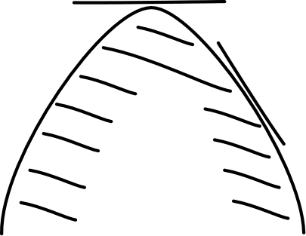
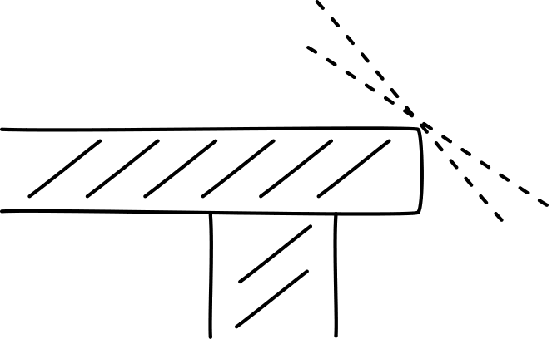
Inadmissible Idealizations
The dome uses many idealizations whose denial would block the indeterminism.
• Point mass of zero extension slides frictionlessly. • Curvature singularity at the apex. • Mass is initially located exactly at apex exactly at rest. • Dome surface is perfectly rigid.
Dome: curvature diverges, but tangent everywhere defined.
The idealizations of the dome are no worse than those routinely used and often less extreme.
Table with sharp edge:
curvature diverges, and tangent undefined.
The objections work backwards: Denying the idealization would block the indeterminism. So deny the idealization.

Slide 33
Two Types of Inadmissible Idealization
External
Idealization fails to represent some independently described specified system.
Internal
Idealization relates badly to theory.
Example:
The dome cannot represent any real dome due to atomic and quantum limits.
Examples:
Logical contradiction. Perfectly rigid bodies in theories prohibiting v>c.
Failure of standard methods. Point mass on surface that is continuous but nowhere differentiable.
Inapplicable.
The dome is not an independently described system.
Inapplicable.
Idealizations of the dome no worse than elsewhere. Unless…

Slide 34
Idealizations created by limits
Badly-
behaved limits
Bad idealizations
The intuition
are
System₁
more realistic
System₂
Discontinuity here
= failed idealization
System₃
less realistic, more idealized
Limit
System

Slide 35
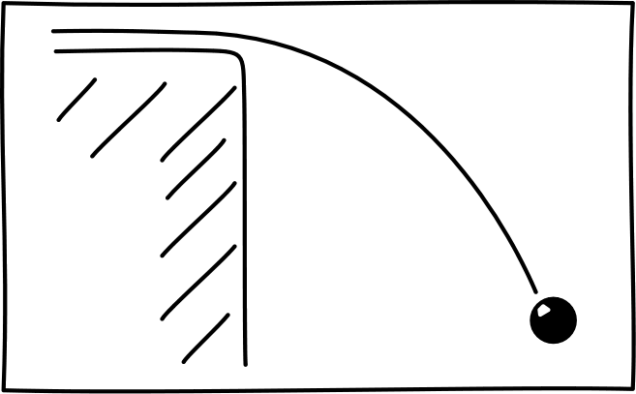
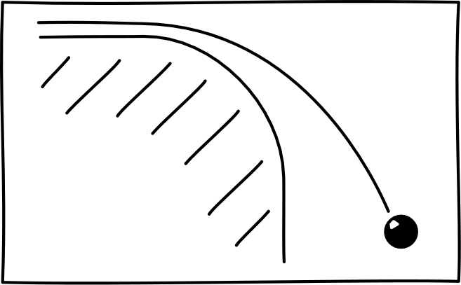
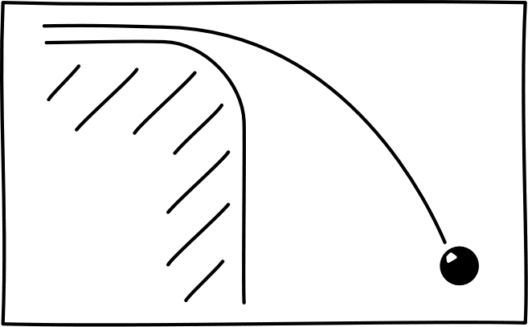
?Badly Behaved Limits are Bad Idealization?
Trajectory of mass over rounded table edge unaffected by taking limit of sharp edge.
Admissible idealization.

Slide 36
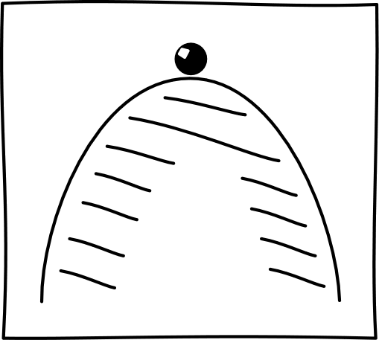
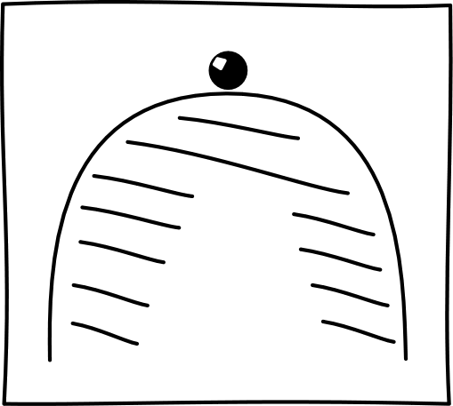
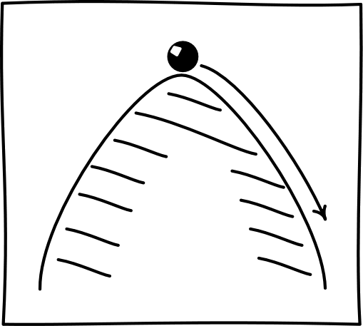
?Badly Behaved Limits are Bad Idealization?
Determinism of motions on dome with everywhere finite curvature changes discontinuously as we take limit of diverging curvature.
Inadmissible idealization??

Slide 37
Idealizations created by limits
Badly-
behaved limits
Bad idealizations
The intuition
are
System₁
more realistic
System₂
Discontinuity here
Limit System that is qualitatively different from the other systems.
The limit system itself may be quite OK.
System₃
less realistic, more idealized
Limit
System

Slide 38
Limits behaving badly
System₁
Property₁
deterministic
Inexact description
System₂
Property₂
deterministic
System₃
Property₃
deterministic
is not
Limit
System
Limit
Property
Exact description
deterministic
Limit system and limit property do
not match.
(indeterministic)
Limit System
System₁
is a bad idealization of
Limit System
is inadmissible.
System₂
NOT
System₃
…

Slide 39
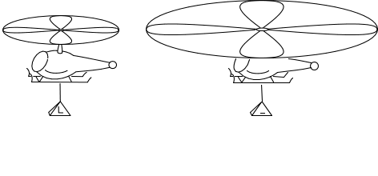
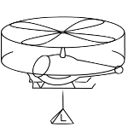
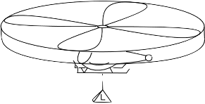
Infinite Helicopter Rotor
Double rotor size. Halve rotor speed.
What is the lift generated by an infinite, non-rotating rotor?
Rotor lift stays the same (at L). Power consumed is halved.
Limit of infinitely many doublings.
. . .
Properties
Lift L
Lift L
Lift L
limit
. . .
Infinite, non-rotating rotor generates NO LIFT and consumes no power.
System
… a bad idealization of …

Slide 40
Rigid Structures are Statically Indeterminate
Forces in a perfectly rigid beam…
Balance of all forces and moments:
V_{A}= V_{B}/2= V_{C}
but
H_{A}=H_{C} = ANYTHING

Slide 41
Deformable Structures are Statically Determinate
Forces in a beam with any elasticity, no matter how small…
Balance of all forces and moments fixes all individual forces.
Rigid structures
are bad idealizations of
deformable structures
in this aspect.

Slide 42
5. When Determinism is Exceptional and Generic
1. The Indeterminism
2. What about Newton’s First Law?
3. What’s New?
4. What’s Wrong?
4a. Incomplete Formulation of Newton’s Laws?
4b. “Unphysical”
4c. Inadmissible Idealizations
5. When Determinism is Exceptional and Generic
6. Conclusion

Slide 43
Newtonian systems with Finitely Many Degrees of Freedom
Dynamical state fixed by n real valued variables
x₁, x₂, … , x_{n}
Generally deterministic.
dx₁/dt = f₁(x₁, … , x_{n})
dx₂/dt = f₂(x₁, … , x_{n})
…
dx_{n}/dt = f_{n}(x₁, … , x_{n})
Generally?
Exceptions: simplest is the dome.

Slide 44
Newtonian Systems with Infinitely Many Degrees of Freedom
Dynamical state fixed by infinitely many real valued variables
x₁, x₂, …
Generally INdeterministic.
when systems are sufficiently coupled so they don’t decompose into infinitely many systems each with finitely many degree of freedom.
dx₁/dt = f₁(x₁, …)
dx₂/dt = f₂(x₁, …)
…
Examples: supertasks with infinitely many masses, colliding, interacting via springs.

Slide 45
Generate multiple solutions…
Choose system such that component n couples with components n-1, n+1.
dx₁/dt = f₁(x₁, x₂)
dx₂/dt = f₂(x₁, x₂, x₃)
dx₃/dt = f₂(x₂, x₃, x₄)
…
Generate two solutions x₁(t), x*₁(t) that agree for t<0 and at t=0 and disagree afterwards by…
Up to minor distractions, this is the structure of masses and springs:
Fine print
f_{n}(x_{n-1}, x_{n}, x_{n+1}) must be invertible in final argument and the inverse arbitrarily differentiable.
x₁(t) and x*₁(t) must be arbitrarily differentiable and agree in all derivatives at t=0.

Slide 46
… by Iteration
dx₁/dt = f₁(x₁, x₂)
dx₂/dt = f₂(x₁, x₂, x₃)
dx₃/dt = f₂(x₂, x₃, x₄)
…
Fix x₁(t).
Solve for x₂(t)
Similarly generate x*₁(t).
Indeterminism is generic since the iteration method is robust under small changes in the system.
dx₁/dt = f₁(x₁, x₂)
dx₂/dt = f₂(x₁, x₂, x₃)
dx₃/dt = f₂(x₂, x₃, x₄)
…
Know x₁(t), x₂(t).
Solve for x₃(t)
dx₁/dt = f₁(x₁, x₂)
dx₂/dt = f₂(x₁, x₂, x₃)
dx₃/dt = f₂(x₂, x₃, x₄)
…
Know x₂(t), x₃(t).
Solve for x₄(t)
etc.

Slide 47
6. Conclusion
1. The Indeterminism
2. What about Newton’s First Law?
3. What’s New?
4. What’s Wrong?
4a. Incomplete Formulation of Newton’s Laws?
4b. “Unphysical”
4c. Inadmissible Idealizations
5. When Determinism is Exceptional and Generic
6. Conclusion

Slide 48
Conclusion
The dome provides the simplest example yet of indeterminism within Newtonian theory.
No need for infinitely many interacting components, space invaders with unbounded speed.
It raises the questions:
What is Newtonian theory?
What grounds judgments that a system is “unphysical”?
When are idealizations inadmissible?

Slide 49
The End

