Slide 1
How to Avoid the Experimenter’s Regress
By Allan Franklin
Presentation by Brett Park

Slide 2
A Confession
Even when reading Collins’ account, I was totally unsympathetic to Weber’s case (and therefore Collins’)
I strongly disliked Collins’ reply to Franklin
Thus, my presentation will be extremely slanted towards Franklin

Slide 3
The Presentation
Collins' and Franklin's positions
A Discussion on Sources
Weber: P-Hacker or Savant Experimentalist?
Duhem Quine case study
Collins' Counterfactual
Meta-analysis
Gems & Integrated HPS

Slide 4
The Two Positions
Franklin
Collins
Weber's critics defeated him primarily through experimental disconfirmation, which is best explained by the non-existence of his phenomena
Weber had many independent lines of evidence piling up against him
It was something besides experimental evidence which broke the regress and sunk Weber's research program:
A charismatic opponent (Garwin)
A last-minute mistake (using the calibration procedure)

Slide 5
Sources
Franklin
Collins
Uses only the published literature because:
Interviews can be misleading
Publications represent scientists considered views
Franklin is a physicist and clearly has a better grasp of the relevant science
Uses both the published literature and interviews with the relevant physicists because:
It is a superset of Franklin's sources
Interviews give us the gritty, closed-door political details of the episode
Collins is a sociologist and so cares more about the human element

Slide 6
Discussion Question
Two uncharitable interpretations:
Franklin is too focused on the physics to see the driving role of the social aspect of this episode
Collins is not technically literate enough to follow the published sources carefully, and thus uses the interviews as a crutch
Which method is superior in this instance?
Or, does the proper choice of sources inevitably end up as part of the debate itself?

Slide 7
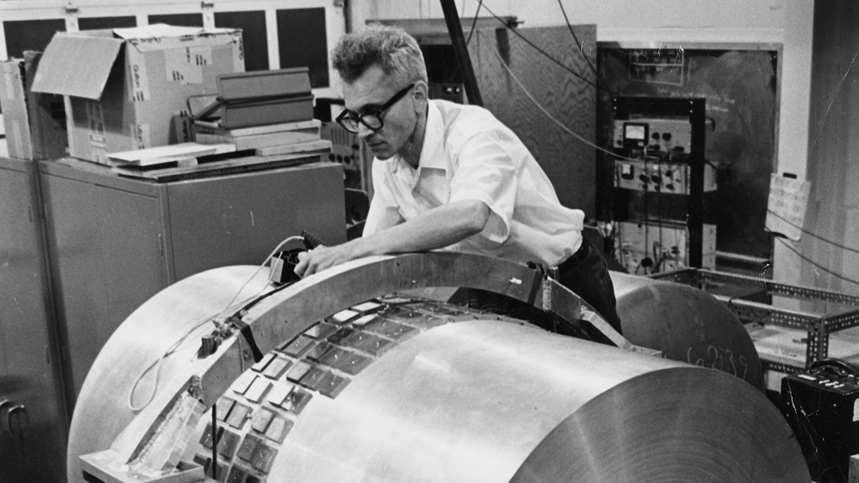
Weber: P-Hacker or Savant Experimentalist?

Slide 8
Collins' Case for Savant Experimentalist
Collins claims that it was plausible to explain Weber's lone positive result by his unique experimental expertise:
Asymmetric incentives between positive and negative results
Weber was an electrical engineer
Weber had spent more time and effort working with the instrument

Slide 9
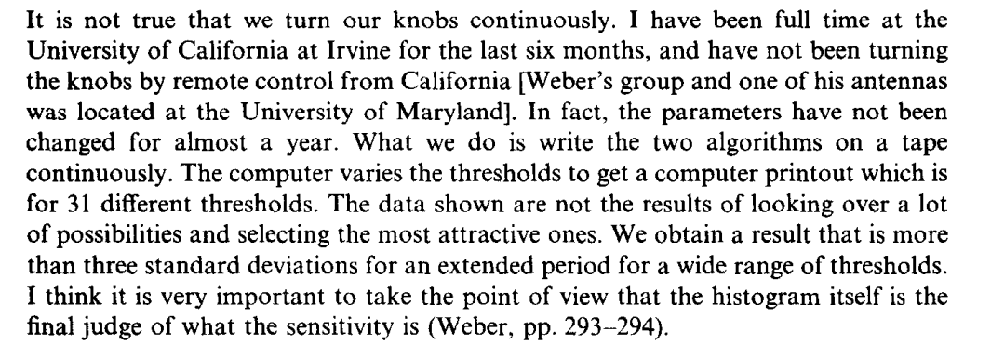
Franklin's case for P-Hacker: Choosing Different Thresholds
Weber's critic (Tyson):
(p. 479)
Weber's Response:
(p. 481)

Slide 10
Franklin's case for P-Hacker: 4 hour time delay result
Weber reported a 2.6 σ result of coincidental waves detected with 1.2 second time delay
However, it was revealed that the different timezones of the observation implied a four hour, 1.2 second time delay
Thus, Weber reported a near 3 σ result which was a known false-positive, undermining his earlier 3 σ results

Slide 11
Duhem-Quine Again
Weber could individually explain away other research group's null results using auxiliary hypotheses
Example: Group 2's instrument cannot detect longer than expected pulses
However, as an ensemble, there were few interpretive options which could consistently explain all of the null results
Example: Group 3 and 4 can detect longer pulses but did not

Slide 12
Duhem-Quine Again (cont.)
Auxiliary Hypothesis | Group 2 | Group 3 | Group 4
H1
H2
H3
= Can explain null result​
= Cannot explain null result
Thus, Weber can individually explain every group's null result using H1, H2, or H3, but the conjunction (H1 & H2 & H3) needs to be internally consistent
In addition, additional auxiliary hypotheses will contradict more and more established science, calling for more auxiliary hypotheses, etc.

Slide 13
Collins' counterfactual
Collins: Weber should not have agreed to the calibration procedure because doing so constrained his interpretive options by assuming
That gravity waves behave like normal electrostatic forces
That a localized pulse is a good proxy for an instrument-wide force
Collins offers a bizarre counterfactual:
Had Weber not made the mistake of agreeing to the calibration procedure, his results might have led to "a schism in the scientific community or even a discontinuity in the progress of science" (Collins, p. 105)
In truth, Weber's choices were to either
Accept the calibration procedure, or
Explain his refusal using additional auxiliary hypotheses
Those auxiliary hypotheses would have been disconfirmed in turn

Slide 14
Meta-Analysis: Collins is Weber
Weber is data-dredging to get his significant results
Collins is data-dredging the history to put Weber on a par with his critics

Slide 15
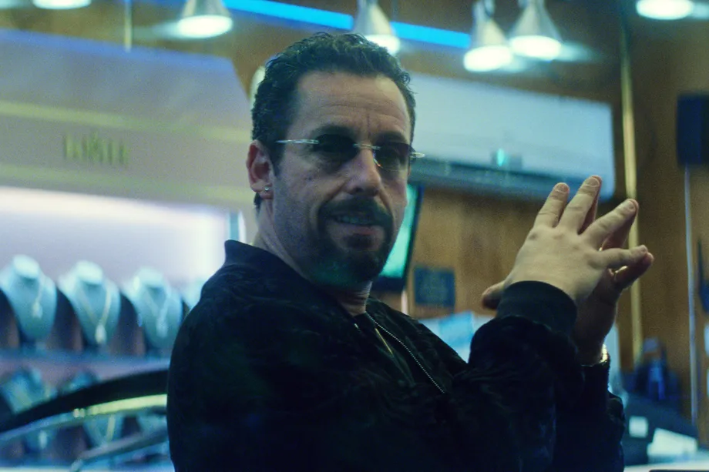
Gems
Extra Context needed for Charts
Clear example of the Duhem-Quine problem
Franklin Sticks more closely to the first-order facts of the episode

Slide 16
Integrated HPS
History
Philosophy
Published papers
Collins' History
Realism
SSK & Experiment's Regress

