Slide 1
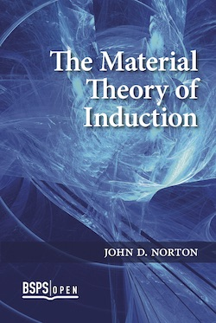
Integrating History and Philosophy of Science: Darwin, Inference to the Best Explanation and More John D. Norton
&
Material Theory of Induction.
BSPS Open. Ch 8-9

Slide 2
Inference to the Best Explanation
WINNER
Among many theories adequate to experience, choose …
Theory₂
Theory₃
Theory₁
Theory₄
… the best explnation.
Observation and experiment.

Slide 3
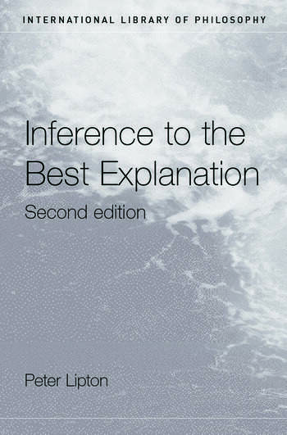
Peter Lipton’s summary
Loveliness of an explanation
Likeliness of an explanation

Slide 4
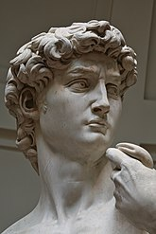
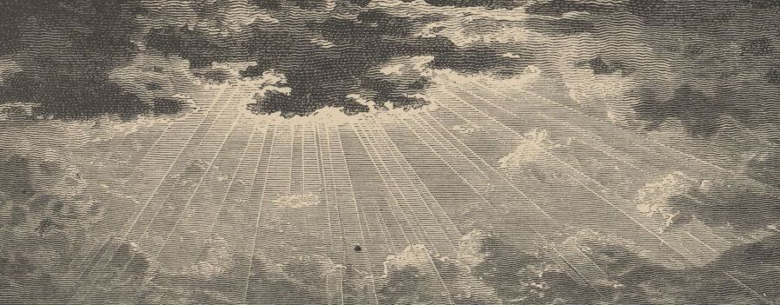
What precisely is inference to the best explanation?
Loveliness?
Explanation?
AHA! AHA!
AHA!
What is the special power of explanation that makes it truth conducive?

Slide 5
A better explanation is…
… more consilient
… simpler
… better analogy
… more plausible
… less ad hoc
… lovelier
and
…mechanism, scope,
fertility, fit, unification,
…
…
One task
Explicate explanation.
Complicated, heterogeneous notion of explanation.
????
Many tasks
Explicate all these …
Simple homogenous notion of truth?

Slide 6
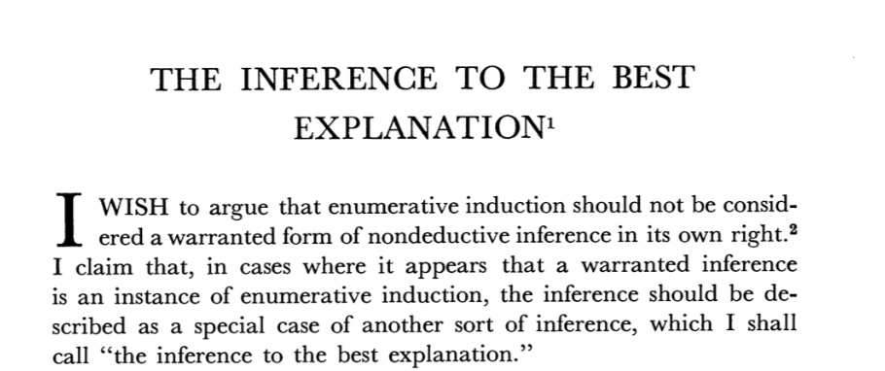
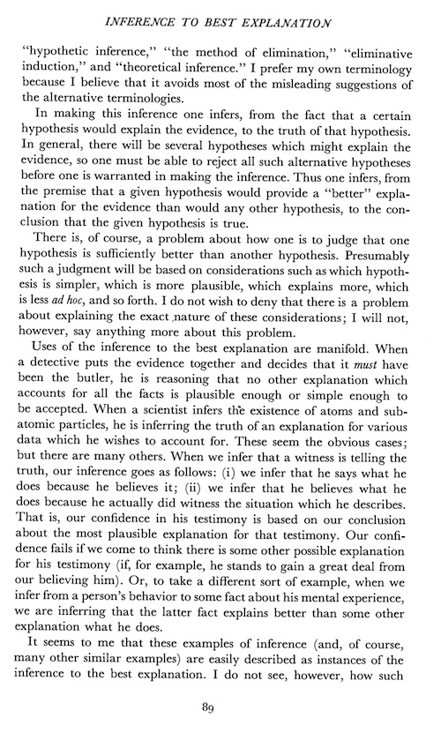
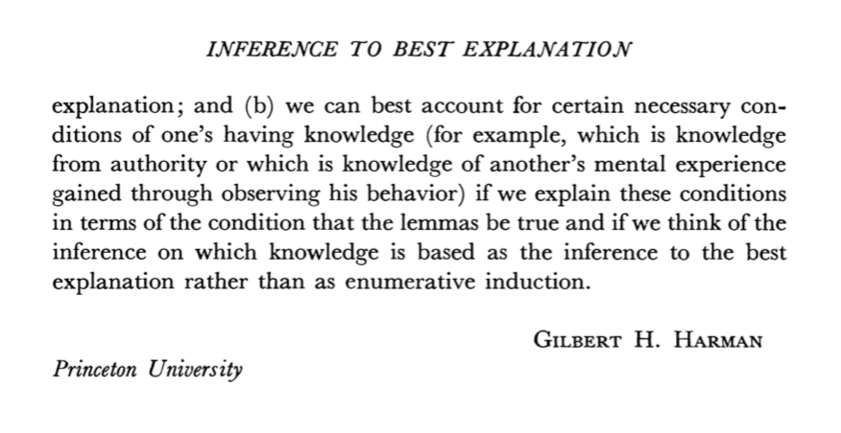
Gilbert Harman
“There is, of course, a problem about how one is to judge that one hypothesis is sufficiently better than another hypothesis. Presumably such a judgment will be based on considerations such as
which hypothesis is simpler,
which is more plausible,
which explains more,
which is less ad hoc,
and so forth. I do not wish to deny that there is a problem about explaining the exact nature of these considerations; I will not, however, say anything more about this problem.”

Slide 7
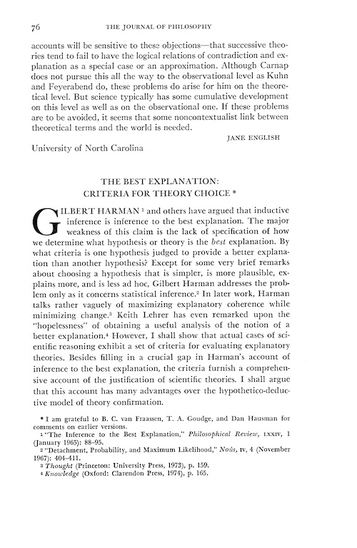
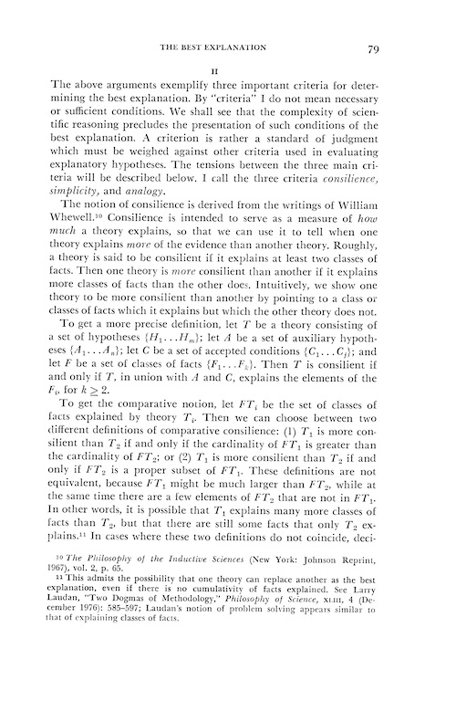
Paul Thagard
“ … three important criteria for determining the best explanation …
… standard of judgment which must be weighed against other criteria …
… I call the three criteria
consilience,
simplicity,
and analogy.”

Slide 8
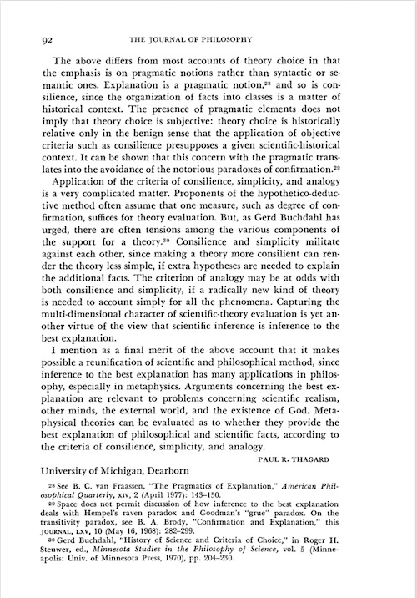
Paul Thagard
“Application of the criteria of consilience, simplicity, and analogy is a very complicated matter.
… Consilience and simplicity militate against each other…
… analogy may be at odds both consilience and simplicity.”

Slide 9
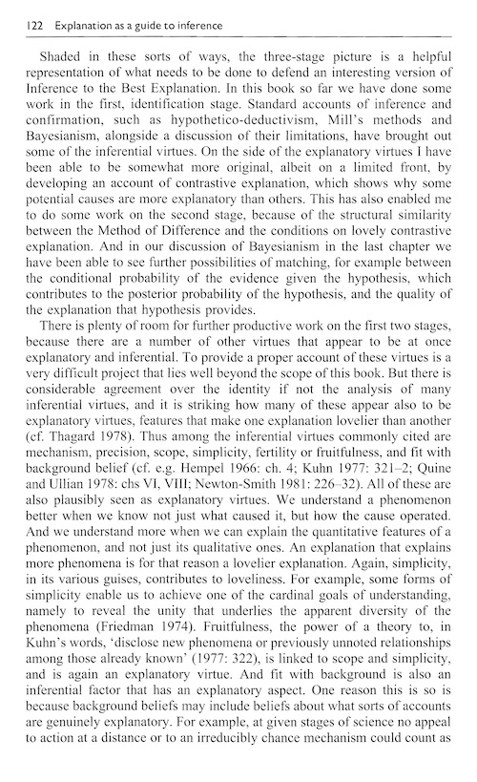
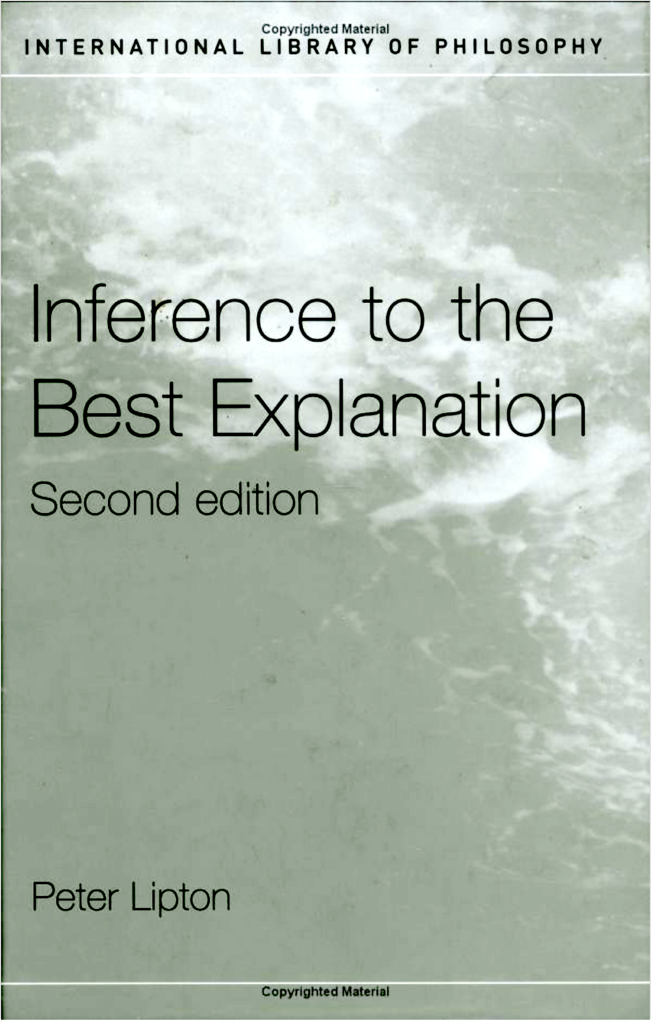
Peter Lipton
“…inferential virtues commonly cited are
mechanism,
precision,
scope,
simplicity,
fertility or fruitfulness, and
fit with background belief…
All these are plausibly seen as explanatory virtues.”
Added, p. 139 “unification”

Slide 10
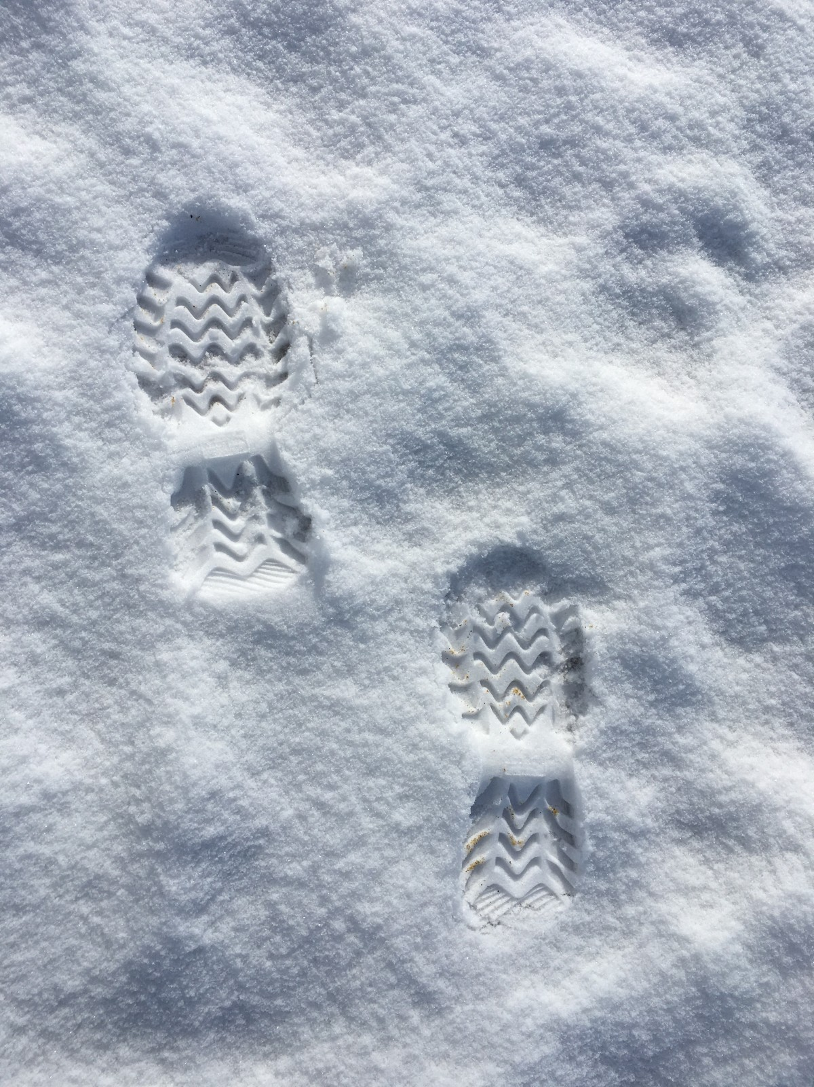
Importance of real case studies
“Faced with tracks in the snow of a certain peculiar shape, I infer that a person on snowshoes has recently passed this way.”
(Lipton, 2004, p. 6)
“Of course, there is always more than one possible explanation for any phenomenon–the tracks might have instead been caused by a trained monkey on snowshoes, or by the elaborate etchings of an environmental artist–so we cannot infer something simply because it is a possible explanation. It must somehow be the best of competing explanations.”
(p. 56)

Slide 11
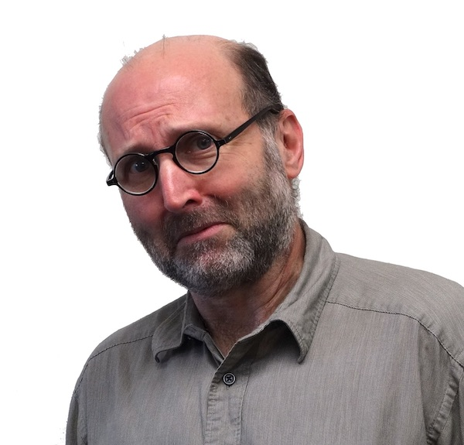
What is inference to the best explanation?
How does it work?

Slide 12
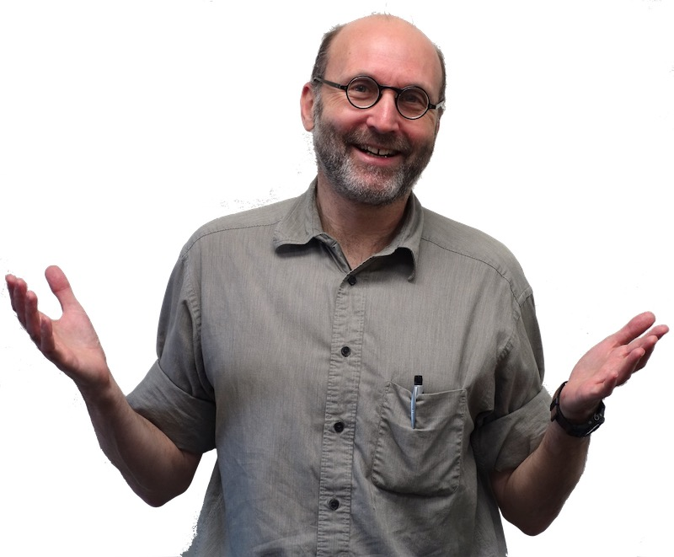
I’ll go the history and look at the canonical cases of IBE.
How did they work?

Slide 13
Two Step Structure
Step 1
Favored theory or hypothesis.
vs
Foil
(one or more)
Adequate to the evidence, usually deductively entails it.
Fails.
Evidence contradicts it; or incurs evidential debt.
No distinctive, inductively potent notion of explanation.
Strength of abduction from failure of foil.
Step 2
Favored theory is better.
Favored theory is best.
Hard to establish. Often neglected.

Slide 14
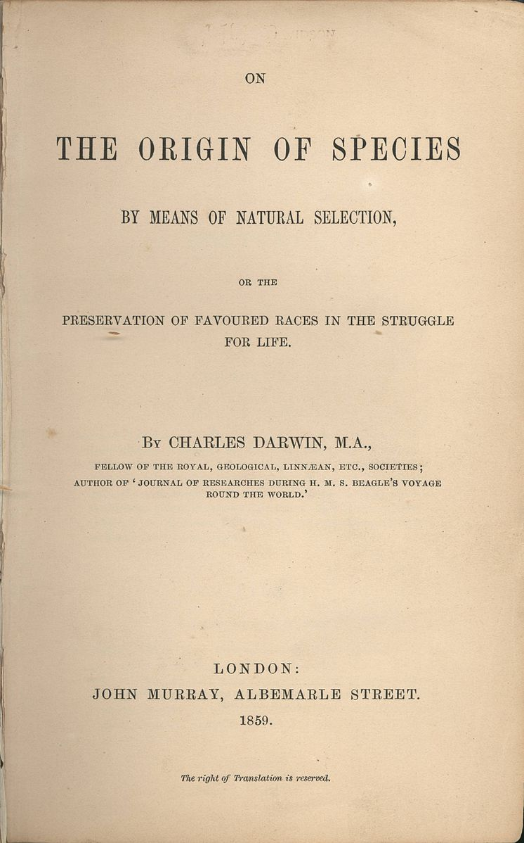
Darwin for Natural Selection
“Many other facts are, as it seems to me, explicable on this theory. How strange it is that a bird, under the form of a woodpecker, should prey on insects on the ground; that upland geese which rarely or never swim, should possess webbed feet; that a thrushlike bird should dive and feed on sub-aquatic insects; and that a petrel should have the habits and structure fitting it for the life of an auk! and so in endless other cases. But on the view of each species constantly trying to increase in number, with natural selection always ready to adapt the slowly varying descendants of each to any unoccupied or ill-occupied place in nature, these facts cease to be strange, or might even have been anticipated.”
6th ed, 1876, p. 414.

Slide 15
Two Step Structure
Step 1
Natural selection
vs
Special creation
Webbed feet from adaptation of aquatic bird to land.
Webbed due to arbitrary choice of designer.
Step 2
Favored theory is better.
Favored theory is best.
??? Tacit assumption that options are exhaustive.

Slide 16
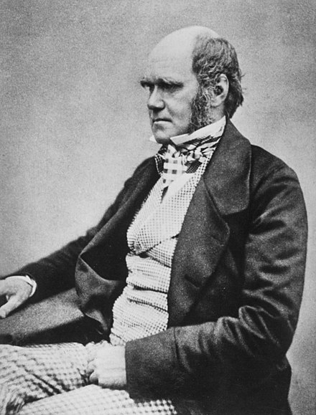
Darwin knows he is using a novel argument form.
It can hardly be supposed that a false theory would explain, in so satisfactory a manner as does the theory of natural selection, the several large classes of facts above specified. It has recently been objected that this is an unsafe method of arguing; but it is a method used in judging of the common events of life, and has often been used by the greatest natural philosophers. The undulatory theory of light has thus been arrived at; and the belief in the revolution of the earth on its own axis was until lately supported by hardly any direct evidence. It is no valid objection that science as yet throws no light on the far higher problem of the essence or origin of life. Who can explain what is the essence of the attraction of gravity? No one now objects to following out the results consequent on this unknown element of attraction; notwithstanding that Leibnitz formerly accused Newton of introducing “occult qualities and miracles into philosophy.”
(Added to 6th. Ed, 1876, p. 421)

Slide 17
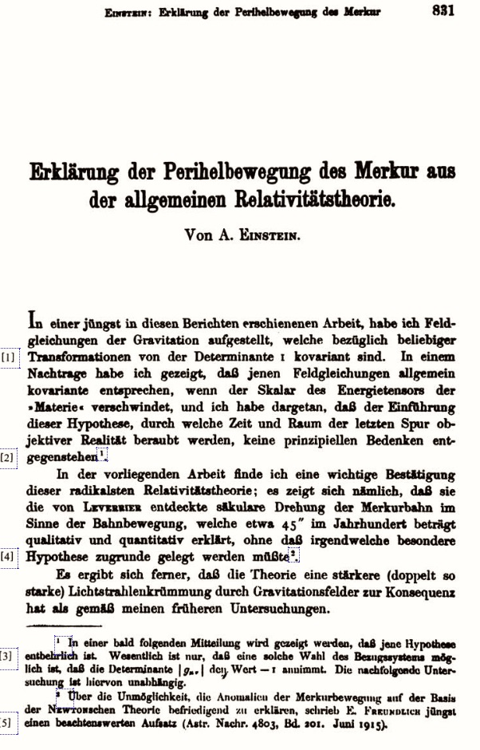
“Explanation of the Perihelion Motion of Mercury by the General Theory of Relativity.”
In the present paper, I find an important confirmation of this most radical theory of relativity; that is, it turns out that the secular rotation of Mercury’s orbit in the direction of the orbital motion, discovered by Leverrier, which amounts to about 45” in a century, is explained qualitatively and quantitatively, without having to posit any special hypothesis at all.
November 18, 1915

Slide 18
Two Step Structure
Step 1
General relativity
vs
Foils
1. Other planet or planets
2. Flattened sun
3. Distributed matter in zodiacal light
4. Deviations from 2 in inverse square law
Perihelion motion of Mercury derived.
Contradicted by the (extended) evidence
February 27, 1915
Step 2
Favored theory is better.
Favored theory is best.
??? Tacit assumption that options are exhaustive.

Slide 19
Abduction
Foil
Foil eliminated
Generalization from better to best
Darwin on the origin of species
Independent creation
Refuted by traits without function
Tacit assumption of exhaustive choice
Lyell’s uniformitarian geology
Geologies using presently unknown causes
Novel causes incur an undischarged evidential debt
Known versus unknown causes is exhaustive
Thomson for cathode rays as charged particles
Cathode rays are processes in the ether.
Contradiction with experiment: Ether waves are bent by a uniform field
Tacit assumption of exhaustive choice
Lenard for cathode rays as ether processes
Cathode rays are processes in matter
Contradiction with experiment: cathode rays in evacuated tubes
Choice between matter and ether posed as exhaustive dilemma.
Einstein’s explanation of Mercury’s anomalous motion
Many. Modifications to Newtonian theory. Unobserved masses.
Contradiction with experience. Undischarged evidential debt.
Step not taken.
Cosmic background radiation from the big bang
Alternative cosmologies, especially steady state cosmology
Taken tacitly
Empirical failure
Lavoisier’s oxygen chemistry.
Contradiction. Matter has weight (gravity), but phlogiston has levity.
Fact (matter has weight) is one of many warranting facts.
Phlogiston chemistry.
Newtonian corpuscular theory.
Undischarged evidential debt. Contradiction with experiment.
Wave theory of light.
Complicated.

Slide 20
How was the history of science and the philosophy of science integrated?
&
Philosophy of science.
History of science
What is IBE? Why does it work?
Canonical examples suggest an account.
Cogency of account checked. Internal superiority over other accounts.
Instantiation of account in other historical examples checked.
Open challenge
Account fails if we can find any historical counterexample.

Slide 21
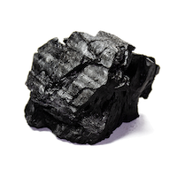
Gems and antigems
The new account of IBE is simple, transparent and not troubled by the failures of earlier accounts.
History played a central role in the discovery of the account and in testing it.
I still have a nagging sense that there’s something more to explanation. But WHAT?!

