Slide 1
Dense and Sparse Meaning Spaces When Referential Stability Fails and Succeeds John D. Norton Department of History and Philosophy of Science University of Pittsburgh “Dense and Sparse Meaning Spaces: When Referential Stability Fails and Succeeds,” Prepared for Theo Arabatzis, Corinne Bloch and James Lennox, eds., Concepts, Induction, and the Growth of Scientific Knowledge. https://sites.pitt.edu/~jdnorton/homepage/cv.html#manuscripts

Slide 2
The Main Claim
Failure of meaning invariance in scientific change
Density of the meaning space
Presumed by many antirealists
Denied by realists

Slide 3
Reference
Language
Meaning space
denotation not connotation
“dogs”
“planet Mars”
“Brooklyn Bridge”
For realists: the real world
For antirealists: artificially created intermediary between us and the unknowable nuomena

Slide 4
Dense Meaning Space
Language
Meaning space
“22/7” approx. for π
3.14285741…
3.14159292…
3.14159265…
“355/113” approx. for π
“π”
Favored by antirealists
No error tolerance
Slight change in language
Change in referent

Slide 5
Sparse Meaning Space
Language
Meaning space
“the city in which the Temple was built”
Favored by realists
“the city in which Jesus, son of God, was crucified”
“the city from which Mohammed, God’s true prophet, ascended to heaven”
Error tolerance
Slight change in language
NO change in referent

Slide 6
Kuhn, Structure of Scientific Revolutions
“Consider, for another example, the men who called Copernicus mad because he proclaimed that the earth moved. They were not either just wrong or quite wrong. Part of what they meant by ‘earth’ was fixed position. Their earth, at least, could not be moved. Correspondingly, Copernicus’ innovation was not simply to move the earth. Rather, it was a whole new way of regarding the problems of physics and astronomy, one that necessarily changed the meaning of both ‘earth’ and ‘motion.’ Without those changes the concept of a moving earth was mad. On the other hand, once they had been made and understood, both Descartes and Huyghens could realize that the earth’s motion was a question with no content for science.”

Slide 7
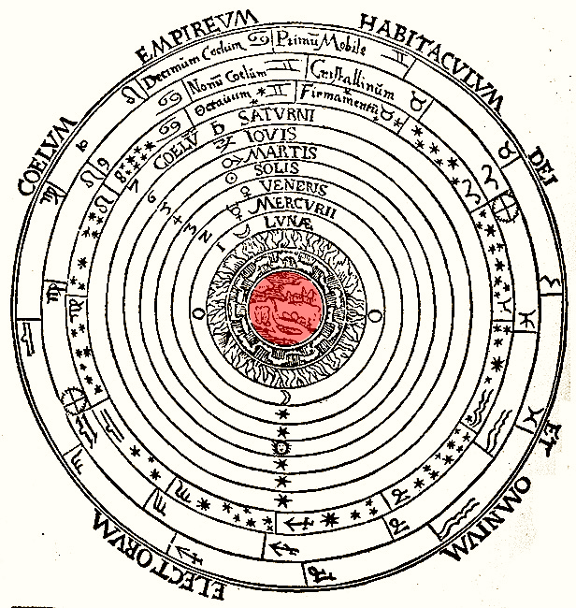
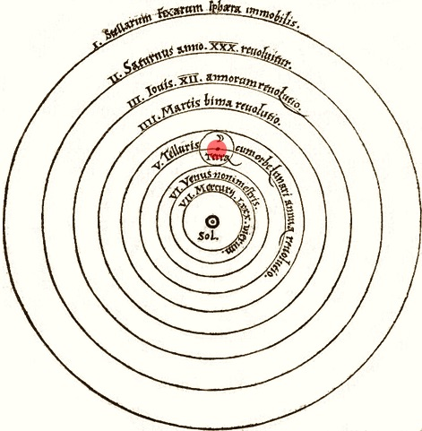
Dense Meaning Space
Language
“earth” Ptolemy
“earth” Copernicus

Slide 8
Sparse Meaning Space
Language
“earth” Ptolemy
“earth” Copernicus

Slide 9
Kuhn, Structure of Scientific Revolutions
“Apparently Newtonian dynamics has been derived from Einsteinian, subject to a few limiting conditions. Yet the derivation is spurious, at least to this point.
…
But the physical referents of these Einsteinian concepts are by no means identical with those of the Newtonian concepts that bear the same name. (Newtonian mass is conserved; Einsteinian is convertible with energy. Only at low relative velocities may the two be measured in the same way, and even then they must not be conceived to be the same.) Unless we change the definitions of the variables in the N₁’s, the statements we have derived are not Newtonian.”
Antirealist:
different referent.
Realist:
Same referent different properties ascribed.

Slide 10
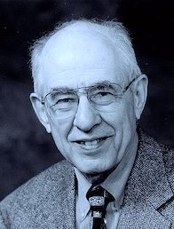
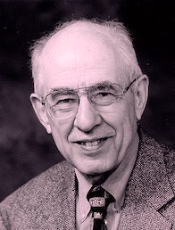
Putnam, Twin Earth
Putnam
Twin Putnam
“On Twin Earth, there is a Twin equivalent of every person and thing here on Earth. The one difference between the two planets is that there is no water on Twin Earth. In its place there is a liquid that is superficially identical, but is chemically different, being composed not of H₂O, but rather of some more complicated formula which we abbreviate as “XYZ”. The Twin Earthlings who refer to their language as “English” call XYZ “water”…
…when an Earthling (or Oscar for simplicity's sake) and his twin on Twin Earth say “water” do they mean the same thing?”

Slide 11
Dense Meaning Space
Language
H₂O
“water” earth
XYZ
“water” twin earth
XYZ is incompatible with everything we know in chemistry, quantum mechanics, …
Density of the meaning space is a wild fantasy.

Slide 12
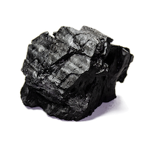
I am finally at peace with the literature on meaning invariance that for so long was baffling to me.
The supposition of the failure of meaning invariance cannot be used to sustain antirealism. Antirealism can entail failure of meaning invariance.
Referee’s report: “This paper cannot be published since it neglects to defer to the astute analysis in a paper by [referee’s name] that resolves all the open problems of meaning invariance.”

