Slide 1
Planck's Quantum Crisis and Shifts in Guiding Assumptions
By John M. Nicholas
Presentation by Brett Park

Slide 2
Presentation
Thesis
Review of Planck and the QM crisis
Relevance to thesis
Conclusions
Gems
Discussion Questions

Slide 3
Relevant Theses about Guiding Assumptions
GA 2. When a set of guiding assumptions runs into empirical difficulties:
(2.5) those difficulties become grounds for rejecting the guiding assumptions only if they persistently resist solution (Persistence)
(2.7) those difficulties become acute only if a rival theory explains them. (Hindsight)
GA3. New sets of guiding assumptions are introduced only when the adequacy of the prevailing set has already been brought into question. (Crisis-Response)

Slide 4
Thesis of the paper
"Why do scientists lose confidence in the fundamental doctrines of their sciences? It is my conviction that they regard them as gravely problematic when compelled to by alternatives which exhibit success or great promise of it, and that they are given up only when there are available alternatives." P. 317
Throughout the paper, he will argue for (Rival) and against (Persistence) and (Crisis-Response), citing the birth of quantum mechanics
Thesis (paraphrased): the driving force behind scientists relinquishing their guiding assumptions is not in the guiding assumptions failure but the success of alternatives.

Slide 5
Max Planck
German physicist working at the turn of the century
Self-described as conservative by nature
Worked on Black Body radiation and the "Ultraviolet Catastrophe"

Slide 6
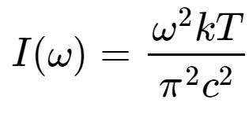
The Ultraviolet Catastrophe
A Black-body is a body that absorbs all electromagnetic radiation, and emits radiation which depends only on the body's temperature
Classical Distribution for Blackbody Radiation (solid line):
Does not fit empirical observation (dotted line) for high frequency radiation
[1]

Slide 7
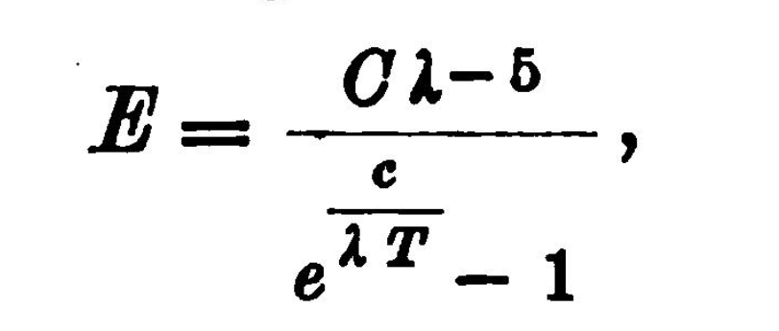
Planck's Law
In 1900, Planck found an expression which matched empirical observation:
Whose molecular derivation seemed to require that energy be "quantized" i.e. can only be absorbed and emitted by discrete energy values (n=1,2,3,…):
[2]

Slide 8
Motivating Question
We now consider this event to mark the beginning of the transition from classical to quantum mechanics.
What did this look like at the time to working physicists, particularly Planck?
According to Kuhn: "quantum mechanics was born from a variety of difficulties surrounding black body radiation, specific heats and the photo-electric effect ... the awareness of anomaly had lasted so long and penetrated so deep that one can appropriately describe the field affected by it as in a state of growing crisis" (Kuhn, 1970, p. 86)
Here, Kuhn is arguing for (Persistence) and (Crisis-Response)
Nicholas believes (Hindsight) is a better characterization

Slide 9
Guiding Assumptions: Continuity
The Principle of Continuity: physical properties of matter can take on a continuum of values
(Contra Persistence): Unquestioned guiding assumption even as "anomalies" accrued
(Contra Crisis-Response) & (Hindsight): Only after the arrival of quantum theory was discontinuity considered

Slide 10
Guiding Assumptions: Thermodynamics
Phenomenological Thermodynamics: orthodox view of thermodynamics (Clausius & early Planck) was that it is a perfectly general framework which describes observable thermodynamic behavior
Vs.
Boltzmann's Statistical Mechanics: the laws of thermodynamics are statistical generalization about molecular behavior
(Contra Crisis-Response): Planck was aware of Boltzmann's rival approach well before he defected to it
(Contra Persistence): Planck accepted Boltzmann's approach without a long period of recognized anomaly

Slide 11
Guiding Assumptions: Equipartition Theorem
Equipartition Theorem: in thermal equilibrium, energy is evenly distributed amongst the system's degrees of freedom
Used to derive classical blackbody distribution
Problem: a solid body (finite degrees of freedom) could never reach equilibrium with the EM field (infinite degrees of freedom); it would lose all its energy to electromagnetic radiation
Puzzle or Anomaly?: At the time, it was unclear whether this was a puzzle to be solved by classical mechanics (perhaps by limiting degrees of freedom of the EM field) or indicated a deeper problem with classical statistical mechanics
Projecting Backward: Only after Planck suggested energy quanta and Einstein gave this a physical interpretation (photons) did equipartition look retrospectively like an anomaly for classical physics

Slide 12
Guiding Assumptions: Wave-Theory of Light
Wave-Theory of Light: light is a continuous wave
Problem: Contrary to the wave-theory, Philipp Lenard showed that the energy of electrons emitted from a cathode depends on the wavelength, not the intensity, of the light (photo-electric effect)
Puzzle or Anomaly?: At the time, this was taken to indicate that there was an intermediate process between the light-wave and the electron ejection
Projecting Backward: Einstein saw this as the seed of his semi-corpuscular theory of light, but only after he had conceived of the hypothesis

Slide 13
Conclusions
During Plank's quantum crisis, it was only after rival theories explained anomalies that old guiding assumptions were rejected
Anomalies/Crises are retrospectively diagnosed

Slide 14
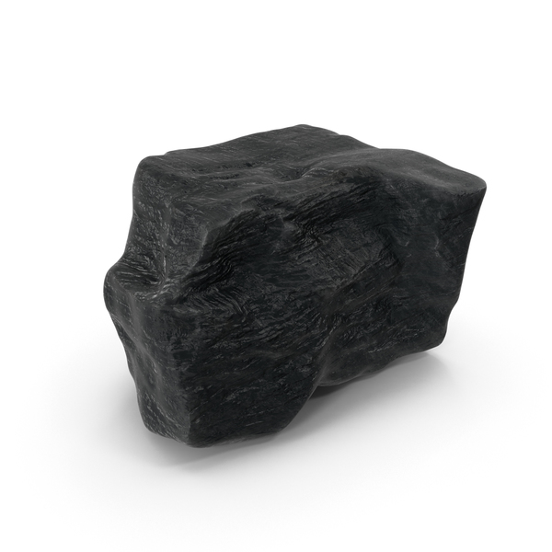
Gems
Interesting Thesis
Firehose of Historical Details
Difficult to get a big picture

Slide 15
Sources
[1] Taken from the Feynman Lectures on Physics: https://www.feynmanlectures.caltech.edu/I_41.html#mjx-eqn-EqI4113
[2] Taken from Planck's 1905 "Über eine Verbesserung der Wienschen Spektralgleichung": https://archive.org/details/verhandlungende01goog/page/n214/mode/2up?view=theater

