Slide 1
An Inductive Calculus for Infinite Lottery Machines
John D. Norton
Department of History and Philosophy of Science
University of Pittsburgh
Based on “Infinite Lottery Machines” in The Material Theory of Induction. Draft at http://www.pitt.edu/~jdnorton/homepage/cv.html#material_theory

Slide 2
Material Theory of Induction
The inductive inferences appropriate to some domain are warranted by fact of the domain.
In a sufficiently regular domain, There may be a calculus of induction peculiar to it.
There is no universal calculus of inductive inference.
Now..
Illustration of a non-probabilistic calculus in the domain of an infinite lottery.

Slide 3
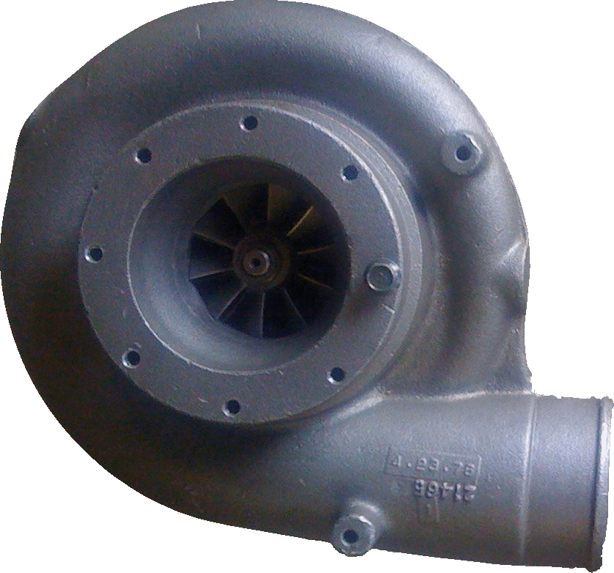
An infinite lottery machine
27
Fair selection made among infinitely many balls 1, 2, 3, …
= without favor to any number or numbers.
1
3
2

Slide 4
Problems in inductive inference
To what extend should we expect:
• Some specific number to be drawn?
27? 3,668? …
• Some set of numbers?
Odd numbers? Even numbers?
Numbers greater than 100?...
• Outcomes on repeated trials?
100 trials, all with numbers greater than 100?

Slide 5

Probabilistic Analysis
Probability P(n) of outcome n must satisfy:
1
Fairness of selection
ε = P(1) = P(2) = P(3) = ….
ε = 0
P(1) + P(2) + P(3)+ …
= 0 + 0 + 0 + …
= 0
2
Normalization
P(1) + P(2) + P(3)+ … = 1
ε > 0
P(1) + P(2) + P(3)+ …
= ε + ε + ε + …
= ∞
Contradiction

Slide 6
Escapes
Drop countable additivity.
Finite additivity only.
Infinitesimal probabilities
P(1) = 0
P(1) + P(2) = 0
P(1) + P(2) + P(3) = 0
...
ε = P(1) = P(2) = P(3) = ….
where
0 < ε <
( )
any positive real number
CANNOT take infinite limit.
So we can posit independently:
P(1) + P(2) + P(3) + … = 1
P(even) = P({2, 4, 6, ...}) = ½
...
Both preserve finite additivity.
My claim: finite additivity must go!

Slide 7
“Choosing without favor”
≠ each outcome has equal probability.
Probability may not be well-defined.
Label independence
All true statements pertinent to the chances of different outcomes remain true when the labels are arbitrarily permuted.
1
2
1
3
2
1
4
3
2
4
3
4
“1 or 2 arise roughly as often as 3 or 4.”
“1 or 2 arise roughly as often as 3 or 4.”
“1 or 2 arise roughly as often as 3 or 4.”

Slide 8
An infinite lottery machine
27
Permuting the labels on the balls has no effect on the chances of the outcomes.
1
3
2
“Chance” is now generalized beyond probability. A general, as yet unspecified, measure of indefiniteness.

Slide 9
Odd and even
1
2
3
4
5
6
7
8
9
…
2
1
4
3
6
5
8
7
9
…
Chance [Even] = Chance [Odd]

Slide 10
Co-infinite Infinite Sets
1
2
3
4
5
6
7
8
9
…
1
2
3
4
…
10¹
10²
10³
10⁴
10⁵
All co-infinite infinite sets have the same chance.

Slide 11
No probability measure captures these properties of chance
?
no powers of 10
?
?
P( ) = P( ) = P( ) = P( )
10, 100,
1000,
10000,
1, 2, 3, 4,
5, 6,7, 8, 9,
11, 12, …
odd
even
…
Finite additivity fails.

Slide 12
Outcome sets equivalent under label independence
finite_{n}: finite set with n members
n = 1, 2, 3, …
e.g. Members of finite₃ are
{1, 2, 3}, {27, 5, 134}, …
infinite_{co-infinite}: infinite set whose complement is also infinite
e.g. even numbers, odd numbers, prime numbers, powers of ten, …
infinite_{co-finite}: infinite set whose complement is finite of size n
n = 1, 2, 3, …
e.g. complements of finite_{3,} all numbers greater than ten, …

Slide 13
Equivalent sets have equivalent chances
Ch(finite_{n}) = V_{n}
n = 1, 2, 3, …
Ch(infinite_{co-infinite}) = V∞
“as likely as not”
Ch(infinite_{co-finite-n}) = V_{-n}
n= 1, 2, 3, …
Ch(empty-set)
= V₀ “certainly not”
Ch(all-outcomes)
= V₋₀ “certain”
V∞
V∞
V∞
V∞
Ch( ) = Ch( ) = Ch( ) = Ch( )
10, 100,
1000,
10000,
1, 2, 3, 4,
5,6,7, 8, 9,
11, 12, …
odd
even
…
no powers of 10

Slide 14
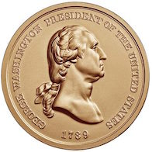
But what does the chance function Ch(.) mean?
NOT: give an explicit definition.
NOT: subjective Bayesian elicitation
The probabilists’ approach:
Contrive circumstances in which an assertion of probability is re-expressed as an assertion of very high or very low probability.
Connect with non-probabilistic expectations, else all we do is relate probabilities to probabilities, without giving them independent meaning.
Coin toss:
P(H=heads) = 0.5
In very many independent coin tosses,with probability near one, there will be roughly one half H.
Rule of coordination:
Very low probability outcomes generally do not happen; and very high probability outcomes generally do.

Slide 15
Chance Ch(.) informally
Unlikely: succeeds in only finitely many cases.
Ch(finite_{n}) = V_{n}
n = 1, 2, 3, …
Ch(infinite_{co-infinite}) = V∞
“as likely as not”
Ch(infinite_{co-finite-n}) = V_{-n}
n= 1, 2, 3, …
Intermediate chances all the same; easier than probabilistic case.
Likely: fails in only finitely many cases.
Rule of coordination:
Very low chance outcomes V_{n} generally do not happen; and very high chance outcomes V_{-n} generally do.

Slide 16
Chance of a number less than or equal to N?
1
2
…
N
…
N+1
N+2
Chance is V_{N}
Does not happen
Chance is V_{-N}
Does happen
…no matter how big N is!

Slide 17
1000 independent drawings
All 1000 numbers are less than or equal to N.
All 1000 numbers are the same
8
8
8
…
8
1
N
7
…
3
Chance is V_{N1000}
Does not happen
Chance is V∞
“as likely as not”

Slide 18
Frequency of even in N drawing
5
3
2
8
6
7
4
9
…
7
Chance (0 even in N draws) =
Chance (1 even in N draws) =
Chance (2 even in N draws) =
…
Chance (N/2 even in N draws) =
…
Chance (N-1 even in N draws) =
Chance (N even in N draws) =
V∞
V∞
V∞
V∞
V∞
V∞
Otherwise might we end up with frequencies that authorize an additive probability measure?

Slide 19
Measure problem in cosmology
In an eternally inflating universe,
infinitely many patches like our local universe
and
infinitely many unlike our local universe.
unlike
unlike
unlike
like
like
like
unlike
like
unlike
like

Slide 20
Guth, Steinhardt: no probabilities
Steinhardt (2011, p. 42)
As an analogy, suppose you have a sack containing a known finite number of quarters and pennies.
…For an infinite collection of coins, there are an infinite number of ways of sorting that produce an infinite range of probabilities. So there is no legitimate way to judge which coin is more likely. By the same reasoning, there is no way to judge which kind of island is more likely in an eternally inflating universe.
Guth (2007, p. 11)
However, as soon as one attempts to define probabilities in an eternally inflating spacetime, one discovers ambiguities. The problem is that the sample space is infinite, in that an eternally inflating universe produces an infinite number of pocket universes. The fraction of universes with any particular property is therefore equal to infinity divided by infinity—a meaningless ratio.

Slide 21
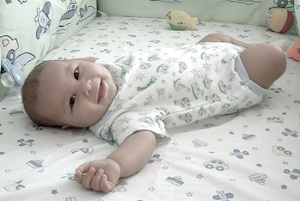
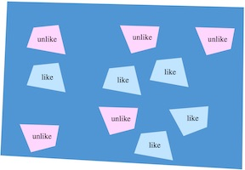
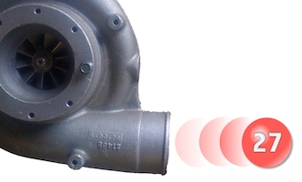
Benchmarking with a randomizer
The probability that your unborn child will be a girl is 0.5.
The chance that eternal inflation spawns a patch like ours is “as likely as not.”
The probability is the same as tossing a head in a fair coin toss.
The chance is the same as drawing an even number in an infinite lottery.

Slide 22
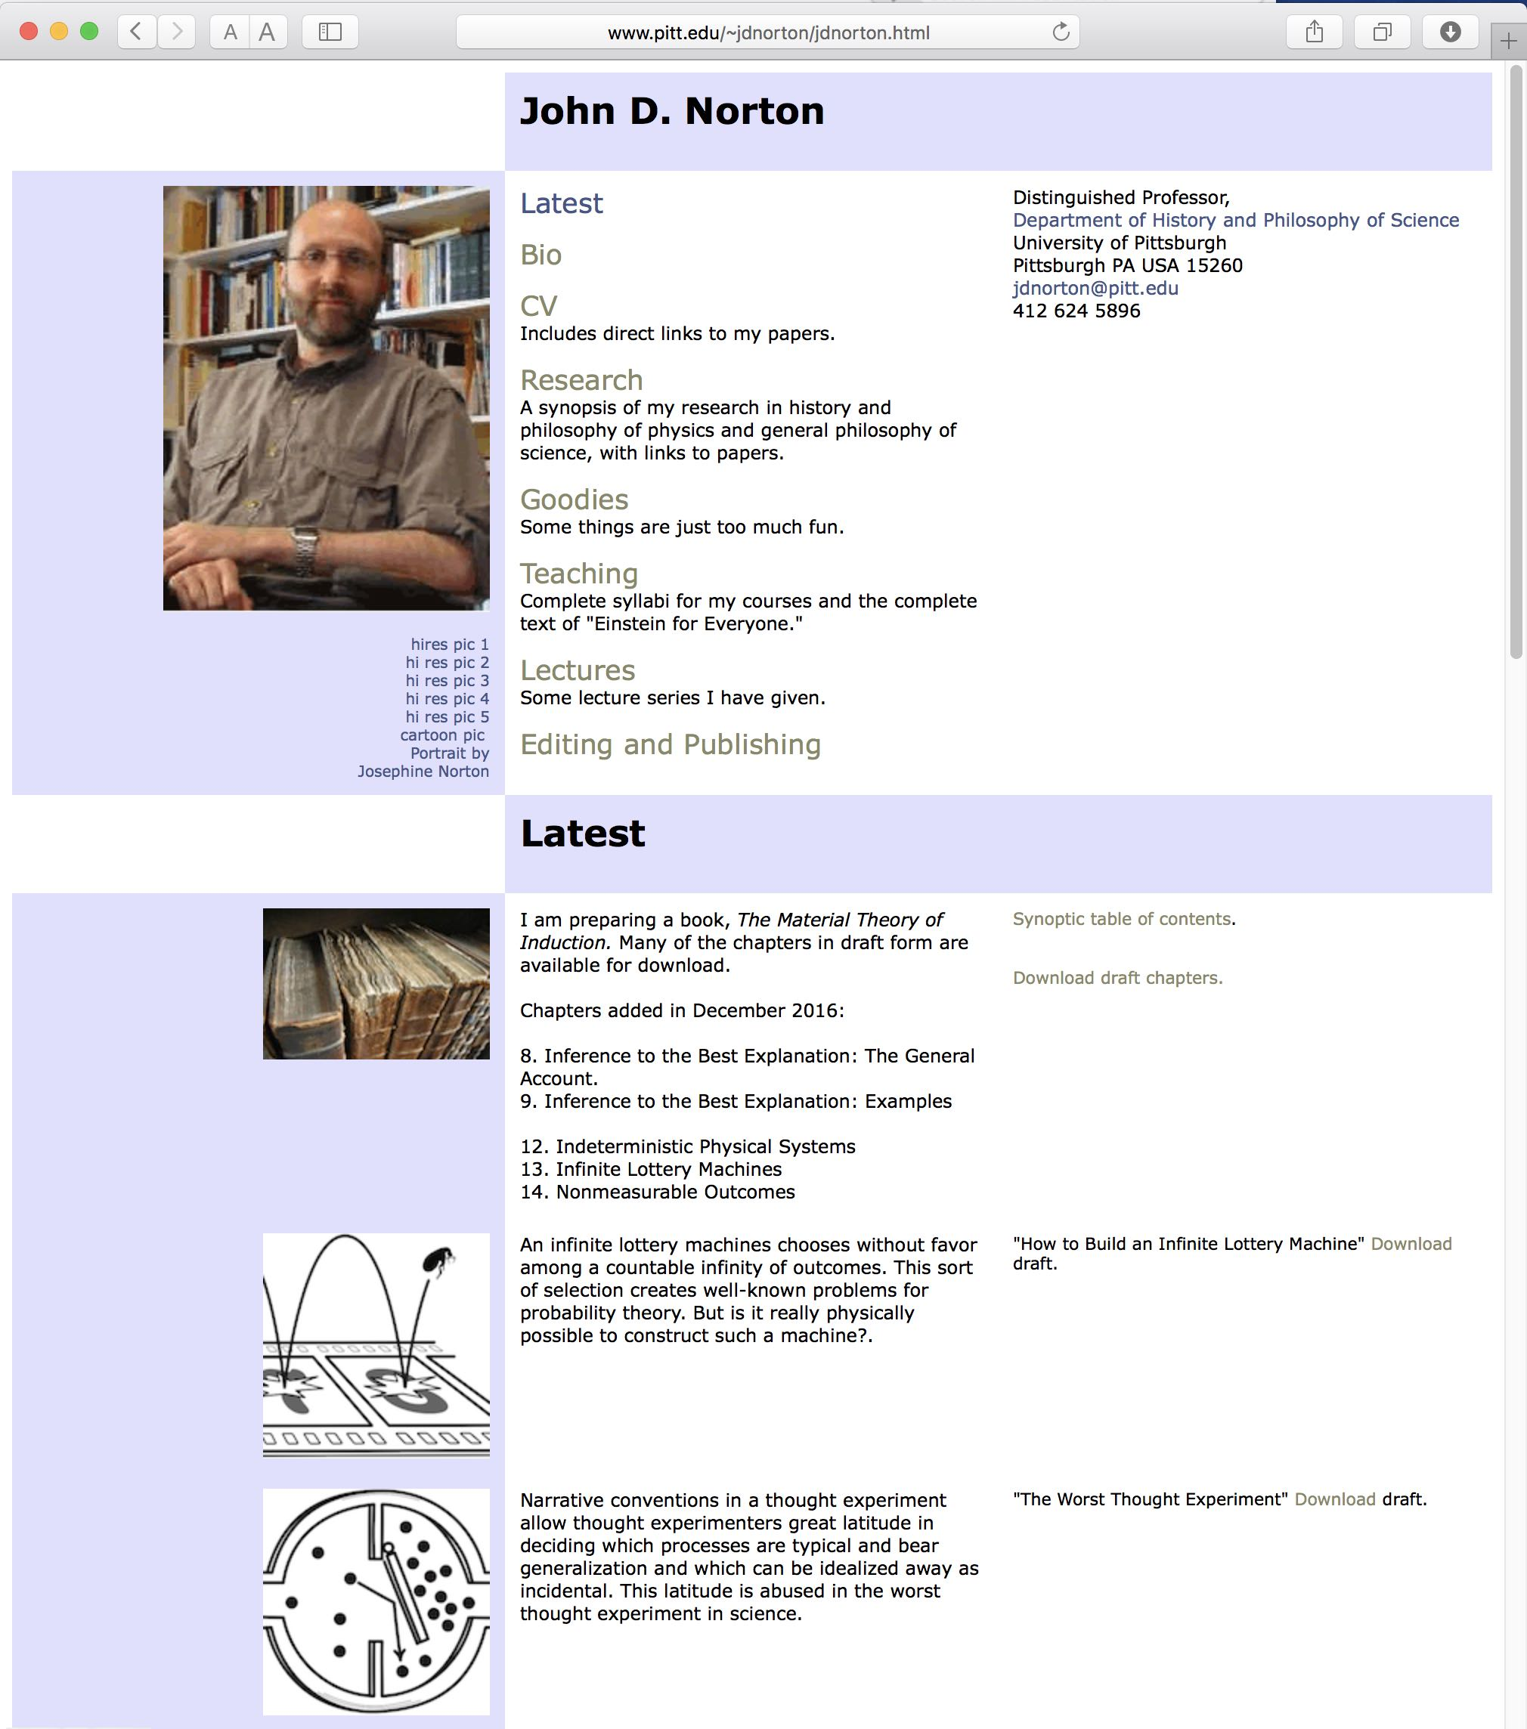
Are infinite lottery machines physically possible?

