Slide 1
Nevin Climenhaga, “Evidence and Inductive Inference,” Forthcoming in The Routledge Handbook of the Philosophy of Evidence, ed. Maria LasonenAarnio and Clayton Littlejohn (Routledge, 2020)
http://philsci-archive.pitt.edu/17450/

Slide 2
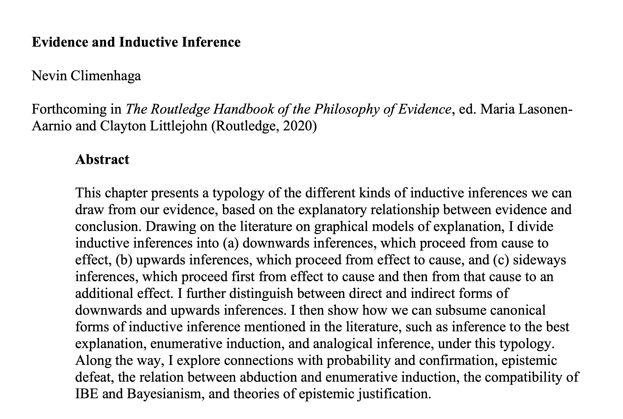

Slide 3
Goals (from abstract)
A typology of the different kinds of inductive inferences we can draw from our evidence.
Subsume canonical forms of inductive inference mentioned in the literature,
such as inference to the best explanation, enumerative induction, and analogical inference.
Divide inductive inferences into
(a) downwards inferences,
(b) upwards inferences,
(c) sideways inferences
Explore connections with probability and confirmation, epistemic defeat, the relation between abduction and enumerative induction, the compatibility of IBE and Bayesianism, and theories of epistemic justification.
Distinguish between direct and indirect forms of downwards and upwards inferences

Slide 4
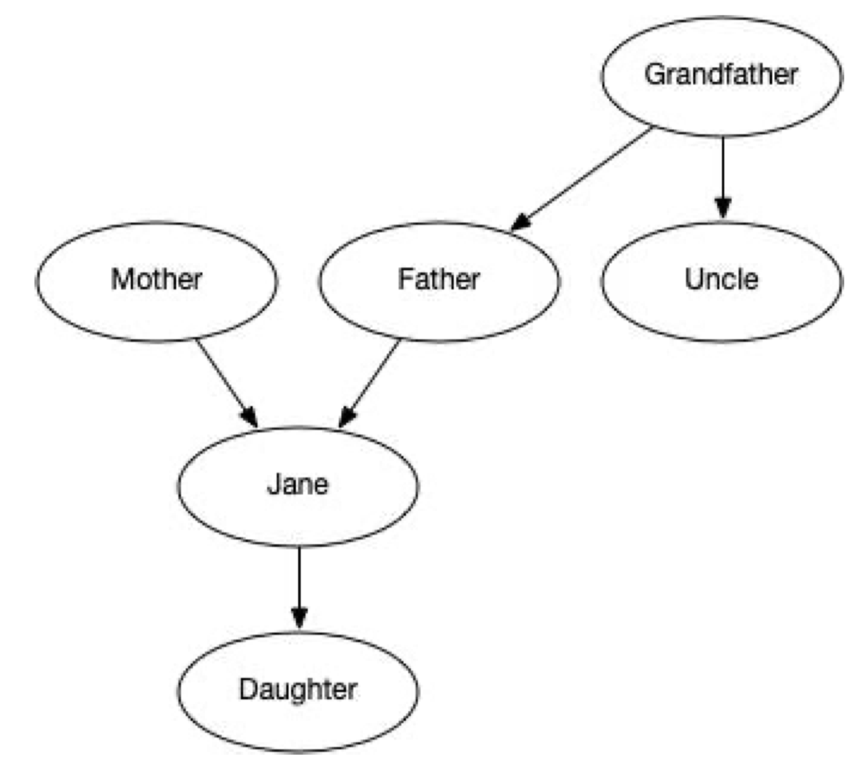
The Technical Gadget
Variables:
Grandfather smokes,
Father smokes,
…
DAG:
Directed Acyclic Graphs
Represent causal relations and non-causal grounding relations.
Arrows:
Grandfather smokes
increases probability that
Father smokes
…
Markov condition satisfied.
“A DAG represents explanatory relations between our variables by use of directed arrows.”
Acyclic:
No cyclic feedback loops.
Mother smokes
Father smokes

Slide 5
Inference forms to be accommodated (List from p.3)
- Abduction
- Analogical inference
- Bayesian inference
- Causal inference
- Direct inference
- Enumerative induction
- Inverse inference
- Inference to the best explanation
- Predictive inference
- Statistical inference
- Universal inference

Slide 6
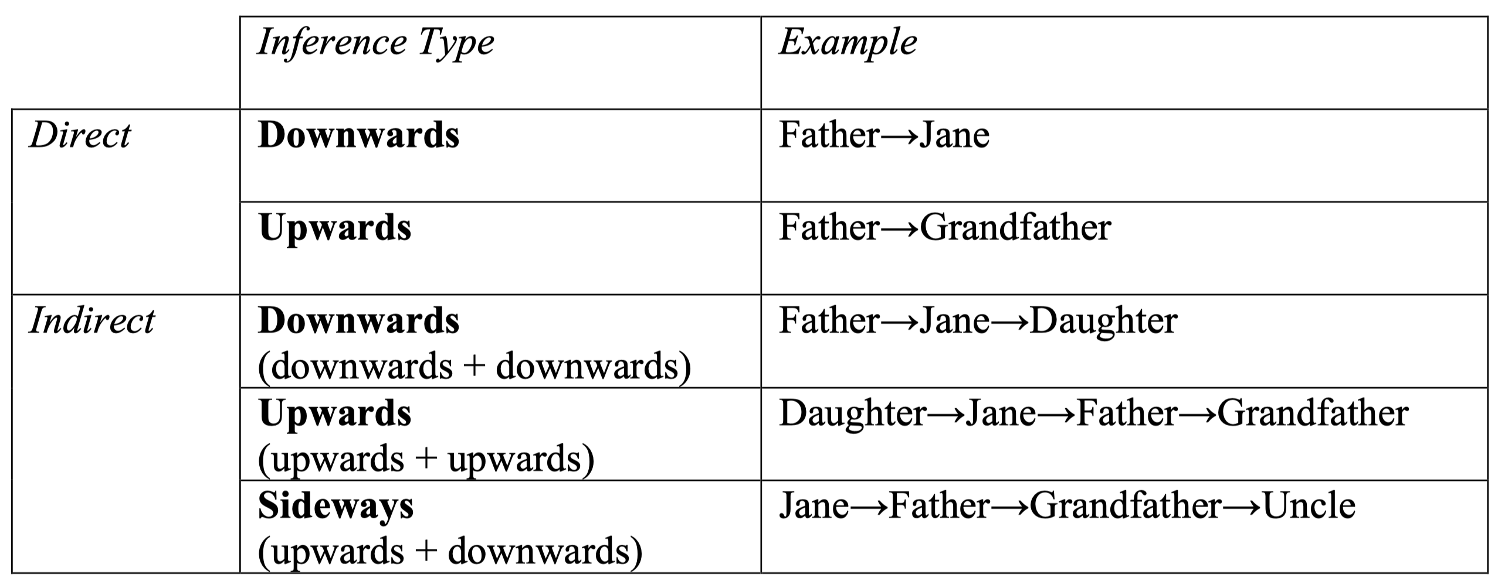
Mapping inference types begins

Slide 7
Direct
upward
downward

Slide 8
Indirect
upward
downward

Slide 9
Indirect
sideways

Slide 10
Downward types
Cause to effect
Explanation to its prediction
Direct inference (i.e. population to sample)
downward
Causes include qualitative hypotheses:
Friend promises to meet for lunch
Friend meets for lunch

Slide 11
Upward types
Bayesian inverse inference
Sample to its population
Enumerative induction
(=special case of inference to the best explanation).
Abduction
Inference to the Best Explanation in general
Causal inferences (e.g. Mill)
upward

Slide 12
Sideways
Predictive
(one sample to a different sample)
Analogical inference
sideways

Slide 13
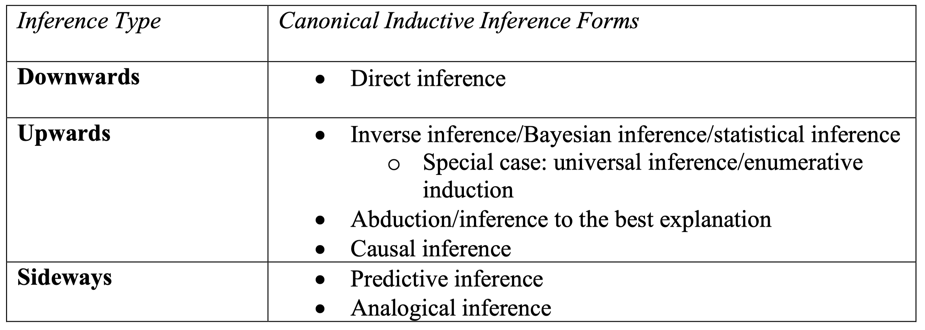
Summary

Slide 14
Have we learned anything useful?
“The model of inference presented here fits most naturally with a form of foundationalism about epistemic justification,…”
“… our typology precludes inferring downwards from evidence A to B and then upwards from B to C. You cannot infer from Father’s smoking to Jane’s smoking, and then from Jane’s smoking to Mother’s smoking.
no
yes
“… difficult to reconcile with some rival theories of epistemic justification. For example, on coherentism, what matters for justification is how well your beliefs cohere with each other.”
This looks like a failure of the system.
A bug not a feature.
Coherence alone is not enough, but it is usually counted as strengthening evidential support.
Whewell: consilience of inductions.

Slide 15
Assessment:
This is not a useful handbook survey article, but merely one person’s attempt at a general theory of inductive inference.
DAG representation of systems is narrow.
System structured by causal or grounding relations relations represented by simple arrows.
There is a probability measure over the variables of the system.
Markov condition holds.
The causal/grounding relations are represented by the probability measure.
The causal/grounding relations admit no cycles.
The zealot’s fallacy
I have a favorite technical gadget.
I can fit examples of A, B and C into it.
I have a useful, general theory of A, B and C.
DAG accounts of causation.
A, B and C = various types of inductive inferences.
I have a general theory of inductive inference.

